Slide 1



CONTACT_LIST WEB APP
AASTHA PANDEY
[1SV21CS001]

Slide 2
OUTLINE
Introduction
Background of the internship
Works performed
Achievements’ and Results
Objectives and goals

Slide 3

Introduction
This Internship[2023-24] was conducted by Pentagon Space in collaboration with Shridevi Institute of Engineering and Technology. This presentations presents to you the full 30 days recap and a glimpse of my project work.
3

Slide 4
Internship Role and Objectives
The goal of a full-stack internship is typically to provide individuals with a holistic understanding and practical experience in both front-end and back-end web development.
Some Key points include:
Project Experience
Full Development Lifecycle Understanding:
Problem-Solving Skills:
Version Control and Deployment:
Adaptability and Flexibility:
Continuous Learning and Improvement:
Professional Growth:
4

Slide 5
“The expert in anything was once an intern.”
Helen Hayes
5

Slide 6

Mini-Project
CONTACT_LIST
An Express.js application that serves as a simple contact list management system. It uses the EJS (Embedded JavaScript) template engine for rendering views.
A form for adding new contacts, and you display existing contacts in a list with the ability to delete them.
6

Slide 7
CHALLENGE FACED
The major challenge for me was to that how do I use the minimal amount of resource for my website to create a good web, integration issues, error handling, etc.

Slide 8
Strengths: Functionality: The project appears to have fundamental functionality for managing a contact list, including adding new contacts, displaying them, and deleting existing ones. Technology Stack: The use of Node.js, Express.js, EJS, and MongoDB with Mongoose is a common and effective technology stack for building web applications. Code Structure: The code is modular and follows a standard structure for a Node.js application with Express and Mongoose. Routes, models, and views are separated, making the codebase organized. Responsive Design: The inclusion of Font Awesome for icons and external stylesheets suggests attention to UI design and aesthetics.

Slide 9
Learning and Achievements
Front-End Development Skills
Back-End Development Skills
API Development
Database Management
Version Control and Collaboration
Project Planning and Architecture
Problem-Solving and Troubleshooting
Continuous Learning

Slide 10
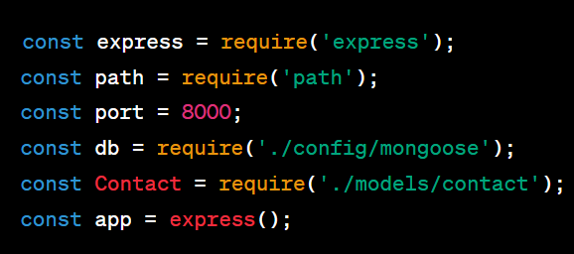
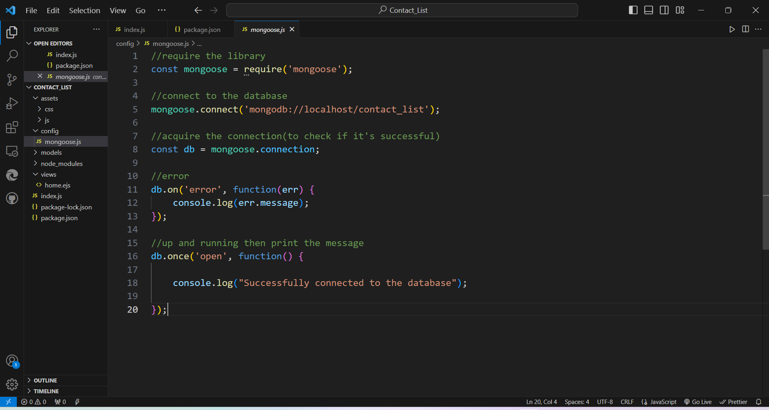
Snapshots

Slide 11
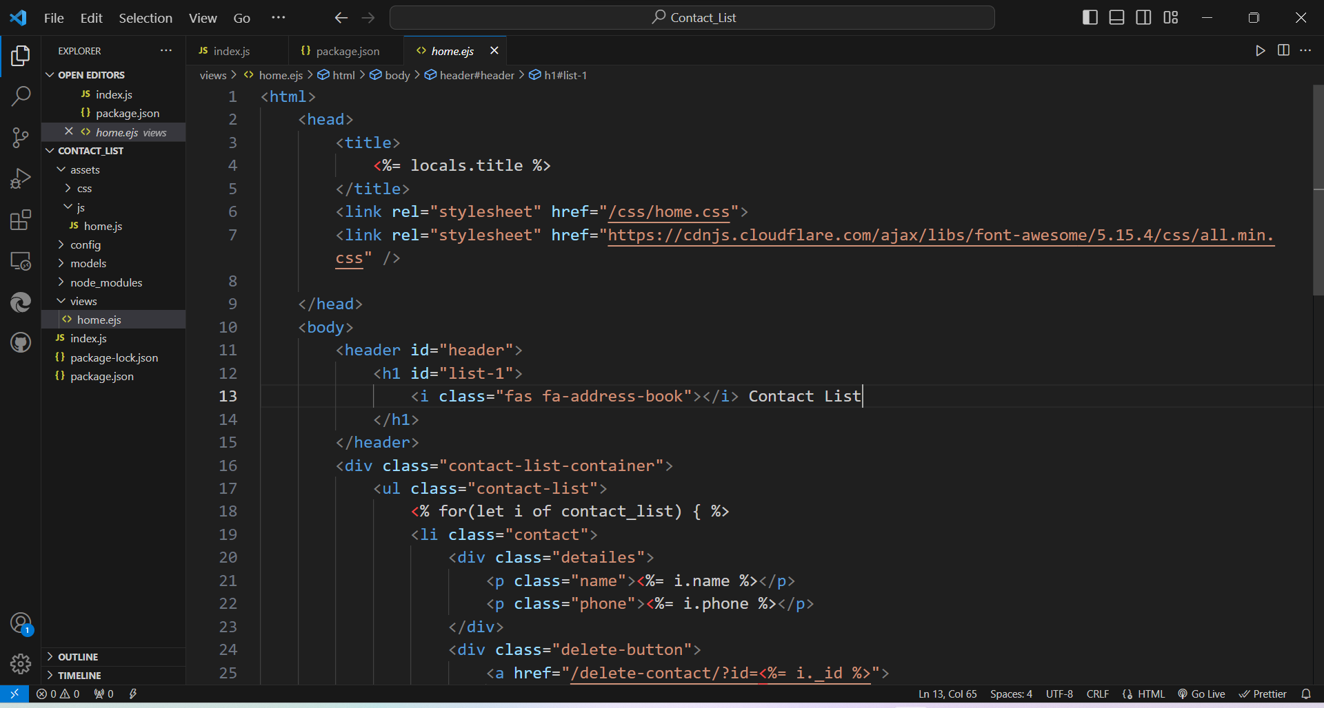
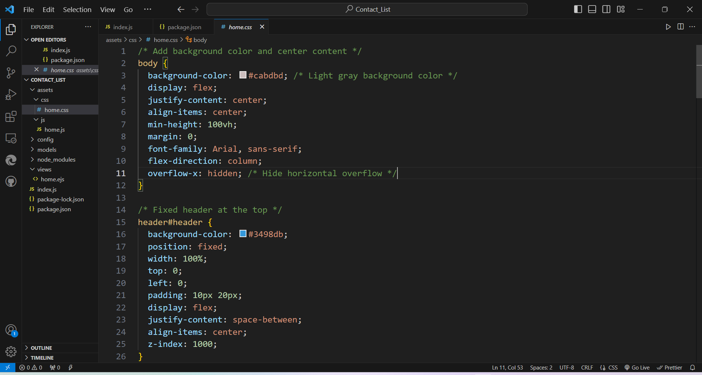

Slide 12
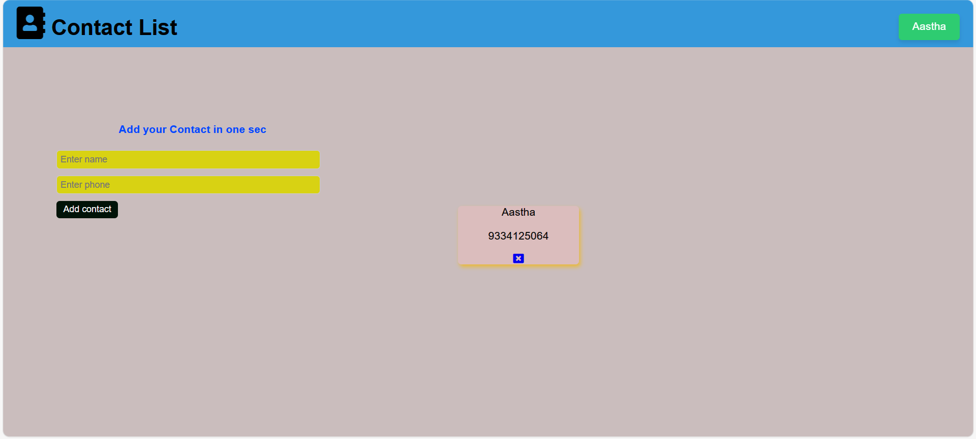

Slide 13
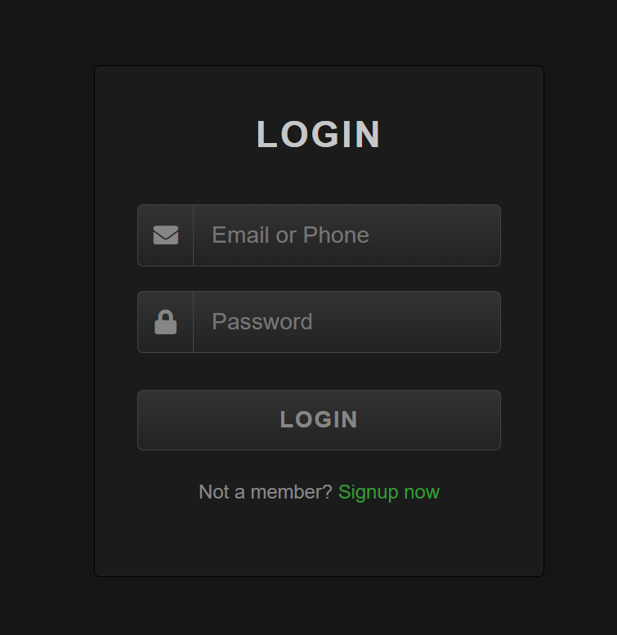
Other projects…
Animated Login Form Page →

Slide 14
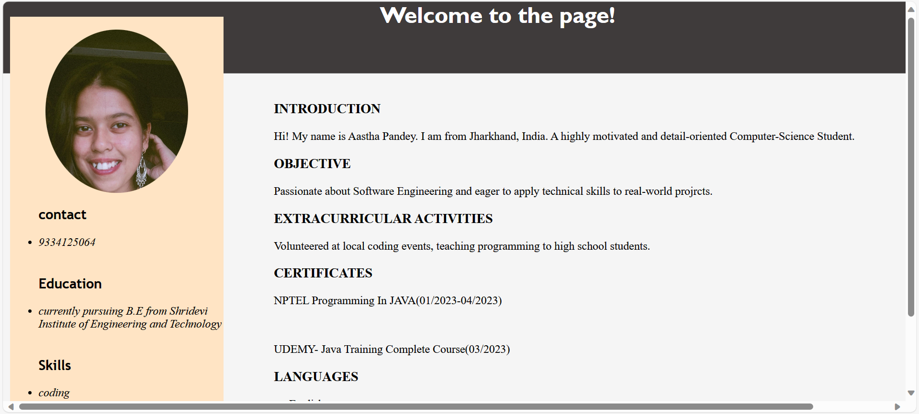
Resume website →

Slide 15
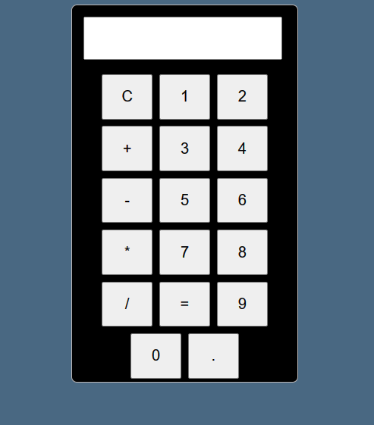
Calculator →

Slide 16

Summary
In conclusion, the full-stack development internship has been a transformative experience, shaping not only my technical skills but also fostering personal and professional growth. The amalgamation of technical proficiency, problem-solving acumen, effective communication, adaptability, continuous learning, networking, and a commitment to feedback has left an indelible mark on my journey towards becoming a well-rounded professional in the field. This internship serves as a foundation for future endeavors, encapsulating the essence of growth in a dynamic and challenging environment.
16

Slide 17




Thank you
aastha157/Contact_List_App (github.com)
contact-list-app – Overview – Vercel
(25) Aastha Pandey | LinkedIn

