Slide 1
DATA ANALYTICS WITH GENAI · CAPSTONE PROJECT
UPI Transaction Analytics
An End-to-End Business Intelligence Pipeline for a Digital Payments Platform
Business
Understanding
Data
Validation
Database
Design
SQL
Ingestion
Python
Analysis
Statistical
Testing
Power BI
Dashboards
Strategic
Insights
Prepared by Aastha Maurya
Tools Used: Excel · MySQL · Python (Pandas, SciPy, Statsmodels) · Power BI

Slide 2
PROJECT ROADMAP
Nine-Steps Analytics Pipeline
From raw UPI transaction data to boardroom-ready insight — each stage validated before the next began.
1
Business Understanding
2
Data Validation (Excel)
3
Database Design (SQL DDL)
Define KPIs, hypotheses & analytical goals
Foreign-key checks, cleaning, quality log
Schema, keys & constraints
4
Data Ingestion
5
Python ↔ SQL Pipeline
6
Cleaning, Transform & EDA
Load cleaned data into MySQL
SQLAlchemy connection & dataframe load
Derived KPIs & exploratory analysis
7
Statistical Testing
8
Power BI Dashboards
9
Strategic Insights
T-test, ANOVA, Chi-square, Correlation
Executive & Fraud Analyst views
Findings & business recommendations
2

Slide 3
STEP 1 · BUSINESS UNDERSTANDING & ANALYTICAL PLANNING
Framing the Business Problem
CORE BUSINESS CHALLENGES
KEY KPIs TRACKED
Fraud risk across devices, merchants and regions
Transaction Volume
Transaction Failure Rate
Failed / declined transactions eroding trust
Fraud Detection Rate
Customer Retention
Customer churn and inconsistent engagement
Merchant Activity
Device Risk Score
Merchant activity and onboarding quality
WORKING HYPOTHESES
Regulatory & compliance exposure
Rooted devices are associated with higher fraud rates.
These pain points shaped every KPI and hypothesis that followed.
Metro / high-density regions show lower transaction failure rates.
Fraud likelihood varies significantly by merchant category.
3

Slide 4
STEP 2 · DATA VALIDATION USING EXCEL
Cleaning the Data Before It Ever Touched SQL
7
9.69%
248
0
tables cross-checked for referential integrity
of Customer_Master rows flagged — invalid mobile number length
missing resolution timestamps in Fraud_Alert_History
duplicate primary keys found across all tables
VALIDATION CHECKS PERFORMED
DATA QUALITY LOG (SAMPLE)
Foreign-key checks — Customer_ID, Merchant_ID, UPI_ID, Device_ID, Transaction_ID linked correctly across all 7 tables
Table | Issue Found | Action | Status
All Tables | Inconsistent header casing | Converted to Proper Case | Done
Customer_Master | Mobile number ≠ 10 digits | Flagged for review (969 rows) | Review
Customer_Master | Gender: Male/MALE/male | Standardized to “Male” | Done
Device_Info | Inconsistent Last_Active format | Standardized yyyy/mm/dd hh:mm:ss | Done
Fraud_Alert_History | Resolution_Time blanks | Marked for review / imputation | Review
Conditional formatting to surface blank fields in amount, status, fraud_flag, risk_score, device_type
Categorical standardization — e.g. “succes” → “Success”, “Androd” → “Android”, Male/MALE/male → “Male”
Consistent date formatting applied across all date/time columns
4

Slide 5
STEP 3 · DATABASE DESIGN (SQL DDL)
A Seven-Table Relational Schema
Device_Info
PK Feedback_ID
Customer_Feedback_Surveys
PK Device_ID
Device_Info
PK Customer_ID
Customer_Master
PK UPI_ID
UPI_Account_Details
PK Transaction_ID
UPI_Transaction_History
PK Merchant_ID
Merchant_Info
PK Alert_ID
Fraud_Alert_History
Central fact table UPI_Transaction_History references every dimension via foreign keys (Customer_ID, UPI_ID, Device_ID, Merchant_ID); Fraud_Alert_History in turn references Transaction_ID.
Constraints applied: PRIMARY KEY & FOREIGN KEY on all linking columns · NOT NULL on mandatory fields · CHECK (Age ≥ 18, Risk_Score 0–1, Satisfaction_Score 1–5, Amount ≥ 0)
5

Slide 6
STEP 4 · DATA INGESTION INTO SQL
140,500 Records Loaded & Verified
Cleaned datasets were imported into MySQL Workbench (LOAD DATA INFILE) and validated with row-count, spot-check and foreign-key integrity queries.
POST-LOAD VALIDATION
Row counts in MySQL matched source CSV/Excel files exactly
Random spot-checks joined transactions to customer & bank details correctly
Zero orphaned foreign keys across Device, UPI Account, Merchant & Customer links
248 blank resolution_time values in Fraud_Alert_History corrected to proper TIMESTAMP type
6

Slide 7
STEP 5 · CONNECTING PYTHON TO SQL
Building a Live Analysis Pipeline
1
2
3
4
5
Install Libraries
Create Engine
Query with Pandas
Load All 7 Tables
Validate Schema
→
→
→
→
pandas · sqlalchemy · pymysql
SQLAlchemy connection string to MySQL (mysql+pymysql)
pandas.read_sql_query() executes SQL directly into dataframes
Every table pulled into its own dataframe for analysis
df.info() confirms dtypes & row counts match SQL exactly
Result: MySQL connection successful — all seven tables loaded with row counts and schema verified to match the source database exactly.
7

Slide 8
STEP 6 · DATA CLEANING, TRANSFORMATION & DERIVED KPIS
Turning Raw Fields Into Analysis-Ready Metrics
MISSING VALUE TREATMENT
DERIVED KPIs CREATED
Merchant_ID
Transaction Value / Customer
Filled with “P2P_No_Merchant” (peer-to-peer transfer, not a merchant payment)
Total Amount ÷ Number of Transactions
Failure_Reason
Filled with “None_successful” for completed transactions
Merchant Fraud Ratio
Fraud Transactions ÷ Total Transactions by Merchant
Other numeric fields
Filled with column median
Device Fraud Ratio
Fraud Transactions ÷ Total Transactions by Device
SCALING
Risk_Score → Min-Max Normalized · Amount → Z-score Standardized (outlier-prone, unbounded)
Transaction Failure Rate
Failed Transactions ÷ Total Transactions = 5.87%
8

Slide 9
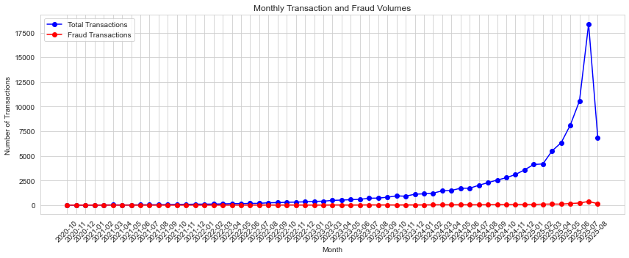
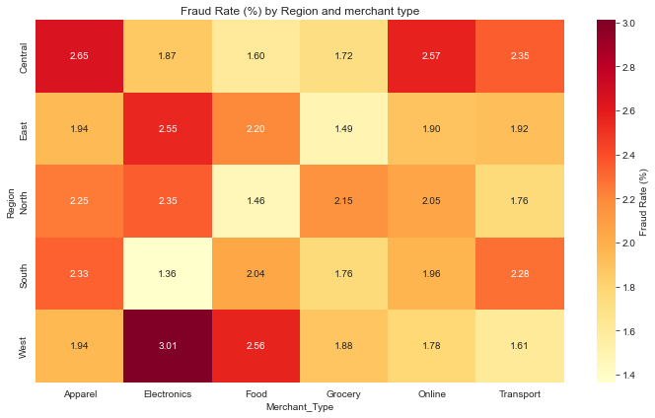
STEP 6 · EXPLORATORY DATA ANALYSIS
What the Transaction Data Reveals
Monthly transaction volume climbed sharply through mid-2025 while fraud volume stayed comparatively flat — fraud is growing slower than legitimate usage.
West + Electronics is the riskiest cell (3.01% fraud rate) — nearly 2× the platform average.
9

Slide 10
ADDITIONAL INSIGHT · TRANSACTION BEHAVIOR
Transaction Behavior at a Glance
A closer look at how customers actually use the platform, drawn from the live Executive Dashboard.
100K
₹42.42
Feature_Phone
Total Transactions
Avg. Transaction Amount
Top Device Used
TRANSACTION VOLUME BY TYPE
WHAT THIS TELLS US
Peer-to-peer activity (Send + Receive) makes up almost 70% of all volume — the platform is still used mainly for personal transfers, not shopping.
Merchant Payments are a meaningful quarter of volume (25.08%) — this is the segment most exposed to the Electronics/Apparel fraud risk seen earlier.
Bill Pay is the smallest category (5.1%) but tends to be recurring and predictable — a good candidate for lighter-touch fraud checks.
Feature_Phone being the top device by usage (not just by fraud rate) means the earlier fraud recommendation for this segment protects a large share of real users, not a small edge case.
10

Slide 11
ADDITIONAL INSIGHT · FRAUD RESOLUTION PERFORMANCE
How Well the Fraud Team Keeps Up
Operational performance behind the fraud numbers, drawn from the live Fraud & Operations Dashboard.
2,000
248
87.60%
45.64K
Total Fraud Alerts
Still Open
Alerts Resolved
Avg. Resolution Time (sec)
FRAUD ALERTS BY ROOT CAUSE
WHAT THIS TELLS US
Root causes are almost evenly split (494–507 alerts each) — no single alert type dominates, which matches our earlier statistical finding that fraud has no one clear driver.
87.60% of alerts are resolved, leaving 248 (12.4%) still open — a manageable backlog, but worth tracking so it doesn't grow as transaction volume scales.
An average resolution time of ~45.64K seconds (about 12–13 hours) suggests most alerts are handled within a working day, though faster triage on Suspicious_Login cases could reduce exposure window.
11

Slide 12
STEP 7 · STATISTICAL ANALYSIS IN PYTHON
Testing the Hypotheses Against Real Data
Test | Question Asked | Statistic | p-value | Conclusion
T-Test | Does avg. amount differ between fraud & non-fraud transactions? | t = 0.0841 | 0.933 | Fail to reject H₀
ANOVA | Does avg. amount differ across merchant types? | F = 0.9392 | 0.454 | Fail to reject H₀
Chi-Square | Is fraud associated with device type? | χ² = 5.6743 | 0.129 | Fail to reject H₀
Correlation | Does risk score relate to fraud occurrence? | r = -0.0016 | 0.612 | No significant link
Interpretation: none of the four tests found a statistically significant relationship at the whole-dataset level — fraud risk in this data is better explained by combinations of factors (region × merchant × device) than any single variable alone, reinforcing the case for multivariate monitoring rather than single-field rules.
ASSUMPTIONS & LIMITATIONS
Welch's t-test used — equal variance between groups was not assumed
No Bonferroni / FDR correction applied across the four tests, raising false-positive risk
Fraud cases are rare relative to normal transactions (class imbalance) — this reduces statistical power
Correlation reflects association only, not causation, and results are specific to this dataset's time window
12

Slide 13
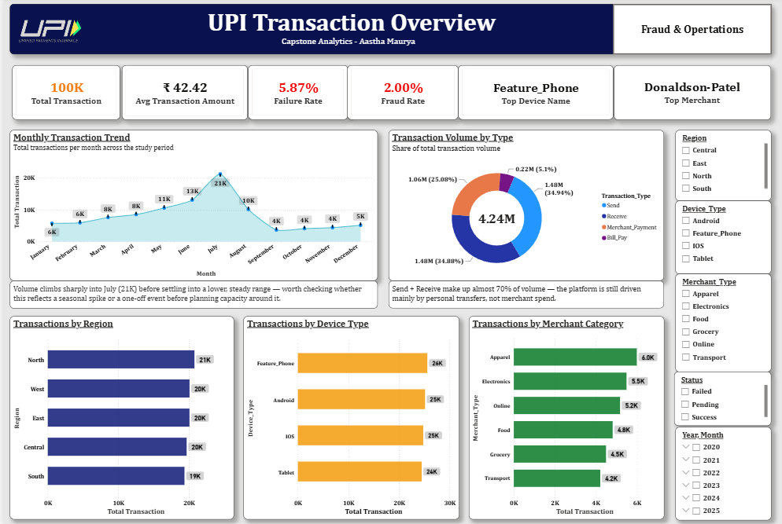
STEP 8 · POWER BI DASHBOARD SUITE
Executive Dashboard
Live view — connected to the full 7-table data model
13

Slide 14
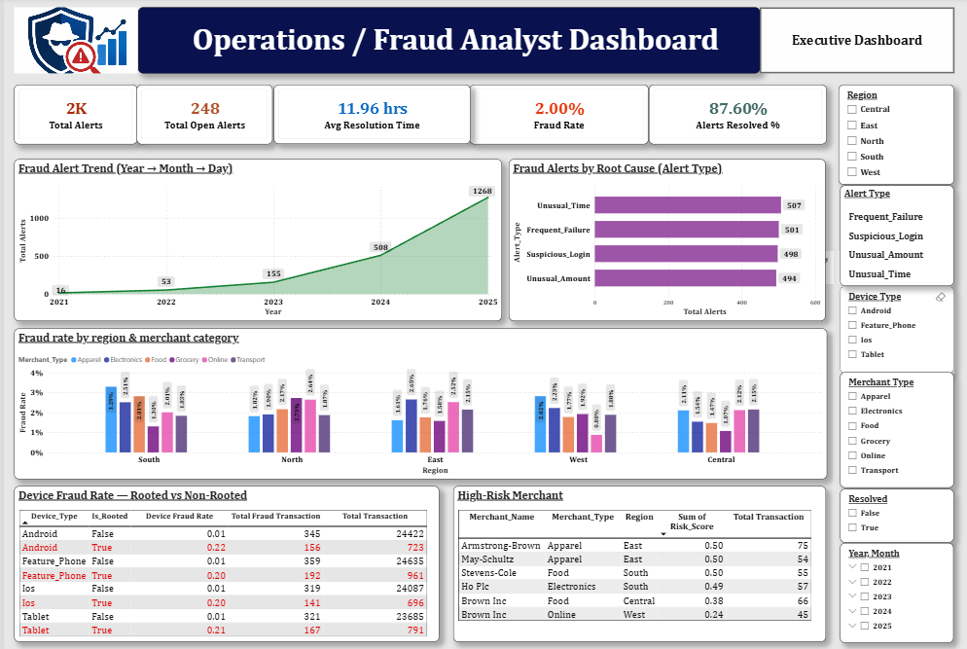
STEP 8 · POWER BI DASHBOARD SUITE
Operations / Fraud Analyst Dashboard
Drill-down fraud alert trends, root causes, and high-risk device / merchant views
14

Slide 15
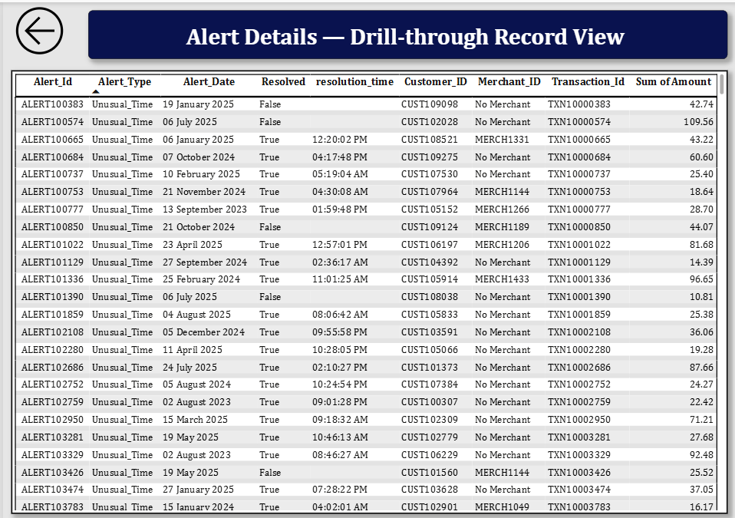
STEP 8 · POWER BI DASHBOARD SUITE
Alert Details — Drill-through Record View
Row-level fraud alert investigation — customer, merchant, transaction & resolution time
15

Slide 16
STEP 9 · STRATEGIC INSIGHTS & RECOMMENDATIONS
From Data to Decisions
TOP DATA-DRIVEN INSIGHTS
STRATEGIC RECOMMENDATIONS
West region × Electronics merchants is the single riskiest segment — 3.01% fraud rate, ~2× the platform average
Targeted device security
1
Add step-up authentication / rooted-device checks in West + Electronics to cut the highest-risk segment's exposure.
Overall transaction failure rate sits at 5.87%, a direct lever for customer trust and retention
2
Merchant onboarding review
Transaction volume is scaling rapidly (18× growth from baseline months) while fraud volume grows far more slowly
Re-screen high fraud-ratio merchants; tighten risk-scoring at onboarding to reduce future fraud inflow.
3
None of the four statistical tests found a single dominant fraud driver — risk is multivariate, not rule-based
4
Customer education & data hygiene
Fix the 9.69% invalid mobile-number records and run a failure-reason education push to lift the 5.87% failure rate.
9.69% of customer records carry invalid mobile numbers — a data-quality gap with compliance implications
5
16

Slide 17
Thank You
UPI Transaction Analytics — a full-stack view from raw data to boardroom insight.
Excel
MySQL
Python
Power BI
Validation & quality log
Schema & ingestion
EDA & statistical testing
Executive dashboards
Aastha Maurya · Data Analytics with GenAI — Capstone Project
17

