Slide 1
Blood Management System
Aastha Sahu
Emp Id: 200603

Slide 2
Requirments
Java[JDK 8+]
Visual Studio Code
MySql
JDBC Driver
MySql Connector

Slide 3

Functional Requirments
1. Login Credential: The Admin should be able to login with the username and password provided by the management.
2. Donor portal:
2.1 Add the donor details
2.2 Delete the donor details
3.3 Update the donor details
3. Receiver portal:
3.1 Add the receiver details
3.2 Delete the receiver details
3.3 Update the receiver details
4. Report: Admin should generate the report consisting of total blood available for each blood group.

Slide 4
Scope
The scope of the Blood Management System project includes the following functionalities:
- Login credential for Admin – Only authenticated admin will be able to add,update or delete the Donor or Receiver data.
- Donor Portal – In Donor portal admin will be able to add , update or delete the donor details that are present in the database .
- Receiver portal – In Receiver portal admin will be able to see all the request ;
- Report – Report will generate all the records ( Donor and Receiver ) present in the Database;

Slide 5
Introduction
Menu driven project for blood bank management system.
Perform CURD operations w.r.t Admin,Donor and Receiver.
It helps to register the details of donors, blood collection details as well as blood issued reports.

Slide 6
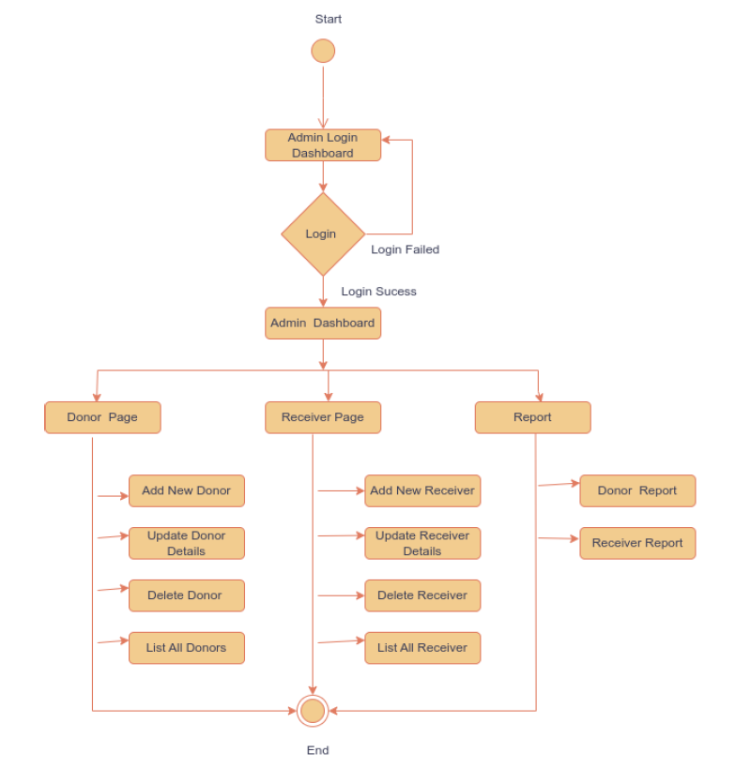
Architecture

Slide 7
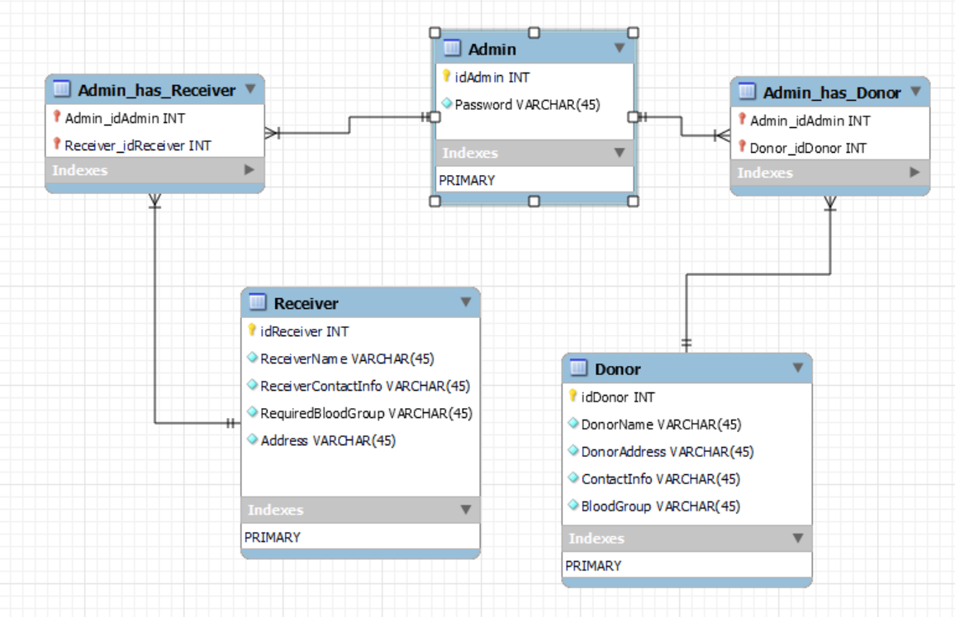
Class Diagram

Slide 8
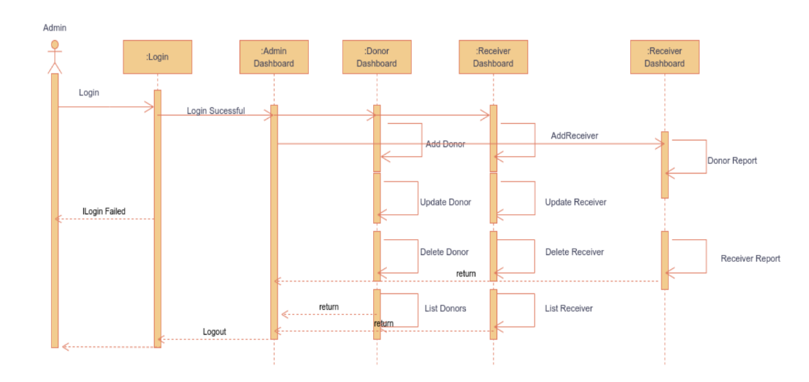
Sequence Diagram

Slide 9
User Interface
The user interface (UI) of the Blood Management System is designed to provide a user-friendly and intuitive experience for managing blood donor records. The UI is built using React.js, ensuring responsiveness and modern design principles. The layout is designed to be clean, organized, and easy to navigate, facilitating efficient interaction with the application's features.

Slide 10
Conclusion
The creation of a console based Blood Management System using Java and SQL offers streamlined blood inventory control. The system’s java interface allows medical professionals to manage donations, track blood types and oversee distribution. The integration of an SQL database ensures data accuracy for efficient reporting and analysis. It is light weight and easy to access. Future improvements could explore more user friendly interface with more functionalities. This system overall demonstrate the importance of efficient blood inventory management

Slide 11
References
1. https://docs.oracle.com/en/java/javase/17/docs/api/index.html
2. https://docs.oracle.com/cd/E17952_01/index.html

