Slide 1
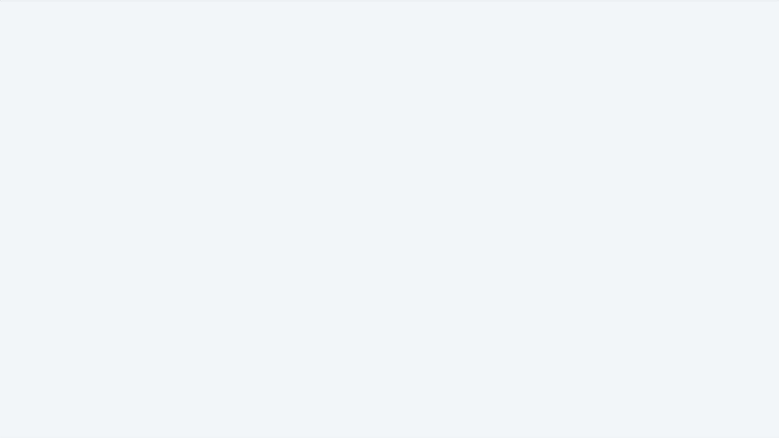

SEGMENTATION_FAULT
DOCTAMY
NOV 2022

Slide 2


1
TABLE OF CONTENTS
Problem
2
Solution
3
Work-Flow
4
Market Research
5
Future Scope

Slide 3


Problem –
Medical and health literacy among patients.

Slide 4
What?
PROBLEM
Medical and health literacy among patients.
Why?
Most of the time patients don't have specialization like doctors do and thus have a lack of knowledge about what doctor's guides prescribe and instruct them.
Why now?
Often leading them to misunderstand diagnoses done by doctors leading to side e"ects and even death.

Slide 5
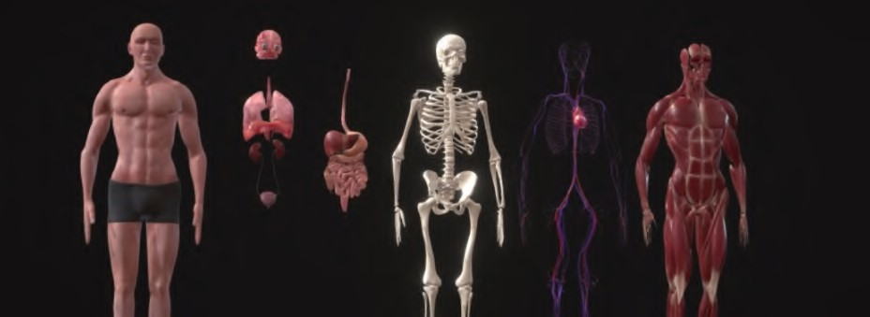

Our mission is to give the patient and his family a clear view and analysis of his previous and current disease that they are facing.
OUR MISSION

Slide 6
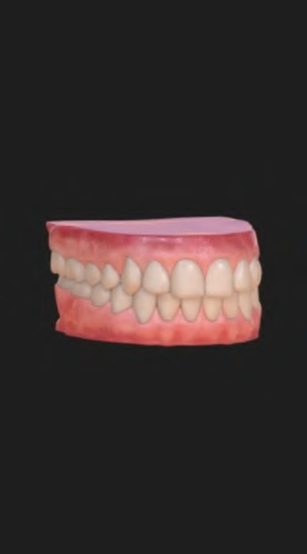
SOLUTION
We devise a plan to make your medical diagnosis more visually appealing by creating an interactive 3d model of your body. Both Doctor and Patient will have access to his 3d model. The doctor would be able to see the specific body diagrams he is specialized in and would be able to select and make diagnose. This will make sure that your previous reports are saved in visual form and you can access them later.
This will help patients easily understand the doctor's diagnosis through visual means.

Slide 7
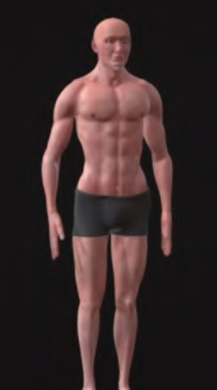
What part we are going to show?
We will be showing full potential of our application, using a body part, the demo will demonstrate all the listed features of the application.
Test analysis, 3D Visuals all will be implemented in the project which we are going to present.

Slide 8


Workflow
1
2
3
Patient Registers on our application and visits a registered doctor
The patient can get him/herself tested (if recommended)
The test results are shown in the form of a 3D-Model of the a"ected organ, along with a patient readable summary of test results

Slide 9
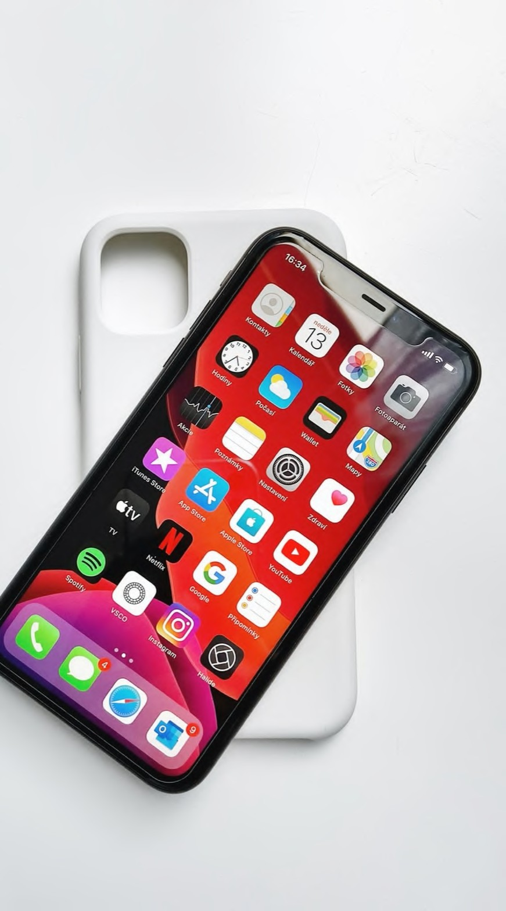

Python-(flask)
TECH STACK
for backend purposes.And can easily connect or ML models
ReactJs
for making component-wise rendering.
Blender
For generating 3d models

Slide 10
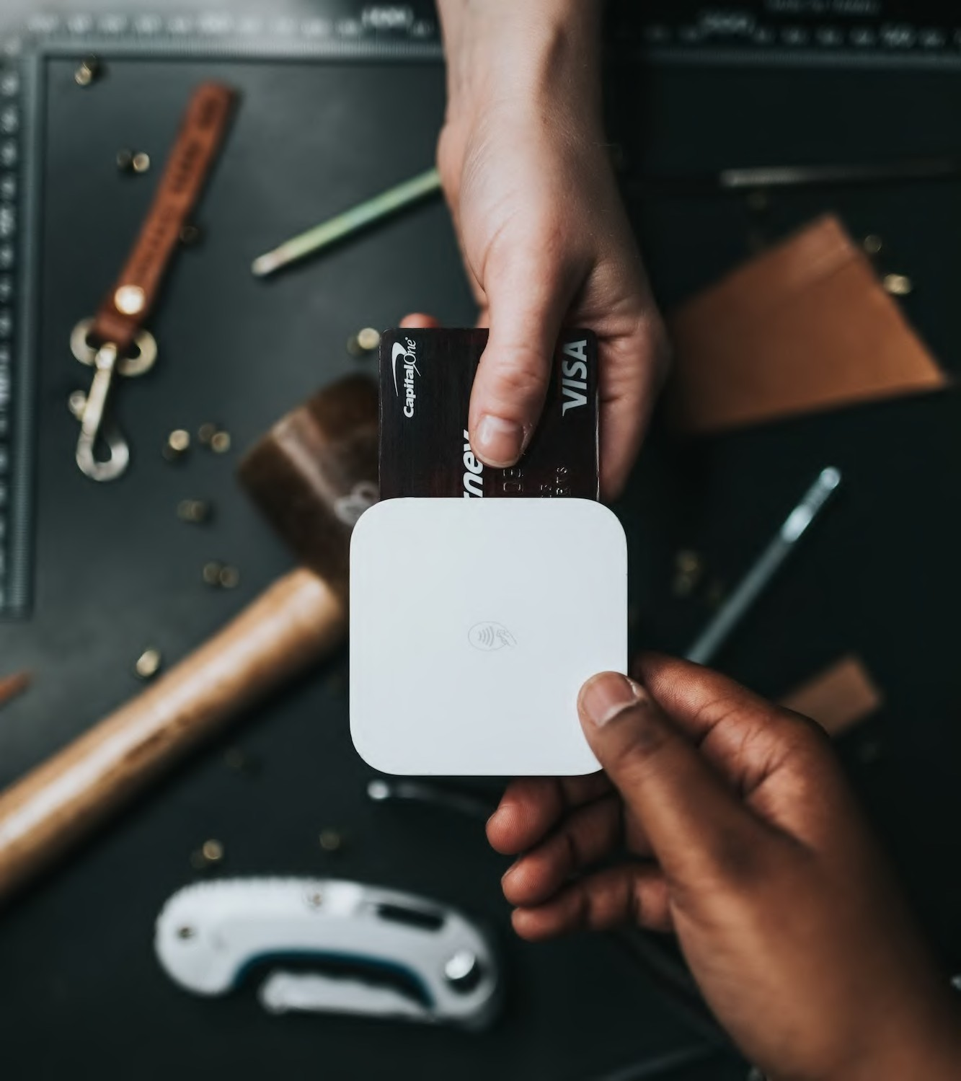
REVENUE AND
BUSINESS MODEL
DOCTAMY
Our Business will target the medical industries which is a very huge market (37.2B$).
Our model is subscription based.
Targeting Hospitals and medical professionals
Will be free for patients

Slide 11
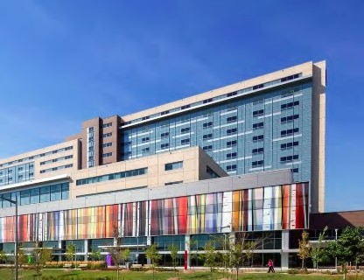
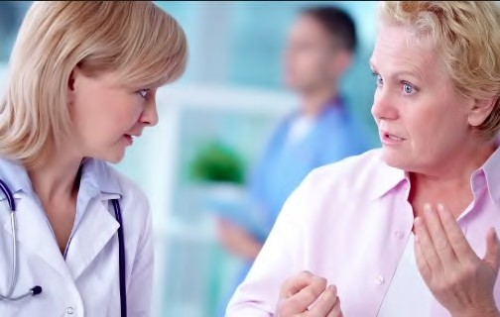

OUR TARGET MARKET
Hospitals
Patients
Medical students
Hospitals will generate the maximum revenue. The data and reports that is saved ,will be customized according to hospital specifics and makes it easier for hospitals , doctors and patients to keeps record of detailed and easy to understand reports .
The medical students will perform a very vital role as they can do research-based studies through our portal (with patient's consent) by studying their reports as case studies as we will be saving their medical history.
This service will be completely free for patients
.By taking the cut from the medicines suggested by the doctors, we will also generate revenue.

Slide 12

COMPETITION
Competitive Advantages
☑ Giving reports in a visual format.
☑ Now reports would be easy to understand.
☑ Doctors have easy access to the previous record.
☑ No more on-paper reports all things are digitalized.

Slide 13


Competitors
DOCTAMY
Practo
3D4medical
EMR report
3d visualization
Doctors Portal
Medical record Track

Slide 14
Over
75MILLION
adults in U.S have Basic and Below Basic Health literacy.

Slide 15

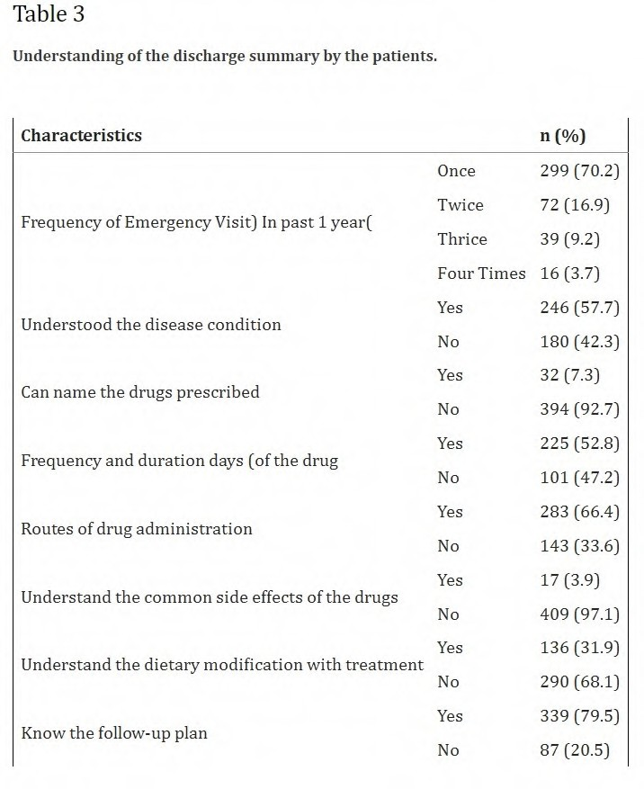
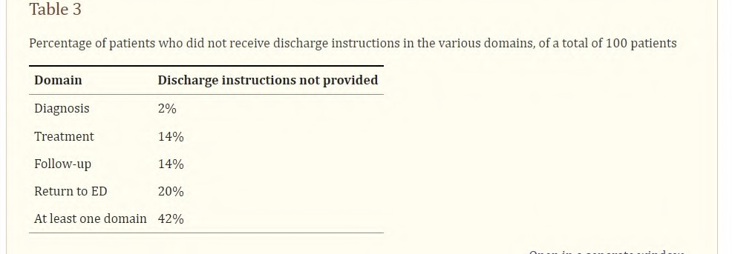
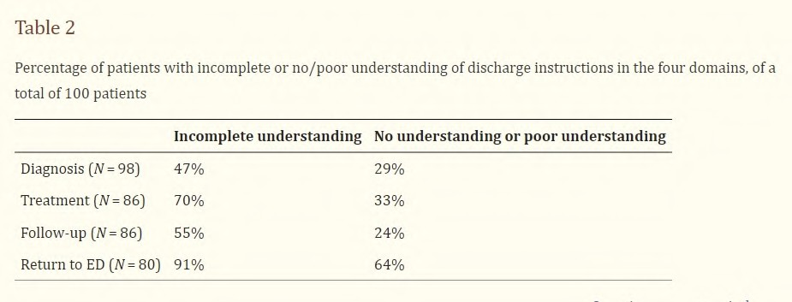
Statistics
~ by NATIONAL LIBRARY OF MEDICINE
(NATIONAL CENTER OF BIOTECHNOLOGY INFORMATION

Slide 16
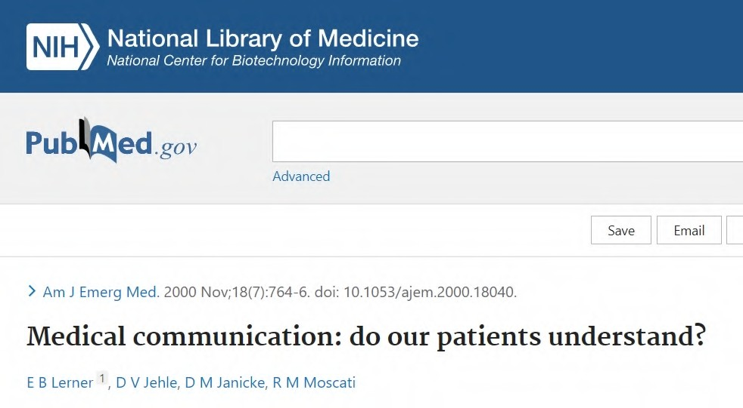
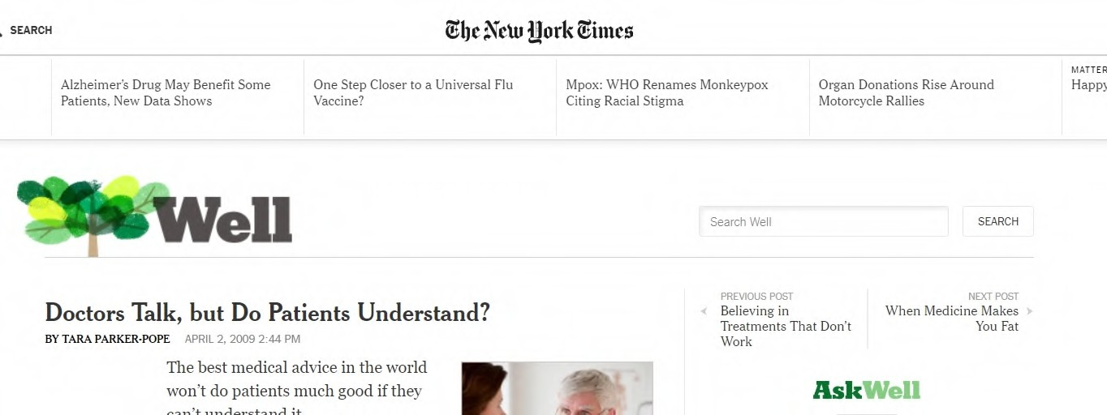
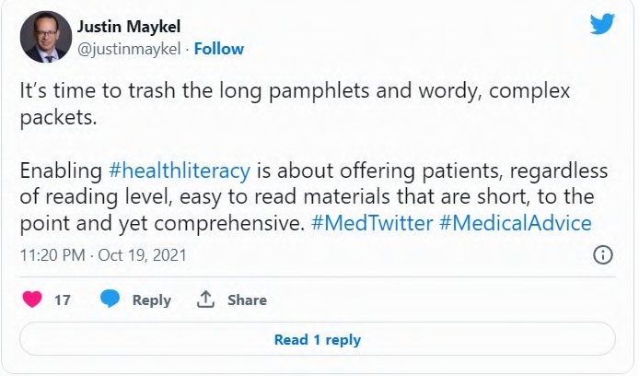
Some Articles and Blogs
https://pubmed.ncbi.nlm.nih.gov/11103725/
HTTPS://ARCHIVE.NYTIMES.COM/WELL.BLOGS.NYTIMES.COM/2009/04/02/DOCTORS-TALK-BUT-DO-PATIENTS-UNDERSTAND/

Slide 17
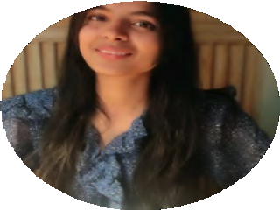
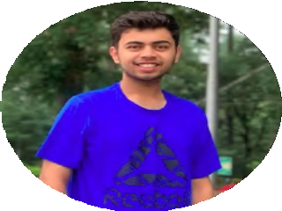



Our team has years of experience across diverse industries
Aastha Garg
R&D
Sarthak Pant
SDE
BSN Abhiram
SDE
Yash Bhandari
SDE
She is an expert in
researching new stu" and getting things together. And her skills on the front end are phenomenal
He is an expert in
developing new stu" from scratch plus his leadership skills are good.
He is an expert in
backend development and can easily solve any problem addressed to him.
He can make anything
work because of his knowledge in di"erent fields of tech helps the team at crucial times.

Slide 18

DOCTAMY
Thank you
I

