Slide 1

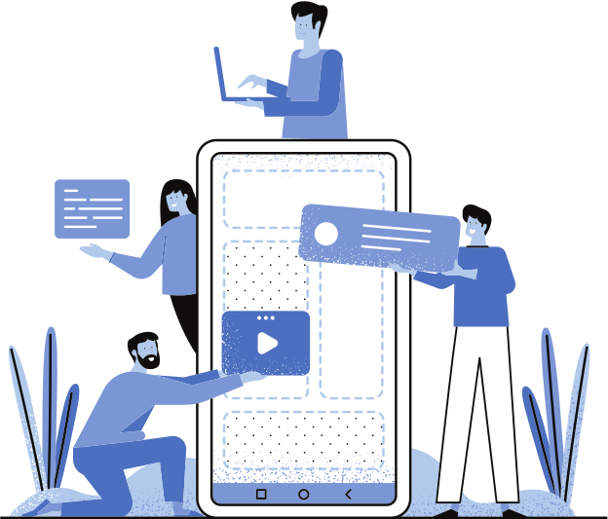
EDDY STUDY
FLUTTER PROJECT
Presented by: Aastha Jajoo

Slide 2

OVERVIEW
01
02
03
INTRODUCTION
PROBLEM STATEMENT
FUNCTIONALITIES
04
05
06
REQUIREMENTS
IMPLEMENTATION
CONCLUSION

Slide 3





INTRODUCTION
EddyStudy is a comprehensive flashcard app that enhances learning efficiency with spaced repetition, aiding effective memorization and retention.
It offers an intuitive interface and customizable features for seamless flashcard creation, organization, and review, catering to students, professionals, and lifelong learners.

Slide 4

PROBLEM STATEMENT
Develop a secure and user-friendly flashcard app to address the need for reliable user identification and authentication, ensuring data privacy and protection.
Create a seamless user experience by implementing a flashcard app, enabling users to access personalized content while safeguarding their accounts from unauthorized access and enhancing overall app security.

Slide 5
FUNCTIONALITIES
User-Friendly Design: Navigate effortlessly with an intuitive interface.
Organized Stacks: Arrange flashcards into categorized stacks for efficient studying.
Graphical Results: View performance feedback in visual graphs after tests.
Timer Functionality: Set time limits for focused flashcard sessions.

Slide 6


REQUIREMENTS
(SOFTWARE)
Development Environment:
o Flutter SDK
o Dart
o Android Studio IDE
o Android emulator

Slide 7
REQUIREMENTS
(HARDWARE)
Development Machine:
Processor: Intel Core i5 or better (or equivalent)
RAM: 8 GB minimum, 16 GB recommended
Storage: At least 10 GB of free space for the development environment, dependencies, and project files
Internet Connection

Slide 8
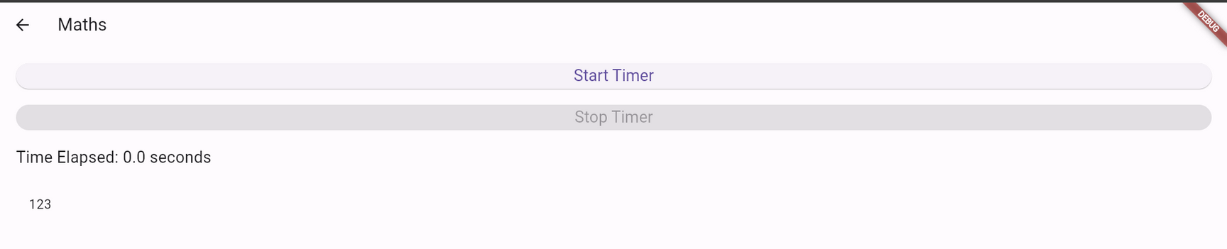
IMPLEMENTATION
TIMER FUNCTIONALITY
THE APP INCLUDES A TIMER FEATURE FOR FLASHCARD TESTS, ENABLING USERS TO SET TIME CONSTRAINTS AND ENHANCE FOCUS DURING STUDY SESSIONS.

Slide 9
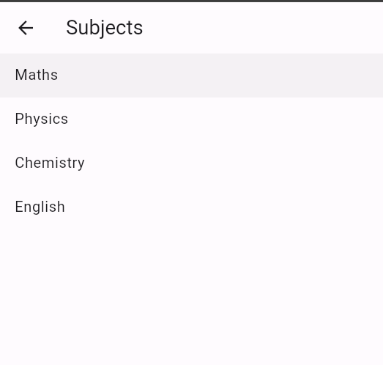
IMPLEMENTATION
ORGANIZED STACKS
FLASHCARDS ARE EFFICIENTLY ORGANIZED INTO STACKS, ALLOWING USERS TO CATEGORIZE AND MANAGE THEIR STUDY MATERIALS EFFECTIVELY.

Slide 10
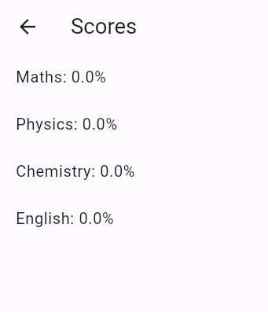
IMPLEMENTATION
TEST RESULTS
AFTER COMPLETING FLASHCARD TESTS, USERS RECEIVE FEEDBACK PRESENTING THEIR PERFORMANCE AND PROGRESS OVER TIME, FACILITATING VISUAL ANALYSIS AND COMPREHENSION.

Slide 11
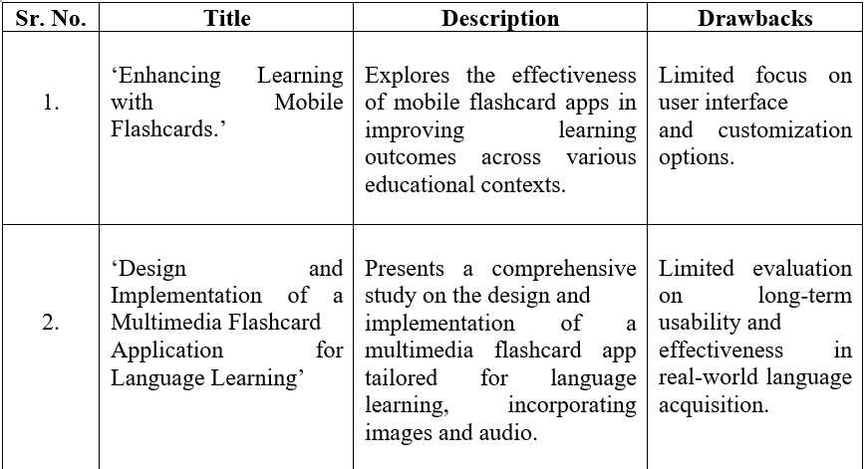
LITERATURE SURVEY

Slide 12
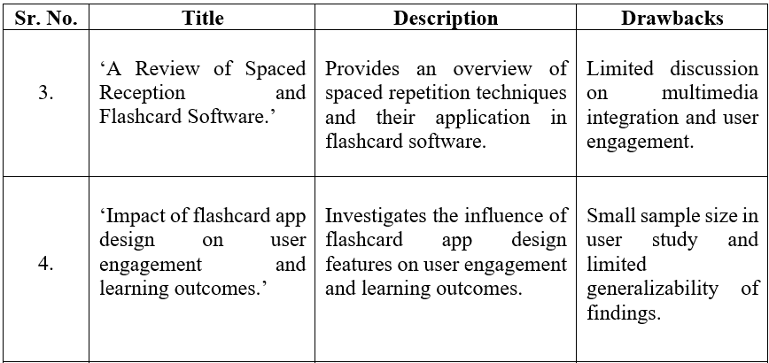
LITERATURE SURVEY

Slide 13
CONCLUSION
EDDYSTUDY PRESENTS AN INNOVATIVE SOLUTION FOR EFFICIENT AND PERSONALIZED LEARNING THROUGH ITS INTUITIVE INTERFACE, MULTIMEDIA SUPPORT, ORGANIZED STACKS, PERFORMANCE ANALYTICS, AND TIMER FUNCTIONALITY. WITH EDDYSTUDY, USERS CAN EMBARK ON A JOURNEY OF KNOWLEDGE ACQUISITION AND RETENTION, MAKING LEARNING AN ENGAGING AND REWARDING EXPERIENCE.

Slide 14
PROGRESSIVE WEB APP

Slide 15
PROBLEM STATEMENT
THE CURRENT WEBSITE LACKS OFFLINE FUNCTIONALITY AND STRUGGLES WITH SLOW LOADING TIMES, HINDERING USER EXPERIENCE AND ENGAGEMENT. TO ADDRESS THESE ISSUES AND ENHANCE ACCESSIBILITY, THERE IS A NEED TO DEVELOP A PROGRESSIVE WEB APP (PWA) THAT OFFERS SEAMLESS OFFLINE ACCESS, FAST LOADING SPEEDS, AND ENGAGING FEATURES ACROSS VARIOUS DEVICES.

Slide 16
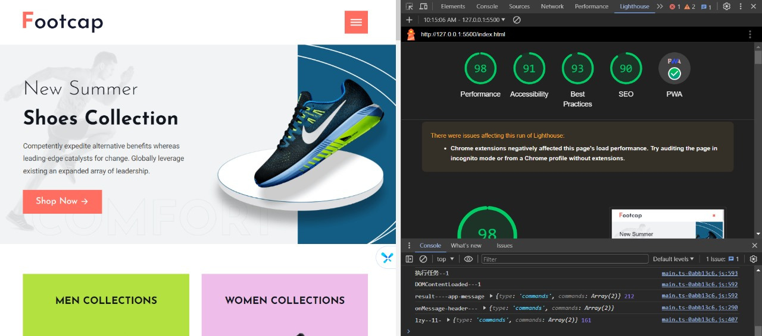
IMPLEMENTATION

Slide 17
CONCLUSION
PROGRESSIVE WEB APPS (PWAS) OFFER A SEAMLESS USER EXPERIENCE ACROSS DEVICES, COMBINING THE BEST OF WEB AND NATIVE APPLICATIONS. WITH THEIR OFFLINE CAPABILITIES, FAST LOADING TIMES, AND ENGAGEMENT FEATURES, PWAS REPRESENT THE FUTURE OF MOBILE AND WEB DEVELOPMENT, PROMISING ENHANCED ACCESSIBILITY AND USER SATISFACTION.

Slide 18

THANK YOU

