Slide 1

Project Title – Healthcare Analytic For Doctor visit TIRTC
AICTE STU ID : STU6a64510b46cf11784959243
[Student Name: VERMA AASTHA MADAN]

Slide 2

PROBLEM STATEMENT
The main objective is to analyze patient-related information and identify useful patterns in doctor visits. Students can compare age, health condition, illness, income, chronic conditions, and healthcare support with the number of visits.

Slide 3
Project Description
The Doctor Visits Data Analysis project focuses on analyzing patterns in healthcare utilization using a dataset containing information about patients' demographic characteristics, health conditions, socioeconomic factors, and healthcare access. The project explores how factors such as age, gender, income, number of illnesses, health status, reduced activity, chronic conditions, and healthcare coverage are associated with doctor visits.
Using Python, Pandas, NumPy, and Matplotlib, the dataset is cleaned, explored, and analyzed through exploratory data analysis (EDA). Various visualizations, including bar charts, line charts, scatter plots, and heatmaps, are used to identify important patterns and relationships.

Slide 4

WHO ARE THE END USERS?
Doctors and Healthcare Professionals – To understand patient visit patterns and health-related factors.
Hospitals and Clinics – To plan staff, facilities, and healthcare resources.
Researchers and Data Analysts – To study healthcare utilization and identify trends.
Government and Public Health Departments – To support healthcare planning and policy development.
End Users: Doctors, hospitals, healthcare planners, researchers, data analysts, and government/public health departments.

Slide 5

Technology Used
Python – Programming and data analysis
Pandas – Data cleaning and data manipulation
NumPy – Numerical calculations
Matplotlib – Creating graphs and charts
Seaborn – Data visualization and statistical analysis

Slide 6
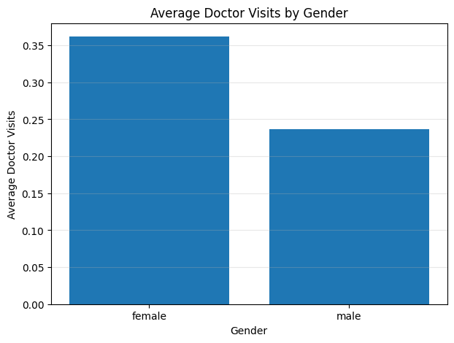
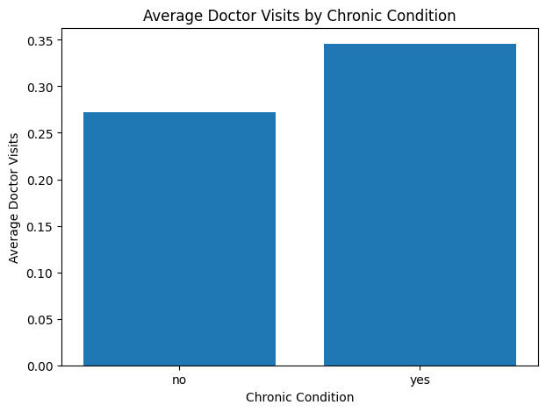
RESULTS
[Add screen shots of your code ]
GitHub Repository
🔗 View Project on GitHub

Slide 7
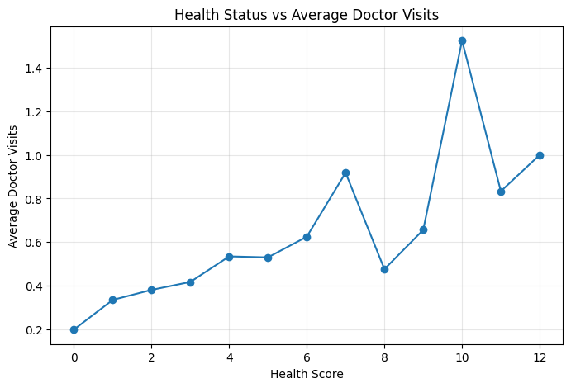
RESULTS
[Add screen shots of your code ]
GitHub Repository
🔗 View Project on GitHub

Slide 8
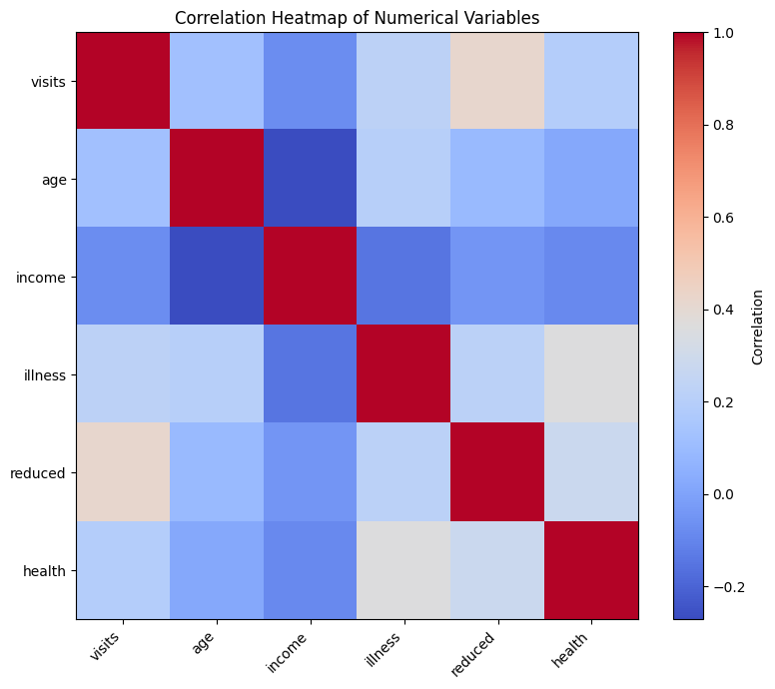
RESULTS
[Add screen shots of your code ]
GitHub Repository
🔗 View Project on GitHub

Slide 9
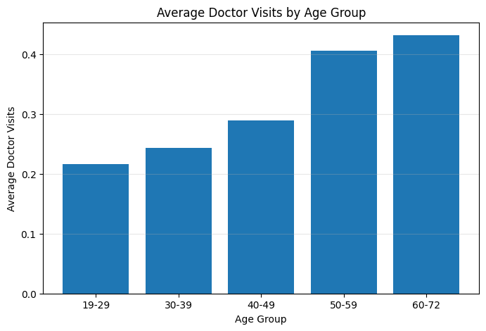
RESULTS
[Add screen shots of your code ]
GitHub Repository
🔗 View Project on GitHub

Slide 10
Thank you
.
.

