Slide 1
Marina International Hotel Database Management System

Slide 2
AGENDA
Introduction
ERD
Relational Data Model
SQL Queries:
Join
View
Stored procedure

Slide 3
INTRODUCTION
Marina International is a chain of hotels. Every hotel has several departments: inventory, housekeeping, front office, security, guest service, etc. Each hotel has only two types of rooms, Regular and Premium. Each type of room is priced differently. A guest books a room either through the hotel’s website or directly by walk-in. A booking ID is generated at the time of booking, and the guest’s booking details are stored.

Slide 4
PRIMARY GOAL
To design a management system for Marina International Hotels to track their day-to-day operations like bookings, services, and guest information to help manage inventory and pricing.

Slide 5
Entity Types of the Hotel
Hotel
Attributes of a hotel are Unique Hotel ID, Name of the hotel, Address (Street, City, State, and Zipcode), Phone No., website link, and rating of the hotel (on a scale of 1-5)
Room
Attributes of a room are Room ID, Price, Room Type, and Capacity of a room.
Guest
Details of guest information include Guest ID, ID Type, Name (First Name and Last Name), Address, and Phone Number.
1
2
3

Slide 6
Entity Types of the Hotel
Attributes of the service are Service ID, Service Charge, and Service Type.
Service
Employee
Department
The attributes of the department are Department ID, and Name.
Details of employees include Employee ID, Name (First name and Last name), Phone No., Address, Salary, and Designation.
4
5
6

Slide 7
Associative Entity Types:
Booking Information – Whenever a guest books a room, we are recording booking information. Attributes of booking information are – BookingID, CheckINdate, CheckOutDate, CheckInTime, CheckOutTime and PaymentType.
Weak Entity Types:
Dependent Information – If a guest is accompanied by a dependent then we are storing the dependent name and relationship with the guest.

Slide 8
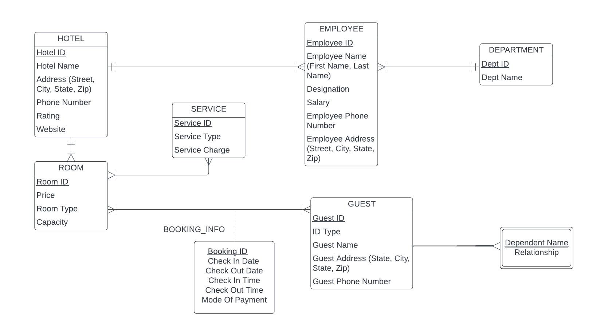
Entity Relationship Model

Slide 9
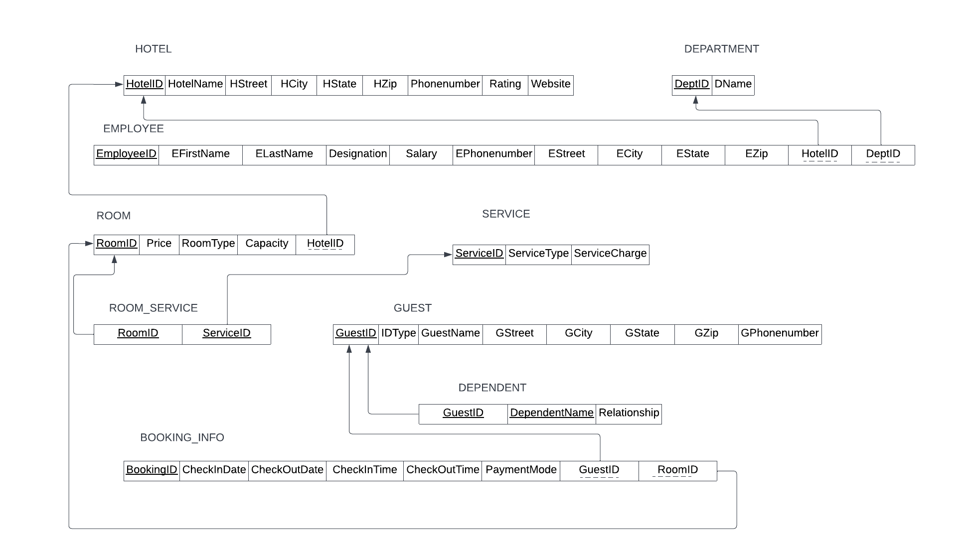
Relational Data Model

Slide 10
SQL Queries
1. JOIN
Cross Join
Inner Join
Left Join
Natural Join
2. VIEW
3. STORED PROCEDURES

Slide 11
JOIN
CROSS JOIN – cross join of all the tables:
select * from hotel_T cross join department_T cross join employee_T cross join service_T cross join guest_T cross join room_T cross join Bookinfo_T cross join Dependent_T cross join roomservice_T;

Slide 12
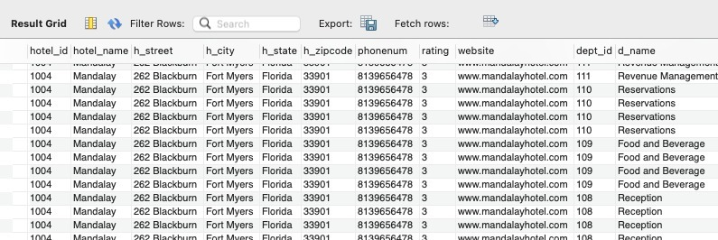

Slide 13
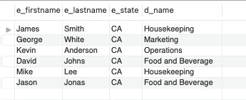
2. INNER JOIN Example 1 - Employee names and department names of employees who live in CA:
select distinct employee_T.e_firstname, employee_T.e_lastname, employee_T.e_state, department_T.d_name from employee_T inner join department_T on employee_T.dept_id=department_T.dept_id where e_state='CA’;

Slide 14
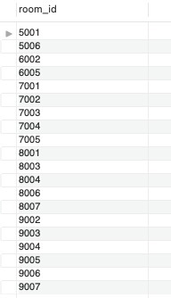
INNER JOIN
Example 2 - roomID of rooms which took any kind of service:
select distinct roomservice_T.room_id from roomservice_T inner join room_T on roomservice_T.room_id=room_T.room_id;

Slide 15
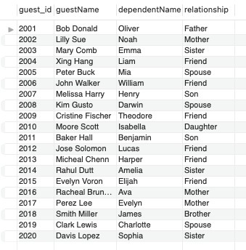
3. LEFT JOIN – selecting guests who have dependents:
select distinct guest_T.guest_id, guest_T.guestName, Dependent_T.dependentName, Dependent_T.relationship from guest_T left join Dependent_T on guest_T.guest_id=Dependent_T.guest_id;

Slide 16
4. NATURAL JOIN - Rooms which took any kind of service :
select distinct roomservice_T.room_id from roomservice_T natural join room_T;

Slide 17


Average price of premium rooms:
select avg(room_T.price) as 'Avg Price’
from room_T where roomtype = 'Premium’;
Employee details for employee whose name starts with M:
SELECT * from employee_T where e_firstname LIKE 'M%’;

Slide 18
Guest information for guest who checked-in on 2020-03-21:
select * from guest_T INNER JOIN Bookinfo_T ON guest_T.guest_id = Bookinfo_T.guest_idWHERE Bookinfo_T.checkIn_date = '2020-03-21’;

Slide 19
VIEWS
A view is a virtual table based on the result-set of an SQL statement.
Example 1
CREATE VIEW v_hotel1 AS
SELECT room_t.room_id, price, roomtype, capacity, hotel_id, booking_id, checkIn_date, checkOut_date, checkIn_time, checkOut_time, Paymentmode, guest_id FROM room_t Inner join bookinfo_t on room_t.room_id=bookinfo_t.room_id;

Slide 20
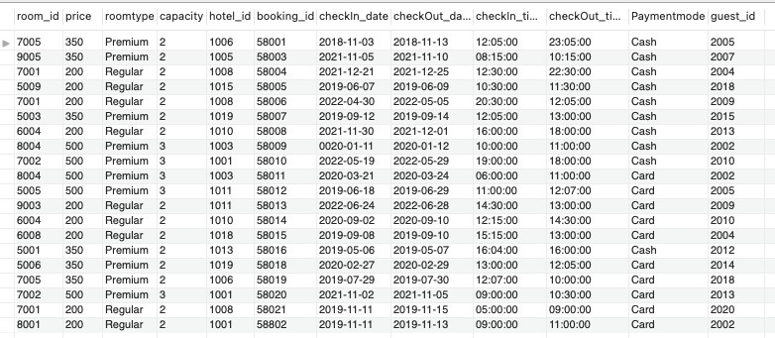
select * from v_hotel1;

Slide 21
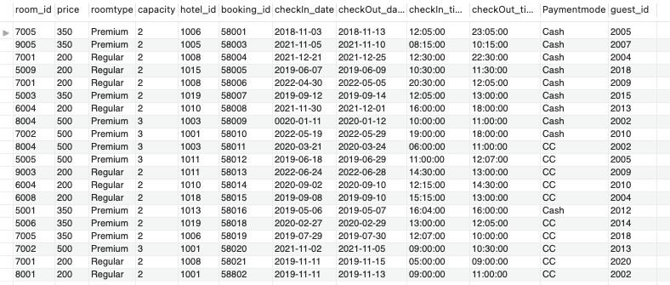
Update cell value in view:
UPDATE v_hotel1 SET Paymentmode = 'Card' WHERE Paymentmode = 'CC’;

Slide 22
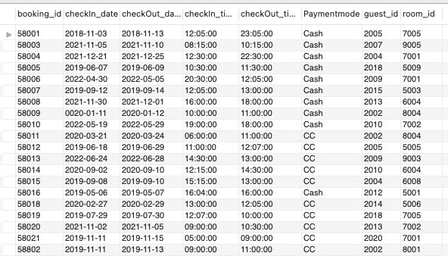
Update to view will update cell value in original table too:
select * from bookinfo_t;

Slide 23
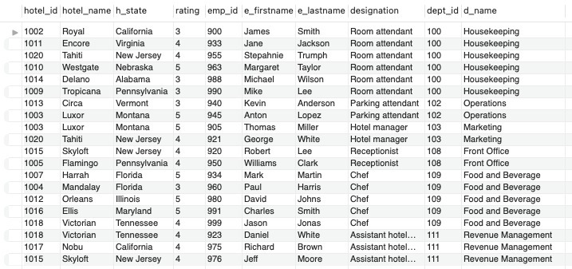
Example 2:
CREATE VIEW v_hotel2 AS SELECT hotel_t.hotel_id, hotel_name, h_state, rating, emp_id, e_firstname, e_lastname, designation, department_t.dept_id, d_name FROM hotel_t inner join employee_t on hotel_t.hotel_id=employee_t.hotel_id inner join department_t on employee_t.dept_id=department_t.dept_id
select * from v_hotel2

Slide 24
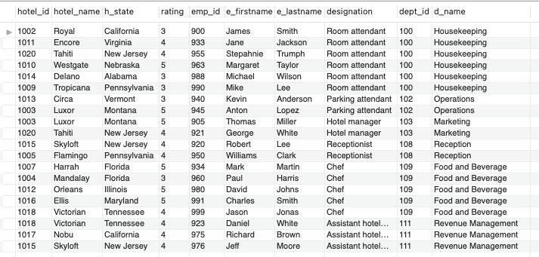
Update cell value in view:
UPDATE v_hotel2 SET d_name = 'Front Office' WHERE d_name = 'Reception’;
select * from v_hotel2;

Slide 25
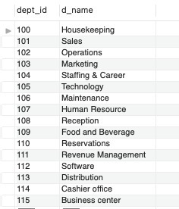
Update to view will update cell value in original table too:
select * from department_t;

Slide 26
STORED PROCEDURE:
A stored procedure is a prepared SQL code that you can save, so the code can be reused over and over again.
Example1: Selecting employees from a particular state DELIMITER //
CREATE PROCEDURE sp_emp_by_city(IN instate VARCHAR(10))
BEGIN
SELECT * FROM employee_T WHERE e_city = instate;
END//
DELIMITER;

Slide 27

CALL sp_emp_by_city('San Jose’);
Example 2: Find all guest information
DELIMITER //
CREATE PROCEDURE sp_guest()
BEGIN
SELECT * FROM guest_T;
END//
DELIMITER ;

Slide 28
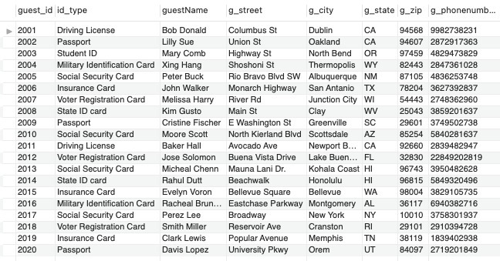
CALL sp_guest;

Slide 29
Thank you
Group 7
Aastha Tandon
Anisha Shenoy
Apoorva Tyagi
Sukirti Bhat

