Slide 1

Advanced System Programming
Group Members:
Shruti Saini & Aasthaba Zala

Slide 2
What is a Socket?
A socket is an endpoint of a two-way communication link between two different programs running on the network.
A socket is a communications connection point (endpoint) that you can name and address in a network. Socket programming shows how to use socket APIs to establish communication links between remote and local processes.
Socket Programming provides the ability to implement real time analytic, instant messaging, binary streaming, and document collaboration.

Slide 3

What is Socket Programming
Socket programming is a way of connecting two nodes on a network to communicate with each other. One socket(node) listens on a particular port at an IP, while other socket reaches out to the other to form a connection. Server forms the listener socket while client reaches out to the server.

Slide 4
Application of Socket Programming
Sockets allow applications to communicate using built in mechanism of hardware and operating system. Many of the apps from today’s most popular software packages including web browsers, peer to peer file sharing systems, and even more instant messaging applications rely on the concept of Sockets.
As we all know the famous messaging app that is the WhatsApp Messenger is also using the socket programming concept for free messaging or chatting. There is not only messaging application which uses socket programming but there are also many apps which are using it to send and receive the data from client and server like Grofers, OLA and Uber.

Slide 5
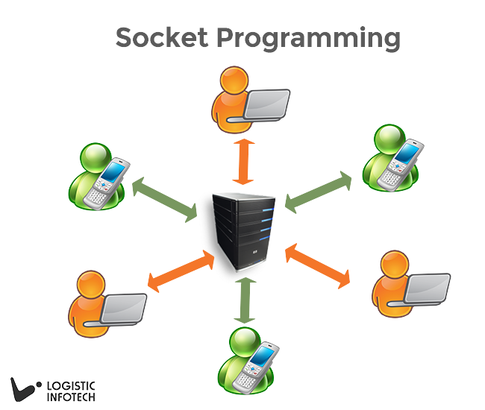

Slide 6

Demo

Slide 7

Thank you
This Photo by Unknown author is licensed under CC BY-SA.

