Slide 1

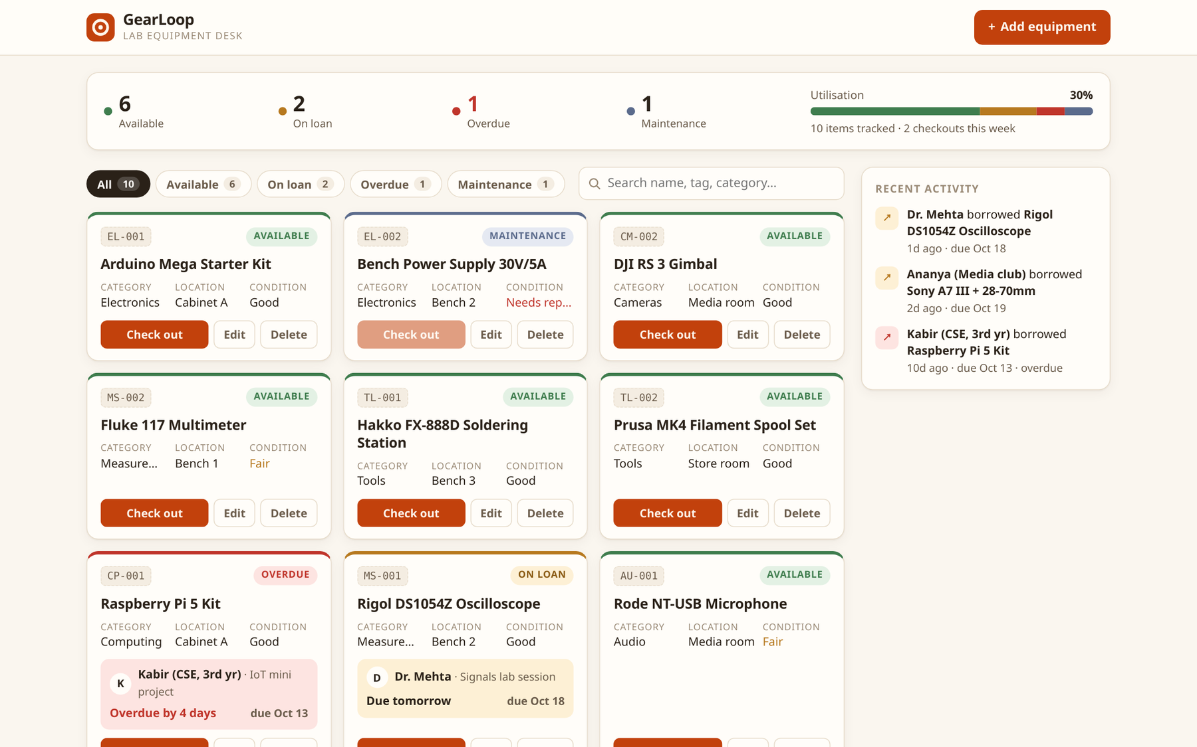
GearLoop
A lab equipment desk, taken from a laptop to a monitored Kubernetes cluster
DevOps Final Capstone · Aastik Nayyar
React · FastAPI · PostgreSQL · Docker · GitHub Actions · Trivy · GHCR · Terraform · Kubernetes · Helm · Ingress · HPA · Prometheus · Grafana
Notes:
GearLoop is a lab equipment checkout desk. The app is small on purpose: the point of the capstone is the path from a developer laptop to a monitored, autoscaling Kubernetes deployment. Everything in this deck is from the real running system.

Slide 2
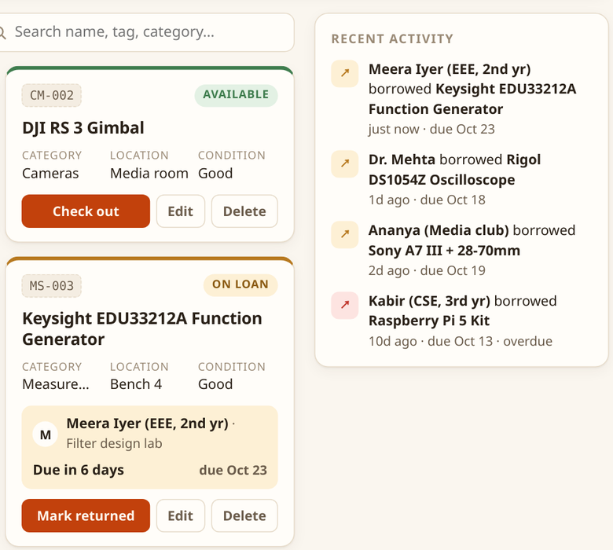




What GearLoop does
Labs lend out oscilloscopes, cameras and dev kits on paper slips. Items go missing, nobody knows what is overdue, and broken gear gets lent out again.
Register equipment
asset tag, category, location, condition
Check out and return
borrower, purpose, 1–30 day loans
Overdue at a glance
status derived from due dates
Repairs block lending
"Needs repair" moves an item to Maintenance
Notes:
Four jobs: register, check out and return, see what is overdue, and keep broken gear out of circulation. The status of each item is derived from its active loan and its condition, not stored separately, so it can never drift.

Slide 3









Tech stack
Frontend
Backend
Database
React 19 · Vite 8 · plain CSS · vitest
FastAPI · SQLAlchemy 2 · Pydantic · Alembic
PostgreSQL 17 (StatefulSet + PVC)
Containers
CI/CD
Infrastructure as Code
multi-stage Docker · Compose · GHCR
GitHub Actions · Trivy · Argo CD (GitOps)
Terraform: kubernetes · helm · random
Kubernetes
Observability
Quality gates
minikube · Helm · ingress-nginx · HPA
Prometheus · Grafana · Alertmanager
pytest · ruff · alembic check · actionlint
Notes:
Everything here is open source and runs on one laptop. Python and React for the app, PostgreSQL for data, Docker and GitHub Actions for build and delivery, Terraform and Helm to describe the cluster, Argo CD for GitOps, and the Prometheus stack for monitoring.

Slide 4
Architecture: laptop to monitored cluster
Developer
git push
GitHub Actions
ruff · pytest · vitest · helm lint · tf validate · Trivy
GHCR + Git
images :<sha> · tag bump commit
Terraform
namespaces · monitoring · Argo CD
applies
Argo CD pulls
Kubernetes cluster (minikube)
Browser
gearloop.local
Ingress
ingress-nginx
/
frontend ×2
nginx (React build)
Argo CD
auto-sync · prune · self-heal
/api
backend ×2–6
FastAPI · HPA on CPU
scrape
Prometheus
ServiceMonitor
Grafana
dashboard
initContainer migrates
PostgreSQL
StatefulSet + PVC
Namespace gearloop · Pod Security "restricted" · NetworkPolicy · PDBs · PrometheusRule alerts
Notes:
Top row is the delivery path: a push runs the pipeline, which tests, builds and scans both images and pushes them to GHCR tagged with the commit SHA, then commits that tag to Git. Argo CD inside the cluster pulls the change and deploys that exact SHA. Terraform declares the cluster setup: the namespaces, quota, the monitoring stack and Argo CD itself. Inside the cluster the browser only ever talks to the Ingress, and Prometheus scrapes the backend.

Slide 5
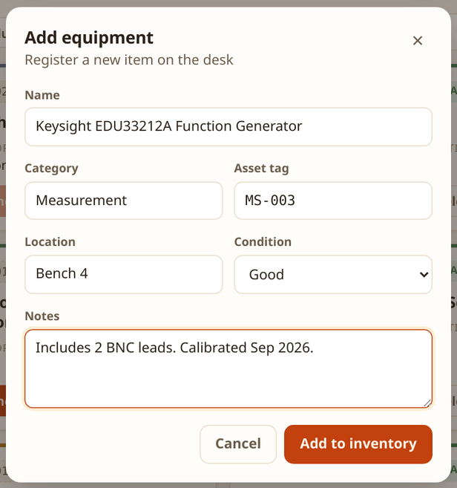
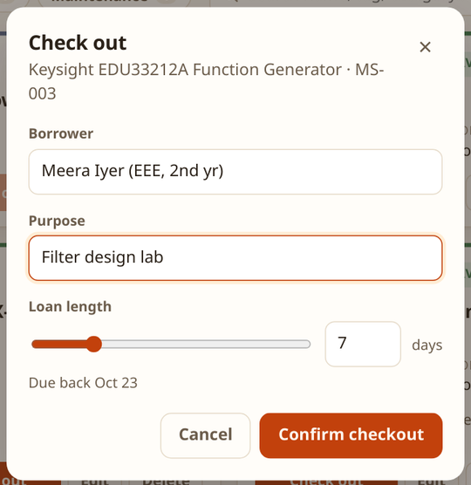
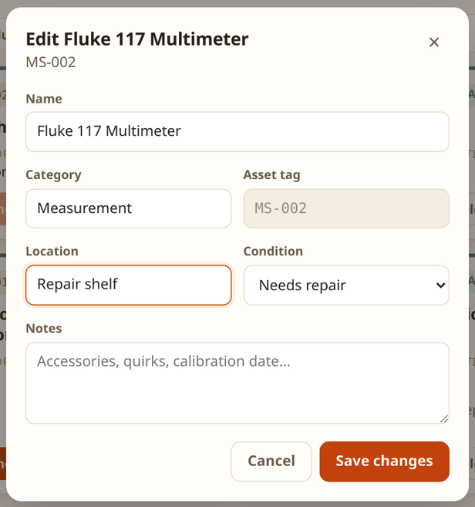
Core workflows in the UI
1 Register
2 Check out
3 On loan
4 Repair
Asset tags are unique; the API answers 409 on duplicates.
Borrower, purpose and a 1–30 day loan; due date shown live.
Card shows who has it and when it is due; the activity feed updates.
Setting "Needs repair" blocks new checkouts until fixed.
Notes:
The four main flows. All four are real screenshots from the running app. Dialogs are in-app rather than browser confirm boxes, and every API error comes back as a readable toast.

Slide 6
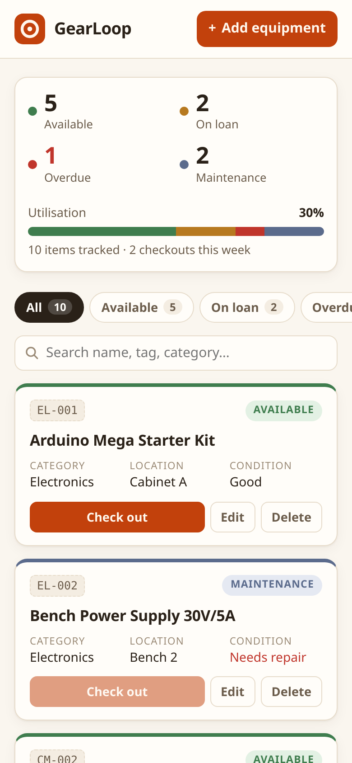
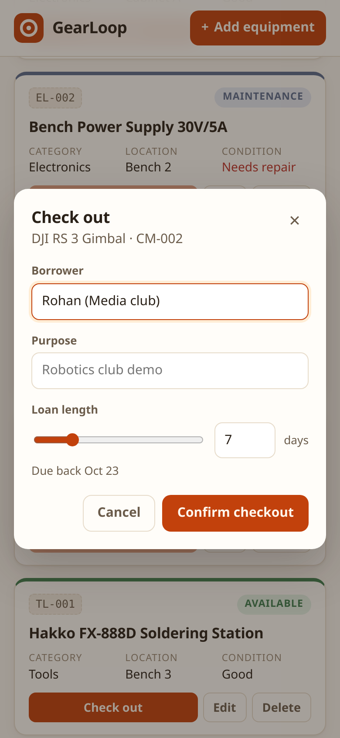
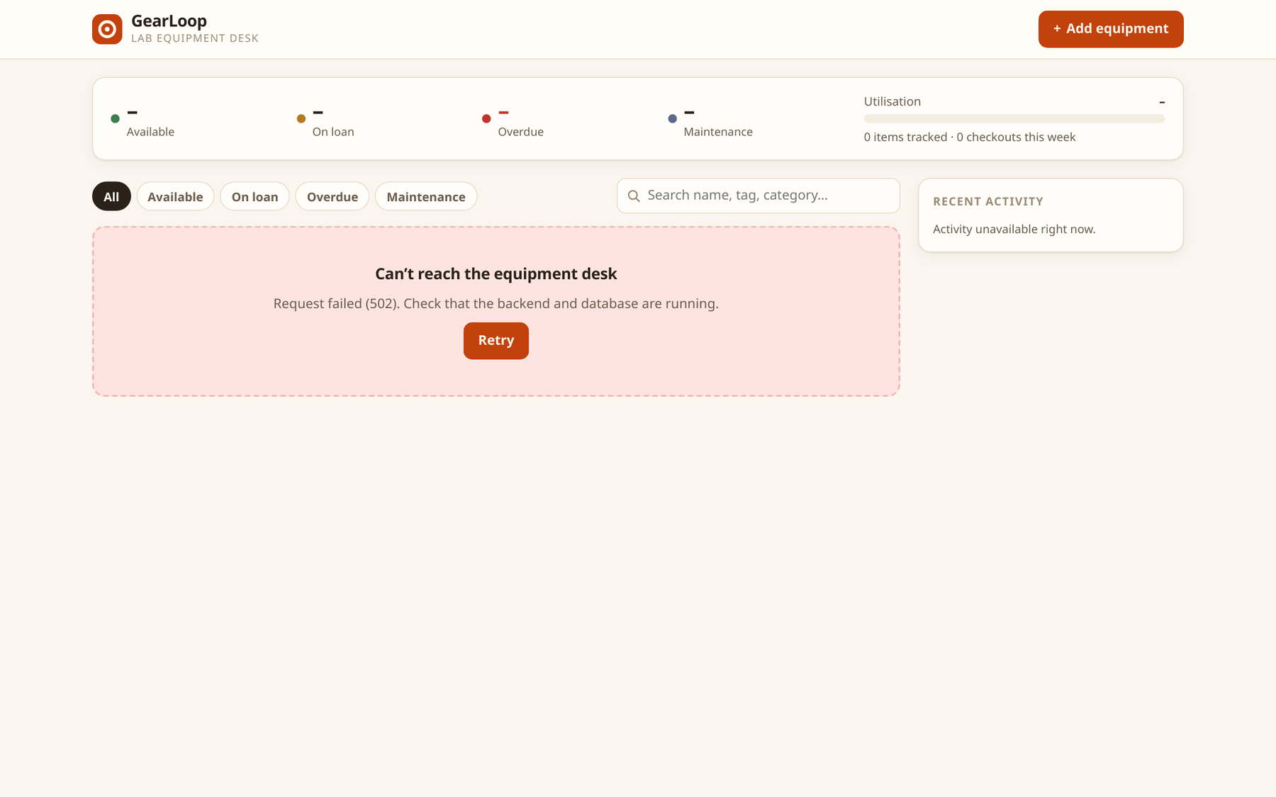
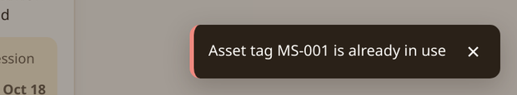
Responsive, and honest about failure
Backend container stopped: clear message + Retry instead of a blank page
Phone layout down to 360px
Summary stacks, chips scroll
In-app dialogs, no browser confirm()
API errors (409 / 422) as toasts
Notes:
Left: the phone layout at 390 pixels. Right: what the user sees when the backend is stopped, which I captured by stopping the backend container. Below: the duplicate asset tag error coming back from the API.

Slide 7
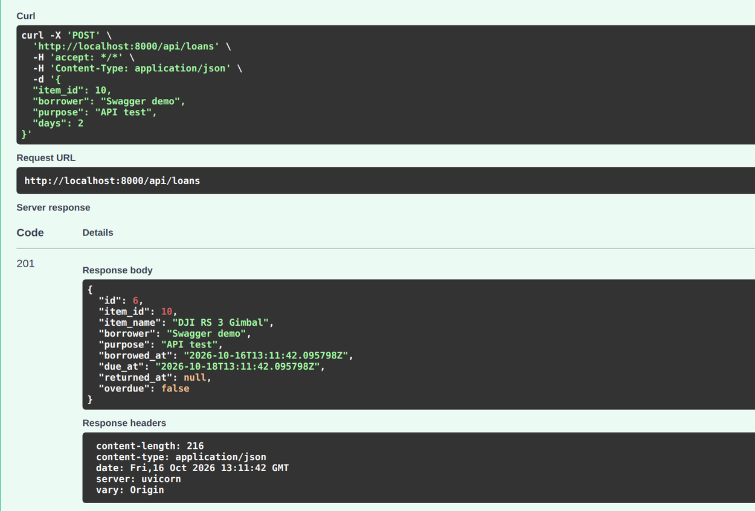
FastAPI backend: 10 endpoints + probes
Method | Path | Purpose
GET | /health /ready /metrics | liveness · readiness · metrics
GET | /api/stats | counts, utilisation %, checkouts this week
GET | /api/items?status=&q= | list, filter, search
POST | /api/items | register (409 on duplicate tag)
PUT · DELETE | /api/items/{id} | update · delete (409 while on loan)
GET | /api/loans?active= | loan history / open loans
POST | /api/loans | check out (409 if unavailable)
POST | /api/loans/{id}/return | check in
Swagger /docs: POST /api/loans → 201 Created
SQLAlchemy 2 models · Pydantic validation · a partial unique index guarantees one open loan per item, even under concurrent checkouts
Notes:
Ten REST endpoints plus three operational ones. /health is liveness and never touches the database. /ready checks the database and the schema, so a pod with a bad DB password stops receiving traffic instead of restart-looping. Business rules are enforced in the database too, not only in Python.

Slide 8
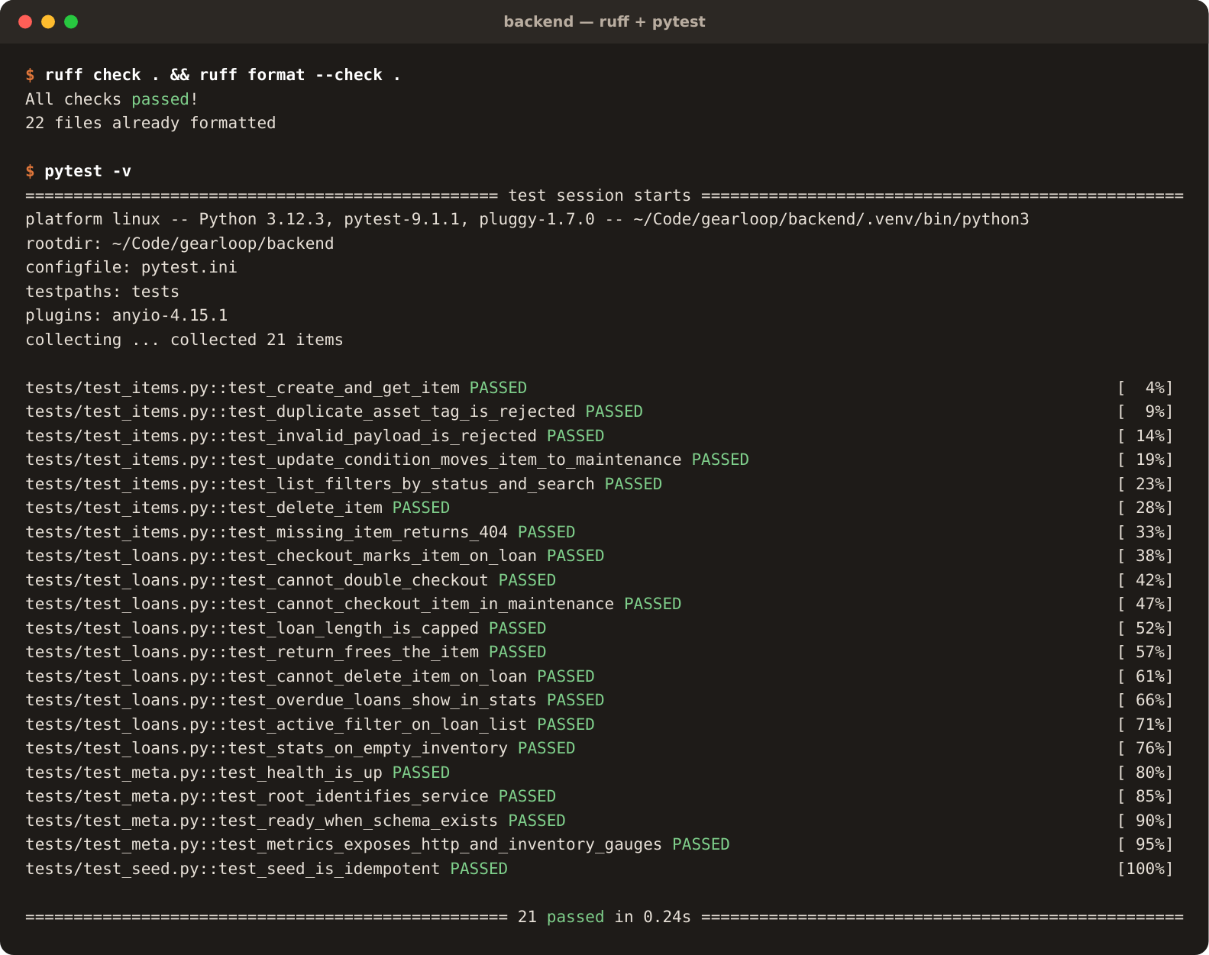
Tests: the first quality gate
21
5
backend tests (pytest)
frontend tests (vitest)
Tests run on in-memory SQLite: never the real database
CI also migrates a real PostgreSQL 17 and runs alembic check to catch model/migration drift
ruff lint + format check before anything is built
A failing test stops the pipeline: no image is pushed
Notes:
Bad code should die here, before Docker. 21 backend tests cover health, items, loans, overdue logic and the metrics endpoint. The CI job also applies the real migrations to a Postgres service container.

Slide 9
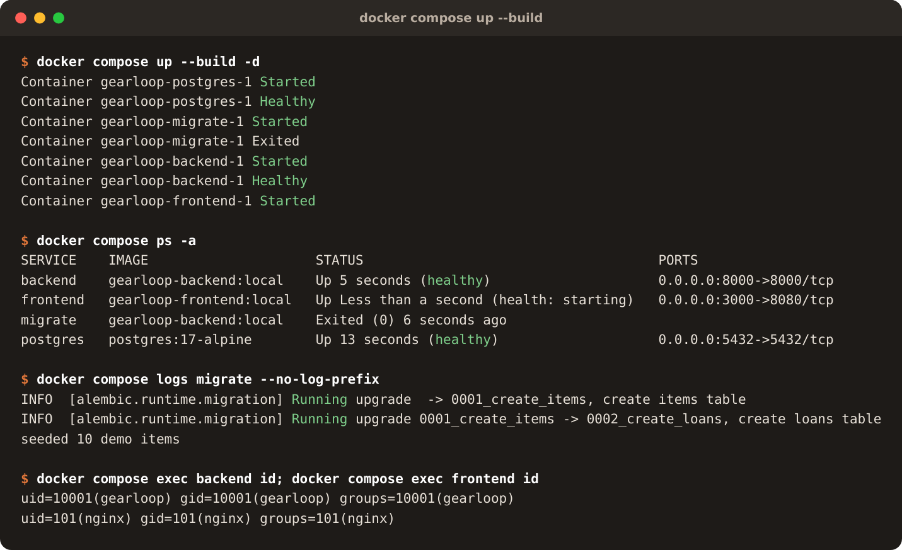
Docker: one command, four services
Startup order is enforced: postgres healthy → migrate exits 0 → backend healthy → frontend
Multi-stage builds: Node only in the frontend build stage; backend venv built separately
Non-root: backend uid 10001, unprivileged nginx uid 101
No pip at runtime: removes its vendored CVEs (next slides)
Notes:
docker compose up --build brings up Postgres, a one-shot migrate job, the API and the UI, each waiting on the previous one to be healthy. Both images run as non-root users, which the compose output proves with id.

Slide 10




CI/CD pipeline (GitHub Actions)
backend
ruff · migrate · pytest
images (matrix: backend, frontend)
buildx → Trivy SARIF → Trivy gate → push ghcr.io/…:<sha>
gitops (main only)
commit the SHA tags to values-gitops.yaml [skip ci] → Argo CD syncs
frontend
vitest · vite build
infra
helm lint · terraform validate
Commit-SHA tags
Actions pinned to SHAs
PRs build, main ships
Pull-based deploy
every image traces back to one commit; never :latest
a moved or hijacked tag cannot change what runs
images are pushed only from main
CI never holds cluster credentials; Argo CD pulls from Git
Notes:
Three test jobs run in parallel. Only if all pass does the image job build both images, scan them and push them tagged with the commit SHA. On main, a final job commits the new tags to Git for Argo CD; CI never talks to the cluster. Honest status: the workflow is linted with actionlint but has not run on GitHub yet, because the repo is not pushed.

Slide 11
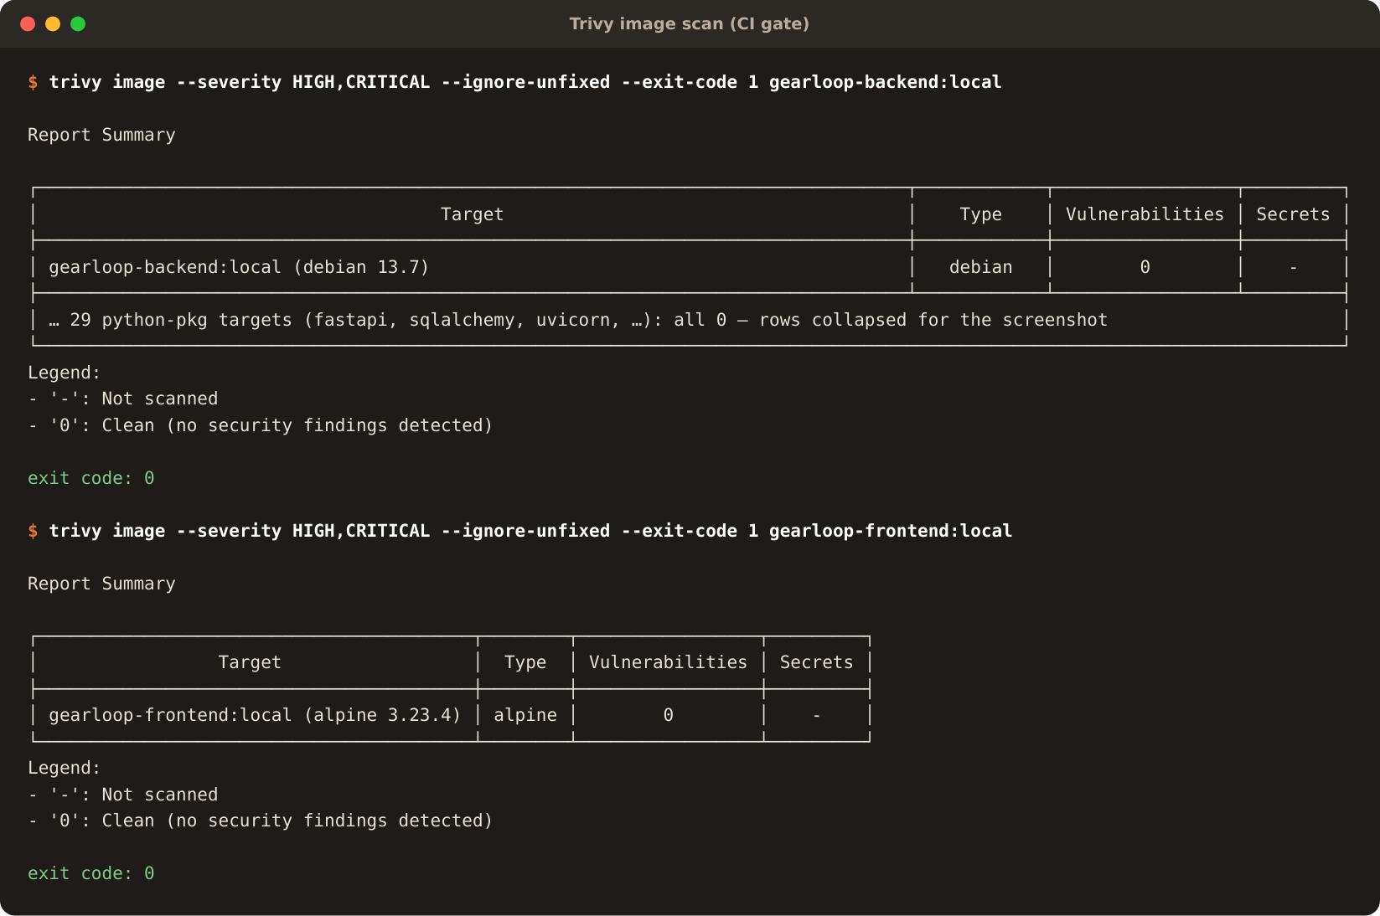
DevSecOps: the Trivy gate earned its place
4 HIGH
→
0
fixable HIGH / CRITICAL CVEs in the backend image
First backend build failed the gate: urllib3 (×2), msgpack, setuptools
None were GearLoop dependencies: all were copies vendored inside pip itself
The app never runs pip, so the fix was to remove pip from the runtime image, not to ignore the findings
CI scans twice: full SARIF report to GitHub Security, then a blocking HIGH/CRITICAL gate
Notes:
This is the CVE explanation the rubric asks for. The scan found four fixable HIGH vulnerabilities, all inside pip. Removing pip from the final image fixed them at the source. Both images now scan clean for fixable HIGH and CRITICAL issues.

Slide 12
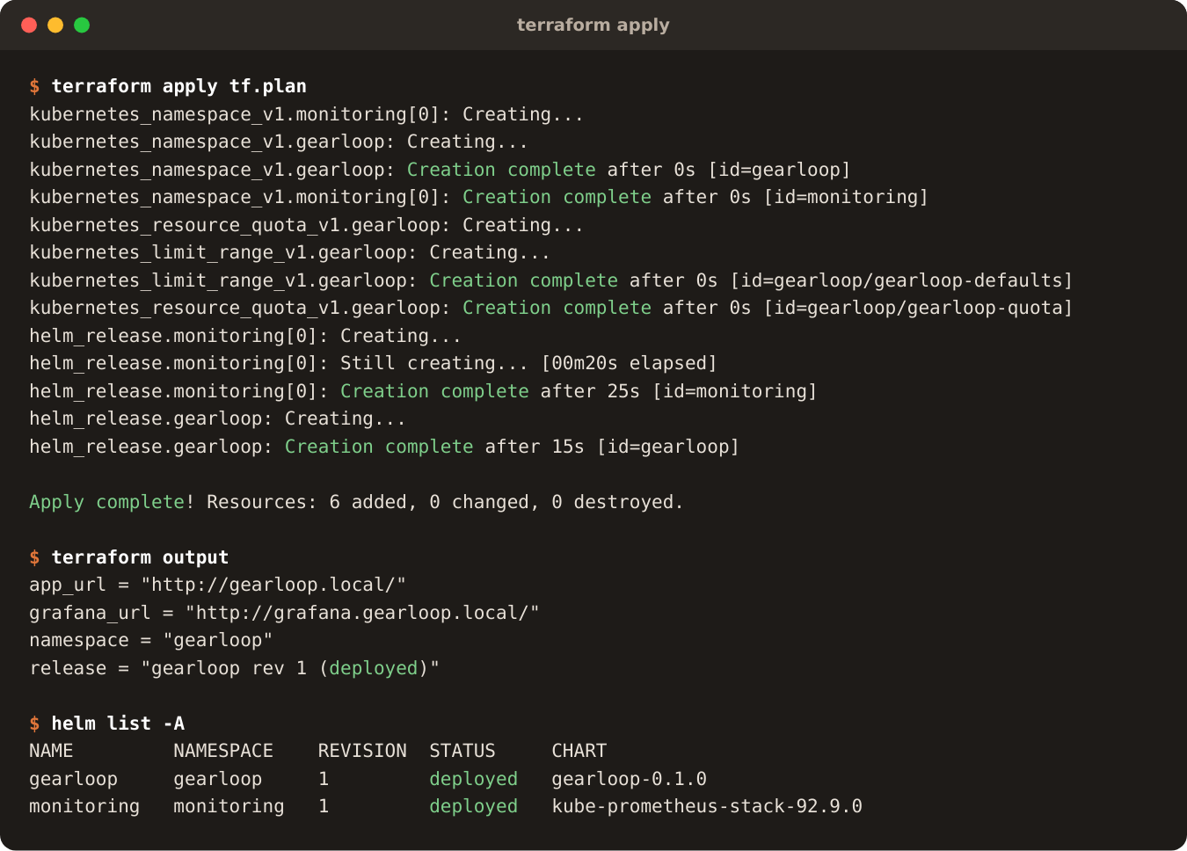
Terraform: the cluster setup as code
No cloud account needed: the kubernetes and helm providers manage the local cluster, so plan, apply and destroy really run.
kubernetes_namespace_v1
gearloop (PSA restricted) + monitoring
quota + limit range
caps what the namespace can request
helm_release.monitoring
kube-prometheus-stack 92.9.0 (CRDs first)
helm_release.gearloop
../helm/gearloop · atomic, waits for Ready
Real run on minikube; destroy then removed both namespaces and the Postgres volume
6
~40 s
0
resources
apply on minikube
left after destroy
Notes:
AWS is out of scope for this project, so Terraform manages the local cluster instead of creating one in the cloud. It owns both namespaces, the quota and limit range, and the two Helm releases, in dependency order: monitoring first because the app chart needs its CRDs. I ran plan, apply, destroy and apply again. Because Terraform owns the namespaces, destroy also removes the things Helm keeps on uninstall, like the database Secret and the Postgres volume.

Slide 13
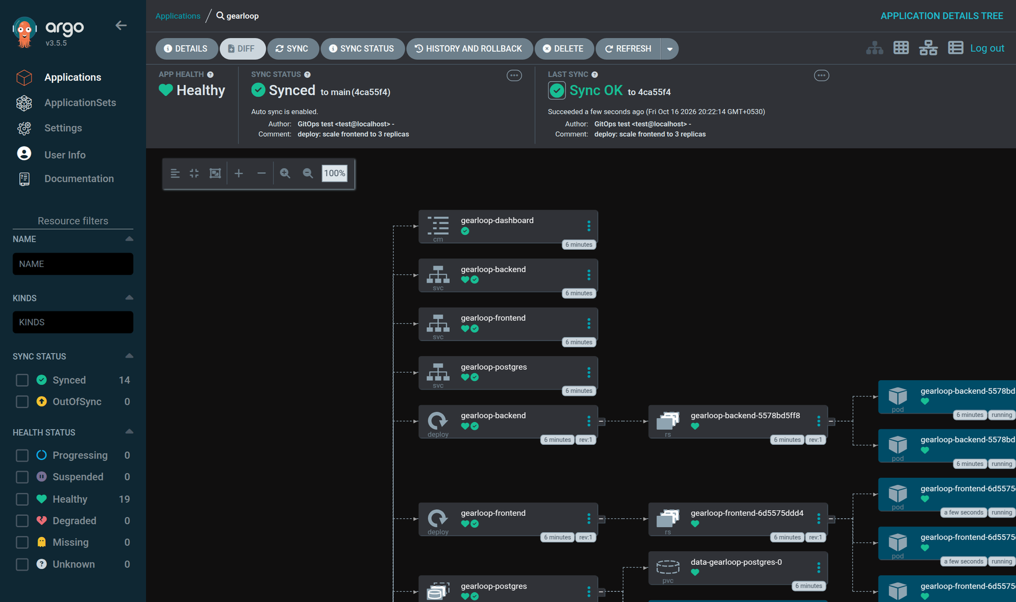
GitOps with Argo CD
18 s
from git push to synced pods
2 s
self-heal reverts a manual kubectl change
0
secrets in Git (DB Secret comes from Terraform)
CI commits the new image tag to values-gitops.yaml; Argo CD (auto-sync, prune, self-heal) pulls it. GitHub never needs access to the cluster.
Synced / Healthy; tested against a local Git server before the GitHub push
Notes:
Deployment is pull-based. The pipeline does not run helm against the cluster. It only commits the new image tag to Git, and Argo CD running inside the cluster notices and syncs. That is why it works with a laptop cluster GitHub cannot reach. I tested it before pushing: a commit synced in 18 seconds, and a manual scale-down was reverted in 2 seconds. Argo CD cannot run Helm lookup, so the database password comes from a Terraform-created Secret and never appears in Git.

Slide 14
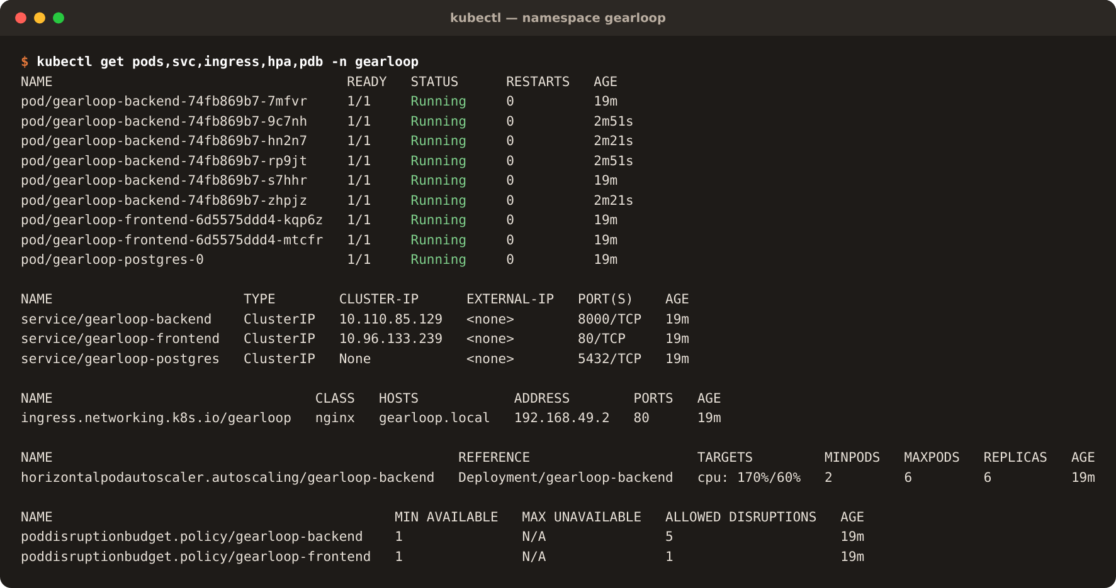


Kubernetes + Helm
Deployments
≥2 replicas, zero-downtime rolling updates
Postgres StatefulSet
PVC, password kept across upgrades
Migrations in an initContainer
Postgres advisory lock, so replicas never race
Startup, readiness, liveness
/ready gates traffic on the DB
helm history: rev 1, installed by terraform apply helm test: Succeeded
Locked down
PSA restricted · read-only FS · NetworkPolicy · PDBs
Notes:
One Helm chart deploys everything, and Terraform installs it. Before switching to Terraform I also tested upgrades and a rolling restart of six pods with no downtime. helm test runs a smoke-test pod that checks the API, the UI and the UI-to-API proxy.

Slide 15
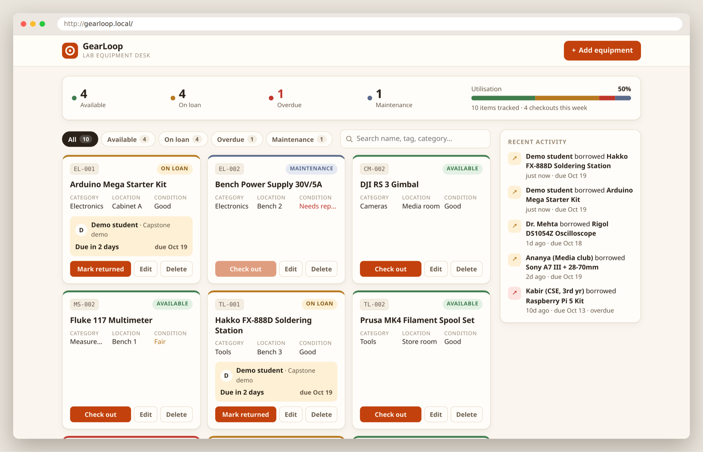
Ingress: one origin for the browser
Path | Routed to
/ | frontend (nginx)
/api | backend (FastAPI)
/docs | backend (Swagger)
/openapi.json | backend
No CORS and no backend hostname in the JavaScript bundle. The Ingress is only configuration; the ingress-nginx controller does the routing.
Bug found while capturing this deck
After a node restart, nginx exited with "host not found in upstream" before CoreDNS was ready. It now resolves the Service per request and stays up.
Notes:
The app is served at gearloop.local through ingress-nginx. Slash goes to the frontend, slash-api and the docs go straight to the backend. While capturing these screenshots I restarted minikube and found the frontend crash-looping, because nginx resolves its upstream once at startup. Fixed and committed.

Slide 16
Autoscaling under load (real run)
2 → 6
backend replicas
438 %
CPU of request at peak (target 60 %)
~45 s
from first scale-up to six pods
scripts/load-test.sh runs 30 in-cluster workers. The HPA needs CPU requests on the pods and a metrics source (metrics-server).
Notes:
These are the real samples from the load test I ran while making this deck. CPU jumped to more than seven times the target, and the HPA doubled the deployment, then tripled it. Scale-down is deliberately slower, with a two-minute stabilisation window, so it does not flap.

Slide 17
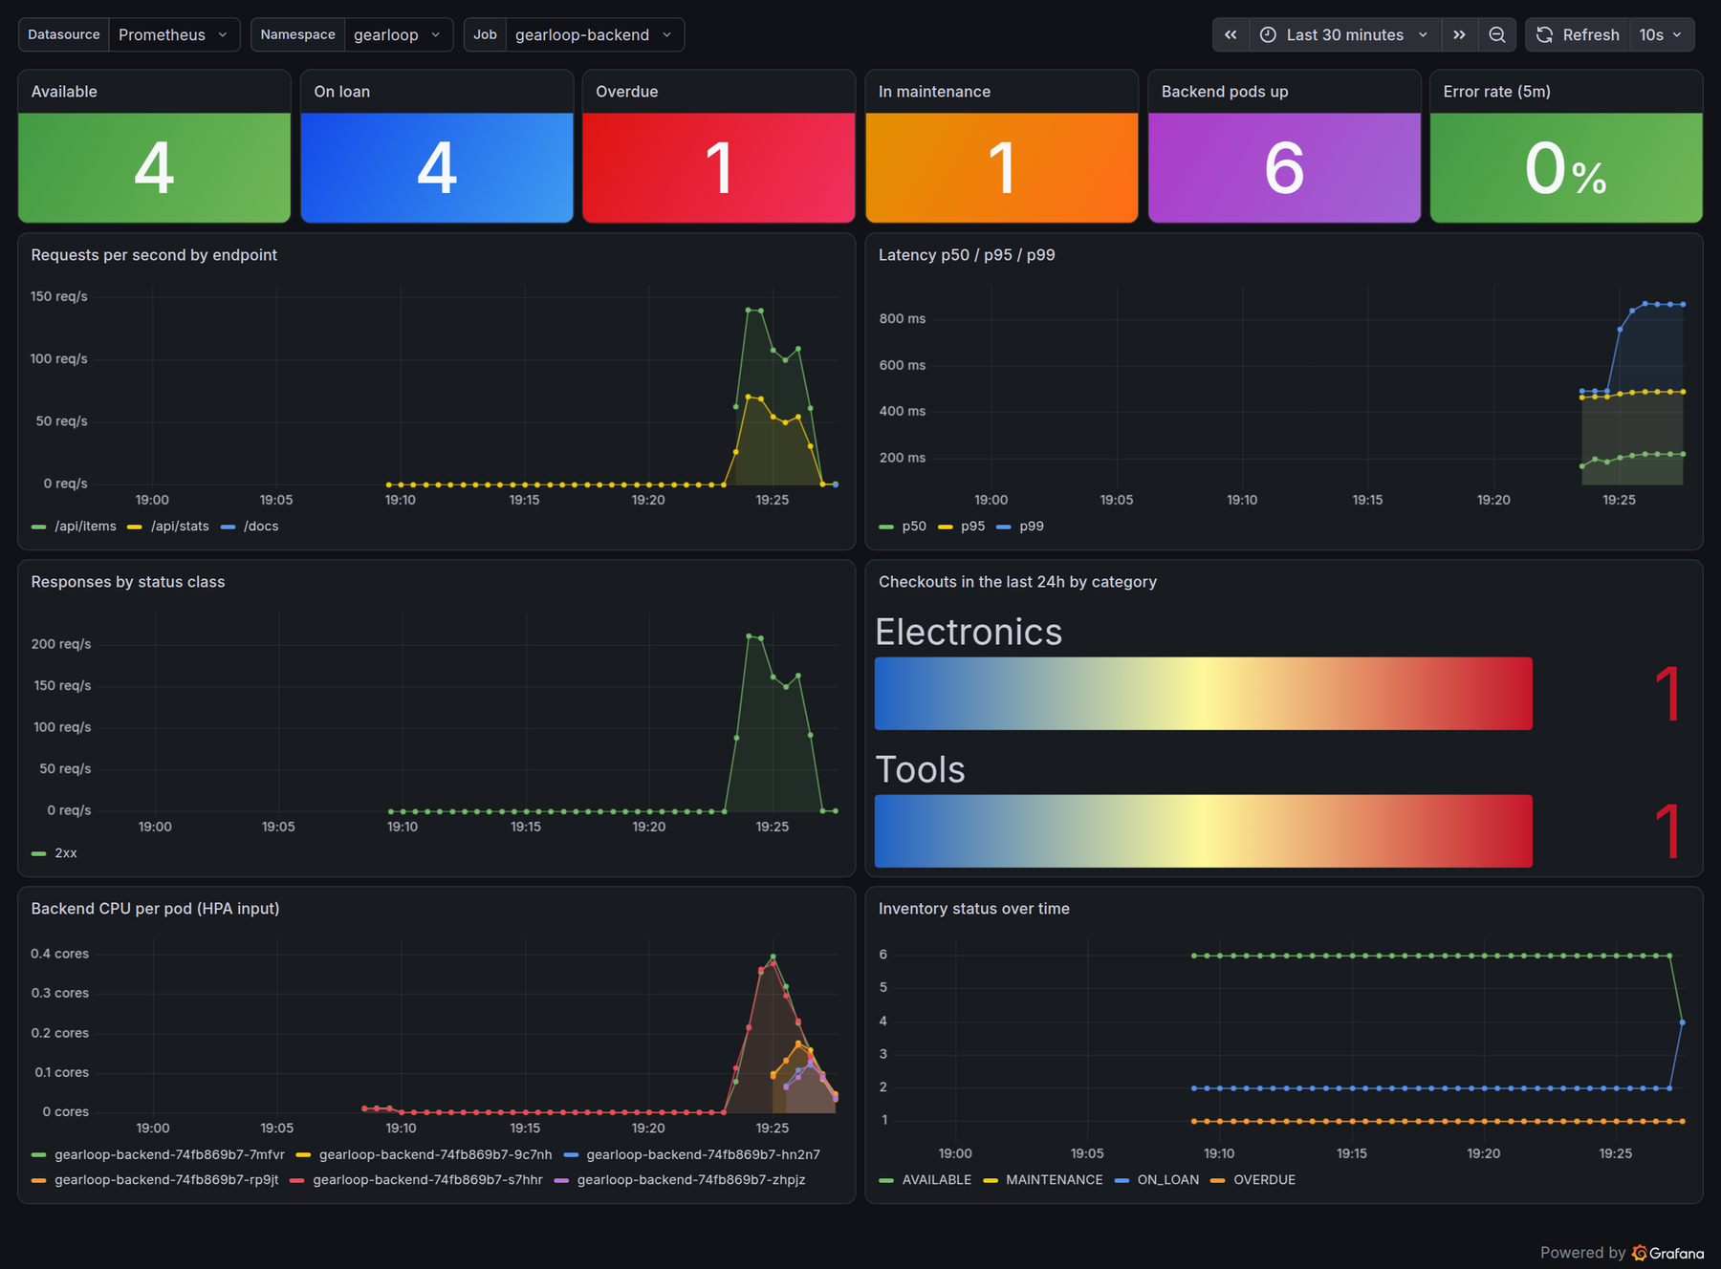
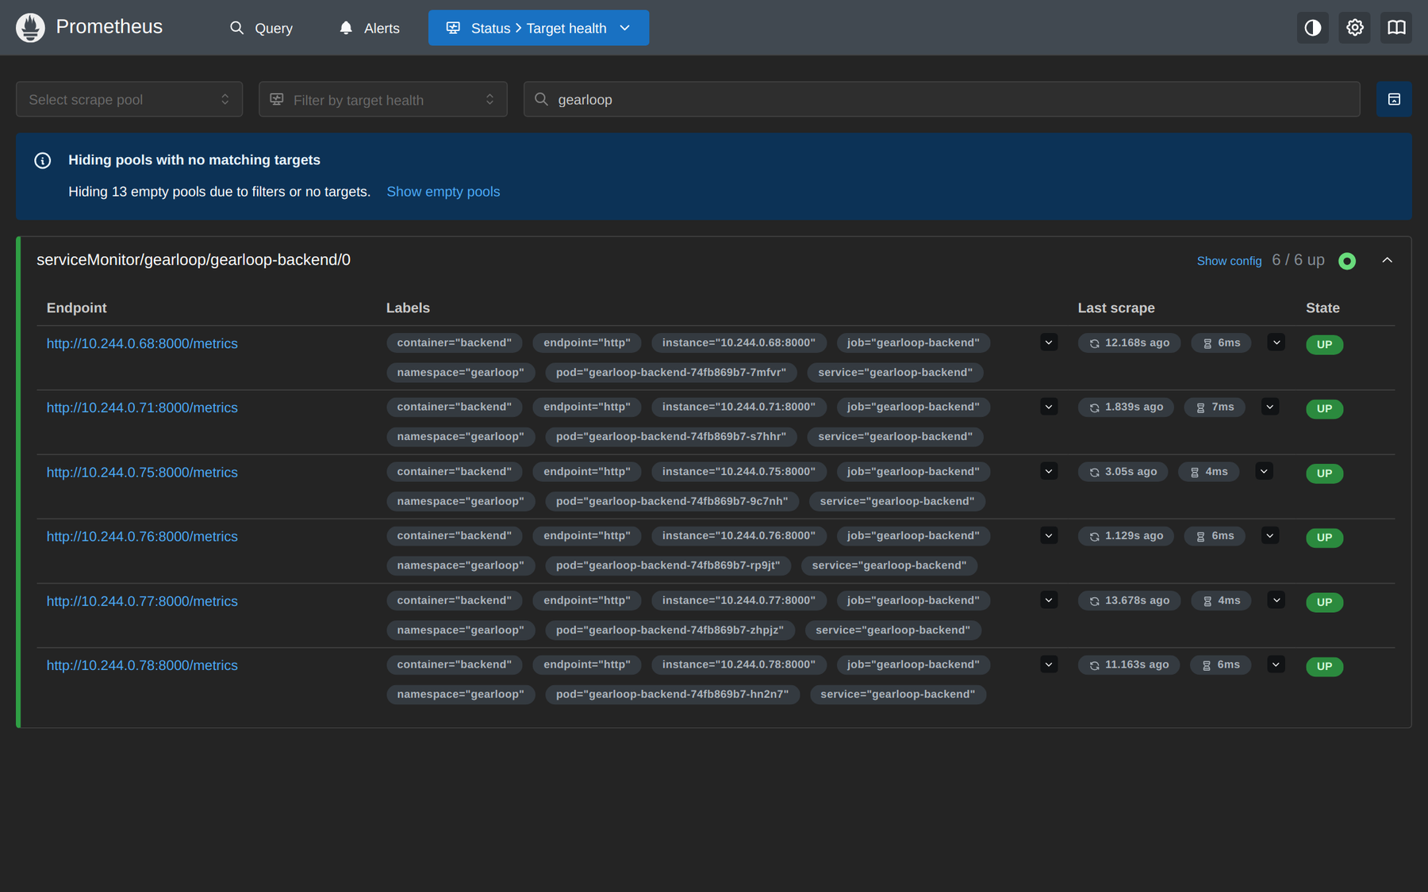
Observability: Prometheus + Grafana
Prometheus: every backend pod scraped and UP
Dashboard as code: shipped in the chart and auto-imported
Business metrics: items by status and checkouts per category, read from the DB at scrape time
4 alert rules: backend down, 5xx > 5 %, p95 > 500 ms, overdue gear
Notes:
The Grafana dashboard ships inside the Helm chart as a ConfigMap, so a fresh cluster gets it automatically. Besides HTTP traffic and latency it shows business data: how many items are on loan or overdue. All four alert rules are loaded; the overdue-equipment rule is pending because one item really is overdue.

Slide 18

What testing on a real cluster caught
Helm install deadlock
Frontend crash loop
Migrations ran in a post-install hook, but Helm waits for Ready pods first, and pods were not Ready without tables.
After a node restart nginx resolved the backend before DNS was up and exited.
Fix initContainer + Postgres advisory lock
Fix Resolve per request with the Service FQDN
4 HIGH CVEs
Wrong checkout counts
Trivy blocked the backend image: pip's vendored urllib3, msgpack, setuptools.
Per-pod counters lose the first event and disagree across replicas.
Fix Remove pip from the runtime image
Fix Gauge read from the DB at scrape time
Notes:
Unit tests passed for all of these. Each one only showed up in a real environment: a real helm install, a node restart, a real scan, and real multi-replica metrics. That is the argument for the whole DevOps layer.

Slide 19
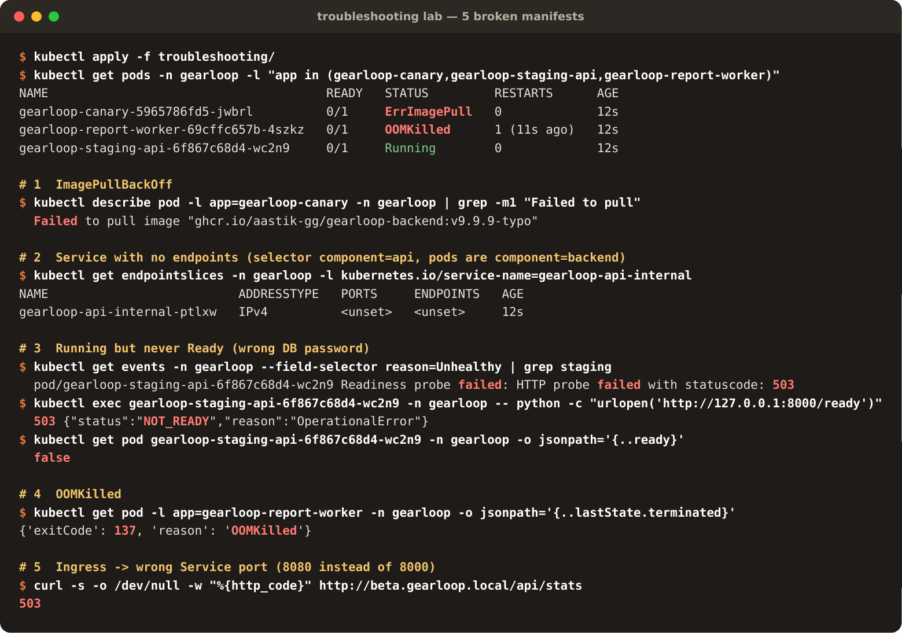
Troubleshooting lab: 5 broken manifests
Symptom | Root cause
ImagePullBackOff | tag that was never pushed
No endpoints | Service selector matches no pods
Running, not Ready | wrong DB password → /ready 503
OOMKilled (137) | memory limit below real usage
Ingress 503 | points at Service port 8080, not 8000
Each scenario has a guided diagnosis and fix in troubleshooting/README.md. All five were applied to the cluster and produce exactly the documented symptom.
Notes:
Live demo candidate: apply one manifest and diagnose it with describe, events and endpointslices. My favourite is number three, because it shows why liveness and readiness are separate probes.

Slide 20
Key learnings
Test on a real cluster
Readiness is not liveness
Unit tests passed for all four bugs on the previous slide; only real installs, restarts and scans exposed them.
A bad DB password should stop traffic (/ready), not restart-loop the pod (/health).
Pull beats push for deploys
Fix CVEs at the source
With GitOps, Git is the record of what runs, and CI needs no cluster credentials.
Removing pip from the image beat ignoring four HIGH findings.
Own what you create
Measure from the source of truth
Terraform owning the namespaces made destroy leave nothing behind.
DB-backed gauges agree across replicas; per-pod counters did not.
Notes:
Six things I would do the same way again. The biggest one: every serious bug in this project passed the unit tests and only appeared in a real environment.

Slide 21
What is verified, and what is next
 | Area | Evidence
Done | App, tests, migrations | 21 pytest + 5 vitest; migrations on PostgreSQL 17
Done | UI | every dialog clicked through on the live stack; mobile at 390px
Done | Docker + Trivy | compose brings up 4 services; both images non-root and scan clean
Done | Kubernetes + Helm | installed by Terraform; upgrades + rolling restart tested; helm test passing
Done | Ingress · HPA · monitoring | routing verified; HPA 2 → 6; targets UP; dashboard populated
Done | Troubleshooting lab | all 5 scenarios reproduce their symptom
Done | Terraform | plan / apply / destroy on minikube; destroy leaves nothing behind
Done | Argo CD (GitOps) | local Git server: sync in 18 s, self-heal in 2 s; GitHub-backed after the push
Next | GitHub Actions | actionlint clean; runs once the repo is pushed to GitHub
Notes:
Being explicit about status. Everything marked Done was run and screenshotted. The one remaining item needs something outside this laptop: a push to GitHub so the pipeline can run.

Slide 22
Live demo
1
Codebase: folder structure and key files
2
Push a change; the pipeline runs end to end
3
Terraform plan / state on the local cluster
4
Argo CD: synced app, GitOps flow, self-heal
Code → CI/CD → Terraform → Argo CD → Kubernetes → Prometheus → Grafana
5
Kubernetes: pods, services, ingress, the app
6
Prometheus targets UP
Thank you
7
Grafana live while the HPA scales out
Notes:
Demo order follows the video requirements in the rubric: codebase, CI/CD, Terraform, Argo CD, Kubernetes, Prometheus, Grafana. The exact commands are in demo/RECORDING-GUIDE.md.

