Slide 1


RISC-V 5-Stage Pipeline Processor
Aamir Suhail Burhan
Graduate Student, Department of Electrical & Computer Engineering
University of Colorado Boulder

Slide 2
Agenda
Introduction
Design
Behavioral Simulation
Challenges Faced
Work Breakdown Structure
Learnings & Conclusion

Slide 3
1. Introduction
RISC-V is an Instruction Set Architecture established using reduced instruction set computer (RISC) principles.
Tools - Vivado 2023.2
Language - Verilog
Hardware - NEXYS A7 100T
Validation - Vivado Simulator [Behavioral Simulation]

Slide 4
2. Design

Slide 5
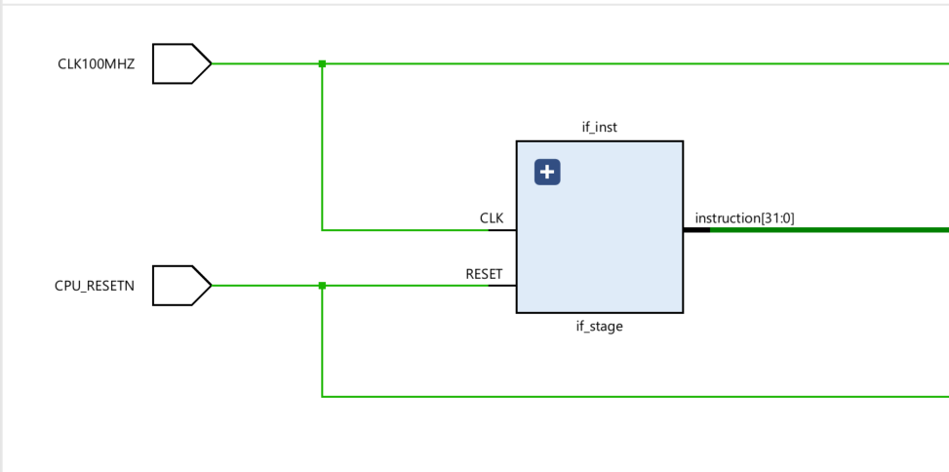
2.1. Instruction Fetch Stage

Slide 6
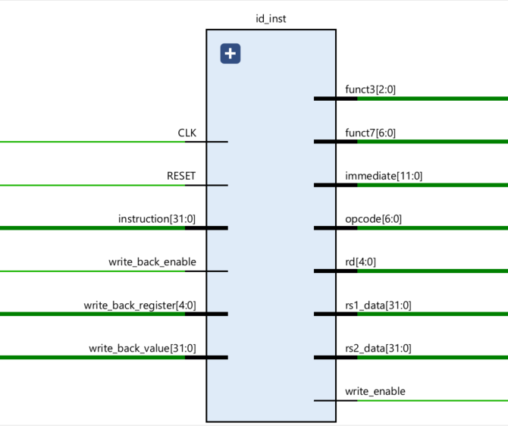
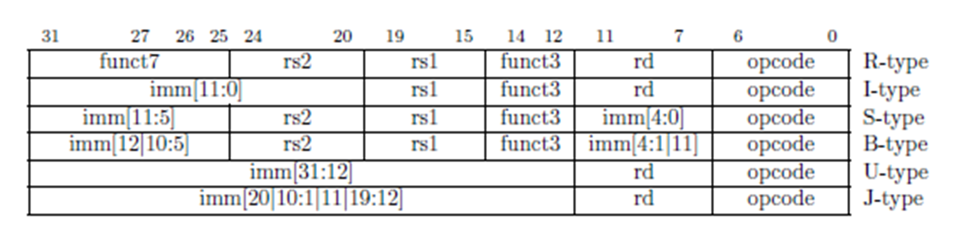
Types of Instructions Implemented:
1. Register Type
2. Immediate Type [Add & Load]
3. Store Type
2.2. Instruction Decode & WriteBack Stage

Slide 7
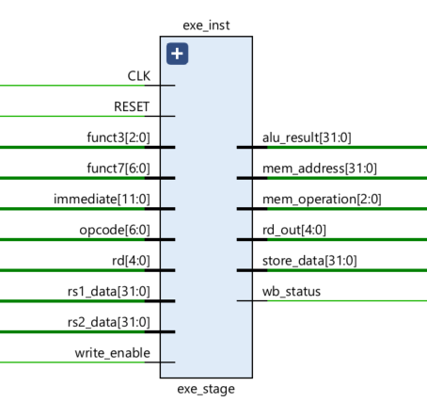
2.3. Execute Stage

Slide 8
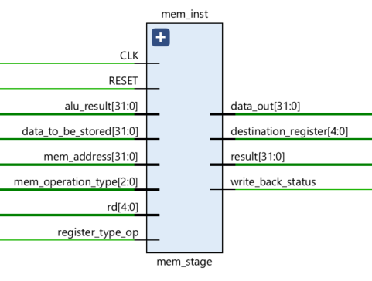
2.4. Memory Stage

Slide 9
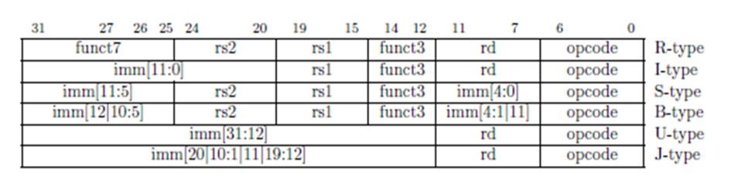
3. Behavioral Simulation( z[0] = a*x[0] + y[0])
Values Loaded Into Instruction Memory at reset:
1. Add Immediate Value of a into R9: 0000000 00011 00000 000 01001 0010011 [0x00300493]
2. Load Value of x[0] into R1: 0000000 00000 00000 010 00001 0000011 [0x00002083]
3. Load Value of y[0] into R2: 0000000 00001 00000 010 00010 0000011 [0x00102103]
4. Multiply 'a * x[0]' Result in R8: 1111111 00001 01001 000 01000 0110011 [0xFE148433]
5. Add y[0] + R8, Result placed in R5: 0000000 00010 01000 000 00101 0110011 [0x002402B3]
6. Store R5 Result in Memory: 0000000 00101 01010 010 00000 0100011 [0x005022A3]

Slide 10
3. Behavioral Simulation
NOP????

Slide 11
3. Behavioral Simulation( z[0] = a*x[0] + y[0])
Values Loaded Into Instruction Memory at reset:
1. Add Immediate Value of a into R9: 0000000 00011 00000 000 01001 0010011 [0x00300493]
2. Load Value of x[0] into R1: 0000000 00000 00000 010 00001 0000011 [0x00002083]
3. Load Value of y[0] into R2: 0000000 00001 00000 010 00010 0000011 [0x00102103]
4. NOP x 2
6. Multiply 'a * x[0]' Result in R8: 1111111 00001 01001 000 01000 0110011 [0xFE148433] {a = 3, x[0] = 6}
7. NOP x 3
10. Add y[0] + R8, Result placed in R5: 0000000 00010 01000 000 00101 0110011 [0x002402B3] {y[0] = 8}
11. NOP x 3
14. Store R5 Result in Memory: 0000000 00101 01010 010 00000 0100011 [0x005022A3]

Slide 12
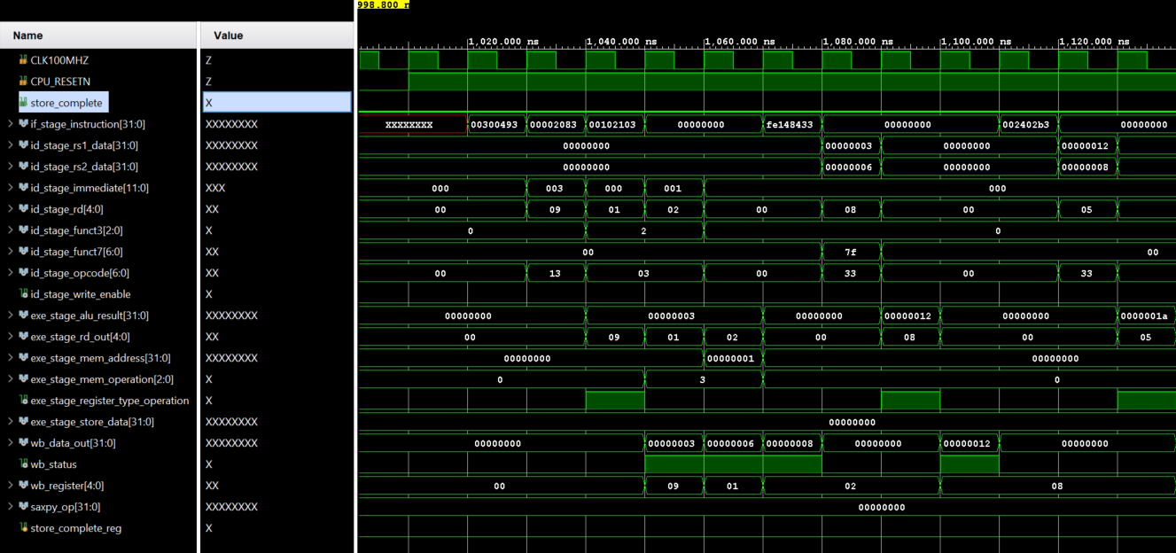
ADDI R9, R0, 3
LW R2, 1(R0)
MUL R8, R9, R1
NOP
ADD R5, R2, R8
LW R1, 0(R0)
NOP

Slide 13
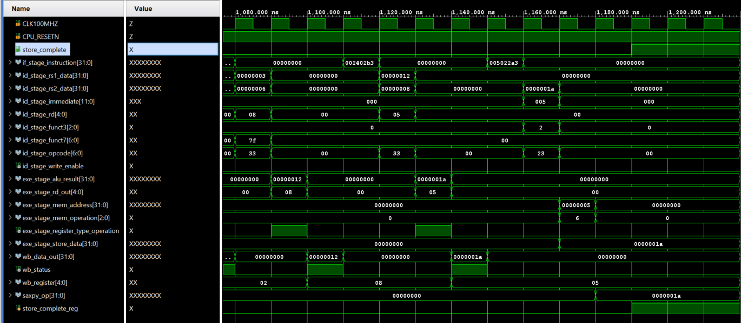
NOP
MUL R8, R9, R1
NOP
SW R5, 5(R0)

Slide 14
4. Challenges Faced
Initial Design Involved Using DDR2 present on the NEXYS Board
Timing Closure Issues

Slide 15
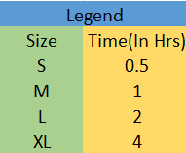
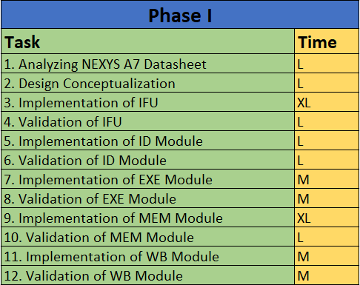
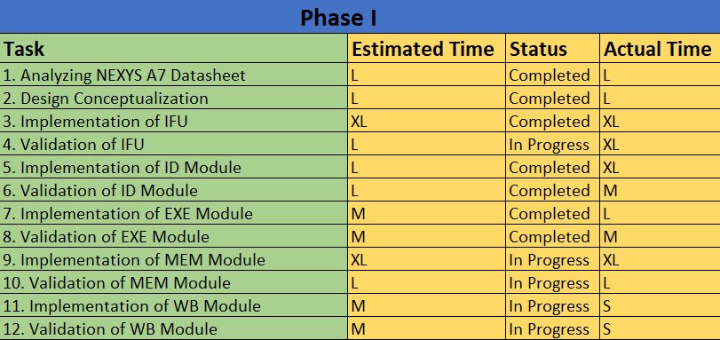

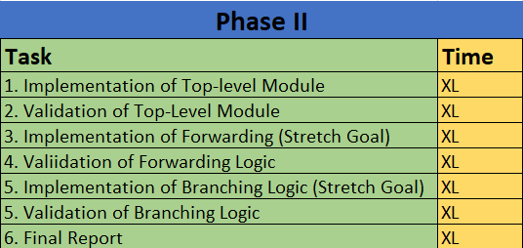
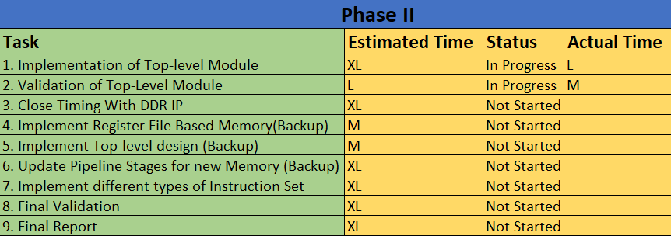
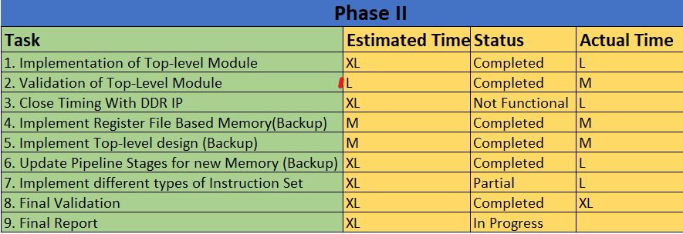
5. Work Breakdown Schedule
M3.1
M3.2
M3.3

Slide 16
6. Learnings & Conclusion
Understood the RISC-V ISA in a detailed manner by implementing a basic version of the processor design.
Realization of the performance improvements the concept of Forwarding provides.
Complexity of meeting timing requirements to avoid data hazards.
Importance of a compiler to provide instructions which improve speed was better understood.

Slide 17
Thank You!

