Slide 1
Databases
Where all the data hangs out…

Slide 2

GOALS – WHERE I WANT TO BE IN TWO WEEKS
Develop understanding of database definition
Develop a working knowledge of how to model a problem
Entities
Relationships
One to One
One to Many
Many to Many
Cardinality
Develop an understanding of relational databases
Design basic tables with attributes
Learn to use a commercial database

Slide 3




WHAT IS A DATABASE ?
Most often we refer to database systems such as
Microsoft Access
Microsoft SQL Server
Oracle
MySql – Open Source – Sun – Oracle
What does a database do?
It organizes data so it can more easily be retrieved.
What kind of data is stored?
Text
Numbers
Pictures
Movies
Audio

Slide 4
Some Common Databases Usages
Google Search
Class schedules at a university
Airline schedules
Hospital patients
Many E-Commerce Sites
Ebay
Amazon
Maps
Almost all organizations today use some type of database to track products and customers or to deliver services.

Slide 5



SIMPLE EXAMPLES
Google search
Search on the word Pittsburgh
Client Server architecture
Database of stored web addresses
University of Pittsburgh Find People
Robert Perkoski
iStockPhoto
http://www.istockphoto.com/
Search for dog

Slide 6

BUILDING BLOCKS OF A DATABASE MODEL
A database model is a reflection of the real world and it contains structures that will be implemented in the database itself.
Okay let's simplify.
Look at what in the real world you want to turn into a database.
Break it down into entities or parts
Create tables to hold data about the parts
Look at the relationship between these parts

Slide 7


LETS START WITH AN EXAMPLE
Let's build a database model of a school like Pitt
Well what are some of the parts of a school?
Hmmm, lets see:
So, these parts are called Entities
Lets work with students classes and faculty.
Students | Classes
Buildings | Courses
Faculty | Staff
Residence Hall | Cafeteria

Slide 8
TABLE IT
Each entity will have its own table.
A table consists of rows and columns
Each row represents one instance of that entity
Example:
A Student entity table would consists of rows of individual students
Each column represents a characteristic of the entity – called an attribute
Example:
A student entity table could have a name, age, address of each student

Slide 9
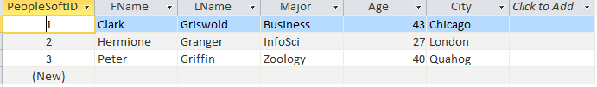
Sample Table With Rows and Columns
Each attribute is shown along with the table name and various rows or instances.
Student Table
Attribute
Row
Adapted from http://clwb.org/2011/03/21/cloud-watching-2-%E2%80%93-how-to-manage-30bn-trees-worth-of-data/

Slide 10
SOME PRACTICE QUESTIONS
What would each row of an entity titled courses of a college database be?
Each individual course
What are some typical attributes for a faculty?
Name | Department | Room Number
Rank | Age | Gender

Slide 11
RELATIONSHIPS
All entities have relationships between them. We have to discover them through looking at real life examples.
Now, there are three types of relationships
One to One Also known as 1:1
One to Many Also known as 1:M
Many to Many Also known as M:N
We are mostly interested in 1:M and M:N
Lets look more closely at what exactly is a relationship.

Slide 12
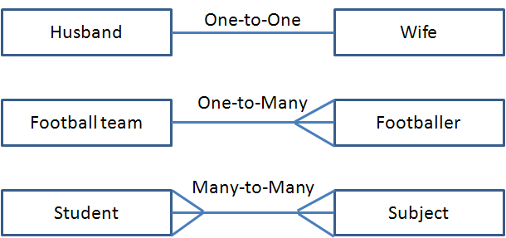
RELATIONSHIPS
Examine each one of the following:
Sports Team
Players
Classes
Adapted from http://fms-itskills.ncl.ac.uk/db/relationships.html

Slide 13


Hints to discover relationships
Start with two entities. For example lets do Sports teams and Players
Select one instance from entity on the left and follow this sentence pattern.
" ONE Team HAS Many Players"
Now reverse it!
" ONE Player BELONGS to One Team
????
L. Entity
Verb
Relationship
R.Entity
R. Entity
Verb
Relationship
L.Entity
If you have 1:M in one direction and 1:1 in the other you have a 1:M relationship

Slide 14

HINTS TO DISCOVER RELATIONSHIPS
Okay let's do another one.
What is the relationship between Students and Classes
So, ONE Student can TAKE Many Classes
Good we have a 1:M going left to right
Now, do the other direction
ONE class has MANY Students.
So, we have another 1:M going right to left.
Conclusion:
If you have 1:M relationships in both directions you have a M:N relationship.
Remember: ALWAYS and I mean ALWAYS start your test sentences with the word ONE

Slide 15
ANOTHER EXAMPLE
Describe the relationships between these entities
Owners and Pets
Now lets introduce rules. You can state whatever rules you want for your situation. For example: There is always one primary owner of a pet even if it is shared custody.
Usually, you discover rules based upon observation, talking to people and reviewing forms.
Apartment Building and Apartments
Apt 3B means nothing without knowing what apartment building it is in.
Company and Workers
Depends on how you make your rules – they need to reflect reality!!

Slide 16


Rule of thumb for building databases
Knowing the answers you want from your database should be your guiding design rule!
So, if you want to know which students have the highest GPA’s each term you better be tracking course grades as attributes and have specific actual dates indicating the start and end of a term.
Remember, if you don’t put the data in you can’t get it out.
Old computer saying:
Garbage In = Garbage Out

Slide 17
Listing attributes makes sense but why do we need relationships??
Relational Databases
The type of database we are talking about is called a relational database. There are other types.
Developed by Edgar Frank Codd while working for IBM around 1970’s
This type of database uses tables where each row must be unique
One of the fields needs to be a key.
1:M table relationships uses a key field from the parent in the child table
M:N table relationships use a third table

Slide 18
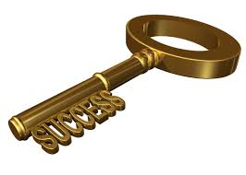
HOW KEYS ARE THE KEY TO RELATIONAL DATABASES
First, what column makes each row unique in this table of Faculty
Answer:
Nothing – two rows could be same
Unlikely does not guarantee uniqueness
Lname | Fname | School | Hired
Milton | George | IS | 9/23/1950
Small | Lennie | English Lit | 10/05/2000
Joad | Ruthie | IS | 01/01/2001
Joad | Noah | History | 01/01/2001

Slide 19

HOW KEYS ARE THE KEY TO RELATIONAL DATABASES
Often an ID column is added as the first column that generates a unique number guaranteeing each row is unique
This acts as a primary key:
Fac_ID | Lname | Fname | School | Hired
001 | Milton | George | IS | 9/23/1950
002 | Small | Lennie | English Lit | 10/05/2000
003 | Joad | Ruthie | IS | 01/01/2001
004 | Joad | Noah | History | 01/01/2001
PK

Slide 20
HOW KEYS ARE THE KEY TO RELATIONAL DATABASES
Lets look at the Student table.
Now examine the relationship between Faculty and advising Students
One faculty member ADVISES Many Students
One student is advised by ONE faculty member
So, we have a 1:M relationship between Faculty and Student tables.
How do we implement this? Next slide please!
StudentID | Lname | Fname | Major
001 | Reed | Eliza | Religious Studies
002 | Reed | John | Rehabilitation Science
003 | Temple | Maria | Education

Slide 21
HOW KEYS ARE THE KEY TO RELATIONAL DATABASES
Foreign Key
A primary key column from the One table placed into the Many side table of a 1:M relationship.
An illustration helps.
Step 1: Take a 1:M relationship like Faculty Advises Students
Step 2 Identify the Primary Key of One side = Fac_ID
Add that column to the M side table – give diff name if you like but its values will come from the PK column
Faculty
Fac_ID
Lname
Fname
School
Student
StudentID
Lname
Fname
Major
FK_Fac_ID
PK
Advises
1:M
Foreign Key

Slide 22
PUTTING IT TOGETHER
Faculty Table
Fac_ID | Lname | Fname | School | Hired
001 | Milton | George | IS | 9/23/1950
002 | Small | Lennie | English Lit | 10/05/2000
003 | Joad | Ruthie | IS | 01/01/2001
004 | Joad | Noah | History | 01/01/2001
Student Table
StudentID | Lname | Fname | Major | FK_Fac_ID
001 | Reed | Eliza | Religious Studies | 003
002 | Reed | John | Rehabilitation Science | 001
003 | Temple | Maria | Education | 001

