Slide 1
Sweet Tunes
A music video download interface prototype

Slide 2
About the Interface
Target audience: Anybody!
Anyone can use Sweet Tunes to upload or download music.
Access: Free to use.
All music uploaded to Sweet Tunes is assumed to be legal and obey all copyright laws, therefore, anyone can download the music since it is free to the public.

Slide 3
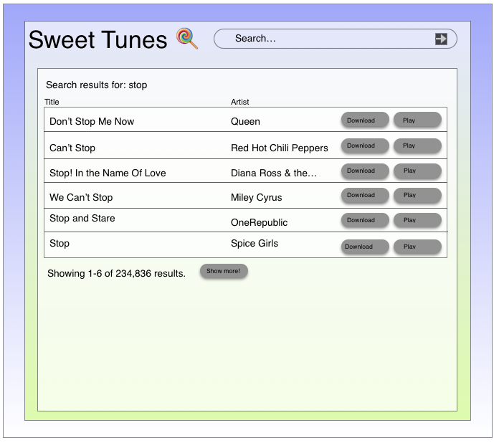
Search Page layout
Search results will show up with title and artist, as well as a download link or a play link.
User can control how many results they view
Search results are based on relevance
User can also change what they are searching for: can search for artist, song title, etc.

Slide 4
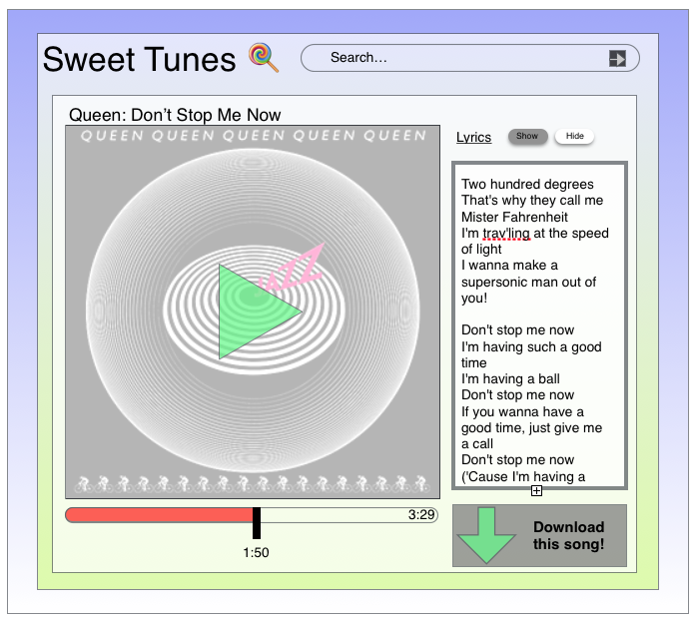
Play screen
Users can also use Sweet Tunes to play music as well
Music video will show up, and if the song has no video, the album artwork of the song will show up.
A green triangle over the video/picture is the play button, progress bar is at bottom
Lyrics option
Download option

