Slide 1
How to think about logic problems.
Subtitle: Ways to drive yourself crazy

Slide 2
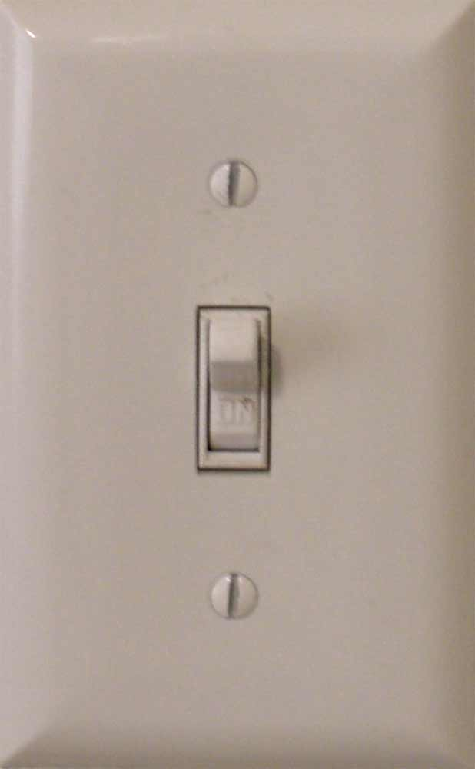

Starting Point
Read the problem very carefully.
A 0 typically means no electricity or off
A 1 typically means there is electricity or on
So if you want a light bulb to turn on you would turn the electricity on
1

Slide 3


Another example
Lets look at the sensors and the waste plant
First the sensor should activate when it doesn't detect a flame
So a sensor would turn on the electricity represented by a 1 if it detected no flame which would turn off the valve.
1

Slide 4

More difficult
Two sensors change everything
We now have four conditions.
Sensor A | Sensor B | Output After Gate ?
0 – no electric | 0 - no electric | Depends on gate
0 – no electric | 1 – electric | Depends on gate
1 – electric | 0 - no electric | Depends on gate
1 – electric | 1 - electric | Depends on gate

Slide 5

Truth Tables
Create a big truth table that has the outcomes for AND, OR, XOR, NAND.
And, begin to think which gate would do what you want. Translate the 0 and 1's to represent your problem. Example: First row says Sensor A is zero which means it does not sense a problem (there is flame) and Sensor B is 0. With an AND gate the output would be 0 no electricity. Is this what you want? If yes, then look at the next three rows and see if they fit your desired outcome. Remember, you want to focus on when the two inputs will create a 1 which will close off the valve.
Input A | Input B | AND | XOR | OR | NAND | NOT
0 | 0 | 0 | 0 | 0 | 1 | If 0
0 | 1 | 0 | 1 | 1 | 1 | Then 1
1 | 0 | 0 | 1 | 1 | 1 | If 1
1 | 1 | 1 | 0 | 1 | 0 | Then 0

Slide 6

Try Drawing IT
So, under what conditions will I get a 1 here? Think of all four possibilities if your sensors are 0 or 1 using a specific gate.
B
Some Gate??
1
You can draw it on the logic lab too: http://www.neuroproductions.be/logic-lab/

Slide 7

Be methodical and careful
One of the keys is to take your time and make sure you read the problem and understand when a sensor would generate electricity or be energized.
Walk through the four scenarios ( if two sensors) to find the one that solves the problem you are looking at.
Questions
What does it mean when a sensor produces a 1?
What does it mean when a sensor produces a 0?
When do you want a 1 ( activation) coming out of the gate?

