Slide 1
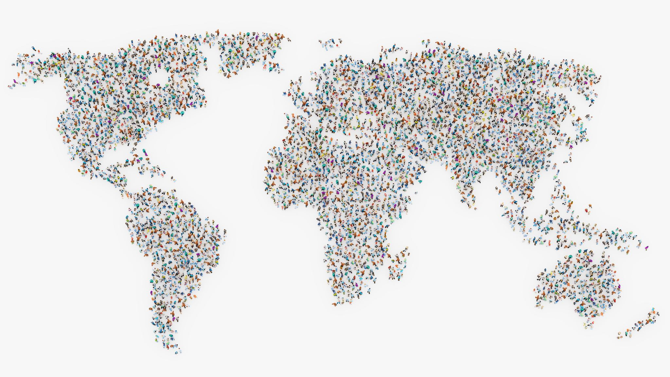
Geographic Location on COVID Recovery

Slide 2
Problem
Question
How does the location of an individual affect their chance of recovering from the coronavirus?
Motivation
This question interested me due to its current impact on society; every individual in the world right now has been affected by this historical event, whether directly or through social stigmatization
Focus
The recoverability of the illness in order to help contain or provide the best resources for those affected
Focus on the number of recovered cases with the assumption that greater recovery means better resources and handling of the virus aftermaths

Slide 3
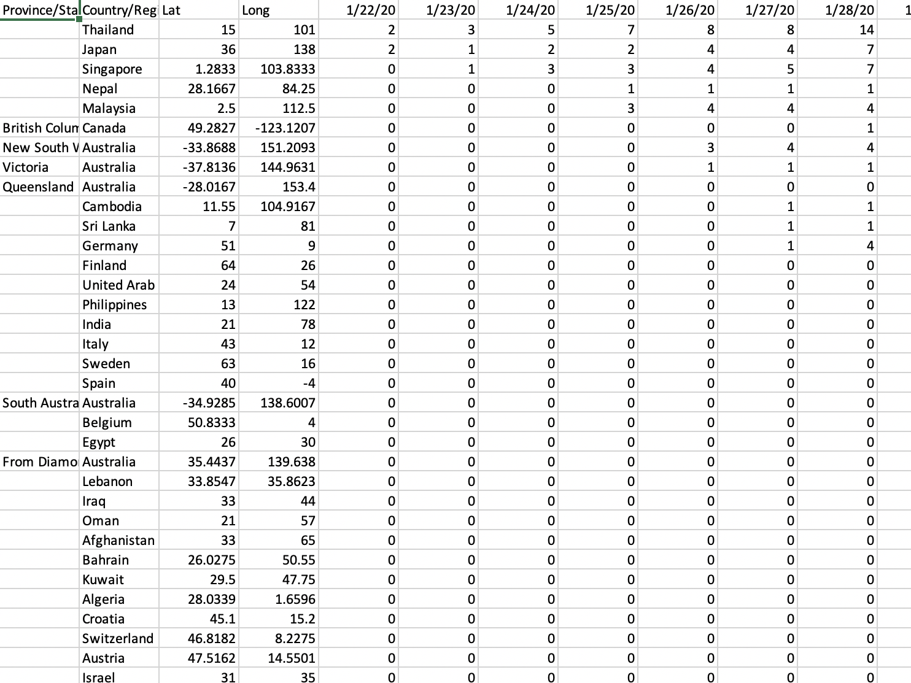
Data Used
John Hopkins coronavirus tracking website
Updated daily with a new column for each day
https://data.humdata.org/dataset/novel-coronavirus-2019-ncov-cases
Three files:
Confirmed, recovered, deaths

Slide 4
Approach
Calculate and append the sum of each row as a separate column at the end of the file
Drop the individual columns representing counts for each day are no longer relevant
Merge into one single DataFrame on the “Province/State” and “Country/Region” columns
Outliers also cannot be dropped, as these are significant pieces of data
Combine different instances of "Country/Region" and reindex
Scale the graph of the three columns with log transformation

Slide 5
Approach (cont.)
Plotting all three relevant columns onto one single plot
Results in a wide graph with significantly large or small values, which is not ideal for analysis but provides a general sense of the shape of the data
Parallel coordinates; separates the columns into three separate points on the x-axis and the rows into different colored lines
Readjusting has to be done to this plot accommodate the sheer size of the data
Clustering (in progress)
Ideally would show any existing patterns between the three categories
Taking the ratio of the “total_deaths” column and “total_recovered” column
The smaller the ratio, the higher the chance that an infected patient will recover instead of perishing
Naïve Bayes
Cross-validation is a resampling procedure that can help evaluate machine learning models like Naïve Bayes when given a limited data sample

Slide 6
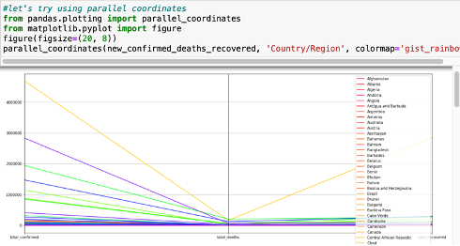
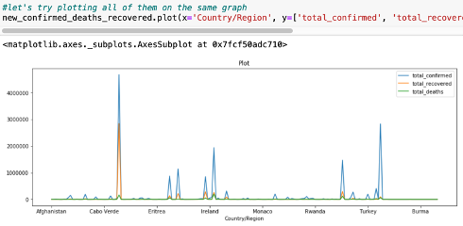
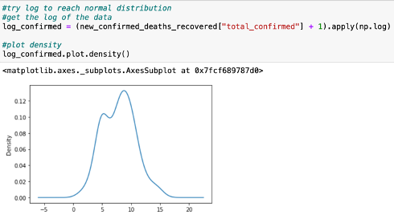
Some Visualizations

Slide 7
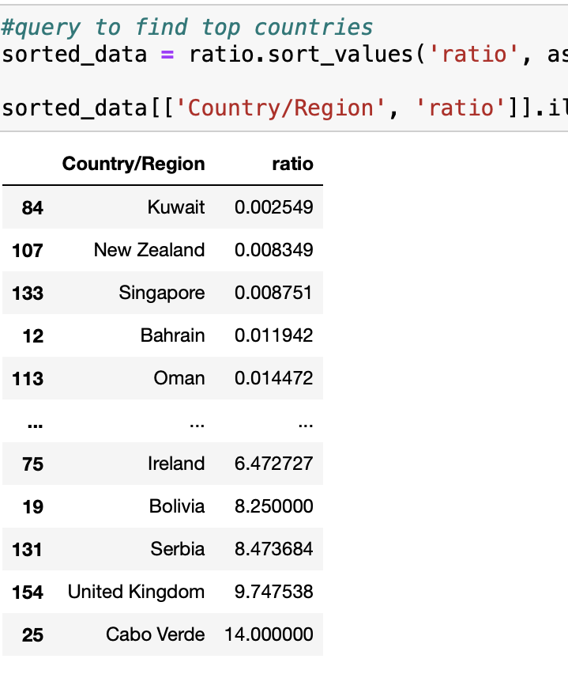
Conclusions
Since the ratio was derived from taking the quotient of deaths and recovered, the larger the ratio, the more likely the chance of death. The smaller the number of the ratio, the greater chance of recovery.
It only calculates recoverability and disregards other factors.
For example, countries with very few cases could easily have a very high or low recoverability, and a number does not encompass the patients that are still ill or the resources a country has. To gain a more well-rounded view of different countries' different solutions to this virus, more analysis must be done.

Slide 8
Limitations
Data mismatch
Different sources had different relevant information presented in different formats and different country representation
As a result, I settled on using only the information Johns Hopkins has published since they format their files similarly and have consistent data
This may have yielded less perceptive analysis, but it directs the conversation away from the deaths and rather address the problem by trying to isolate a solution through seeing which countries recovered most effectively

Slide 9
Sources
[1] WHO.int. 2020. COVID-19 Situation Reports. [online] Available at: <https://www.who.int/emergencies/diseases/novel-coronavirus-2019/situation-reports/> [Accessed 14 April 2020].
[2] Centers for Disease Control and Prevention. 2020. Coronavirus Disease 2019 (COVID-19). [online] Available at: <https://www.cdc.gov/coronavirus/2019-ncov/faq.html#Coronavirus-Disease-2019-Basics> [Accessed 14 April 2020].
[3] Buchholz, K., 2020. Infographic: Coronavirus: Upward Trajectory Or Flattened Curve?. [online] Statista Infographics. Available at: <https://www.statista.com/chart/21112/covid-19-growth-curve-selected-countries/> [Accessed 14 April 2020].

