Slide 1
INVESTOR & PARTNER BRIEFING · SEPTEMBER 2026
Ceres Analytics
We make the public financial record usable.
Company filings and official statistics, cleaned up, stored properly, and traceable back to the document they came from. You can reach it through an API, through your own AI assistant, or through specialists we run for you.
[FOUNDER 1] · [FOUNDER 2]
[EMAIL] · ceresanalytics.[tld]
Running today in Japan
Nothing in the system is specific to Japan

Slide 2
Unusable public data
Most of it cannot actually be used. It is free to download, but making it usable is where the cost is, and every firm pays that cost on its own.
Filings are documents, not data. Thousands of companies publish long reports in their own language, mostly in the same few weeks of the year.
WHAT THIS SOUNDS LIKE IN PRACTICE
“Twenty of my companies filed this month. I will read three of them properly and never open the rest.”
Statistics come formatted for print. Old text encodings, layouts that change without notice, and blank cells that get read as zeros.
Revisions overwrite history. What you download today is not what anyone could see last year, so a backtest run on it is wrong.
An analyst covering Asian equities. The gap between what companies disclose and what anyone actually reads is the whole opportunity.
So every firm rebuilds the same thing. They extract the same filings, get some of it wrong, and lose the work when the analyst leaves.
THE PROBLEM
2

Slide 3
Ingest, store, serve
We pull from official sources, store everything in one schema with its provenance, and let people get at it however suits them.
Sources
Statistics agencies, filing regulators, central banks, customs
any country
↓
Adapters
Download, parse, check it makes sense, archive the original
one small module per source
↓
The database
Series, observations, releases, every past version, provenance
one schema for everything
↓
Tool layer
One set of functions that everything else is built on
shared by every surface
↓
An API
An MCP server
Specialists
For engineers and quant teams who want the data inside their own systems.
So anyone's AI assistant can query it directly, with nothing to install.
Analysts we wrote and run, which watch your companies and report back.
WHAT WE BUILT
3

Slide 4
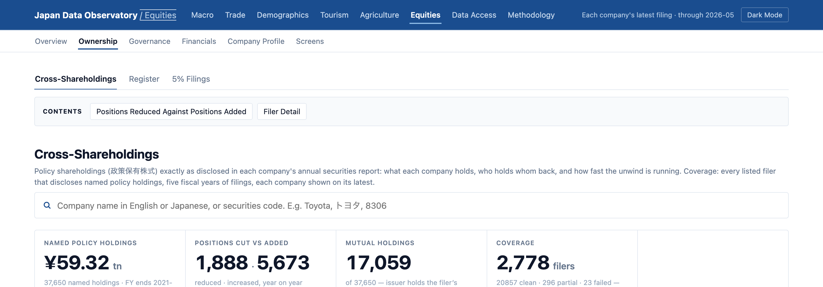
What we cover
Every listed Japanese company, six years of its filings, and the main national statistics. All of it from official sources, none of it retyped.
HOW A NEW SOURCE GETS ADDED
Each source is one small module that downloads, parses and checks that one thing. Everything else is shared. We have never had to change the database to fit a new source, so when a customer asks for wages or rents the answer is weeks, not quarters.
Every cross-shareholding that every listed company discloses, with the reason it gives for holding it. About ¥59tn in total. A terminal will show you one company's disposal. It will not let you rank all of them.
HOW THE FILINGS GET READ
Getting from a 200-page securities report to a row you can sort on is most of the engineering here. The useful parts arrive as text blobs, companies write their holdings out by hand, and some filings do not add up. We handle the first two and flag the third rather than hide it.
THE DATA
4

Slide 5
Fix difficult formats
A real Bank of Japan file, republished every ten days, listing every government bond it owns. Most of this was never meant to be read by a machine.
MEI260831.XLSX, AS PUBLISHED
WHAT A PARSER HAS TO WORK OUT
（単位：億円）
1
Fifteen rows of furniture first. Titles, a department, a phone number and the units, before any data starts.
(100 million yen)
B
C
D
E
###########
a column too narrow
for its own date
銘柄
回号
保有残高
2
257 columns, six of them used. The rest are empty and have to be ignored rather than trusted.
Issue
Issue Number
Amount Outstanding
2年債
464
14,875
2-Year JGB
465
12,234
3
The bond type is a label, not a column. 2年債 is on one row, 2-Year JGB on the next, then twenty-one blank rows that still belong to it.
466
7,884
467
6,029
…
…
5年債
149
66,733
4
The unit sits in a floating cell. Everything is in 億円, so every figure is multiplied by a hundred million.
5-Year JGB
150
57,060
151
36,523
5
Two languages in one merged cell, split by a line break.
339 issues · 9 bond types · ¥517.7tn · reissued every ten days
WHAT COMES OUT
One row per issue, the tenor carried down, the unit applied, and the file it came from recorded.
10-Year JGB · issue 378 · ¥2,930.0bn · 2026-08-31 · mei260831.xlsx
HARD FORMATS
5

Slide 6
Point-in-time history
You can ask what a number was, not just what it is now. Agencies revise and overwrite. We never do, so every revision sits next to the version it replaced.
Quant teams cannot work without this. Test a signal on today's numbers and you have tested it on information nobody had at the time. We can give you the data exactly as it stood on any date.
WHAT THAT LOOKS LIKE
A statistic as first published: 1.9%
The same month after a later revision: 2.0%
Every other source now shows only the revised figure. We can show you either, and tell you which one a trader would have seen on the day.
Nobody can build it later. Once an agency overwrites a number, that version is gone unless someone was recording it. We were.
It gets better on its own. Every month the ingest runs, the record gets deeper. Someone starting in 2028 starts with nothing and stays two years behind.
POINT-IN-TIME
6

Slide 7
Agent access
Any AI assistant can query the database directly, as tools over MCP. One line to connect it, then people just ask.
Nothing to install. One address pasted into Claude, an internal copilot or a code editor.
$ claude mcp add ceres https://[host]/mcp
Which of the big financials cut the most cross-shareholdings last year? Chart it.
✓
get_unwind_ranking
4 filers · FY2026
They ask, it answers. Our tools return the numbers and the source. The assistant does the chart, the table or the note.
✓
get_company_holdings
as filed · with sources
POSITIONS REDUCED, LATEST FISCAL YEAR
MS&AD
52
Same code underneath. The website, the API and the assistant call the same functions, so the numbers cannot drift apart.
Mizuho FG
15
SMFG
13
MUFG
9
Source: annual securities reports, FY2026. Every bar links to the filing.
AI ACCESS
7

Slide 8
Our way in
This is how we get into a firm. We are not trying to win the interface, we sit behind whichever assistant the customer already uses.
FIRST
THEN
AND
Someone pastes one address
Our tools show up
Every answer cites a filing
›
›
Into Claude, their code editor, or the copilot their employer has rolled out.
Their assistant can now answer questions about filings, statistics and their own saved screens.
So the analyst can check it, and so can the person who has to sign off on it.
Trying it costs nothing. There is no software to approve, so an analyst can test it on a Tuesday afternoon without asking anyone. That is how a company our size gets into a bank.
Once it is in, taking it out hurts. When an assistant already answers these questions, removing us is a step backwards that the analyst notices the same day.
AI ACCESS
8

Slide 9
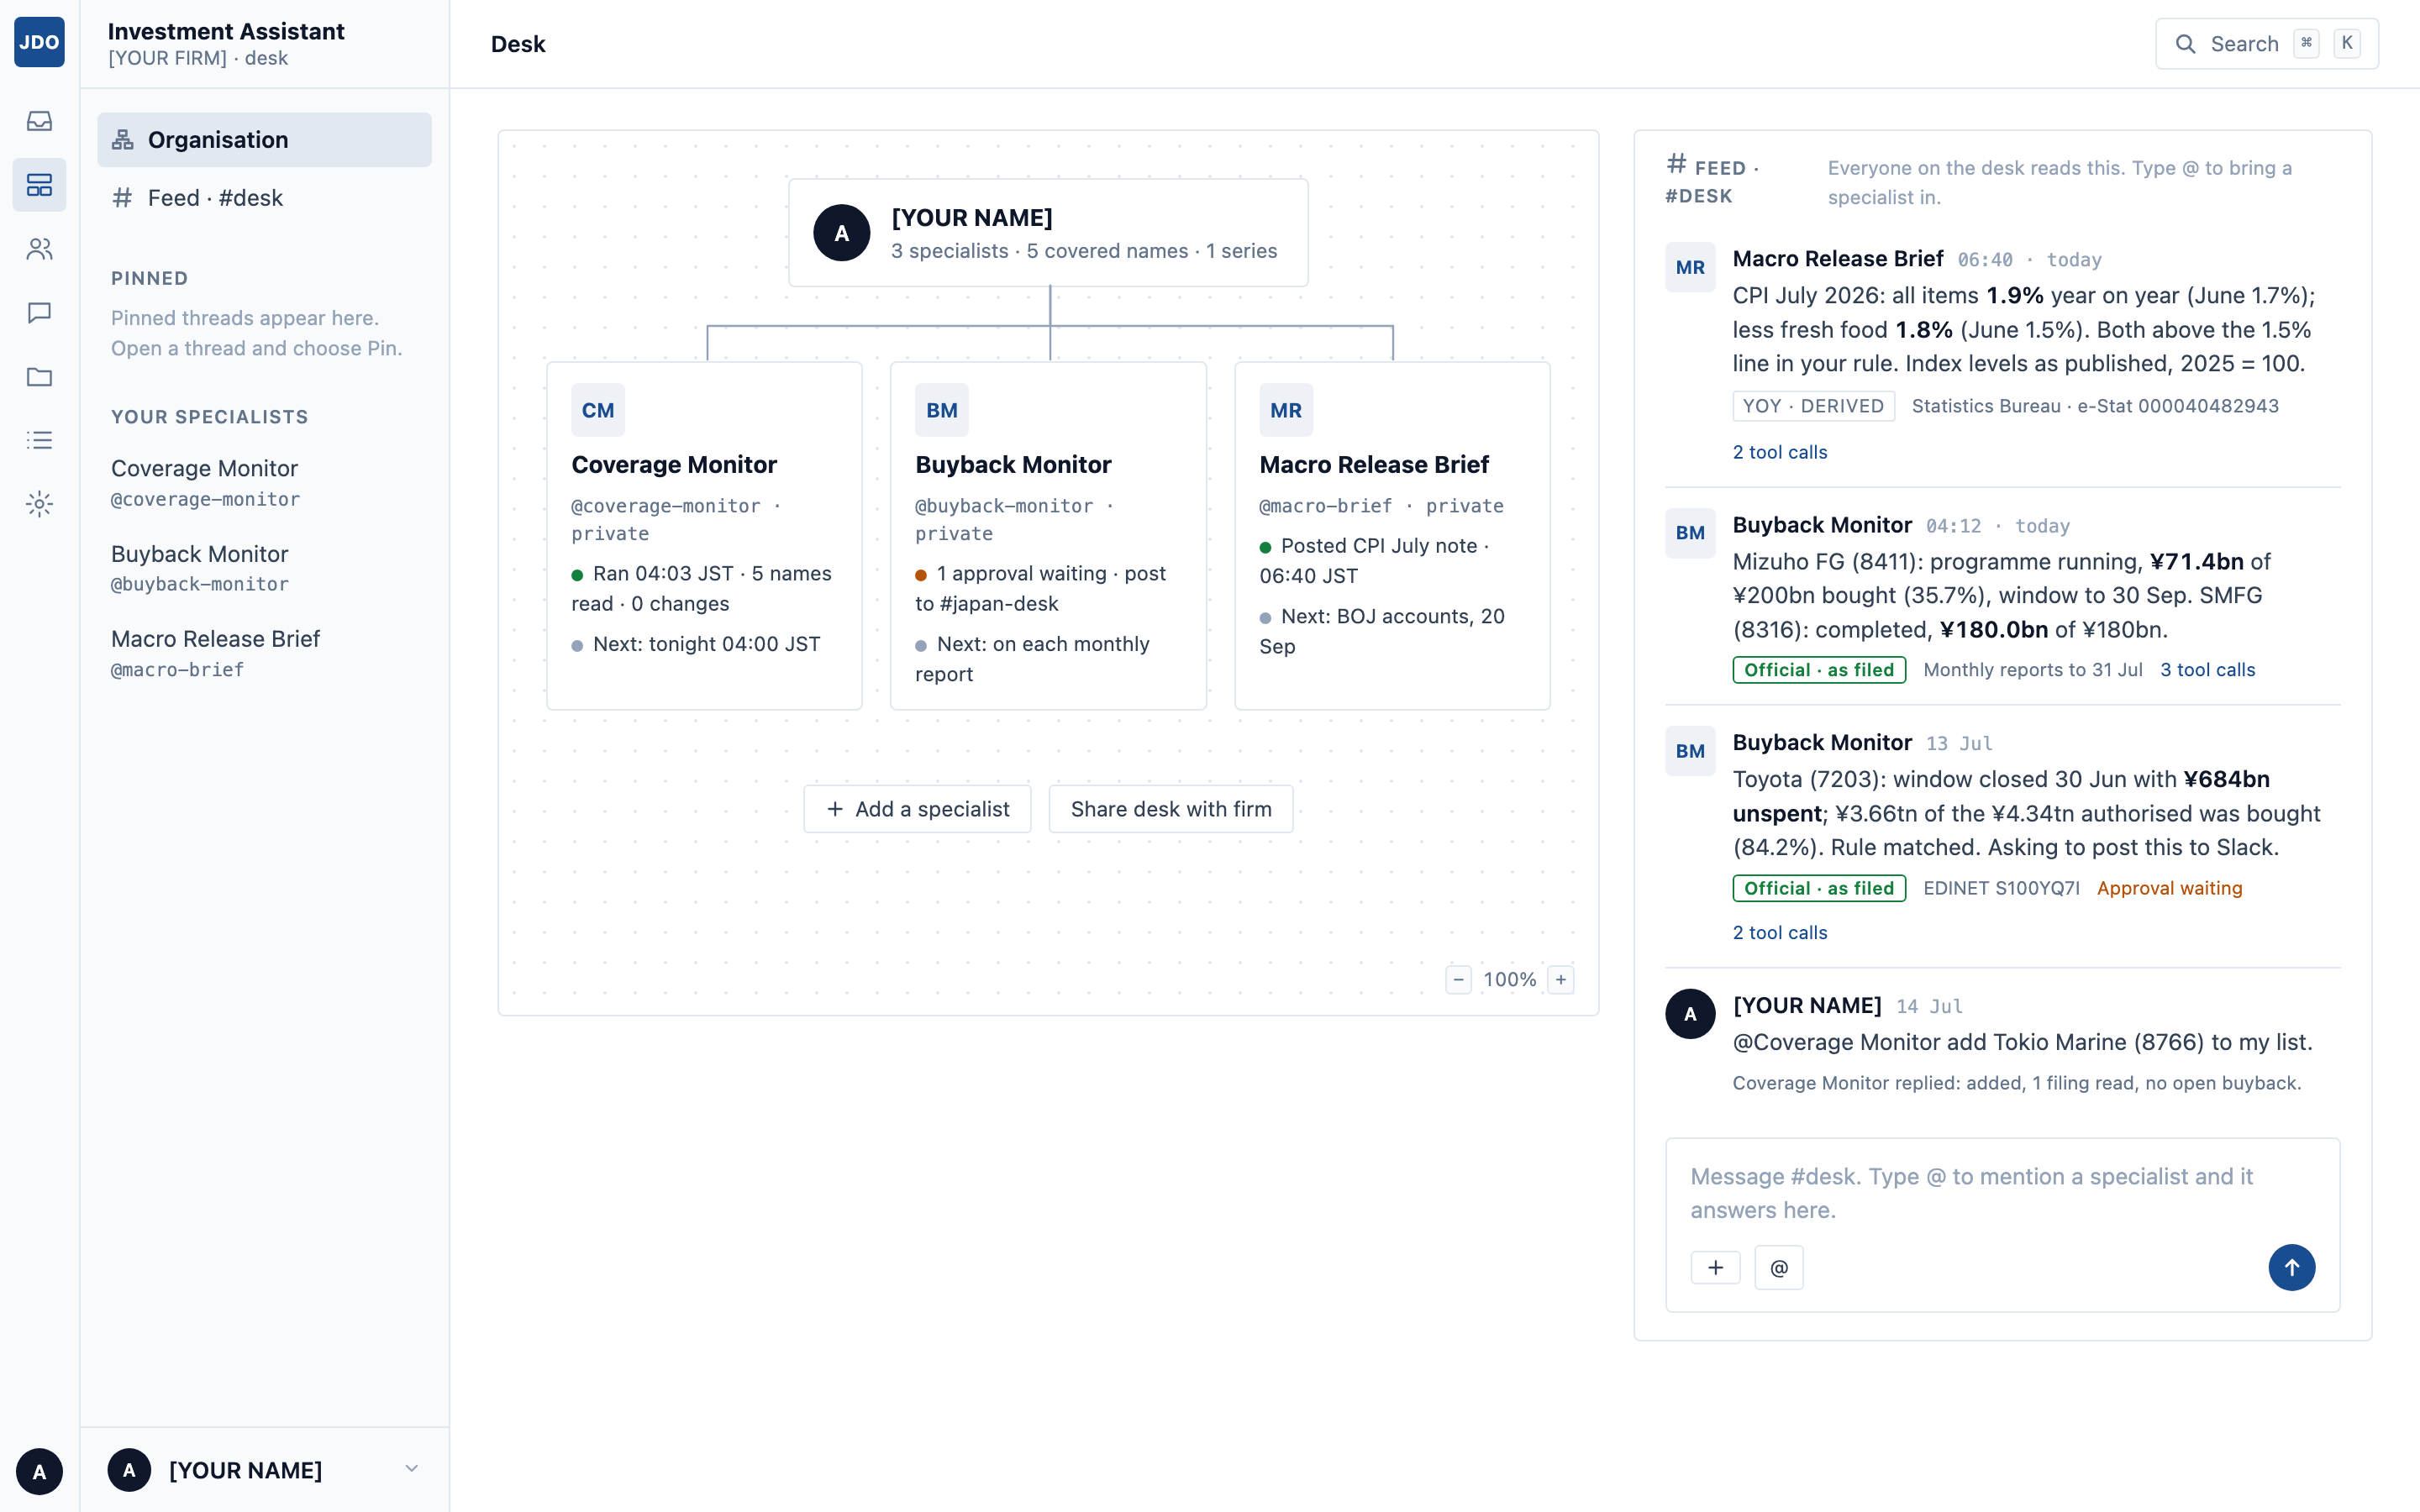
The desk
What your specialists found overnight. You tell us which companies you cover, and they report back with the filing attached to every claim.
It tells you what happened, in a sentence. “MS&AD cut 52 cross-holdings this year.” You can act on that.
You can see what is watching. Each specialist shows when it last ran and when it runs next.
Everything is sourced. The filing, the badge, and the tool calls behind each line.
The desk belongs to the team, not to one person's login.
THE DESK
9

Slide 10
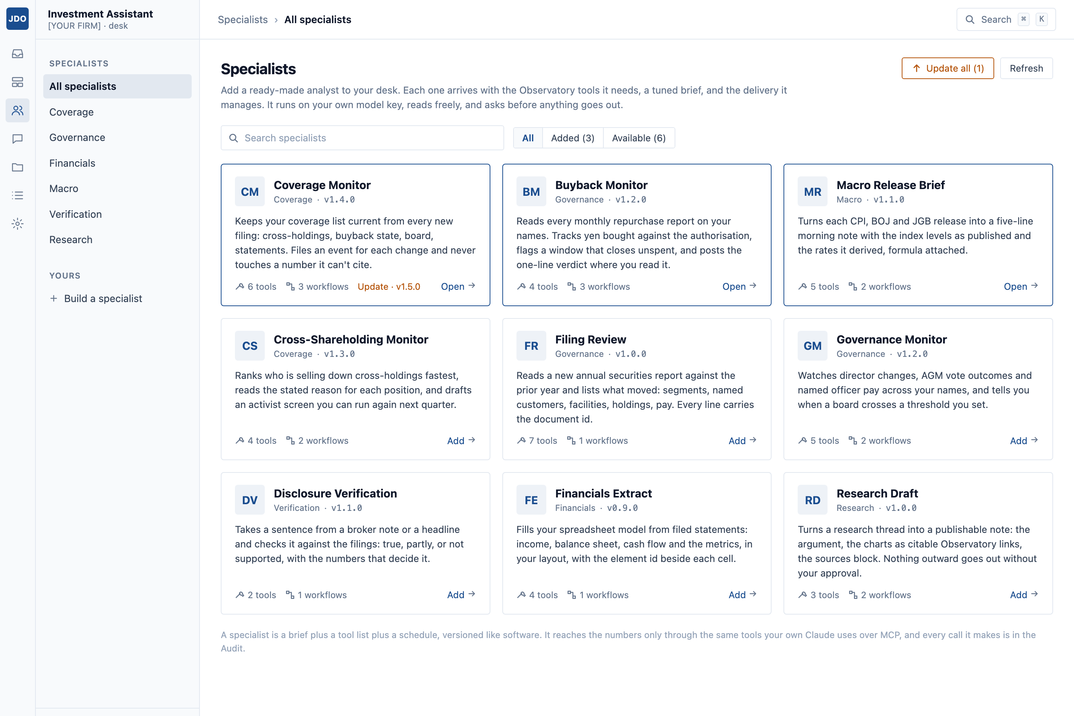
Add specialists
Each is an analyst with a written brief, a fixed set of tools it may use, a schedule and somewhere to report. We write them, version them and maintain them.
WHY WE WRITE THEM RATHER THAN LET CUSTOMERS DO IT
They have version numbers
You accept an update the way you would for any software. A prompt that quietly changes its behaviour is not something a firm can rely on.
We can say exactly what they can reach
Each one has a fixed list of tools, so we can answer the security question precisely instead of vaguely.
One fix reaches everybody
Nine briefs we maintain is a product. Ten thousand that customers wrote is a support problem we could not survive.
SPECIALISTS
10

Slide 11
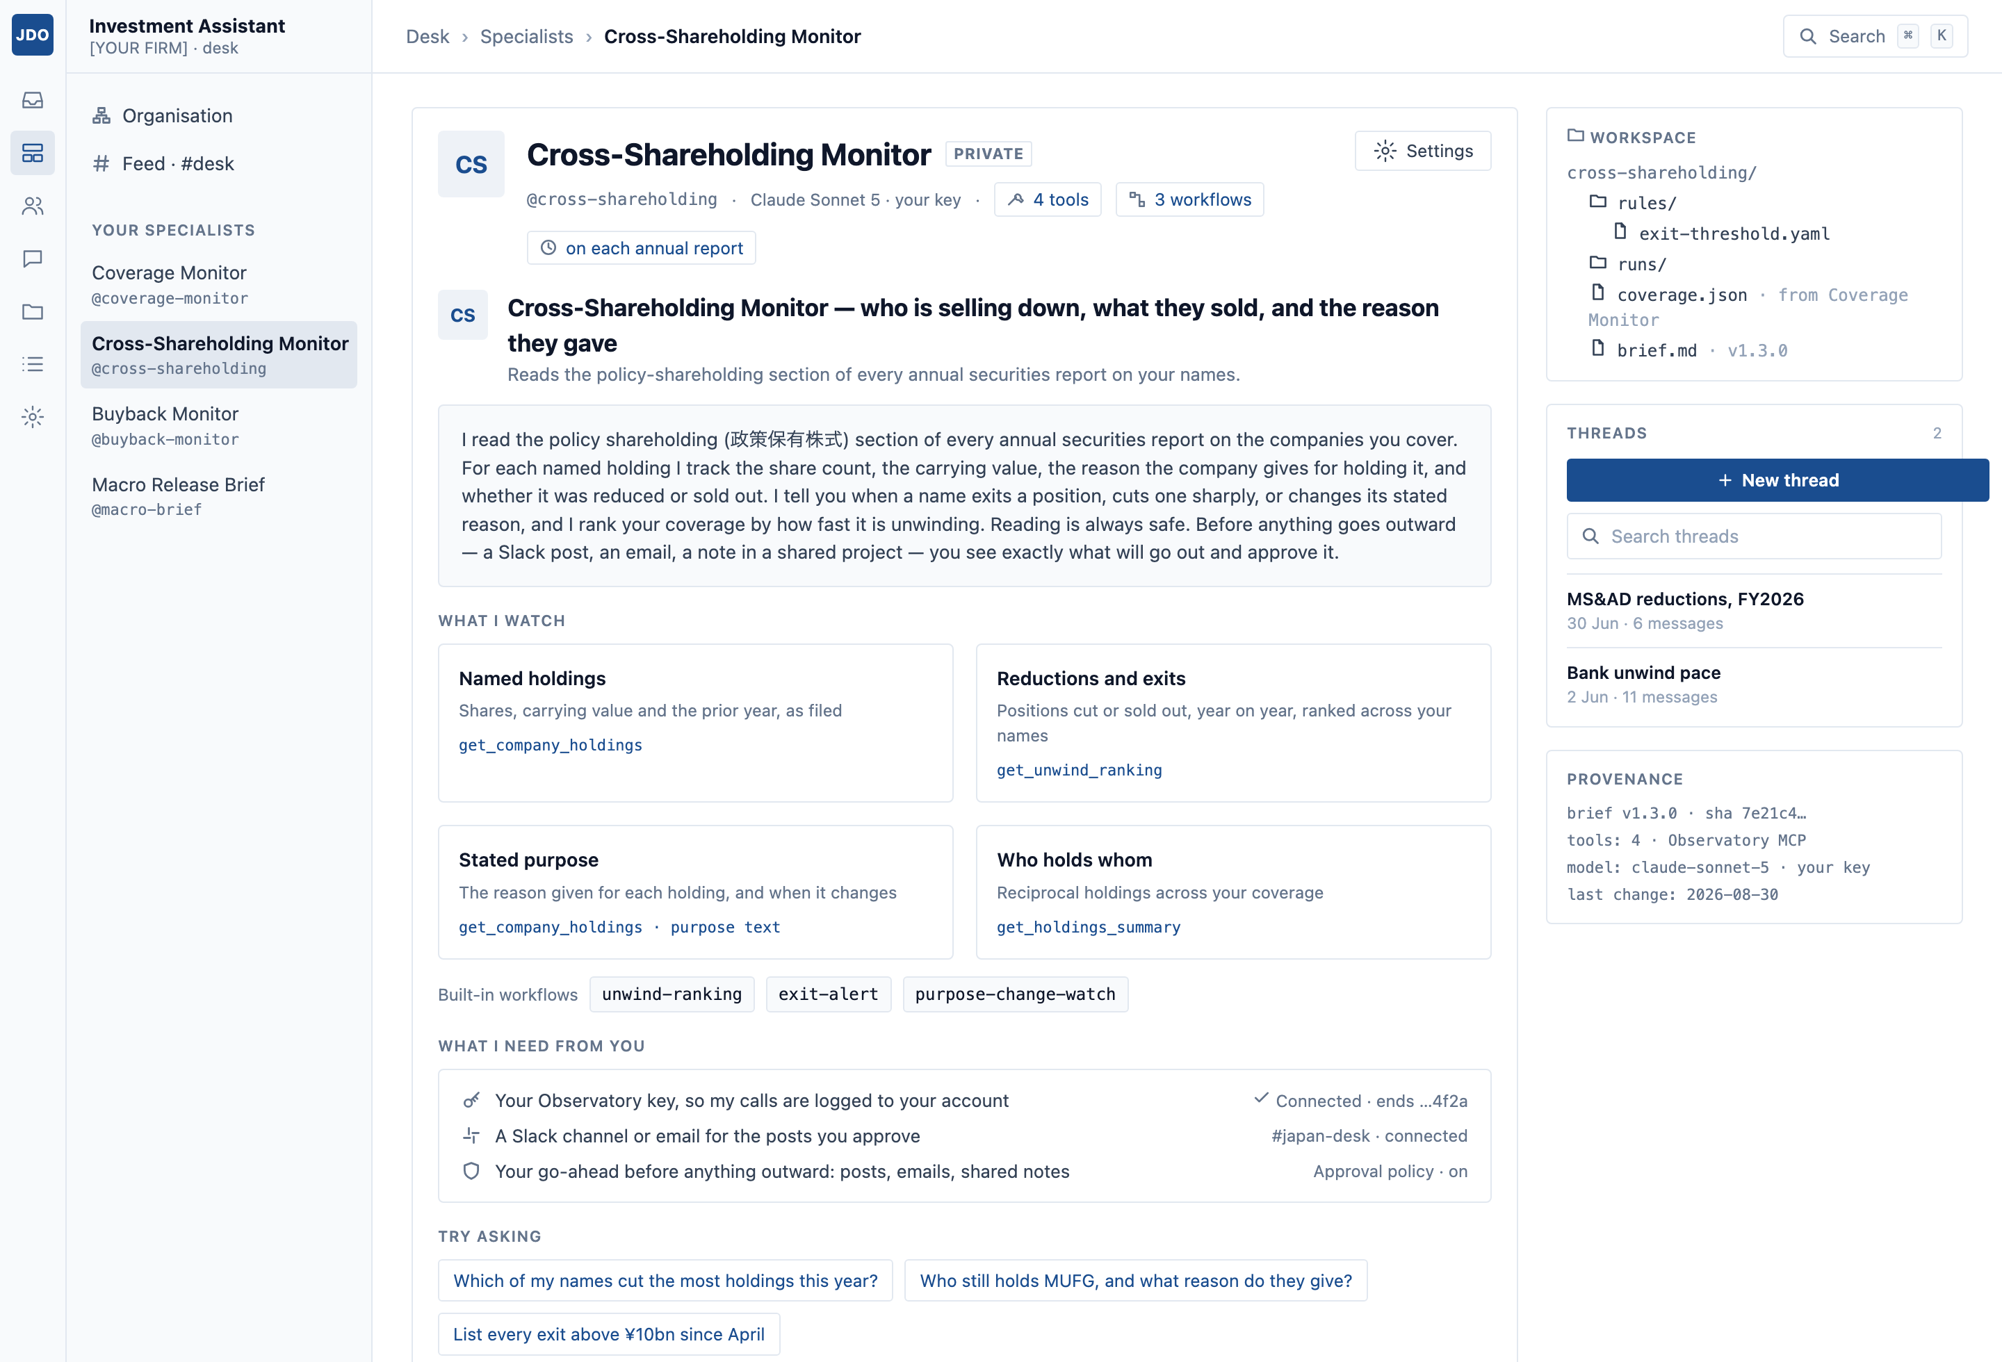
One up close
The Cross-Shareholding Monitor reads the policy-shareholding section of every annual report on your names, and tells you who is selling down and why.
Why this one matters. Japanese companies still hold about ¥59tn of each other's shares and are under pressure to sell. Every disposal is disclosed, and almost nobody reads them.
It explains itself. The page says what it watches, which tools it uses for each part, and what it needs from you.
You can see every run. When it ran, what set it off, what it found, and what it did about it.
You can ask it things. Threads sit alongside the scheduled work and keep their own memory.
ONE UP CLOSE
11

Slide 12
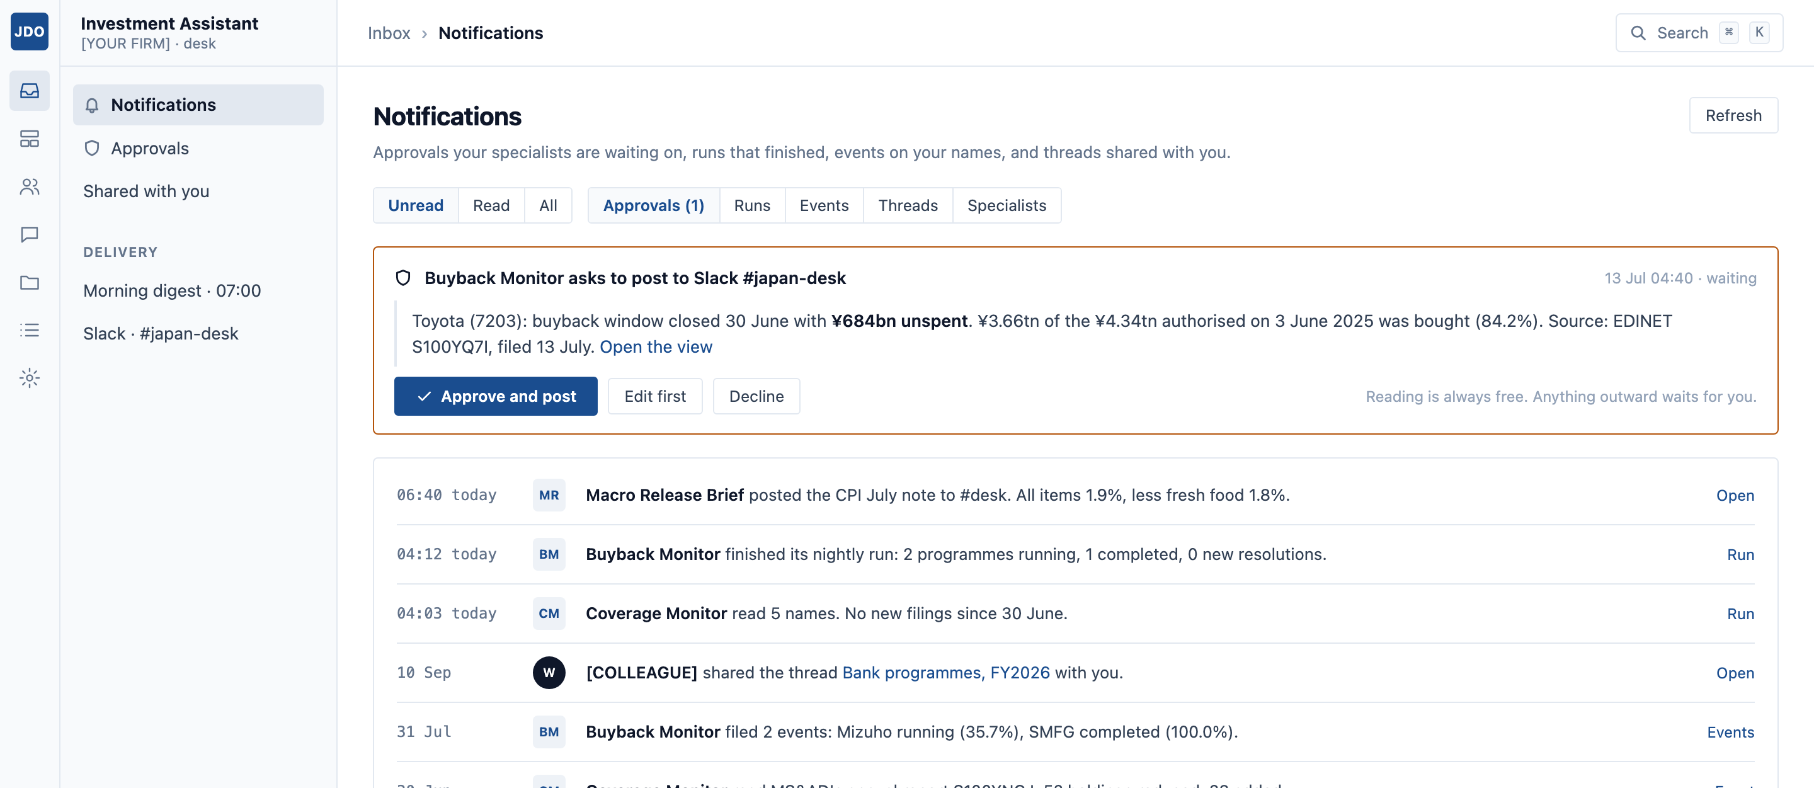
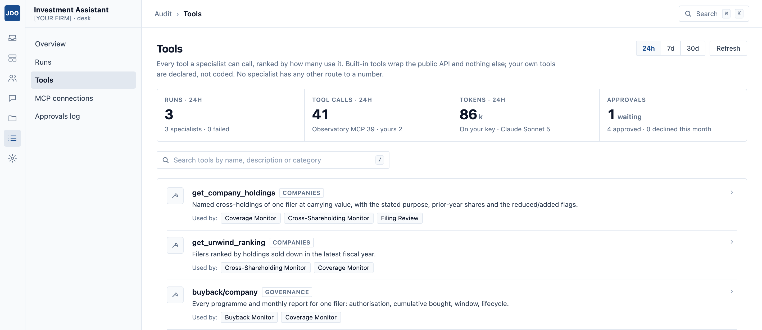
Approval and audit
It can read everything, but it cannot send anything until you have approved it. These are the two screens a compliance officer asks about first.
Before a specialist posts to Slack or sends an email, it stops and shows you the exact words. Reading the database never needs approval. Anything leaving the desk always does.
Every tool, who used it and how often, and the runs, calls and tokens behind them. You can answer “what has this thing been doing?” precisely.
There is no tool that can place a trade, and no way to add one. We are not in the order path and do not intend to be. That is usually the sentence that settles the room.
CONTROL
12

Slide 13
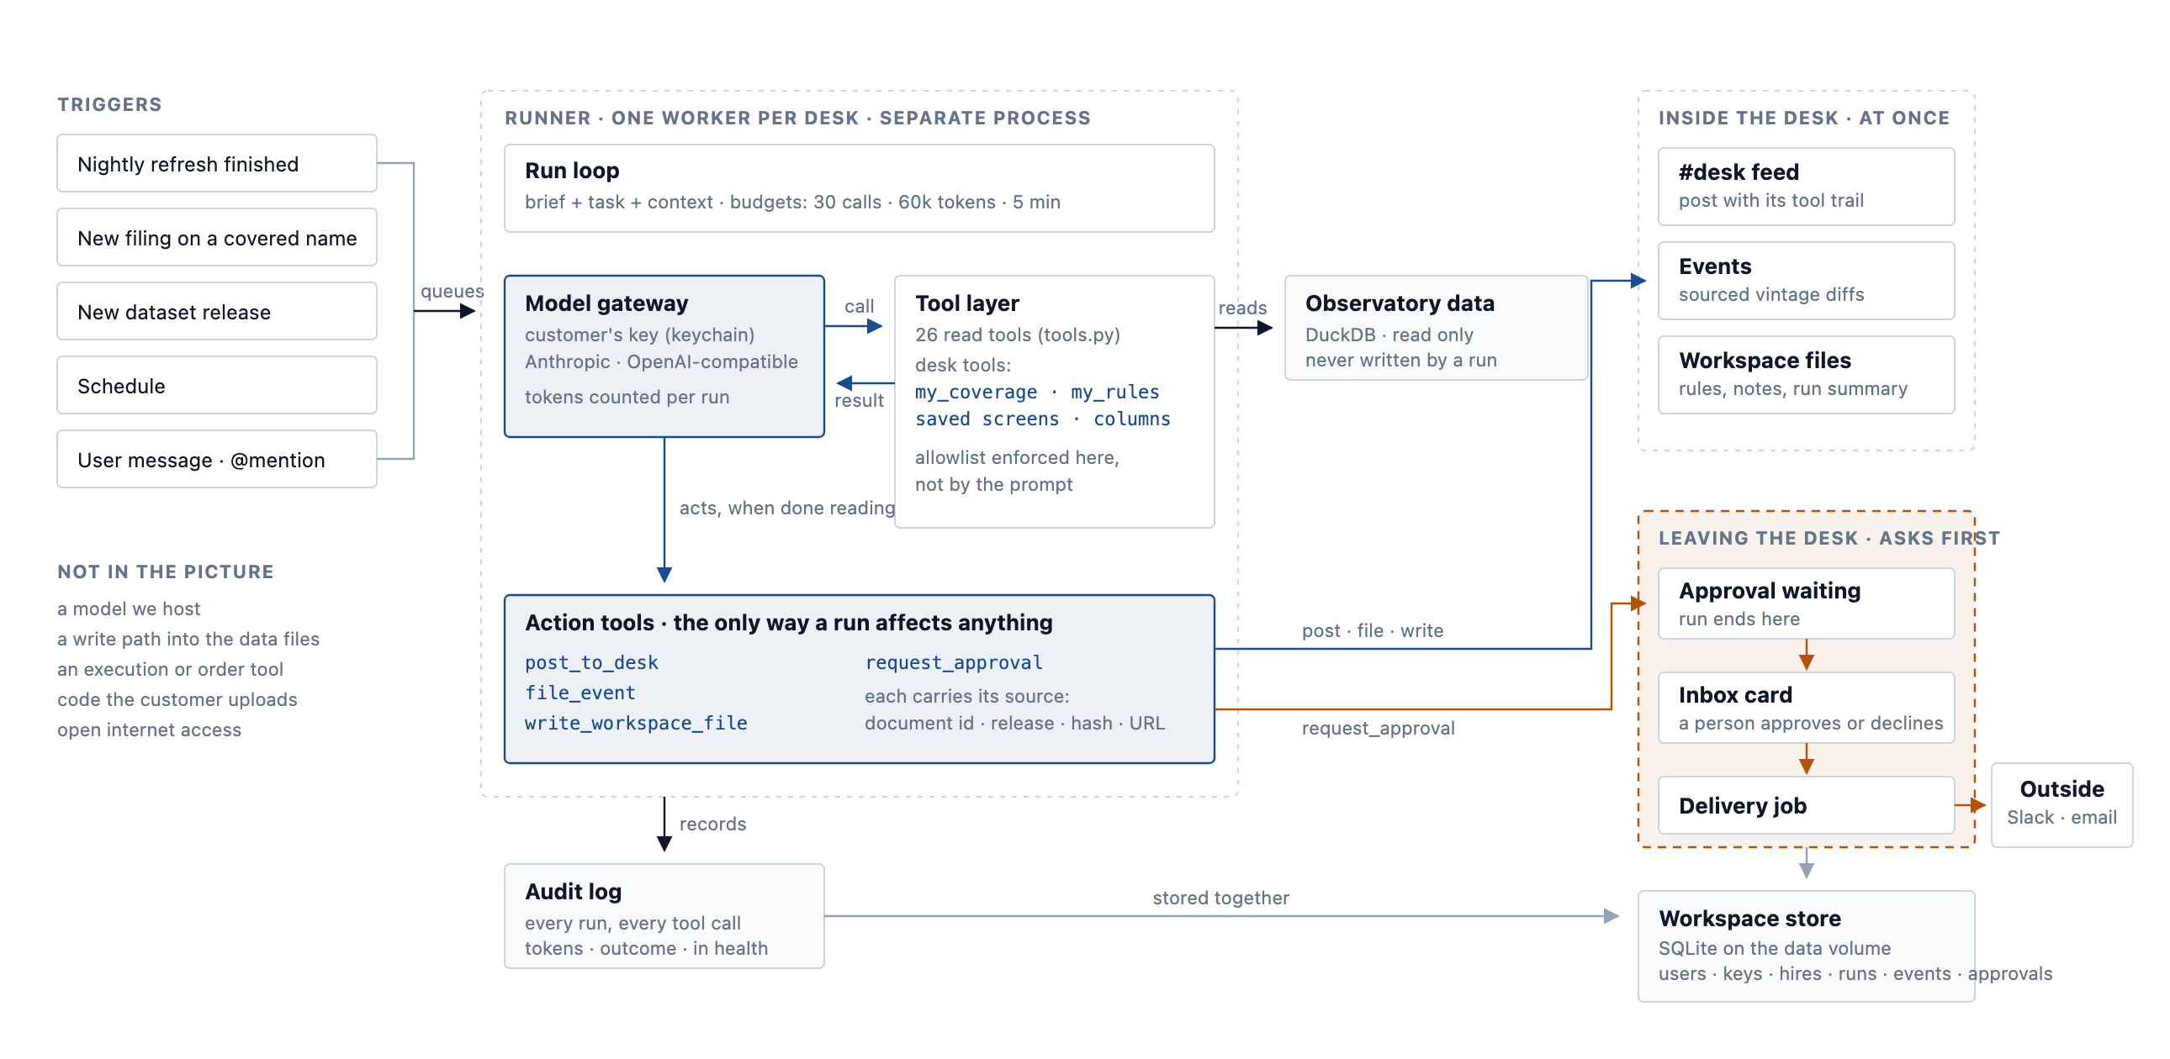
Under the hood
How a specialist actually runs. The tools it may use are enforced by our runner, not by the wording of its brief, and every call is written down.
Blue is the work the model does: it reads through tools, then acts through four of them. Amber is the only line that matters, and crossing it needs a person. The model runs on the customer's own account, not ours.
UNDER THE HOOD
13

Slide 14
Users and tiers
Four kinds of user on the same database, with the same provenance. What differs is what each needs from it and how they pay.
Investment firms
FIRM TIER
Researchers
FREE
Analysts, portfolio managers and quant teams. They want a watch on the companies they cover, history they can test against, and screens a terminal does not offer.
Economists and finance academics. They need data they can cite and reproduce years later. We give it away, because their citations make us the obvious source.
Journalists
INDIVIDUAL TIER
Private investors
INDIVIDUAL TIER
Financial and investigative reporters. One sourced answer to one question, with the filing attached. The assistant does the reading.
Serious individuals and family offices. The same company facts the professionals have, at a price one person can pay without asking anyone.
Free is the website and citable links. Individual adds a coverage list, alerts, API and AI access, and specialists. Firm adds shared desks, an audit trail, a licence and someone to call. Prices come after the first customers have told us what they will pay.
WHO USES IT
14

Slide 15
Why it holds
Everything we ingest is free and public, so the first question in every meeting is why a customer cannot just do it themselves. Three answers.
The history we have already recorded
The detail underneath the headline
It is cheaper than building it
Millions of stored versions of numbers that have since been revised. Nobody can go back and collect those, and the gap grows every month we keep running.
Individual item prices, shareholdings with the reason given, named customers, board ages, vote results. Terminals stop at the top line.
A bank could rebuild this with a team in a year, then lose it when that team moves on. We cost less than the build, every year, and we keep going.
DEFENSIBILITY
15

Slide 16
Where we are
What is running today, and what is not. Japan Data Observatory is the first deployment, built by two of us and in production since August 2026.
WORKING NOW
BEING BUILT
NOT THERE YET
The ingest runs without anyone watching it
The specialists and the runner
Nobody is paying us yet
Accounts, keys and the desk
No signed pilots
A public API and website
Approvals and delivery
First revenue is the next milestone
The MCP server, live and connectable
Every listed company, six years of filings
WHERE WE ARE
16

Slide 17
What happens next
Get someone paying before adding another country. The first firm that pays us will teach us more than the next ten datasets would.
NOW TO END OF 2026
FIRST HALF OF 2027
SECOND HALF OF 2027
Find out if people pay
Sign a firm
Add a second market
Accounts, keys and the desk
The full set of specialists
Korea or Taiwan, same machinery
Two specialists running for real
Shared desks and audit for teams
Ask for the data as it stood on any date
Approvals and the morning email
Licence wording and support
Distribution through partners
Aim: three people paying
Aim: one firm signed
Aim: five firms, costs covered
WHAT HAPPENS NEXT
17

Slide 18
The team
One of us has sold to these customers for years. The other builds the system.
[FOUNDER 1]
[FOUNDER 2]
MARKET AND PRODUCT
[ENGINEERING]
[Years] selling equities to institutions across Asia, and the author of Asia Economics Observations, which is how we reach our first customers. Clients have been asking for these numbers for years.
[Their name, what they have built before, and one concrete thing that shows they can do this at scale. Two or three lines.]
What the two of us have already done: a working system with a public API and an AI interface, covering every listed company in Japan, built in a few weeks. So the question is not whether we can build it. It is whether we can sell it, and that is what the next year is for.
TEAM
18

Slide 19
WHAT WE ARE ASKING FOR
[AMOUNT] to reach first revenue.
Eighteen months for the two of us, the hosting, and the selling that turns a working system into a paying one.
[%]
[%]
[%]
BUILDING
SELLING
RUNNING IT
The specialists, accounts, and the adapters for the next market.
The newsletter, conferences, and getting in front of forty desks.
Hosting, monitoring, licensing, and the compliance answers firms ask for.
The most useful thing you could do
Introduce us to one fund or one head of research. Right now that is worth more to us than the money.
[EMAIL]
ceresanalytics.[tld]

