Slide 1
OFDM RADAR WAVEFORM DESIGN BY P4-PHASE CODED SEQUENCE
Produced By Aata Nokhostin Roohi
December 2022

Slide 2
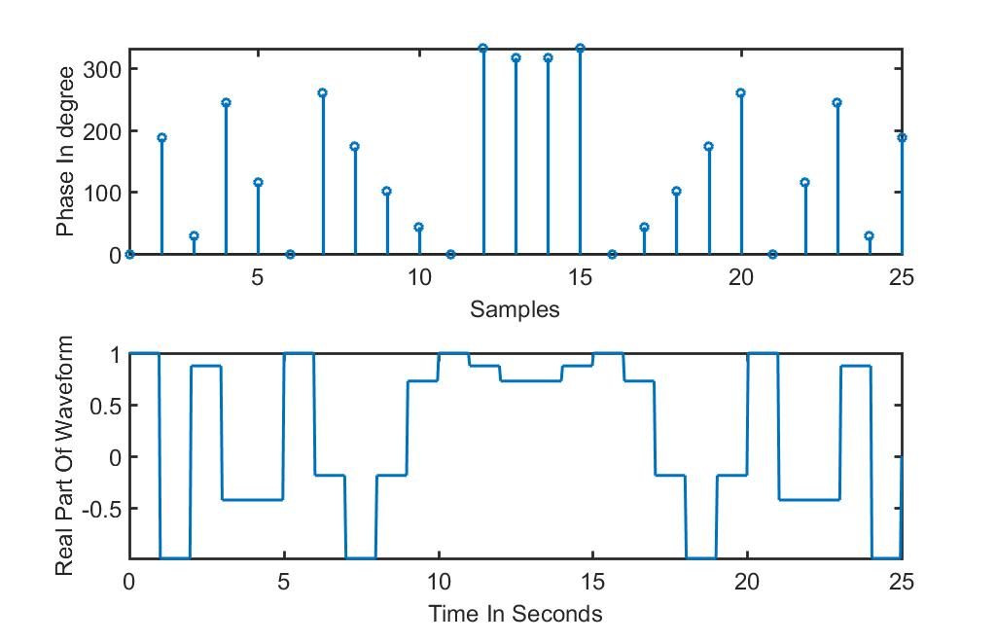
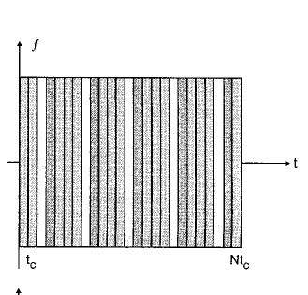
P4-Phase Code Sequence
M=25
1
13

Slide 3
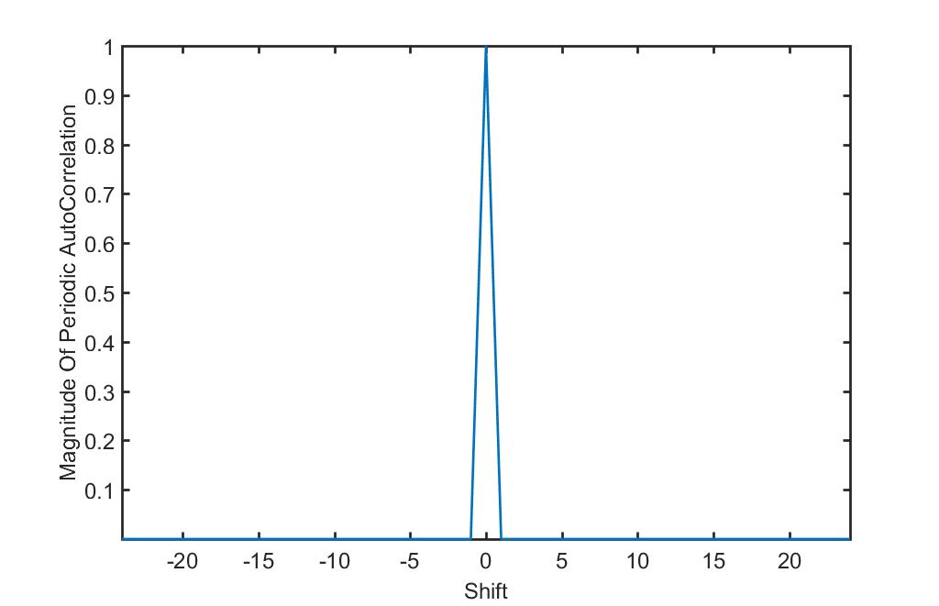

P4-Phase Code Sequence
Has Ideal Periodic ACF
ZERO Side-lobe
2
13

Slide 4
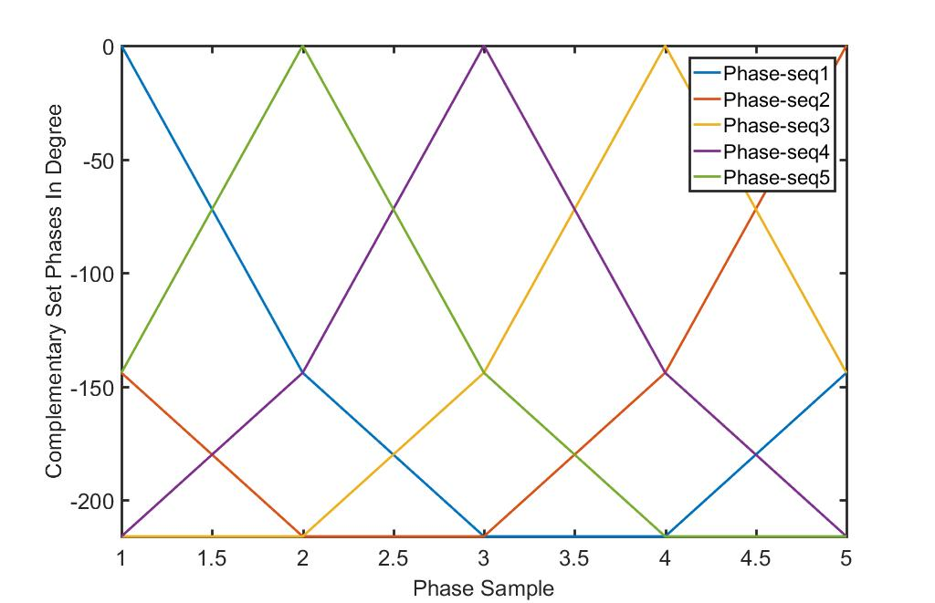
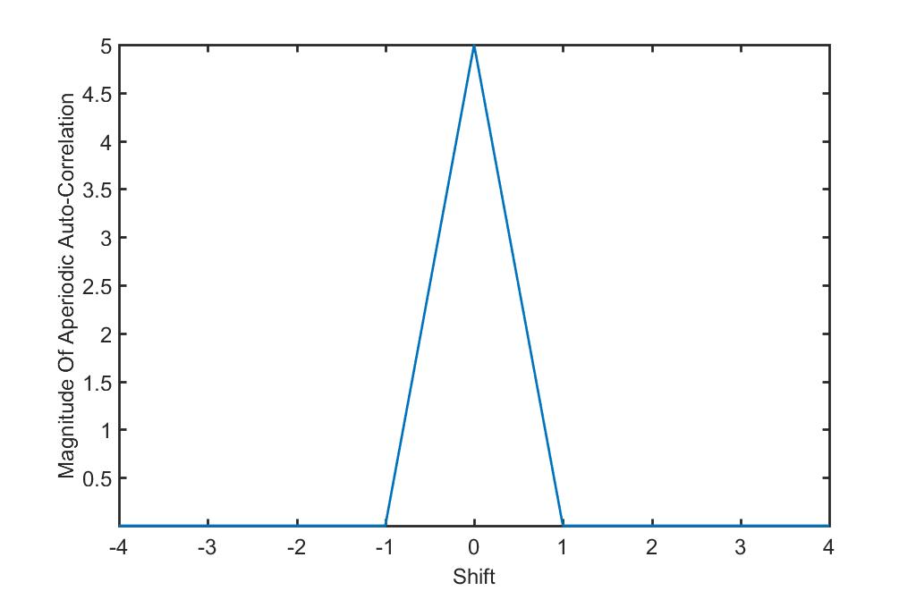
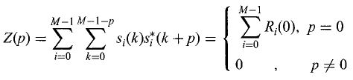
P4-Phase Code Sequence
Ideal Aperiodic ACF By All Cyclic Shifts
All Cyclic Shifts For Length=5
ZERO Side-lobe
3
13

Slide 5
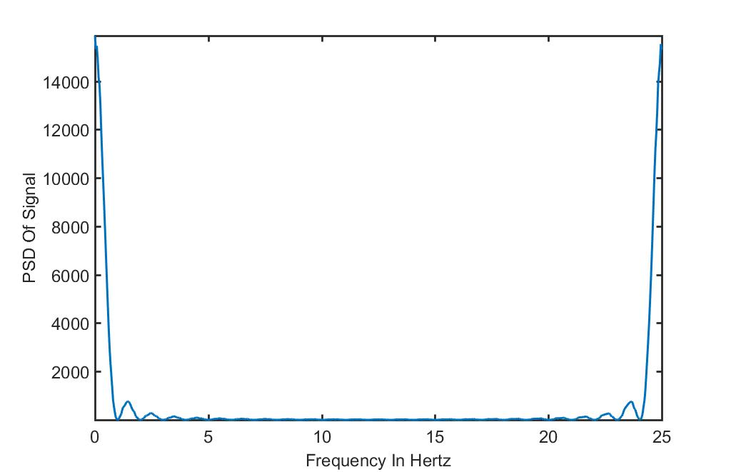
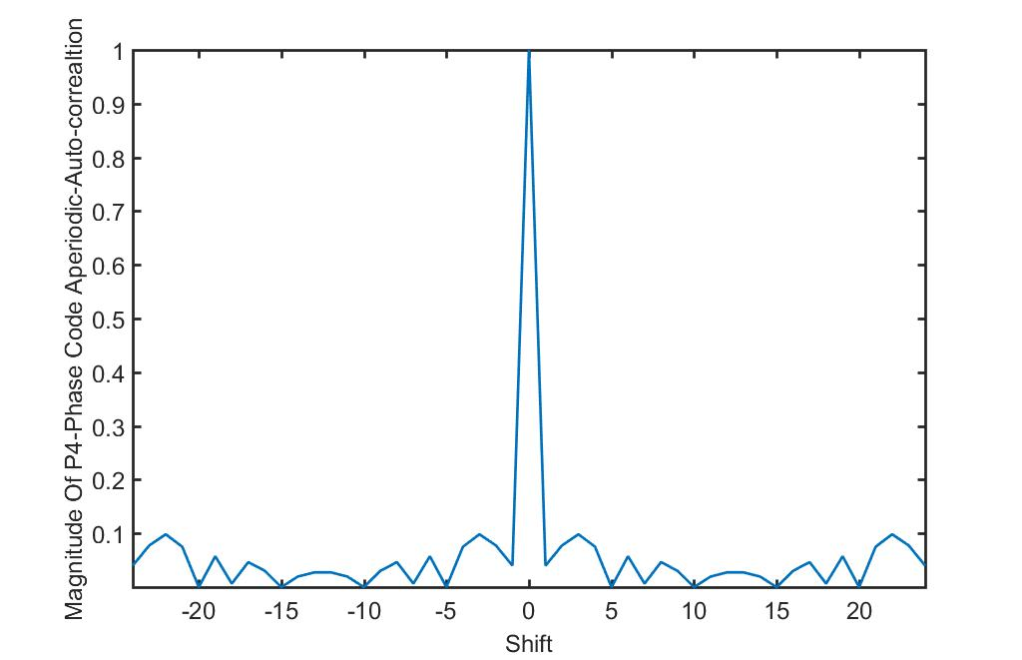

P4-Phase Code Sequence
Aperiodic ACF
PSD
Length=25
PSL=-20.1755dB
4
13

Slide 6
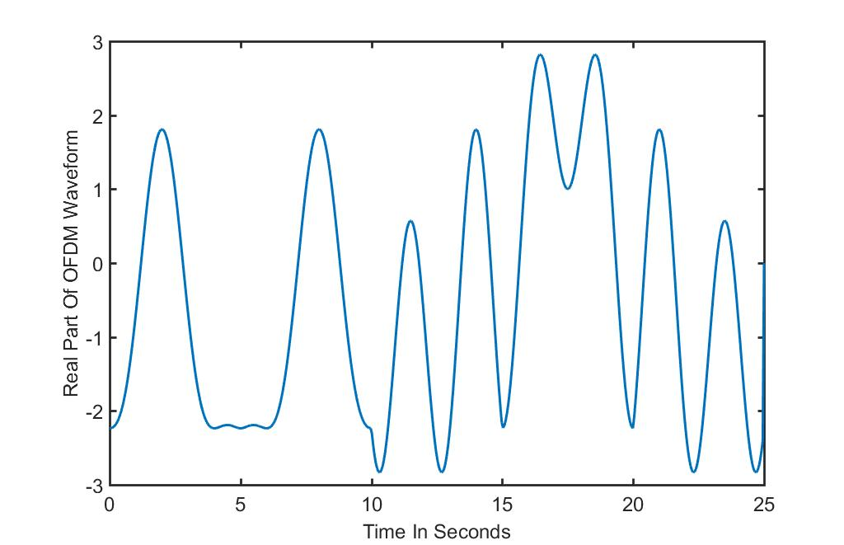
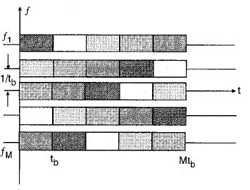
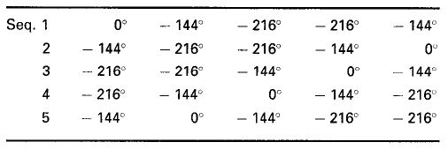
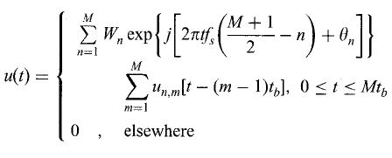
OFDM BY P4-Phase Sequence
Order=Cyclic
Length=5
PMEPR=1.7371
5
13

Slide 7
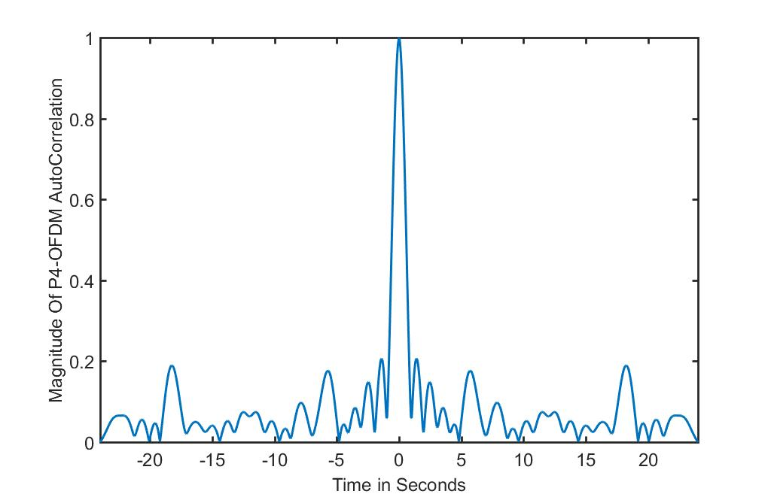
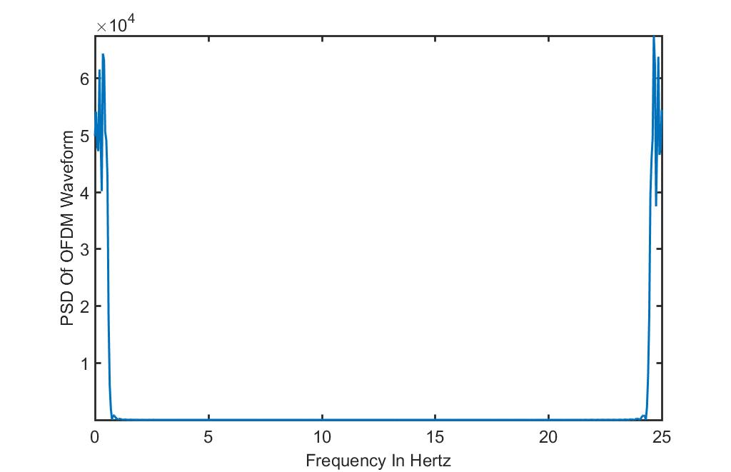
OFDM BY P4-Phase Sequence
ACF
PSD
PSL=-13.75dB
Length=5;tb=5s
More Spectrum Efficiency
6
13

Slide 8
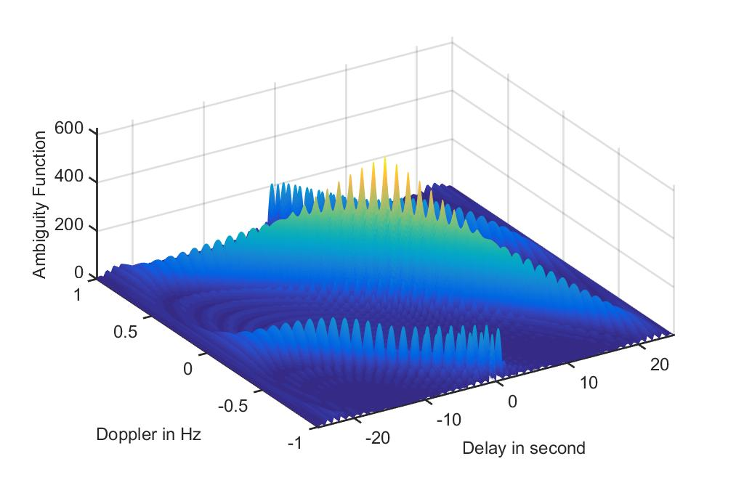
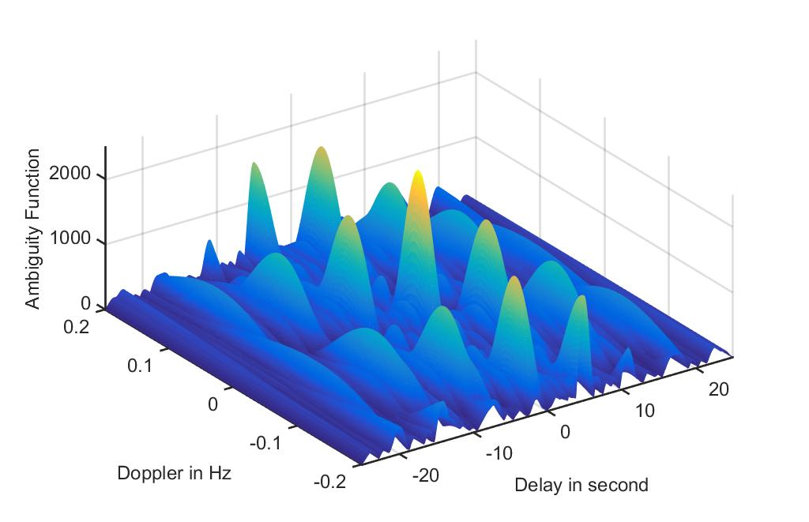
OFDM BY P4-Phase Sequence
P4;M=25
Cyclic OFDM;M=5
7
Frequency-Doppler Coupling
13

Slide 9
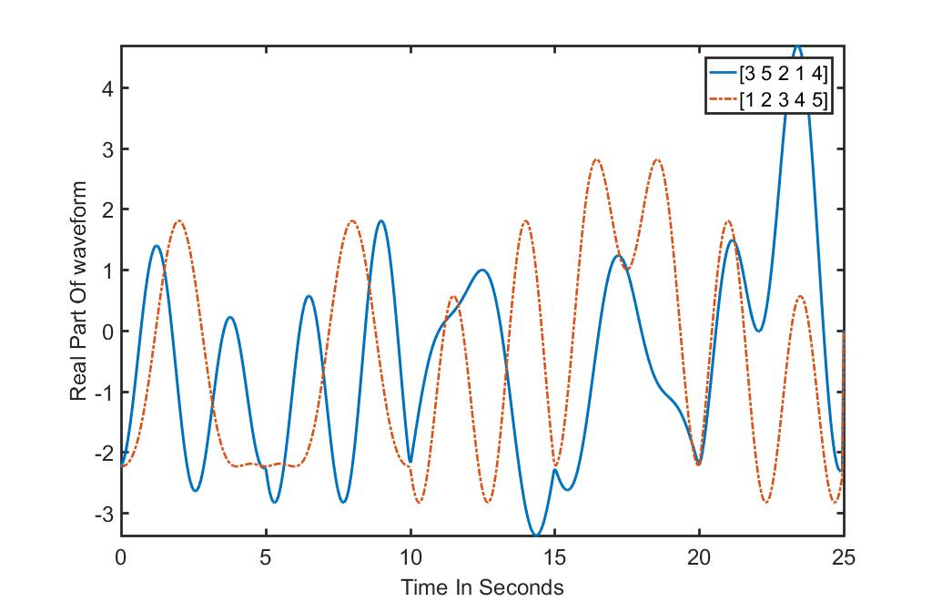
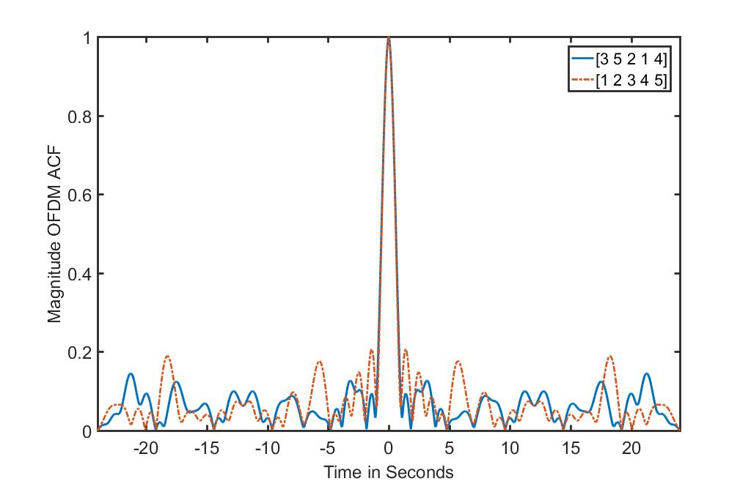
PMEPR COMPARISON IN OFDM FOR VARIOUS ORDERS
ORDER FOR PSL REDUCTION=[3 5 2 1 4]
ORDER FOR PMEPR REDUCTION=[1 2 3 4 5]
PMEPR=1.7371
PMEPR=4.4073
PSL=-13.75dB
PSL=-18dB
8
13

Slide 10
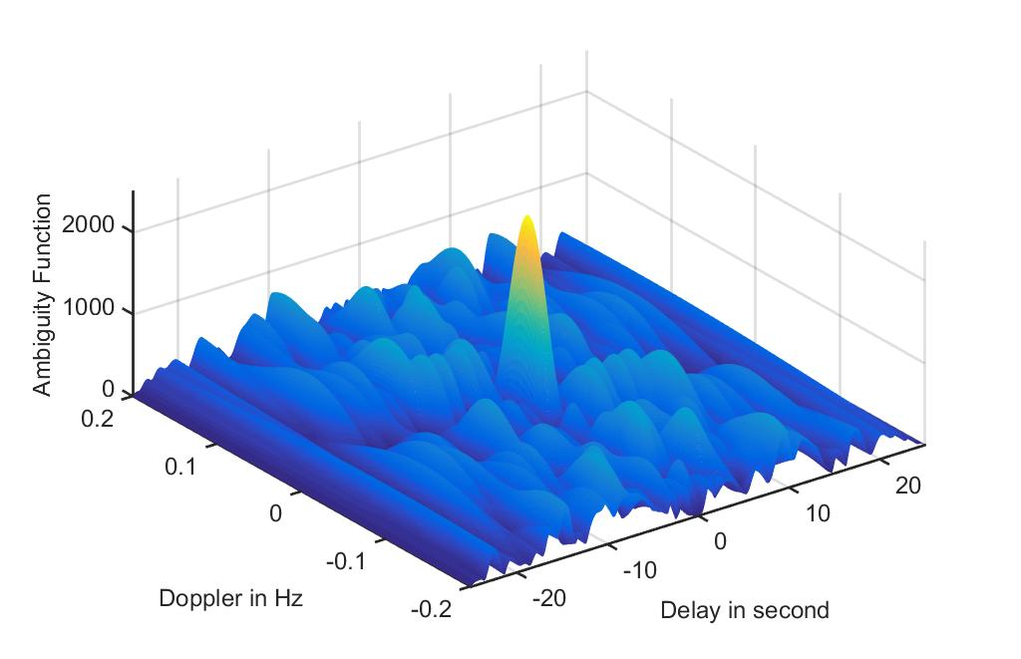
AMBIGUITY FUNCTION FOR OPTIMUM SEQ IN PSL REDUCTION
Eliminating Frequency-Doppler Coupling
9
13

Slide 11
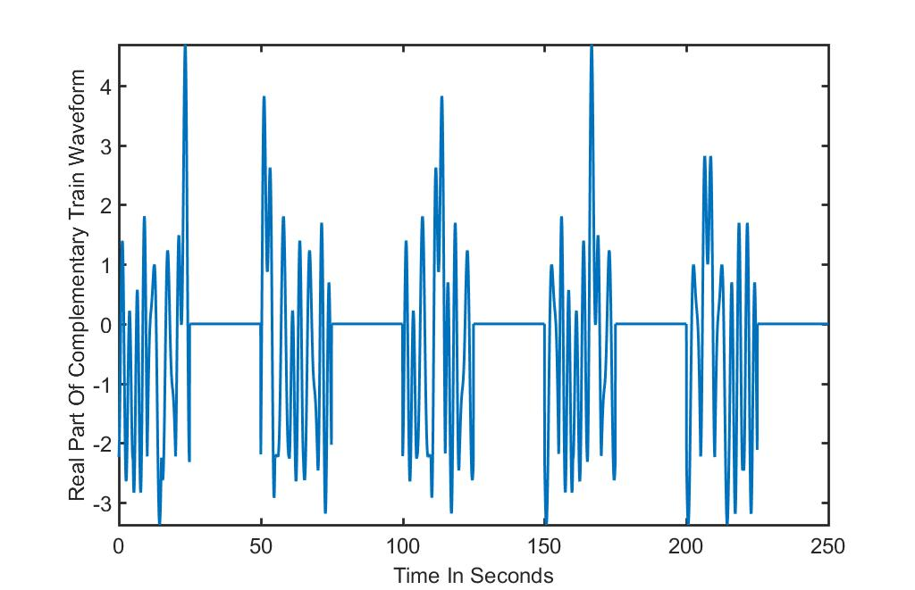
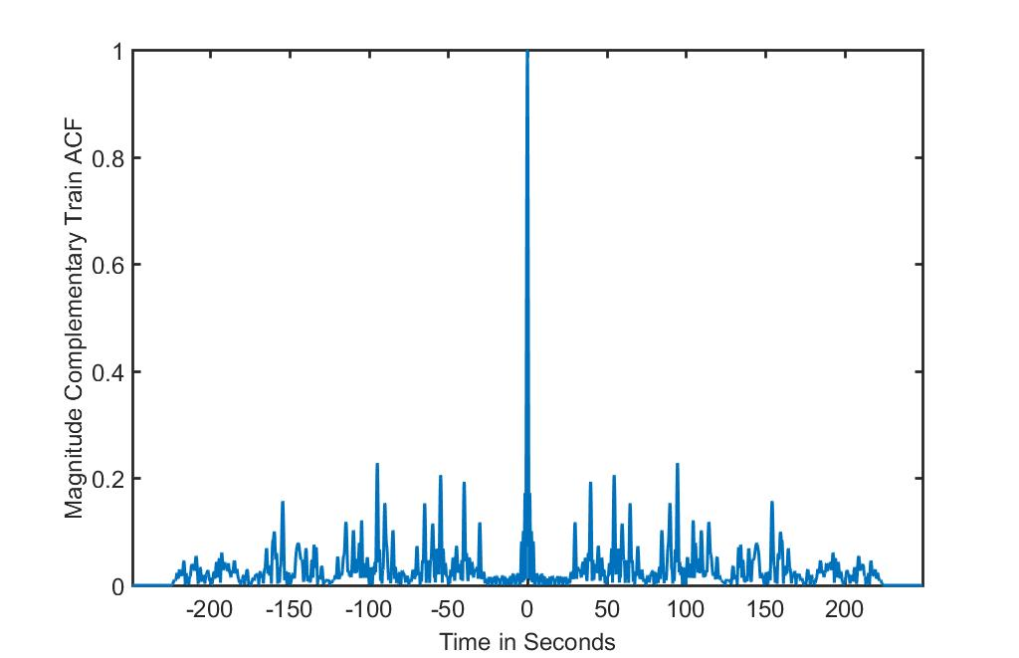
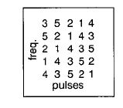
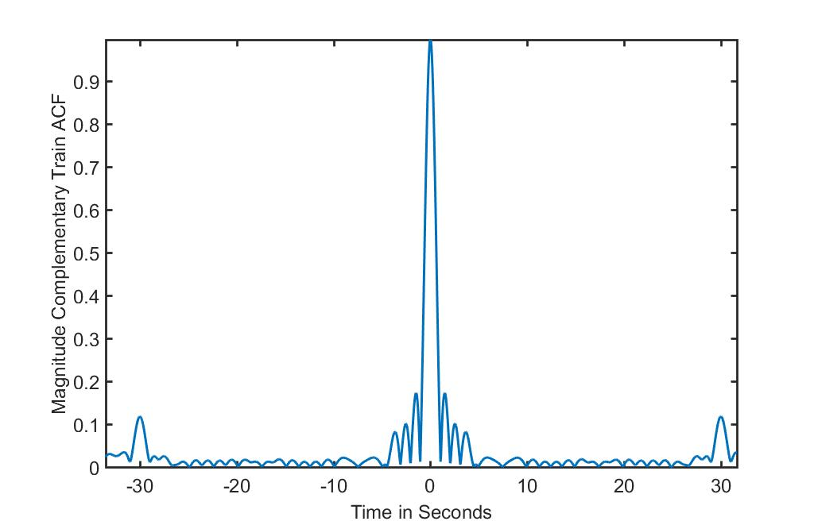
Reducing PSL BY COMPLEMENTAR TRAIN
Zoom Vision
Side Lobe Reduction Out Of Bit Duration
10
13

Slide 12
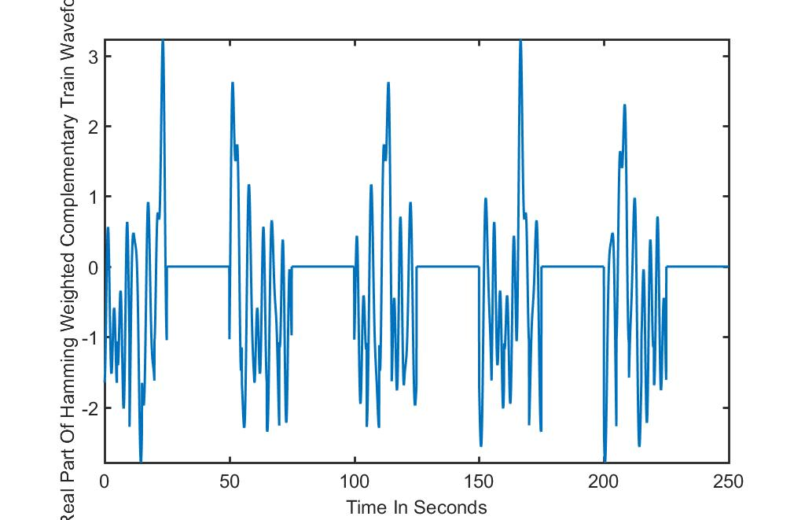
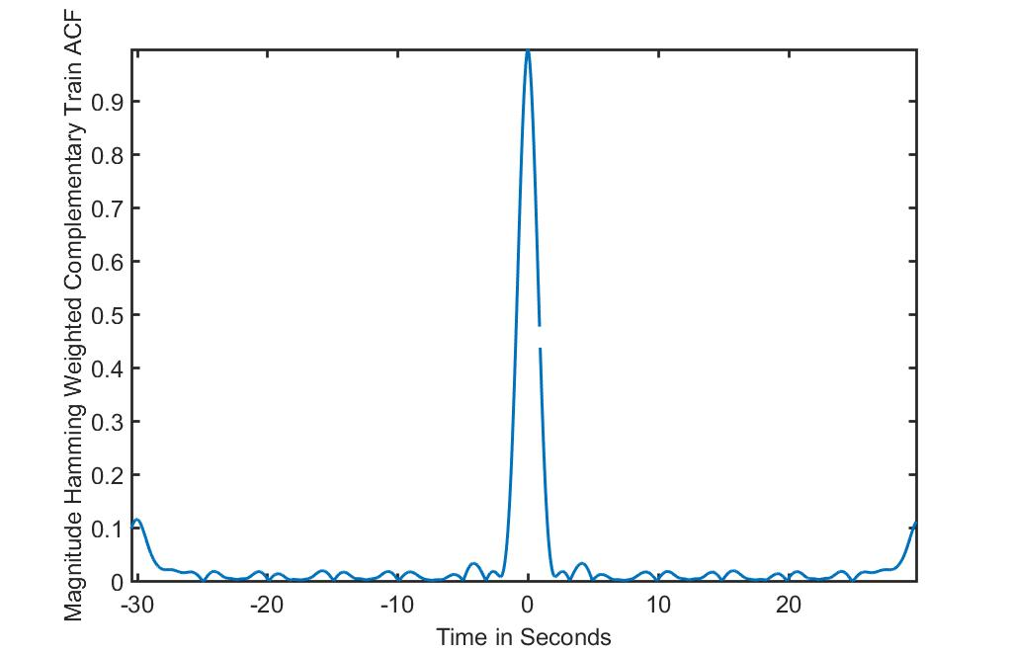

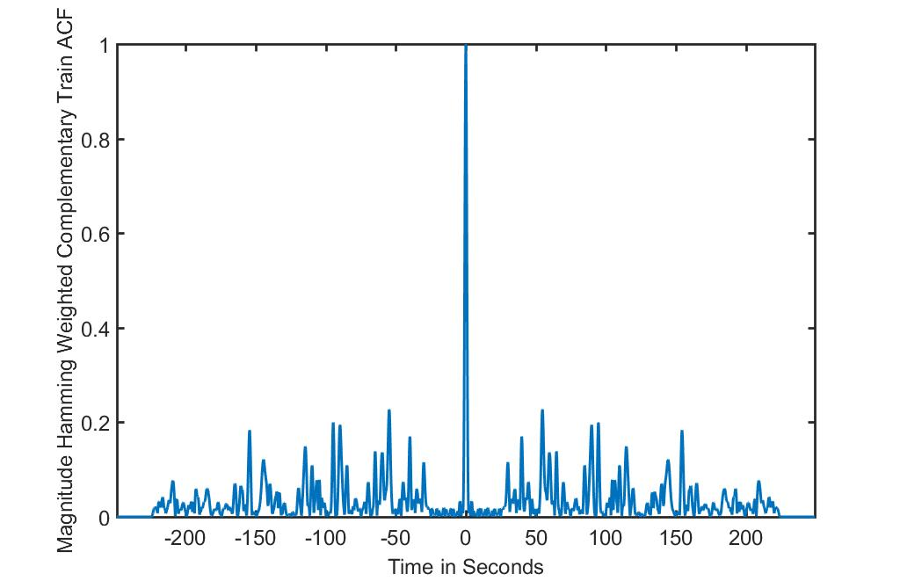
Reducing PSL BY COMPLEMENTAR TRAIN & HAMMING FEQUENCY WEIGHTING
Zoom Vision
PSL=-30.17dB
11
13

Slide 13
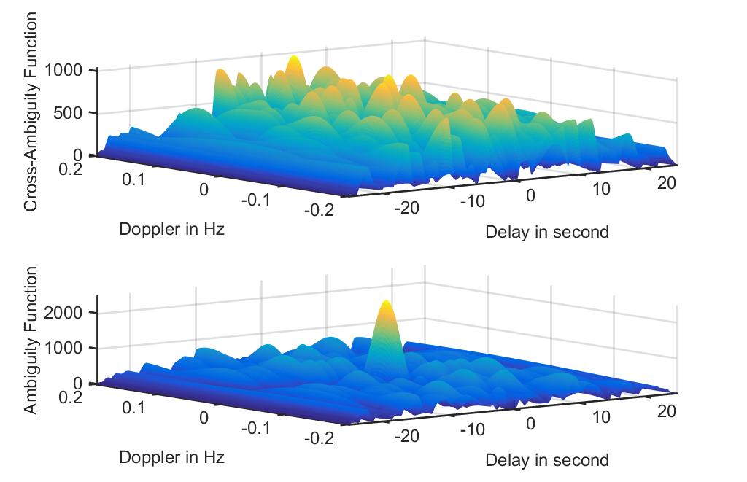
COMPARISON AMBIGUITY & CROSS AMBIGUITY FUNCTION
12
13

Slide 14
END

