Slide 1
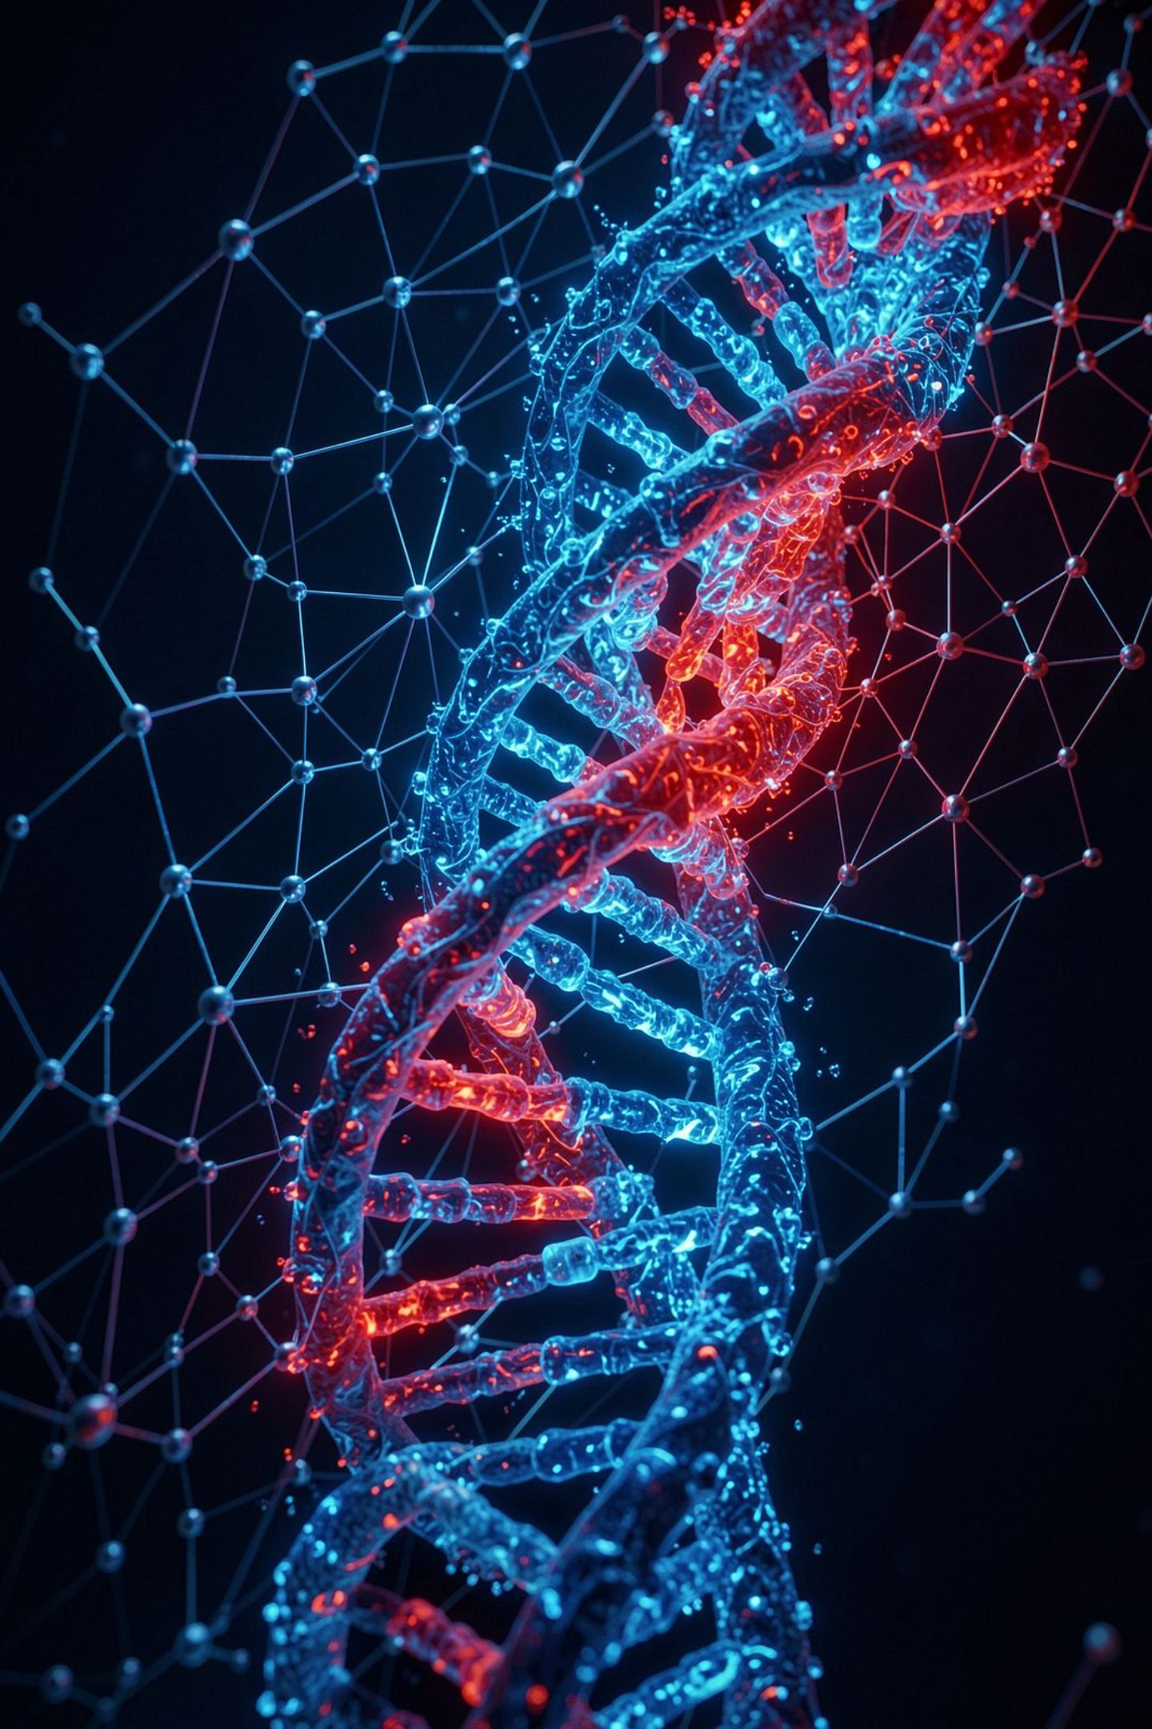
CureVerseAI
The Biological Intelligence Layer
AI-powered biological intelligence connecting scientific data, AI models, evidence, reasoning, visualization, and simulation across Research, Drug Development, Medicine, Biotechnology, and Education.
Team: Arooj Kanwal • Umme Hani • Aatazaz Hussain
HACKATHON PROJECT PRESENTATION

Slide 2
The Big Idea
CureVerseAI is a unified biological intelligence platform — not a collection of disconnected scientific tools. It connects biological data, AI models, scientific evidence, reasoning, visualization, simulation, and learning inside one ecosystem.
Our core journey follows five stages that move from raw biological inquiry toward human understanding:
Investigate
Discover
Stimulate
Explore
Learn

Slide 3
Why Biology Needs an Intelligence Layer
The Scale of the Problem
The Real Challenge
Modern biology produces enormous amounts of information through genomic databases, protein resources, pathway systems, drug databases, disease knowledge, literature, and computational models.
The challenge is increasingly not only finding information, but connecting information across sources and understanding what those relationships mean.
CureVerseAI is designed to provide that connecting intelligence layer — bridging raw scientific data and human understanding.

Slide 4

The Problem We Are Solving
Biomedical and biological workflows are fragmented. A researcher may investigate a gene in one resource, a protein in another, pathways somewhere else, drug information in a separate database, and supporting evidence in scientific literature.
Context Switching
Information Overload
Fragmented Workflows
Constantly moving between disconnected tools breaks scientific thinking and slows discovery.
Enormous volumes of data across isolated sources make it difficult to form a connected biological picture.
Genes, proteins, pathways, drugs, and evidence live in separate silos with no shared context.
CureVerseAI brings these steps into a unified workflow.

Slide 5

The Core Problem in One Sentence
Scientific knowledge is expanding faster than humans can manually connect it.
CureVerseAI addresses this gap by combining data retrieval, biological context, AI-assisted analysis, evidence integration, reasoning, visualization, and simulation in a single platform.

Slide 6
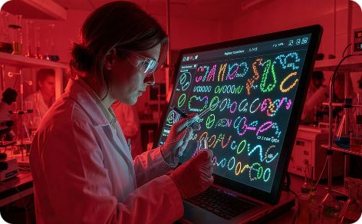
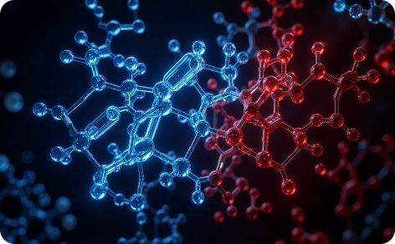
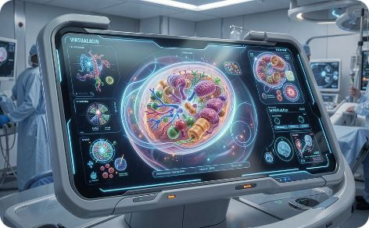
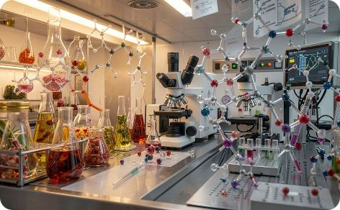

Our Solution
CureVerseAI provides five connected scientific domains, each with its own scientific workflow while sharing a common intelligence layer.
Research
Drug Development
Medicine
Biotechnology
Investigate biological evidence.
Discover therapeutic opportunities.
Simulate biological states and interventions.
Explore biological materials and molecular potential.
Education
Turn scientific intelligence into understandable learning.

Slide 7
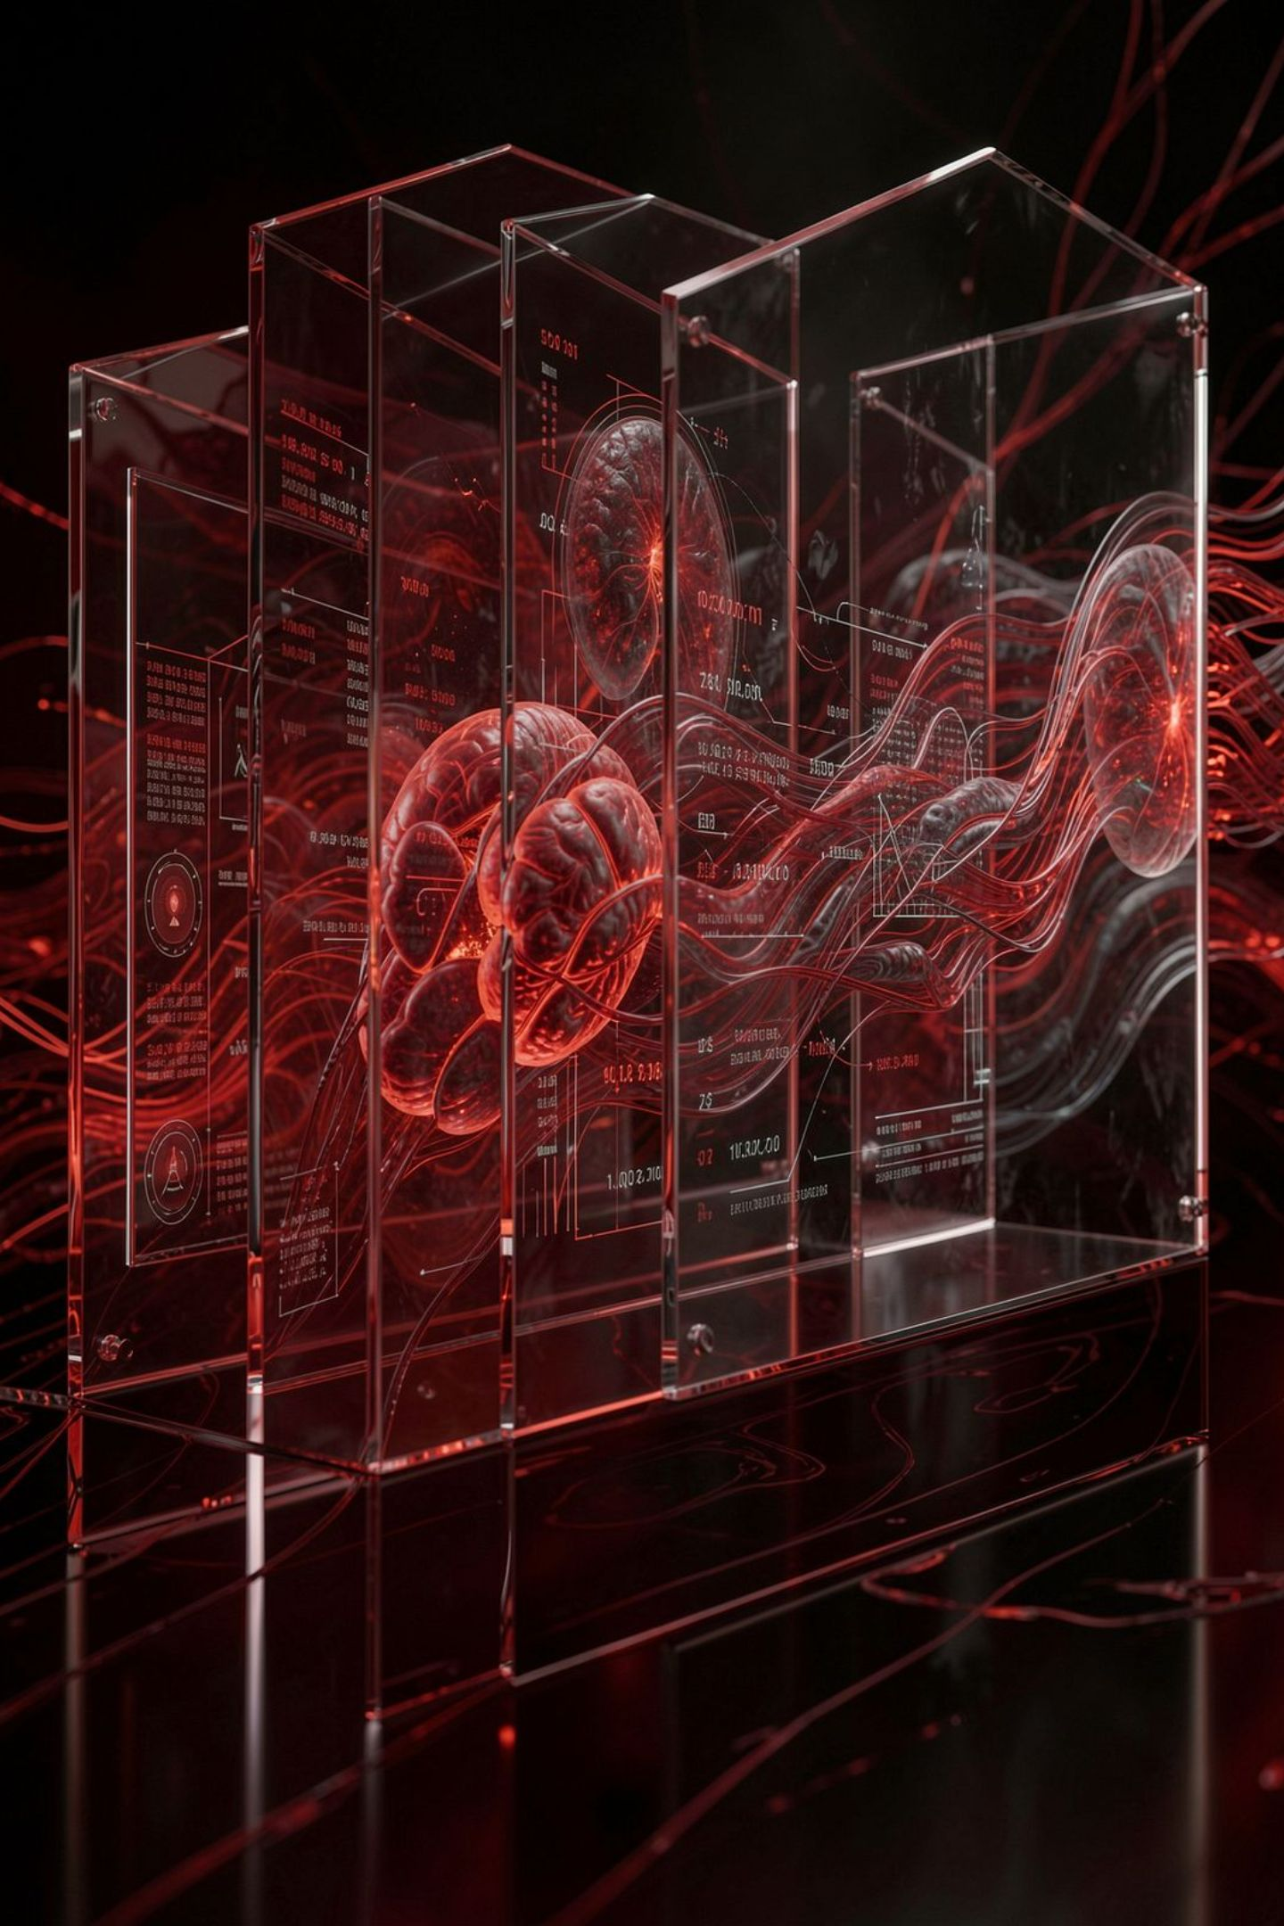
Our Theme
"The Biological Intelligence Layer"
The platform is built around the idea that biological intelligence should sit between raw scientific data and human understanding. Instead of returning disconnected records, CureVerseAI aims to connect evidence, relationships, mechanisms, models, and visual explanations.

Slide 8
What We Want to Achieve
We want to make complex biological intelligence more connected, interpretable, interactive, and accessible.
Long-Term Objective
Core Goals
An ecosystem where a discovery made in Research can inform Drug Development, a target or compound can enter Medicine simulation, Biotechnology can contribute biological materials and compounds, and all of these scientific concepts can become understandable through Education.
Connected biological intelligence
Interpretable scientific workflows
Interactive simulation and exploration
Accessible learning for all levels

Slide 9
Platform Journey
CureVerseAI follows five cognitive stages that move from raw biological inquiry toward human understanding. Each stage maps to a scientific domain and a distinct mode of intelligence.
Investigate
1
Research — investigates biological evidence: genes, proteins, variants, pathways, and supporting literature.
2
Discover
Drug Development — discovers therapeutic opportunities by reasoning from disease mechanisms toward targets and hypotheses.
Simulate
3
Medicine — simulates biological states and interventions through a Virtual Cell model.
4
Explore
Biotechnology — explores biological materials, anatomy, compounds, and molecular potential.
Learn
5
Education — turns scientific intelligence into understandable, interactive learning content.

Slide 10
Five Domains at a Glance
🔬 Research
💊 Drug Development
🏥 Medicine
Investigate genes, proteins, variants, pathways, and evidence.
Reason from disease mechanisms toward targets and therapeutic hypotheses.
Simulate disease and treatment behavior through a Virtual Cell.
🧬 Biotechnology
📚 Education
Analyze biological materials, anatomy, compounds, and potential applications.
Learn complex biology through interactive scientific content and AI assistance.
CureVerseAI — The Biological Intelligence Layer connecting all five domains in a single unified ecosystem.

Slide 11
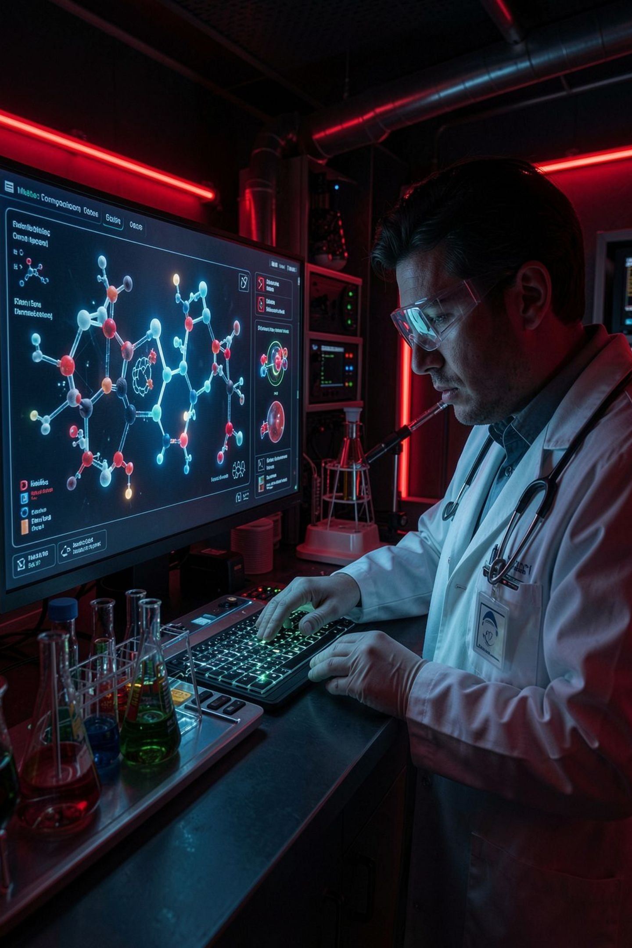
DOMAIN OVERVIEW
The Research Domain
Research is the scientific investigation layer of CureVerseAI. It allows users to explore biological entities and relationships through structured workflows rather than isolated searches.
Biological Context
Connects entities to their biological environment
Molecular Information
Structured molecular data and representations
Pathways & Variants
System-level relationships and variant context
AI-Assisted Reasoning
Protein intelligence and external evidence integration

Slide 12
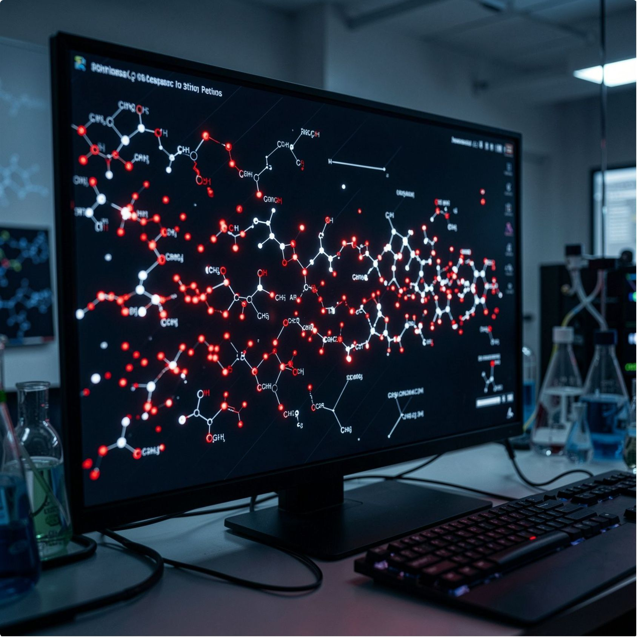
RESEARCH USE CASE 1
Gene Explorer
Gene Explorer transforms a simple gene query into a connected biological investigation by combining gene identity, molecular context, associated proteins, pathways, disease relationships, and scientific evidence in one view.
Instead of only answering “What is this gene?”, CureVerseAI helps users understand “How does this gene function within the larger biological system?”—connecting biological data and evidence into a structured, AI-assisted research insight.

Slide 13
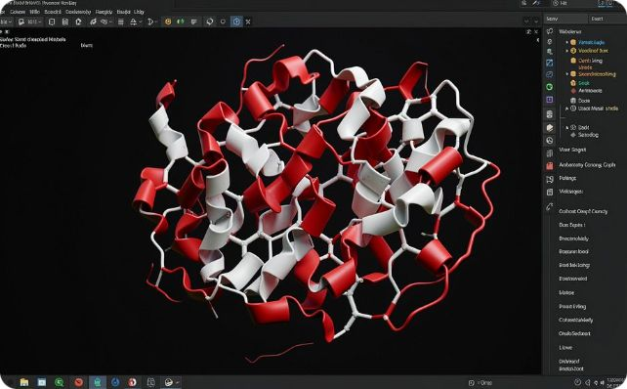
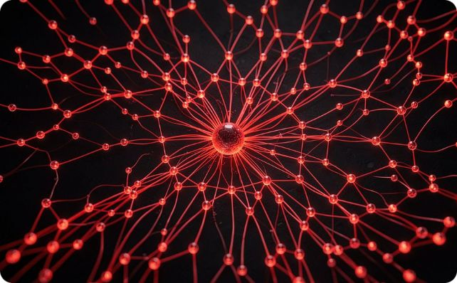

RESEARCH USE CASE 2
Protein Explorer
Protein Explorer focuses on protein-level intelligence. It combines protein identity and sequence information with computational representations and biological context.
Protein Identity & Sequence
Biological Context
Molecular Role & Relationships
Combines protein identity and sequence information with computational representations
Integrates biological context alongside molecular data
Helps move from a protein record toward a more meaningful understanding of its molecular role and relationships

Slide 14
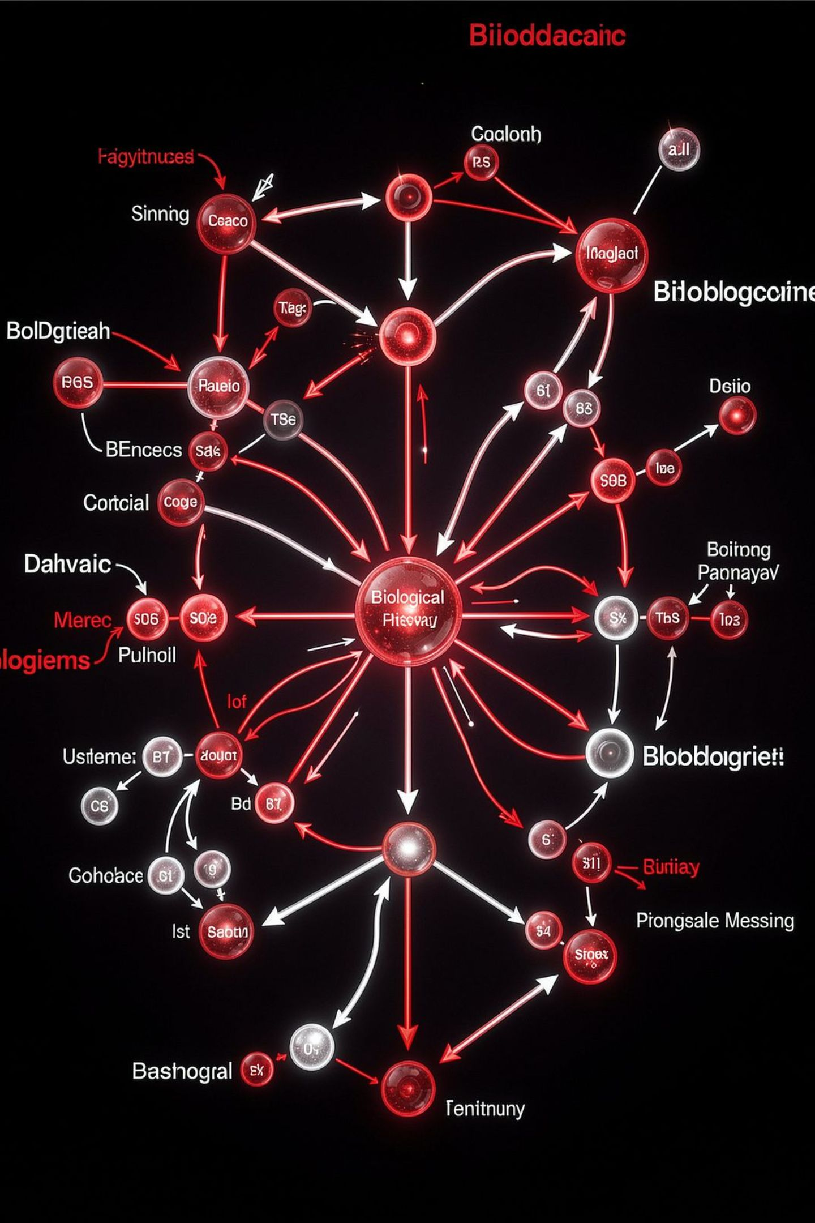
RESEARCH USE CASE 4
Pathway Explorer
Pathway Explorer focuses on biological systems and relationships. Instead of viewing genes and proteins independently, the workflow helps users understand how biological entities participate in pathways and signaling processes.
System-Level Perspective
Disease Research Value
Understand how biological entities participate in pathways and signaling processes
Creates a system-level perspective valuable for disease research
Therapeutic Discovery
Supports therapeutic discovery through pathway-level understanding

Slide 15
RESEARCH USE CASE 5
Evidence Research
Evidence Research combines external scientific evidence with biological context and AI-assisted reasoning. CureVerseAI works with scientific resources to organize supporting evidence and provenance — the result is intended to be evidence-aware rather than unsupported generated text.
Open Targets
ChEMBL
Target-disease association evidence
Bioactive compound and drug data
UniProt
Reactome
Protein sequence and functional information
Curated biological pathway data

Slide 16
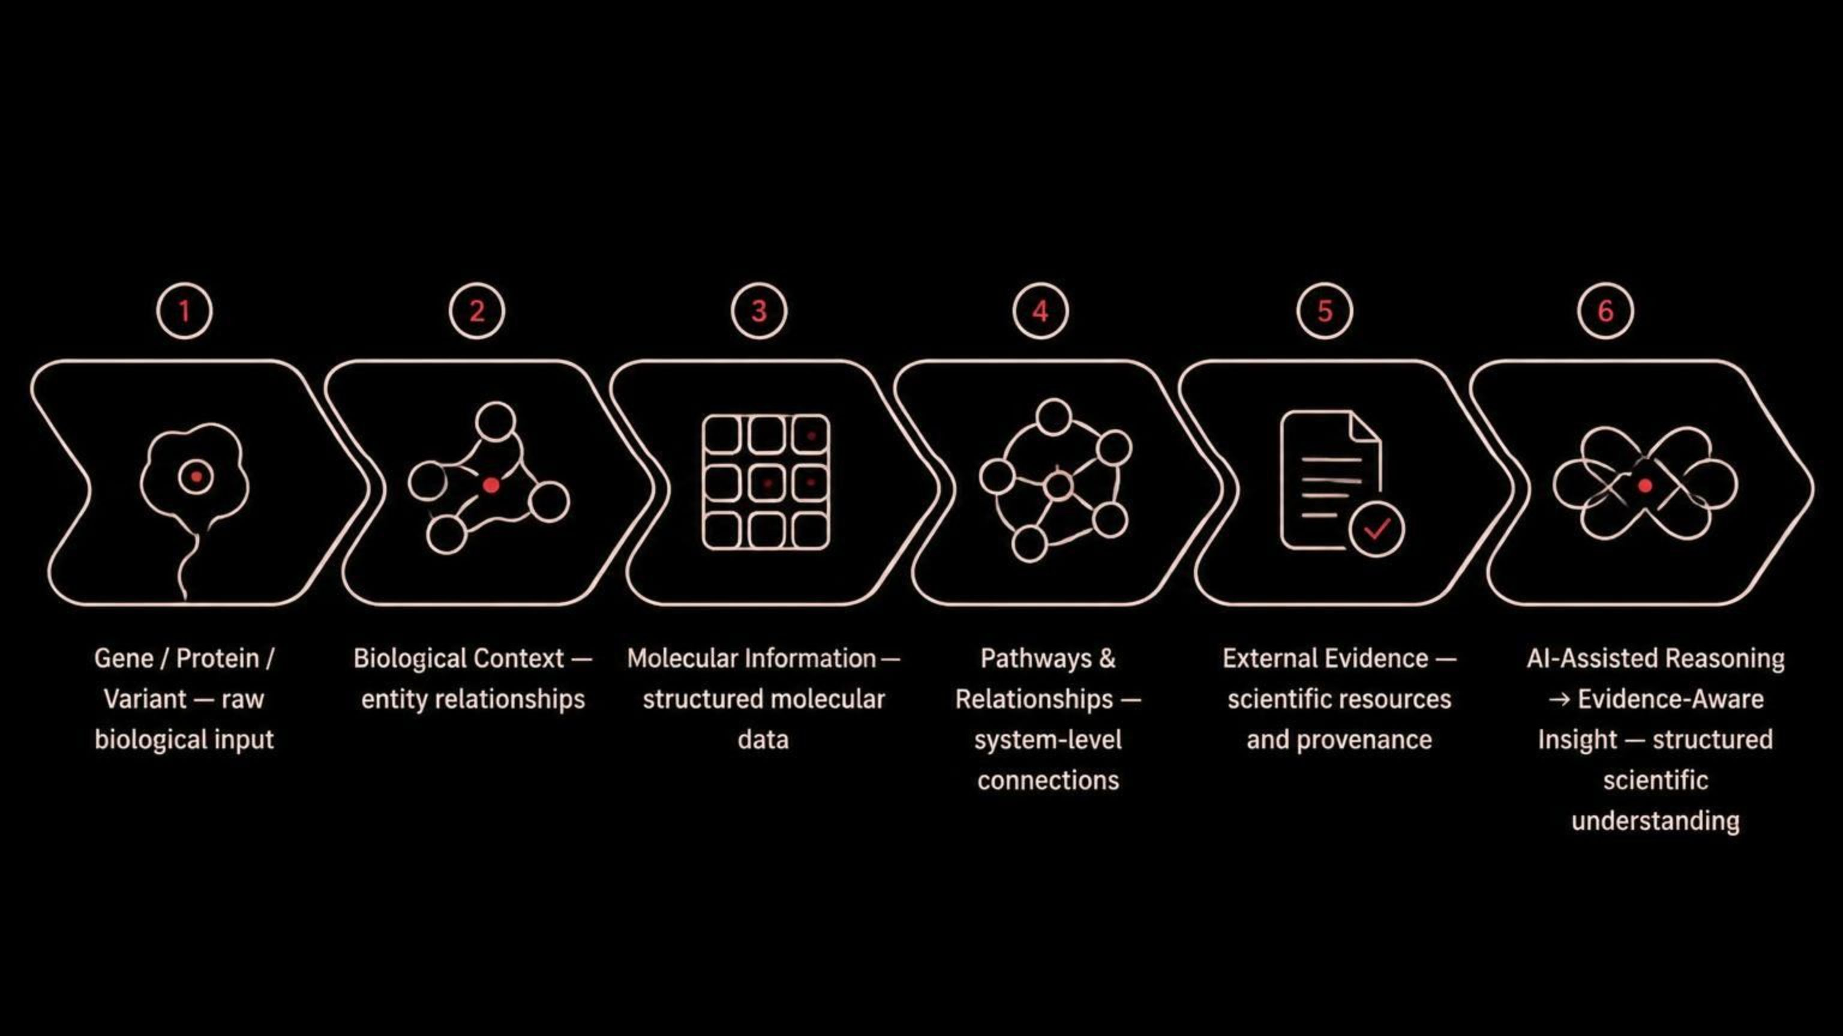
INTELLIGENCE FLOW
Research Intelligence Flow
The Research workflow moves from raw biological information toward structured scientific understanding. This demonstrates how CureVerseAI moves from Gene / Protein / Variant through Biological Context, Molecular Information, Pathways & Relationships, External Evidence, and AI-Assisted Reasoning, arriving finally at Evidence-Aware Insight.

Slide 17
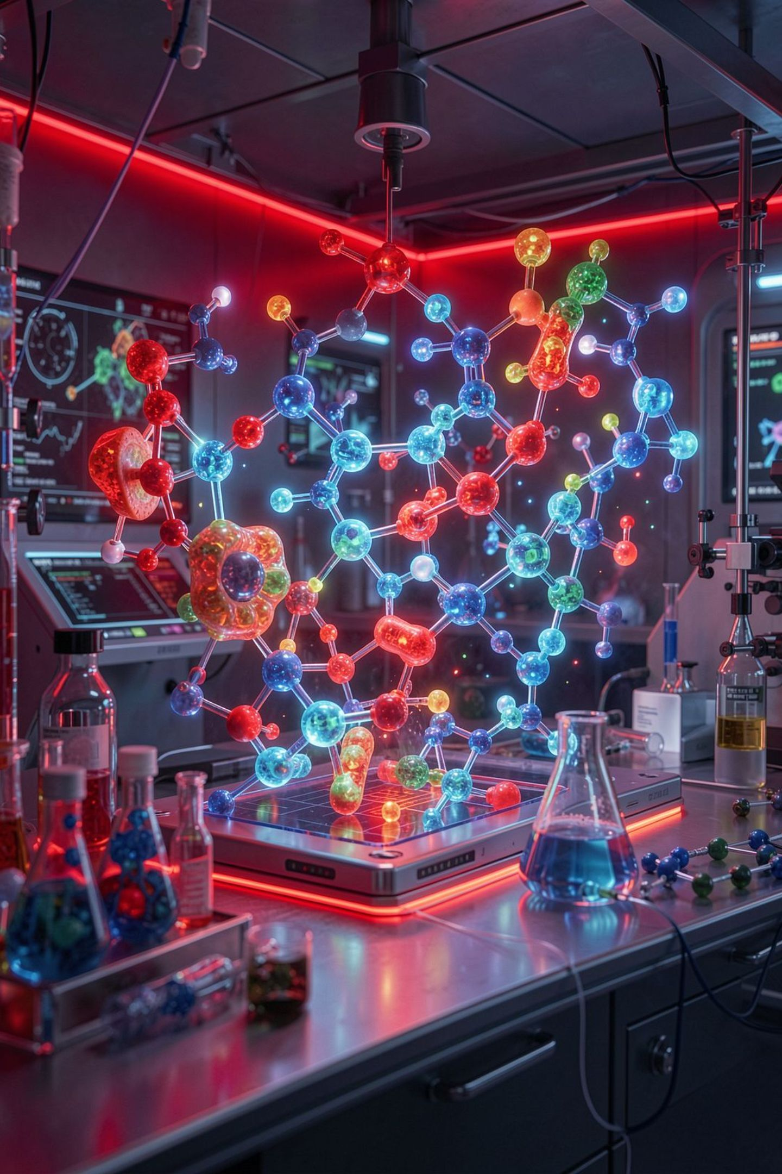
DOMAIN OVERVIEW
The Drug Development Domain
Drug Development focuses on therapeutic discovery as a biological reasoning problem. Instead of simply asking which drug exists for a disease, CureVerseAI connects disease biology, mechanisms, targets, compounds, interventions, and supporting evidence. The domain is organized around disease-centric scientific workflows.
Disease Biology
Mechanisms & Targets
Understand the biological consequences of disease
Connect mechanisms to therapeutic targets
Compounds & Interventions
Link compounds and interventions to supporting evidence

Slide 18
DRUG DEVELOPMENT USE CASES
Disease Analysis & Reverse Engineering
Use Case 1 — Disease → Biological Impact
Use Case 2 — Reverse Disease Engineering
A disease is analyzed through its biological consequences. The workflow moves from disease to affected organ or tissue, cellular region, molecular mechanisms, and biological impact.
The objective is to make disease biology understandable as a connected visual and scientific process rather than a paragraph of disconnected facts.
Reverse Disease Engineering starts from the observed disease phenotype and works backward toward possible biological contributors.
The reasoning chain can move through biological effects, mechanisms, genes, variants, pathways, and potential contributing factors. Evidence strength and biological relevance are emphasized instead of presenting unsupported probabilities of causation.

Slide 19
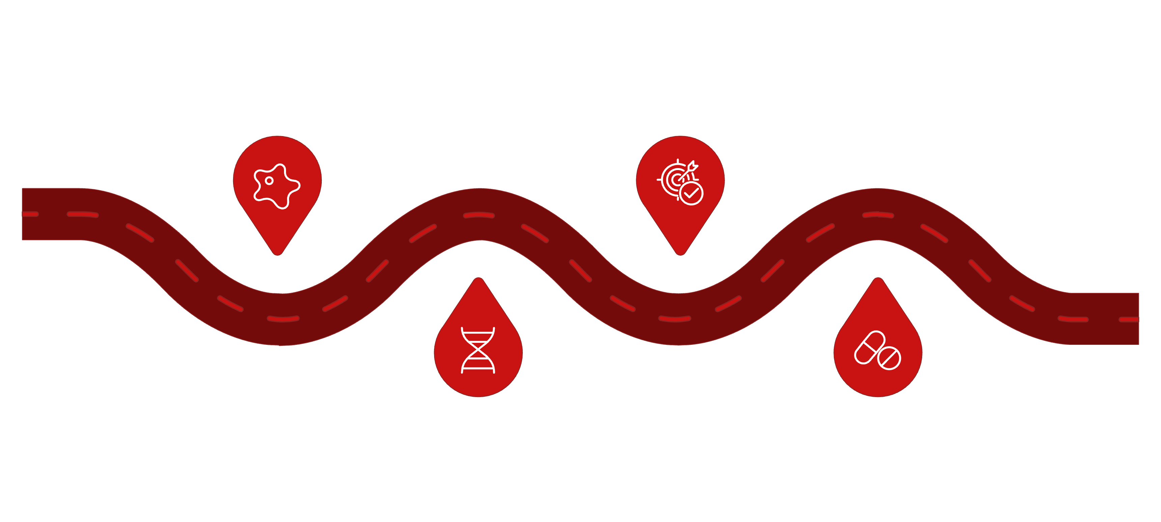
Drug Development Use Case 3 — Therapeutic Discovery
Disease
Target
Define clinical condition and phenotype
Select molecular target for intervention
Mechanism
Compound
Identify underlying biological pathway
Propose compound or therapeutic approach

Slide 20
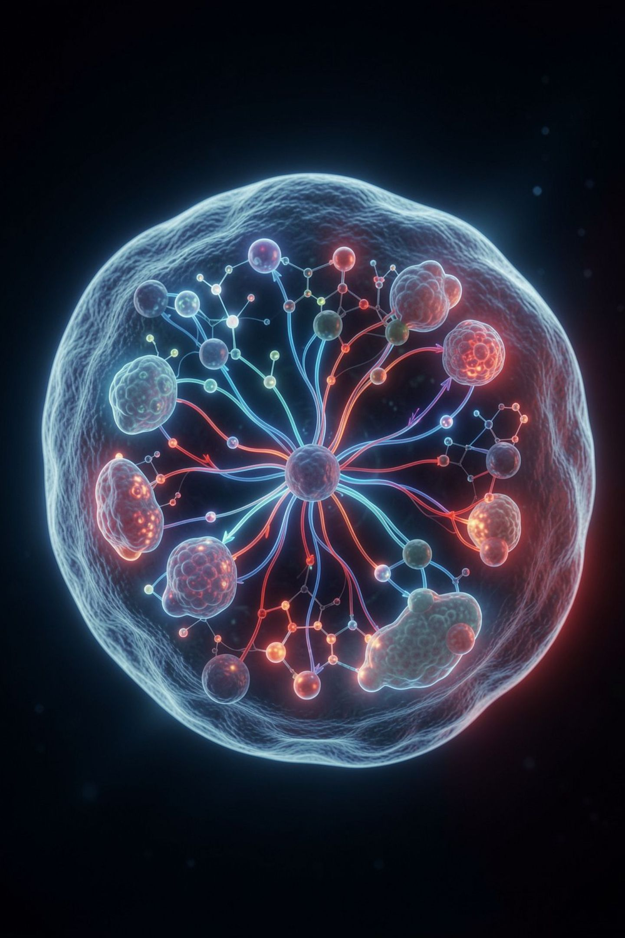
Medicine Domain — The Virtual Cell
Medicine in CureVerseAI is built around a Virtual Cell concept. Rather than treating medicine as a simple lookup system, the platform represents biological states and visualizes how disease conditions and interventions can change those states.
The Central Question
What happens to a modeled biological system when a condition or intervention is introduced?
Beyond Search
The Virtual Cell moves users from reading about a mechanism to seeing a modeled biological state change.
What It Communicates
Changes in cellular structures, signaling, molecular activity, pathways, and biological state.

Slide 21
Medicine Use Case 1 — Virtual Disease Simulation
The Workflow
What Users See
The Virtual Disease Simulation begins with a healthy virtual cell. A disease condition is introduced as a biological perturbation, and the system visually represents a transition toward an altered cellular state.
The experience communicates changes across multiple biological dimensions — from cellular structures and signaling to molecular activity and pathways.
Cellular structure changes
Signaling pathway alterations
Molecular activity shifts
Pathway disruptions
Overall biological state transition

Slide 22



Medicine Use Case 2 — Treatment Simulation
Treatment Simulation starts with a disease-state cell and introduces an intervention. The workflow connects the intervention to relevant targets and pathways, then visualizes the modeled cellular response.
Disease-State Cell
Intervention Introduced
Modeled Cellular Response
Starting point: an altered biological state representing the disease condition
A treatment is applied and connected to relevant targets and pathways
The system visualizes the biological response to the intervention
This is intended as computational biological simulation and interpretation — not a clinical treatment recommendation.

Slide 23
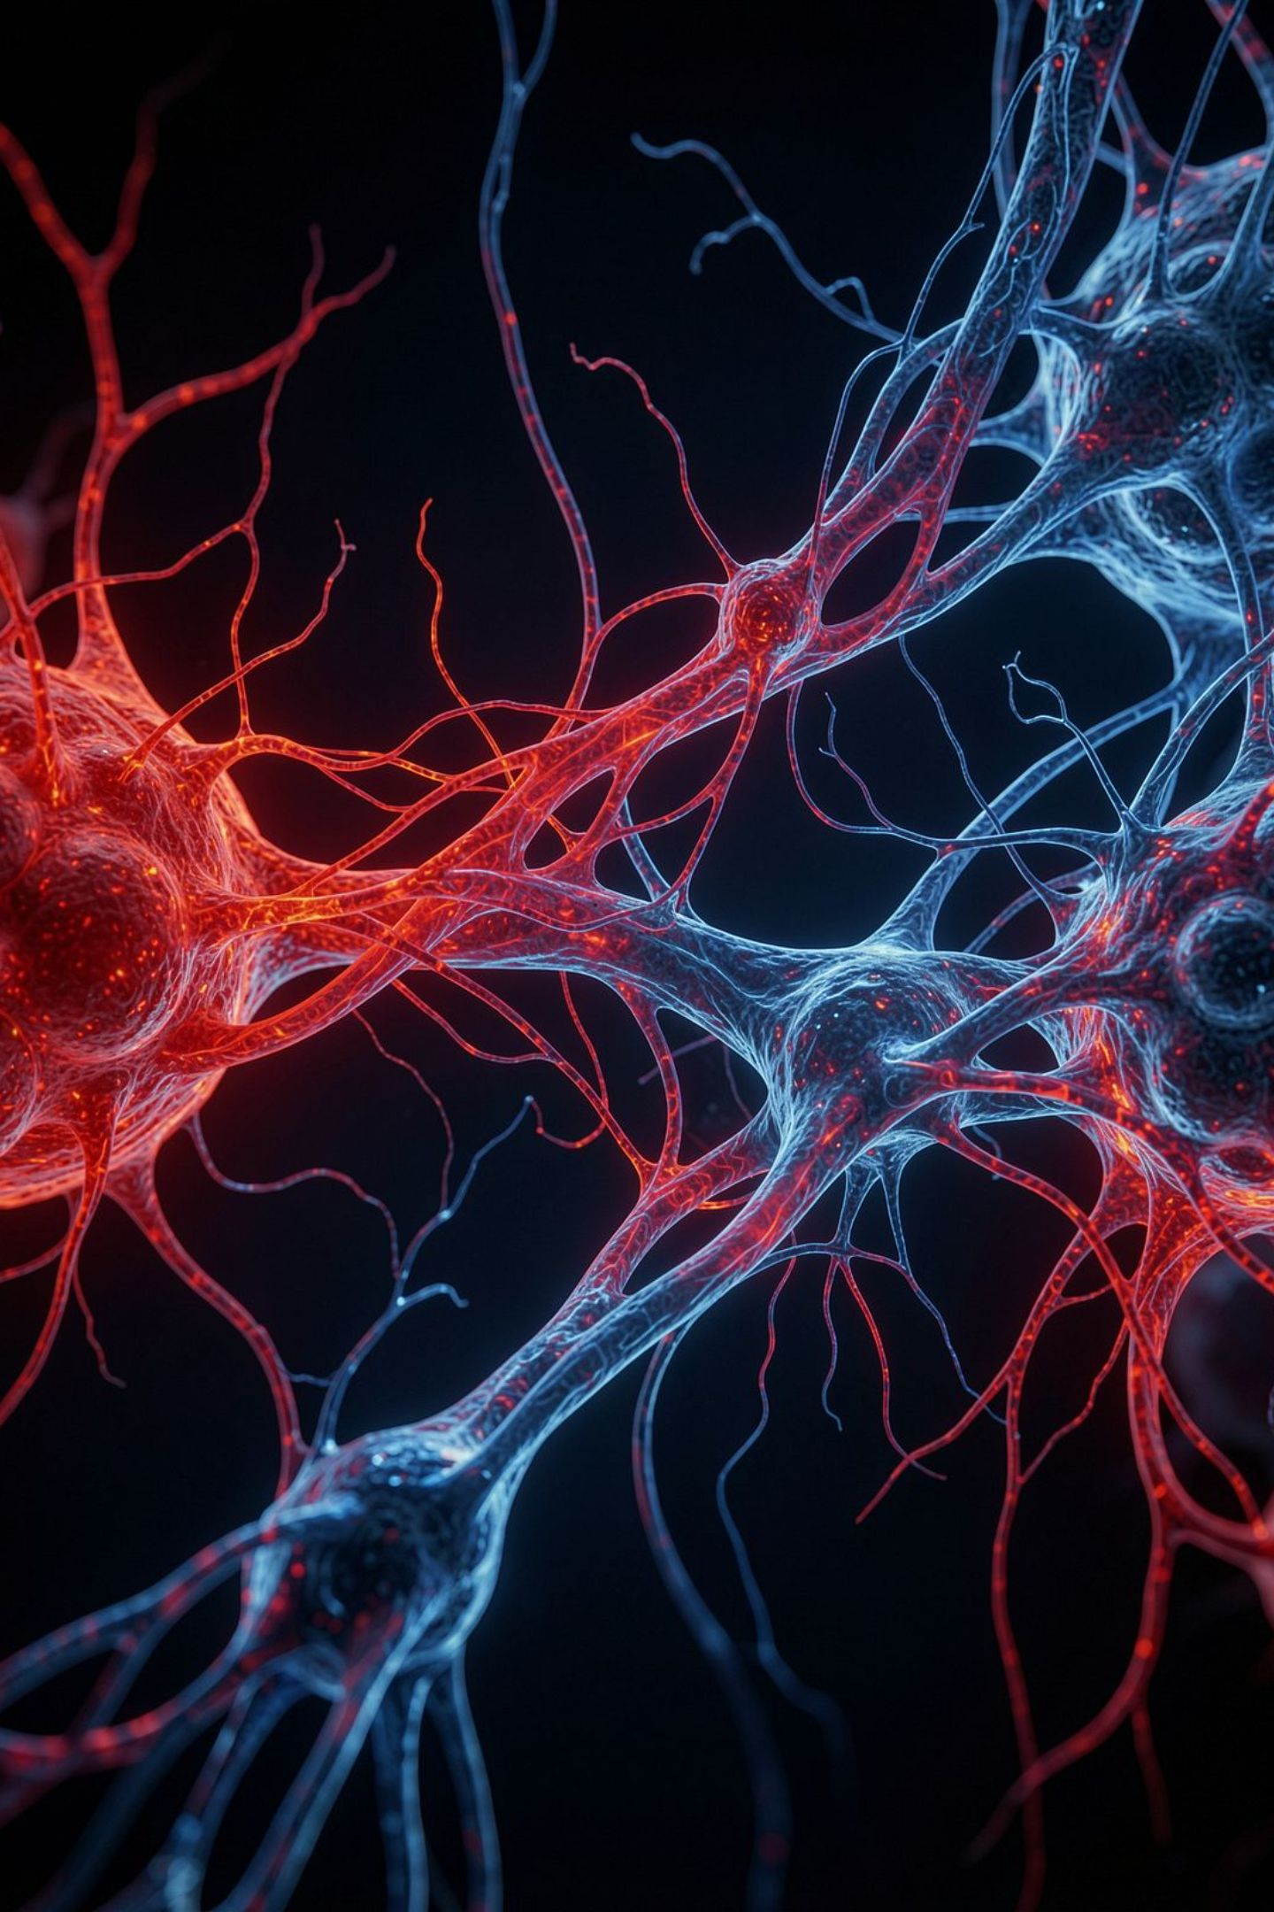
Why the Virtual Cell Matters
The Virtual Cell gives CureVerseAI a fundamentally different interaction model from a conventional biomedical search engine. Users can move from reading about a mechanism to seeing a modeled biological state change.
Scientific Evidence
Grounded in research and supporting data
Therapeutic Hypotheses
AI-assisted hypothesis generation made visible
Biological Mechanisms
Pathways and targets visualized in context
Visual Understanding
A bridge between data and biological intuition

Slide 24
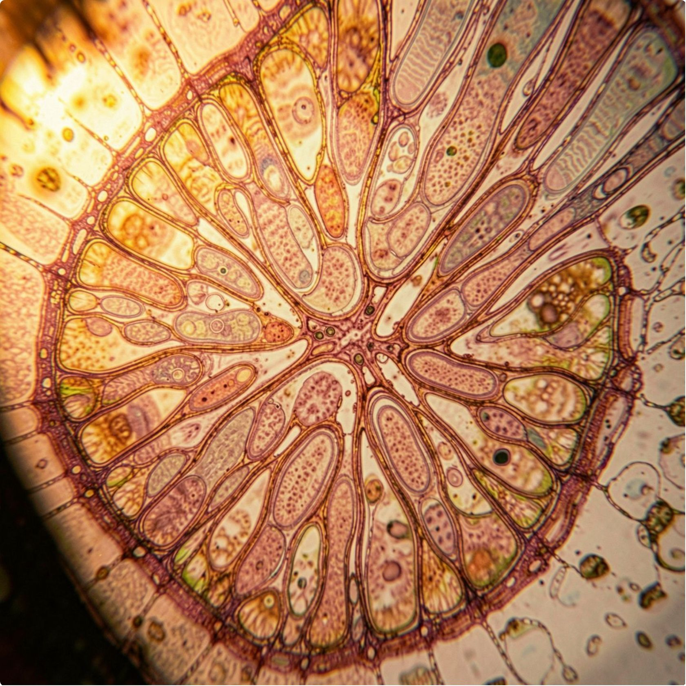
Biotechnology Domain
Biological Materials → Intelligence
CureVerseAI’s Biotechnology Domain transforms biological materials into deeper scientific insight by analyzing their visible and anatomical characteristics, associated compounds, biological properties, and potential medical relevance. It connects material → anatomy → compounds → mechanisms → biological effects to help users understand the science behind biological resources.
The domain goes beyond simple identification by enabling deep biological anatomy, edible/non-edible analysis, medical potential assessment, and biological compound discovery—creating a bridge between biotechnology research and downstream medicine and therapeutic simulation.

Slide 25
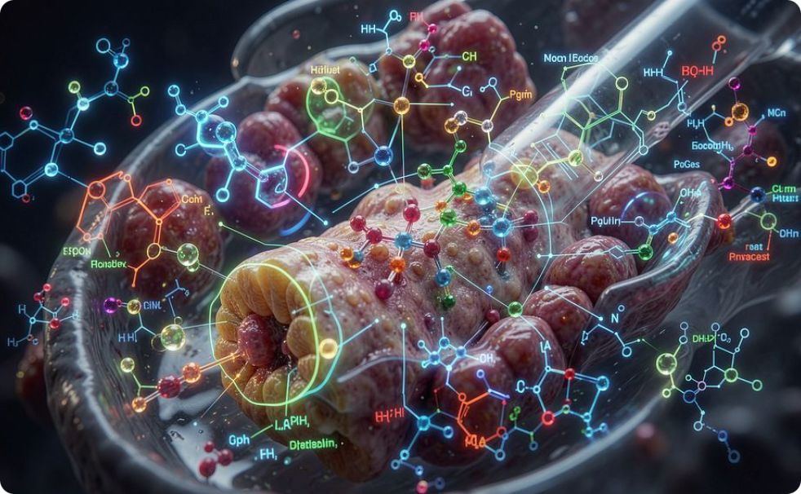
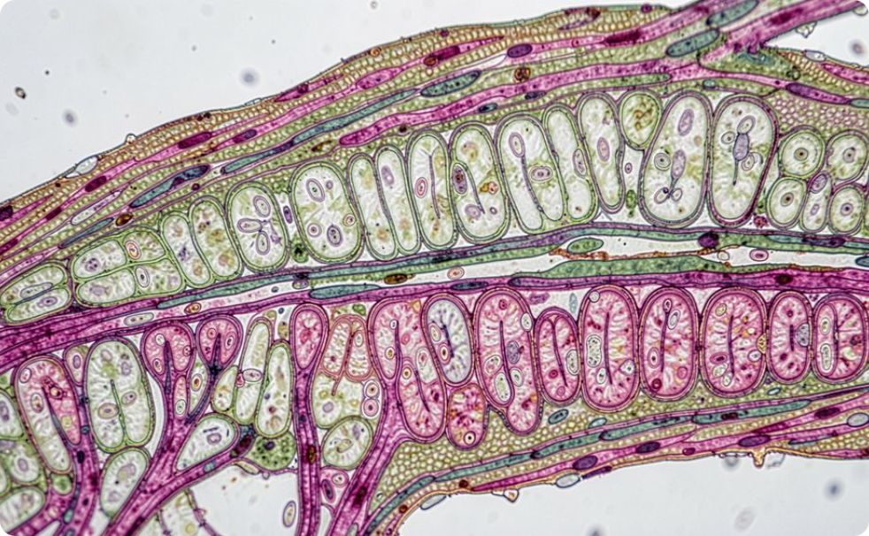
Biotechnology Use Cases 1 & 2
Use Case 1 — Biological Material → Medical Potential
Use Case 2 — Deep Biological Anatomy
Deep Biological Anatomy allows a biological material to be explored structurally. For plant materials, the experience can move through leaf, stem, root, epidermal structures, mesophyll, vascular tissues, cortex, and other anatomical regions — connecting structure with biological function and molecular properties.
A biological-material image becomes the starting point for deeper analysis. The workflow examines visual and anatomical features, connects them with possible biological compounds or properties, explores mechanisms, and organizes potential applications with an explanation of why the material may be relevant. Image analysis alone is not treated as proof of medical efficacy or safety.

Slide 26
Biotechnology Use Case 3 — Edible / Non-Edible Analysis
This workflow organizes biological-material analysis into three categories, preserving scientific uncertainty where image data alone is insufficient.
Potentially Edible
Potentially Non-Edible
Uncertain — Verification Required
Analysis suggests the material may be safe for consumption, supported by biological context
Analysis raises concerns about safety or suitability for consumption
Image alone cannot establish food safety; scientific value comes from combining visual analysis with biological context and supporting evidence
The platform preserves uncertainty because an image alone cannot establish food safety. The scientific value comes from combining visual analysis with biological context and supporting evidence.

Slide 27
DOMAIN
Education Domain
Education transforms CureVerseAI's scientific intelligence into interactive learning experiences. Instead of presenting complex biological knowledge only as static text, the platform uses a variety of formats to make biology easier to explore and understand.
Articles, Videos & References
AI-Assisted Conversation
Visual Explanations
Interactive dialogue that helps learners explore complex biological concepts at their own pace.
Visual explanations and structured learning workflows that make biological mechanisms easier to explore and understand.
Curated scientific content including articles, videos, books, and references — structured for progressive learning.

Slide 28
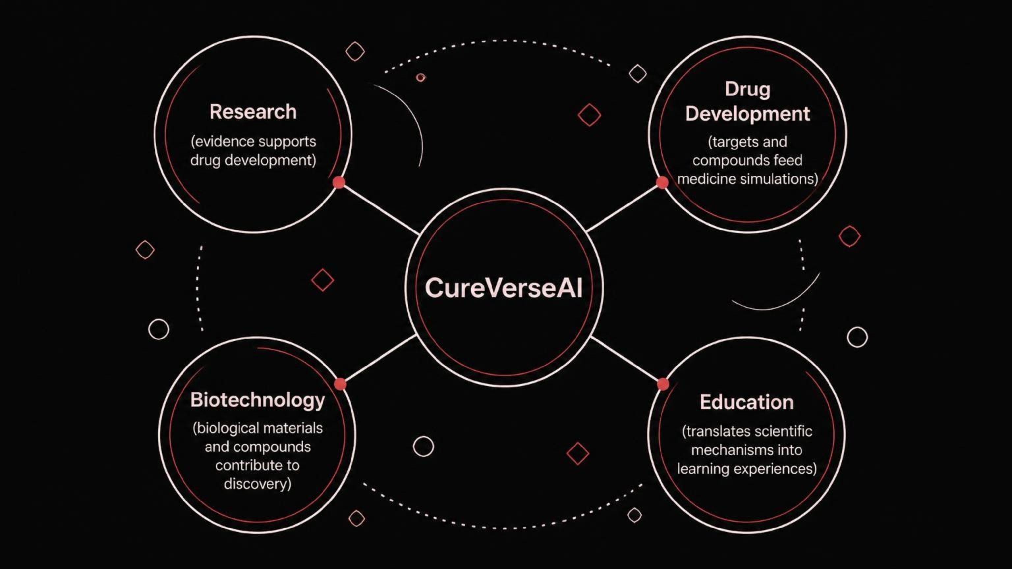
CORE ARCHITECTURE
Cross-Domain Intelligence

Slide 29
END-TO-END SCENARIO
A Complete Scientific Journey
A complete scenario can begin with a biological material in Biotechnology and flow through every domain of the platform. The material can be explored for anatomy and compounds, a compound can be connected to a target and pathway, Research can investigate supporting evidence, Drug Development can organize a therapeutic hypothesis, Medicine can simulate the intervention in a Virtual Cell, and Education can turn the mechanism into an interactive explanation.
01
02
03
Biotechnology
Research
Drug Development
Explore biological material for anatomy and compounds
Connect compound to target and pathway; investigate supporting evidence
Organize a therapeutic hypothesis
04
05
Medicine
Education
Simulate the intervention in a Virtual Cell
Turn the mechanism into an interactive explanation

Slide 30
AI + SCIENCE
Evidence + AI
CureVerseAI combines AI-assisted reasoning with established scientific resources. The architecture includes integrations and intelligence around leading scientific databases, alongside biological knowledge and protein-model capabilities. This approach is intended to keep scientific reasoning connected to evidence and provenance.
AI-Assisted Reasoning
Scientific Resources
Biological inference, target analysis, and evidence reasoning powered by AI — grounded in established scientific resources.
Open Targets — target-disease associations
ChEMBL — bioactive compound database
UniProt — protein sequence and function
Reactome — pathway knowledgebase
Alongside biological knowledge and protein-model capabilities.

Slide 31
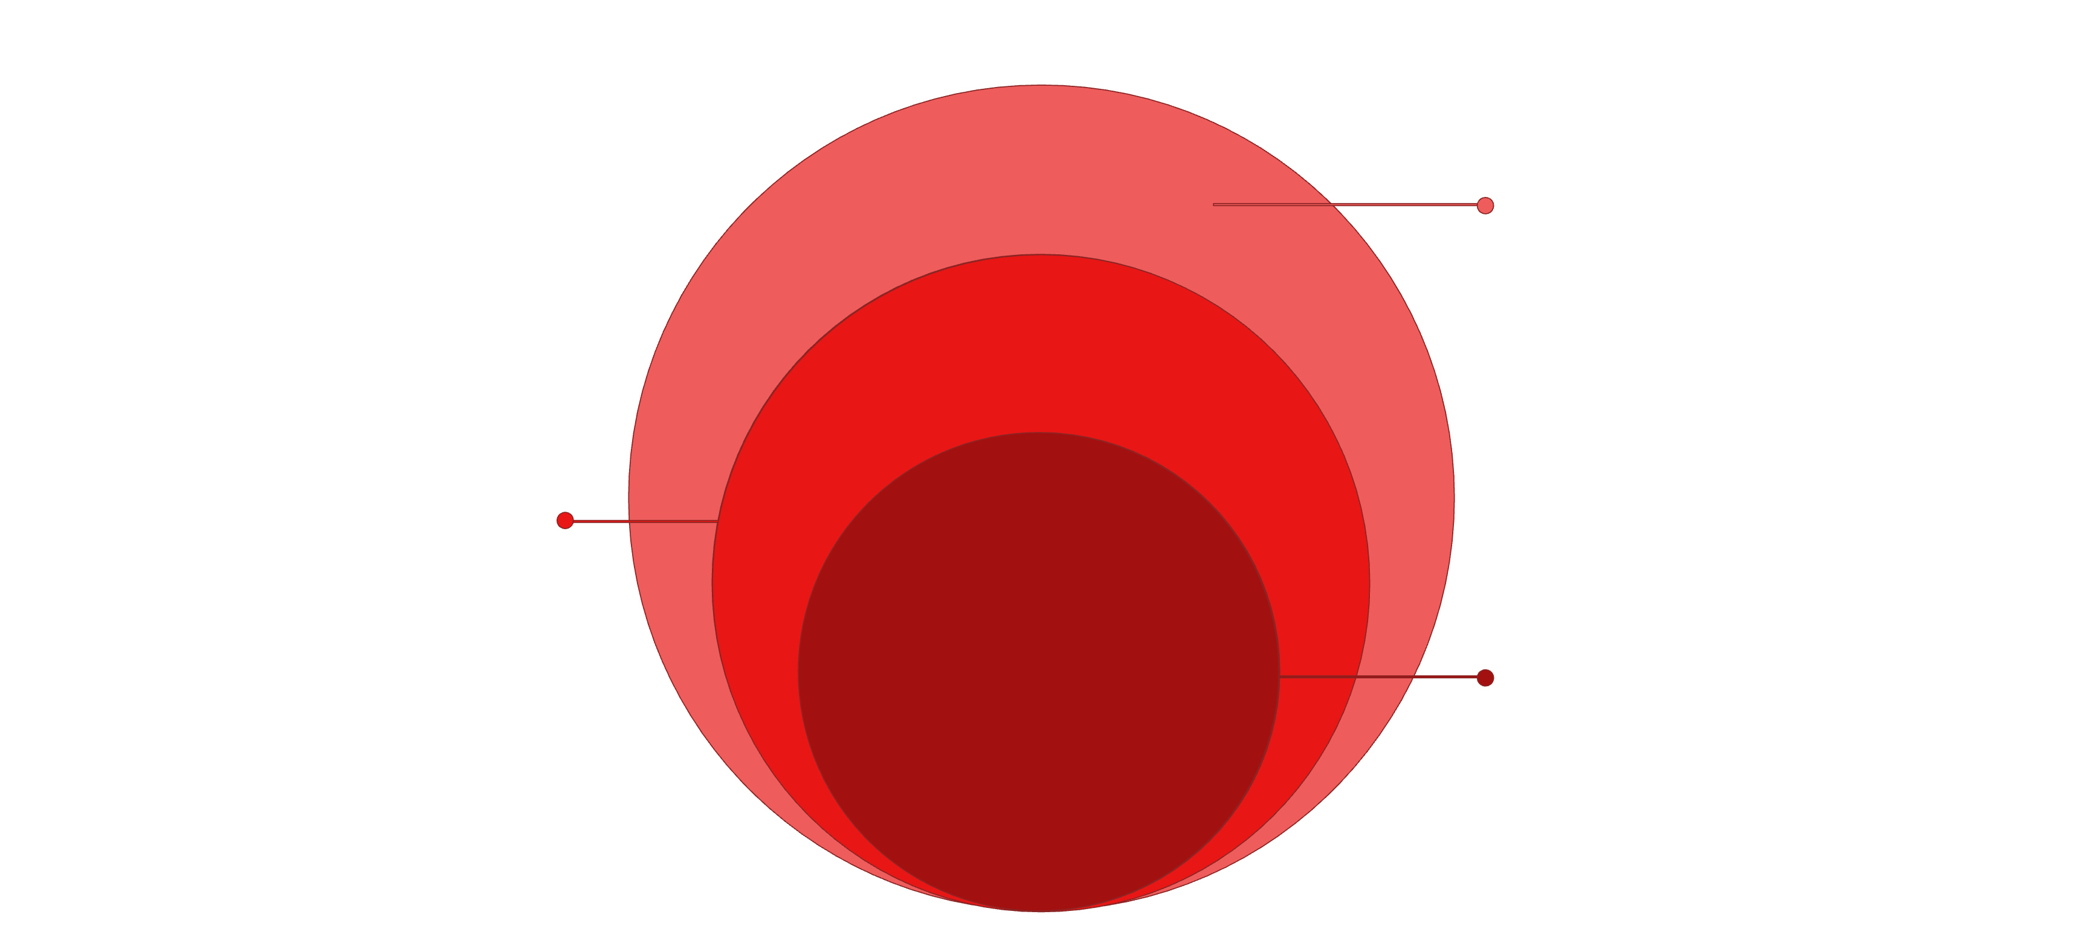
PLATFORM DESIGN
Technical Architecture
Frontend
Next.js + React interfaces and scientific visualizations
Backend API
FastAPI service layer integrating data and models
AI Engine
Biological inference, target analysis, evidence reasoning

Slide 32
UNDER THE HOOD
Technology Stack
Frontend
Backend
Next.js, React, TypeScript, CSS, responsive interfaces, interactive visualization, and animations.
Python, FastAPI, Pydantic, REST APIs, and service-oriented architecture.
AI Engine
Scientific Resources
Python, biological inference, protein intelligence, target analysis, evidence reasoning, and scientific data integration.
Open Targets, ChEMBL, UniProt, Reactome, protein sequence resources, and biological knowledge systems.

Slide 33

DIFFERENTIATION
What Makes CureVerseAI Different
CureVerseAI combines ideas that are usually separated: biological research, evidence reasoning, therapeutic discovery, virtual biological simulation, biological-material intelligence, and education.
Its differentiation is not simply the use of AI. It is the way AI, evidence, biological relationships, visualization, simulation, and domain workflows are connected into one ecosystem.

Slide 34
VISION & TEAM
Impact & Closing
Our objective is to create a platform that can help researchers investigate biological questions, help innovators explore therapeutic hypotheses, help users understand biological materials, help visualize disease and intervention mechanisms, and help students learn complex biology. The broader ambition is to make biological intelligence more connected, interpretable, and interactive.
CureVerseAI — Science for a Healthier Tomorrow.
Team: Arooj Kanwal · Umme Hani · Aatazaz Hussain

