Slide 1
EDUAID
Submitted By : Aatazaz Hussain
ARID No : 23-ARID-771
Submitted to : DR.M.Habib

Slide 2
EDUAID
We designed the EduAid website with a clean, intuitive interface to ensure a seamless user experience for students and educators. Using a mobile-first, responsive design approach, we prioritized accessibility, performance, and ease of navigation. The site integrates AI features and personalized dashboards to enhance learning engagement and progress tracking.

Slide 3
Introducing EduAid: Bridging Educational Financial Gaps
EduAid is a student-focused web platform that aims to bridge the financial gap for students seeking higher education in Pakistan. It follows a Study Now, Pay Later model and includes key sections such as Our Inspiration, Mission, Insights, University Partners, and more.

Slide 4
Bnotstrap Integration Method
Integrate Bootstrap via CDN for full access to its features.
Location of CDN Link
Place the CDN link in the section of your HTML document.
Benefits of Using CDN
Allows access to responsive components without local downloads.
Integrating Bootstrap
Using CDN
A guide to integrating Bootstrap into your p ojects
Access to Component Library
Gain access to a comprehensive Ibrary of pre-styled components.
Responsive Utilities
Utilize responsive g id systems and utilities for flexibility.
Pre-styled Buttons and Navbars
Easily add pre-designed buttons and navigation bars to your site.
Use of Cards and Elements
Implement cards and other UI elements for better user experience.
^œn'ea 1°nç
preseutotions

Slide 5
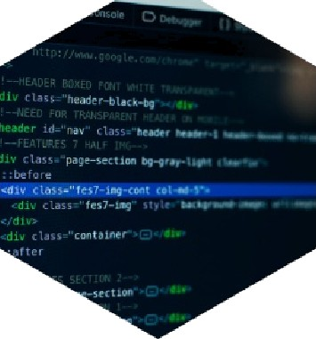
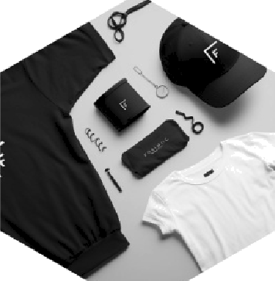

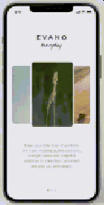
Effective Navbar Configuration Using Bootstrap
Navbar Structure
Utilizes Bootstrap's navbar classes for a structured layout.
Logo Placement
Features logo and brand name positioned on the left side for visibility.
Navigation Links
Includes navigation links aligned to the right using a flex container.
Call-to-Action Button
Incorporates a prominent 'Contact Us’ button styled with Bootstrap classes.
Responsive Design
Navbar adapts to screen sizes, collapsing into a hamburger menu on smaller devices.
^œn'ea 1°nç
preseutotions

Slide 6












Aleena Nadeem: A Journey of Inspiration
How Aleena Nadeem's journey shaped EduAid's mission
Aleena‘s Early Struggles
Mission Statement
Overcame significant personal challenges to pursue education and empower others.
Inspired by her journey, Aleena founded EduAid to support underprivileged learners.
To provide accessible education and resources to those in need.
Empowerment Through Education
Believes education is the key to breaking the cycle of poverty.
EduAid has transformed the lives of many students in underserved areas.
Continuously striving to expand EduAid's reach and impact.
preseutotions

Slide 7
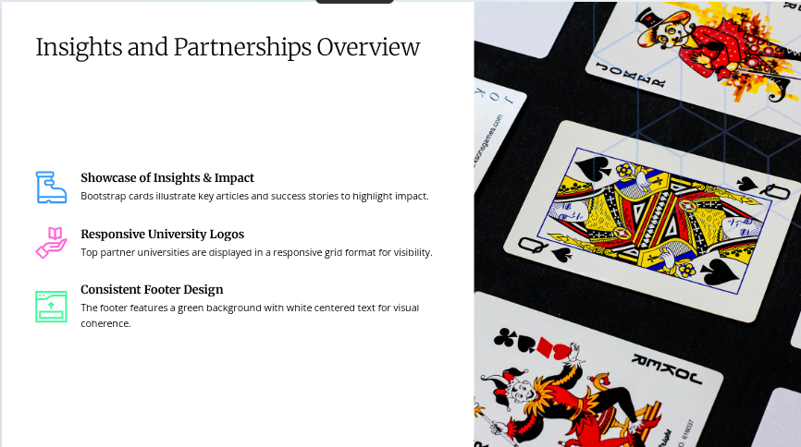

Slide 8
SNPL Model Overview
EduAid employs the SNPL model, enabling students to study without upfront costs.
Financial Aid During Studies
Students receive financial aid throughout their education, alleviating immediate financial stress.
Repayment After Employment
Students repay the aid once they secure employment, ensuring financial stability during
studies.
EduAid's Innovative Financial Model
Access to Quality Education
The model promotes access to quality education by reducing financial barriers for students.
Removing Upfront Financial Burden
By eliminating upfront costs, EduAid supports more students in pu^suing higher
education.
^œn'ea 1°nç
preseutotions

Slide 9
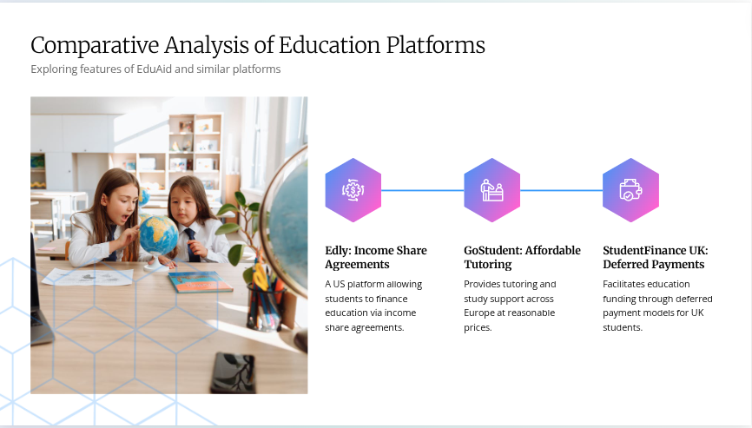

Slide 10
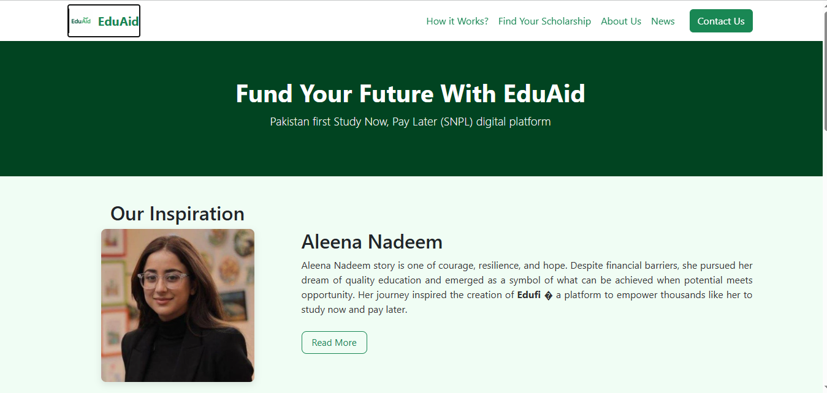

Slide 11


Slide 12


Slide 13


Slide 14


Connect with EduAid for More Info
Than you for your attent on For more information on EduAid, please reach out to us using the conta
Orovidea.

