Slide 1
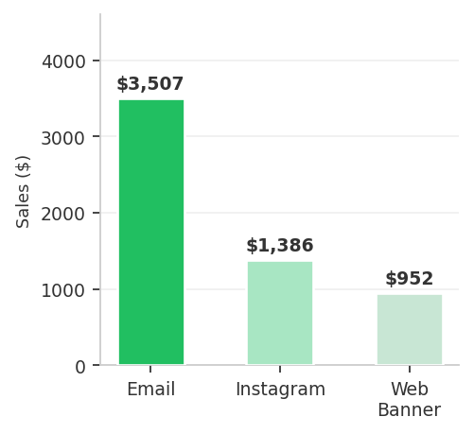
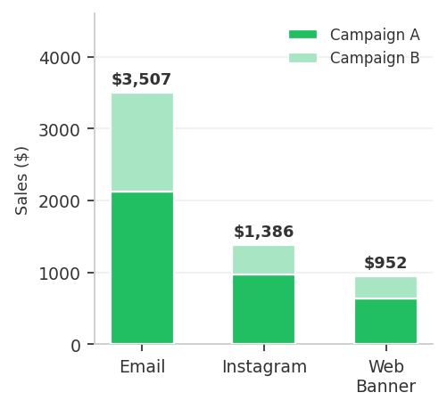
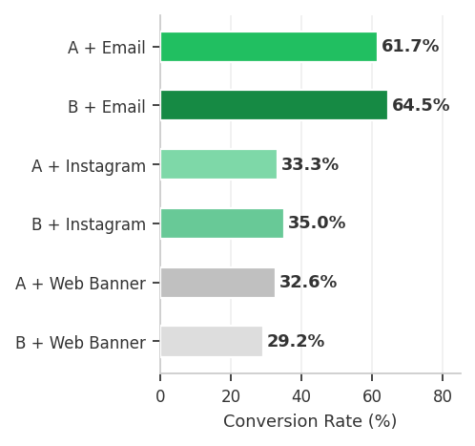
Double Down on Email — Campaign A Wins New Customers
New Customer Sales by Channel ($)
Campaign A Dominates in Email for New Customers
Email Conversion Rate Leads All Channels (60%+)
Recommendation: Invest in Campaign A via Email. Among new customers, this combo drives $2,124 in sales at a 61.7% conversion rate — the highest of any channel. Scale Email + Campaign A to accelerate new customer acquisition.

