Slide 1
Goals
Determine the weighting to apply to background pixels when calculating the training loss
Determine the optimal segmentation threshold to convert model output probabilities into a vein mask.

Slide 2
Background Goal 1: Determine the weighting to apply to background pixels when calculating the training loss
On average, about 2% of the pixels in an image are marked as vein. This allows a model to obtain 98% accuracy by classifying all pixels as “not in vein”.
This is a standard problem in model fitting, typically termed having an “imbalanced dataset”. In the worse case, it can lead to the model never classifying any pixels as in vein, a more likely case is that accuracy will be lower and training will take longer.
A typical approach to alleviate the problem is change the importance, or weight, of the in and out of vein pixels when calculating the loss. For example, since 98% of the pixels are out-of-vein, we could multiply the loss of each out-of-vein pixel by 0.02, so that when added up, their total would be much closer to that of the loss of the 2% of in vein pixels.
Typically I would just use the 2% value, but I was worried that it might not be correct, since our training masks do not mark all pixels within a vein as “in-vein” but only represent a 1 pixel wide skeleton that runs though the veins. With this in mind, it is unclear what weight values should be used.
With no clear value, I trained models using weights for the out-of-vein pixels of 0.01, 0.05, 0.1, and 0.2.

Slide 3
Training
Goal 1: Determine the weighting to apply to background pixels when calculating the training loss
The 819 training images were split into:
719 Training images
100 Validation Images
Validation images were chosen by taking one image from 100 randomly chosen genotypes
Validations images will be used to validation the final model
Training was performed using 3-fold cross validation:
719 Training images were split into 3 sets of ~240 images (240,240,239 = 719).
3 Training runs were performed, using two of the sets (480 images) for training and the last set (240 images) for testing. The training and testing sets are rotated for each of the three runs, such that each set is the testing set for one training run.
The model was trained on all images within each training dataset 800 times.
Cross-validation training was performed for each of the loss weights (0.01, 0.05, 0.1, and 0.2)
4 weights * 3 models/cross validation = 12 models trained.
Training took ~5 days per model.

Slide 4
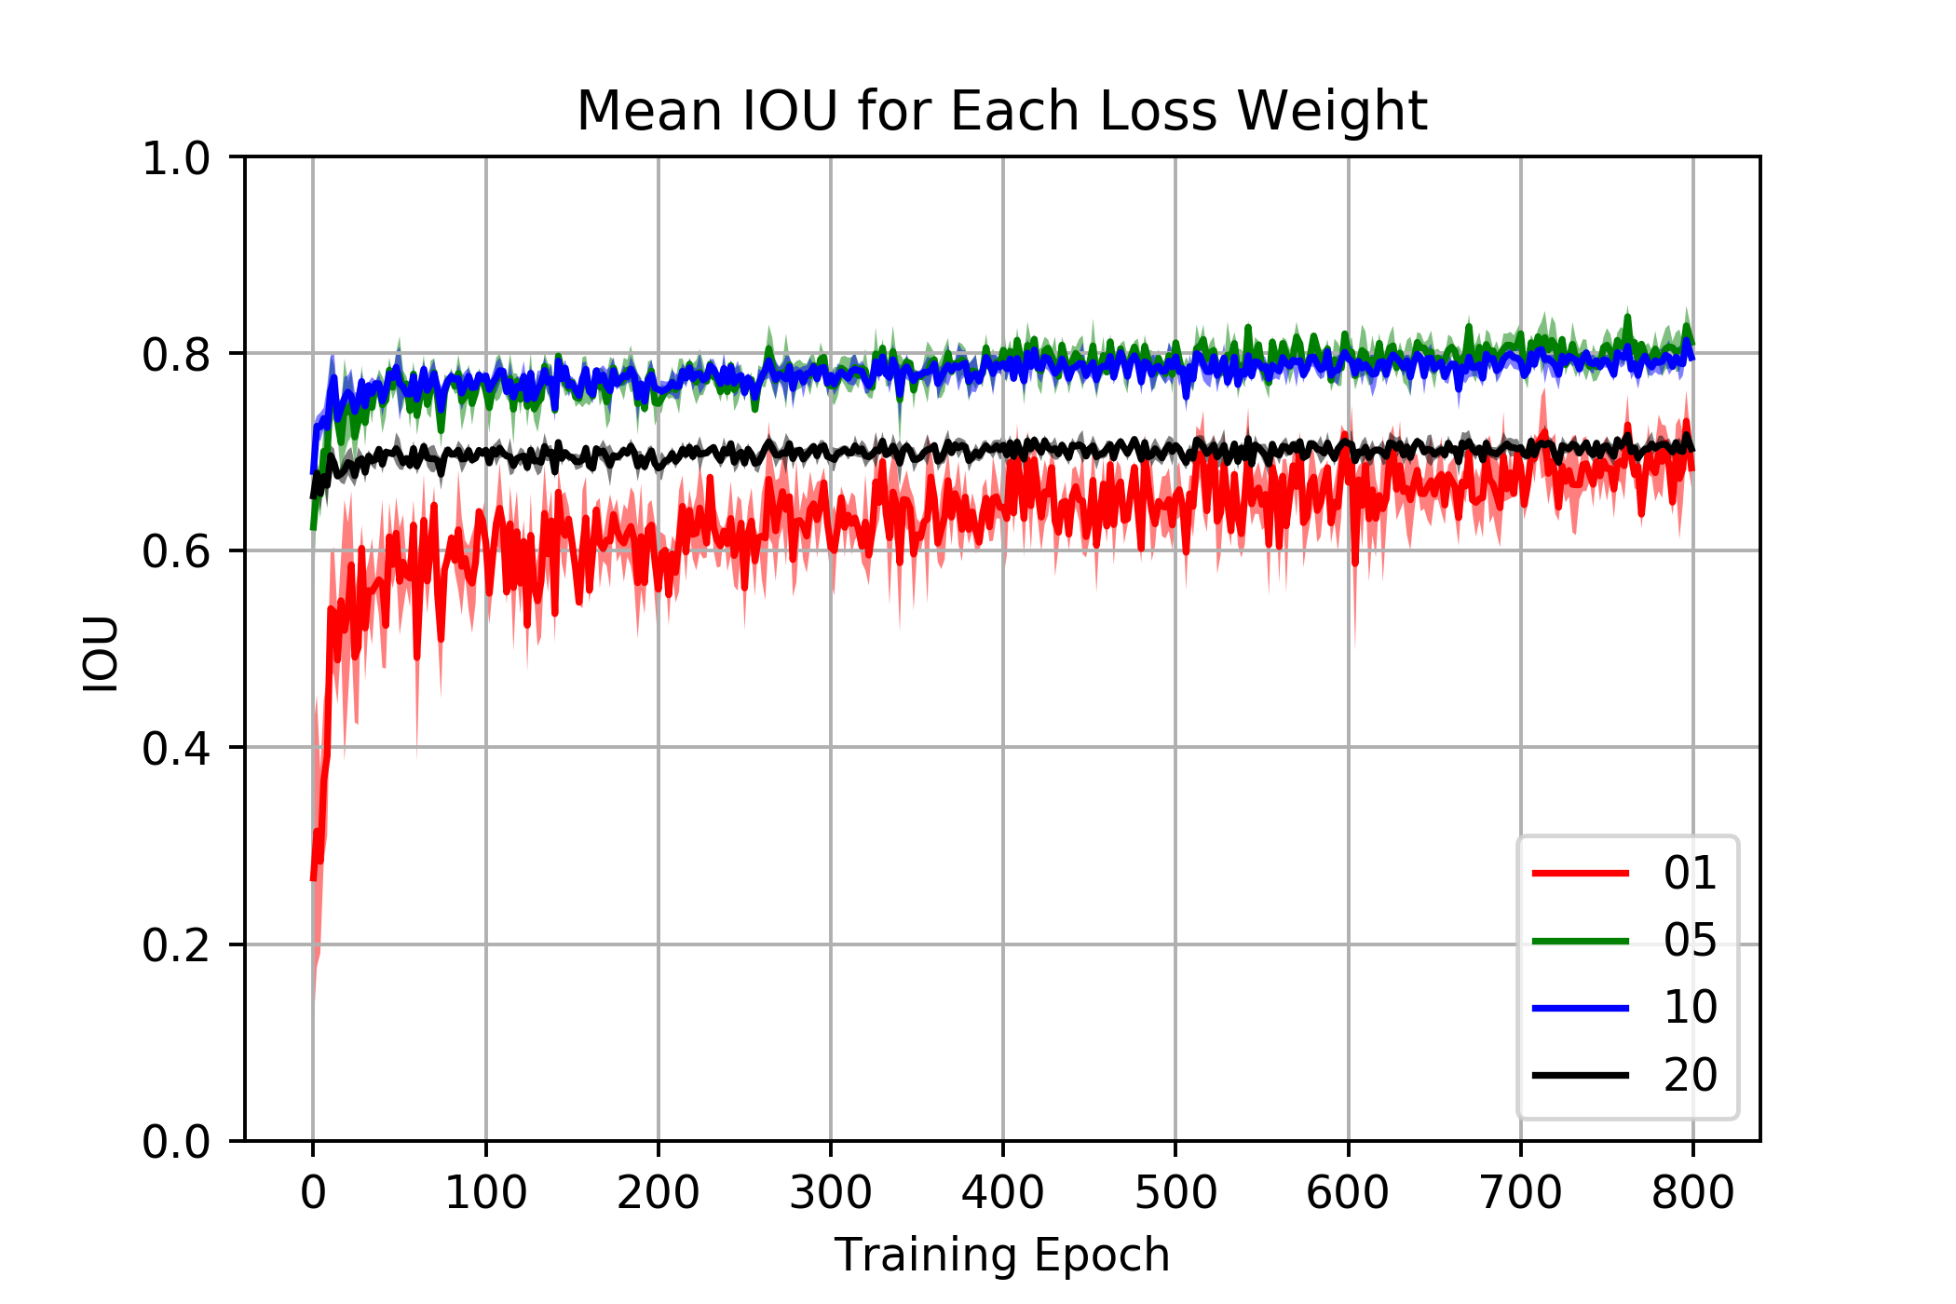
Evaluation
Goal 1: Determine the weighting to apply to background pixels when calculating the training loss
Evaluation of each loss weight was performed using the intersection over union (IOU, also known as the Jaccard Index).
The IOU is between 0 and 1. It is 1 if the model output and the training mask perfectly match.
Lines indicate mean of the cross validation runs for IOU at each training epoch (1 iteration through all the images)
Shading indicates the standard deviation of the 3 cross-validation runs
Note the low variability between runs.
A loss weight of 0.05 was chosen for all downstream work.
0.01
0.05
0.1
0.2
Loss Weight

Slide 5
Background
Goal 2: Determine the optimal segmentation threshold to convert model output probabilities into a vein mask.
The model outputs a probability between 0 and 1 that a pixel is within a vein.
The probability must be converted to a binary mask of in/out of vein pixels for analysis using a cutoff (threshold) value.
The ideal cutoff value is unknown.
To identify the best cutoff value, each of the 3 models trained with a loss weight of 0.5 from Goal 1 were used to segment their respective training images using cutoff values of 0.2, 0.3, 0.4, and 0.5

Slide 6
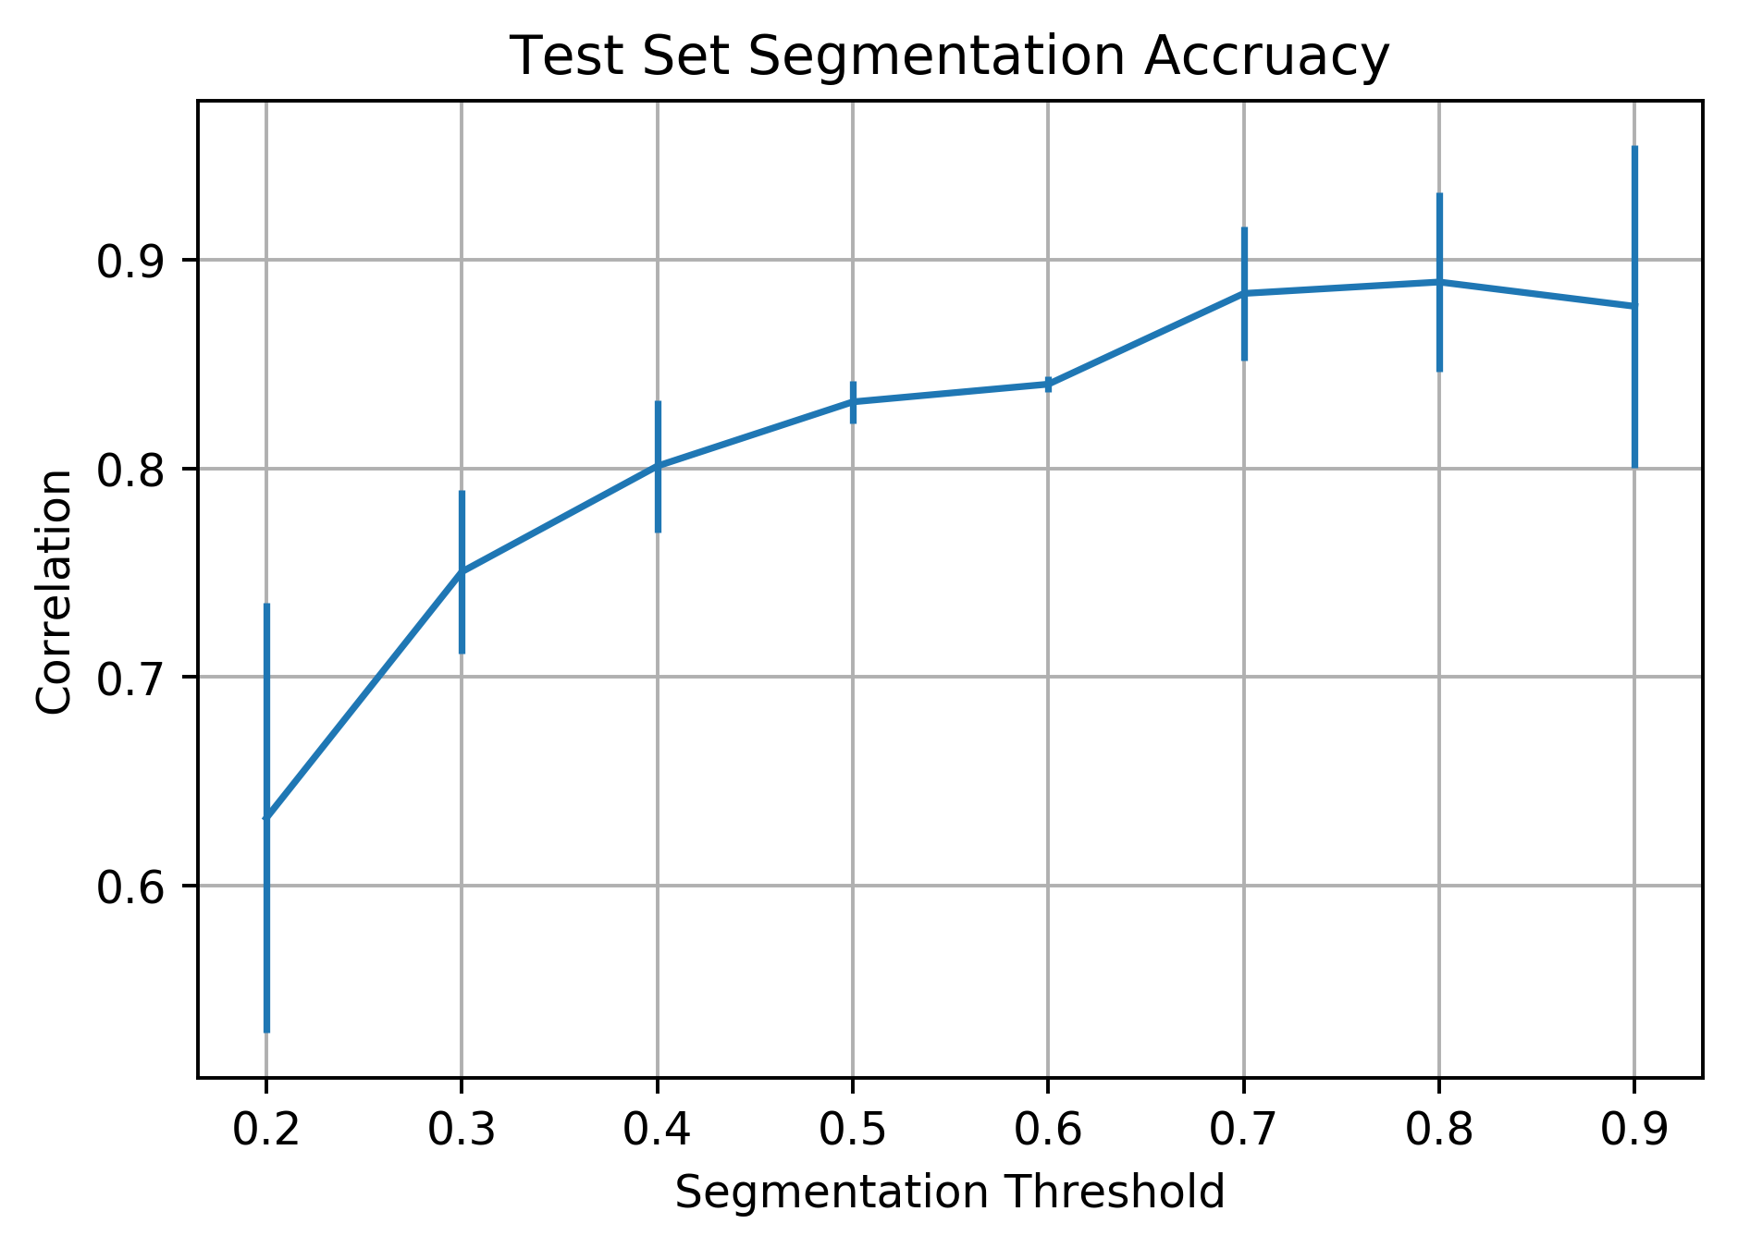
Evaluation
Goal 2: Determine the optimal segmentation threshold to convert model output probabilities into a vein mask.
Vein lengths were extracted using each of the cutoffs and the Pearson correlation between the AI segmented and human measured vein lengths was calculated.
I plan on using the 0.7 cutoff moving forward. It provides the highest correlation when considering the combined mean and std.

Slide 7
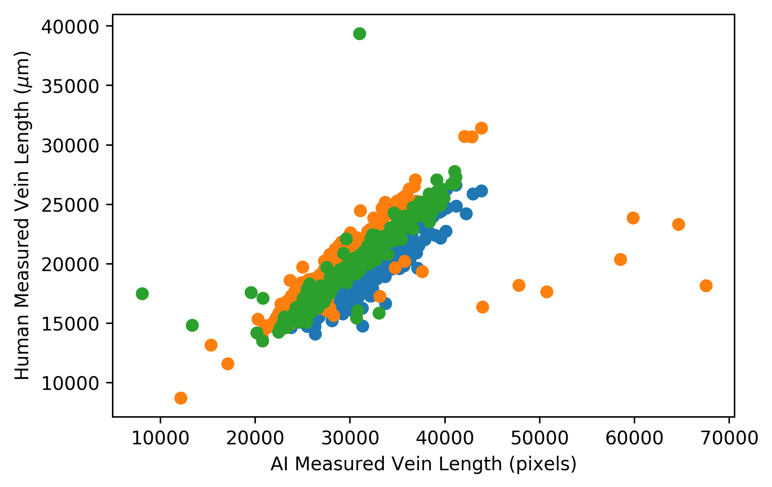
Evaluation
Goal 2: Determine the optimal segmentation threshold to convert model output probabilities into a vein mask.
Scatter plots of the ~200 images in each testing set for each of the three cross-validation trained models.
The extreme outliers are consistent across thresholds, suggesting they are due to badly segmented images, not due to an incorrect threshold. I will get the id’s of these images later to confirm.

Slide 8
Next Steps
A final model, trained on all 719 images in the training set is already finished training using the 0.05 loss weight. I will use it to segment the 100 validation images and measure vein length from the images using the 0.7 cutoff determined here.
Since the final model was trained on all images, I expect it to have a correlation with human measured veins of at least that of the cross-validated models (>= 0.87).
Code is already in place to use the trained model to segment all images in a folder, convert the output probabilities to masks, and extract vein lengths, as well as the necessary submission scripts to submit this work as jobs to sapelo2. I will provide details on how to use them shortly, I still need to check that they are well documented.
I will be updating the GitHub repository with all new code and data shortly. It is currently all on sapelo2 at /work/jmblab/cotter/burke_leaf_veins/

