Slide 1
NLP Assignment-3
Team-32
Prasham Walvekar - CS21BTECH11047
Kallu Rithika - AI22BTECH11010
Armaan - CS22BTECH11051

Slide 2
Q.1 Multi-label Emotion Classification
Problem Statement Classify text samples into appropriate emotion categories - such as anger, fear, joy, sadness, and surprise by developing a model that can identify the presence or absence of each emotion in multilingual datasets.
Languages Chosen
English (most commonly used, easy interpretability and understanding)
Hindi + Marathi
Linguistic similarity - similar words, and similar script - devanagari
Belong to the top 100 languages of the world which SOTA transformer models are trained on
We understand both languages

Slide 3
ENGLISH

Slide 4
Architectural Approaches
Experimented with different pretrained transformers and classification techniques.
Transformers used: (from Hugging Face)
bert-base-uncased
roberta-base
distilbert-base-uncased
xlm-roberta-base
Classifiers used:
MLP head with 1 hidden layer (num_layers = 1)
MLP head with num_layers = 2
BiLSTM (hidden_state = 64, num_lstm_layers = 2) + MLP head (num_layers = 2)
Attention Pooling + MLP head (num_layers = 2) -> pools based on attention scores given to tokens (instead of using the class token) before passing to classification head
Notes:
Use of bert-based transformers - gives embeddings based on context, captures bi-directional context, they are State of The Art.
Use of BiLSTM - for sequential flow, and to capture short-term dependencies like “not good” or “very angry”
Use of attention pooling - Learns which tokens matter most for the task

Slide 5
Training Approach
Dataset -
train.csv (split: 90% train, 10% validation): 2768 samples
test.csv: 2767 samples
Training approach -
Phase-1: Transfer Learning (for first 3-5 epochs)
Freeze all layers of transformer
Phase-2: Fine-tuning (for rest of the epochs)
Unfreeze a fixed number of last few layers of transformer
Dynamically unfreeze a few layers of transformer incrementally with each epoch
Unfreeze all layers of transformer (we found this to give best results)
Loss criterion -
BCEWithLogitsLoss
Helpful for multi-label classification tasks
Outputs logits (probability vector) with same length as number of labels / emotions
Focal Loss
Focal Loss helps NLP models focus on hard-to-classify texts (like rare classes) by down-weighting easy predictions, making it useful for imbalanced or multi-label text classification.
Other important features -
Optimizer - AdamW (works best for fine-tuning of transformers)
Learning Rate Scheduler (reduces/increases LR based on validation score for better convergence)

Slide 6
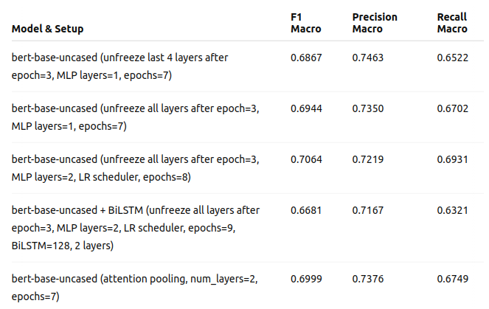
Results (BCE LogitsLoss)
Using bert-base-uncased

Slide 7
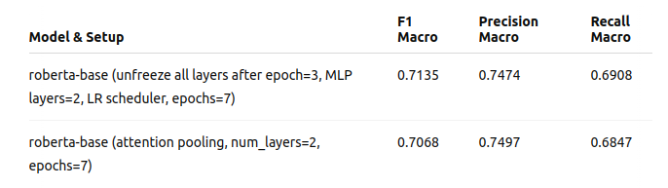
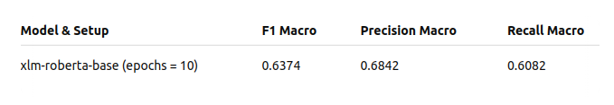
Results (Contd.)
2. Using roberta-base: (Best Performance)
3. Using xlm-roberta-base:

Slide 8
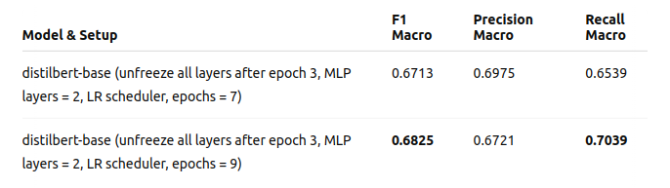
Results (Contd.)
4. Using DistilBERT

Slide 9
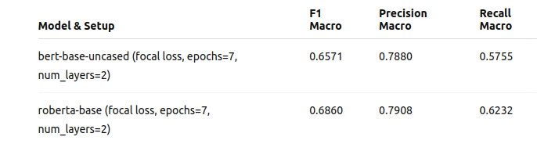
Results (Focal Loss)
Experimental Results Using Focal Loss

Slide 10
MULTI-LINGUAL
(HINDI + MARATHI)

Slide 11
Architectural Approaches
Experimented with different pretrained transformers and classification techniques.
Transformers used: (from Hugging Face)
xlm-roberta-base
xlm-roberta-large
bert-base-multilingual-cased (mBERT)
ai4bharat/indic-bert
Classifiers used:
MLP head with 1 hidden layer (num_layers = 1)
MLP head with num_layers = 2
Attention Pooling + MLP head (num_layers = 2)
Notes:
Use of multilingual bert-based transformers - trained on top 100 languages of the world, including hindi and marathi
mBERT - trained on top 104 languages
Indic-bert - trained on 12 Indian languages including hindi and marathi
Muril - trained on regional indian languages

Slide 12
Training Approach
Dataset -
Training: interleaved marathi and hindi datasets (split: 90% train, 10% validation) Total samples:
Marathi: 2415
Hindi: 2556
Testing: interleaved marathi and hindi datasets Total samples:
Marathi: 1000
Hindi: 1010
Training Approach (Transfer learning + fine-tuning), Loss criterion, Optimizer, LR Scheduler - Same as we did for English

Slide 13
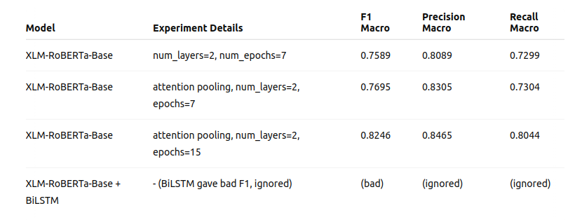
Results (BCEWithLogitsLoss)
1. Using xlm-roberta-base:

Slide 14
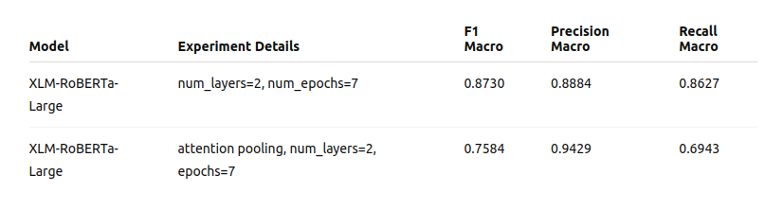
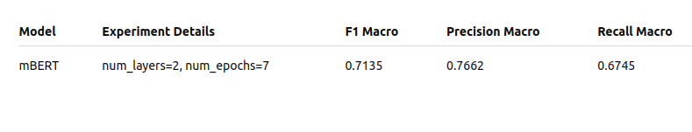
Results (Contd.)
2. Using xlm-roberta-large: (best performance)
3. Using bert-base-multilingual-cased (mBERT):

Slide 15
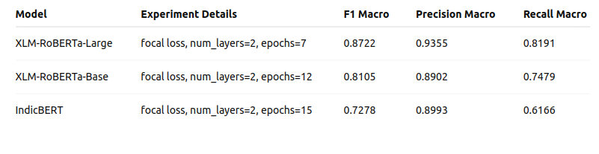
Results (Focal Loss)
Experimental Results Using Focal Loss

Slide 16
INTERPRETABILITY

Slide 17
Interpretability and Faithfulness Check
Tool Used : LIME (Local Interpretable Model-agnostic Explanations)
Goal : Check if the model relies on real emotional context or just keyword shortcuts.
Approach :
Used LIME to highlight important words per emotion.
Tested sentence variants with negations, sarcasm, and misleading patterns, punctuations (ex: exclamations)
Findings :
Model relied on keywords like “sad” or “thrilled” for example, ignoring the context.
Shows signs of undesirable shortcut learning.

Slide 18
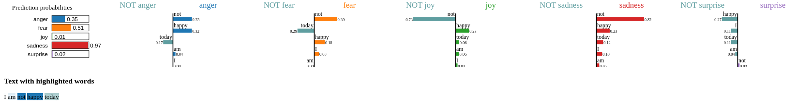
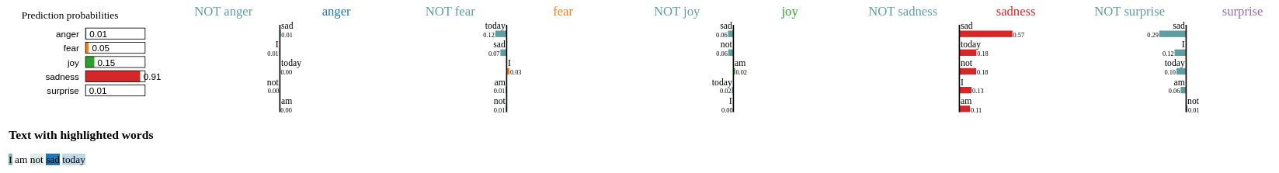
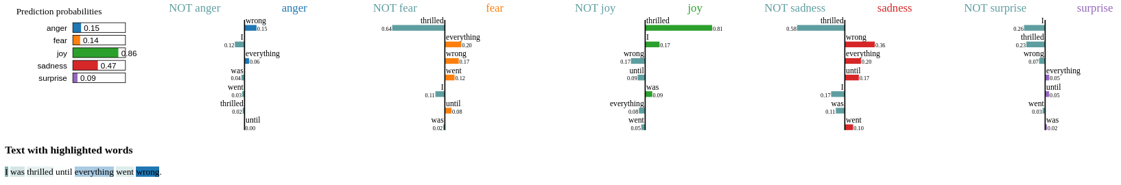
Results
Interpretability - Roberta-base Model on English Sentences
Notes:
Highlight if the model has learned any undesirable shortcuts to classify and how to address them - Faithfulness).

Slide 19
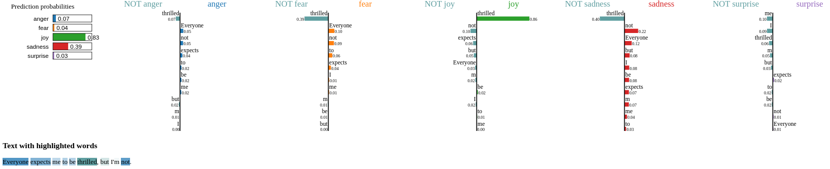
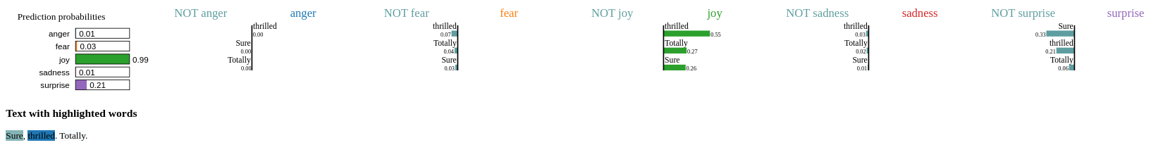
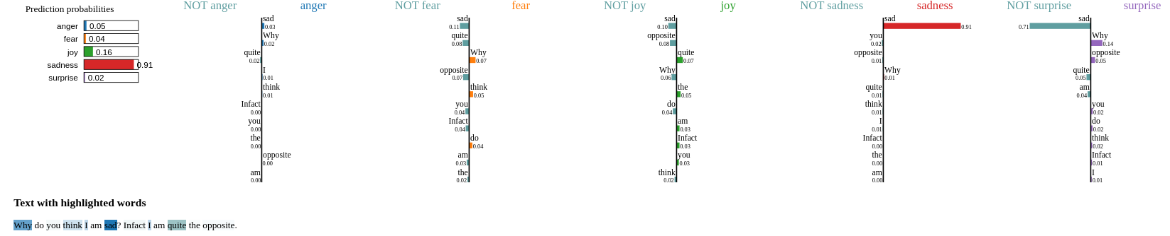

Slide 20
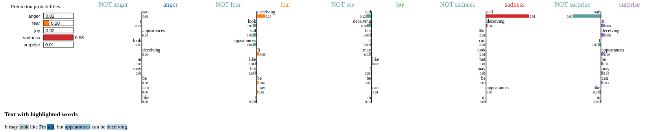
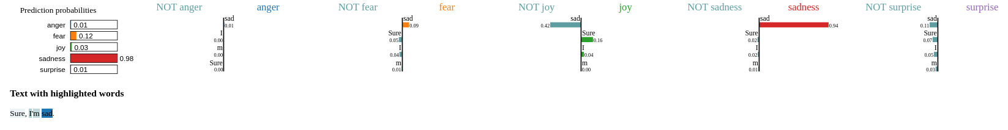

Slide 21
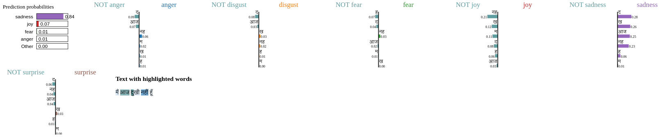
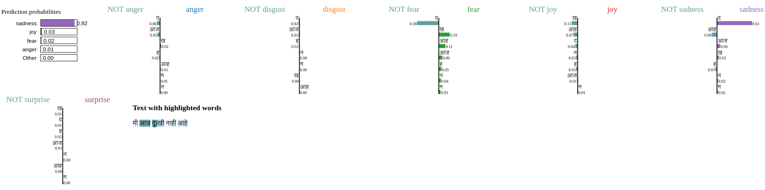
Results
Interpretability - xlm roberta base Model on Hindi and Marathi Sentences
Notes:
Highlight if the model has learned any undesirable shortcuts to classify and how to address them - Faithfulness).

Slide 22
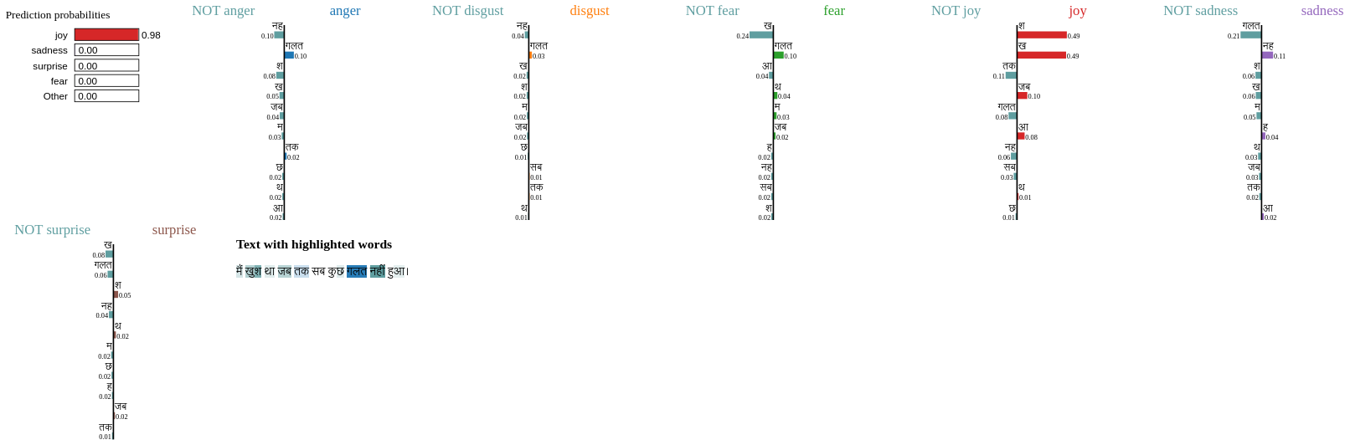
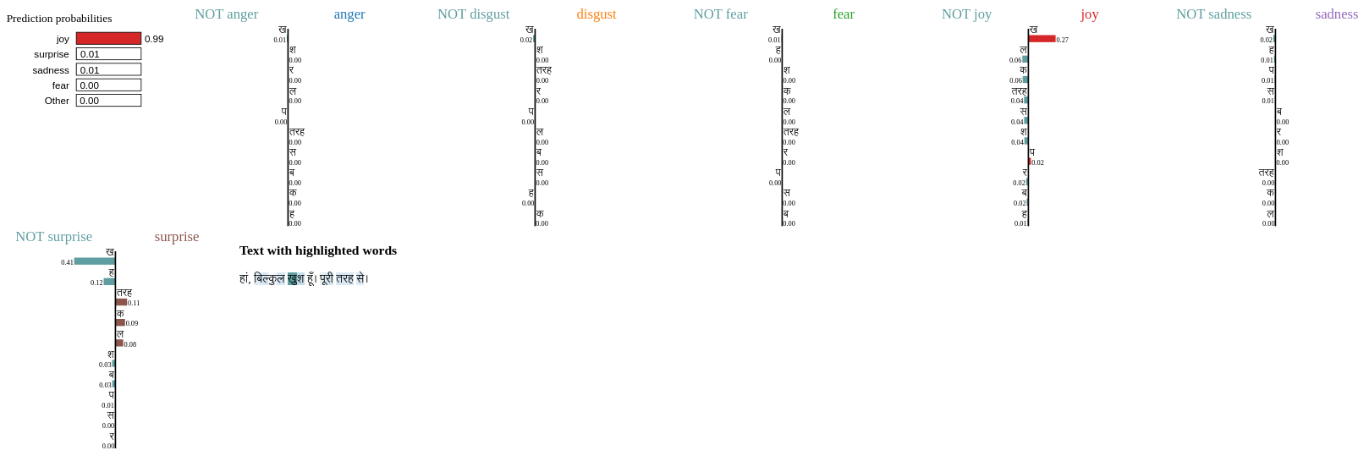

Slide 23
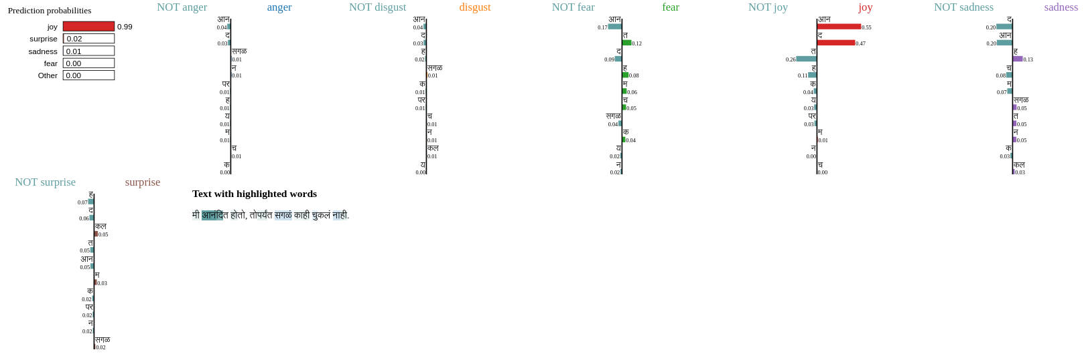
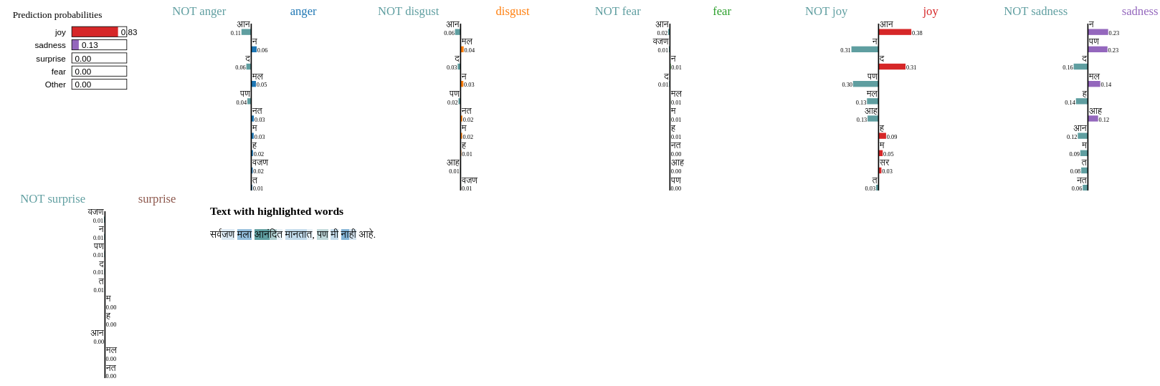

Slide 24
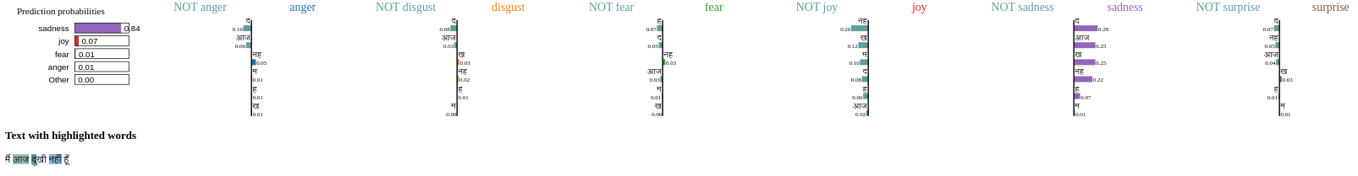
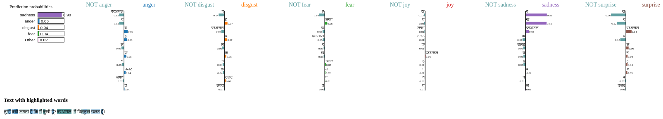
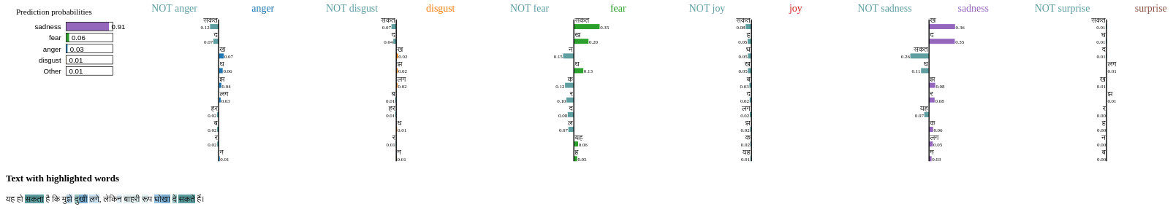

Slide 25
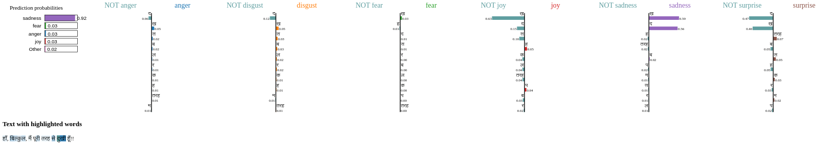
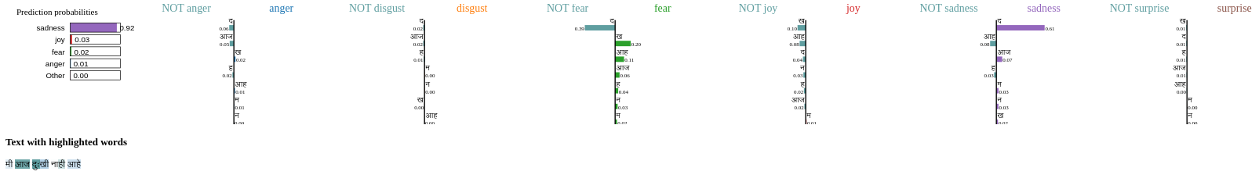
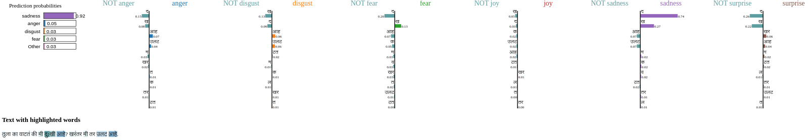

Slide 26
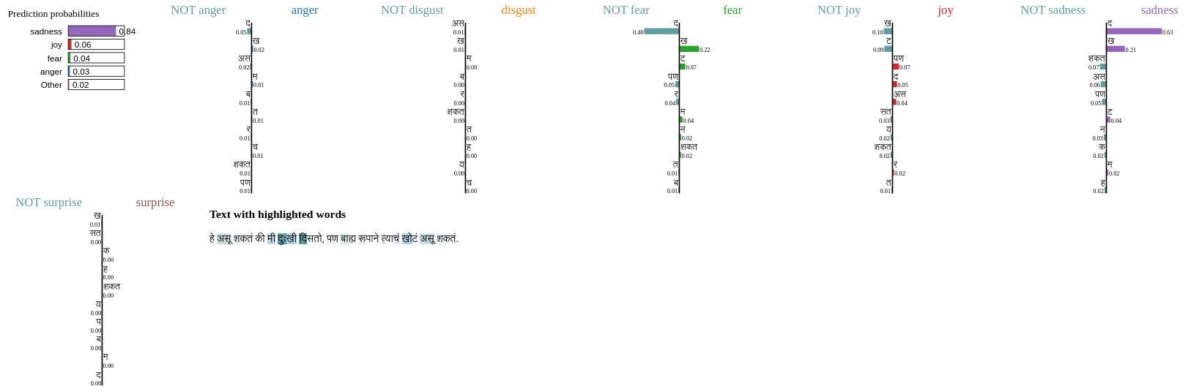
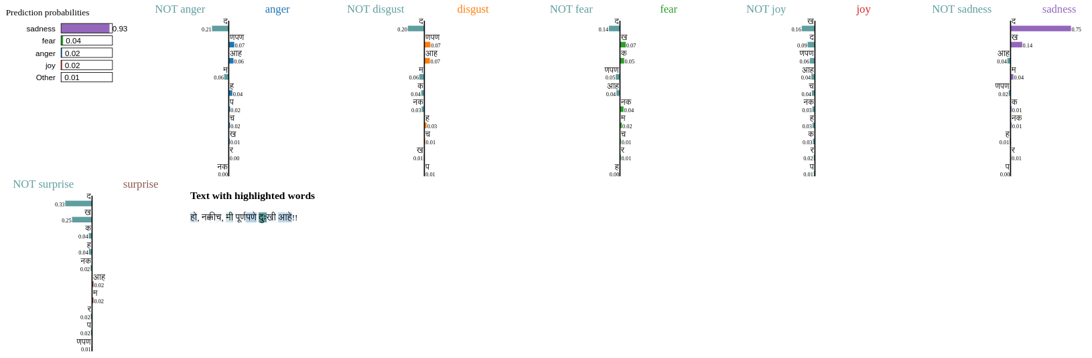

Slide 27
Summary of unfaithfulness (English)
Set1: S4: "I am not sad today" -> predicts sadness due to emphasis on "sad"
Set2: (Undesirable shortcuts observed) 1. S2: "I was thrilled until everything went wrong." -> predicts joy based on "thrilled" (but the sentence indicates the opposite, indirectly) 2. S3: "Everyone expects me to be thrilled, but I'm not." -> predicts joy (the speaker is not feeling joy) 3. S4: "Sure, thrilled. Totally." -> predicts joy (can't recognize the sarcasm)
Set3: (Undesirable shortcuts observed) 1. S1: "I am not sad today" -> predicts sadness due to word "sad" (can't recognize negation here due to "not") 2. S2: "Why do you think I am sad? In fact I am quite the opposite." -> predicts sadness (but the speaker clearly indicates the opposite) 3. S3: "It may look like I'm sad, but appearances can be deceiving." -> predicts sadness (though the speaker suggests the opposite, indirectly) 4. S4: "Sure, I'm sad."-> predicts sadness (Can't recognize sarcasm)

Slide 28
Summary of unfaithfulness (Hindi + Marathi)
Set1:
Hindi: Wrong prediction for "I am not sad" -> emphasis on word "sad" (undesirable shortcut to associate "dukhi" to sadness)
Marathi: Wrong prediction for "I am not sad" -> emphasis on word "sad" (undesirable shortcut to associate "dukhi" to sadness)
Set2:
Hindi:
1. S2: "I was happy until everything went wrong" -> predicts joy based on word "khushi"
2. S4: "Sure! I am totally happy." -> predicts joy, can't understand sarcasm
Marathi:
1. S2 and S4: same prediction and reason as Hindi
2. S3: "I was happy, until everything went wrong" -> predicts joy based on the word "anandit"

Slide 29
Summary of unfaithfulness (Hindi + Marathi) (Contd…)
Set3:
Hindi: 1. S1: "I am not sad today." -> predicts sadness (can't capture negation)
2. S2: "Why do you think I am sad? In fact, I am quite the opposite." -> predicts sadness (even though it mentions in the end that it's the opposite)
3. S3: "It may look like I am sad, but external looks can be deceiving." -> predicts sadness (even though indirectly the person means the opposite)
4. S4: "Sure, I am sad." -> predicts sadness (can't capture sarcasm)
Marathi:
Same predictions and reasons mentioned above for hindi

Slide 30
Mitigation Strategy based on Interpretability Analysis
Contrastive Learning: We can use contrastive loss to teach the model to differentiate between subtle language features like irony, sarcasm, or sarcasm-like patterns. Or even patterns like negation.
Adversarial training: Include samples which the model predicts wrongly (adversarial samples) based from interpretability analysis and re-train the model on the modified datasets

Slide 31
THANK YOU

