Slide 1


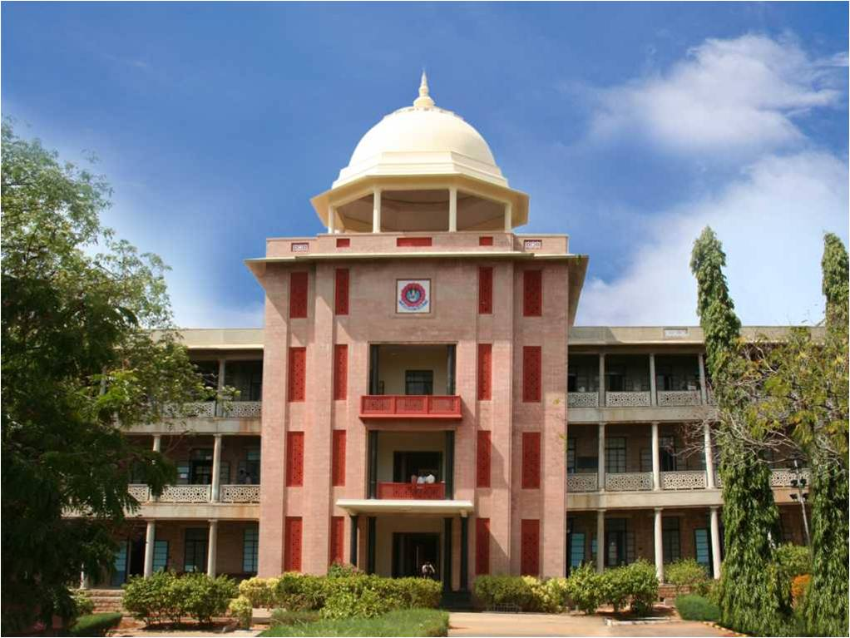
Fish-detection in marine environment using deep-learning approach
THIAGARAJAR COLLEGE OF ENGINEERING, MADURAI-15
(A Govt. Aided Autonomous Institution affiliated to Anna University)
- where quality and ethics matter
Thanush A A
Research Project
*
Department of Computer Science and Business Systems
1

Slide 2
Research area identified
Research Area: Applied Deep Learning and Computer Vision
Specific Research Area: Marine Analytics using Computer Vision
*
Department of Computer Science and Business Systems
2

Slide 3
Problem Statement
Due to the highly dynamic nature of marine environment, it is challenging to monitor and study ecological process
Although comprehensive image and video data can be collected, the processing of image data in ecological context is mostly manual and therefore very labor-intensive
As a result, only a portion of the available recordings can be analyzed which is greatly limiting the potential advances that can be made from these data streams.
*
Department of Computer Science and Business Systems
3

Slide 4
Objectives
To develop a system which is capable of automating the process of monitoring in marine ecosystem
To enhance the computational efficiency and accuracy of object tracking model in marine environment
To explore the various models and propose a deep learning model with higher accuracy
*
Department of Computer Science and Business Systems
4

Slide 5
Expected Outcomes
A program that is able to analyse the image/video input of marine ecosystem with a good accuracy and present some useful inferences
A highly accurate and computationally efficient object detection algorithm
A fine-tuned fish detection model with higher accuracy

Slide 6
Tools and Technologies proposed to be used
Deep Learning
Object Detection
Computer Vision
Image processing
Pytorch/TFLite Framework
*
Department of Computer Science and Business Systems
6

Slide 7
Literature survey (5 Recent Papers)
Title of the paper | Journal name and year of publication | Inference of the paper (bulleted points) | Q1/Q2/Q3/Q4
Temperate fish detection and classification: a deep learning based approach | Applied Intelligence, 2022 | 2 step deep learning approach a) Yolov3 with cnn architecture for detection b) CNN – SENet Architecture for classification Fish4knowledge dataset (of temperate region fishes) Metrics used for accuracy – IOU, MaP value accuracies after training for the proposed model – 87.74% (without augmentataion) 83% (with augmentation) | Q2
YOLO fish detection with Euclidean tracking in fish farms | Journal of Ambient Intelligence and Humanized Computing, 2021 | Proposed model – MSR YOLOv3 Dataset – collected from their own setup (farm fishes) Addition of MSR algorithm increased the performance of the yolov3 model Detects fish in unclear water | Q1
*
7

Slide 8
Automatic fish detection and tracking of movement for ecology | Ecology and Evolution, 2021 | Used for tracking the behaviour of yellowfin Bream Models proposed – SiamMask, Seq-NMS, and MOSSE Metrics used – precision, recall, f1 score, mAP5.0 Results mAp5.0: SiamMask, MOSSE – 78% Seq-NMS – 84% | Q1
Accurate Fish Detection under Marine Background Noise Based on the Retinex Enhancement Algorithm and CNN | Journal of Marine Science and Engineering, 2022 | Dataset used – LIFEClef dataset Proposed model – MSR-CNN model Performs significantly better than other baseline models like RCNN, Fast-RCNN, Yolov3 mAp of proposed model – 78.31 | Q2
Deep neural network-based real time fish detection method in the scene of marine fishing supervision | Journal of Intelligent and Fuzzy systems, 2021 | Proposed model – Yolov3-tiny-mobileNET To increase the speed of the algorithm in real-time object detection Dataset – NCFM dataset Missing detection or false detection can be observed in other computationally efficient yolov3 models | Q2

Slide 9
Tools and Dataset details
Object detection model – Yolov5
Computer Vision and Image Processing – Opencv module
Dataset – Brackish water dataset (v4)
Publicly available
6 classes – fish, small_fish, crab, shrimp, jellyfish, and starfish
Link: https://www.kaggle.com/aalborguniversity/brackish-dataset
*
Department of Computer Science and Business Systems
9

Slide 10
Block Diagram
Video/Image output
(with bounding boxes)
Output
Input
Image/Video Input
Data Preprocessing
Object Detection
model
Other statistical
inferences
Validation and fine tuning of model
*
Department of Computer Science and Business Systems
10

