Slide 1


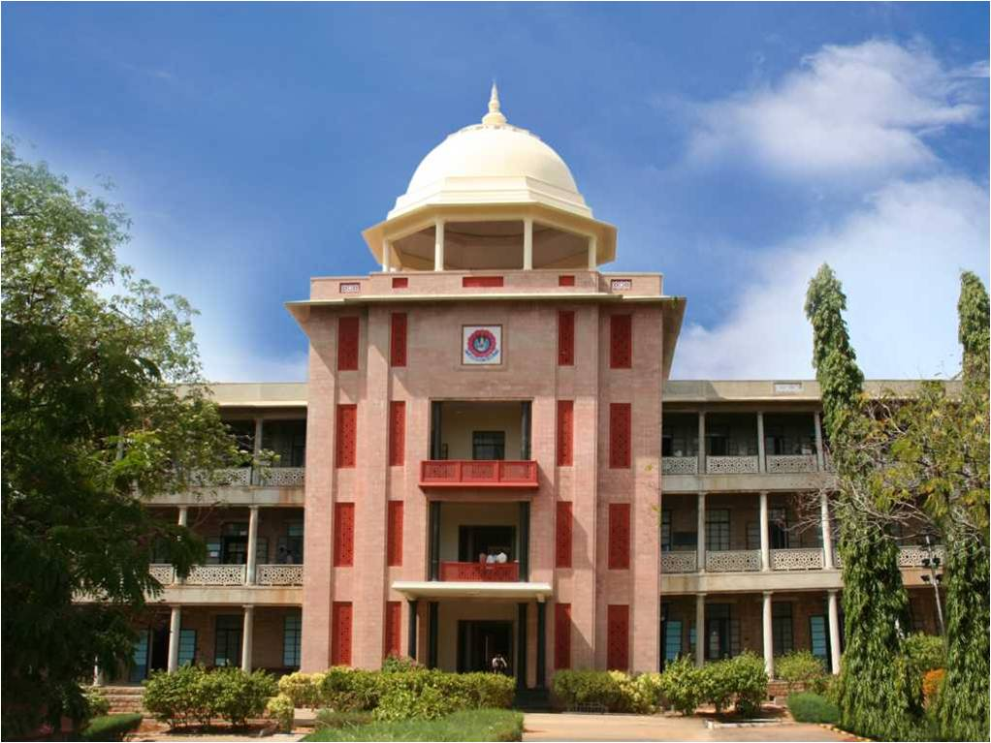
Real Time Fish Detection
THIAGARAJAR COLLEGE OF ENGINEERING, MADURAI-15
(A Govt. Aided Autonomous Institution affiliated to Anna University)
- where quality and ethics matter
Thanush A A
Research Project
*
Department of Computer Science and Business Systems
1

Slide 2
Research area identified
Type the url of the industry
Scope of the Industry
OR
Type the Research area identified
Specific Research area
*
Department of Computer Science and Business Systems
2

Slide 3
Problem Statement
This slide should tell in 2 or 3 lines the compelling need for the problem and who will be using this solution
*
Department of Computer Science and Business Systems
3

Slide 4
Objectives
- Should be atleast 2 or 3 bulleted points.
*
Department of Computer Science and Business Systems
4

Slide 5
Tools and Technologies proposed to be used
*
Department of Computer Science and Business Systems
5

Slide 6
Literature survey (5 Recent Papers)
Title of the paper | Journal name and year of publication | Q1/Q2/Q3/Q4 | Inference of the paper (bulleted points)
*
Department of Computer Science and Business Systems
6

Slide 7
Tools and Dataset details
*
Department of Computer Science and Business Systems
7

Slide 8
Block Diagram representation of the proposed work with clear input, processing, output
*
Department of Computer Science and Business Systems
8

