Slide 1
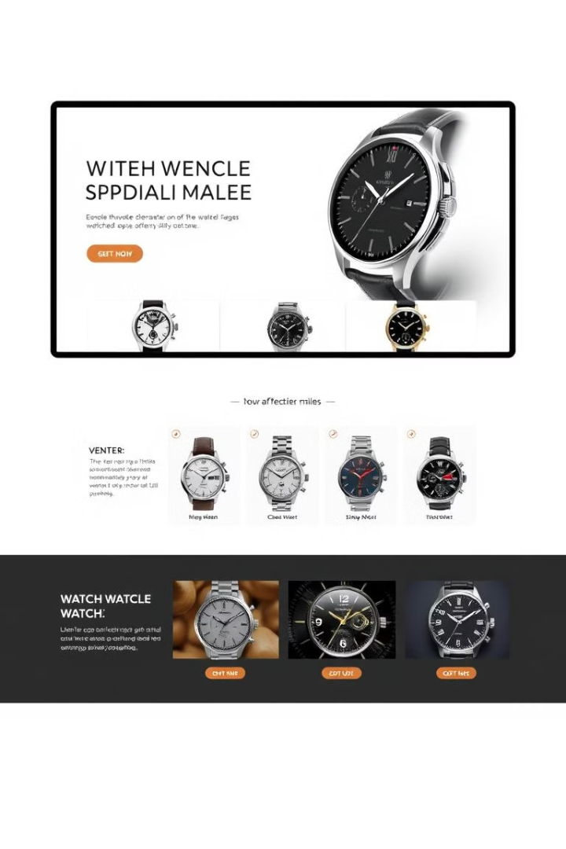
Simple Online Watch Store
This presentation outlines the development of a simple online watch store. The project utilizes a range of technologies. These include HTML, CSS, JavaScript, Java, and MySQL.
by S.M.Aathish Vijay
CP

Slide 2
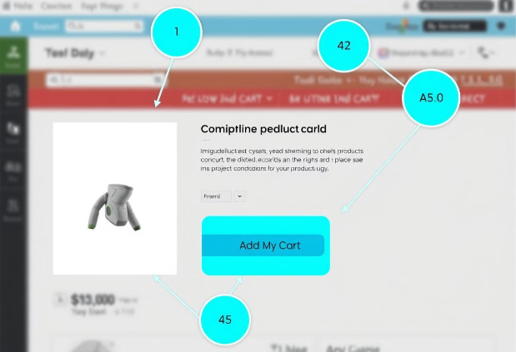
Frontend: HTML Structure
Semantic Layout
Product Cards
HTML5 structure ensures a semantic and accessible layout. Elements like `
Clean and simple markup ensures easy maintenance. Example: `
`, ``, ``, and `
`, `
` provide organization.
`.
Responsive Design
Responsive design uses the meta viewport tag: ``.

Slide 3

Frontend: CSS Styling
1
Visual Presentation
2
Layout Implementation
3
Responsiveness
CSS manages visual presentation and layout. Consistent color palettes and typography reinforce branding.
Basic CSS grid or Flexbox layouts handle product listings. Example: `.product-card { width: 300px; border: 1px solid #ccc; }`.
Media queries ensure responsiveness across screen sizes. Example: `@media (max-width: 600px) { .product-card { width: 100%; } }`.

Slide 4




Frontend: JavaScript Functionality
Interactive Elements
DOM Manipulation
Form Validation
JavaScript powers interactive elements and dynamic updates. Includes `addToCart()` function for shopping cart actions.
DOM manipulation updates the cart display and product details dynamically.
Simple form validation is implemented for user registration and login.

Slide 5
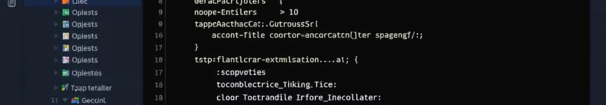
Backend: Java with Spring Tool Suite
Java & Spring
1
Java and Spring Tool Suite handle backend logic and API development.
2
Spring MVC
Spring MVC framework manages requests and responses.
RESTful API
3
RESTful API endpoints support product catalog, cart management, and user authentication. Example: `@RestController`.

Slide 6
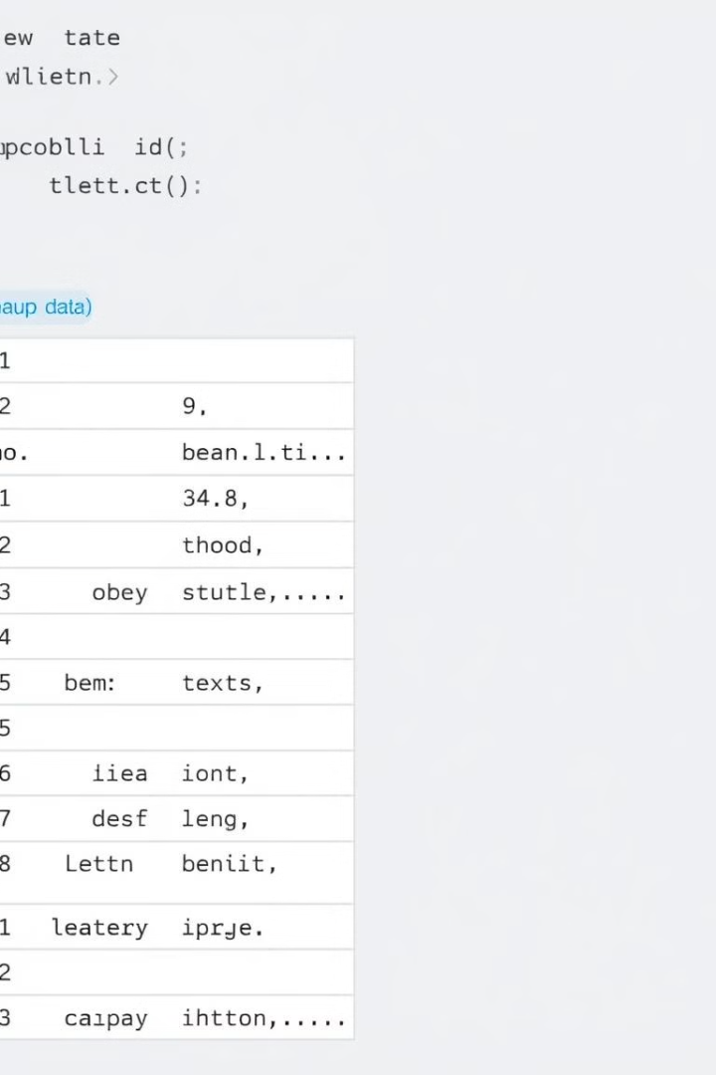



Backend: MySQL Database
MySQL
MySQL database stores product information, user accounts, and order details. Includes a `products` table.
JDBC/JPA
JDBC or Spring Data JPA interacts with the database.
Basic Queries
Basic database queries retrieve products and authenticate users. Example: `SELECT * FROM products WHERE category = 'luxury';`.

Slide 7



Project Structure & Workflow
2
Frontend
1
Structure
Workflow
3
Spring Tool Suite organizes: controllers, services, repositories, models. Frontend files are in a `static` folder. Workflow involves user interaction, JavaScript, API requests, Java controller, and database queries.

Slide 8

Conclusion & Next Steps
Summary
Achievements
Future
The project demonstrates a functional online watch store. It leverages various technologies.
Key achievements include a working product listing and "Add to Cart" feature.
Potential enhancements: payment gateway integration, advanced search filters, user reviews.
Project demo available. Questions are welcome.

