Slide 1
Introduction to Python
Machine Learning and Computer Vision
Ajad Chhatkuli
ETH Zurich/ NAAMII

Slide 2

Linear Systems

Slide 3
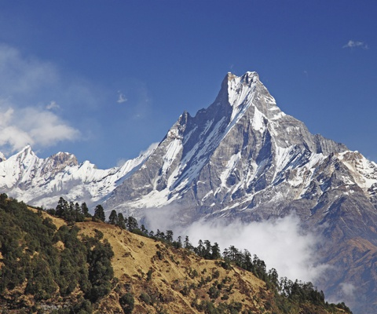
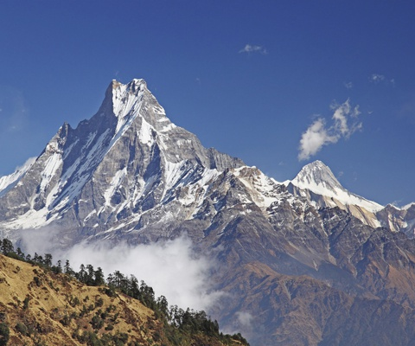
Image to Image transformations

Slide 4
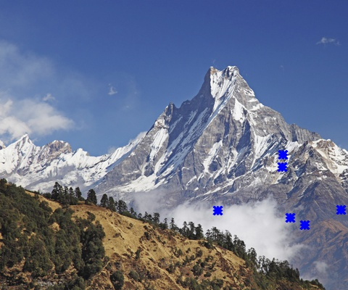
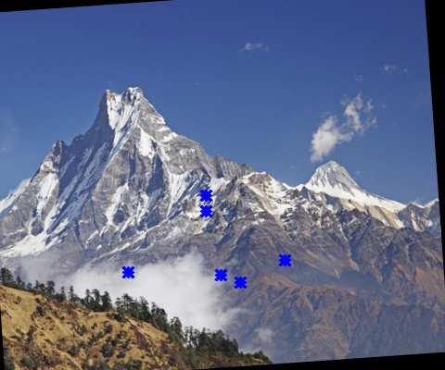
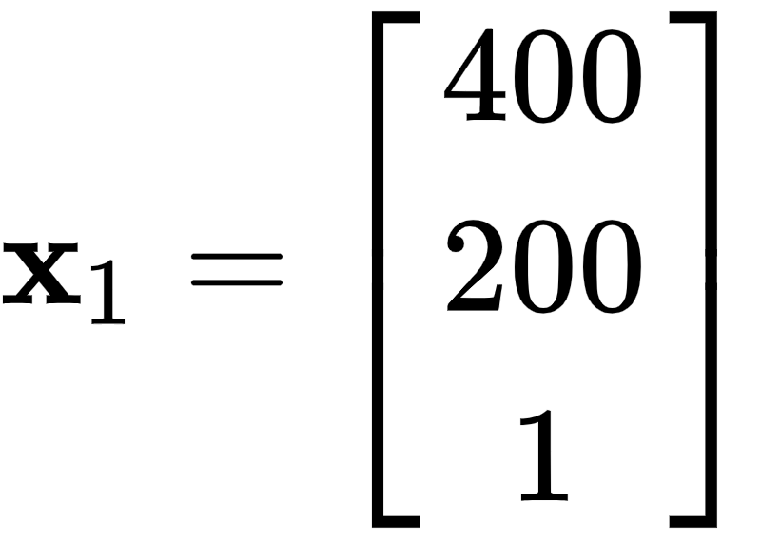
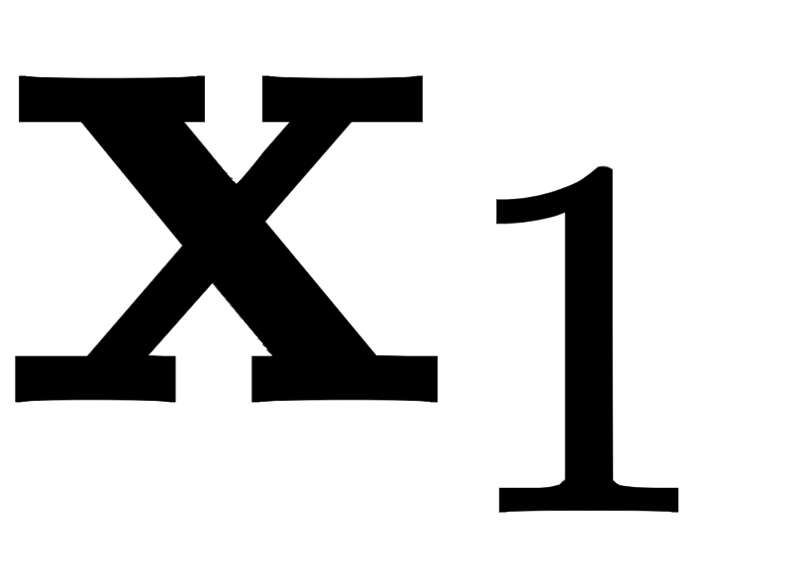
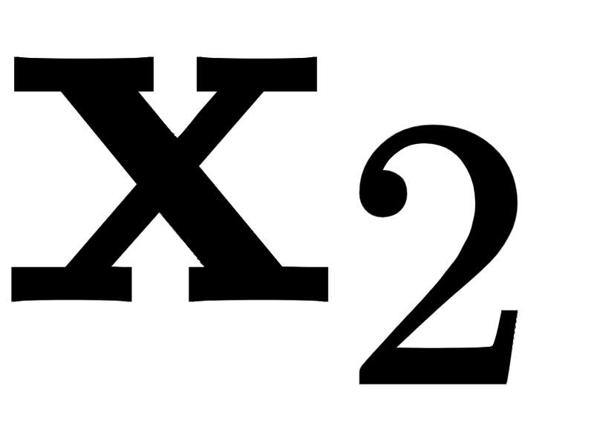
Image to Image transformations

Slide 5

Affine Homography

Slide 6
Task: Join two Images using OpenCV and Numpy

Slide 7

Linear Systems

Slide 8
Panorama/ Image Stitching
Solve for A!

Slide 9


Affine Homography

Slide 10

Affine Homography
Two rows (equations) per point

Slide 11

Affine Homography- 1 example point

Slide 12

Affine Homography- use more points

Slide 13

Reformulate Linear System to find A

