Slide 1
Fundamentals of Electrical and Electronics (4300018)
Micro project Topic:- Diode & Rectifiers
By
Roll no:- G21Cp47
Krish Makwana.

Slide 2
Introduction : diode
The diode is the simplest and most fundamental non-linear circuit element .
Like a resistor, it has two terminals.
Unlike a resistor, it has a non-linear current voltage characteristic.
Its use in rectifiers is the most common application.

Slide 3
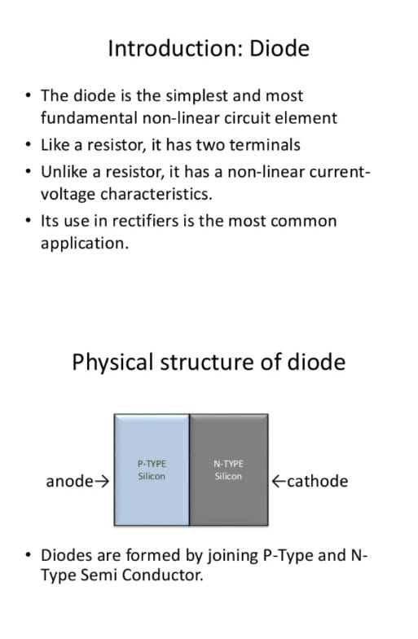
Physical structure
Diodes are formed by joining P-type and N-type Semiconductor.
Diode is an electric device which allow current to flow only in one direction.

Slide 4
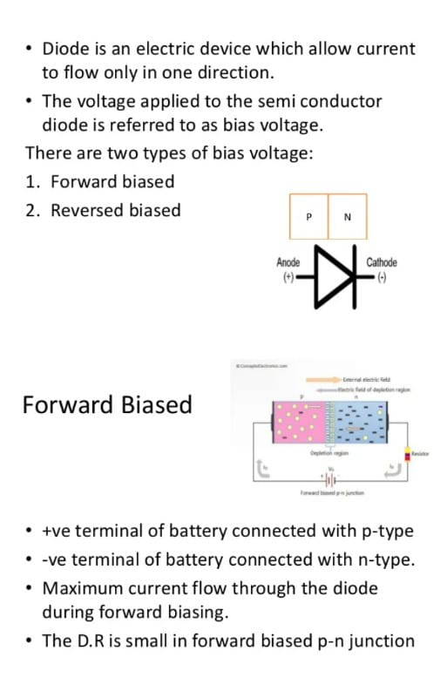
The voltage applied to the semiconductor diode is referred to as bias voltage.
There are two types of bias voltage:
Forward biased
Reversed biased

Slide 5
Forward biased
+ve terminal of battery connected with p-type.
-ve terminal of battery connected with n-type.
Maximum current flow through the diode during forward biasing.
The D.R is small in forward biased p-n junction.

Slide 6
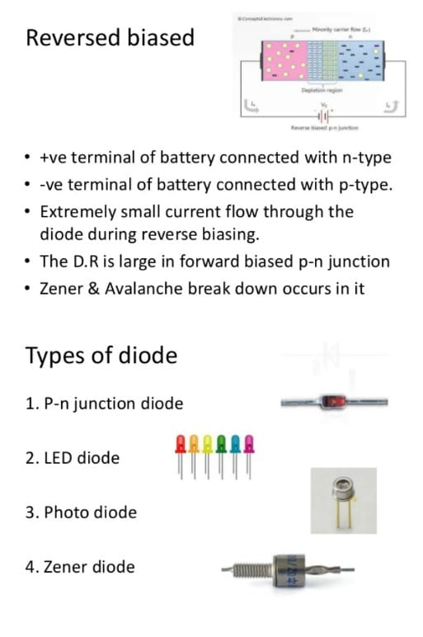
Reversed biased
+ve terminal of battery connected with n-type.
-ve terminal of battery connected with p-type.
Extremely small current flow through the diode during reverse biasing.
Zener & Avalanche break down occurs in it.

Slide 7
Types of diode
P-n junction diode
LED diode
Photo diode
Zener diode

Slide 8
A diode is a PN junction with p-type on one side and n-type on the other. When a positive voltage is applied to the p-type side, it shrinks and overcomes the depletion zone, causing the current to flow from the p-type to the n-type side.
A light- emitting diode are made of two lead semiconductor light source . It is a p-n junction diode, which emits light when activate.
A Photodiode is a semiconductor device that converts light into current .A small amount of current is also produced when no light is present.
A Zener diode is a diode which allows current to flow in the forward direction in the same manner as an ideal diode, but also permits it to flow in the reverse direction when the voltage is above a certain value known as the break down voltage.

Slide 9
Application of diode circuit
Rectifier circuit
Half wave rectifier
Full-wave rectifier
Bridge rectifier
Clippers

Slide 10
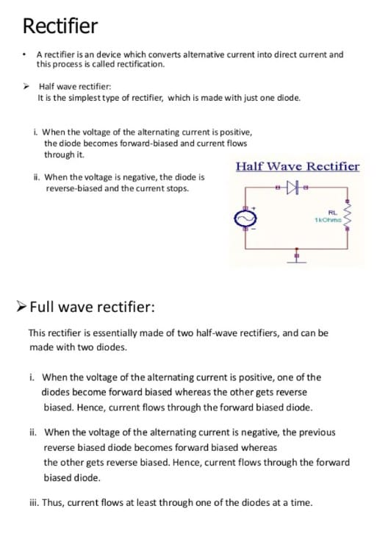
Rectifier
A rectifier is an device which converts alternative current into direct current and this process is called rectification.
Half-wave rectifier:
It is the simplest type of rectifier, which is made with just one diode.
When the voltage of the alternating current is positive, the diode becomes forward-biased and current flows through it.
When the voltage is negative, the diode is reverse-biased and the current stops.

Slide 11
Full wave rectifier:
The rectifier is essentially made of two half wave rectifiers, and we can be made with two diodes.
When the voltage of the alternating current is positive, one of the diodes become forward biased whereas the other gets reverse biased, current flows through the forward biased diode.
When the voltage of the alternating current is negative, the previous reversed biased diode becomes forward biased whereas the other gets reverse biased. Hence, current flows through the forward biased diode.
Thus, current flows at least through one of the diodes at a time.

Slide 12
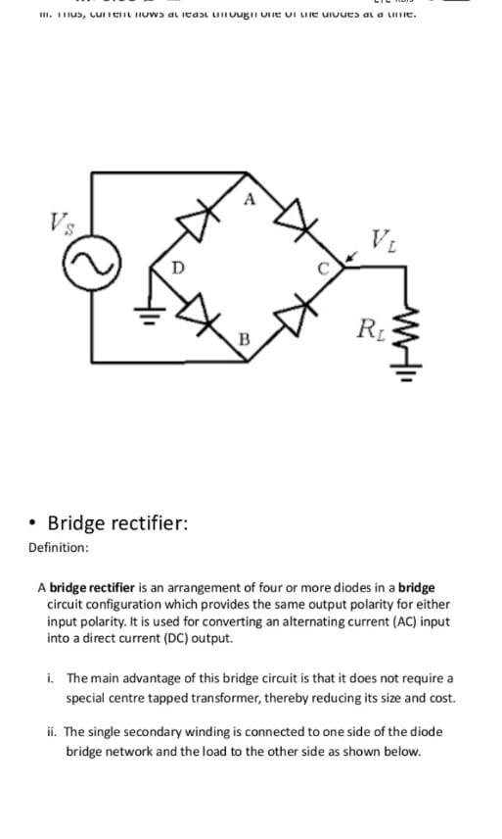
Full wave rectifier:

Slide 13
Bridge rectifier:
A bridge rectifier is an arrangement of four or more diodes in a bridge circuit configuration which provides the same output polarity for either input polarity. It is used for converting an alternating current input into a direct current output.
The main advantage of this bridge circuit is that it does not require a special center tapped transformer, thereby reducing its size and cost.
The single secondary winding is connected to one side of the diode bridge network and the load to the other side as show below.

Slide 14
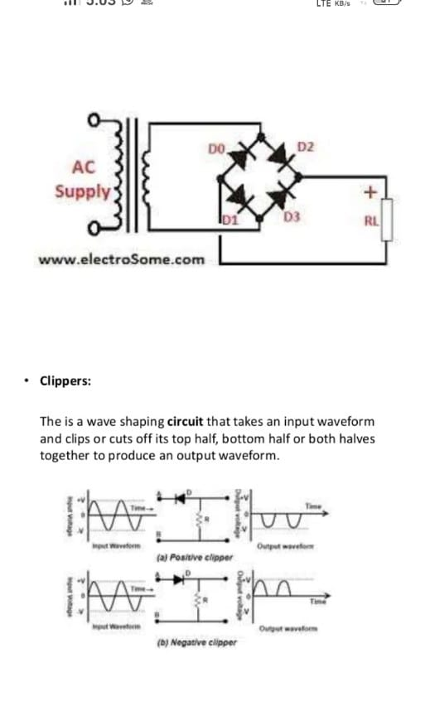
Bridge rectifier:

Slide 15
Clippers:
the is a wave shaping circuit that takes an input waveform and clips or cuts off its top half, bottom half or both halves together to produce an output waveform.

Slide 16
Thank you

