Slide 1

Final Project Presentation
A.Y. 2026-2027
Indian Railways AI-Powered Automatic Block Planning System
Multi-Department Decision-Support & Dynamic Conflict Resolution Prototype for Maintenance Possessions on the Prayagraj Jn - Kanpur Central Corridor, North Central Railway
Presented by :
Name | SAP ID | Roll No.
Dishank Shah | 70322200027 | C181
Aatman Satra | 70322200110 | C157
Under the guidance of : Prof. Jasleena Gonsalves
Computer Engineering Department, MPSTME, Mumbai Campus

Slide 2
Abstract
Maintenance demands from Civil (TMS), Traction/OHE (TDMS) and S&T (SMMS) are submitted independently, causing repeated, fragmented line shutdowns and punctuality losses.
Decision-support prototype for the 191 km Prayagraj Jn (PRYJ) - Kanpur Central (CNB) trunk corridor, NCR: 16 block sections (8 UP Main + 8 DOWN Main).
Result: 13 multi-department demands co-scheduled into only 6 consolidated blocks, eliminating 7 redundant shutdowns.
1. MCDA Prioritization
2. CP-SAT Optimizer
3. IR-Copilot
Explainable 6-factor urgency score (0.0 - 100.0) with plain-English rationale.
Google OR-Tools CP-SAT bundles demands into Mega Blocks in the 01:00-05:00 AM night lull, penalizing passenger path disruption.
20-document rulebook RAG (IRPWM, ACTM, SEM, G&SR) with Google Gemini fallback (gemini-3.5-flash-lite).
Frontend: React 18, TypeScript, Tailwind CSS - 24-hour Gantt matrix, live schematic with TSLW, "Apply NOW vs In Future" workflow, Form T/409 generator (CSV/PDF).
Backend: FastAPI (Python 3.12), Pydantic v2.
Keywords: Block Planning, CP-SAT, MCDA, Possession Bundling, RAG, Gemini AI, Human-in-the-Loop, Prayagraj Division.
Computer Engineering Department, MPSTME, Mumbai Campus

Slide 3
Introduction: Background & Problem Statement
1.1 Background & Context
1.2 Problem Statement & Challenges
Indian Railways: 4th-largest network; 68,000+ route-km; 13,000+ passenger and 8,000+ freight trains daily.
Over 120% line-capacity utilization on Golden Quadrilateral trunks.
Prayagraj Division (NCR): 191 km double-track, 130 km/h electrified PRYJ-CNB corridor (Rajdhani, Vande Bharat, Prayagraj Express + bulk freight).
Possessions needed for USFD weld repair, ballast tamping, 25kV OHE overhaul, EI point machine tests.
Departmental silos: TMS, TDMS, SMMS each apply via BDMS independently.
Repeated closures: same 15 km section shut 3 times a week.
Subjective prioritization: no algorithm to compare rail flaw vs OHE hotspot vs relay drift.
Premium path disruption: Vande Bharat / Rajdhani pushed into loops, cascading delays.
Administrative overhead: Form T/409, S&T T/351 and pilot authorities drafted manually.
Computer Engineering Department, MPSTME, Mumbai Campus

Slide 4
Aim, Objectives, Scope & Users
Aim: AI-assisted decision-support prototype automating intake, scoring, constraint-based bundling, scheduling and sanctioning of multi-department blocks.
Unified ingestion: normalized schema for Civil, Electrical, Signalling demands.
MCDA: transparent 5-factor, 0-100 score with rationales.
CP-SAT: assign tasks to feasible windows; maximize bundling, minimize disruption.
Bidirectional model: UP Main (PRYJ-CNB) and DOWN Main (CNB-PRYJ), 16 sections.
AI Copilot: offline 20-doc RAG + Gemini fallback.
HITL: Sanction for Scheduled Slot vs Apply Block NOW.
Live telemetry: train tracking, loop regulation, TSLW (G&SR 15.09).
Output: Form T/409 caution orders with CSV/PDF export.
1.4 Scope & Boundaries
191 km, 8 sections x UP/DOWN = 16 blocks; P.Way, TRD (25kV OHE), S&T.
24-hour tactical planning, 3-day rolling advance window.
Offline prototype: no writes to CRIS COA / BDMS; final authority rests with the Section Controller.
1.5 User Personas
Chief Section / Block Controller
Sr. Section Engineers: P.Way, TRD/OHE, S&T
Divisional Operations Manager (DOM / Sr. DOM) - corridor KPIs
Computer Engineering Department, MPSTME, Mumbai Campus

Slide 5
Literature Survey & Research Contribution
2.1 Constraint Programming
2.2 Possession Bundling
2.3 MCDA
Possession scheduling is NP-hard (job-shop with setup times) [2],[3]. MILP scales poorly; CP-SAT uses lazy clause generation + CDCL to solve in seconds.
Budai [6], Liden [5]: bundled possessions improve capacity; shadow blocks inside a CSM tamping closure amortize diversion cost.
Black-box ML faces regulatory resistance; weighted linear MCDA [7] is fully auditable.
2.4 RAG & LLMs
2.5 Human-in-the-Loop
2.6 Our Contribution
LLMs hallucinate on IRPWM / G&SR; RAG [9] grounds answers in verified text. Gemini handles open-ended queries.
Parasuraman [10], Shneiderman [11]: high decision support, human execution authority. Controller approves, rejects, modifies or advances any block.
Synthesis of MCDA scoring + CP-SAT + hybrid RAG/Gemini + UP/DOWN modeling + interactive control dashboard (NOW vs scheduled).
Computer Engineering Department, MPSTME, Mumbai Campus

Slide 6
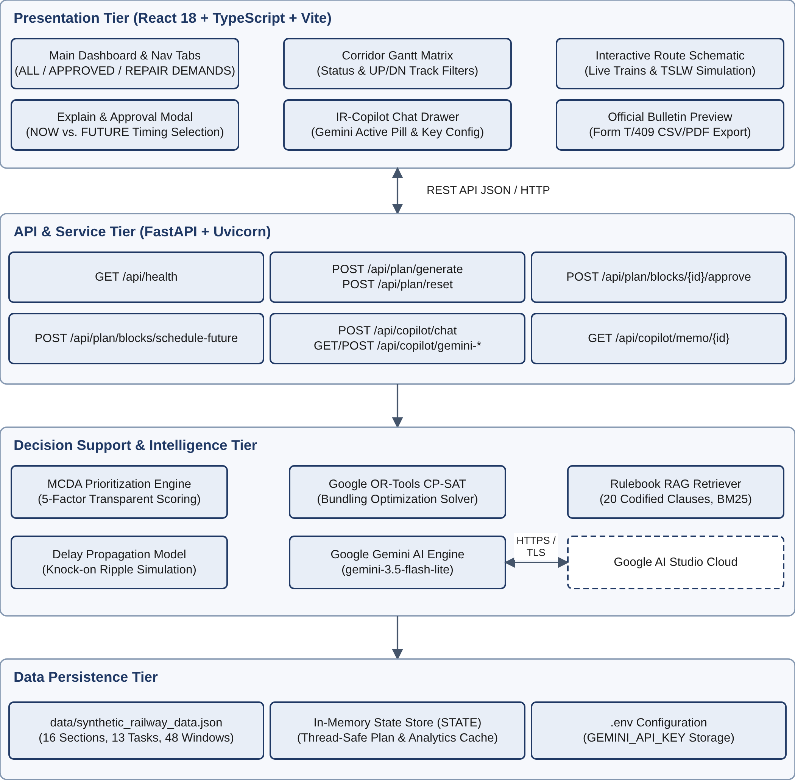
System Design & Architecture
Presentation: React 18, TypeScript, Vite 5, Tailwind CSS, Lucide icons (SPA).
API & Orchestration: FastAPI + Uvicorn, Python 3.12, async REST.
Analytics & Optimization: TaskPrioritizer (MCDA), BlockPlanningOptimizer (CP-SAT), RailwayRulebookRAG, DelayPropagationModel.
External AI: Gemini (gemini-3.5-flash-lite) via google-genai SDK, httpx fallback.
Data: seeded synthetic JSON, thread-safe in-memory cache with disk sync.
Computer Engineering Department, MPSTME, Mumbai Campus

Slide 7
Corridor Model & Data Contracts
# | Station Pair | UP / DOWN ID suffix | Km | Length | Speed | Density
1 | Prayagraj Jn - Subedarganj | PRG_SFG | 827.0-831.5 | 4.5 km | 110 | 115 GMT
2 | Subedarganj - Manauri | SFG_MRE | 831.5-845.2 | 13.7 km | 130 | 125 GMT
3 | Manauri - Bharwari | MRE_BRE | 845.2-865.8 | 20.6 km | 130 | 130 GMT
4 | Bharwari - Sirathu | BRE_SRO | 865.8-888.4 | 22.6 km | 130 | 128 GMT
5 | Sirathu - Khaga | SRO_KGA | 888.4-914.6 | 26.2 km | 130 | 120 GMT
6 | Khaga - Fatehpur | KGA_FTP | 914.6-945.0 | 30.4 km | 130 | 135 GMT
7 | Fatehpur - Bindki Road | FTP_BKO | 945.0-977.3 | 32.3 km | 130 | 132 GMT
8 | Bindki Road - Kanpur Central | BKO_CNB | 977.3-1018.0 | 40.7 km | 130 | 140 GMT
Enums: Department (ENGINEERING, TRD, ST); Severity (EMERGENCY, CRITICAL, ROUTINE); BlockStatus (PROPOSED, APPROVED, REJECTED, MODIFIED).
Models (Pydantic v2): Section; UnifiedMaintenanceTask (MCDA factors, duration, priority); ScheduledBlock (bundled tasks, yield, authority); PlanAnalytics (availability, bundling ratio, punctuality).
CorridorBlockWindow: NIGHT_LULL 01:30-04:30, MIDDAY_GOODS_GAP 11:30-13:45, AFTERNOON_GAP 15:00-17:00.
Computer Engineering Department, MPSTME, Mumbai Campus

Slide 8
Methodology: MCDA Scoring Engine
S(t) = min( 100, F_severity + F_overdue + F_density + F_statutory + F_speed + F_mega )
Severity (0-40)
Overdue (0-20)
Density (0-15)
Statutory (0/15)
Speed (0/10)
Mega Block (0/25)
• 40: Emergency (rail fracture, OHE snap)
• 25: Critical (SEJ gap, point defect)
• 10: Routine (tamping, screening)
• Formula: min(20, days_overdue x 5)
• Linear escalation: +5 pts / day
• Capped at max 20 pts after 4 days
• Formula: min(15, GMT / 150 x 15)
• Heavy freight & express trunk factor
• Calibrated for PRYJ-CNB high GMT
• 15: Mandatory compliance inspection
• 0: Discretionary maintenance
• Prevents regulatory violation backlog
• 10: Active caution order on block
• 0: Normal sectional speed
• Restores 130/160 km/h corridor speed
• 25: Tagged for Joint Mega Block
• 0: Unbundled single-dept task
• Directly boosts multi-dept bundling
Cumulative Block Yield: Total Yield(b) = sum of S(t) for tasks in block b - safety value resolved per possession, incentivizing bundling.
Validation: every task score stays within 0-100; block yields above 100 are shown as "Combined Yield: X pts (N tasks)".
Computer Engineering Department, MPSTME, Mumbai Campus

Slide 9
Methodology: CP-SAT Constraint Optimizer
Decision Variables
Constraints
Objective (maximize)
x(t,w) = 1 if task t assigned to window w
y(w) = 1 if window w is used
b(w) = 1 if w is a bundled block (>= 2 departments)
dept_in_win(w,d) = 1 if department d has a task in w
Feasibility: same section and duration(w) >= duration(t)
Each task at most once: sum_w x(t,w) <= 1
Window linkage: y(w) <= sum_t x(t,w); x(t,w) <= y(w)
Bundling: 2*b(w) <= sum_d dept_in_win(w,d)
Same-department tasks must fit in window duration
sum W(t,w)*x(t,w) + sum( 10*beta*b(w) - lambda*impact(w)*y(w) )
W = 10*S(t) - 120*day_offset + E_emergency + V_speed
beta = 40 (bundling reward)
lambda = 150 (disruption penalty)
E_emergency = 1500*(3 - day_offset) forces Day 0 for emergencies
Computer Engineering Department, MPSTME, Mumbai Campus

Slide 10
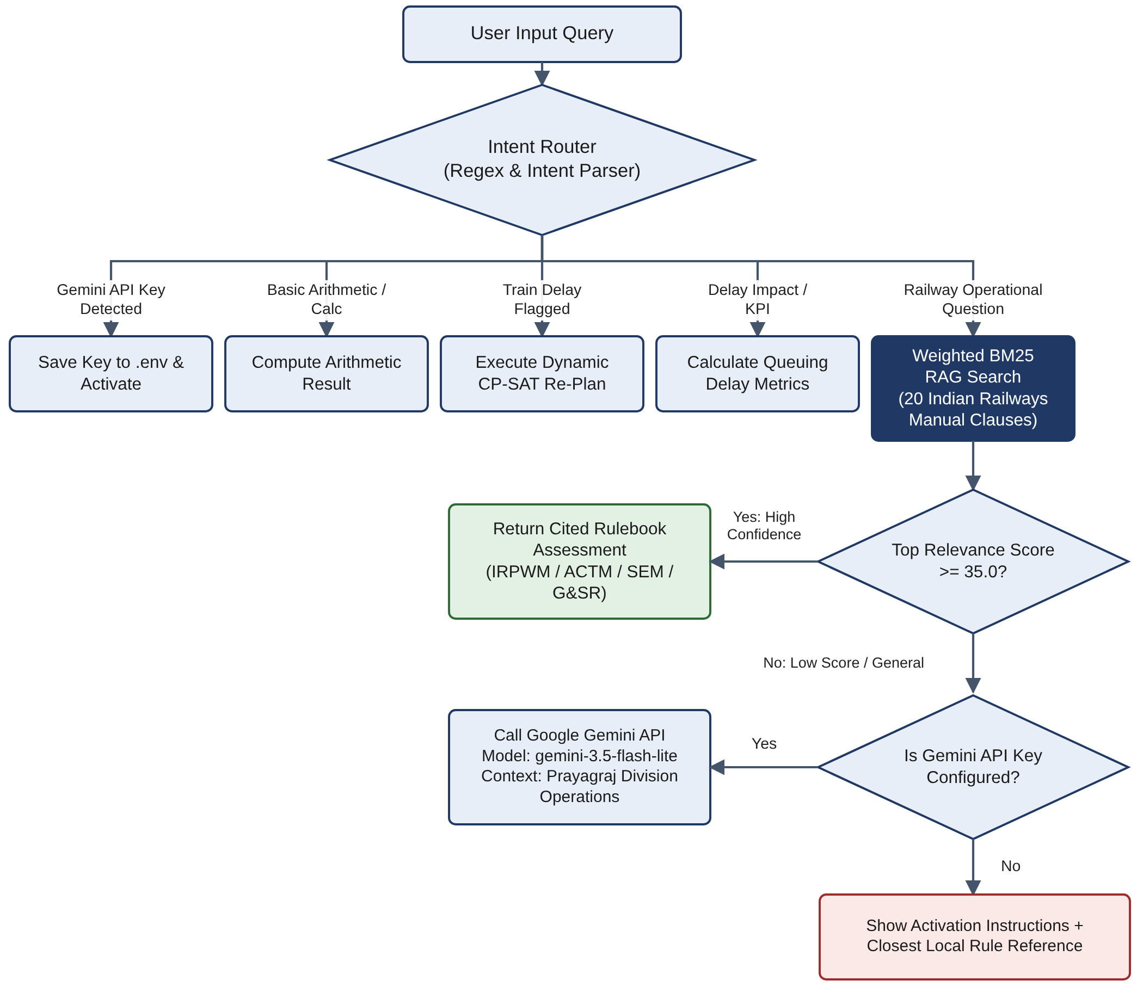
IR-Copilot: Hybrid RAG + Google Gemini
20-document knowledge base (selected)
IRPWM_605: thermit/flash butt weld cooling 30-45 min, 30 km/h
IRPWM_812: tamping protocols, adjacent-line speed limits
IRPWM_610: emergency fish-plating, broken rails
ACTM_207: 25kV OHE isolation, Power Block, earthing
ACTM_502: neutral section PTFE insulator overhaul
SEM_124: S&T disconnection T-351 / reconnection T-352
SEM_304: point machine 5 mm obstruction test
GSR_1506: Traffic Block authority, Caution Order T/409
GSR_1509: TSLW pilot authority
GSR_418: detonators 1200 m, banner flag 600 m
IR_MEGABLOCK_POLICY: night-lull consolidation
Offline RAG first; Gemini fallback for open-ended queries.
Computer Engineering Department, MPSTME, Mumbai Campus

Slide 11
Delay Model, Controller Approval & Live Schematic
5.4 Delay Propagation
5.5 HITL: NOW vs FUTURE
5.6 Live Schematic & TSLW
Saved Closures = Σ (|tasks(b)| - 1) = 7 closures
Saved Minutes = 7 closures x 95 min = 665 min
Pax Delay Saved = 665 min x 1.8 = 1,197 min
Trains Protected = round(7 x 2.14) = 15 express rakes
Freight Demurrage = 7 x 2.4 x ₹1,800 x 1.75 = ₹1,13,400
Punctuality Recovery = min(99.4%, 84.5% + 1.8*N + 0.015*min) = 98.5%
A. Future slot [AI recommended]: e.g. tonight 01:30-04:30 IST; daytime expresses unaffected.
B. Apply NOW: start = current clock time; signals locked RED; trains regulated.
C. Custom slot: controller sets date and time.
12301 Howrah Rajdhani: UP, 130 km/h
12417 Prayagraj Express: UP, 110 km/h
BOXN-804 freight: regulated to loop siding
22436 Vande Bharat: DOWN, 130 km/h
TSLW (G&SR 15.09): pilot over adjacent line at 30 km/h under Caution Order T/409
Computer Engineering Department, MPSTME, Mumbai Campus

Slide 12
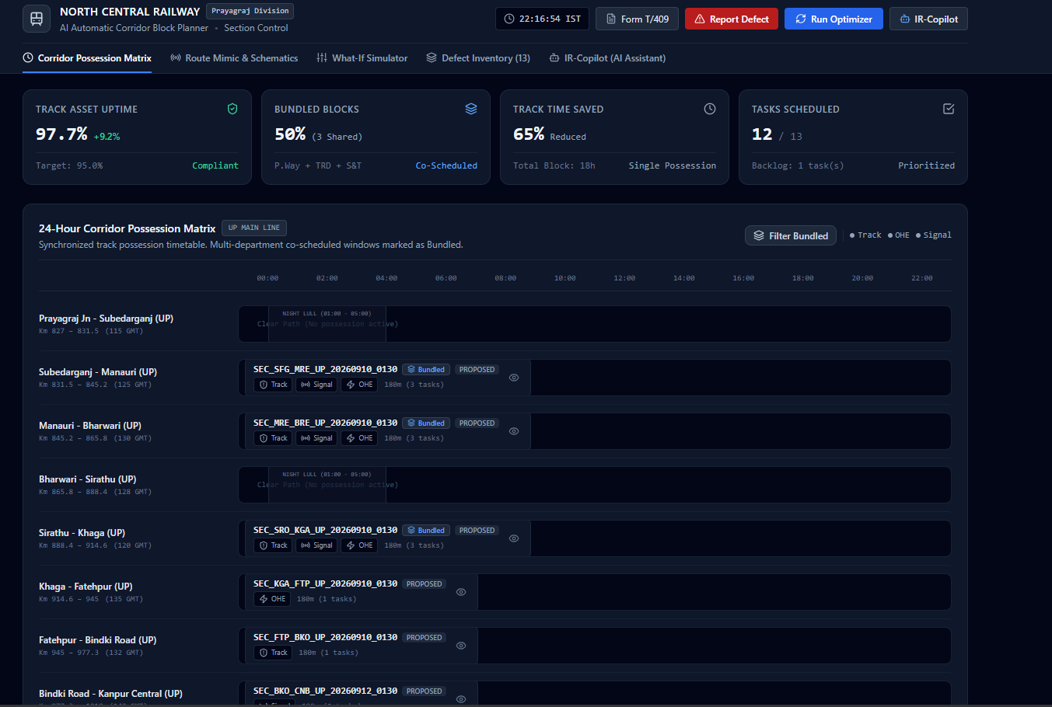
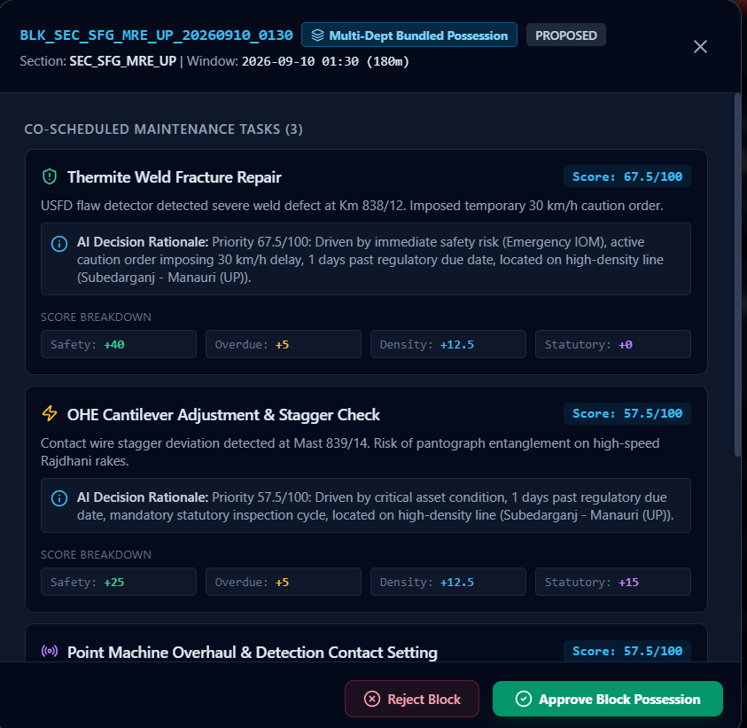
System Prototype: Interactive Corridor Gantt & Permit Sanction
Live React 18 / TypeScript Dashboard implementing Multi-Department Bundling and Human-in-the-Loop Sanction
24-Hour Corridor Schedule & Conflict Matrix (TMS / TDMS / SMMS)
Human-in-the-Loop Permit Sanction Review
• AI Decision-Support: Recommends night slot (01:30-04:30 IST) to avert passenger train disruption.
• Apply NOW vs Future: Controller emergency override with signal interlocking & OTP verification.
• Interlocking Integrity: Enforces red signal aspects and locks point levers prior to track possession.
• 16 Bidirectional Block Sections: 191 km PRYJ-CNB trunk corridor.
• Night-Lull Optimization: OR-Tools CP-SAT bundles civil, OHE, and S&T tasks into 01:00-05:00 AM lull.
• Zero Backlog: All 13 maintenance demands scheduled; 7 duplicate shutdowns eliminated.
Computer Engineering Department, MPSTME, Mumbai Campus

Slide 13
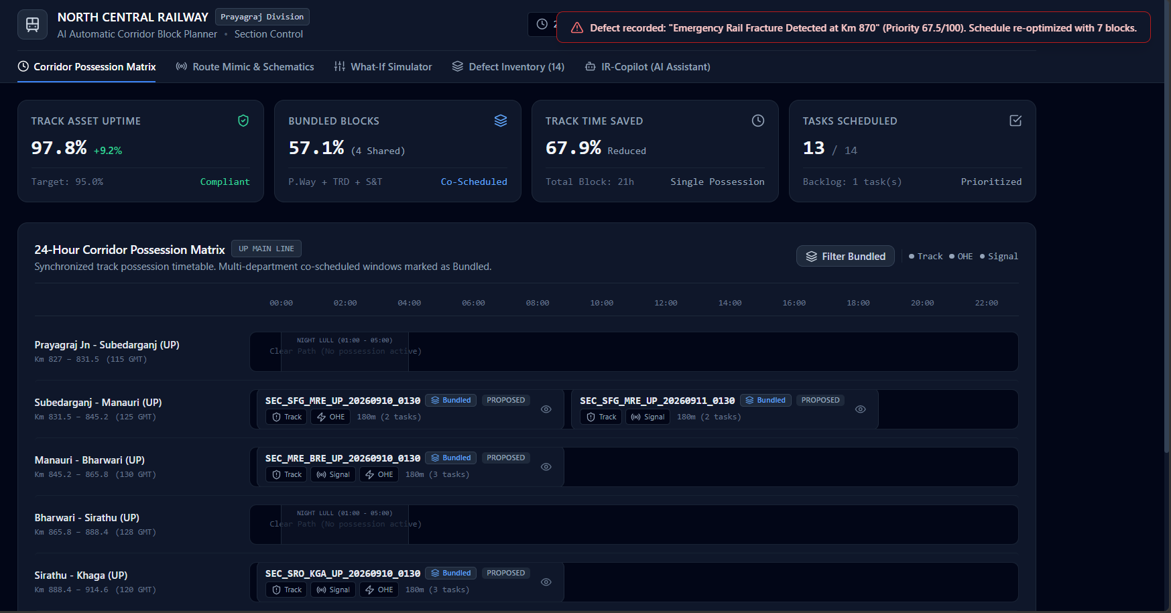
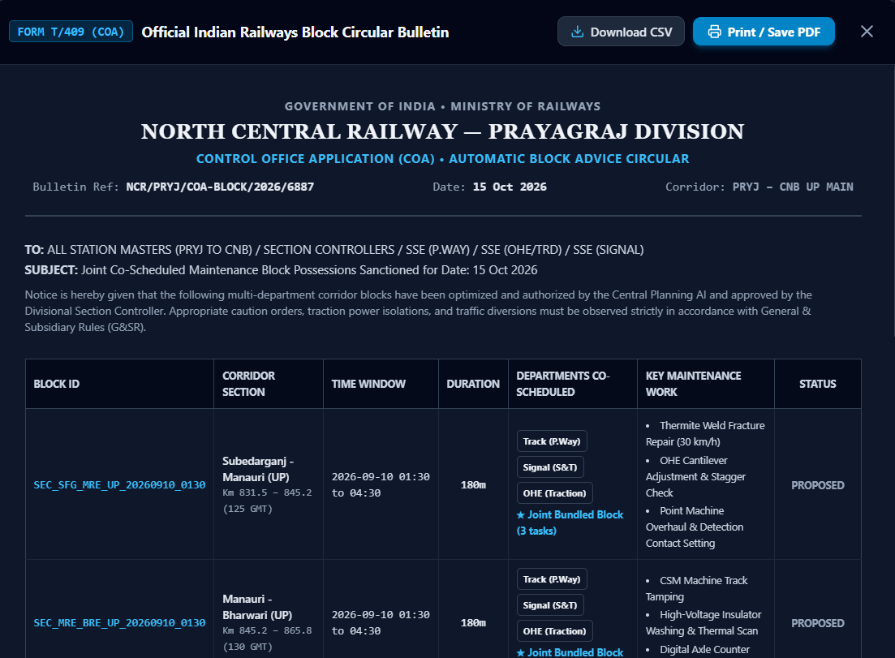
System Prototype: Digital Twin Track Schematic & Form T/409
Real-Time Track Interlocking, Dynamic Train Pilotage, and Statutory Railway Compliance Generation
Live Corridor Track Schematic & TSLW Simulator (G&SR 15.09)
Form T/409 Caution Order Bulletin
• Statutory Operating Compliance: Automated caution bulletin conforming to Indian Railways General & Subsidiary Rules.
• Strict Speed Restriction: 30 km/h over tamping & weld cooling zone (km 842/10 - 845/20).
• Multicast Dispatch: Automatically issued to Station Masters, Section Controller, Loco Pilot, and Guard.
• Live Digital Twin: Real-time telemetry tracking 12301 Rajdhani (130 km/h), 22436 Vande Bharat, and BOXN-804 freight.
• Temporary Single Line Working (TSLW): Opposite-direction pilotage over UP track under G&SR 15.09 at 30 km/h.
• Dynamic Interlocking: Section red-aspect locking, loop siding regulation, and caution boards active.
Computer Engineering Department, MPSTME, Mumbai Campus

Slide 14
Testing & Verification
Env: Windows 10/11 x64, i5/Ryzen 5 (4C/8T), 4 GB RAM (4-8 GB paging), Python 3.12.2, Node 20, Vite 5.4.21, OR-Tools 9.9.3963 CP-SAT
ID | Scenario | Observed Output | Status
TC-01 | System initialization | 16 sections (8 UP + 8 DN), 13 tasks loaded | PASS
TC-02 | MCDA calculation (ENG_001 weld fracture) | Score 67.5/100 with rationale | PASS
TC-03 | CP-SAT bundling (POST /api/plan/generate) | 13 tasks in 6 blocks; 0 unassigned | PASS
TC-04 | Bidirectional distribution | 4 blocks UP Main, 2 DOWN Main | PASS
TC-05 | Approval state isolation | Only targeted block APPROVED | PASS
TC-06 | Immediate execution (NOW) | Block times set to current IST | PASS
TC-07 | RAG: thermit weld Para 605 | IRPWM_605: 45 min buffer, 30 km/h | PASS
TC-08 | Gemini fallback: Kavach TCAS braking curve | Routed to Gemini; authoritative answer | PASS
TC-09 | Caution order (GET /api/copilot/memo/{id}) | Form T/409 with checklists and limits | PASS
TC-10 | Past-date advance block | HTTP 400 with current IST timestamp | PASS
Computer Engineering Department, MPSTME, Mumbai Campus

Slide 15
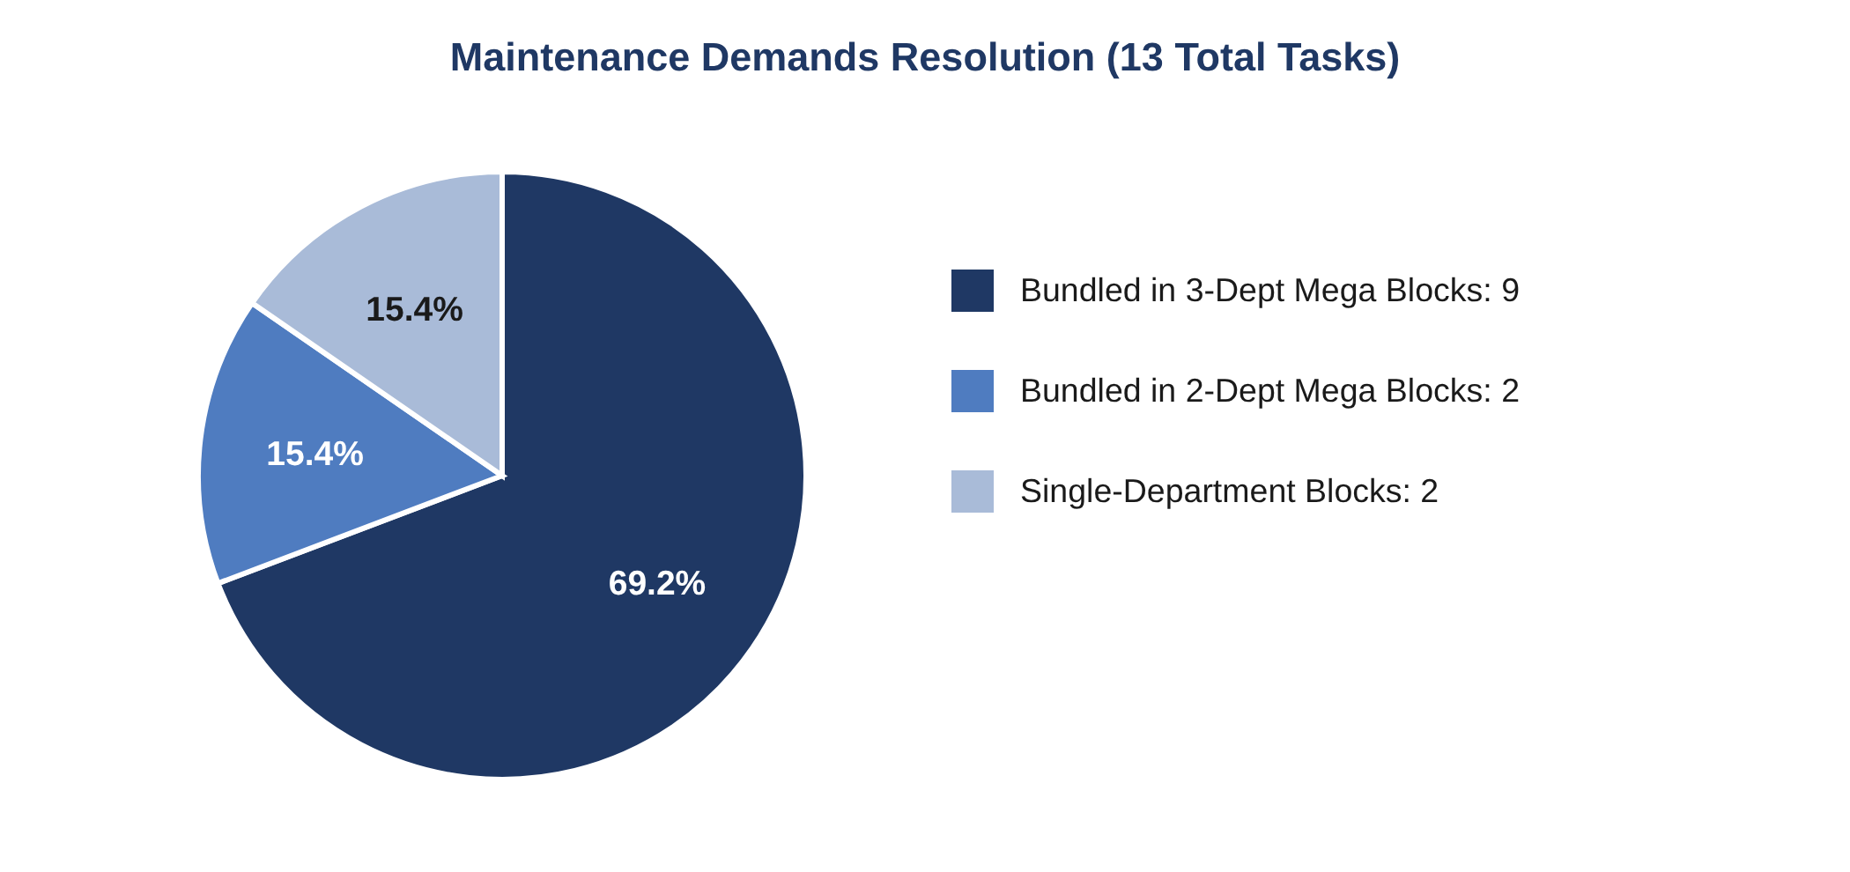
Results: 13 Demands into 6 Bundled Blocks
Block | Direction | Tasks Bundled | Departments | Yield
SFG-MRE (UP) | UP | ENG_001, TRD_001, SNT_001 | Eng + TRD + S&T | 182.5
SRO-KGA (DN) | DOWN | TRD_003, ENG_003, SNT_003 | Eng + TRD + S&T | 161.0
MRE-BRE (UP) | UP | ENG_002, TRD_002, SNT_002 | Eng + TRD + S&T | 129.0
BKO-CNB (DN) | DOWN | SNT_004, ENG_005 | Eng + S&T | 108.0
KGA-FTP (UP) | UP | TRD_004 | TRD | 23.5
FTP-BKO (UP) | UP | ENG_004 | Engineering | 23.2
Tasks demanded / scheduled: 13 / 13 (100%); backlog 0
7 duplicate shutdowns eliminated
Bundling ratio 66.7% (4 of 6 blocks)
Asset availability 98.5%
Idle window reduction 71.7%
Passenger delay saved: 1,197 min
Freight demurrage avoided: Rs 1,13,400
Punctuality preservation: 98.5%
Task scores 23.2 (ENG_004) to 69.0 (SNT_004)
Solver: 0.18-0.42 s, optimal (limit 10 s)
Pie: resolution of 13 demands
Computer Engineering Department, MPSTME, Mumbai Campus

Slide 16
Advantages, Limitations, Safety & Risks
7.1 Advantages
7.2 Limitations
Single unified multi-department possession timetable
Night-lull shift protects Vande Bharat / Rajdhani
Auditable MCDA rationales
NOW or Future execution flexibility
Codified IRPWM, ACTM, SEM, G&SR grounding
Simulated telemetry (no NTES / RTIS feeds)
Section-level model: no crossovers, turnouts, IBH
Machine run-in/out and crew rest approximated (no CMS)
7.3 Safety-Critical Considerations
7.4 Risk Management Matrix
Level 3/4 decision support: recommends and drafts only
Section Controller / Station Master authenticates every permit and movement
Peak-hour block: lambda = 150 + night-lull bonus
Thermit cooling: mandatory 45 min buffer
4 GB OOM: 4-8 GB paging buffer
Past-date block: backend rejects before IST now
AI hallucination: RAG threshold >= 35, verbatim clauses
Computer Engineering Department, MPSTME, Mumbai Campus

Slide 17
Conclusion & Future Scope
8.1 Summary of Accomplishments
8.2 Future Roadmap
Integrates AI, constraint programming and knowledge retrieval for 191 km PRYJ-CNB, 16 bidirectional sections.
13 demands resolved in 6 blocks: 66.7% bundling, 98.5% availability, 1,100+ passenger delay minutes saved.
Explainable, human-centred interface.
Direct CRIS integration: COA 2.0, TMS, BDMS APIs
Kavach / TCAS interoperability with 30 km/h braking profiles
Track temperature sensors for IRPWM Para 904 hot-weather patrolling
Migrate to encrypted PostgreSQL / TimescaleDB with RBAC
8.3 Concluding Remarks
Bridges academic operations research and control-office reality; a scalable foundation for intelligent corridor maintenance under the vision of Viksit Bharat 2047.
Computer Engineering Department, MPSTME, Mumbai Campus

Slide 18
References
[1] Ministry of Railways, Indian Railways Year Book & Operating Statistics, 2024.
[2] Rossi, van Beek, Walsh, Handbook of Constraint Programming, Elsevier, 2006.
[3] Google OR-Tools Team, CP-SAT Solver, Google Developers, 2024.
[4] D'Ariano, Pacciarelli, Pranzo, Branch and bound for train scheduling, EJOR 183(2), 2007.
[5] J. Liden, Railway infrastructure maintenance survey, Transp. Res. Procedia 10, 2015.
[6] Budai, Huisman, Dekker, Scheduling preventive railway maintenance, JORS 57(9), 2006.
[7] Belton, Stewart, Multiple Criteria Decision Analysis, Kluwer, 2002.
[8] Lewis et al., Retrieval-augmented generation, NeurIPS 33, 2020.
[9] Parasuraman, Sheridan, Wickens, Types and levels of human interaction with automation, IEEE SMC-A 30(3), 2000.
[10] Shneiderman, Human-centered AI, Int. J. HCI 36(6), 2020.
[11] Railway Board, IRPWM, 2020.
[12] Railway Board, G&SR with Amendments, NCR Prayagraj, 2022.
[13] Railway Board, ACTM, Vol. II.
[14] Railway Board, Signal Engineering Manual (SEM), Parts I & II.
[15] FastAPI Framework, fastapi.tiangolo.com, 2024.
[16] React Documentation, Meta Open Source, react.dev, 2024.
Computer Engineering Department, MPSTME, Mumbai Campus

Slide 19
Thank You
Questions & Discussion
Dishank Shah (C181) | Aatman Satra (C157)
Under the guidance of Prof. Jasleena Gonsalves
Department of Computer Engineering, MPSTME, SVKM's NMIMS, Mumbai
GitHub Repository: https://github.com/aatman0212/IndianRailways-AI-Block-Planner
Live Interactive Demo: http://localhost:5173 | REST API: http://localhost:8000/docs
Computer Engineering Department, MPSTME, Mumbai Campus

