Slide 1
Date:
TITLE: Mask R-CNN for image segmentation
NAME(ID) : Kunal Mohta 2017A7PS0148P
Himank Methi 2017A3PS0274P
Aatman Borda 2017A3PS0278P
Supervisor :

Slide 2
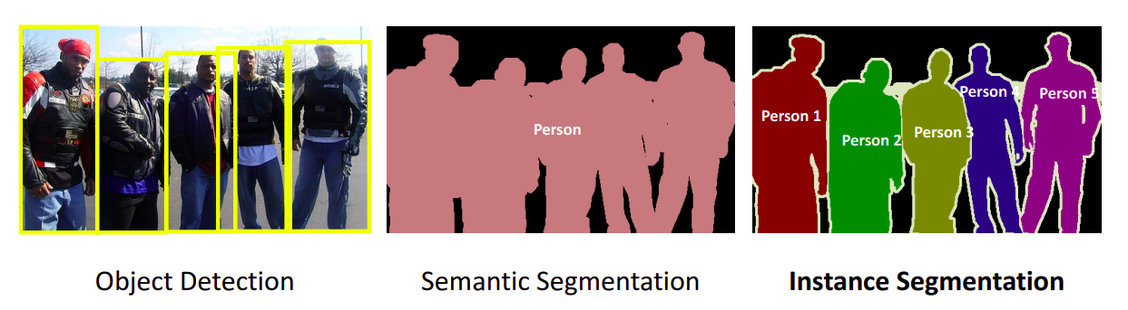
Problem
3 tracks of challenges in computer vision
Mask R-CNN

Slide 3
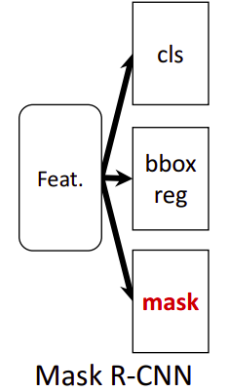
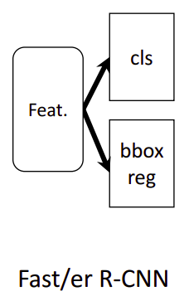
Problem
Instance segmentation :- Identification of boundaries around object at pixel level.
It is difficult because it combines 2 classical tasks - object detection & semantic segmentation.
Mask R-CNN is a leading model for the purpose of instance segmentation.
It is an extension of Faster R-CNN, which is a fast and accurate model for object detection.

Slide 4
Dataset - Coco 2014
Standard dataset for object detection and segmentation.
Size - 82,783 train images, 40,504 validation images.
Clean dataset with annotations (label, bounding box, mask) available on official website (http://cocodataset.org/#home).
Annotations given in JSON format:-
{
"info": {...},
"licenses": [...],
"images": [...], // relevant
"annotations": [...], // relevant
"categories": [...]
}

Slide 5
Structure of annotations
Image metadata
{
...
"file_name": "COCO_val2014_000000*.jpg",
"height": ...,
"width": ...,
"id": 514508
...
}
Bounding box & Mask
{
"segmentation":[
[coordinates of polygon
representing mask]
],
"image_id": ...,
"bbox": [coords of bounding box] //**
}
**NOTE: not using coordinates of bbox from annotations because they are subject to change on image modification (cropping, augmenting) - instead calculating these from the extremities of the mask itself

Slide 6
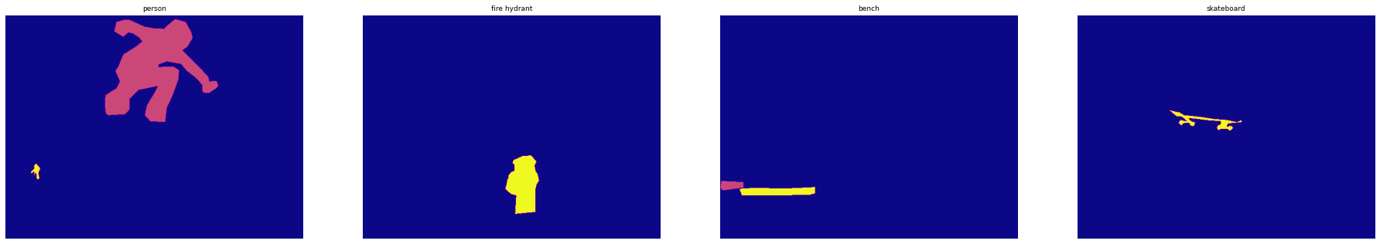
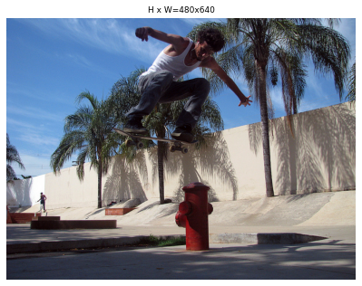
Visual appearance of masks

Slide 7
Pre-processing
Input Image
Subtraction of Mean
Rescale and Conversion to Tensor
Image tensor padding to dimensions [MAX_DIM, MAX_DIM]
Output Image Tensor

Slide 8
Pre-processing
An important task before starting the training process was to store dataset information into appropriate data structures for model to work on.
Dataset is provided to the model with following info:-
Image metadata - id, shape (height x width)
Ground truth bounding box, mask and detected class
RPN ground truths - for training of RPN

Slide 9
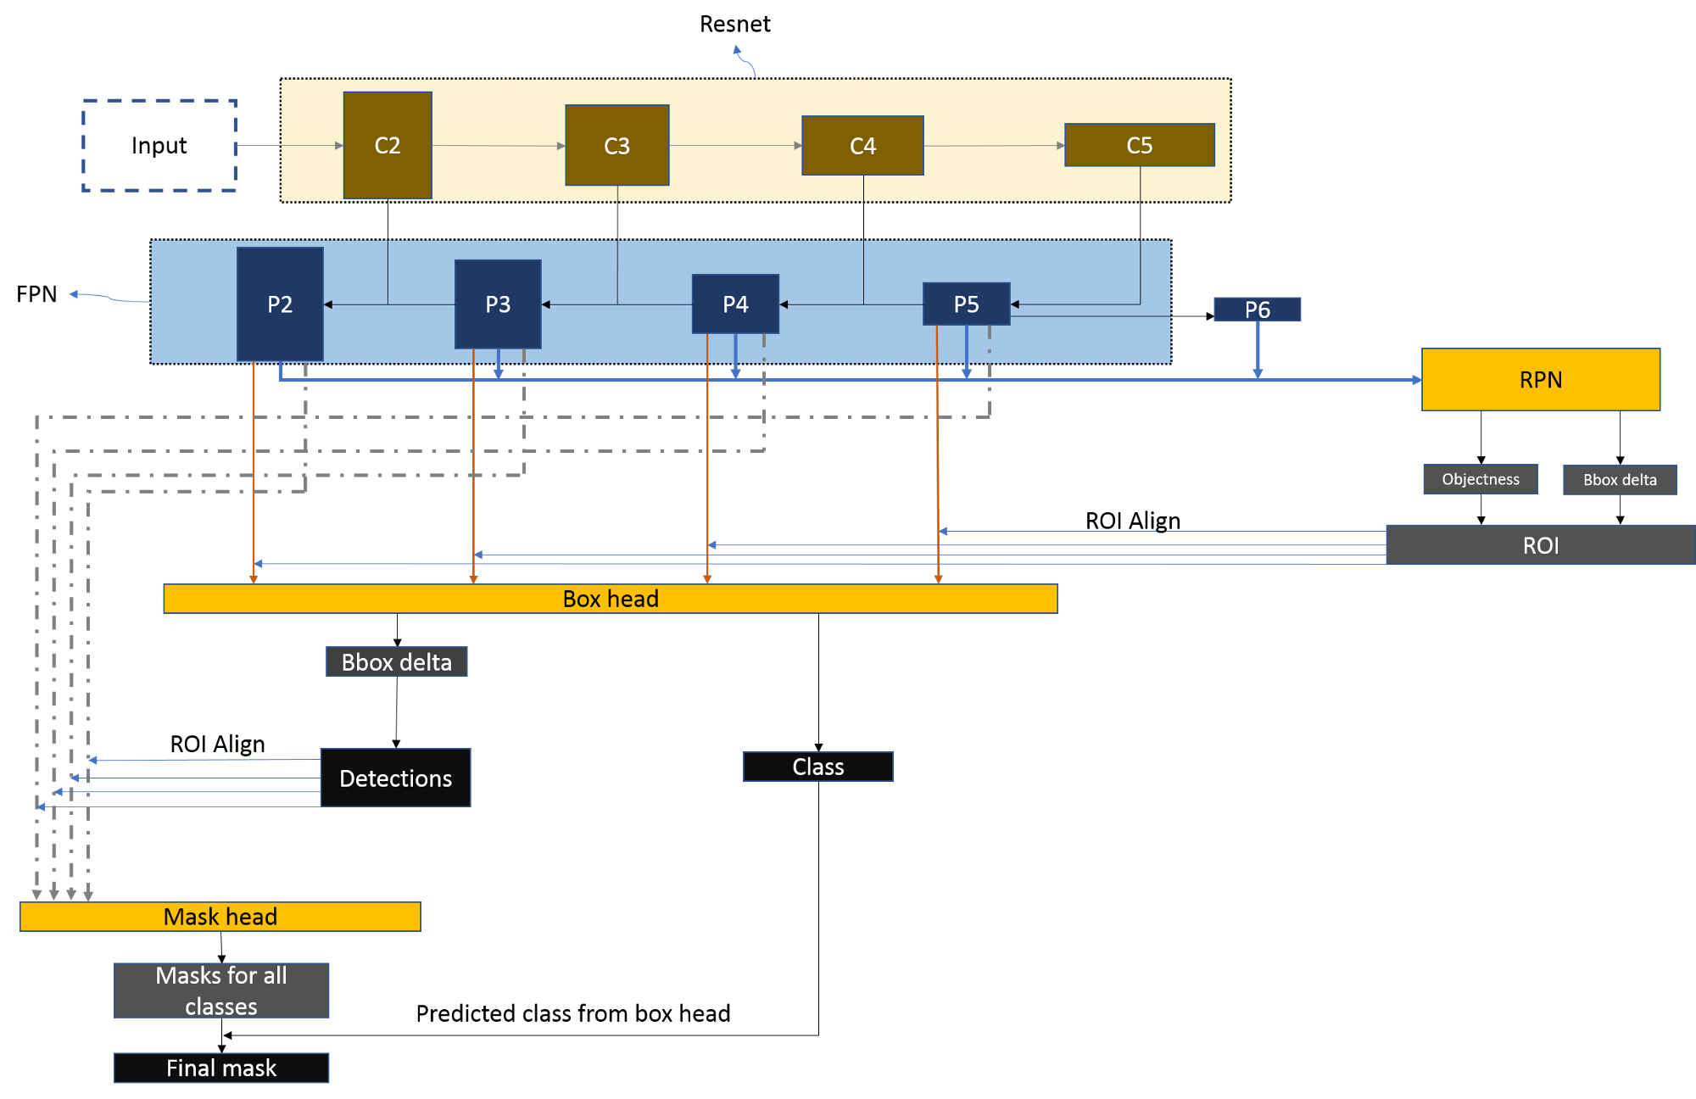
Complete structure

Slide 10
Steps (in a nutshell)
Conv. net
(Resnet + FPN)
Region proposal network (RPN)
Input Image
Feature maps
Fully connected layers
RoI Align
Region of Interests (RoI)
Bounding
box
Class
name
Mask

Slide 11
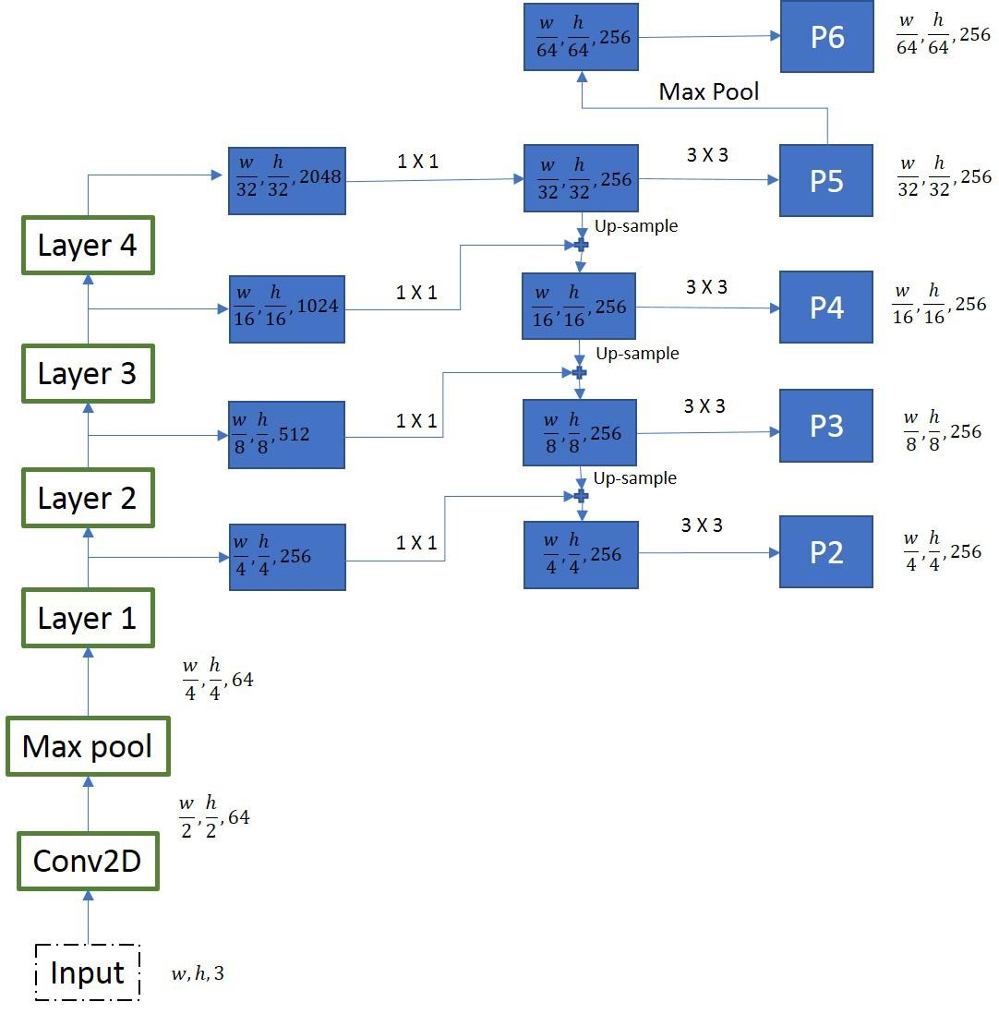
Backbone
Feature Pyramid Network
ResNet 101

Slide 12
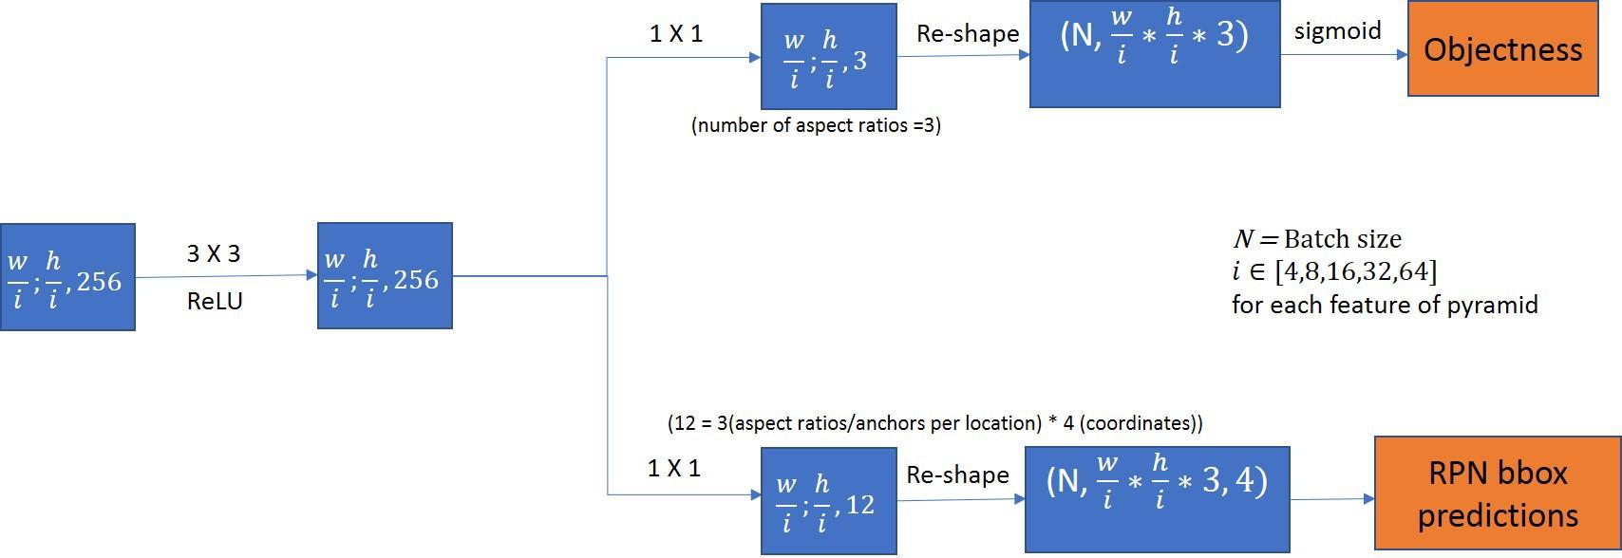
Region Proposal Network

Slide 13
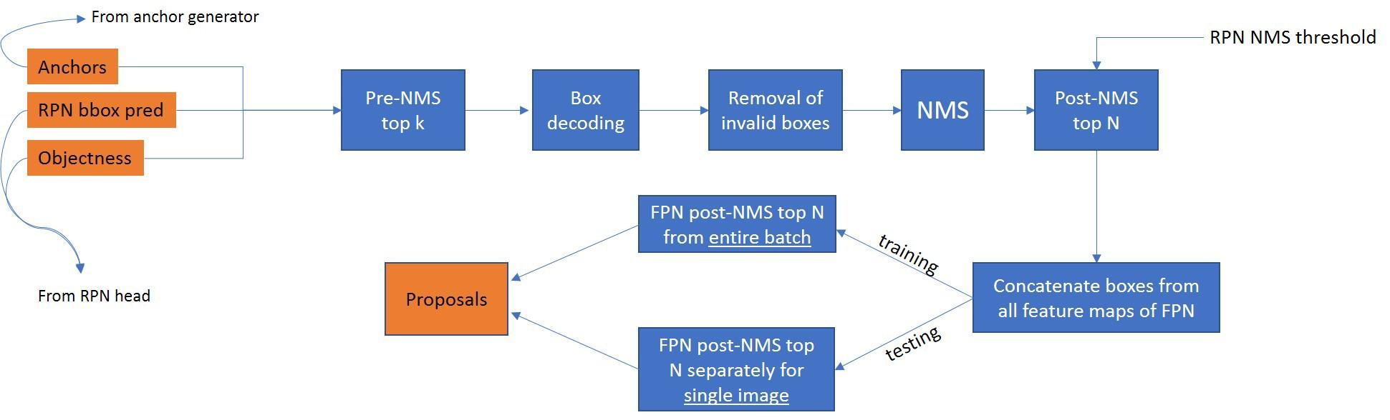
RPN (conti.)

Slide 14
Thank You

