Slide 1
Coronary Artery Disease Prediction using Machine Learning Classifiers
Name: | Roll Number:
Aatman Vaidya | AU1940108
Homak Patel | AU1940042
Mohit Rohida | AU2129001
Vishwa Raval | AU1940131

Slide 2
Introduction
What is Coronary Artery Disease?
The need to address the disease prediction through ML.
Leading cause of death, taking 17.9 million lives every year as per WHO.
Why the early prediction of the disease is needed?
[Source: WHO site]

Slide 3
Problem Statement
The aim of this project is to train a best-fit supervised machine learning model based on the selected training dataset, that predicts whether an individual has 10-years future risk of Coronary Artery Disease, given the details (input features) of that individual.
[Defining 10-years future risk: Based on the input feature values of current time, predict/estimate if the given individual is susceptible to CAD in the next 10 years.]

Slide 4
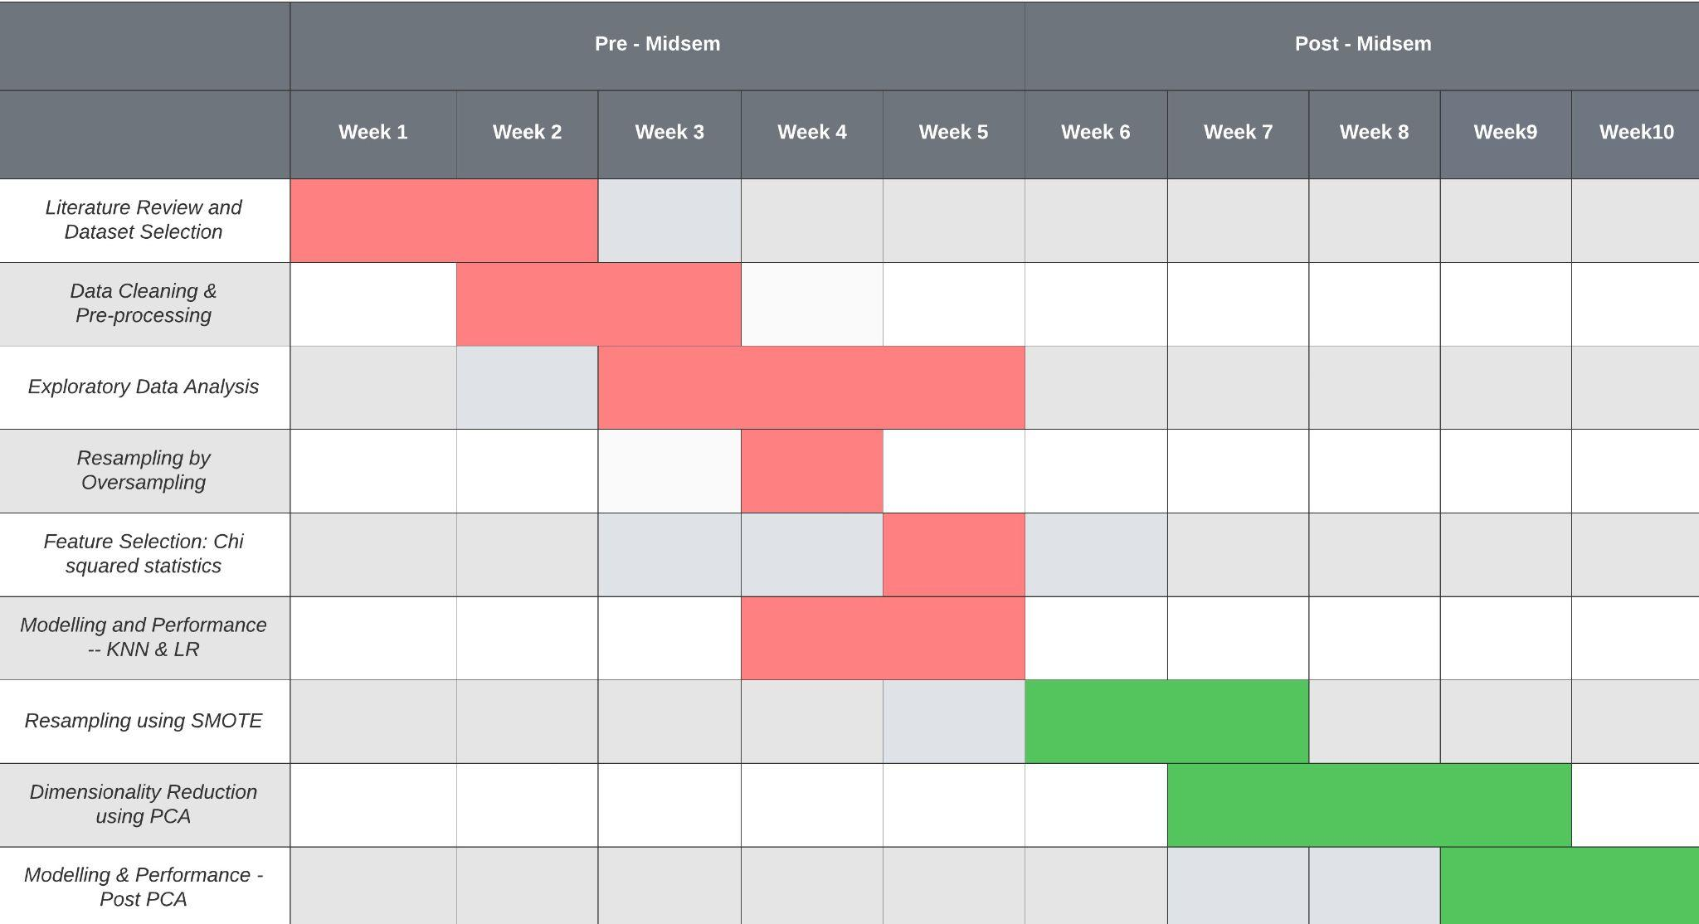
Gantt Chart

Slide 5
Existing body of work
M. Giardina, F. Azuaje, P. McCullagh and R. Harper - genetic algorithms (GA) and weighted k-nearest neighbours (WkNN) [1].
Hubert Haoyang Duan - Used k-NN and Random Forest classifiers. Random Projections and MTD for feature selection [2].
Hillary Vasquez-Gonzaga, Juan Gutierrez-Cardenas - Comparison between Random Forest and XGBoost algorithm [3].
[1] M. Giardina, F. Azuaje, P. McCullagh and R. Harper, "A Supervised Learning Approach to Predicting Coronary Heart Disease Complications in Type 2 Diabetes Mellitus Patients," Sixth IEEE Symposium on BioInformatics and BioEngineering (BIBE'06), 2006, pp. 325-331
[2] Duan, H. H. (2014). Applying supervised learning algorithms and a new feature selection method to predict coronary artery disease. arXiv preprint arXiv:1402.0459.
[3] Vasquez-Gonzaga, H., & Gutierrez-Cardenas, J. (2021, July). Comparison of Supervised Learning Models for the Prediction of Coronary Artery Disease. In 2021 5th International Conference on Artificial Intelligence and Virtual Reality (AIVR) (pp. 98-103)

Slide 6
Approach - Post Mid Semester
About Model prediction:
Pre-Mid Semester - Summary
Resampling Using SMOTE
Dimensionality Reduction
Literature review & dataset selection
Dimensionality = 15
Sample size = 4240
Data cleaning & pre-processing
Exploratory data analysis
Resampling - oversampling
Feature selection - chi squared analysis
Modeling & performance
KNN & logistic regression
Class Imbalance Problem
Class1 << Class2
SMOTE
Why
How
Working Procedure
Advantages over oversampling
Performance & Hyperparameters
Feature Selection & Feature Extraction
Feature Extraction
Principal Component Analysis
Why PCA? - overcome curse of dimensionality
Transformation of the data into most informative space
Allows the use of lower dimensions while saving optimal information
Dataset- Framinghamheartstudy.org. n.d. Cardiovascular Disease (10-year risk) | Framingham Heart Study. [online] Available at: <https://framinghamheartstudy.org/fhs-risk-functions/cardiovascular-disease-10-year-risk/> [Accessed 27 March 2022].

Slide 7
Approach
Principal Component Analysis - Process:
Obtain covariance matrix S for given dataset
Find eigenvalues for the covariance matrix.
Obtain eigenvectors for 5 eigenvalues with maximum magnitude. These will be our 5 principal components.
This projects our dataset on 5 dimensional-space formed from principal components obtained.
Pros & Cons - Discussion
Final Modeling
Data splitting and scaling
KNN
Value of K
5 (Before PCA)
9 (On the new dataset, post PCA)
Logistic Regression
Penalty: L1
Performance measures
Recall>Accuracy
F2-Score>F1-Score
AUC/ROC

Slide 8
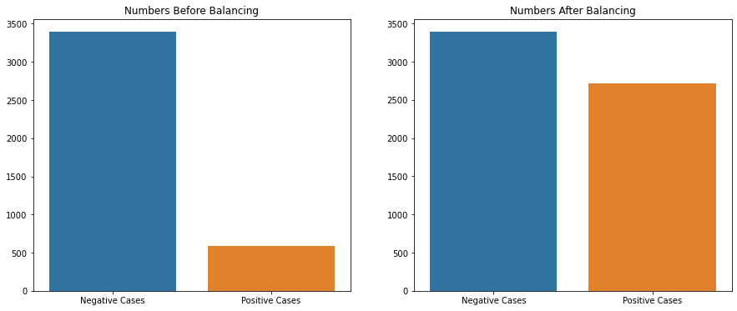
Final Results - Data Balancing Using SMOTE

Slide 9
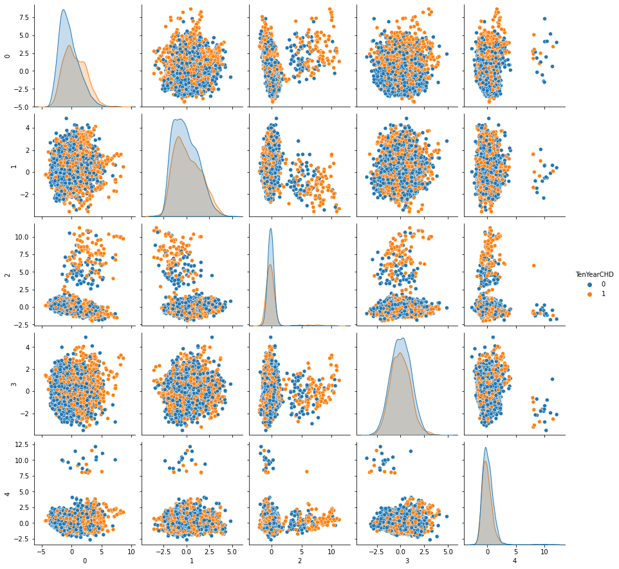
Final Results - Pairplot after PCA

Slide 10
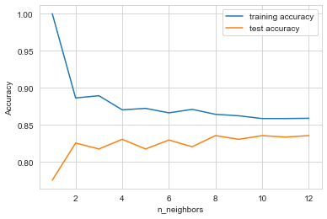
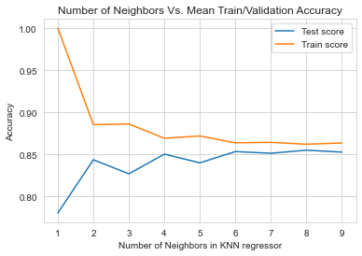
Final Results - Deciding the value of k in kNN
Pre PCA Dataset
Post PCA Dataset

Slide 11
Final Results - Performance Measures
Measures | Pre-PCA | Post-PCA
Accuracy | 0.763255 | 0.8325
Precision | 0.78 | 0.78
Recall | 0.76 | 0.83
F1 Score | 0.786733 | 0.78
F2 Score | 0.834389
AUC | 0.839396 | 0.653970
Measures | Pre-PCA | Post-PCA
Accuracy | 0.675626 | 0.8335
Precision | 0.68 | 0.78
Recall | 0.68 | 0.83
F1 Score | 0.684569 | 0.77
F2 Score | 0.694263
AUC | 0.734181 | 0.709885
kNN
Logistic Regression

Slide 12
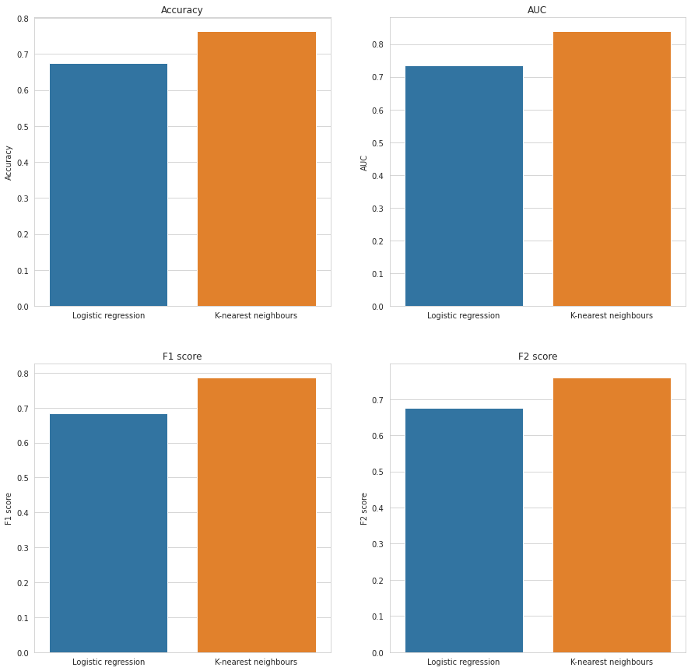
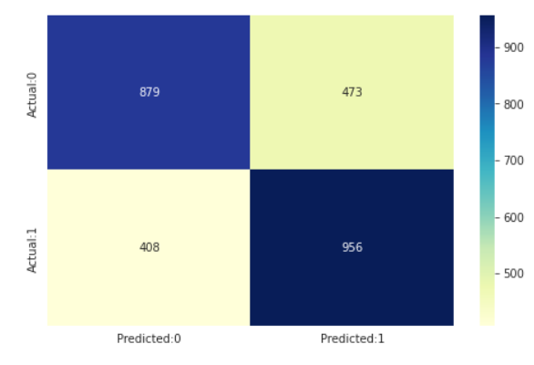
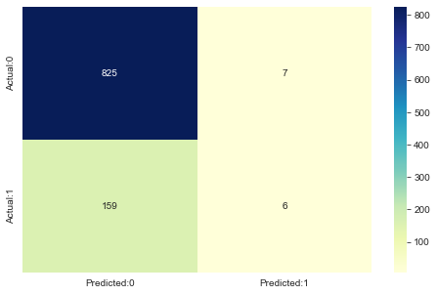
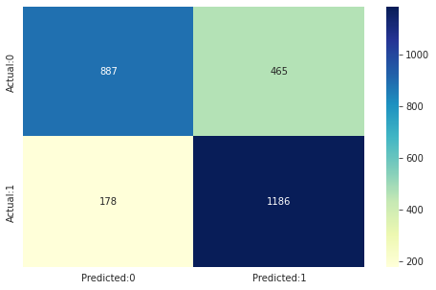
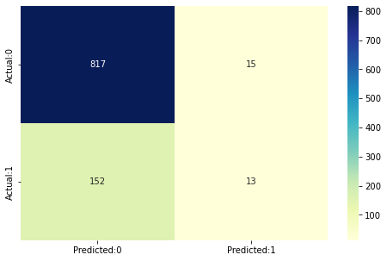
Final Results - Logistic Regression & kNN
Confusion Matrix
Logistic Regression - Pre PCA
Logistic Regression - Post PCA
kNN - Pre PCA
kNN - Post PCA

Slide 13
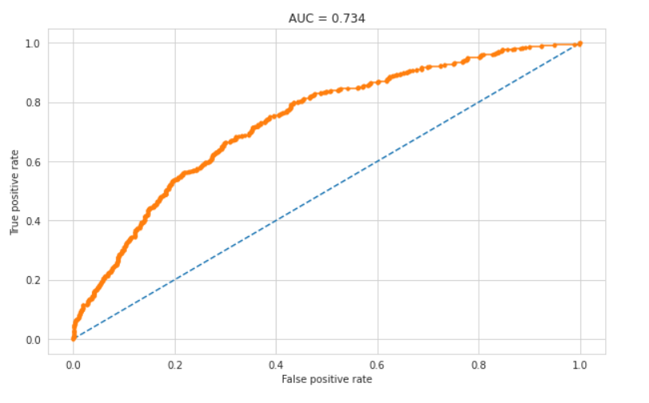
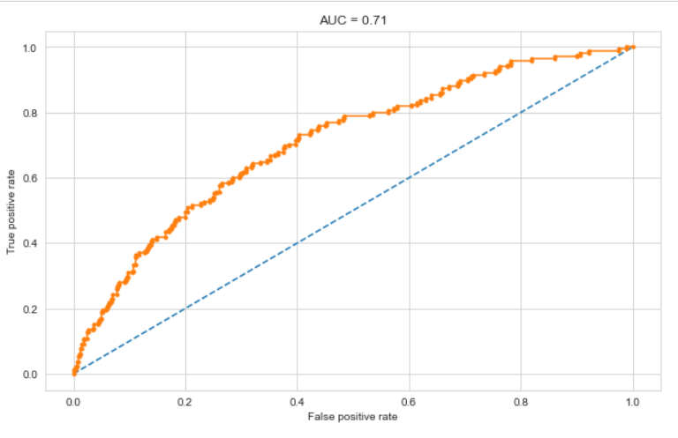
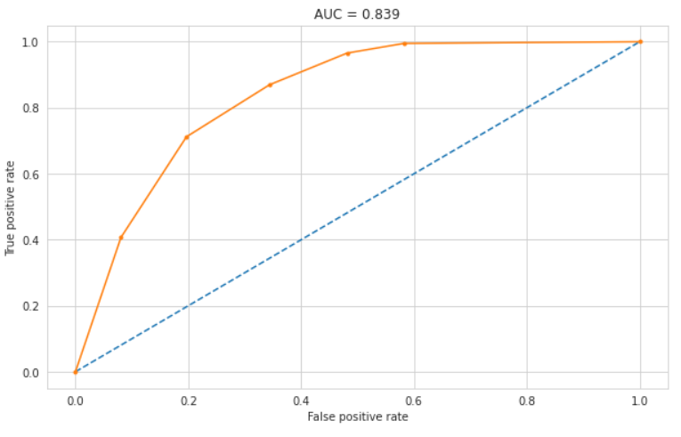
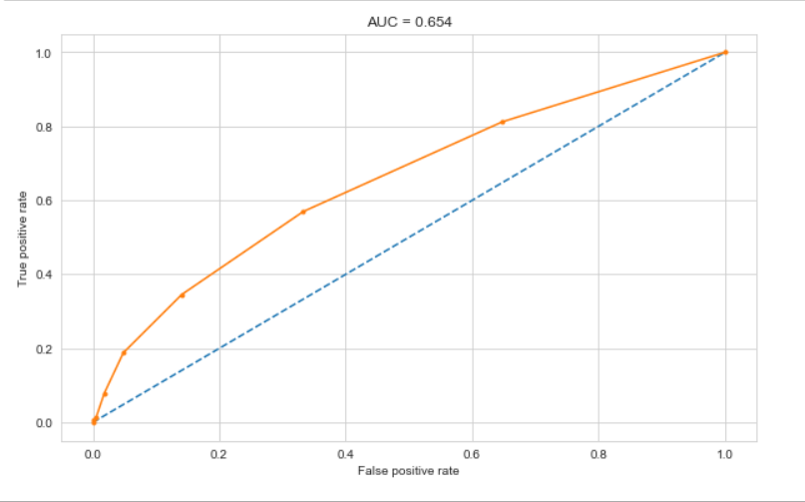
Final Results - AUC/ROC
Logistic Regression - Pre PCA
Logistic Regression - Post PCA
KNN - Pre PCA
KNN - Post PCA

Slide 14
Conclusions
Comparison between Logistic Regression and kNN
Reasons
SMOTE
Advantages & Disadvantages
Better approaches - Discussion
The effect of PCA on Framingham Dataset for Coronary Artery Disease Prediction
On kNN & Logistic Regression
On other models
Future work
Models like: Support Vector Machine, Random Forest
Other Feature Extraction techniques - Such as QDA, FLDA

Slide 15
References
M. Giardina, F. Azuaje, P. McCullagh and R. Harper, "A Supervised Learning Approach to Predicting Coronary Heart Disease Complications in Type 2 Diabetes Mellitus Patients," Sixth IEEE Symposium on BioInformatics and BioEngineering (BIBE'06), 2006, pp. 325-331, DOI: 10.1109/BIBE.2006.253297.
H. H. Duan, “Applying supervised learning algorithms and a new feature selection method to predict coronary artery disease,” arXiv.org,03-Feb-2014[OnlineAvailable: https://arxiv.org/abs/1402.0459. [Accessed: 20-Mar-2022]. .
H. Vasquez-Gonzaga and J. Gutierrez-Cardenas, ‘Comparison of Supervised Learning Models for the Prediction of Coronary Artery Disease’, 2021 5th International Conference on Artificial Intelligence and Virtual Reality (AIVR). ACM, Jul. 23, 2021. doi: 10.1145/3480433.34804
Dataset- Framinghamheartstudy.org. n.d. Cardiovascular Disease (10-year risk) | Framingham Heart Study. [online] Available at: <https://framinghamheartstudy.org/fhs-risk-functions/cardiovascular-disease-10-year-risk/> [Accessed 27 March 2022].
"Cardiovascular diseases", Who.int, 2022. [Online]. Available: https://www.who.int/health-topics/cardiovascular-diseases/#tab=tab_1. [Accessed: 20- Mar- 2022]
"Understanding the ROC Curve and AUC", Medium, 2022. [Online]. Available: https://towardsdatascience.com/understanding-the-roc-curve-and-auc-dd4f9a192ecb. [Accessed: 20- Mar- 2022]
R. Bharti, A. Khamparia, M. Shabaz, G. Dhiman, S. Pande, and P. Singh, ‘Prediction of Heart Disease Using a Combination of Machine Learning and Deep Learning’, Computational Intelligence and Neuroscience, vol. 2021. Hindawi Limited, pp. 1–11, Jul. 01, 2021. doi: 10.1155/2021/8387680.
S. Kumar, "Chi-Square Test for Feature Selection in Machine learning", Medium, 2022. [Online]. Available: https://towardsdatascience.com/chi-square-test-for-feature-selection-in-machine-learning-206b1f0b8223. [Accessed: 20- Mar- 2022].
“Coronary artery disease: Causes, symptoms, diagnosis & treatments,” Cleveland Clinic. [Online]. Available: https://my.clevelandclinic.org/health/diseases/16898-coronary-artery-disease. [Accessed: 20-Mar-2022].
Heart.org, 2022. [Online]. Available: https://www.heart.org/-/media/phd-files-2/science-news/2/2021-heart-and-stroke-stat-update/2021_heart_disease_and_stroke_statistics_update_fact_sheet_at_a_glance.pdf?la=en. [Accessed: 20- Mar- 2022]

