Slide 1
Coronary Artery Disease Prediction using Machine Learning Classifiers
Name: | Roll Number:
Aatman Vaidya | AU1940108
Homak Patel | AU1940042
Mohit Rohida | AU2129001
Vishwa Raval | AU1940131

Slide 2
Introduction
What is Coronary Artery Disease?
The need to address the disease prediction through ML
Statistics related to Coronary Artery Disease
Why the early prediction of the disease is needed?
[Source: WHO site]

Slide 3
Problem Statement
The aim of this project is to train a best-fit supervised machine learning model based on the selected training dataset, that predicts whether an individual has 10-years future risk of Coronary Artery Disease, given the details (input features) of that individual.
[Defining 10-years future risk: Based on the input feature values of current time, predict/estimate if the given individual is susceptible to CAD in the next 10 years.]

Slide 4
Existing body of work
A supervised ML algorithm which was used which incorporated genetic algorithms and weighted KNN was applied to categorize individuals with type 2 diabetes mellitus (T2DM) based on the presence or absence of coronary heart disease (CHD) problem [1].
Comparing the accuracy of Random Projections using the k-NN classifier vs MTD Feature Selection and Random Forest for predicting artery disease [2].
In very recent work, a comparison of different supervised learning models for the prediction of CAD was done. The comparisons revealed that utilizing a whole set and a subset of features as input for the Random Forest and XGBoost algorithms produced the best results [3].

Slide 5
Approach
About Model prediction:
Selection of an appropriate training dataset
Data Cleaning & Pre-processing
Exploratory Data Analysis
Literature review for a data set:
Reliable & Relevant
Uniform
Representative & Comprehensive
Diverse
Dimensionality = 15
Sample size = 4240
Handled:
Missing Values
Duplicate Values
Removable Outliers
Important statistical insights
Correlation Matrix
Univariate Analysis
Categorical Features
Numerical Features
Bivariate Analysis
Selective pairwise plotting
Multivariate Analysis

Slide 6
Approach
Resampling
Dimensionality Reduction
Selection of Prediction Model
Class Imbalance Problem
Class1 << Class2
Solved by oversampling the positive cases
Disadvantage of oversampling:
Overfitting
SMOTE based approach (future work)
Feature Selection
SelectKBest features (K=10)
Score function - chi squared statistics
Future work:
ANOVA instead of chi squared
Principal Component Analysis
Data splitting and scaling
Logistic Regression Model
K-Nearest Neighbours
K value = 3
Performance measures
Accuracy
F1-Score
AUC

Slide 7
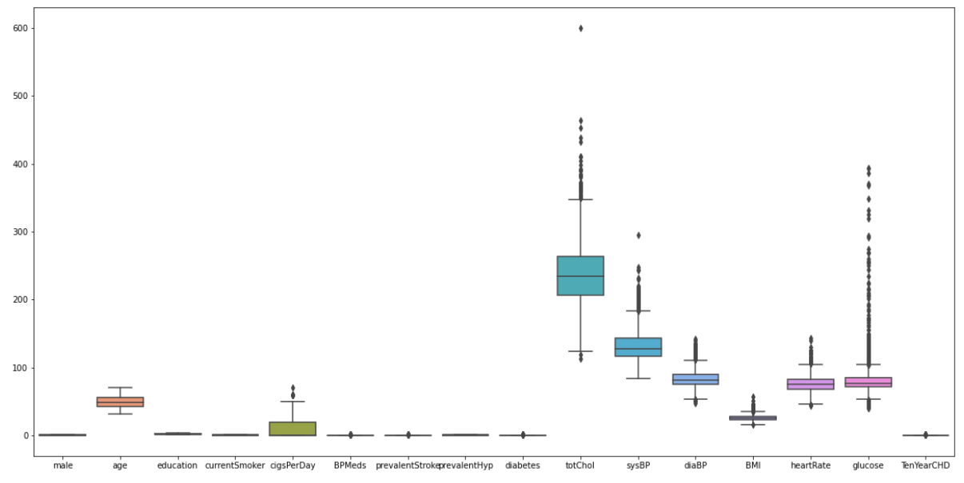
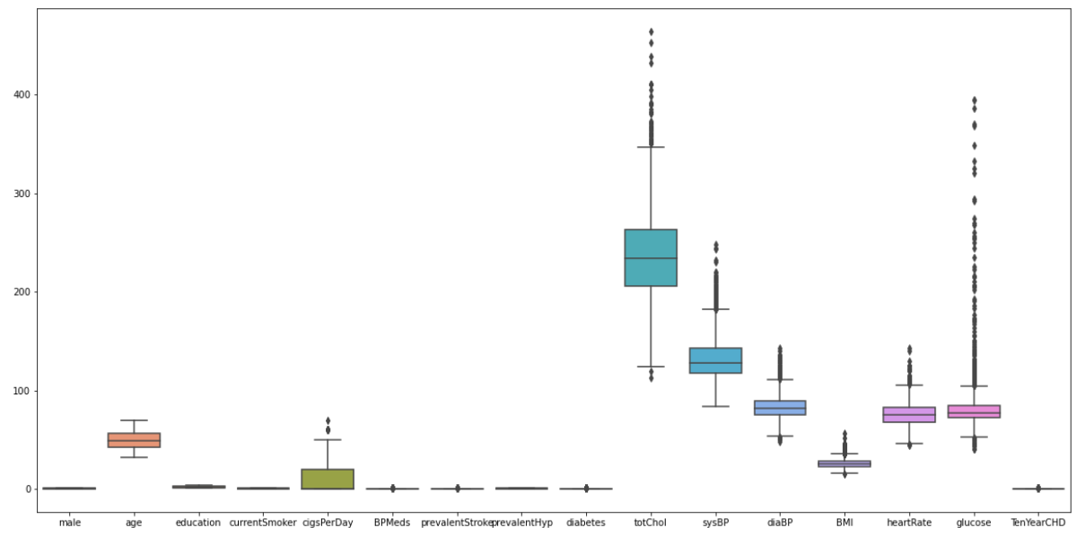
Initial Results
2. Outliers Handling:
Before Handling:
After Handling:
Null Values Handling:
Features with null values:
Glucose: Replaced by Mode
Other features: Null values removed
Feature Name | # of null values
education | 105
cigsPerDay | 29
BPMeds | 53
totChol | 50
BMI | 19
heartRate | 1
glucose | 388

Slide 8
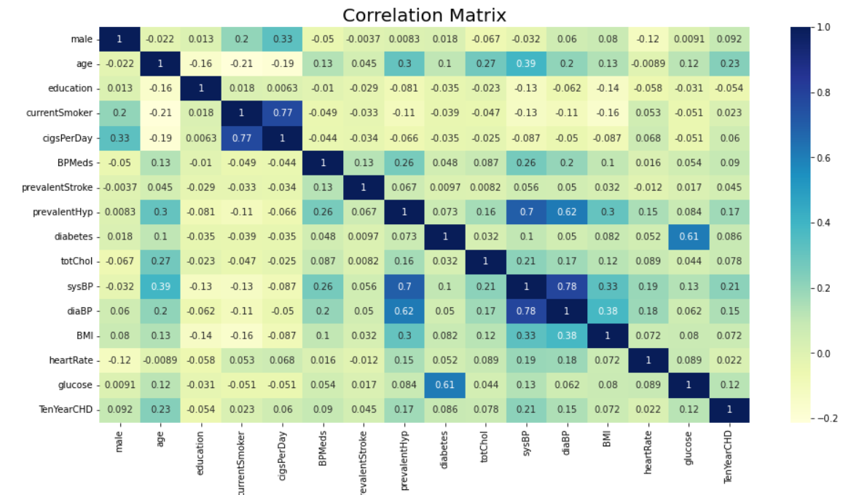
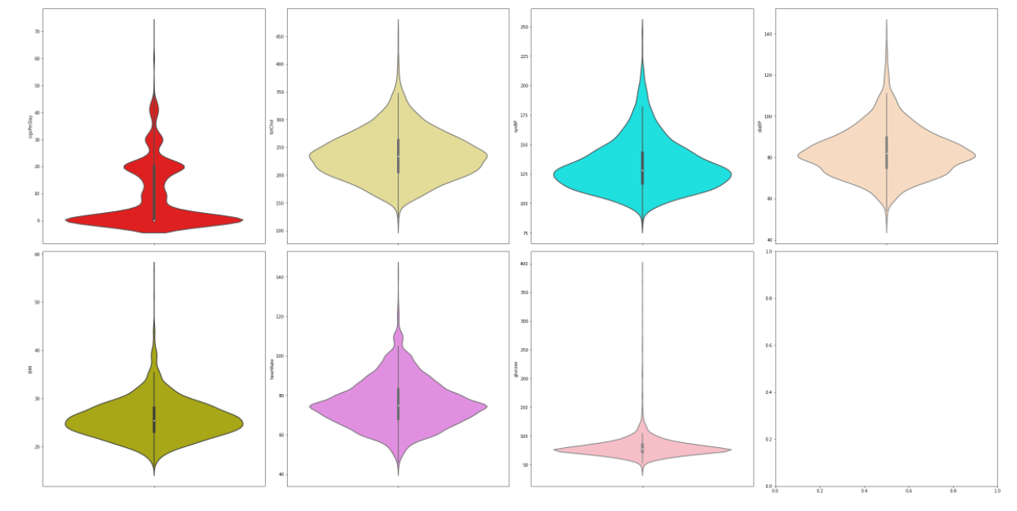
Initial Results
Exploratory Data Analysis
2. Univariate Analysis:
Numerical Features
Distribution Estimation - Using Histogram as well as violin plots
Nearly Gaussian - glucose, totChol, sysBP, diaBP and BMI
Categorical features:
Features with imbalanced data distribution: BPmeds, prevalentStroke and diabetes
Correlation Matrix:

Slide 9
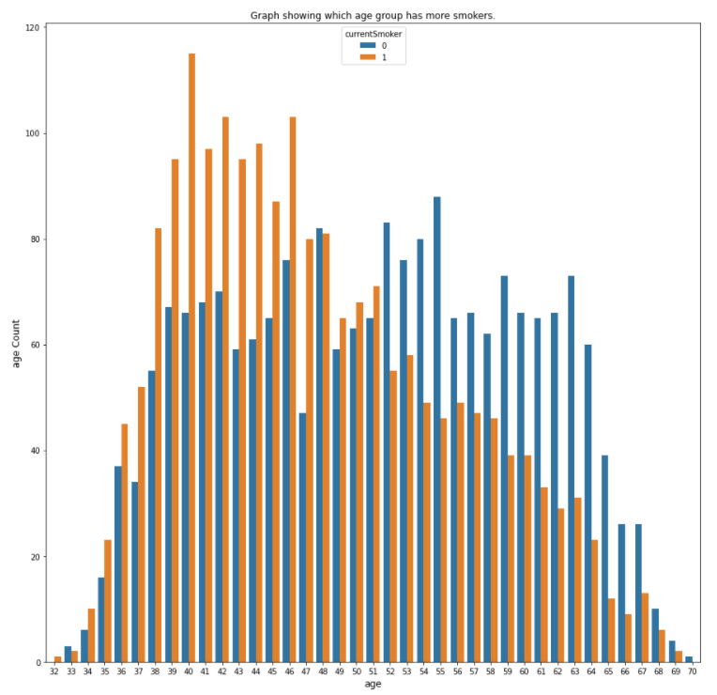
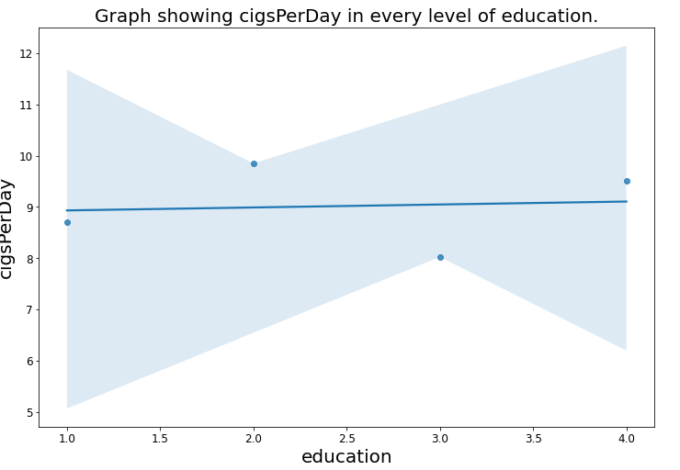
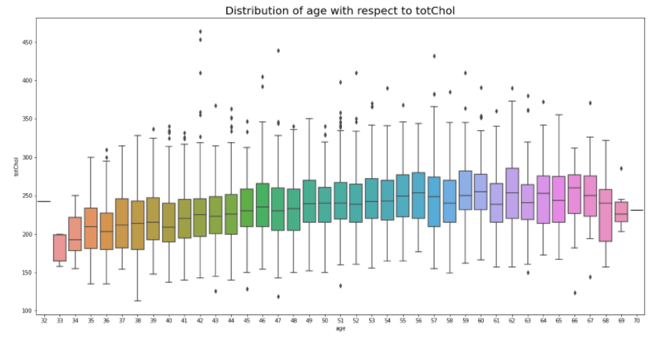
Initial Results - Exploratory Data Analysis
Bivariate Analysis: (Few results are mentioned here with inferences)
No linear relationship
Mid-age groups - more number of currentSmokers
No currentSmokers below 32
and above 70
Aged people have bad cholesterol

Slide 10
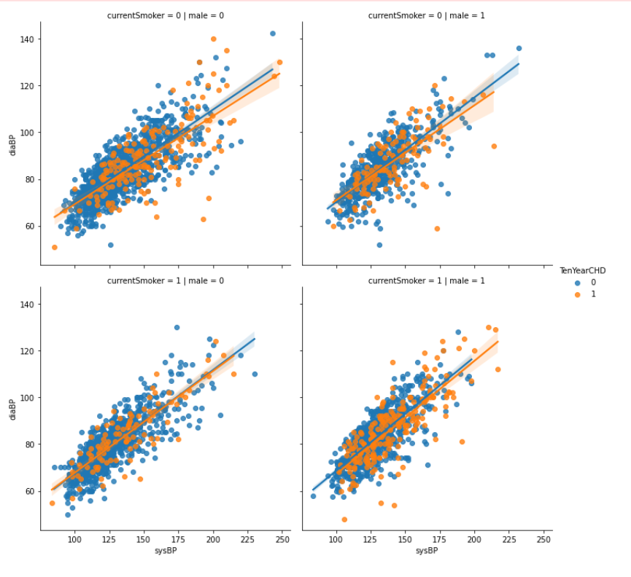
Initial Results - Exploratory Data Analysis
Multivariate Analysis: (An example)
Plotting best fit lines to show relationship between systolic blood pressure and diastolic blood pressure for the individuals based on their gender and if they are current smokers or not

Slide 11
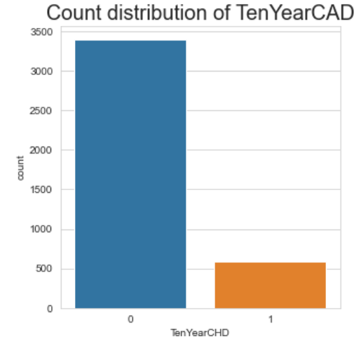
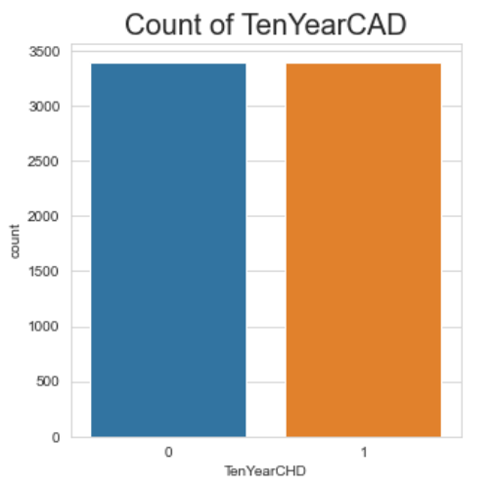
Initial Results
Resampling by oversampling positive cases:
Original Output Data: After Resampling:

Slide 12
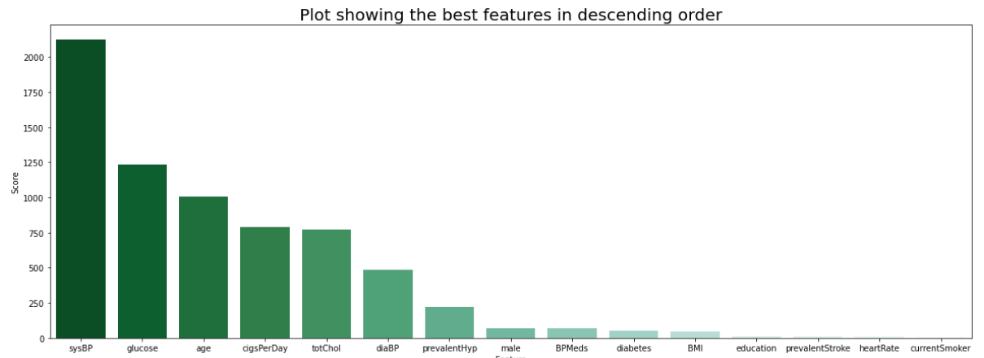
Feature Selection Using χ2 Statistics:
Takes a categorical feature and gets a p-value of that feature with respect to the actual output feature
Higher the p-value value more the dependence on output feature
Problem: Does not support Numerical features and multiclass categorical features
Solution: ANOVA
Source: Medium Article

Slide 13
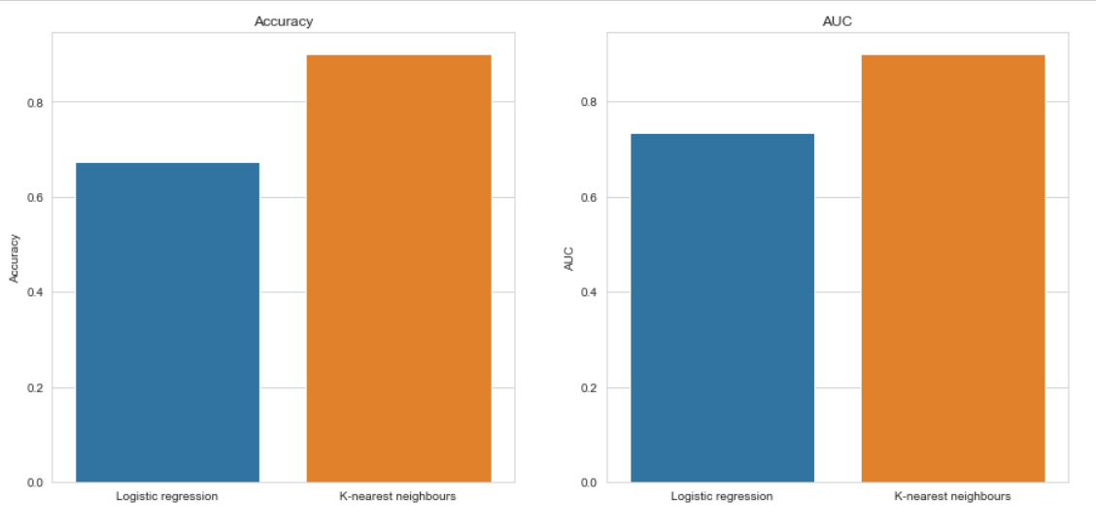
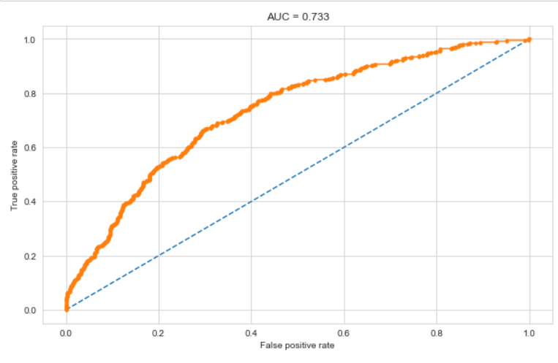
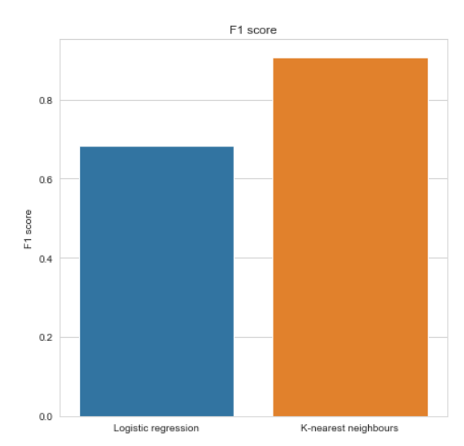
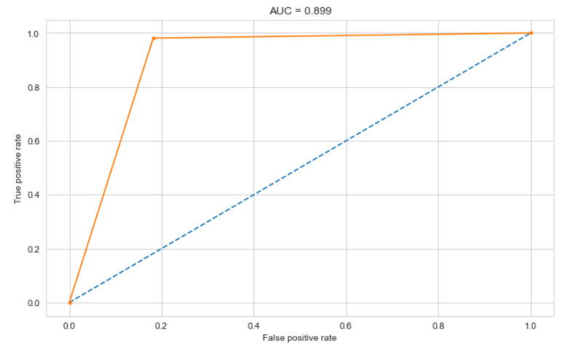
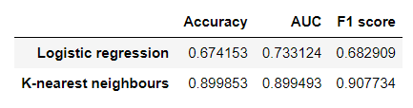
Modelling Results:
Logistic Regression:
KNN:

Slide 14
Role of each group member in the project
Name | Role
Aatman | Multivariate Analysis, Feature Selection, Logistic Regression Modelling, Report preparation
Homak | Bivariate Analysis, Resampling, kNN Model Implementation, PPT preparation
Mohit | General EDA, Feature Selection, Logistic Regression Modelling, Report preparation
Vishwa | Univariate Analysis, Resampling, kNN Model Implementation, PPT preparation

Slide 15
Future work
ANOVA score function or PCA for dimensionality reduction
EDA after dimensionality reduction – Include pairplots
Instead of oversampling, balance the dataset using Synthetic Minority Oversampling Technique (SMOTE)
Apply the same models (LR and KNN) on that lower dimensional data and compare the results
Few other models such as Random Forest, Gradient Boost etc.
The best fit model as per the performance measures
Hyper parameter tuning

Slide 16
References
M. Giardina, F. Azuaje, P. McCullagh and R. Harper, "A Supervised Learning Approach to Predicting Coronary Heart Disease Complications in Type 2 Diabetes Mellitus Patients," Sixth IEEE Symposium on BioInformatics and BioEngineering (BIBE'06), 2006, pp. 325-331, DOI: 10.1109/BIBE.2006.253297.
H. H. Duan, “Applying supervised learning algorithms and a new feature selection method to predict coronary artery disease,” arXiv.org,03-Feb-2014[OnlineAvailable: https://arxiv.org/abs/1402.0459. [Accessed: 20-Mar-2022]. .
H. Vasquez-Gonzaga and J. Gutierrez-Cardenas, ‘Comparison of Supervised Learning Models for the Prediction of Coronary Artery Disease’, 2021 5th International Conference on Artificial Intelligence and Virtual Reality (AIVR). ACM, Jul. 23, 2021. doi: 10.1145/3480433.34804
Dataset- Framinghamheartstudy.org. n.d. Cardiovascular Disease (10-year risk) | Framingham Heart Study. [online] Available at: <https://framinghamheartstudy.org/fhs-risk-functions/cardiovascular-disease-10-year-risk/> [Accessed 27 March 2022].
"Cardiovascular diseases", Who.int, 2022. [Online]. Available: https://www.who.int/health-topics/cardiovascular-diseases/#tab=tab_1. [Accessed: 20- Mar- 2022]
"Understanding the ROC Curve and AUC", Medium, 2022. [Online]. Available: https://towardsdatascience.com/understanding-the-roc-curve-and-auc-dd4f9a192ecb. [Accessed: 20- Mar- 2022]
R. Bharti, A. Khamparia, M. Shabaz, G. Dhiman, S. Pande, and P. Singh, ‘Prediction of Heart Disease Using a Combination of Machine Learning and Deep Learning’, Computational Intelligence and Neuroscience, vol. 2021. Hindawi Limited, pp. 1–11, Jul. 01, 2021. doi: 10.1155/2021/8387680.
S. Kumar, "Chi-Square Test for Feature Selection in Machine learning", Medium, 2022. [Online]. Available: https://towardsdatascience.com/chi-square-test-for-feature-selection-in-machine-learning-206b1f0b8223. [Accessed: 20- Mar- 2022].
“Coronary artery disease: Causes, symptoms, diagnosis & treatments,” Cleveland Clinic. [Online]. Available: https://my.clevelandclinic.org/health/diseases/16898-coronary-artery-disease. [Accessed: 20-Mar-2022].
Heart.org, 2022. [Online]. Available: https://www.heart.org/-/media/phd-files-2/science-news/2/2021-heart-and-stroke-stat-update/2021_heart_disease_and_stroke_statistics_update_fact_sheet_at_a_glance.pdf?la=en. [Accessed: 20- Mar- 2022]

