Slide 1
SPEECH EMOTION RECOGNITION
Fine-tuning Self-Supervised Audio
Transformers for Emotion Recognition
A comparative study across 7 pretrained speech models and 2 emotion-speech datasets
Aatman Vaidya
Audio Signal Processing — Course Project

Slide 2
INTRODUCTION
Why Speech Emotion Recognition?
▪ Speech carries emotional information beyond words — pitch, energy, and rhythm encode affect that text transcripts discard.
▪ Applications: call-center analytics, mental-health monitoring, human-robot interaction, adaptive voice assistants.
▪ Core challenge
– Emotion is expressed differently across speakers, languages, and recording conditions
– Labeled emotional speech datasets are small compared to ASR corpora
▪ Our approach
– Leverage large self-supervised speech models (wav2vec2, HuBERT, WavLM) pretrained on unlabeled audio
– Fine-tune a classification head on each emotion dataset
– Compare 7 model variants across 2 benchmark datasets
PROJECT AT A GLANCE
7
pretrained speech models fine-tuned
2
benchmark emotion-speech datasets
14
model × dataset experiments
0.99
best F1-macro achieved (WavLM-large on EMO-DB)
Speech Emotion Recognition — Fine-tuning Self-Supervised Audio Models
2

Slide 3
DATASETS
Two Complementary Emotion-Speech Corpora
RAVDESS
EMO-DB (Berlin)
▪ 1,440 audio clips — 24 professional actors (12F / 12M)
▪ North American English, acted, studio-quality
▪ 8 emotion classes
– neutral, calm, happy, sad, angry, fearful, disgust, surprised
– Balanced: 192 clips/class (96 for neutral)
▪ Song + speech statements, 2 fixed sentences repeated across actors/intensities
▪ 535 audio clips — 10 German actors (5F / 5M)
▪ German, acted, studio-quality, smaller & more imbalanced
▪ 7 emotion classes
– anger, boredom, disgust, fear, happiness, neutral, sadness
– Ranges 46–127 clips/class
▪ 10 fixed emotionally-neutral sentences spoken in each emotion
Speech Emotion Recognition — Fine-tuning Self-Supervised Audio Models
3

Slide 4
METHODOLOGY
End-to-End Fine-Tuning Pipeline
1
→
2
→
3
→
4
→
5
Load & Split
Preprocess
HPO (Optuna)
Fine-tune
Evaluate
Stratified 70 / 15 / 15 train-val-test split per dataset (seed=42)
Resample to 16 kHz, pad/truncate to 5s, extract model-specific input features
10 trials × 3 epochs search over LR, batch size, warmup, weight decay
Up to 30 epochs, early stopping (patience=5), best hyperparameters from HPO
Held-out test set: accuracy, precision/recall/F1 (macro & weighted)
MODELS FINE-TUNED (7)
distilhubert
wav2vec2-base
wav2vec2-large
hubert-base
hubert-xlarge
wavlm-base
wavlm-large
▪ All pretrained on ~960h LibriSpeech / large-scale unlabeled speech; fine-tuned end-to-end via HuggingFace AutoModelForAudioClassification with a linear classification head.
Speech Emotion Recognition — Fine-tuning Self-Supervised Audio Models
4

Slide 5
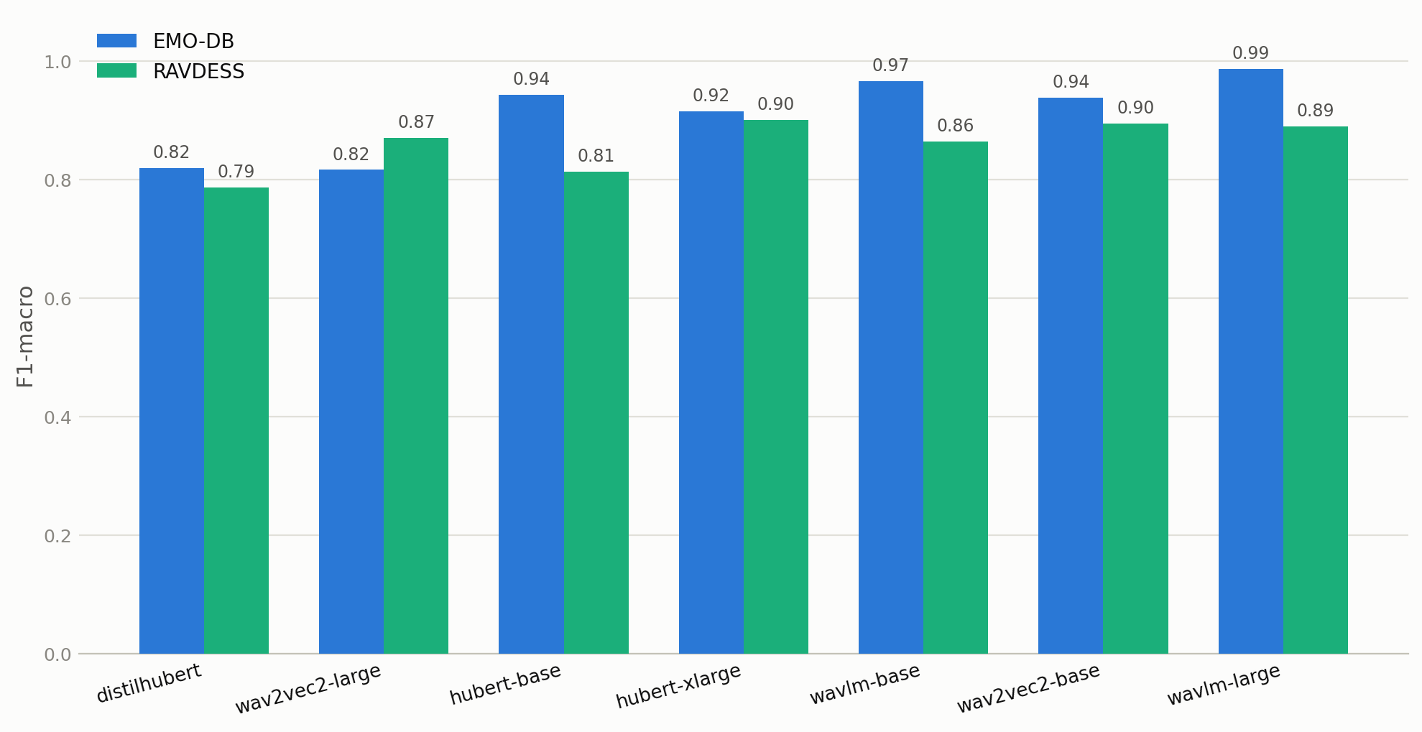
RESULTS
F1-Macro Across Models & Datasets
Model | EMO-DB — Acc. | EMO-DB — F1 (macro) | RAVDESS — Acc. | RAVDESS — F1 (macro)
distilhubert | 0.8272 | 0.8199 | 0.7963 | 0.7862
hubert-base | 0.9383 | 0.9430 | 0.8426 | 0.8133
hubert-xlarge | 0.9136 | 0.9157 | 0.9028 | 0.9006
wav2vec2-base | 0.9383 | 0.9377 | 0.8981 | 0.8951
wav2vec2-large | 0.8395 | 0.8164 | 0.8796 | 0.8700
wavlm-base | 0.9630 | 0.9656 | 0.8704 | 0.8642
wavlm-large | 0.9877 | 0.9863 | 0.8981 | 0.8898
F1-MACRO BY MODEL
▪ WavLM-large is the top performer on both datasets; distilhubert (smallest model) is weakest on both.
Speech Emotion Recognition — Fine-tuning Self-Supervised Audio Models
5

Slide 6
RESULTS
Key Observations
Larger ≠ always better
WavLM is the strongest backbone
wav2vec2-large underperforms wav2vec2-base on EMO-DB (F1 0.816 vs 0.938) — more parameters don't guarantee better fine-tuning on small datasets.
wavlm-large tops EMO-DB (F1=0.986) and is competitive on RAVDESS (F1=0.890); its noise-robust pretraining (denoising + speaker overlap) seems to transfer well to prosodic emotion cues.
EMO-DB scores higher than RAVDESS overall
distilhubert is the efficiency floor
Despite being 3× smaller, most models fit EMO-DB better — fewer classes (7 vs 8), and "calm" in RAVDESS has no EMO-DB analogue and is acoustically close to neutral.
Consistently the weakest model on both datasets (F1 0.82 / 0.79) — expected, as it is a distilled, much smaller checkpoint than the others.
Speech Emotion Recognition — Fine-tuning Self-Supervised Audio Models
6

Slide 7
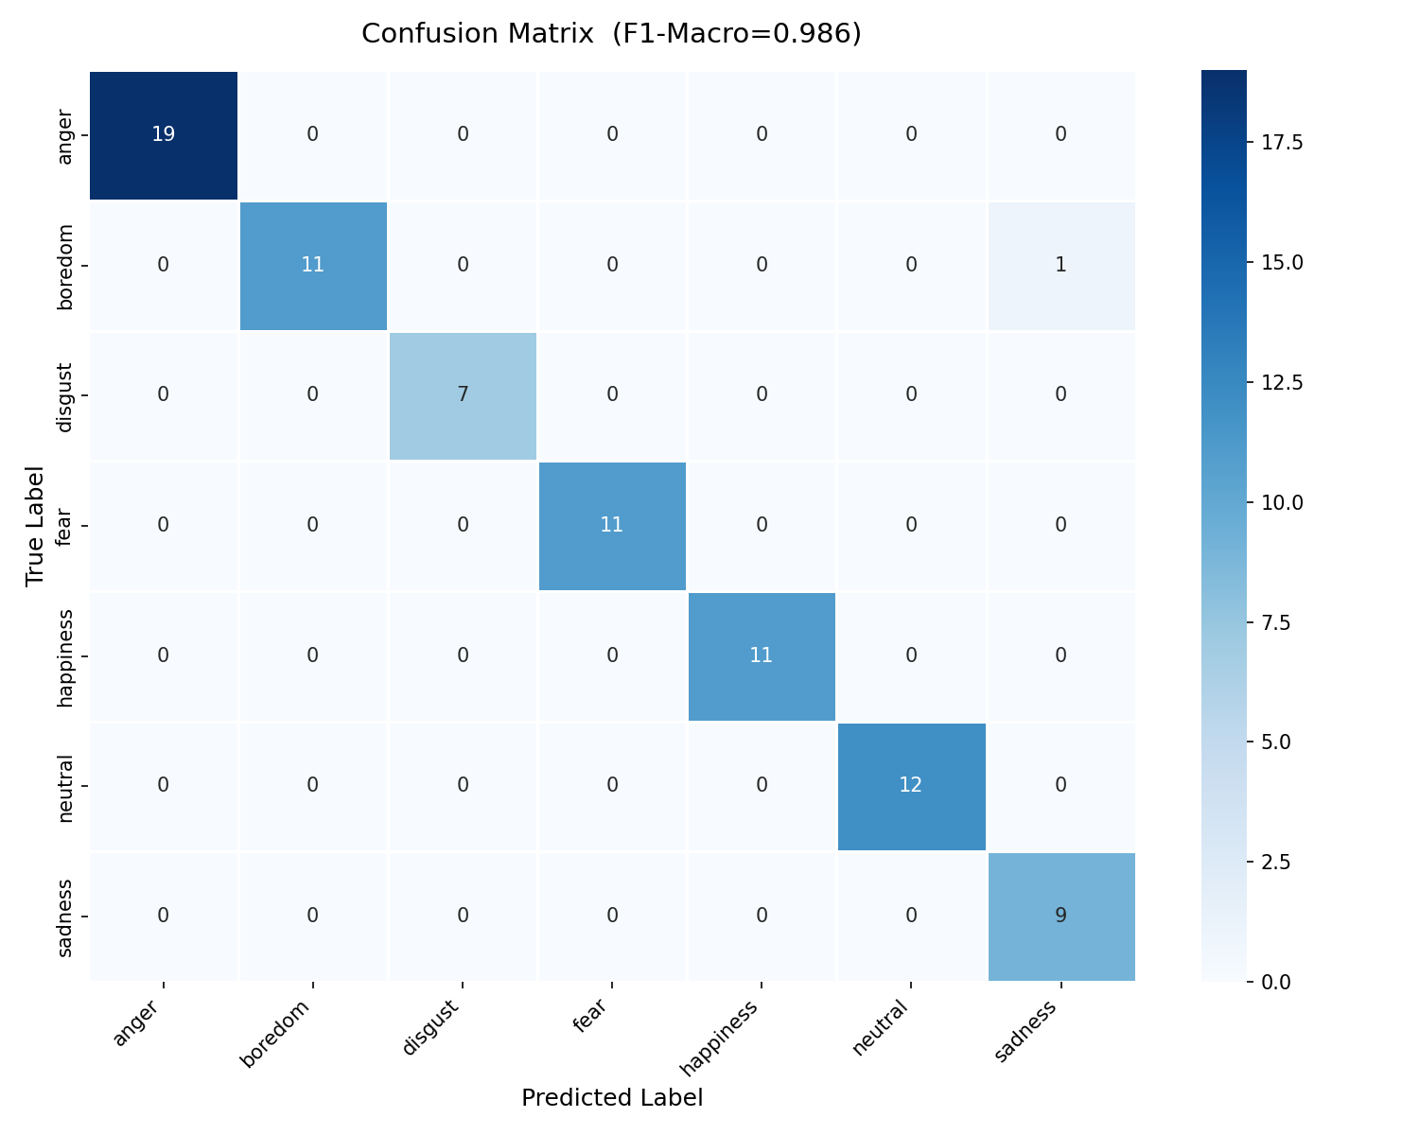
ERROR ANALYSIS
Best Case — WavLM-large on EMO-DB
F1-macro = 0.986
▪ Near-perfect diagonal — 5 of 7 classes classified with zero errors on the test set (81 clips).
▪ Only confusion: 1 "boredom" clip misclassified as "sadness" — both are low-arousal, low-valence emotions with similar flat prosody and slow speech rate.
▪ EMO-DB's small, controlled recording setup (10 actors, fixed sentences, professional studio) makes classes highly separable once a strong pretrained encoder is fine-tuned.
Speech Emotion Recognition — Fine-tuning Self-Supervised Audio Models
7

Slide 8
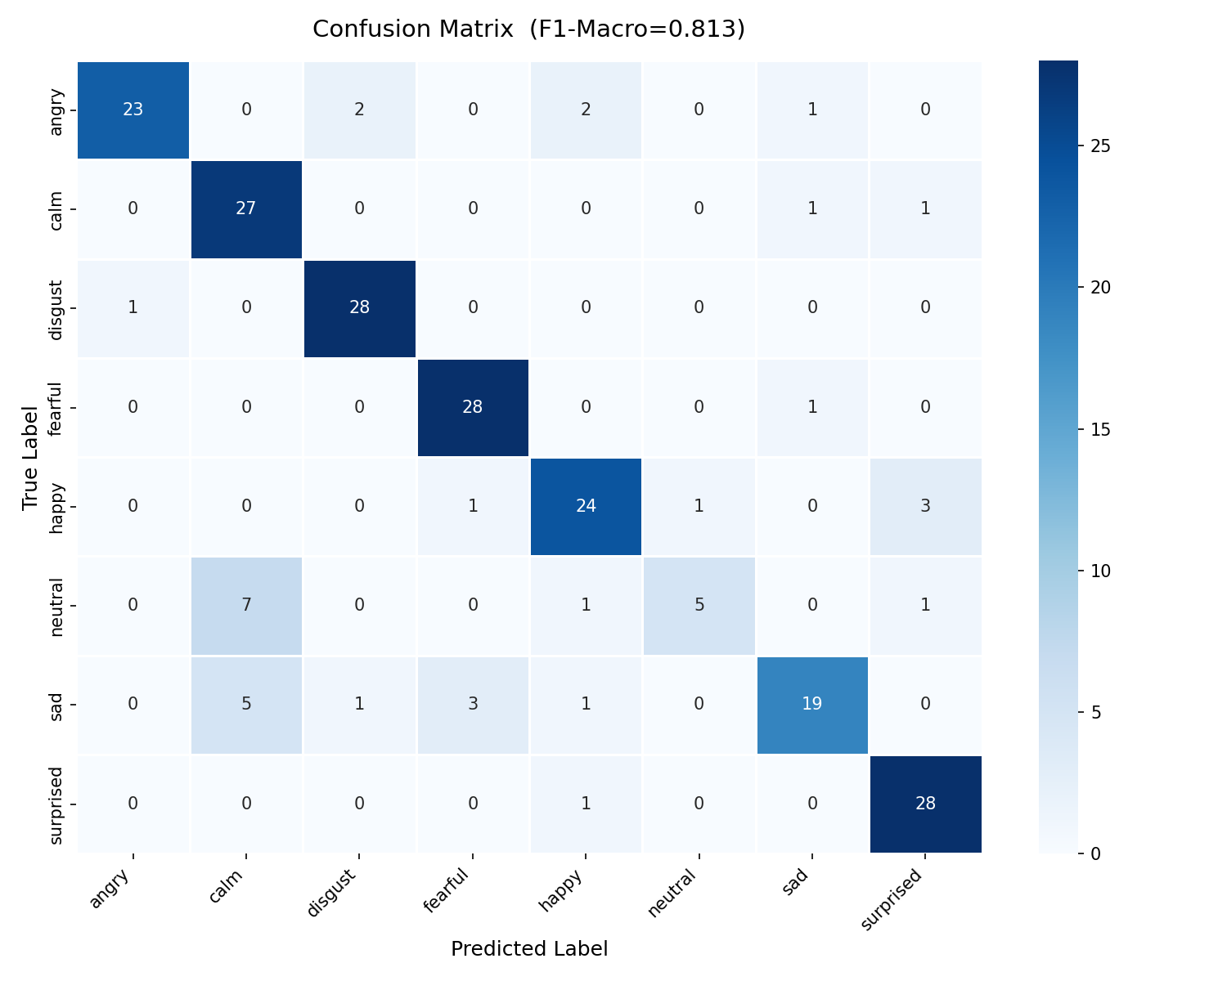
ERROR ANALYSIS
Harder Case — HuBERT-base on RAVDESS
F1-macro = 0.813
▪ "neutral" is the dominant failure mode
– Recall drops to 0.36 — only 5 of 14 neutral clips correctly identified
– 7 of 14 are misclassified as "calm" (precision for calm falls to 0.69)
▪ "calm" and "neutral" are acoustically close: both low arousal, flat pitch contour — a distinction RAVDESS makes but EMO-DB (with no "calm" class) does not.
▪ "sad" also leaks into "calm" (5 of 29 clips) — a broader low-arousal confusion cluster.
▪ This same neutral/calm collapse recurs across most models on RAVDESS, suggesting it is a dataset-level ambiguity rather than a single model's weakness.
Speech Emotion Recognition — Fine-tuning Self-Supervised Audio Models
8

Slide 9
CONCLUSION
Takeaways & Future Work
TAKEAWAYS
FUTURE WORK
▪ Fine-tuning self-supervised speech transformers is highly effective for emotion recognition — best models reach F1 ≈ 0.99 (EMO-DB) and ≈ 0.90 (RAVDESS).
▪ WavLM-large is the most consistent backbone across both datasets.
▪ Model scale alone doesn't predict performance — pretraining objective and robustness (e.g. WavLM's denoising pretraining) matter more than parameter count.
▪ Dataset design directly shapes error patterns: RAVDESS's extra "calm" class creates a persistent neutral/calm confusion absent from EMO-DB.
▪ Cross-corpus evaluation: train on one dataset, test on the other, to measure generalization.
▪ Merge "calm" and "neutral" or add auxiliary arousal/valence labels to resolve the confusion cluster.
▪ Extend to CAMEO (multi-language, larger-scale) — already scaffolded in the pipeline config.
▪ Compare against the classical MFCC + 1D-CNN baseline for a fine-tuning-vs-classical-features ablation.
Speech Emotion Recognition — Fine-tuning Self-Supervised Audio Models
9

