Slide 1
(St)art of Engineering
Aaron Schaefer

Slide 2
Conclusion
Socratic
Listen then communicate
Keep Learning

Slide 3
Disclaimer
Software Developer
Not familiar with other engineering disciplines

Slide 4
Socratic Method
Questions for clarification
Questions that challenge assumptions
Questions that challenge evidence
Questions about perspectives
Questions that challenge consequences or benefits
Questions about the question

Slide 5
6 Hats
Blue – top level view, consensus on the main question(s)
Red – emotions, feelings, biases all shared without judgment
White – facts
Green – solutions
Yellow – good about each solution
Black – bad about each solution

Slide 6
What is the big deal?
“Art is kinda boring and has nothing to do with code”
Architect story
Technical skills don’t get jobs, technical skills get interviews
Technical skills don’t get promotions, technical skills get consideration
Career paths:
Head Engineer – need “soft skills”
Management – need “soft skills”

Slide 7
All careers have a creative component

Slide 8
“Software is the only art form not limited by the laws of physics.”
-Anonymous (maybe Aaron)-

Slide 9
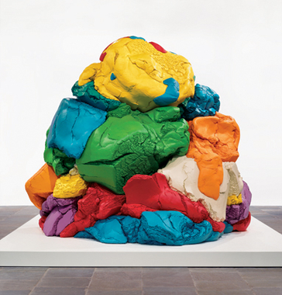
Play-Doh by Jeff Koons

Slide 10
When does a couch become a piece of art?

Slide 11
Engineering is a craft
Technical skills are the hammer and chisel
“This code is ugly”
Need to sell product
Communication is key

Slide 12
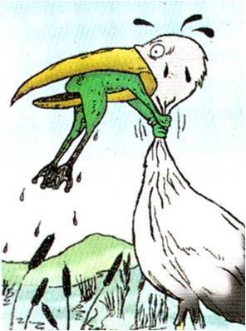
Marketing
Engineering

Slide 13

“To my understanding this was not a corporate decision, this was something individuals did,” Horn said, adding that he felt personally deceived.

Slide 14
“A clever person solves a problem. A wise person avoids it.”
-Albert Einstein-

Slide 15
“The most important skill in acting is listening.”
-Al Pacino-

Slide 16
Lessons in Listening
Listen to customers
Understand scope
Get to heart of issue
Adjust to what is important
Listen to managers, testers, other teams, etc.

Slide 17
Truth
Investigative journalist
Discover truth, don’t try to create it
If you don’t know your customers → no one wants what you built
Emotions become tightly coupled with the truth

Slide 18
“The person who knows HOW will always have a job. The person who knows WHY will always be his boss.” -Diane Ravitch-

Slide 19
Job Candidates
No technical skill, no job
Two sliders
Non-technical skills
Effective communication
Proactive, ask tough questions
Transparency
Coachable
Team mindset
No ego

Slide 20
“If you can’t explain it simply, you don’t understand it well enough.” -Albert Einstein-

Slide 21
“Everyone lives by selling something.” -Robert Louis Stevenson-

Slide 22
Keep Learning
Every 3 years, completely different
Stay sharp – career insurance
In an interview “I don’t know but I can search for that.”
Not a 40-hour week job

Slide 23
Balance
Don’t burn out
Have outlets (family, friends, hobbies, side projects, etc.)
Marathon
Have fun!!!

Slide 24
Network
Requirements:
Meet at least two new people
Sell yourself (major, goals, etc.)
Exchange contact information (email, LinkedIn, etc.)

Slide 25
Conclusion
Socratic
Communicate
Keep Learning

Slide 26
Q & A

