Slide 1
FYP Presentation Real-time Electricity Price Prediction
Presented by:
Tan Wei Song Alvin U1621166C
School of Computer Science and Engineering
Notes:
Good afternoon Prof Cheng Long and Prof Guan, today I will be presenting to you about my final year project on real-time electricity price prediction. This will include the methodology I undertook and the results I achieved at the end of this project.

Slide 2
Acknowledgement
Supervisor: Asst. Prof. Cheng Long
Notes:
Before we get started, I would like to thank Prof Cheng for embarking on this journey with me, giving me advice and comments on the project.

Slide 3
Contents
Introduction
Objective
Literature Review
Data
Overview
Data Pre-processing
Modelling
Results
Conclusion
Notes:
The outline of the presentation is as such and can be interpreted as firstly understanding my project title, the steps taken to gather my results, and lastly concluding my results.

Slide 4
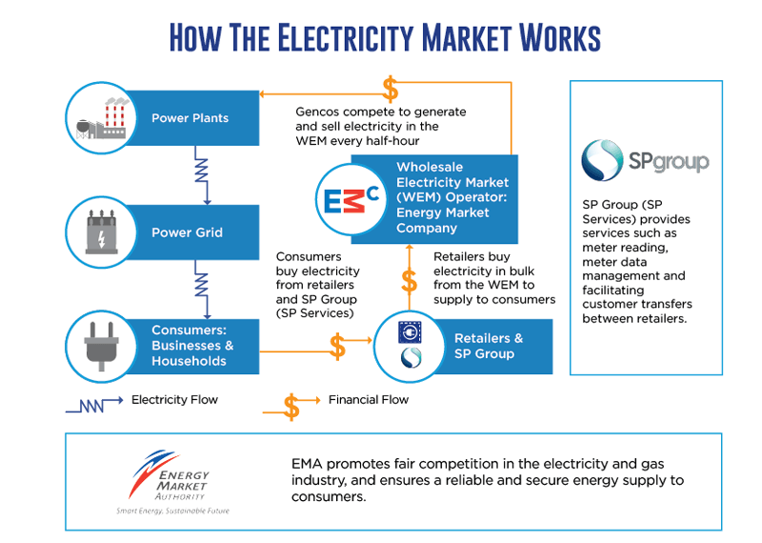
Introduction - Background
Power Generation Companies
Electric Retailers
Consumers
Notes:
Without further ado, I would like to give a brief background information on the electric market here in Singapore.
There are 3 main stakeholders in Singapore’s open electric market and they can be vaguely described as such.
The power generation companies burning either natural gas or oil to produce the electricity and sell them every half hour.
The electricity retailers buying electricity in bulk from the wholesale electricity market and competing to sell electricity to consumers.
And lastly, Consumers who can be classified as being either contestable or non-contestable depending on their level of electricity usage. Contestable consumers may choose to purchase electricity from a retailer or directly from the wholesale market or indirectly from the wholesale market through SP Services. Non-contestable consumers are supplied by SP Services.

Slide 5
Objective
Real-time Electricity Price Prediction
Real-time
Runtime
Implementation
Prediction
Accuracy
Notes:
When we look at the project title, we can identify 2 main objective in our project. The real-time aspect of predicting the price and the accuracy of the predictions.
Real-time requires a responsive interface where output can be quickly shown after entering the input. Thus, the run time of computing the prediction must be accounted for in this project.
The prediction itself must also be representative of the real-world for it to be useful. Even if we cannot predict the absolute value well, having the ability to determine the trend or seasonality is already a right step forward.

Slide 6
Literature Review
Prediction done on other countries with solar and wind farms
Germany and Brazil
Supply and demand
Supply determined by weather
Demand determined by time of use
Common timeseries prediction methods
Multi-layer perceptron (MLP)
Auto Regressive Integrated Moving Average (ARIMA)
Notes:
Studying various research papers, forecasting of electric prices in other countries shows that there are multiple factors that can affect the price.
From these sources, like most free market, prices are determined by the supply and demand.
For supply, these countries have high percentage of their electricity generated via renewable means like solar and wind, the weather plays a big part in how much electricity can be generated within that time period.
Forecasting weather is already a very established field and the researches are able to use the forecasted weather to find a correlation with the supply of electricity and thus the price of
electricity.
For demand, the time of use will be the biggest factor, especially for industrialised area where electricity will peak during operating hours.
A timeseries approach can also be undertaken by only analysing the historical price data.
And the 2 most common methods are the multilayer perceptron and auto regressive integrated moving average models.
So, we will be analysing these factors to see if they are applicable in the Singapore context.

Slide 7

Data
DATE | PERIOD | WEP ($/MWh) | USEP ($/MWh) | DEMAND (MW) | GROSS INJECTION (MWh) | NET INJECTION (MWh)
1/1/2019 0:00 | 1 | 83.33 | 82.7 | 5201.89 | 2555.1 | 2362.296
1/1/2019 0:30 | 2 | 83.83 | 82.71 | 5150.461 | 2549.41 | 2357.615
1/1/2019 1:00 | 3 | 83.19 | 82.7 | 5106.794 | 2519.013 | 2327.042
1/1/2019 1:30 | 4 | 83.13 | 82.69 | 5075.841 | 2492.473 | 2300.457
1/1/2019 2:00 | 5 | 83.2 | 82.67 | 5044.147 | 2453.576 | 2261.511
Notes:
Given some of the domain knowledge from the literature review, we started to analyse the data that we are using.
All data are downloaded and compiled from the Energy Market Company (EMC) website. They are the middleman between electricity buyer and seller, regulating the market and providing the trading infrastructure for Singapore.
The data available are the Wholesale Electricity Price (WEP), Uniform Singapore Energy Price (USEP), power demanded, gross power generated, and net power generated and they are all compiled against the DateTime.
The Wholesale Electricity Price (WEP) is the net purchase price paid by retailers, inclusive of all administrative costs incurred in the wholesale market.
The Uniform Singapore Energy Price (USEP) is the uniform price of energy that applies for settlement purposes for all energy injections or withdrawals that are deemed to occur at the Singapore hub. It is the weighted-average of the nodal prices at all off-take nodes in each half hour.
The demand forecast reports the forecasted electricity consumption of Singapore in each half hour. The demand forecast excludes transmission losses and generation from exempted embedded generators.
The gross injection is the sum of the mega watt hour forecasted electricity supplied by the various facility in each half hour.
The net injection is the sum of the mega watt hour forecasted electricity supplied by the various facility to the Singapore grid in each half hour.

Slide 8
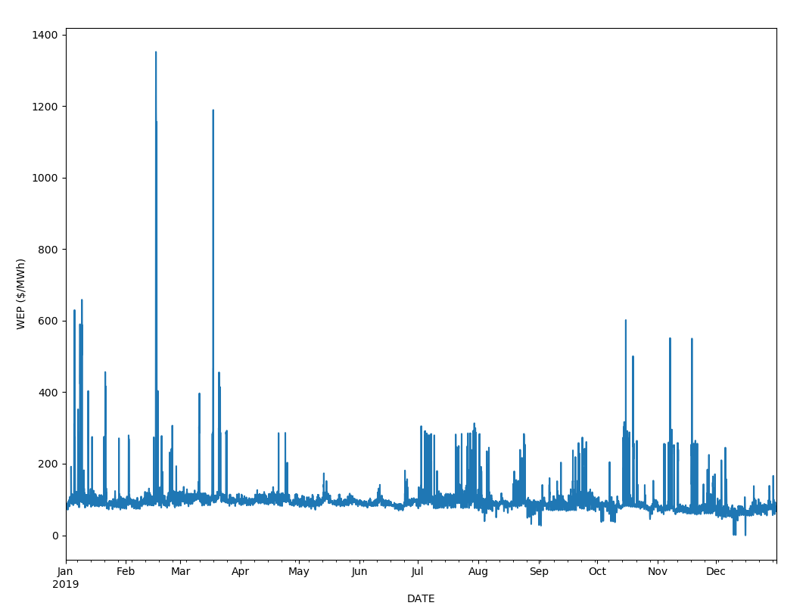
Data
Notes:
Analysing the WEP, we can identify large amount of outliers . To reduce the effect of these outliers on our trained model, we decided to truncate these outliers to 3 standard deviations from the mean.

Slide 9
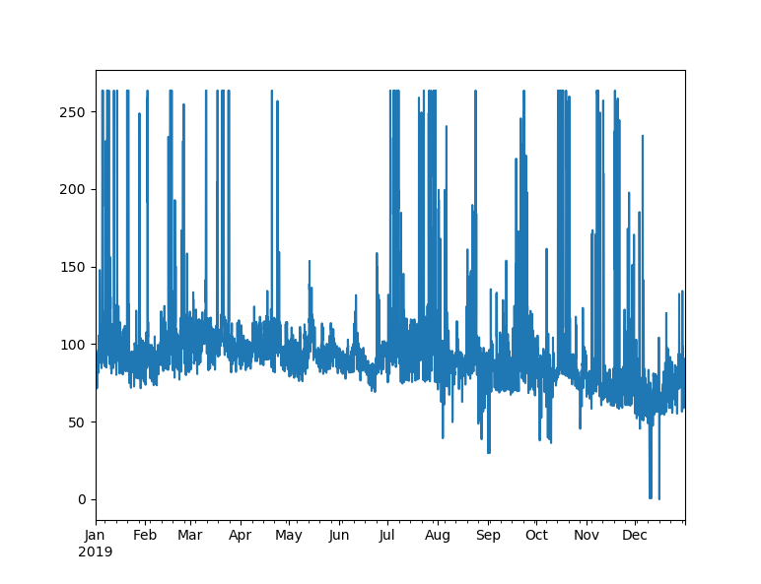
Data
Notes:
Truncating the values will prevent the outliers from skewing the results from what ever models we are using to predict, but still allowing the models to learn about the high price present .

Slide 10
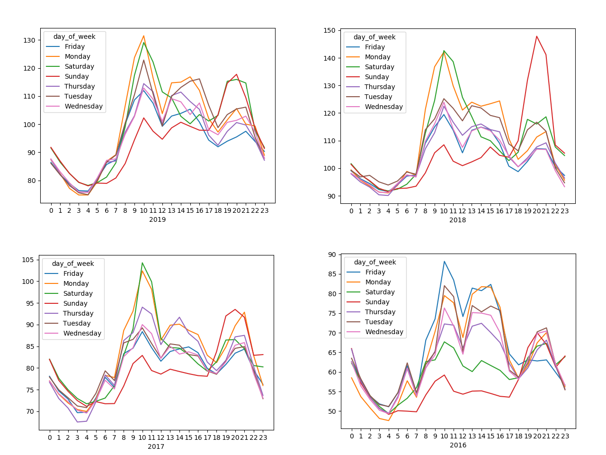
Data – Trends and seasonality
Notes:
Plotting the hourly mean price across different days gave us 2 observations.
Price not only follows a hourly trend, but also different days of the week has different mean prices as well.
The duration between 8 to 10 am and 6 to 9 pm shows large spikes in prices across all the days of the week with Sunday being the lowest during the day but highest during the night.

Slide 11
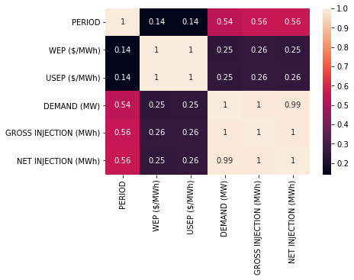
Data - Correlation
Notes:
Despite past research showing the relationship between the price, demand and supply. From our data, they do not have great correlation. Therefore, a timeseries approach will be taken in our project.

Slide 12
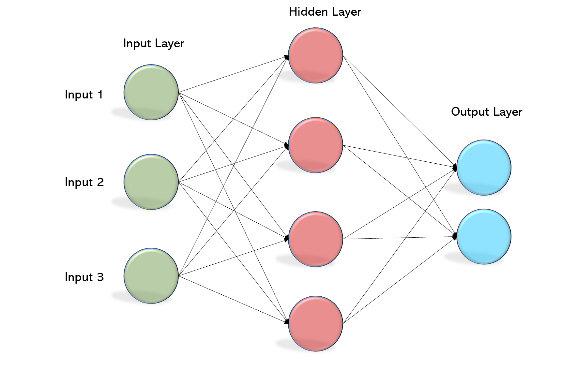
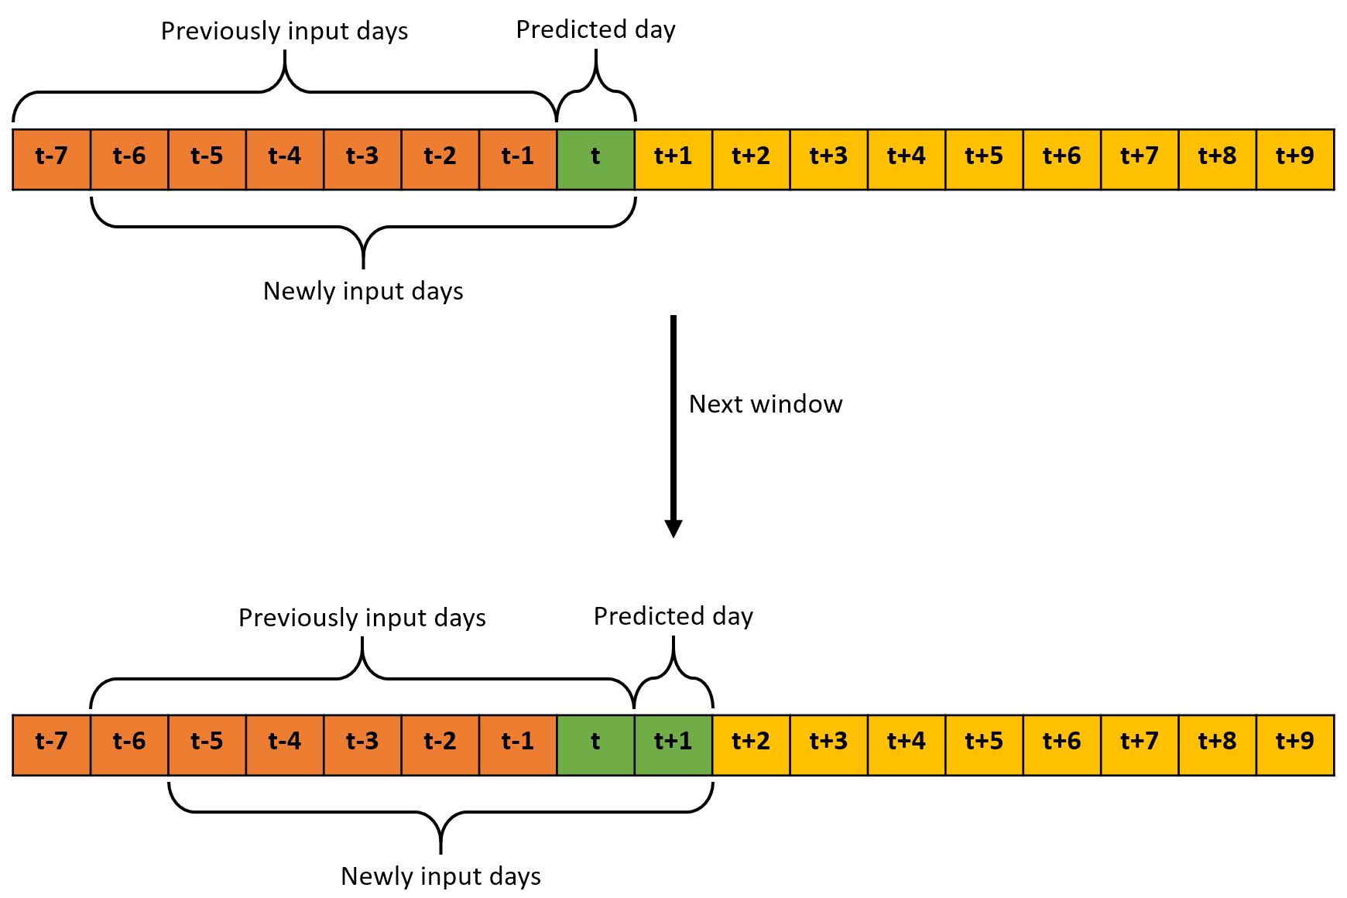
Overview
Purpose
Compare neural network method against statistical methods
Scope
Predicting Wholesale Electricity Price (WEP)
Predict 10 days ahead
Notes:
After our findings,
The purpose of our project will be to compare an artificial neural network against the performance of the other statistical methods in both prediction accuracy and run time duration.
Our scope will be confined to the wholesale electric pricing in Singapore where the cost are calculated every 30 min during time of use. Since the WEP is only available publicly 10 days later, we will need to predict the 10th day price.

Slide 13
Pre-processing
Convert dataset into supervised learning
Training set will be predicted 48 timesteps in advance
Test set will require only 1 step in advance as rolling prediction is performed
T-7
T-6
T-5
T-4
T-7
T-6
T-5
T-4
T-3
T-2
T-1
T
T-3
T-2
T-1
T
Notes:
Since the weekly data shows signs of seasonality, we propose a 7-day time lag to be used to train and predict the next day price. 7 days consists of 336 timesteps while a day has 48 time steps. Thus, we can create a supervised learning set where the input and output vectors will be 336 and 48 long respectively, totaling to a size of 384 columns in our training data.
The 2019 WEP price will be used for training and validation while the 2020 WEP price up to March will be used for testing.

Slide 14
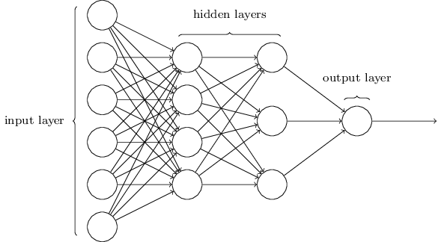
Modelling the Neural Network
4 layers network
Input layer with 7 days of historical prices
2 hidden layers
1 output layer with day-ahead prediction
80/20 validation split
Notes:
The MLP is built primarily with 4 layers. 1 input layer, 2 hidden layer and 1 output layer. The input layer will consists of as many neurons as there are in the 7 days of data. 2 hidden layers are used for their ability to model any arbitrary function.
And lastly, oen output layer with 48 neurons for the 48 timesteps needed to predict in a day.
These predictions will be validated in an 80/20 validation split where the results will be back propagated into the network during training

Slide 15
Modelling the Neural Network
Parameter Optimisation
Neurons per hidden layer | [ 20 – 240 ]
Epochs | [ 20 – 300 ]
Batch size | [ 4 – 64 ]
Notes:
The optimised hyperparameters are found by brute forcing each iteration and comparing them with the mean square error metric during cross validation.

Slide 16
Modelling the Neural Network
Final model configuration
Neurons per hidden layer | 240
Epochs | 300
Batch size | 64
Notes:
And this is the final model configuration we used.

Slide 17
Modelling SARIMA
$$SARIMA \left(p,d,q\right) \left(P,D,Q\right)m$$
p: Trend autoregression order.
d: Trend difference order.
q: Trend moving average order.
P: Seasonal autoregressive order.
D: Seasonal difference order.
Q: Seasonal moving average order.
m: The number of time steps for a single seasonal period.
Notes:
Seasonal Autoregressive Integrated Moving Average, SARIMA or Seasonal ARIMA, is an extension of ARIMA that explicitly supports univariate time series data with a seasonal component.
It adds three new hyperparameters to specify the autoregression (AR), differencing (I) and moving average (MA) for the seasonal component of the series, as well as an additional parameter for the period of the seasonality.
Configuring a SARIMA requires selecting hyperparameters for both the trend and seasonal elements of the series.
There are four seasonal elements that are not part of ARIMA that must be configured
Importantly, the m parameter influences the P, D, and Q parameters of the seasonality. For example, an m of 12 for monthly data suggests a yearly seasonal cycle.
We will be using the pmdarima python library to search for the most optimal hyperparameters

Slide 18
Other statistical models
Holt Winter’s Exponential Smoothing
Seasonal Naive
Notes:
The Holt-Winters seasonal method comprises the forecast equation and three smoothing equations — one for the level ℓt, one for the trend bt , and one for the seasonal component s. We will be using the Holt-Winters’ Additive Method
For this project.
Lastly, the Seasonal Naïve method simply use the last observed value from the previous week to predict the price.
We will be using these 2 methods as a baseline for our neurial network and SARIMA models.

Slide 19
Prediction Methodology
Notes:
A walk forward training is used for the 10 days prediction.
From the diagram, upon predicting the prices at day T, we will slide the inputs window by 1 day, incorporating the previously predicted prices at T to predict the prices at T+1.
We will apply this algorithm with the MLP and baseline models until we have the prices for all 10 days.
However, The SARIMA model will be modelled differently.

Slide 20
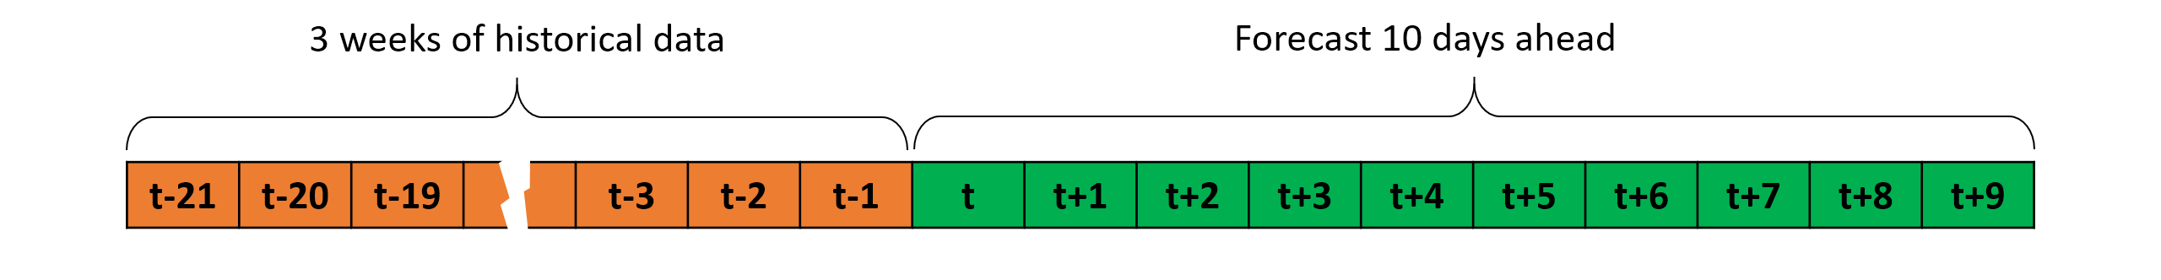
Prediction Methodology - SARIMA
Notes:
As SARIMA requires training for every prediction, retraining the model for 10 times is not feasible with regards to the runtime.
Since the SARIMA model can forecast as many steps forward as needed, we will be using the past 3 weeks of prices to predict the next days of prices.

Slide 21
Results
2 dates compared
30th Jan 2020
26th Feb 2020
1 day prediction
10th day prediction
Notes:
2 dates will be used for visualisation and comparison.
For each date, there will be 2 different predictions made:
The 1 day prediction to test each models ability to model the next day price
And a 10-th day prediction for us to observe how the cumulative error in prediction will affect it

Slide 22
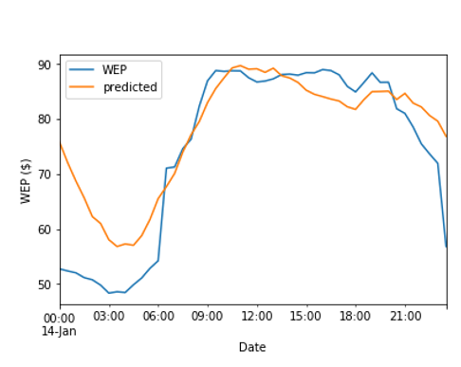
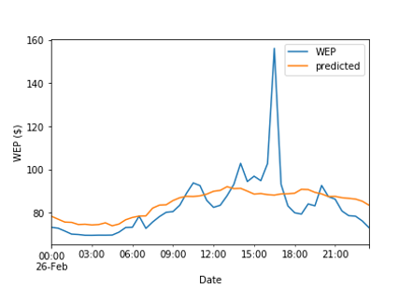
Results – MLP 1 day
1 Day Prediction
Notes:
The MLP model shows some capability in modelling the trend of a day, with the dip at 2pm and the gradual increase after that. However, as shown in the 26 February data, the sudden spike at 4 to 5 pm wasn’t accounted for at all.

Slide 23
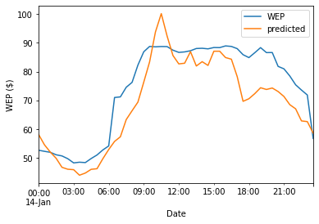
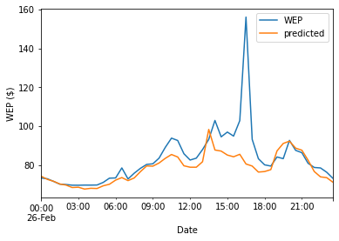
Results – SARIMA 1 day
1 Day Prediction
Notes:
Similarly to the MLP model, the SARIMA can model the daily trend but not the outliers.

Slide 24
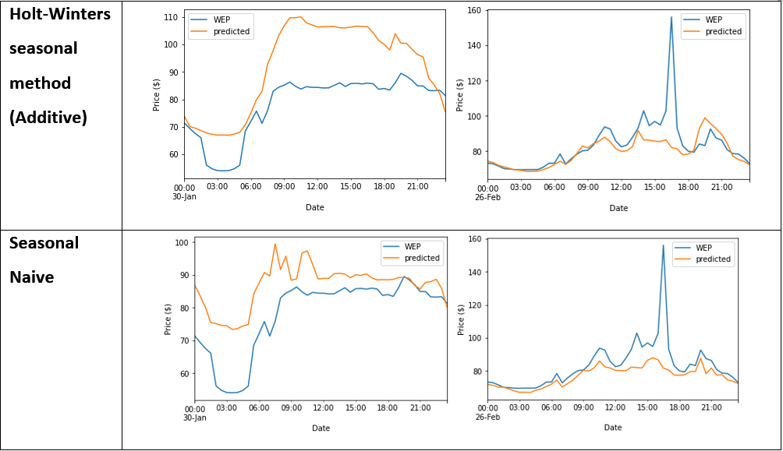
Results – Others 1 day
Notes:
And once again, the same can be said for our baseline methods.

Slide 25
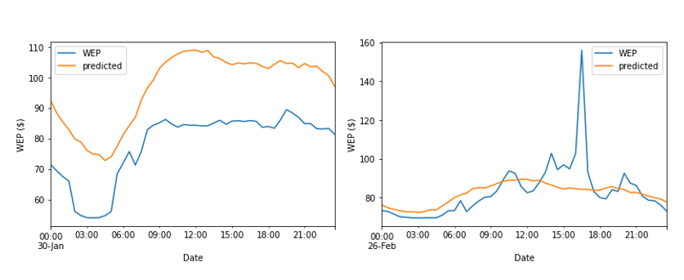
Results – MLP 10th day
10th Day Prediction
Notes:
Looking at the 10th day prediction, even though we can still see the daily trend, there appears to be a larger accuracy error on the 30th January prices.

Slide 26
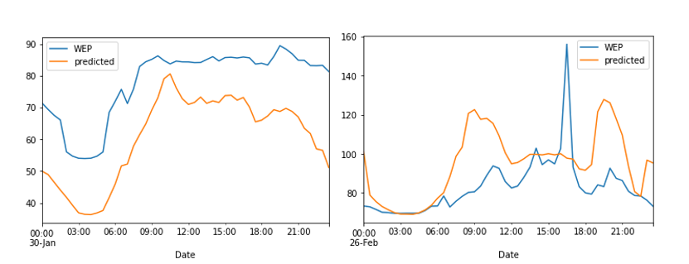
Results – SARIMA 10th day
1 Day Prediction
Notes:
We can also see the same problem in the SARIMA model where there is a major shift in the predicted prices on the 30th January.

Slide 27
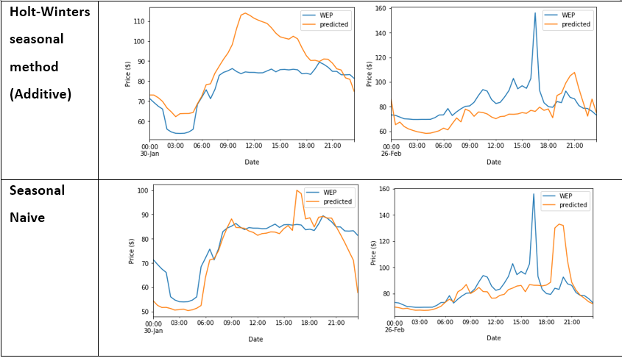
Results – Others 10th day
Notes:
The shift in our baseline models does not seem as pronounce as the other 2. We will need to look at the value of the error metrics to conclude our results.

Slide 28
Results – Error Metrics
 | 30/1/2020
 | MAE | MSE | MAPE
MLP | 8.489415862 | 100.2025 | 12.33354
SARIMA | 7.755643225 | 102.5798 | 10.10524
SES | 10.184583 | 129.0824 | 14.17657
ES | 14.090496 | 253.8571 | 17.95805
Naive | 8.841042 | 124.0843 | 12.93082
 | 26/2/2020
 | MAE | MSE | MAPE
MLP | 5.515156 | 120.1595 | 5.860455
SARIMA | 5.601297 | 152.0624 | 5.590852
SES | 11.38139 | 307.0058 | 12.03786
ES | 5.343782 | 146.7667 | 5.283086
Naive | 6.188958 | 155.7436 | 6.280658
 | 30/1/2020 - 10th
 | MAE | MSE | MAPE
MLP | 18.94647842 | 373.2159 | 25.00028
SARIMA | 17.28722707 | 327.7626 | 22.97553
SES | 10.222083 | 129.5238 | 14.20935
ES | 10.78784 | 190.3937 | 13.76917
Naive | 5.142708 | 58.07003 | 6.97943
 | 26/2/2020 - 10th
 | MAE | MSE | MAPE
MLP | 6.449424 | 145.944 | 6.866359
SARIMA | 14.53031 | 417.9716 | 16.92362
SES | 10.28646 | 259.492 | 10.95702
ES | 13.08831 | 304.9746 | 14.72382
Naive | 9.233333 | 276.5361 | 9.935335
Notes:
Comparing the error metrics across all the methods, the MLP and SARIMA models do well for the 1-day forecast as compared to the other statistical methods. However, for the 10-th day forecast, it might be due to the walk-forward prediction, where errors are compounded, their error increased at a higher rate as compared to the other statistical methods.
This can be show in the 30th of January where both the MLP and SARIMA model performed the best in the 1 day prediction, but the worst in the 10th day prediction.

Slide 29
Results - Runtime
 | MLP | SARIMA | Holts Winter | Naïve
Avg. Time (s) 1-day | 0.257 | 98.101 | 0.0620 | 0.00447
Avg. Time (s) 10th-day | 1.879 | 94.427 | 0.0633 | 0.0110
Notes:
The time take to gather the can be shown in this slide. For the simple statistics method, their runtimes are generally very fast with all of them achieving their forecasts in less than 0.1s. The MLP model performs 2nd best with the 1-day forecast predicted in an average of 0.3s while the 10th-day forecast took a little longer at 1.9s. lastly, the SARIMA suffered greatly in its runtime performance due to having to retrain its model every time new data is inserted.
The MLP proves to be effective in predicting future values with seasonal effects and slightly better than the SARIMA model. This was shown by the neural network ability to map the weekly, daily and hourly pattern of the historical WEP onto the prediction of the next day prices.
However, due to the unpredictable nature of supplying and distributing electricity in Singapore, where generator and transmission infrastructure might fail suddenly, our model cannot accurately forecast the large spikes in price we have seen in our data. We could only try to remove these outliers and predict for the best-case scenario where everything is working as per normal.
Furthermore, for real-time usage, a neural network approach might be better as the SARIMA requires the retraining of the model whenever there is new data. Computation time will be faster for the neural network and information can be displayed earlier.

Slide 30
Conclusion
MLP and SARIMA is good for 1 day prediction, poor when more days are needed
Prediction is difficult due to outliers
Detecting outliers is a problem by itself
Notes:
In conclusion, the neural network performs great when only a day of prices is needed as that is how our model was trained while the statistical methods performs well to model the trends and seasonality.
Furthermore, the nature of our data presents itself with a lot of outliers which are difficult to account for in a timeseries problem without other features to rely on.
Thus, detecting these outliers is a problem in itself.
Further research must be done on this problem to help with increasing the accuracy when predicting the future prices.

Slide 31
THE END
Thank you for your time!
Notes:
I have come to the end of my presentation and I would like to thank you for your time.

