Slide 1


Security / Data Breach and Outage Response Plan
Date: 4/26/2022

Slide 2

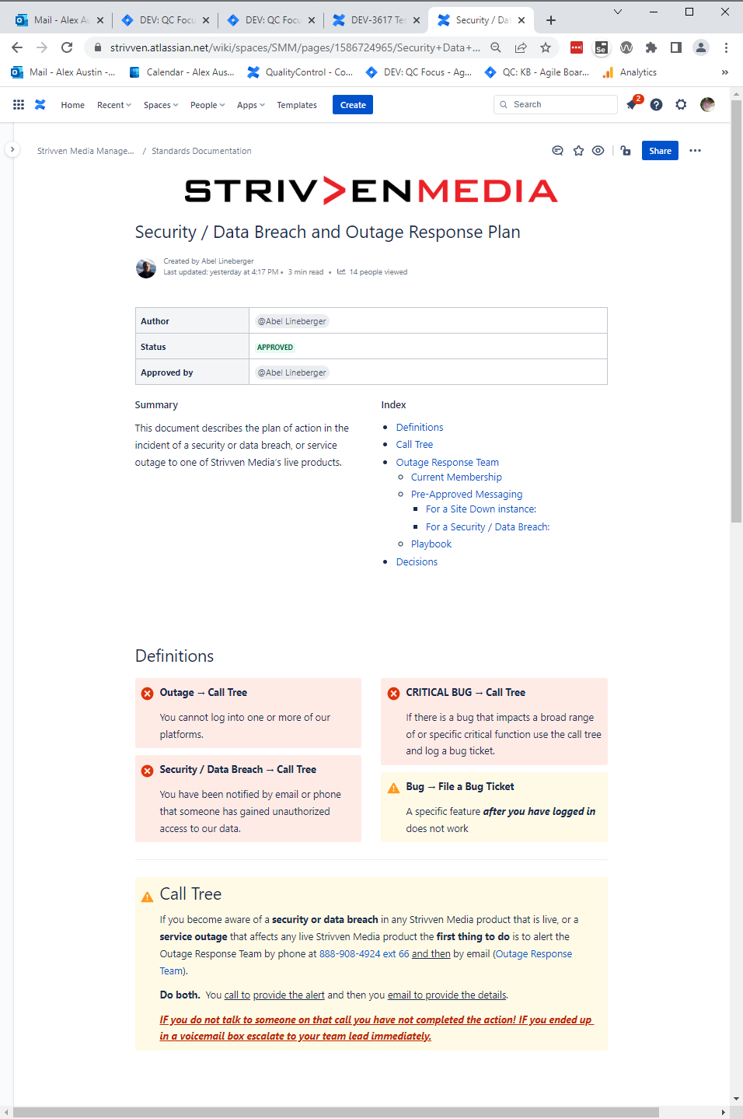
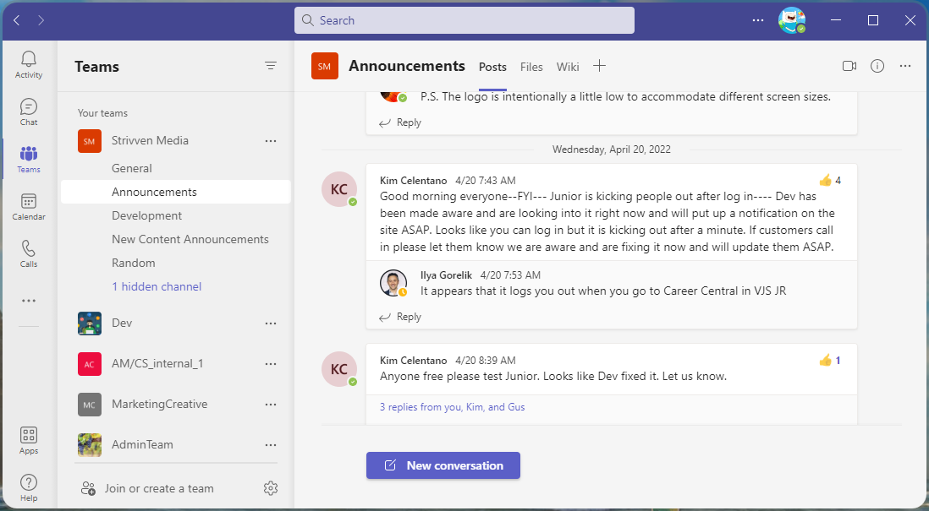
Bugged by Trouble Tickets?
Critical Response Plan
Notes:
We have a fantastic job here at XXXXXX! Working in web technologies, we need to review the Critical Response Plan.
The Critical Response plan breaks down into parts, defining exactly who needs to do what, and when, during a critical event.
A Critical event can be considered an Outage, a Critical Bug, and a Data breach.

Slide 3

Critical Response Plan
Today’s definitions
Outage
What it is, what it means, and what to do.
Critical Bug
What it is, what to do.
Data Breach
What it is, and what to do.
Notes:
Outage, is when the users cannot get into the website at all, on any of the platforms.
A Critical Bug, is when a user can get into one of our platforms, but some critical functionality doesn’t work.
An example could be being able to log into the site, but being bounced out of the site within a few minutes. Or not having any videos work, while in the site.
This could be considered a critical bug, and could follow the Critical Response Plan protocol.
Data Breach, is if some of our customers data was breached.
If a customer calls, and thinks that the system was breached, we will need to collect all information, and forward that to the correct parties.
Information to collect if you have a customer who is reporting a Data Breach,
Any available contact information for reporter.
Time of the discovery and time of the communication to XXXXX (when the customer reached out to you).
What license, district, and what they believe is affected.
Why they believe they had their data compromised?
How they discovered it?

Slide 4
Critical Response Plan
Process:
Check Teams - General Announcements if it is already reported
If it’s not reported – Report It
Call Tree
E-mail
Proper messaging to customer
Thank you for reaching out to us!
Proper Follow-up
Notes:
CRP steps 1, 2 and 3
Check Microsoft Teams Announcements.
If the critical issue has been reported, it will be announced there.
If the issue is not announced, report it by calling and e-mailing the Critical Response Team.
Communicate clearly with the customer using the approved language.

Slide 5
Critical Response Plan
Site Down messaging:
Thank you for reaching out to us!
Our development and support teams are aware the platform is currently unavailable and is currently working to restore the service.
We apologize for any inconvenience. We will notify you as soon as the systems are restored.
Security / Data Breach messaging:
Thank you for reaching out to us!
We are aware of the issue and will notify any party impacted.
If you have not been notified, your data was not exposed or impacted.
Notes:
When something Critical happens on the site, the messaging from our customer facing teams need to be uniform, and supportive.
The following are some approved messaging for you to offer our customers is you get a call for known issues.
Look to the Teams Announcements board; any known issues will be announced there.
For unknown issues, you thank them and tell them you will report it immediately, following the call and e-mail protocol we will be discussing next.
Call and E-mail are both required for any unknown Critical issues, to ensure we are as quick to response as possible, with all team members in place!
Be sure to offer to return communication and follow up with the individual reporting, to keep them updated about the status of their report/concern.

Slide 6
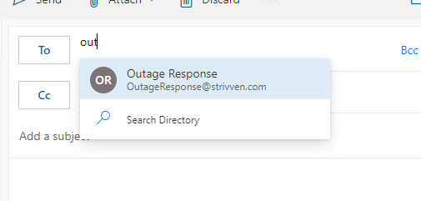
Critical Response Plan
Plan:
Check on Teams General Alerts if the issue has been reported.
If not - Alert the Outage Response team by phone at 888-908-4924 ext 66
Email Outage Response Team
Security / Data Breach and Outage Response Plan
Notes:
When you become aware of a Security or data breach in any XXXXX XXXXXproduct, or a service outage that affects any XXXXX XXXXX Product
Alert the Outage Response team by phone, at XXX XXX XXXX x XX.
Email Outage Response Team
Both of these methods are linked on the XXXXX Security / Data Breach and Outage Response plan page.
Let’s walk through this process and discuss the reasons.
First, you don’t want to report an issue if it has been reported.
It is the job of the people on the Critical Response Team to put an announcement on the Teams Announcements board upon learning of any critical issues as they get them.
Once you have confirmed it is not reported, call the Outage Response team by phone.
There is no bad time to report a critical issue. You discover on a Friday night, that something is collapsing, give the Outage Response Team a call.
There is a phone tree tied to this number, so if the first person doesn’t pick up, it will automatically call the second, and a third, and more! This gets the developers, the DBA, and all people who can work on this, immediately alerted, and ready. You don’t need to do more than call XXX XXX XXXX ext XX
Next: E-mail the Outage Response Team, with the relevant details of the issue.
The E-mail is required; it tracks the time at which the notifications came in, and when things started being done about it.
You must do both; The phone call wakes the giant, the e-mail gives details and fulfills requirements for tracking of Critical Issues.
If it’s an Outage, which product cannot be reached?
If it’s a Critical bug, which product is having the issue?

Slide 7
Critical Response Plan
Gather and share the information:
Behavior being reported
Any available contact information for the reporter
Contact person, school, district, license,
Which Platform
Time of discovery
How they discovered it
Data Breach? (all of the above, and)
Why do they believe their data is compromised?
How did they discover it?
Notes:
Make sure when you are reporting a Critical issue you have the required information to hand over in the call and e-mail.
If it’s an Outage or Critical bug
Gather any information you can get on the reporter, contact person, school, district, license.
Behavior being reported?
Reporter/Contact person
School/district/license
Which Platform?
Time of discovery?
How it was discovered?
If it’s a potential Data Breach, you will also want to gather
Why they believe they had their data compromised?
how did they discover it?

Slide 8

Discussion
Any questions or concerns to raise for the basic submission process and how it’s managed?
This Photo by Unknown Author is licensed under CC BY-SA-NC

Slide 9

Related Links

Slide 10
Links
XXXXX XXXXXSecurity / Data Breach and Outage Response Plan
Google Phishing Quiz

Slide 11
OUR MISSION
To inspire individuals to know that there is no limit to what they can become or achieve in life.
VirtualJobShadow.com is a division of XXXXX Media
1280 Hendersonville Road , Asheville, NC 28803 888.908.4924

