Slide 1
Subway_Mapped
File created on: 9/25/2020 2:09:40 AM

Slide 2
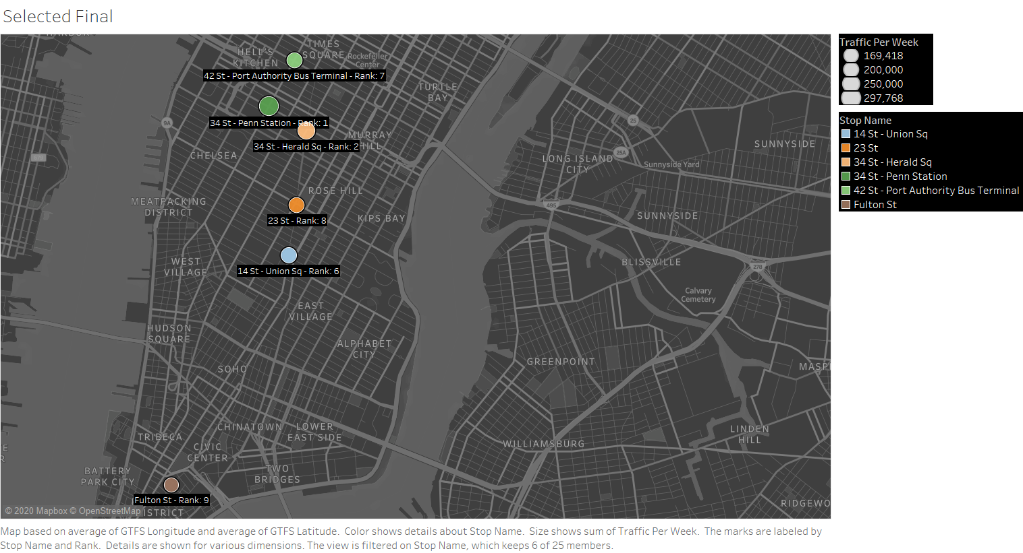

Slide 3
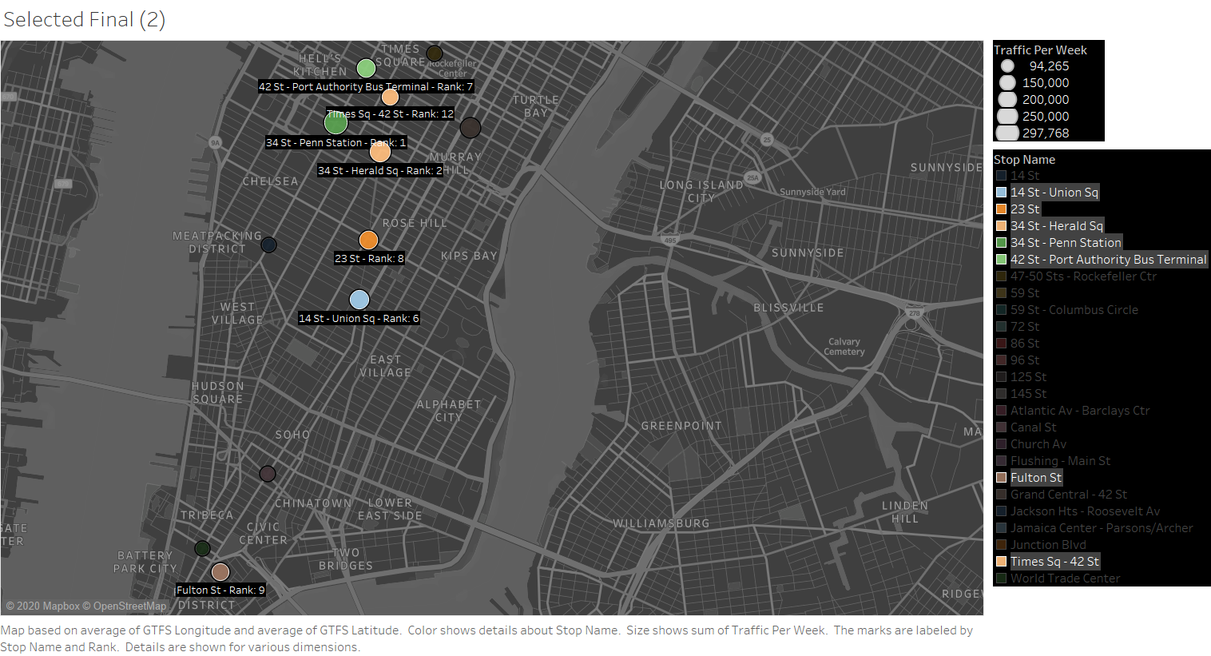

Slide 4
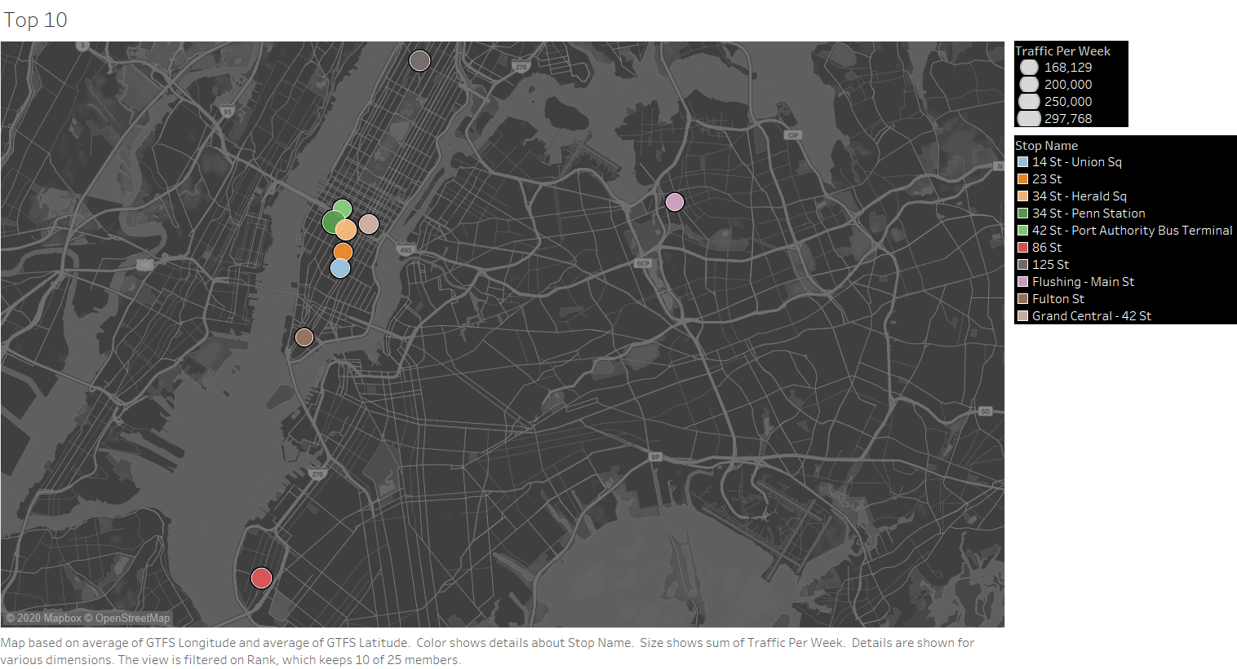

Slide 5
