Slide 1

Predicting Cancer Relapse Using Gene Expression Data
Bioinformatics Machine Learning Project
Aavash Pant
George Mason University

Slide 2
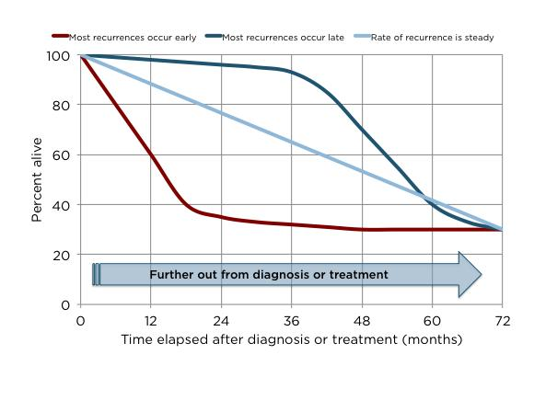
Background & Motivation
Cancer progression is driven by changes in gene expression
Project focuses on predicting whether a cancer patient will experience relapse based on their gene expression profile.
High-dimensional genomic data is difficult to analyze
Machine learning helps uncover hidden patterns

Slide 3
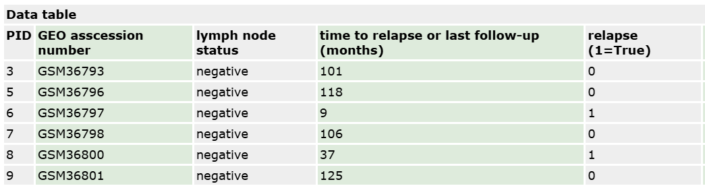
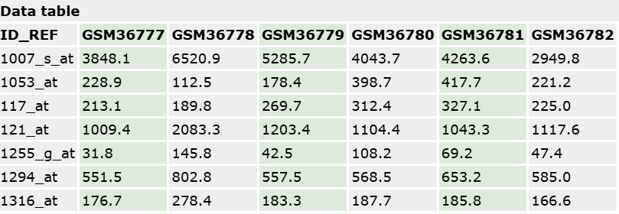
Dataset Overview
dataset from the NCBI GEO database called GSE2034
286 patient samples with thousands of gene features
Binary classification: relapse vs. no relapse
Rows = genes, Columns = patient samples
The dataset includes both gene expression values and clinical labels, which are merged for supervised learning.

Slide 4
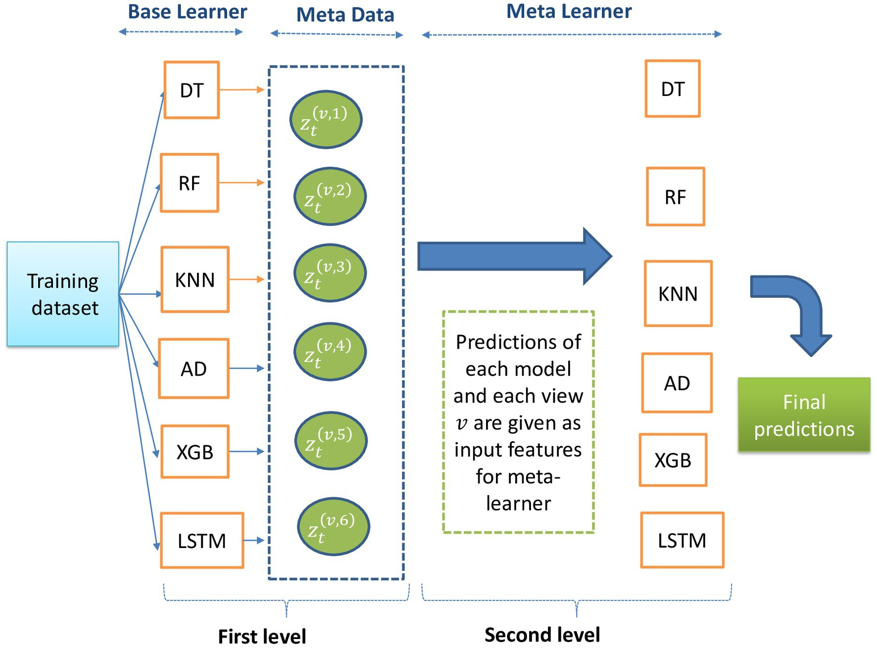
Data processing
Normalize gene expression values
Merge gene expression data with clinical labels
Encode relapse outcome as binary (0/1)
Handle high dimensionality (many genes, fewer samples)
Split data into training and testing sets 70 % training 30 % testing
This Photo by Unknown Author is licensed under CC BY

Slide 5
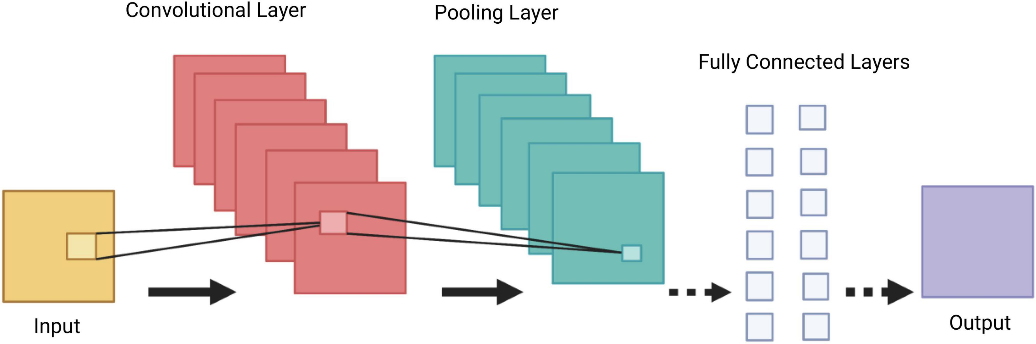
Neural Network Architecture
Model: 1D Convolutional Neural Network (CNN) 2- 3 layer
Input: gene expression vector
Convolutional layers detect local gene patterns
Fully connected layer outputs prediction
Learns interactions between neighboring genes
Conv1 → ReLU → Pool
Conv2 → ReLU → Pool
(Optional Conv3)
Fully Connected → Output

Slide 6
Hyperparameter Tuning
Learning rate
Number of epochs
Batch size
Number of convolutional layers
Kernel size (filter size)
Optimization to improve performance and reduce overfitting

Slide 7
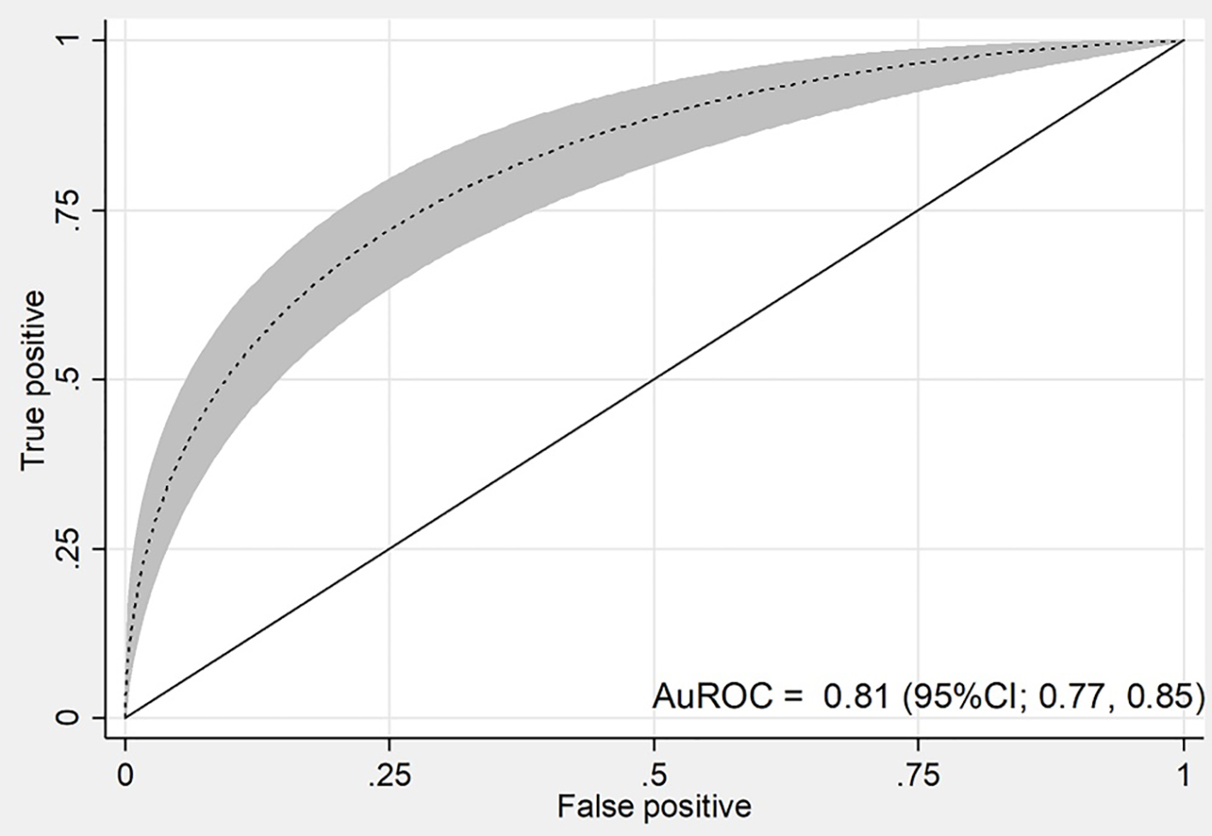
Expected Outcomes & Impact
The main goal of this project is to build a model that can accurately predict whether a patient will experience relapses. non-relapse
Identify important gene patterns
Evaluate model performance using:
AUROC
Accuracy
Precision
Recall

Slide 8
Overview ​
Gene Expression Data (GSE2034)
↓
Merge with Clinical Labels
↓
Data Preprocessing
(Normalization, Encoding, Train/Test Split)
↓
1D Convolutional Neural Network (CNN)
↓
Relapse Prediction (Binary Classification)
↓
Model Evaluation (AUROC, Accuracy, Precision, Recall)

