Slide 1
MACHINE LEARNING MODEL ANALYSIS
CURRENT MODEL
REFINED MODEL APPROACH
ONLINE LEARNING
MEDICAL TEST MODEL
GEOLOCATION CLUSTERING
CORE AI

Slide 2
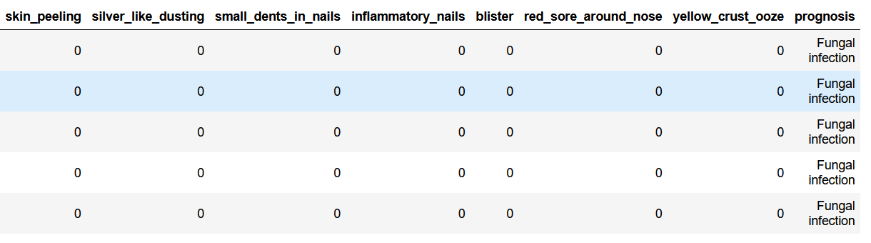
CURRENT MODEL
DATASET INFORMATION-
COLUMNS- 133
ROWS - 4920
TARGET COLUMN - ‘PROGNOSIS’
DATASET

Slide 3
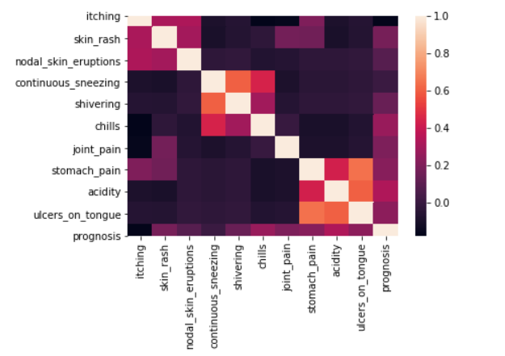
CURRENT MODEL
Performed data analysis and data preprocessing
Trained several classification model for choosing the best algorithm according to our requirement with the help of metrics and probability.

Slide 4
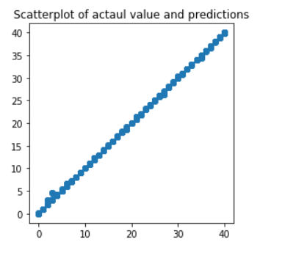
CURRENT MODEL
Algorithms Selected –
1. Random Forest Classifier
2. Stochastic Gradient Descent
3. MultiNomial Naïve Bayes
4. Multi Layer Perceptron

Slide 5
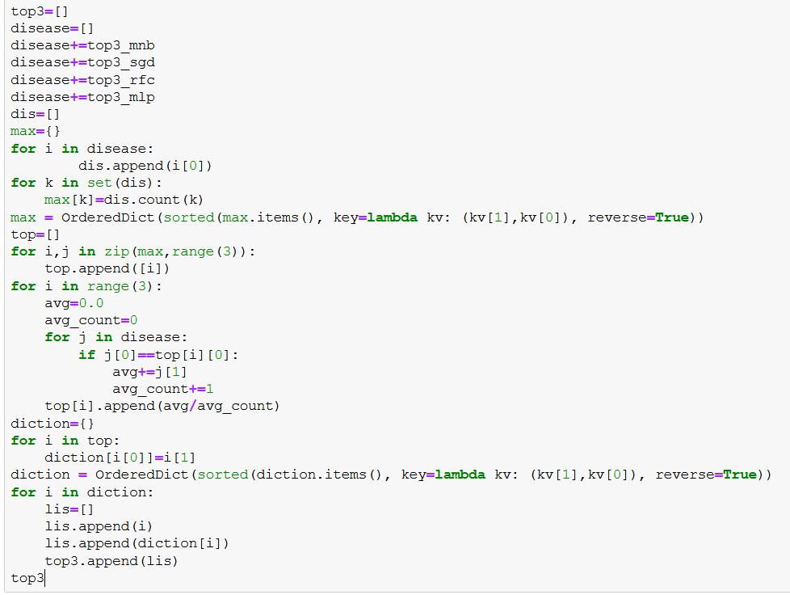
CURRENT MODEL
Logic used for extracting top 3 diseases from 4 models.

Slide 6
REFINED MODEL APPROACH
In the refined model approach, we will more features on the basis of severity of symptoms and classify them age wise.
Algorithmic View
Random Forest Classifier
Age wise
Fever
low
medium
high
Group 1
Group 2
Group 3
Disease 2
Disease 1

Slide 7
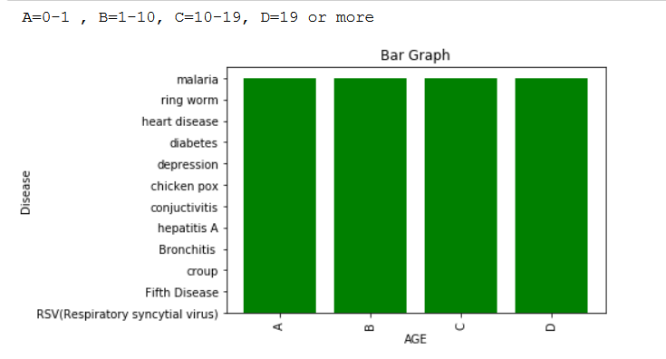
REFINED MODEL APPROACH
We have created a synthetic dataset for predicting the disease age wise and with severity of symptoms.
This bar graph shows diseases occurrence age wise.
Currently we are working on this refined model and it will be the addition of our current model with more features.

Slide 8
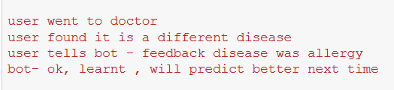
ONLINE LEARNING
In online learning approach, model is updated to adapt the new data.
Feedback feature will be included in the chat bot for taking the information about diagnosis done by doctor.
Model will learn from its mistakes and will predict better next time.

Slide 9



ONLINE LEARNING
Implementation Approach
We will use “partial_fit” method for training that instance to existing model.
Sklearn, it don’t provide partial fit method for random forest classifier.
So, we can use another library “crème” which is developed by a research scholar.
Multinomial Naïve Bayes
SGD classifier
Multilayer Perceptron
Random Forest Classifier

Slide 10
MEDICAL TEST MODEL
We can even provide tests suggestions based on symptoms and diseases.
Testing model will be included after diseases prediction.
We can verify and validate test suggestions with the help of domain expert and hospitals.
Testing examples
Disease clinical test
1. Hepatitis B : Hepatitis B surface antigen test
2. Hepatitis C: Antibodies to HCV test
3. HIV: Antibodies to HIV test
4. Malaria: Plasmodium spp. antigens test
5. Tuberculosis: Mycobacterium tuberculosis bacteria test
6. syphilis: antibodies to Treponema pallidum test.

Slide 11
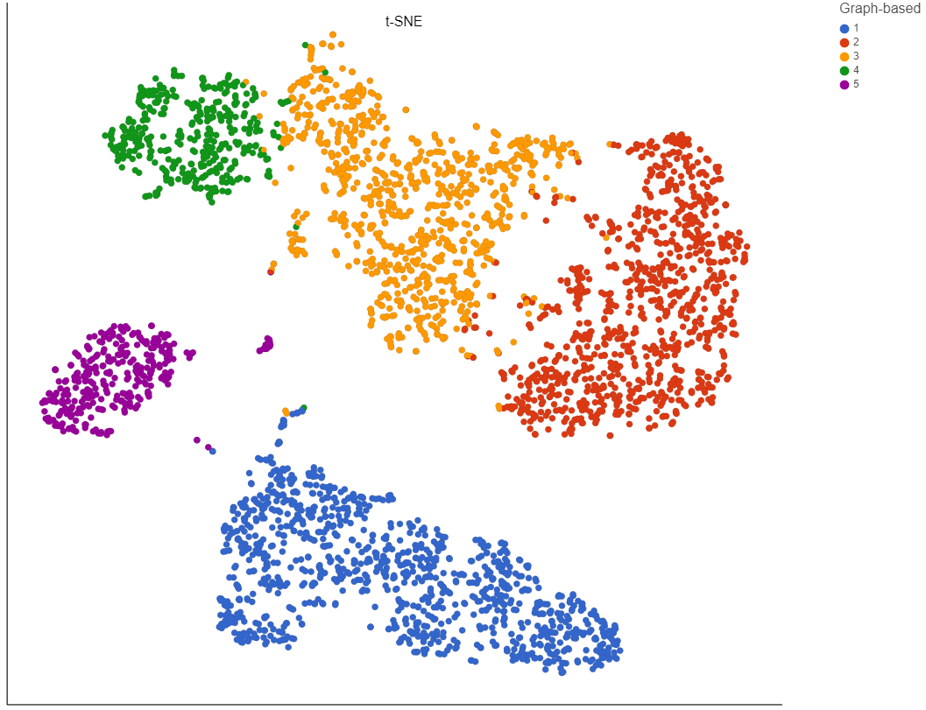
GEOLOCATION CLUSTERING
Cluster diseases and symptoms based on the location with the help of machine learning clustering algorithms and after this, bot can suggest users to be alert of those diseases and can even provide proper precautions .

Slide 12
CORE AI of Chat bot
Geolocation clustering
Prediction with logic
MLP classifier
MN naïve bayes
SGD classifier
Random Forest
Refined Model
Medical test Model

Slide 13

Arcyon Your Personal Health Advisor
The idea behind Arcyon is to provide health related information with the assist of Artificial intelligence. Arcyon gives immediate medical information. It makes it very useful for the user to take necessary medical actions without any hustle.

Slide 14
DIALOGFLOW
Why DialogFlow ?
Dialogflow can analyze multiple types of input from your customers, including text or audio inputs (like from a phone or voice recording). It can also respond to your customers in a couple of ways, either through text or with synthetic speech.
We Integrated dialogflow to our android app to implement chat feature. Here user can interact with our chatbot and do a lot of cool things like predicting diseases based on the symptoms.

Slide 15
Our Prediction Model
Trained our model:
Our dataset has 132 symptoms and 41 diseases.
We used several classification algorithms and finalized 4 classification algorithms for making the model.
Algorithms used: multinomial naïve Bayes, SGD classifier, random forest and multilayer perceptron(neural networks)
We extracted top 3 diseased on the basis of their probability with the help of these algorithms.

Slide 16
2. Created web app using flask :
· Flask is a micro framework written in python used for web applications
· We implemented all our functions in flask.
· We used pickle to store our ml model and unpickled in flask.
3. Committed the code in GitHub :
· GitHub is a platform that provides hosting for software development.
· We uploaded all our source code including model and dataset in GitHub.

Slide 17
4. Created a Heroku account:
· Heroku is platform as a service that enables developers to build , run and operate application entirely in the cloud.
5. Linked the GitHub to Heroku:
· Then we linked our GitHub account with all the source code to Heroku platform to deploy it.
6. Deployed the model:
We deployed our ml model with the help of Heroku.

Slide 18
7. Connected the model to dialog flow:
· After deploying our model on Heroku, it generates a URL with which we connected our dialogflow using webhook
· We enabled webhook in dialogflow which allowed to send predictions from deployed model on the basis of symptoms given by dialogflow.

Slide 19
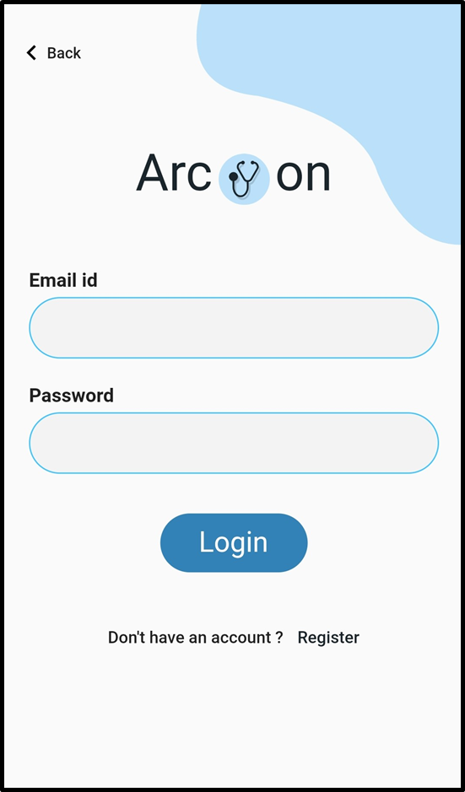
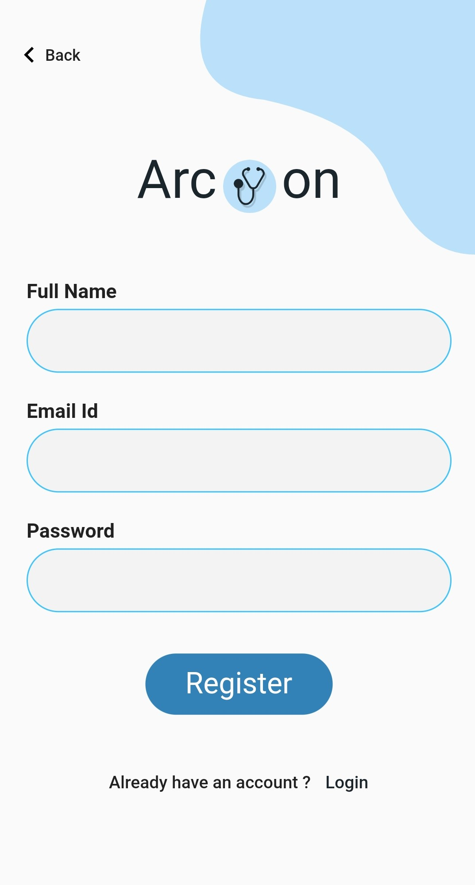
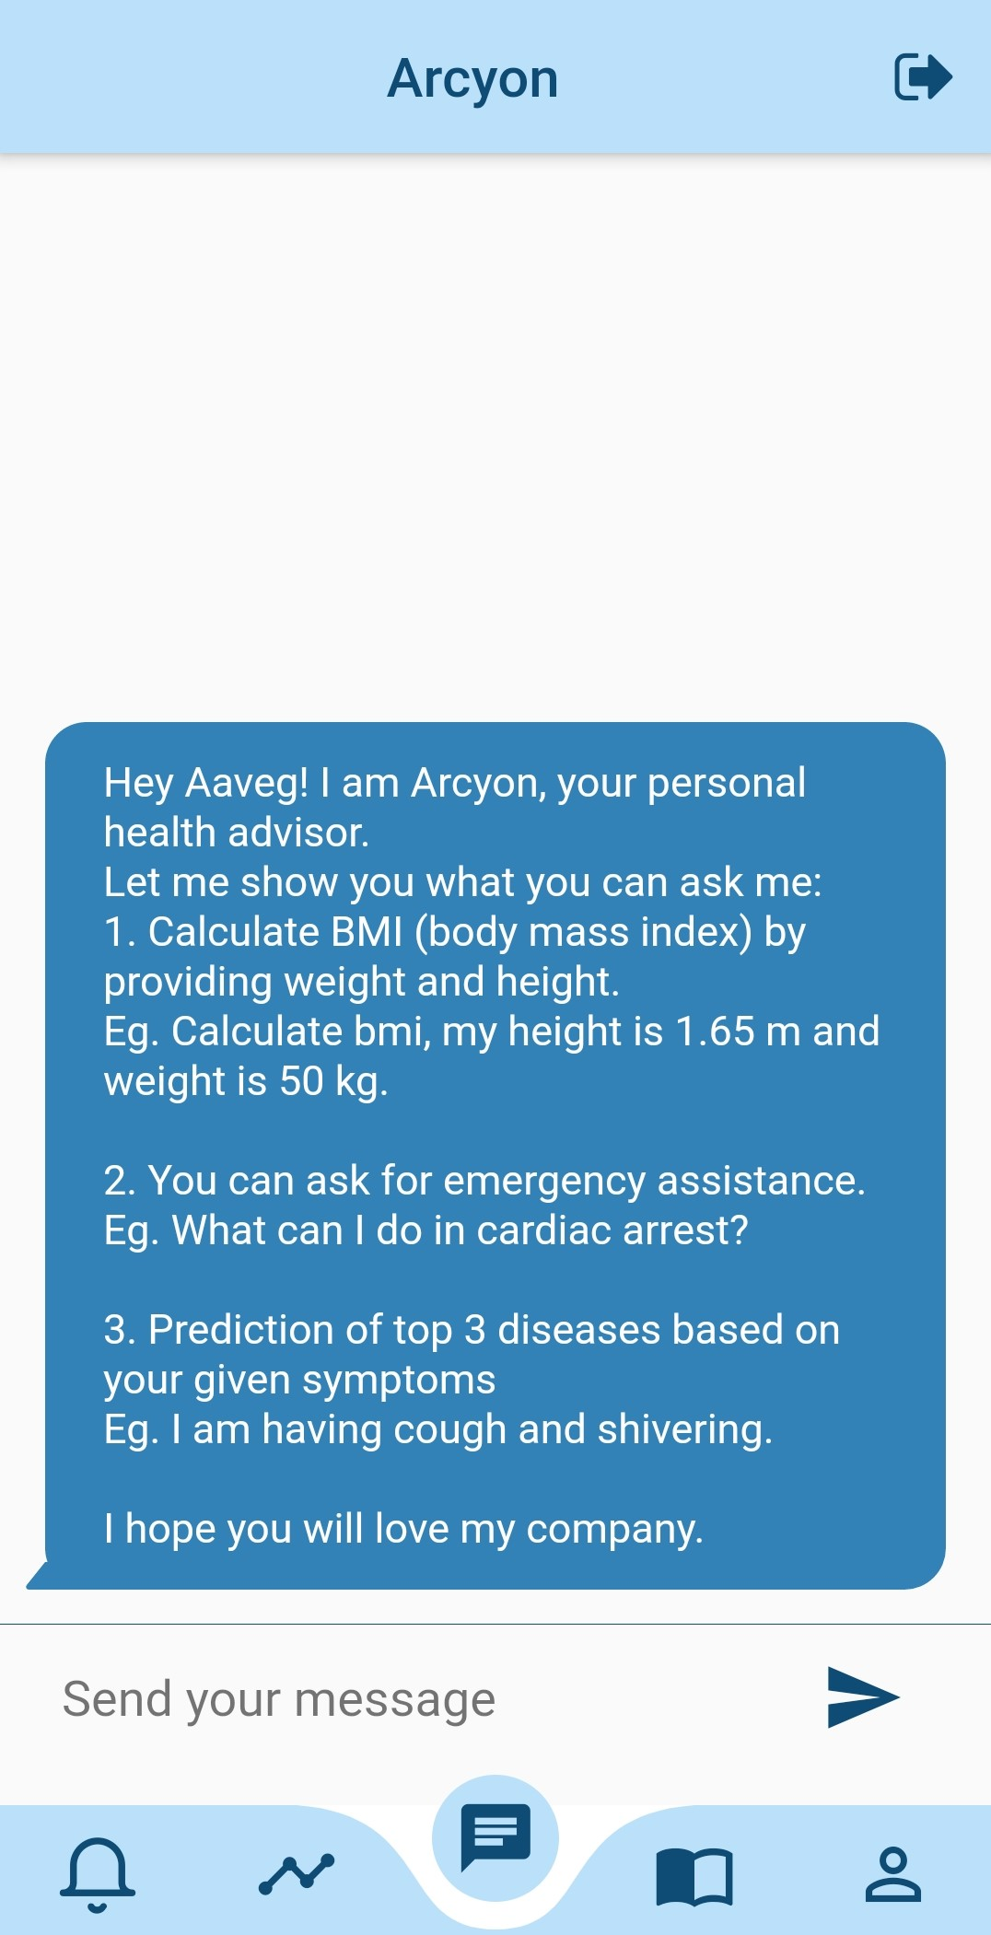
Login Page
Registration Page
Chat
Layout

Slide 20
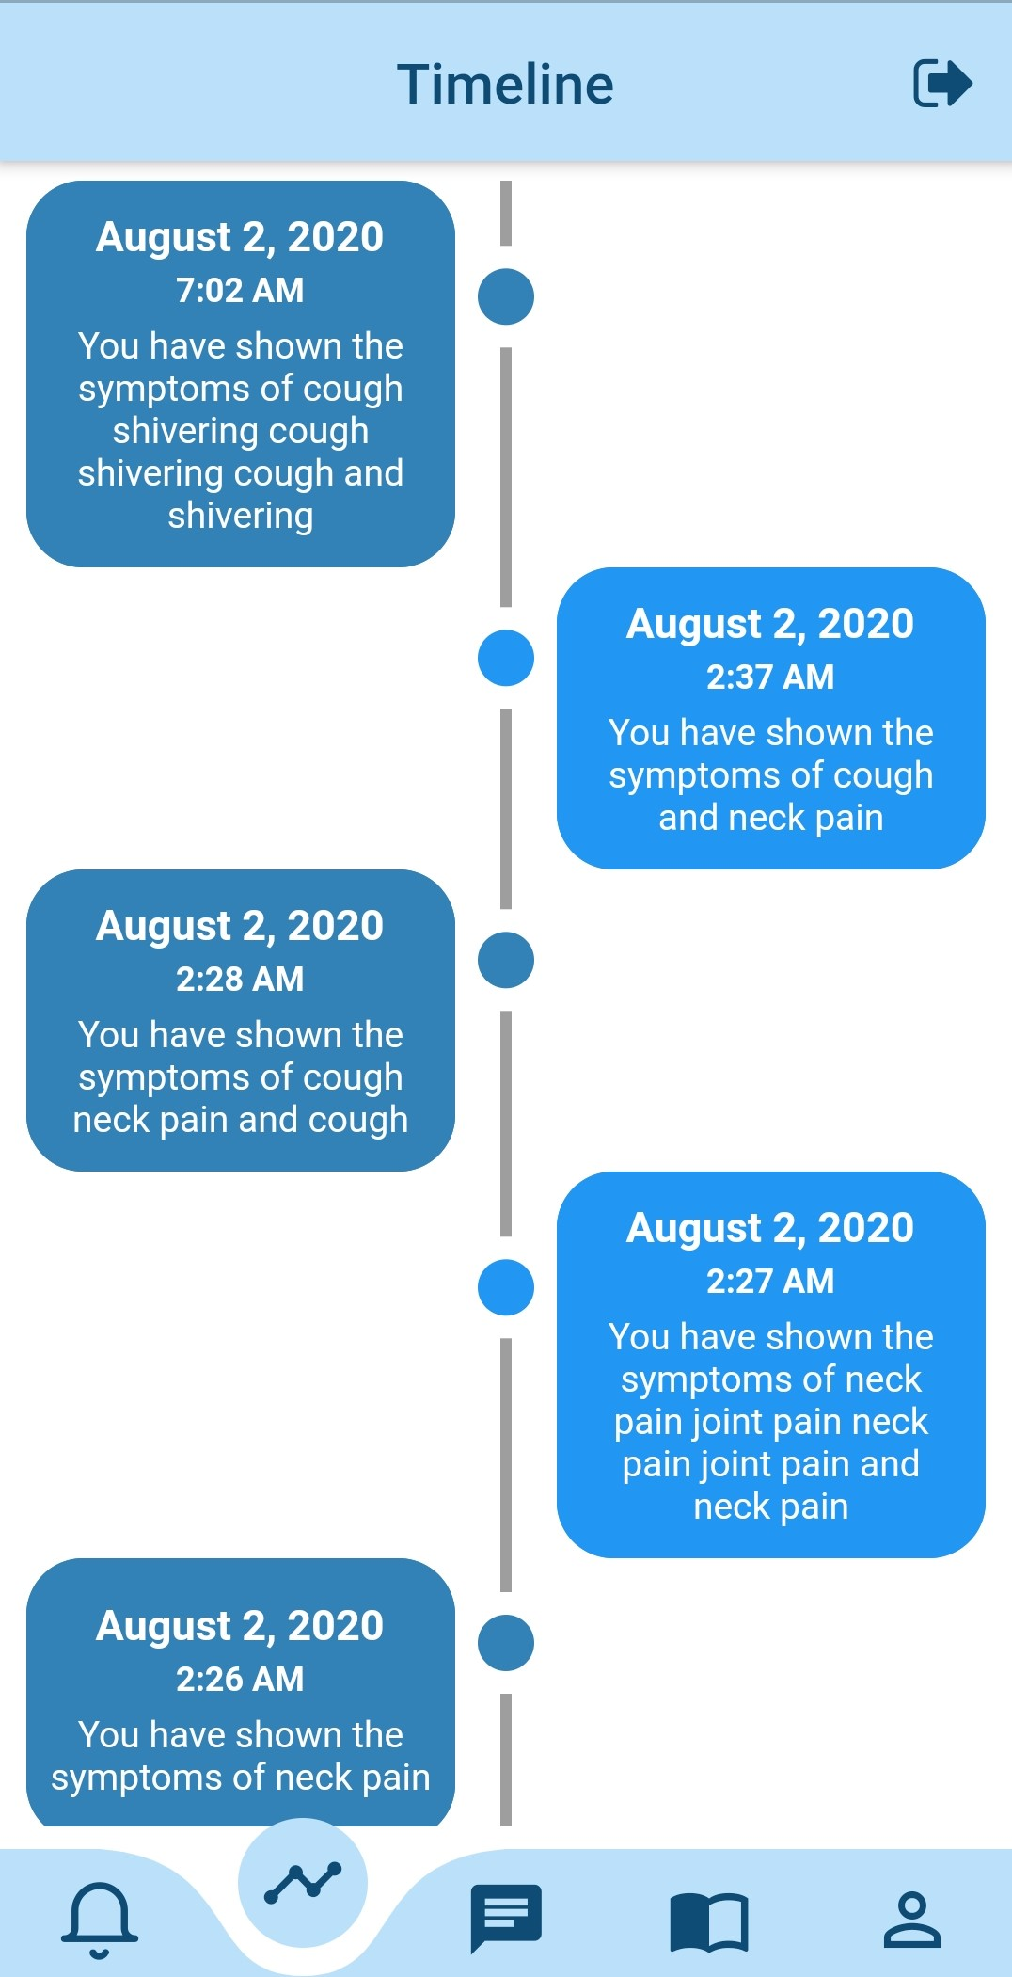
User Timeline
Arcyon keeps record of the users previous symptoms.
This will help the doctor to understand about user’s previous sufferings.
Arcyon saves data using String Regex.
Data is stored in Firebase Firestore Databse which is NoSQL based.
Design is very simple and easy for the user to get data easily.

Slide 21
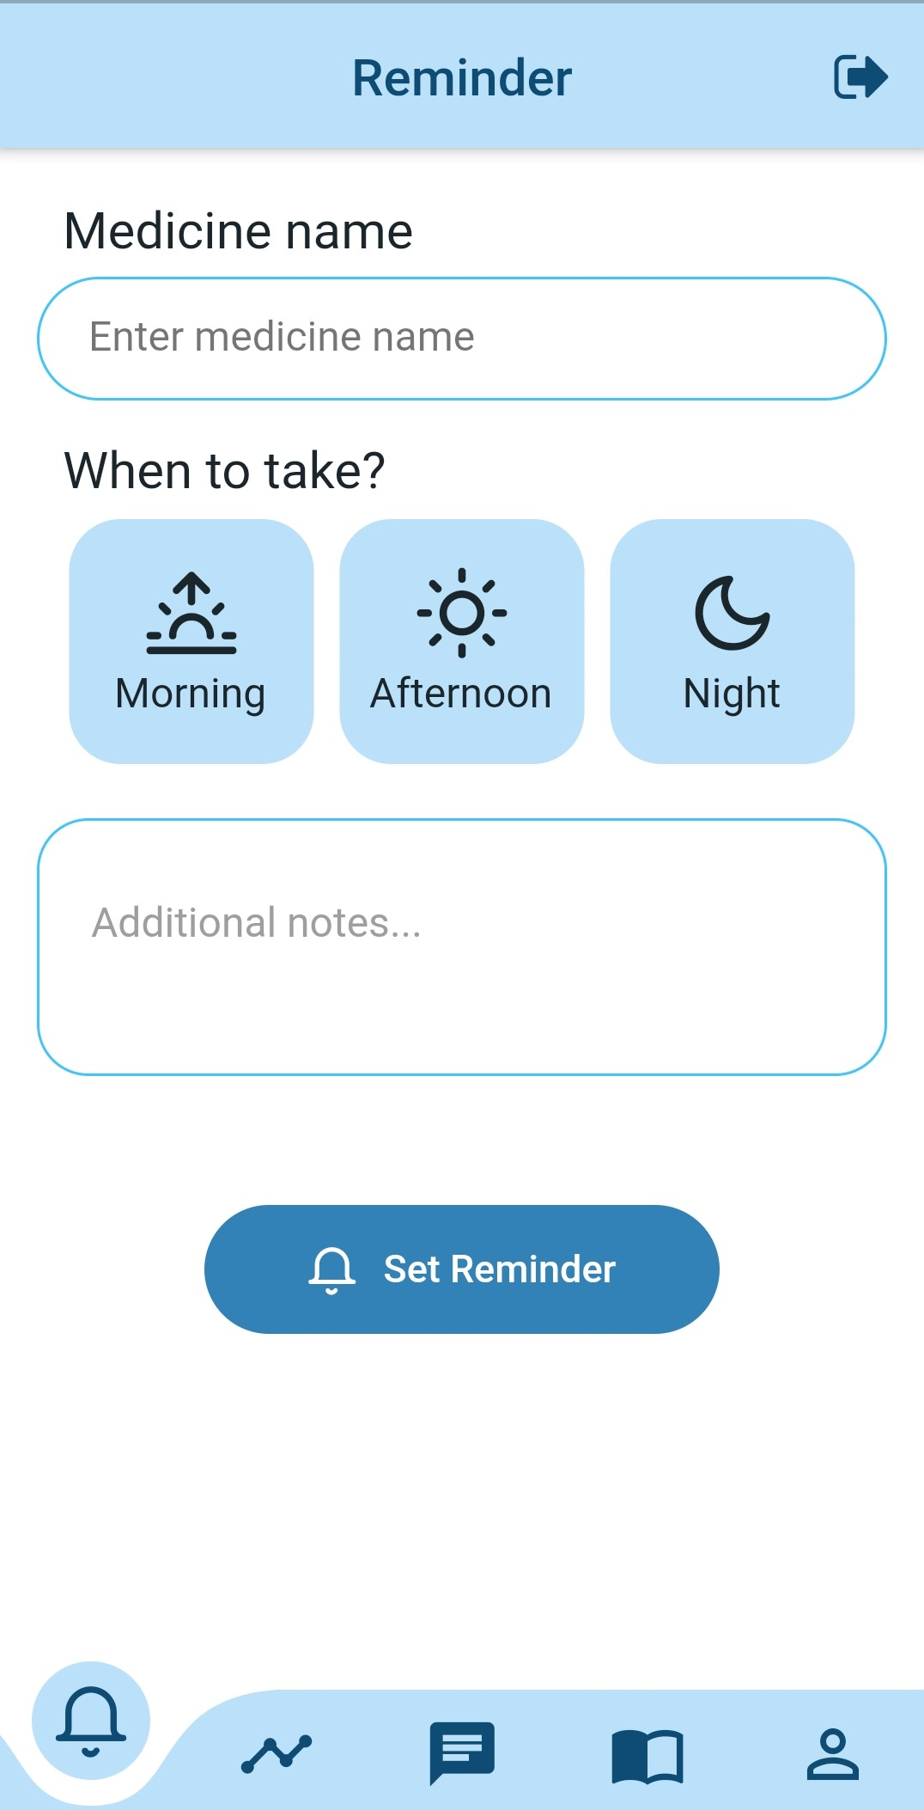
Medication Reminder
In the 21st century busy lifestyle, people easily forget to remember to take their medications, that’s why Arcyon provides a reminder, which will alert the user to take their medications
This helps the application to be more productive and interacting.

Slide 22
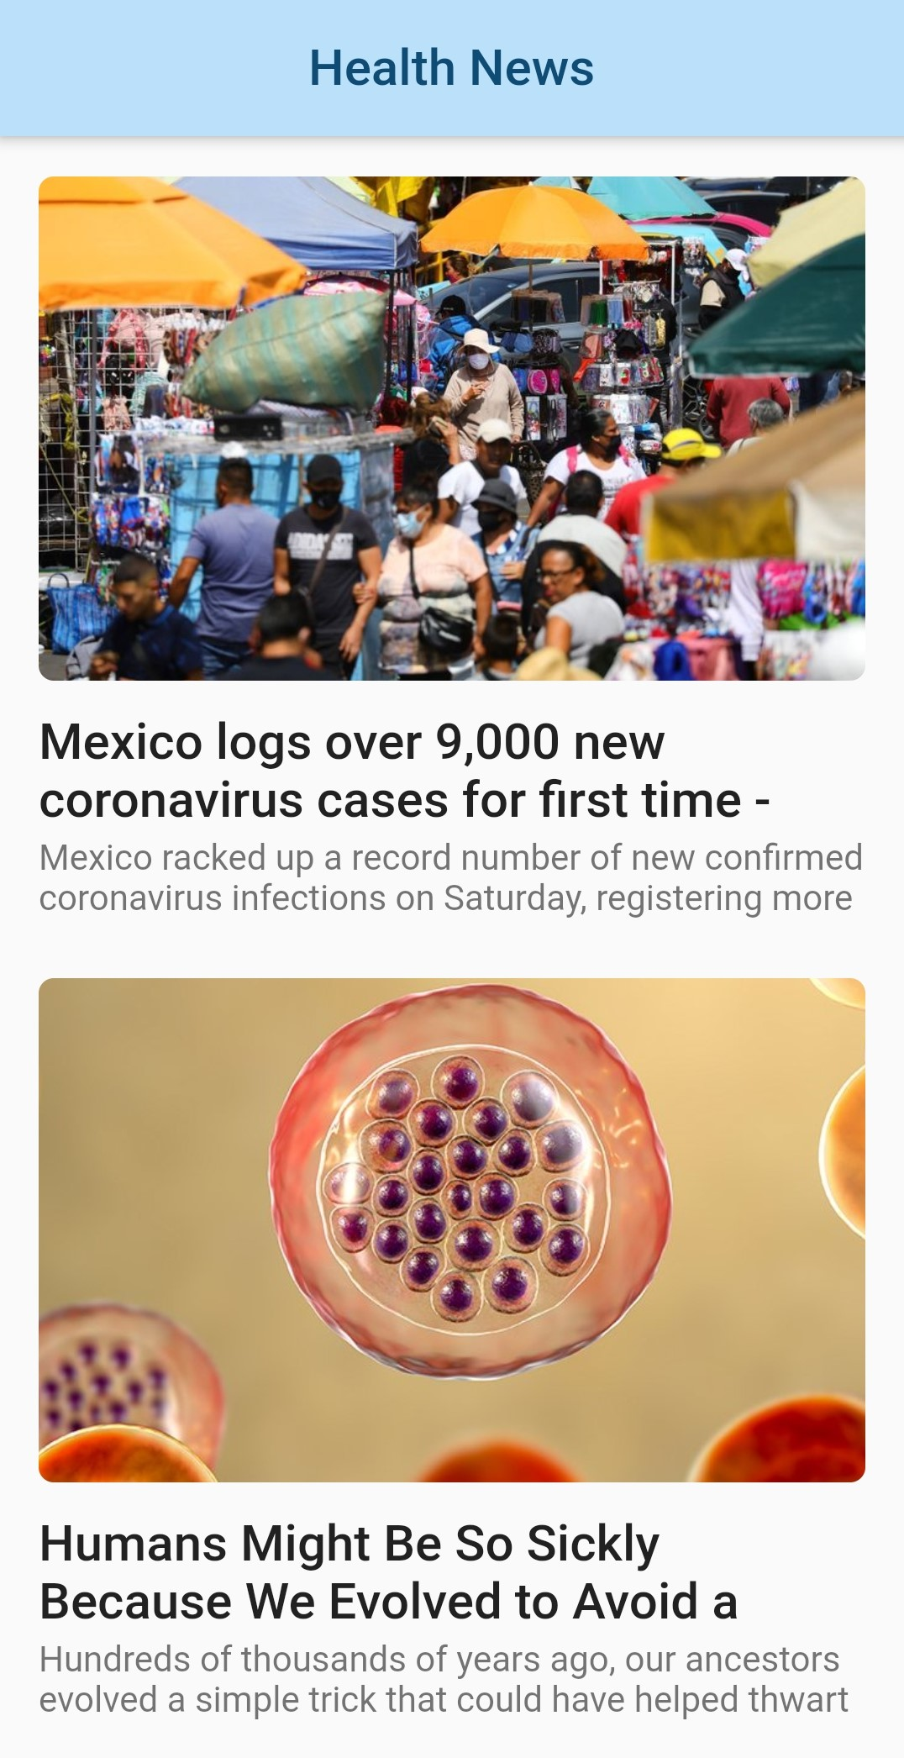
News API
News API is a simple and easy-to-use API that returns JSON metadata for headlines and articles live all over the web right now. The bot will be using News API for current disease spread in the particular location where the user lives.
This is dynamic feature of Arcyon provides the user health related news and some good blogs on health of nearby particular area.

Slide 23
BMI Calculator
Arcyon provides another feature which allow the user to enter his height and weight and the application will calculate his Body mass index for him.
Emergency First Aid
In case of severe medical conditions, Arcyon can provide you with some first aid actions that the user should take until he reaches the hospital.

Slide 24
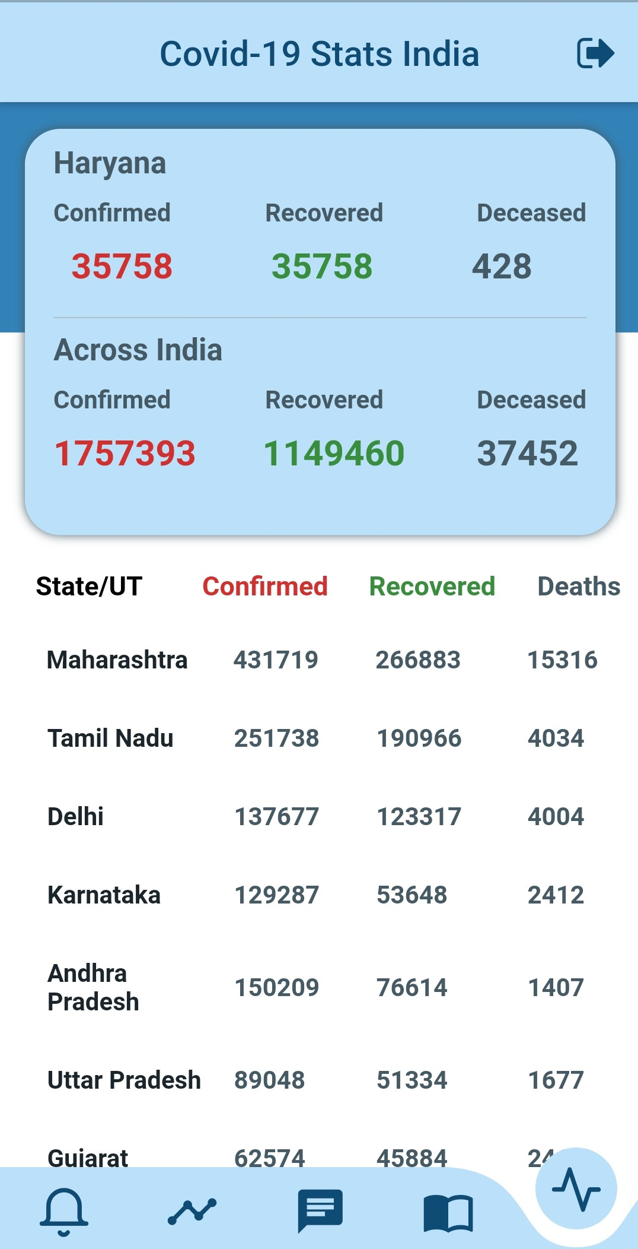
A special Feature
We have included a very simple but very crucial feature which shows you the current statistics of the effect of COVID19.
These stats are continuously updated so that the user has the latest information about the virus

Slide 25
Conclusion
Arcyon is very user friendly.
It provides sufficient accurate results.
It only makes the cautious against what the user might be suffering from.
We tend to take the application on a even higher level.
Our application follows a real world working model.
Still has lot of room for new features.

