Slide 1

Cucumber
Can it be used for CUCM testing?
Alejandro Avella
December 1, 2009

Slide 2
Cucumber (cukes.info)
Cucumber is an open source tool that can execute plain-text functional descriptions as automated tests.
It defines automated scenarios that application must pass to be considered done.
It is a tool for testing any kind of web application, no matter what language it was built in.
The language that Cucumber understands is called Gherkin.
Notes:
Cucumber is an open source tool that can execute plain-text functional descriptions as automated tests. It is supported in English and close to 40 other languages.
It defines automated scenarios that application must pass to be considered done. It defines requirements in more than
a Word document. Once passing, the scenarios serve as regression tests as development continues.
It is a tool for testing any kind of web application, no matter what language it was built in. It can also be used for non-web projects.
The language that Cucumber understands is called Gherkin. We’ll see how Gherkin looks like on this presentation.

Slide 3
Cucumber (Cont.)
Supports collaboration between project stakeholders and application developers.
Cucumber is a Behavior-Driven Development (BDD) Framework built on Ruby.
Allows definition of Executable Requirements.
A simple way to bridge the gap between natural language and Ruby.
Tags: Agile, Dynamic Languages, Project Methodology, Scrum, Test
Notes:
Supports collaboration between project stakeholders and application developers. All team members can see requirements written in English which then are translated to code and automated tests.
Cucumber is a Behavior-Driven Development (BDD) Framework built on Ruby. We’ll see what BDD means shortly.
Allows definition of Executable Requirements that serve two purposes documentation and automated tests written in Gherkin.
A simple way to bridge the gap between natural language and Ruby.
Here are some Tags people have used to describe Cucumber: Agile, Dynamic Languages, Project Methodology, Scrum, Test

Slide 4
Describing Features with Cucumber
Feature: Addition
In order … to avoid silly mistakes
As a … calculator user
I want … to be told the sum of two numbers
Scenario: Add two numbers
Given I have entered 50 into the calculator
And I have entered 70 into the calculator
When I press add
Then the result should be 120 on the screen
Test Setup
Procedure
Expected Results
Notes:
Everything up to and including the Scenario declaration on line 6 is treated as documentation (not executable).
In order is the overall goal.
Feature usually contains a list of scenarios.
we use these three simple words, given, when, and then because they are easily understood by both technical and non-technical contributors to a project.
The Scenario: keyword is followed by a string and then a series of steps.
Each step begins with any of five keywords: Given, When, Then, And
and But.
Given steps represent the state of the world before an event. The purpose of givens is to put the system in a known state before the user (or external system) starts interacting with the system (in the When steps).
When steps represent the event. The purpose of When steps is to describe the key action the user performs
Then steps represent the expected outcomes. Verify that something related to the Given+When is (or is not) in the output.
Even a non-technical team member can read this and figure out what’s going on. And therein
lies the power of Cucumber. It lets us express requirements in language that the whole team can understand.

Slide 5
Automating Features with Cucumber
Given /I have entered (.*) into the calculator/ do |n|
calculator = Calculator.new
calculator.push(n.to_i)
end
Think of the steps in scenarios as method calls, then step definitions are like method definitions.
Steps start with Given, When, Then, And or But.
This is Ruby code, but I think this could be Modena API calls
Notes:
A step definition is a method that creates a step. In this example, we use the Given( ), When( ), and Then( ) methods to write step definitions.
Note the regular expression and how the actual number is passed into the function in the “n” variable. The regular expression is used to identify the desired step implementation.

Slide 6
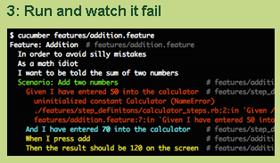

Slide 7
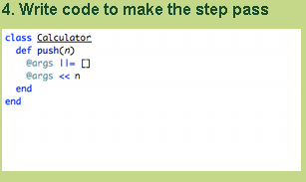
This could be Modena classes
Notes:
Here, the developer defines the code that makes this step to pass.

Slide 8
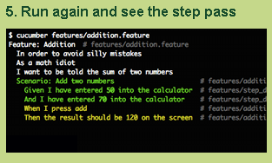
Notes:
The developer runs Cucumber and watches the step pass.

Slide 9
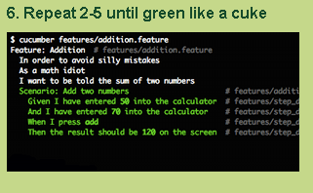
Notes:
This process is repeated until all the steps pass.

Slide 10
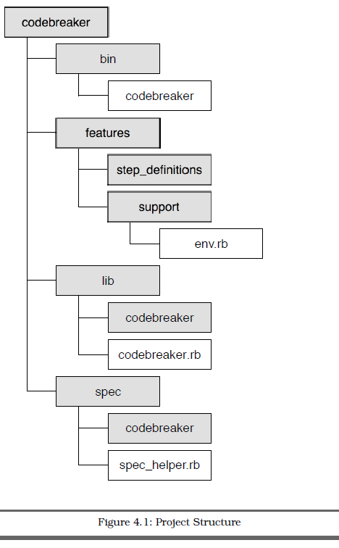
Project Structure
Contains executable scripts and/or binary files
Plain text description of features (.feature files)
Glue that ties plain text scenarios to app. code
Application code
Documentation and automation of RSpec code examples
Notes:
Let’s take a look at the project structure of a project using Cucumber.
bin contains any executable scripts and/or binary files.
features contains files related to documenting and automating Cucumber
features. This is where we already put our plain text feature
files.
The features/step_definitions directory will hold the step definition
files.
Step definitions are written in Ruby (.rb) files, and are the
glue that ties plain text scenarios in the feature files to the application
code.
At this point, the feature files should be in the features/ directory, each
with the .feature file extension. Cucumber recognizes this extension and
treats these files as input.
lib contains the application code.
spec contains files related to documenting and automating RSpec code
examples.

Slide 11
Behavior Driven Development (BDD)
Behavior-driven development is about implementing an application by describing its behavior from the perspective of its stakeholders.
Developer practice that involves writing tests before writing the code being tested.
Write only enough code to pass the one failing example, and no more.
Avoids use of exhaustive up-front requirements gathering process. Instead it favors the creation of an interactive session with working software. Exploratory testing to weed out bugs and edge cases.
Developers write a specification that nails down a small aspect of behavior in a concise and executable form.
Notes:
Behavior-driven development is about implementing an application by describing its behavior from the perspective of its stakeholders. Requirements are written in plain English and are understood by all team members.
Developer practice that involves writing tests before writing the code being tested (Reframing of Test Driven Development).
Begin by writing a very small test for code that does not yet exist. Run the test and, naturally, it fails. Now write just enough code to make that test pass. No more.
Instead it favors the creation of an interactive session with working software. Exploratory testing to weed out bugs and edge cases that we might not think of until we’re actually interacting with the software. What is important is that the investment we’ve made to get this far has been very, very small compared to an exhaustive up-front requirements gathering process. An interactive session with working software is worth a thousand meetings.
Developers write a specification that nails down a small aspect of behavior in a concise, unambiguous, and executable form.
Behavior Driven Development means you write specifications of what your code will have to do. You work in tiny increments... specifying one small aspect of behavior at a time, then implementing it. Note that the word used is Specification, not Verification.

Slide 12
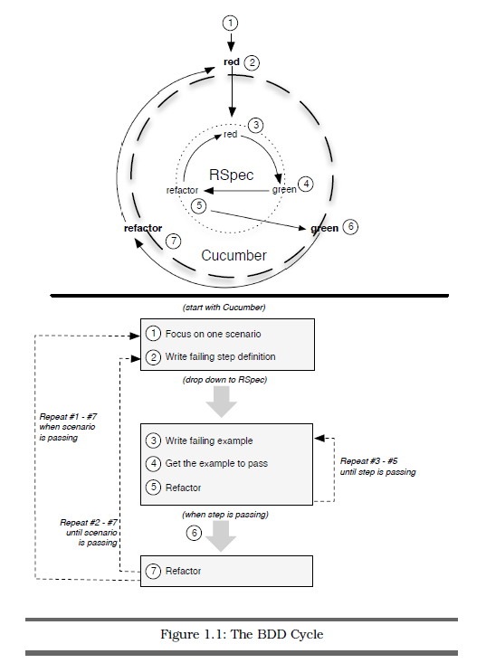
BDD Cycle
Process of driving out code
from the outside in, using Cucumber and RSpec together.
Notes:
This is the BDD cycle. Driving development from the Outside-In, starting with business facing scenarios in Cucumber and working our way inward to the underlying objects with RSpec.
The process is the Red-Green-Refactor cycle straight out of Test-Driven Development. The idea is that you write a
failing example (red), write only enough code to make the example pass (green), and then remove any unwanted duplication (refactor).
Refactoring is the process of changing a software system in such a way that it does not alter the external behavior of the code yet improves its internal structure.”
Once a developer have a failing step in a Cucumber scenario. This is the cue to jump from the outer circle (Cucumber) to the inner circle (RSpec) of the BDD cycle.

Slide 13
Analogy with Web Applications
When /^I create a movie $/ do
  visit movies_path
  click_link "Add Movie"
  fill_in "Title" , :with => "Caddyshack"
  select "1980" , :from => "Release Year"
  check "Comedy"
  click_button "Save"
End
When /^Phone A calls Phone B$/ do
  oPhone$Orig makeCall -digits 2000 -noAnswer
End
Webrat is a Ruby Acceptance Testing for Web Applications that understand these calls
Glue code that needs to be developed
Notes:
Here is an example of a step definition for a web application. In Cucumber, we create step such as “I create a movie”. This step is then translated on a sequence of actions including keywords such as “click_link” and “click_button” that are typical in web applications.
In our case, we could have something such as PhoneA calls PhoneB. This could be translated into a Modena call that makes this action. This is the glue code that needs to be developed.

Slide 14
Translation to our world
Given:
  Configure Phone
  Configure Trunk
  Configure Service Parameter
When:
  Make a call from phone A to phone B
  Press Transfer or Conference softkey
  Configure Call Forward All from phone
Then:
  Verify audio between two phones
  Verify phone displays
  Verify phone status prompt

Slide 15
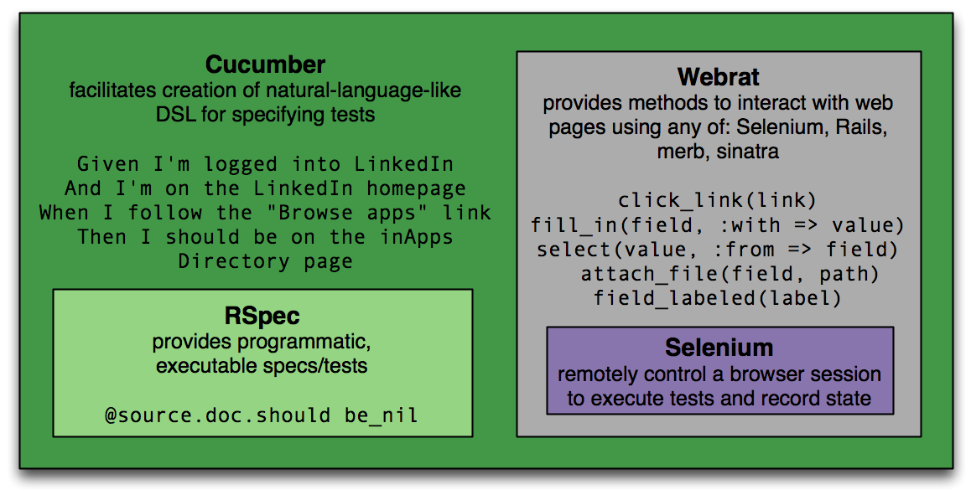
Other Tools
Notes:
Cucumber, based on RSpec, uses Webrat to drive Selenium.
Webrat stimulates the browser.
Watir and Selenium are in-browser testing tools.

Slide 16
References
cukes.info
rspec.info
http://wiki.github.com/aslakhellesoy/cucumber
http://media.railscasts.com/videos/155_beginning_with_cucumber.mov
The Rspec Book, Behaviour Driven Development with RSpec, Cucumber and Friends, David Chelimsky, Dave Astels, Zack Dennis, Aslak Hellesoy, Bryan Helmkamp and Dan North

