Slide 1

Generating scripts automatically and Cucumber
Alejandro Avella
Bryan Gonderinger
January 2010

Slide 2
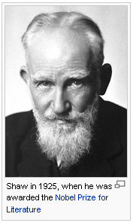
“The reasonable man adapts himself to the world; the unreasonable one persists in trying to adapt the world to himself. Therefore, all progress depends on the unreasonable man. “
  George Bernard Shaw

Slide 3
Agenda
Automatic generation of scripts. (Alejandro)
Tool to generate skeleton scripts (Bryan)
Tool Analysis – Cucumber (Alejandro)
Notes:
Automatic generation of scripts in other to reduce time to the DevTest cycle.

Slide 4


Slide 5


Slide 6
Translating test plans into scripts
Idea: Write test plans with a specific syntax so that they can be translated automatically into scripts.
Can we generate a portion of the Modena scripts automatically?
There will be keywords in the test plan that can be translated into code.
Notes:
What do we mean when we refer to the “Human Network”? A Human Network is a social structure of individuals, business partners or friends that are connected via technology. It connects people with others that have common interests.
This new collaboration is being generated and pushed to people and businesses by end users

Slide 7
Sample translations - Initialization
Test Plan
Phones: Alice and Bob
Modena
eval VapiPhone::[cfgGet ts_info Phone_$Orig type] oPhone$Orig
eval VapiPhone::[cfgGet ts_info Phone_$Dest type] oPhone$Dest
testSection initPhone1 [subst {oPhone$Orig initPhone \
[cfgGet ts_info Phone_$Orig init option]}]
testSection initPhone2 [subst {oPhone$Dest initPhone \
[cfgGet ts_info Phone_$Dest init option]}]
Notes:
Cisco IT is Cisco's first and best customer for most of Cisco's leading-edge enterprise solutions. IT, as a target customer, is uniquely positioned to add greater value to Cisco, both in terms of the direct investments made in IT, and the leveraging of knowledge gained to influence the strategic direction of our products, solutions and services. The first and best customer, or Cisco on Cisco principle, allows Cisco to be among the first business enterprises to enhance product and solution development, drive new increases in productivity, reduce operating costs and support employees and customers.
Demonstrate, through leading by example, the benefits of lessons learned that will make customers and internal Cisco organizations successful in reaping the rewards of new technology and services.
Train Customer Advocacy consultants on the latest products and solutions.
Support Sales growth through enhanced customer confidence by sharing best practices and leveraging internal technical architecture and solution strategy.
Provide critical feedback to Cisco engineering teams as part of ‘ready for market’ evaluations to enhance product and solutions success.
Support the ‘Cisco end-to-end’, ‘Self Defending Network’ and ‘Intelligent Information Network’ marketplace architectural approach.
Demonstrate through ‘first adoption’ that the combination of process reengineering, investments in applications, services and network infrastructure drives a higher level of productivity in the business.
For further information on Cisco on Cisco, including detailed Case Studies, please visit: http://www.cisco.com/en/US/about/ciscoitatwork/index.html

Slide 8
Sample translations - Setup
Test Plan
Laura (Software Architect 3, 1186) is CFA to 1604. CSS CFA = office-hq-css (Phone 7).
Modena
DN oDN
oDN configure -number $ts_info(Phone_$Dest,line-1-number)\
-partitionName $ts_info(Phone_$Dest,line-1-partitionName)
testSection select_1102 {oDN select}
oDN configure -cfaDestination $ts_info(Phone_3,line-6-ext)\
-cfaCSS $ts_info(CallingSearchSpace_2,name)
testSection cfaUpdate_1146 {oDN update}
Notes:
Cisco IT is Cisco's first and best customer for most of Cisco's leading-edge enterprise solutions. IT, as a target customer, is uniquely positioned to add greater value to Cisco, both in terms of the direct investments made in IT, and the leveraging of knowledge gained to influence the strategic direction of our products, solutions and services. The first and best customer, or Cisco on Cisco principle, allows Cisco to be among the first business enterprises to enhance product and solution development, drive new increases in productivity, reduce operating costs and support employees and customers.
Demonstrate, through leading by example, the benefits of lessons learned that will make customers and internal Cisco organizations successful in reaping the rewards of new technology and services.
Train Customer Advocacy consultants on the latest products and solutions.
Support Sales growth through enhanced customer confidence by sharing best practices and leveraging internal technical architecture and solution strategy.
Provide critical feedback to Cisco engineering teams as part of ‘ready for market’ evaluations to enhance product and solutions success.
Support the ‘Cisco end-to-end’, ‘Self Defending Network’ and ‘Intelligent Information Network’ marketplace architectural approach.
Demonstrate through ‘first adoption’ that the combination of process reengineering, investments in applications, services and network infrastructure drives a higher level of productivity in the business.
For further information on Cisco on Cisco, including detailed Case Studies, please visit: http://www.cisco.com/en/US/about/ciscoitatwork/index.html

Slide 9
Sample translations - Setup
Test Plan
Set the “ECC - Call Diversion Maximum Hop Count” service parameter to 2.
Modena
ServiceParameters oServParam
oServParam configure -serviceType "$CCMConDBEnums::ServiceType(SERVICE_CALLMANAGER)" \
-parameterType "$CCMConDBEnums::ParameterType(EXTERNALCALLCONTROLDIVERSIONMAXIMUMHOPCOUNT)"
testSection serviceParameterSelect_a {oServParam select}
oServParam configure -paramValue 2
testSection update_servparam_a { oServParam update }
Notes:
Cisco IT is Cisco's first and best customer for most of Cisco's leading-edge enterprise solutions. IT, as a target customer, is uniquely positioned to add greater value to Cisco, both in terms of the direct investments made in IT, and the leveraging of knowledge gained to influence the strategic direction of our products, solutions and services. The first and best customer, or Cisco on Cisco principle, allows Cisco to be among the first business enterprises to enhance product and solution development, drive new increases in productivity, reduce operating costs and support employees and customers.
Demonstrate, through leading by example, the benefits of lessons learned that will make customers and internal Cisco organizations successful in reaping the rewards of new technology and services.
Train Customer Advocacy consultants on the latest products and solutions.
Support Sales growth through enhanced customer confidence by sharing best practices and leveraging internal technical architecture and solution strategy.
Provide critical feedback to Cisco engineering teams as part of ‘ready for market’ evaluations to enhance product and solutions success.
Support the ‘Cisco end-to-end’, ‘Self Defending Network’ and ‘Intelligent Information Network’ marketplace architectural approach.
Demonstrate through ‘first adoption’ that the combination of process reengineering, investments in applications, services and network infrastructure drives a higher level of productivity in the business.
For further information on Cisco on Cisco, including detailed Case Studies, please visit: http://www.cisco.com/en/US/about/ciscoitatwork/index.html

Slide 10
Sample translations - Main
Test Plan
Alice (Analyst) calls Bob (Assistant) by dialing 1102.
Modena
testSection AliceMakesACall "oPhone$Orig makeCall
-digits $ts_info(Phone_$Dest,line-1-extension)"
Notes:
Cisco IT is Cisco's first and best customer for most of Cisco's leading-edge enterprise solutions. IT, as a target customer, is uniquely positioned to add greater value to Cisco, both in terms of the direct investments made in IT, and the leveraging of knowledge gained to influence the strategic direction of our products, solutions and services. The first and best customer, or Cisco on Cisco principle, allows Cisco to be among the first business enterprises to enhance product and solution development, drive new increases in productivity, reduce operating costs and support employees and customers.
Demonstrate, through leading by example, the benefits of lessons learned that will make customers and internal Cisco organizations successful in reaping the rewards of new technology and services.
Train Customer Advocacy consultants on the latest products and solutions.
Support Sales growth through enhanced customer confidence by sharing best practices and leveraging internal technical architecture and solution strategy.
Provide critical feedback to Cisco engineering teams as part of ‘ready for market’ evaluations to enhance product and solutions success.
Support the ‘Cisco end-to-end’, ‘Self Defending Network’ and ‘Intelligent Information Network’ marketplace architectural approach.
Demonstrate through ‘first adoption’ that the combination of process reengineering, investments in applications, services and network infrastructure drives a higher level of productivity in the business.
For further information on Cisco on Cisco, including detailed Case Studies, please visit: http://www.cisco.com/en/US/about/ciscoitatwork/index.html

Slide 11
Sample translations - Main
Test Plan
Bob answers the call
Modena
testSection BobAnswersCall "oPhone$Dest answerCall"
Notes:
Cisco IT is Cisco's first and best customer for most of Cisco's leading-edge enterprise solutions. IT, as a target customer, is uniquely positioned to add greater value to Cisco, both in terms of the direct investments made in IT, and the leveraging of knowledge gained to influence the strategic direction of our products, solutions and services. The first and best customer, or Cisco on Cisco principle, allows Cisco to be among the first business enterprises to enhance product and solution development, drive new increases in productivity, reduce operating costs and support employees and customers.
Demonstrate, through leading by example, the benefits of lessons learned that will make customers and internal Cisco organizations successful in reaping the rewards of new technology and services.
Train Customer Advocacy consultants on the latest products and solutions.
Support Sales growth through enhanced customer confidence by sharing best practices and leveraging internal technical architecture and solution strategy.
Provide critical feedback to Cisco engineering teams as part of ‘ready for market’ evaluations to enhance product and solutions success.
Support the ‘Cisco end-to-end’, ‘Self Defending Network’ and ‘Intelligent Information Network’ marketplace architectural approach.
Demonstrate through ‘first adoption’ that the combination of process reengineering, investments in applications, services and network infrastructure drives a higher level of productivity in the business.
For further information on Cisco on Cisco, including detailed Case Studies, please visit: http://www.cisco.com/en/US/about/ciscoitatwork/index.html

Slide 12
Sample translations - Main
Test Plan
Alice drops the call.
Modena
testSection Alice_Drops_Call "oPhone$Orig endCall"
Notes:
Cisco IT is Cisco's first and best customer for most of Cisco's leading-edge enterprise solutions. IT, as a target customer, is uniquely positioned to add greater value to Cisco, both in terms of the direct investments made in IT, and the leveraging of knowledge gained to influence the strategic direction of our products, solutions and services. The first and best customer, or Cisco on Cisco principle, allows Cisco to be among the first business enterprises to enhance product and solution development, drive new increases in productivity, reduce operating costs and support employees and customers.
Demonstrate, through leading by example, the benefits of lessons learned that will make customers and internal Cisco organizations successful in reaping the rewards of new technology and services.
Train Customer Advocacy consultants on the latest products and solutions.
Support Sales growth through enhanced customer confidence by sharing best practices and leveraging internal technical architecture and solution strategy.
Provide critical feedback to Cisco engineering teams as part of ‘ready for market’ evaluations to enhance product and solutions success.
Support the ‘Cisco end-to-end’, ‘Self Defending Network’ and ‘Intelligent Information Network’ marketplace architectural approach.
Demonstrate through ‘first adoption’ that the combination of process reengineering, investments in applications, services and network infrastructure drives a higher level of productivity in the business.
For further information on Cisco on Cisco, including detailed Case Studies, please visit: http://www.cisco.com/en/US/about/ciscoitatwork/index.html

Slide 13
Sample translations - After
Test Plan
Verify CDRs.
Modena
testSection chkCDRcreated {getLatestCDRCheck $ccmid 90}
testSection checkCDRs {oCDR fetchAndParseCDR "Expected_CDR.csv" ECC_Modify}
Notes:
Cisco IT is Cisco's first and best customer for most of Cisco's leading-edge enterprise solutions. IT, as a target customer, is uniquely positioned to add greater value to Cisco, both in terms of the direct investments made in IT, and the leveraging of knowledge gained to influence the strategic direction of our products, solutions and services. The first and best customer, or Cisco on Cisco principle, allows Cisco to be among the first business enterprises to enhance product and solution development, drive new increases in productivity, reduce operating costs and support employees and customers.
Demonstrate, through leading by example, the benefits of lessons learned that will make customers and internal Cisco organizations successful in reaping the rewards of new technology and services.
Train Customer Advocacy consultants on the latest products and solutions.
Support Sales growth through enhanced customer confidence by sharing best practices and leveraging internal technical architecture and solution strategy.
Provide critical feedback to Cisco engineering teams as part of ‘ready for market’ evaluations to enhance product and solutions success.
Support the ‘Cisco end-to-end’, ‘Self Defending Network’ and ‘Intelligent Information Network’ marketplace architectural approach.
Demonstrate through ‘first adoption’ that the combination of process reengineering, investments in applications, services and network infrastructure drives a higher level of productivity in the business.
For further information on Cisco on Cisco, including detailed Case Studies, please visit: http://www.cisco.com/en/US/about/ciscoitatwork/index.html

Slide 14
Sample translations - After
Test Plan
Verify RTMT Counters (ExternalCallControlEnabledCallsAttempted).
Modena
testSection GetFinalCounterValue_ECCECA {
csipl_getPerfmonValue $ts_info($ccmid,ip) \
$ts_info($ccmid,username) $ts_info($ccmid,pw) \
"ECCCEnabledCallsAttempted" "-1" "Cisco CallManager"
} -chkres "result == [expr $counterValue_Initial + $ECCECA_add]"
Notes:
Cisco IT is Cisco's first and best customer for most of Cisco's leading-edge enterprise solutions. IT, as a target customer, is uniquely positioned to add greater value to Cisco, both in terms of the direct investments made in IT, and the leveraging of knowledge gained to influence the strategic direction of our products, solutions and services. The first and best customer, or Cisco on Cisco principle, allows Cisco to be among the first business enterprises to enhance product and solution development, drive new increases in productivity, reduce operating costs and support employees and customers.
Demonstrate, through leading by example, the benefits of lessons learned that will make customers and internal Cisco organizations successful in reaping the rewards of new technology and services.
Train Customer Advocacy consultants on the latest products and solutions.
Support Sales growth through enhanced customer confidence by sharing best practices and leveraging internal technical architecture and solution strategy.
Provide critical feedback to Cisco engineering teams as part of ‘ready for market’ evaluations to enhance product and solutions success.
Support the ‘Cisco end-to-end’, ‘Self Defending Network’ and ‘Intelligent Information Network’ marketplace architectural approach.
Demonstrate through ‘first adoption’ that the combination of process reengineering, investments in applications, services and network infrastructure drives a higher level of productivity in the business.
For further information on Cisco on Cisco, including detailed Case Studies, please visit: http://www.cisco.com/en/US/about/ciscoitatwork/index.html

Slide 15
The syntax of a new language
The language could include keywords such as:
  Phones
  Service Parameter
  CFA, CFB, CFNA
  Calls, answers, drops
  CDR, Counters

Slide 16
Other fields that can be translated…
Title
Description
Logical Identifier
Bryan Gonderinger (bgonderi) developed a prototype of this part of the idea.

Slide 17
Automation Autogen Tool
Based on a template, generate skeleton automation script files from test plan
Skeletons consist primarily of comments – users still need to fill in code
Input: Test plan (Excel export), template
Output: Test scripts, job file, suiteinfo.xml

Slide 18
Tool Use – Command-Line Options
>>php /auto/bldr-test/Tools/autogen/autogen.php -h
Command-line options:
-t <test plan filename> - Excel file (TIMS export)-required
-m <template name>
-j <job template name>
-d <output directory> - defaults to current directory
-p <tid prefix> - defaults to "PREFIX"
-a - If specified, then all test cases will be processed, otherwise only those tagged [AU]
-h - Show help/usage

Slide 19
Template Example
#######################################################
# Script Header
#
# Copyright (c) 2005-2010 Cisco Systems, Inc.
#
# Name: <FILENAME>
#
# Purpose:
# <TITLE>
#
# References:
# <EDCS>
#
# Description:
<DESCRIPTION>
#
# Synopsis:
# <FILENAME> -tbcfg <test bed config> -tscfg testsuite.cfg
#
# End of Header
#######################################################

Slide 20
Sample Run
>>php /auto/bldr-test/Tools/autogen/autogen.php -t /auto/bldr-test/Tools/autogen/DemoTestplan.xls
Output directory /tmp/DemoTestplan does not exist - creating...
Output directory /tmp/DemoTestplan created successfully
Appears to be valid test plan document
Found all required column headings
Generating script for test case SIT-070914-chthome-25: Call Forward Busy Feature Interaction
Generating job file
Writing job file /tmp/DemoTestplan/DemoTestplan.job
Generateing suiteinfo.xml file
Writing /tmp/DemoTestplan/suiteinfo.xml

Slide 21
Output Example
##################################################################
# Script Header
#
# Copyright (c) 2005-2009 Cisco Systems, Inc.
#
# Name: SIT-070914-chthome-01.tcl
#
# Purpose:
# New Play Secure Indication Tone Service Parameter
#
# References:
# 612849,EDCS-359628 Rev 22
#
# Description:
# A new service parameter has been added to CUCM which will enable the
# Secure Indication Tone feature.
#
# Synopsis:
# SIT-070914-chthome-01.tcl -tbcfg <test bed config> -tscfg testsuite.cfg
#
# End of Header
##################################################################

Slide 22
Skeleton Scripts – common_setup/common_cleanup
aetest::section common_setup {
# set debug 1
OutputInfo info 0 1 0 "Executing common_setup section"
testGoTo -on common_cleanup
#
# 1. PhoneA, PhoneB, and PhoneC are in the same cluster.
#
#
# 2. PhoneA and PhoneB protected status is set in the variation.
#
#
# 3. PhoneC is configured as protected.
#
}

Slide 23
Skeleton Scripts – Body
aetest::testcase -tc_id "SIT-070914-chthome-15.$lid" {
set testName "SIT-070914-chthome-25"
set testDescr "Call Forward Busy Feature Interaction"
testStart $testName $testDescr
testGoTo -on common_cleanup
#
# 1. PhoneA has Call Forward Busy set to PhoneB.
#
#
# 2. PhoneC calls PhoneA.
#
}

Slide 24
Autogen - Summary
No changes required to test plan
Huge time savings when initially authoring scripts by:
  Generating skeleton scripts / files
  Preventing typos
    Conferencing test plan
    712 TCL suite files
    job file (793 lines)
    suiteinfo.xml file (2864 lines)
    All generated by autogen in 0.6 seconds

Slide 25
Tools out there…
Sid and Jaya found Cucumber during Agile Training
Can we use Cucumber to generate scripts automatically?
Can we use this tool for this idea or somewhere in our process?

Slide 26
Cucumber (cukes.info)
Cucumber is an open source tool that can execute plain-text functional descriptions as automated tests.
It defines automated scenarios that application must pass to be considered done.
It is a tool for testing any kind of web application or other non-web projects.
The language that Cucumber understands is called Gherkin.
Notes:
Cucumber is an open source tool that can execute plain-text functional descriptions as automated tests. It is supported in English and close to 40 other languages.
It defines automated scenarios that application must pass to be considered done. It defines requirements in more than a Word document. Once passing, the scenarios serve as regression tests as development continues.
It is a tool for testing any kind of web application, no matter what language it was built in. It can also be used for non-web projects.
The language that Cucumber understands is called Gherkin. We’ll see how Gherkin looks like on this presentation.

Slide 27
Cucumber (Cont.)
Supports collaboration between project stakeholders and application developers.
Cucumber is a Behavior-Driven Development (BDD) Framework built on Ruby.
Allows definition of Executable Requirements.
A simple way to bridge the gap between natural language and Ruby.
Tags: Agile, Dynamic Languages, Project Methodology, Scrum, Test
Notes:
Supports collaboration between project stakeholders and application developers. All team members can see requirements written in English which then are translated to code and automated tests.
Cucumber is a Behavior-Driven Development (BDD) Framework built on Ruby. We’ll see what BDD means shortly.
Allows definition of Executable Requirements that serve two purposes documentation and automated tests written in Gherkin.
A simple way to bridge the gap between natural language and Ruby.
Here are some Tags people have used to describe Cucumber: Agile, Dynamic Languages, Project Methodology, Scrum, Test

Slide 28
Describing Features with Cucumber
Feature: Addition
In order … to avoid silly mistakes
As a … calculator user
I want … to be told the sum of two numbers
Scenario: Add two numbers
Given I have entered 50 into the calculator
And I have entered 70 into the calculator
When I press add
Then the result should be 120 on the screen
Test Setup
Procedure
Expected Results
Notes:
Everything up to and including the Scenario declaration on line 6 is treated as documentation (not executable).
In order is the overall goal.
Feature usually contains a list of scenarios.
Cucumber uses these three simple words: given, when, and then because they are easily understood by both technical and non-technical contributors to a project.
The Scenario: keyword is followed by a string and then a series of steps. Each step begins with any of five keywords: Given, When, Then, And and But.
Given steps represent the state of the world before an event. The purpose of givens is to put the system in a known state before the user (or external system) starts interacting with the system (in the When steps).
When steps represent the event. The purpose of When steps is to describe the key action the user performs
Then steps represent the expected outcomes. Verify that something related to the Given+When is (or is not) in the output.
Even a non-technical team member can read this and figure out what’s going on. And therein
lies the power of Cucumber. It lets us express requirements in language that the whole team can understand.

Slide 29
Automating Features with Cucumber
Given /I have entered (.*) into the calculator/ do |n|
calculator = Calculator.new
calculator.push(n.to_i)
end
Think of the steps in scenarios as method calls, then step definitions are like method definitions.
There could be step libraries that could be reused.
This is Ruby code. With the ruby-tcl library this could be Modena API calls
Notes:
A step definition is a method that creates a step. We use the Given( ), When( ), and Then( ) methods to write step definitions.
Note the regular expression and how the actual number is passed into the function in the “n” variable. The regular expression is used to identify the desired step implementation.

Slide 30
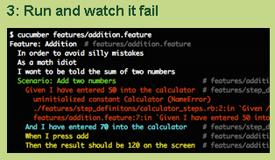
Notes:
In the first line, you can see how to run cucumber. It takes a feature file as input and it shows where the scenario fails.

Slide 31
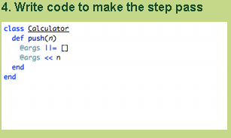
This could be Modena classes
Notes:
Here, the developer defines the code that makes this step to pass.

Slide 32
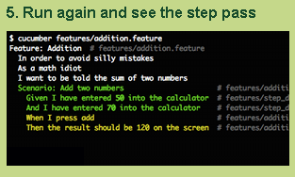
Notes:
The developer runs Cucumber and watches the step pass.

Slide 33
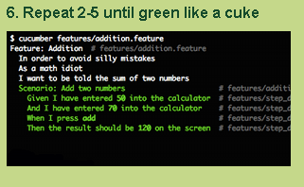
Notes:
This process is repeated until all the steps pass.

Slide 34
Background
Like our DbSetup script
Context to the scenarios in a single feature.
The background is run before each of your scenarios.
Feature: Multiple site support
As a site owner
I want to host blogs for different people
In order to make money
Background:
Given a global administrator named “Greg” And a blog named “Greg’s Blog”
And a customer named “Dr. Bill”
And a blog named “Expensive Therapy”
Scenario 1 …
Scenario 2 …
Scenario 3 …

Slide 35
Outline
Like our test case variations
A way to define variations on a test case
Scenario Outline: eating
Given there are <start> cucumbers
When I eat <eat> cucumbers
Then I should have <left> cucumbers Examples:
| start | eat | left |
| 12 | 5 | 7 |
| 20 | 5 | 15 |

Slide 36
Analogy with Web Applications
When /^I create a movie $/ do
  visit movies_path
  click_link "Add Movie"
  fill_in "Title" , :with => "Caddyshack"
  select "1980" , :from => "Release Year"
  check "Comedy"
  click_button "Save"
End
When /^Phone A calls Phone B$/ do
  @result = @res.eval (“oPhone$Orig makeCall -digits 2000 –noAnswer”)
End
Webrat is a Ruby Acceptance Testing for Web Applications that understand these calls
Glue code that needs to be developed. Ruby calling Tcl
Notes:
Here is an example of a step definition for a web application. In Cucumber, we create step such as “I create a movie”. This step is then translated on a sequence of actions including keywords such as “click_link” and “click_button” that are typical in web applications.
In our case, we could have something such as PhoneA calls PhoneB. This could be translated into a Modena call that makes this action. This is the glue code that needs to be developed.

Slide 37
Translation to our world
Given:
  Configure Phone
  Configure Trunk
  Configure Service Parameter
When:
  Make a call from phone A to phone B
  Press Transfer or Conference softkey
  Configure Call Forward All from phone
Then:
  Verify audio between two phones
  Verify phone displays
  Verify phone status prompt
Notes:
Here are some examples of steps that we could encounter in our test cases.

Slide 38
A Simple script
Scenario: Making a basic call with ECC enabled
  Given Phone A that is a SCCP phone and registers to CmA1.
  Given Phone B that is a SIP phone and registers to CmA1.
  Given CDR is configured.
  Given CmA1 is in use.
  When Get ExternalCallControlEnabledCallsAttempted RTMT counter.
  When Get ExternalCallControlEnabledCallsCompleted RTMT counter.
  When Phone A calls Phone B by dialing 2000.
  When Phone B answers the call.
  When Phone A ends the call.
  Then CDR should have currentRoutingReason = 0, origRoutingReason = 0,
  Then ExternalCallControlEnabledCallsAttempted should be incremented by 1.
  Then ExternalCallControlEnabledCallsCompleted should be incremented by 1.

Slide 39
Other ideas
Write script first and Generate Test Plan from script.
Write a tool like Cucumber that generates TCL directly.
Marketing writes requirements in Cucumber.
Developers use Cucumber.

Slide 40
Conclusion
Template tool could be used to generate templates for all the scripts today.
Mixed feelings about Cucumber. Can Devtest or Developers use it today?
But we want it to show it to a larger audience to stimulate discussion.
Generating scripts automatically idea requires more work

Slide 41
References
cukes.info
rspec.info
http://wiki.github.com/aslakhellesoy/cucumber
http://media.railscasts.com/videos/155_beginning_with_cucumber.mov
The Rspec Book, Behaviour Driven Development with RSpec, Cucumber and Friends, David Chelimsky, Dave Astels, Zack Dennis, Aslak Hellesoy, Bryan Helmkamp and Dan North
http://bcomrtg/wiki/index.php/Automation_Autogen

Slide 43
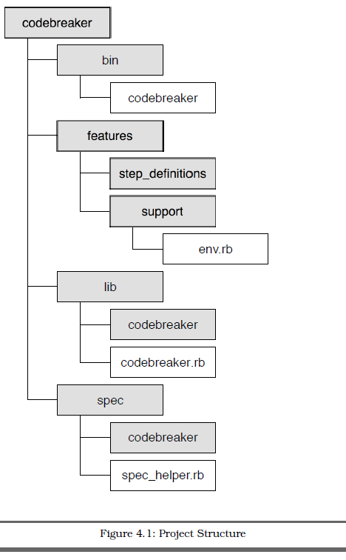
Project Structure
Contains executable scripts and/or binary files
Plain text description of features (.feature files)
Glue that ties plain text scenarios to app. code
Application code
Documentation and automation of RSpec code examples
Notes:
Let’s take a look at the project structure of a project using Cucumber.
bin contains any executable scripts and/or binary files.
features contains files related to documenting and automating Cucumber
features. This is where we already put our plain text feature
files.
The features/step_definitions directory will hold the step definition
files.
Step definitions are written in Ruby (.rb) files, and are the
glue that ties plain text scenarios in the feature files to the application
code.
The feature files should be in the features/ directory, each
with the .feature file extension. Cucumber recognizes this extension and
treats these files as input.
lib contains the application code.
spec contains files related to documenting and automating RSpec code
examples.

Slide 44
Behavior Driven Development (BDD)
Behavior-driven development is about implementing an application by describing its behavior from the perspective of its stakeholders.
Developer practice that involves writing tests before writing the code being tested.
Write only enough code to pass the one failing example, and no more.
Avoids use of exhaustive up-front requirements gathering process. Instead it favors the creation of an interactive session with working software. Exploratory testing to weed out bugs and edge cases.
Developers write a specification that nails down a small aspect of behavior in a concise and executable form.
Notes:
Behavior-driven development is about implementing an application by describing its behavior from the perspective of its stakeholders. Requirements are written in plain English and are understood by all team members.
Developer practice that involves writing tests before writing the code being tested (Reframing of Test Driven Development).
Begin by writing a very small test for code that does not yet exist. Run the test and, naturally, it fails. Now write just enough code to make that test pass. No more.
It favors the creation of an interactive session with working software. Exploratory testing to weed out bugs and edge cases that we might not think of until we’re actually interacting with the software. What is important is that the investment we’ve made to get this far has been very, very small compared to an exhaustive up-front requirements gathering process. An interactive session with working software is worth a thousand meetings.
Developers write a specification that nails down a small aspect of behavior in a concise, unambiguous, and executable form.
Behavior Driven Development means you write specifications of what your code will have to do. You work in tiny increments... specifying one small aspect of behavior at a time, then implementing it. Note that the word used is Specification, not Verification.

Slide 45
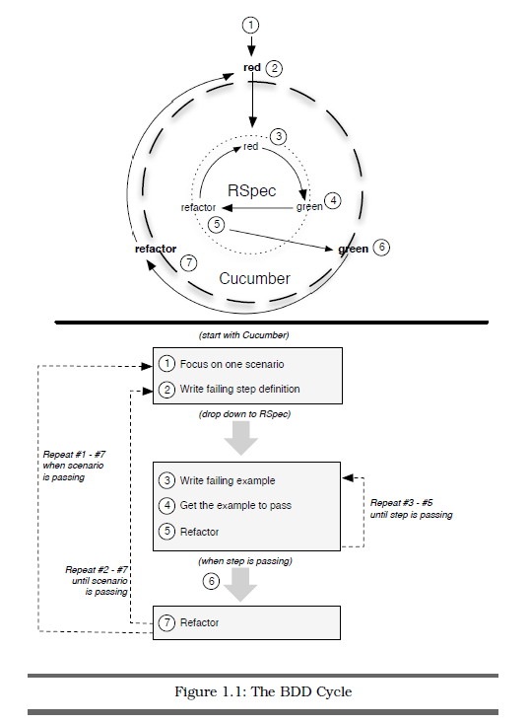
BDD Cycle
Process of driving out code
from the outside in, using Cucumber and RSpec together.
Notes:
This is the BDD cycle. Driving development from the Outside-In, starting with business facing scenarios in Cucumber and working our way inward to the underlying objects with RSpec.
The process is the Red-Green-Refactor cycle straight out of Test-Driven Development. The idea is that you write a failing example (red), write only enough code to make the example pass (green), and then remove any unwanted duplication (refactor).
Refactoring is the process of changing a software system in such a way that it does not alter the external behavior of the code yet improves its internal structure.
Once a developer have a failing step in a Cucumber scenario. This is the cue to jump from the outer circle (Cucumber) to the inner circle (RSpec) of the BDD cycle.

Slide 46
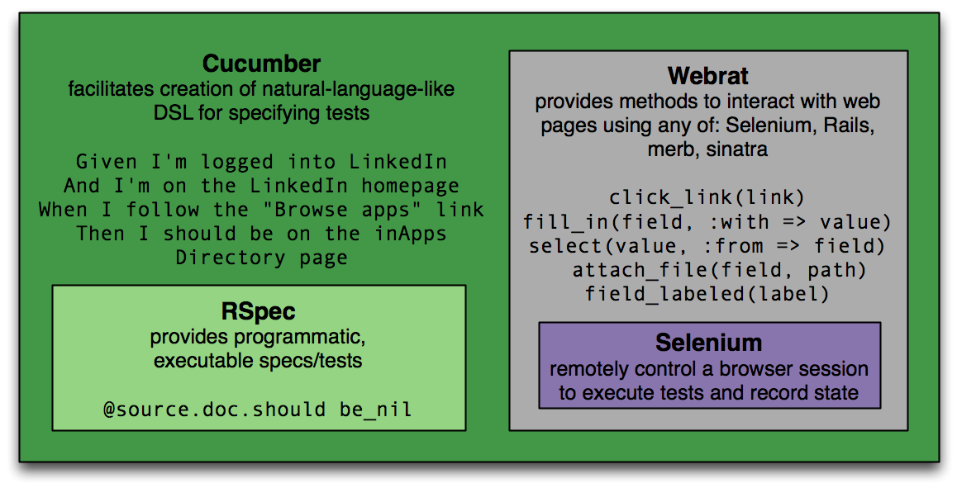
Other Tools
Notes:
Cucumber, based on RSpec, uses Webrat to drive Selenium.
Webrat stimulates the browser.
Watir and Selenium are in-browser testing tools.

Slide 47
Executable specifications
Can we move this idea further upstream, so that FFS can be executed?
Use cases could be written in such a way that they can be translated into automated scripts.
For example, these 3 documents are redundant in the use cases section:
  FFS - EDCS-596000
  Unit Test Plan - EDCS-710242
  DevTest Plan: EDCS-677085

Slide 48
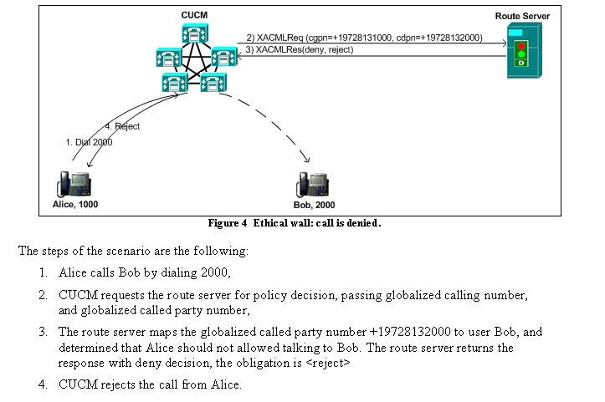
From ECC FFS - EDCS-596000

Slide 49
First step (By Bryan Gonderinger)
“template automation scripts” from test plan documents
Given test plan in Excel format (export to TIMS)
Generates template for all scripts
Generates job file
Generates suiteinfo.xml
Including Title, Description, Logical Identifier and step comments
http://bcomrtg/wiki/index.php/Automation_Autogen
Notes:
From: Bryan Gonderinger (bgonderi)
Sent: Thursday, October 15, 2009 1:38 PM
To: ipcbu-auto-stb(mailer list)
Subject: Automation script autogeneration tool
I’ve put together a tool based on an initial idea by Alejandro Avella with refinements by Chris Thome that generates “template automation scripts” from test plan documents. Right now, it’s still pretty rough, but I think it is usable and would be helpful to someone responsible for writing new automation based on a test plan.
What it does is takes the Excel file that is generated when exporting the test plan to TIMS and uses it to generate a script file for each test case as well as a job file and suiteinfo.xml file. All of these files can be thought of as templates – they still need to be edited manually by the user, but this is still better than constructing them all from scratch (and will reduce the possibility of errors in this information as well).
The tool takes your test plan and uses various template files to generate the scripts and job files. The scripts contain the standard common setup, common cleanup and body sections, but have all the items like the test case title, description and logical IDs filled in from your test plan. The setup/cleanup/body sections also contain the entries from the procedures in your test plan as TCL comments – this allows you to edit the file and easily add the requisite Modena code to actually implement the test cases themselves. The job file contains some generic setup lines as well as the ats_run calls for all the generated scripts. The suiteinfo.xml file will contain all the testcase entries (logical IDs and titles), saving you a lot of work.
I put together a quick Wiki page that contains examples of the three file types at http://bcomrtg/wiki/index.php/Automation_Autogen (in the future, I’ll expand this page to include more information about the tool itself). In the meantime, if you or someone on your team would like to give this tool a try on your test plan, please get in touch with me.
Thanks,
Bryan

Slide 50
A medium complexity script
Scenario: Basic Call Coverage scenario
  Given that prefix is “blank”
  Given that digits are 2000
  Given that forward type is Call Forward All
  Given that forward destination is 7527
  Given that Call Forward No Coverage 2001
  Given that Hunt Pilot is 7527
  Given that partition is pt-hq-internal
  Given that Personal Preferences on the hunt pilot is checked for Hunt Forward No Answer
  Given that Hunt Forward No Answer is blank
  Given that Hunt Forward No Answer CSS is CSS_employee
  Given that Personal Preferences on the hunt pilot is NOT checked for Hunt Forward Busy
  Given the Hunt Forward Busy is blank

Slide 51
A medium complexity script (Cont.)
  Given that Hunt Forward Busy CSS is CSS_employee
  Given that Maximum Hunt Times is set to 60
  Given COLP $ts_info(Phone$Dest,directoryNumber)
  Given exCONPa $ts_info(Phone$Dest,alertingName)
  Given exNumberDivA $ts_info(Phone$initDN,directoryNumber)
  Given exNameDivA $ts_info(Phone$initDN,alertingName)
  Given exNumberDivB $ts_info(Phone$M4,directoryNumber)
  Given exNameDivB $ts_info(Phone$M4,alertingName)
  Given exCLIP $ts_info(Phone$Orig,directoryNumber)
  Given exCNIP $ts_info(Phone$Orig,displayName)
  Given exCOLP_f $ts_info(Phone$Dest,directoryNumber)
  Given exCONP_f $ts_info(Phone$Dest,displayName)
  Given exCLIP_f $ts_info(Phone$Orig,directoryNumber)
  Given exCNIP_f $ts_info(Phone$Orig,displayName)

Slide 52
A medium complexity script (Cont.)
Given that Hunt Pilot 7527 with settings specified above
Given Set Called DN Call Forward type to a Hunt Pilot
Given Set Call Coverage settings for DN
Given Initialize 16 phones
When Make B Busy, if a CFB test case
When A calls B, but B is CFA to Hunt Pilot
Then first line group member rings
Then first line group member stops ringing
Then second line group member rings
Then second line group member stops ringing
Then third line group member rings
Then third line group member stops ringing
Then fourth line group member rings
Then fourth line group member stops ringing
Then after hunting, final forward destination rings as specified in the givens above.
Then phone displays are correct while ringing
Then phone displays are correct after answering
When Phone B ends call
When if phone B busy, end call
Given clear Hunt Pilot settings
Given clear Call Forward settings
Given clear Call Coverage settings

