Slide 1
Cucumber Introduction
May 21, 2013
Alejandro Avella
EDCS-1263541

Slide 2
Agenda
15-minute theory
10-minute demo
How could be used in our team?

Slide 3
Behavioral Driven Development (BDD)
Describe behavior from the perspective of the product managers.
Develop tests before writing the code being tested.
Iterative process.
Explorative testing instead of upfront gathering of requirements.
Developers write a specification that nails down a small aspect of behavior in a concise and executable form.
The behavior is described in the scenarios that are part of the user stories.
Notes:
Behavior-driven development is about implementing an application by describing its behavior from the perspective of the product managers.
Developer practice that involves writing tests before writing the code being tested.
Begin by writing a very small test for code that does not yet exist. Run the test, and, naturally, it fails. Now write just enough code to make that test pass. No more.
Avoids use of exhaustive up-front requirements gathering process. Instead it favors the creation of an interactive session with working software. Exploratory testing to weed out bugs and edge cases.
Developers write a specification that nails down a small aspect of behavior in a concise and executable form.
The behavior is described in the scenarios that are part of the user stories.

Slide 4

Cucumber is an open source tool that can execute plain-text functional descriptions as automated tests.
It defines automated scenarios that application must pass to be considered done.
The language that Cucumber understands is called Gherkin.
Supports collaboration between all members of an Agile team.
Cucumber is a Behavioral Driven Development (BDD) tool, in which tests are written before code is written.
Allows definition of Executable Requirements.
A simple way to bridge the gap between natural language and “glue code” for the step definitions.
Notes:
Gherkin: Given, When, Then
Supports collaboration between all members of an Agile team, including product management, development, test, automation.

Slide 5
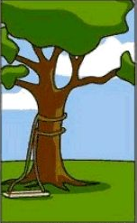
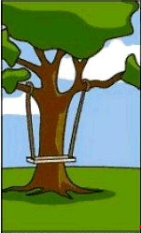







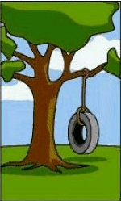
Problem 3 – Everyone is busy, but delivery is slow
Customer speaks to Developer…
Developer:
Developer tells Tester…
Too Many Bug fixes
Developer:
something
Tester:
He want something
ties to a tree, so that he can swing…
ties
tree
Customer:
#$*#&)$#@,
tree, ropes, chair
It should work like this:
sit on chair, chair should be steady
Code
Customer want to have this:
a tree
some ropes
Tie rope to tree
Make a chair hanging
by the rope
Developer
Tester
I want something
ties to a tree,
so that I can swing…
Requirement
Release
Too Many Support cases
Too Many Patches
Developer
Developer
Customer
Customer
Tester

Slide 6
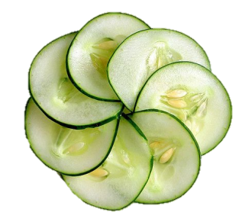
Solution Part 1 - One source of truth (Cucumber Feature File)
Developer
Feature File:
Requirement
Test Case
Component Description
Tester
Customer
Notes:
Solution.
Serve as:
Keyword: Feature

Slide 7
Solution Part 2 - Automation in parallel with development
Write code until scenarios pass
Write scenarios
Commit code & scenarios into Jenkins
Cucumber
Coding
Release
Add automation
Test case automated
Notes:
Make cucumber Executable.
Explain the process.
Keyword: Scenario
By doing this, 1st problem solved. We move automation forward.

Slide 8
Solution Part 3 – Adopt Continuous Integration
deliverable repository
code repository
Jenkins - CI
workspace
build
test
deploy &
publish
code update
report & notify
Notes:
Exec cucumber/automation more often. Hudson.
The typical usage of hudson.

Slide 9
An Agile User Story
Feature: Search
As web user
I want to search with keywords in a Wikipedia
So that I can find the meaning of words
Scenario: Search the dictionary for a keyword
Given I visit the Wikipedia web site
When I search with keyword "cloud"
Then I should see a page with keyword "cloud"
Test Setup
Procedure
Expected Results

Slide 10
Steps
Write the user story on a feature text file.
Run Cucumber given as input this feature text file.
Watch it fail.
Add the glue code to make the steps pass.

Slide 11
Demo
Visit the Wikipedia web site and search for keyword “cloud”
Record test case in Selenium IDE.
Export to Ruby code.
Execute Cucumber and see code fail.
Add “glue code”, so that steps don’t fail anymore.
Complete executable requirement until it is complete (all green).

Slide 12
How could be used in our team?
DE, DT, Automation
Requires fundamental change on how Cisco teams work.
It could be used by all 3 teams moving to a Agile process using Behavioral Driven Development.
Test cases are written first and requirements are executable.
Glue code is written in Ruby, but there is support to other languages.

Slide 13
Summary
Cucumber
provides one source of truth
delivers what customer wants
automates test cases in parallel with development
Jenkins
provides quick feedback
shortens release cycle

Slide 14
References
Website: http://cukes.info
Bridging Communication Gap with Agile Development, Cisco Innovation Test Conference 2012 paper, by Yan Jianghttp://idealabs1.cisco.com/citc/2012/il/wall.php?pid=67
The Rspec Book, Behaviour Driven Development with RSpec, Cucumber and Friends, David Chelimsky, Dave Astels, Zack Dennis, Aslak Hellesoy, Bryan Helmkamp and Dan North http://pragprog.com/book/achbd/the-rspec-book

