Slide 1
Continuous Integration Selective Regression
June 27, 2013
Alejandro Avella

Slide 2
Agenda
10-minute theory
10-minute demo

Slide 3
Credits
Chris Dunn initiated this idea in our group.
Leon Zhao requested me to work on this idea and provided initial guidance.
Peter Yu suggested how to do the mapping of source files to test cases and schedule a job with subset of test cases.
CloudBees customer support pointed out which file contains the changes introduced in a new build in Jenkins (changelog.xml).
Several Cisco engineers provided feedback on the proof of concept, specially members of the MPDBU automation team.
Abdelillah Asraoui will work with me on code coverage to do the mapping of source files to test cases automatically.

Slide 4
Motivation
When many people are working on a project in parallel, there is an “integration problem”
How to ensure that the work done separately can be “integrated” successfully?
Levels of the integration problem:
Merge conflicts: people have modified the same file concurrently.
Compile conflicts: No merge conflicts, but people have modified files concurrently such that the resulting system does not compile.
Test conflicts: No merge conflicts, no compile conflicts, but people have modified files concurrently such that the system does not execute successfully.

Slide 5
Basic concepts of Continuous Integration
The system must be able to be built and tested automatically
The system must be under version control
Everyone commits their changes frequently (every day or two)
Upon commit, the system is immediately and automatically integrated
Compiled, tested, etc.
Problems are uncovered and developers notified

Slide 6
Benefits of Continuous Integration
Reduced risk: system always builds, or else you know it quickly
Bugs and problems discovered closer to the point in time that they were introduced
System is deployable more frequently, enabling more user feedback

Slide 7
Continuous Integration
deliverable repository
code repository
Jenkins - CI
workspace
build
test
deploy &
publish
code update
report & notify

Slide 8
Continuous Integration Selective Regression
deliverable repository
code repository
Jenkins - CI
Changes
Select
Schedule
deploy &
publish
workspace
build
Test
code update
report & notify

Slide 9
Mapping Source Code to Test Cases
Http.java
Rtsp.java
Gui.java
test_001
test_001
test_002
test_001
test_002
test_003
test_005
test_007
test_009
For each source file define a mapping to the associated test cases.
For example, if there are changes on Rtsp.java, only 2 test cases need to be run.
For proof of concept this task is done manually, but for real system code coverage tool will be used (work in progress).

Slide 10
Changes, Select & Schedule Module
Changes
Select
Schedule
Find last build folder in Jenkins
Http.java
Rtsp.java
Gui.java
test_001
test_002
test_003
test_005
test_007
test_009
test_001
test_001
test_002
Find changes in changelog.xml
Find test cases to run based on changes
Find unique list of test cases to run
Create schedule test command dynamically
aims.pl –tims=0 …
-testcasces=test_001

Slide 11
Demo 1 – Continuous Integration with Selective Regression
Show Jenkins configuration
Make a change on source code
Show source control email notification
Jenkins triggers build
Module detects changes
Module selects test cases to run
Module schedules ATS job
Show job running on regression web UI
Show logs on regression web UI
Show email with job results
Repeat demo changing 3 files

Slide 12
References
Web Site: http://jenkins-ci.org/
Introduction to Continuous Integration http://www.youtube.com/watch?v=4sANX9AhM8c
Patent EP0684557A2 - System and method for selective regression testing - Google Patents http://www.google.com/patents/EP0684557A2?cl=en
Swarnendu Biswas, Rajib Mall, Manoranjan Satpathy and Srihari Sukumaran, "Regression Test Selection Techniques: A Survey", Informatica, 2011 http://www.cse.ohio-state.edu/~biswass/files/informaticasurvey.pdf
EDCS-393953, Source-Aware Selective Regression Tooling - Approaches

Slide 14
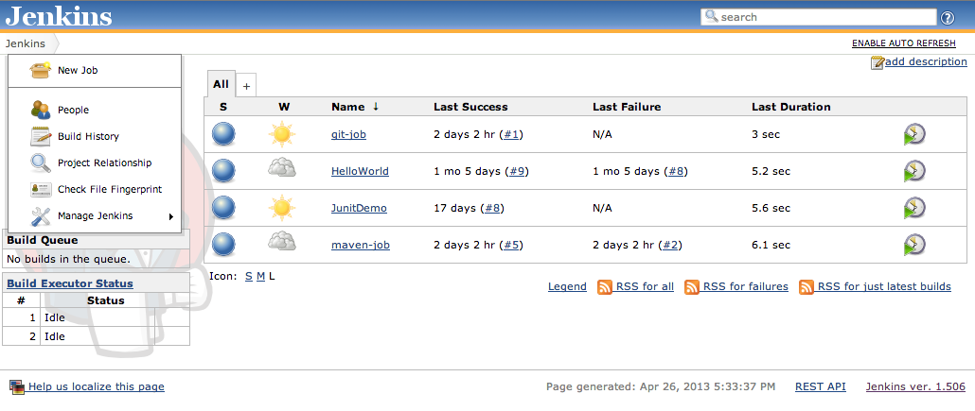
Jenkins GUI

