Slide 1




Increase Test Coverage
Code Coverage
Continuous Integration
Reduce Script Runtime
SPVSS Automation Team: spvss-vat@cisco.com
Title

Slide 2

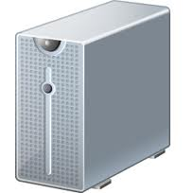
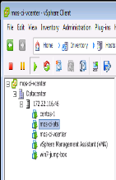


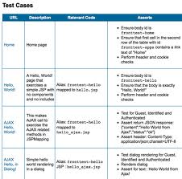

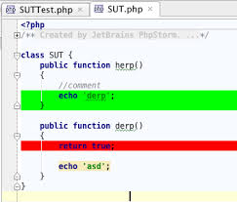


Code Coverage and Continuous Integration Dynamic Regression Flow Diagram
Execute reduced test suite BASED ON CHANGES
Continuous Integration
Continuous Integration
Dynamic Regression
Goal 1:Reduce Test Execution time
Build Server
creates image
Mapping
Source files to test cases
More test
Cases to pool
New code commit
Rally Db
Goal
2: Increase
Test Coverage
Code Coverage Improvement Tool (CCIT)
Test Plan augmented
Code Coverage Report e.g. Jacoco

