Slide 1

REG(EXP?)

Slide 2

An average programmer

Slide 3
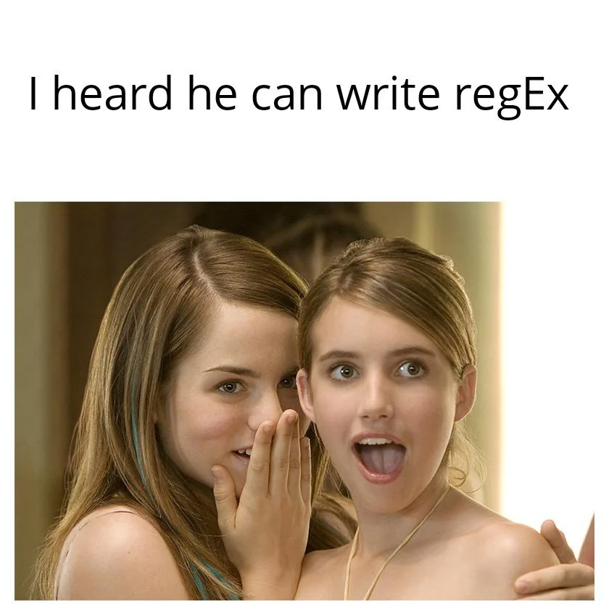
An average QA Engineer
I heard he can write regexp

Slide 4
Basic concepts
Characters
Quantifiers
Metacharacters
Grouping
Special Sequences

Slide 5
Tools
grep –P “pattern” file.txt
-p = Interpret PATTERN as a Perl regular expression.
sed –r “s/pattern/replace/” file.txt
-r = use extended regular expressions in the script.
perl -p -e "s/pattern/replace_string/g" file.txt
-p = loop over lines and print each line (after processing)
-e = command line script

Slide 6
Characters
Character | Description | Example
a | Finds “a” character in the text | a
Ea | Finds “Ea” | Ea
Hello | Finds “Hello” | Hello

Slide 7
Quantifiers
Character | Description | Example
? | 0 or 1 time | Hello?
+ | 1 or more times | Hello+
* | 0 or more times | Hello*
{x} | X times | Hello{3}
{x,} | X or more times | Hello{2,}
{x,y} | >=x and <=y times | Hello{1,4}
{,y} | 0 or <=y times | Hello{,5}

Slide 8
Metacharacters
Character | Description | Example
^ | Starts with | ^Hello
$ | Ends with | It$
. | Any character (except newline character) | He..o
| | Either or | Hello|Ողջույն
\ | special sequence/escape characters | 25\$

Slide 9
Grouping
Character | Description | Example
() | Capture and group | ^(abc(xyz))$
(:?) | (non-c­apt­uring) group | ^(?:abc)(xyz)$
[] | A set of characters | 2[0-9], [գմ]րել, [A-Z][a-z]+ [a-mA-M0-4]+ [+-?*]
[^] | Anything except this characters | []

Slide 10
Special Sequences 1
Character | Description | Example
\d | [0-9] | \d\d:\d\d
\D | [^0-9] | \D+\d\D+
\w | [0-9a-zA-Z_] | \w+:\d+
\W | [^0-9a-zA-Z_] | Begin\W+end

Slide 11
Special Sequences 2
Character | Description | Example
\s | Any white space | \w+\s+\w+
\S | Anything except white spaces | \S+\s+\S+
\b | Returns a match where the specified characters are at the beginning or at the end of a word | \bword\b
\B | Returns a match where the specified characters are present, but NOT at the beginning (or at the end) of a word | space\B

Slide 12

When you were just introduced to the regexp

Slide 13
Advanced concepts
Greedy and non-Greedy Quantification
Grouping
Find replace
Positive/Negative look ahead/behind (Assertions)

Slide 14
Grouping (Advanced)
pattern | Text | groups
(\d+):(\d+) | “16:30” | Group1=“16” Group2=“30”
(?:\d+):(\d+) | “16:30” | Group1=“16”
((\d)\d):(\d\d) | “18:05” | Group1=“18” Group2=“1” Group3=“05”
((\d)(\d)):((\d)(\d)) | “19:07” | Group1=“19” Group2=“1” Group3=“9” Group4=“07” Group5=“0” Group6=“7”

Slide 15
Greedy and non-Greedy Quantification
pattern | Text | matched
\/.*?\/ | “/website!#91subdir/123$8734/” | “/website!#91subdir/”
<div>(.+)</div> | “<div>Text1</div> <div></div>” | “<div>Text1</div>” Group1=Text
<div>(.+?)</div> | “<div>Text1</div> <div></div>” | “Text1”

Slide 16
Positive/Negative look ahead/behind
Character | Description | Example
(?=foo) | Lookahead Asserts that what immediately follows the current position in the string is foo | a(?=b)
(?<=foo) | Lookbehind Asserts that what immediately precedes the current position in the string is foo | (?<=b)a
(?!foo) | Negative Lookahead Asserts that what immediately follows the current position in the string is not foo | a(?!c)
(?<!foo) | Negative Lookbehind Returns a match where the specified characters are present, but NOT at the beginning (or at the end) of a word | (?<!b)a

Slide 17


Slide 18
Links
https://regex101.com/ - regex testing service
https://regexlearn.com/playground - regex testing service
https://regexone.com/ - interactive tutorial
https://regexlearn.com/ - interactive tutorial

Slide 19
[abc] | A single character of: a, b or c
[^abc] | A character except: a, b or c
[a-z] | A character in the range: a-z
[^a-z] | A character not in the range: a-z
[a-zA-Z] | A character in the range: a-z or A-Z
. | Any single character
a|b | Alternate - match either a or b
\s | Any whitespace character
\S | Any non-whitespace character
\d | Any digit
\D | Any non-digit
\w | Any word character
\W | Any non-word character
(?:...) | Match everything enclosed
(...) | Capture everything enclosed
a? | Zero or one of a
a* | Zero or more of a
a+ | One or more of a
a{3} | Exactly 3 of a
a{3,} | 3 or more of a
a{3,6} | Between 3 and 6 of a
^ | Start of string
$ | End of string
\b | A word boundary
\B | Non-word boundary
(?=foo) | Lookahead
(?<=foo) | Lookbehind
(?!foo) | Negative Lookahead
(?<!foo) | Negative Lookbehind
(.+?) | Non-greedy
(.*?) | Non-greedy

