Slide 1
CES — Compliance Evidence System
Platform walkthrough, screen by screen · for new users and new engineers
State: master, 11 November 2026 · demo data (Contoso Defense, simulator tenant)
Notes:
Walk through the product the way a customer meets it. Every screenshot is from the demo tenant; nothing here is a real customer.

Slide 2
Seven steps, seven sections of the portal
1
2
3
4
5
6
7
Onboard
Assess
Plan
Remediate
Collect Evidence
Monitor
Prepare
who, which tenants, where the CUI boundary sits
read the tenant, score it (SPRS)
owned, dated actions and a POA&M
simulate first; live only behind approval and a gate
gather and review what the assessor asks for
evaluate, raise findings, track drift
SSP, signed packages, assessor workspace
A US defence contractor that handles CUI has to meet the 110 requirements of NIST SP 800-171 and prove it to a CMMC Level 2 assessor. BHD built the engines that touch a tenant; Aavya built the platform around them — portal, API, database, roles, approvals and the runner that carries work to Windows.
Notes:
The seven steps are also the seven sections of the sidebar. The split BHD/Aavya explains most of the design.

Slide 3
Who uses it
Org admin
Compliance manager
IT security admin
Evidence reviewer
runs the customer account; confirms the CUI boundary; manages users
does most of the work: runs assessments, plans, collects evidence, prepares the package
runs monitoring; requests and executes AdminOps
second pair of eyes on evidence (never their own)
Senior approver
Assessor
BHD operator
Platform admin
approves POA&M, AdminOps and escalations
read-only workspace; asks for items
Blue Heron’s engineer on the engagement: Stamper, runner, system health
Blue Heron’s system owner — never sees customer data (PB-01)
Notes:
Roles are a single table used by the sidebar and the API. Route rules add the second-person checks.

Slide 4
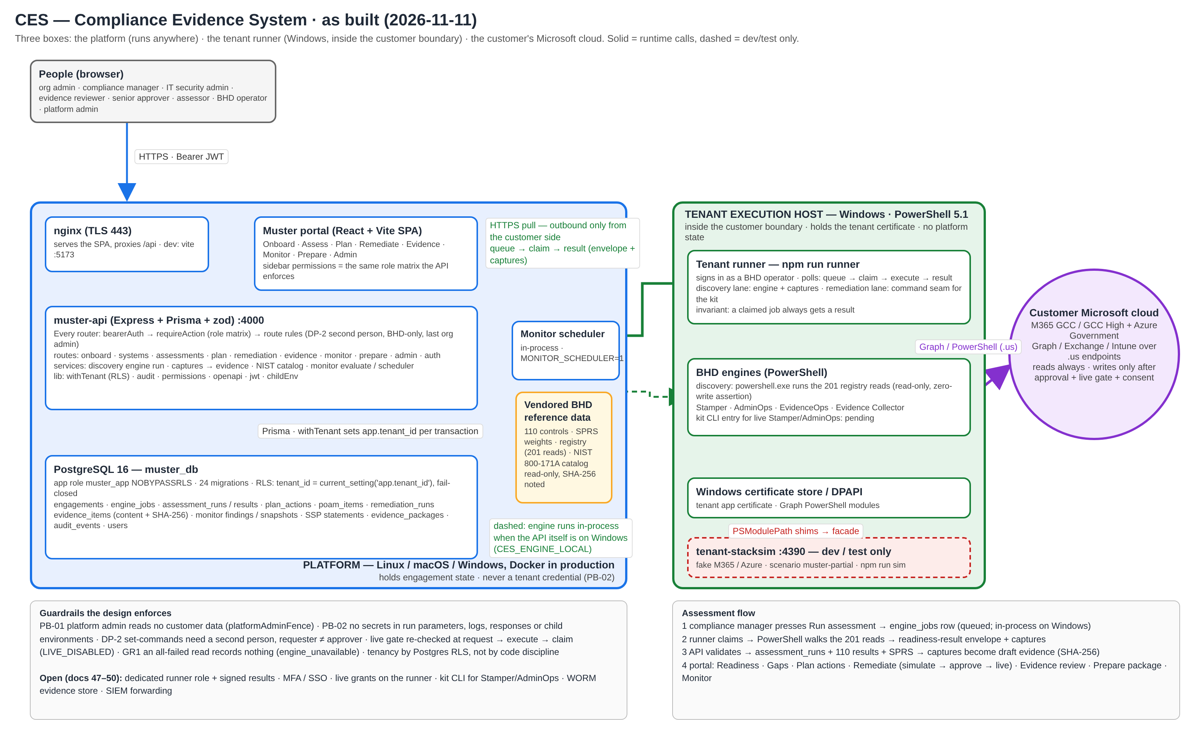
How it is built — three boxes
Notes:
Platform runs anywhere; the runner is Windows inside the customer boundary; the engines talk to the Microsoft cloud. Editable source: docs/architecture/ces-platform.drawio.

Slide 5
Why it is shaped this way
Engines need Windows, the portal does not
The runner pulls, the platform never calls in
Postgres enforces tenancy
BHD’s 201 registry reads and Stamper/AdminOps spawn powershell.exe. The platform stays OS-neutral; the Windows part is as thin as possible.
queue → claim → result over HTTPS: no inbound port at the customer, no platform credential that can reach a tenant. Runner off? Work queues.
Every query sets the tenant id in its transaction; row-level security compares it; the app role cannot bypass it. A bug gets zero rows, not another tenant’s.
One role table, used twice
Simulate first, live behind a gate
An empty read is not evidence
Sidebar and API read the same matrix; a test fails if they drift. Second person, BHD-only and last-admin rules sit on the routes.
Live is refused unless the engagement has live access and a consent, re-checked at request, execute and claim.
If every command failed on the host, nothing is recorded (engine_unavailable). The engine never credits what it could not read.
Notes:
Each of these is an ADR (doc 44). If a change needs one of them to bend, it needs an ADR first.

Slide 6
When someone presses Run assessment
1
Compliance manager presses Run assessment
The API writes an engine job. On Windows it runs the engine in-process; elsewhere the job waits for a runner.
2
The runner claims the job
PowerShell walks the 201 reads against the tenant (or simulator) and produces a readiness-result envelope plus raw captures.
3
The API lands the result
Validates the envelope, writes the run and 110 results, computes SPRS, files each capture as draft evidence with its SHA-256.
4
The portal takes over
Readiness, gaps, plan actions, remediation (simulate → approve → live), evidence review, SSP and packages, monitoring.
Notes:
Unknown is honest: roughly 150 of 320 objectives need a document or a person; they stay unknown until then.

Slide 7
Getting in
1. Sign in

Slide 8
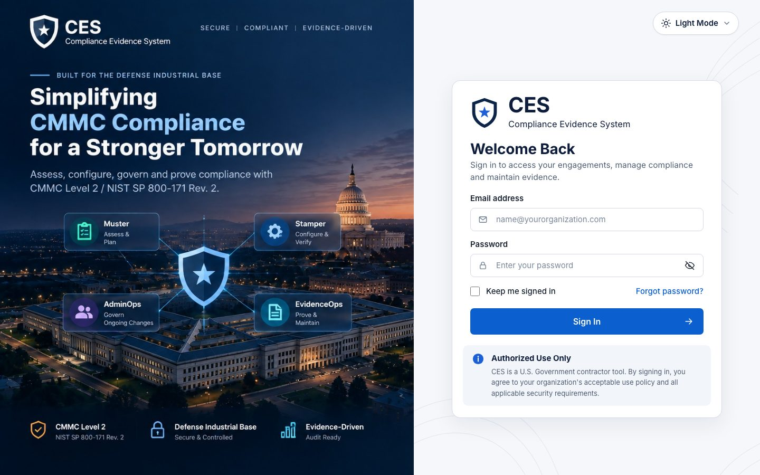
1. Sign in
Who everyone
Where /
Email and password. A temporary password forces a change on first sign-in; 'remember me' keeps the session on this browser. Five wrong passwords in 15 minutes pauses the account.
Reset link goes to e-mail (demo build: printed in the API log)
Theme switch (light/dark) top right
Account menu after sign-in: change password, sign out
Notes:
Sign in — Email and password. A temporary password forces a change on first sign-in; 'remember me' keeps the session on this browser. Five wrong passwords in 15 minutes pauses the account.

Slide 9
Onboard
2. Organizations · 3. Tenants · 4. Scope — CUI boundary · 5. Systems inventory · 6. Onboarding checklist

Slide 10
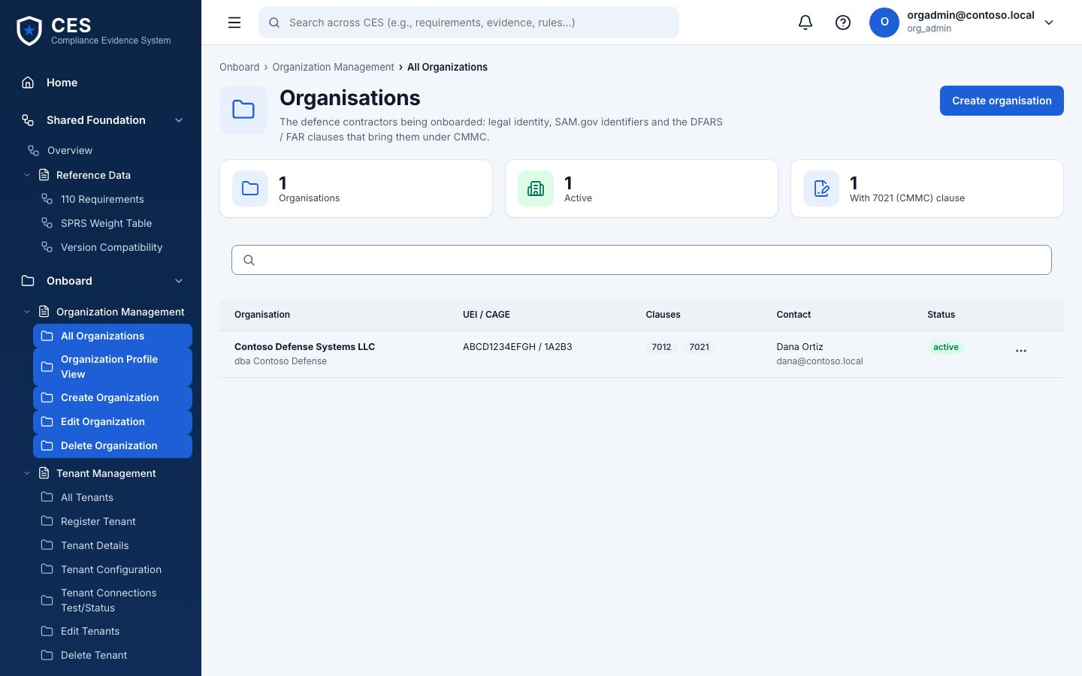
2. Organizations
Who org admin
Where #/onboard/organizations
The customer's legal entities. Everything else in the engagement hangs off one of these.
Create organization: legal name and basics
Table lists what exists; open a row to edit
Deleting is a soft close, history stays
Notes:
Organizations — The customer's legal entities. Everything else in the engagement hangs off one of these.

Slide 11
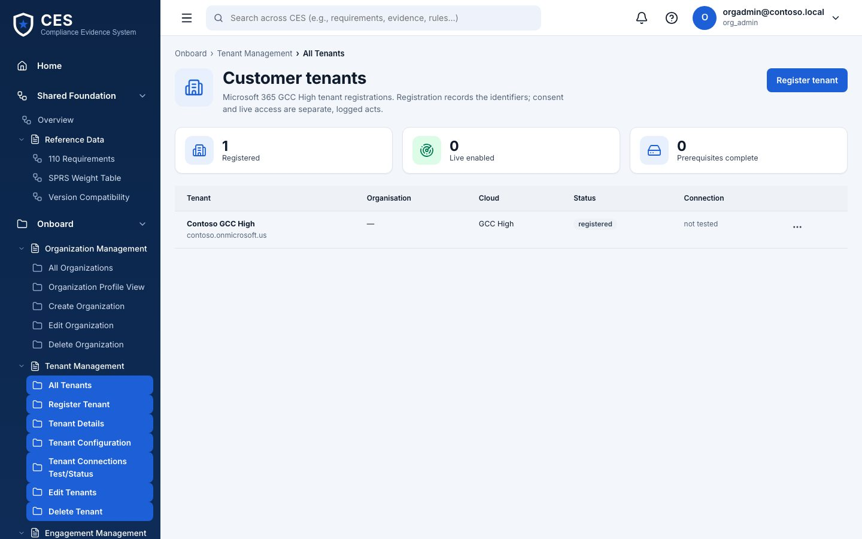
3. Tenants
Who org admin
Where #/onboard/tenants
The Microsoft 365 / Azure tenants in scope (GCC or GCC High). In the demo the tenant points at the simulator.
Register tenant: name, cloud, identifiers
Connection checks show whether the platform can reach it
No credentials are stored here — the runner holds the certificate
Notes:
Tenants — The Microsoft 365 / Azure tenants in scope (GCC or GCC High). In the demo the tenant points at the simulator.

Slide 12
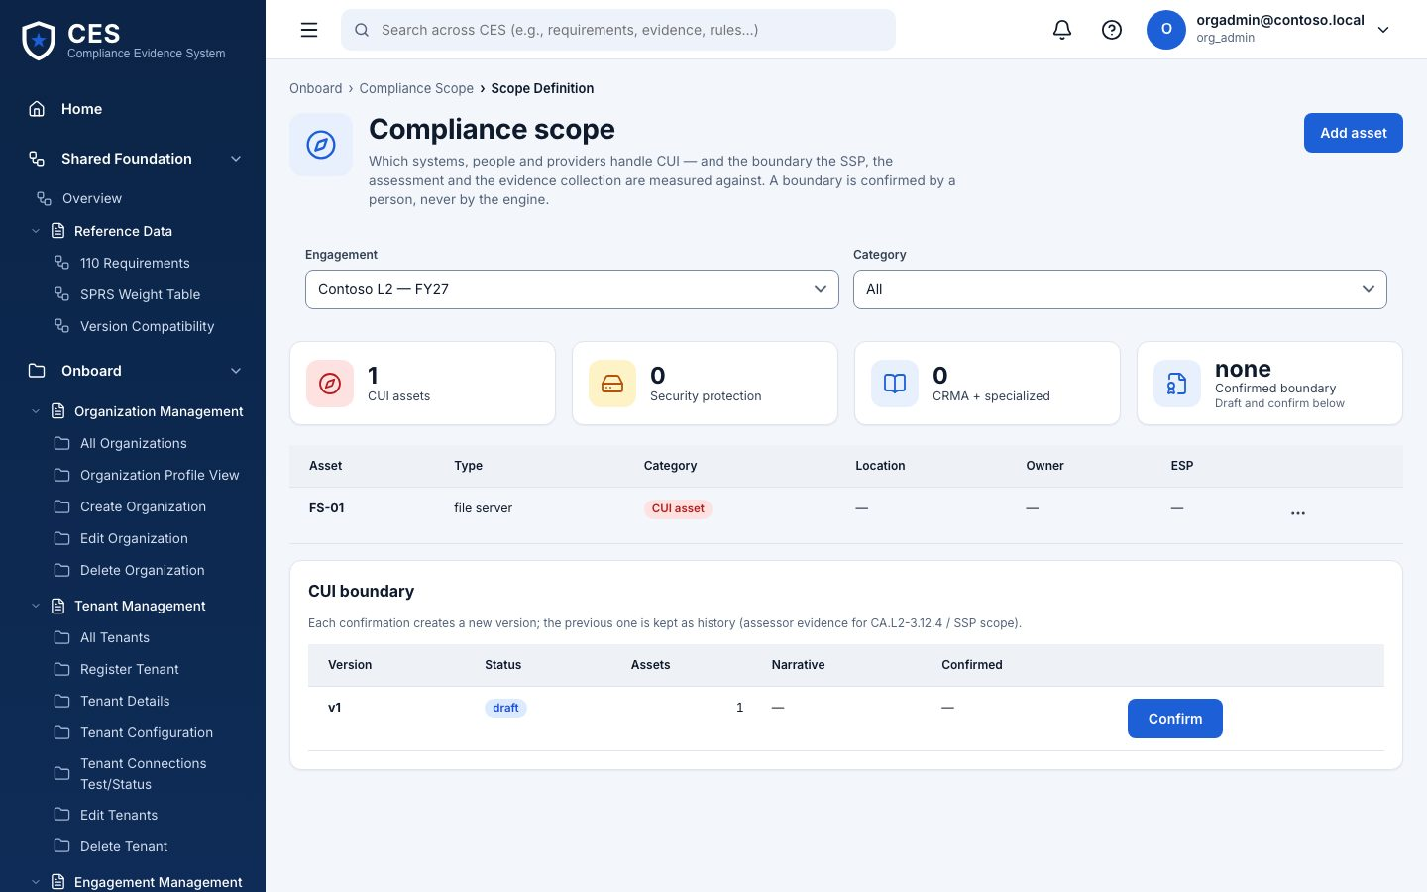
4. Scope — CUI boundary
Who compliance manager drafts · org admin confirms
Where #/onboard/scope
Which systems and assets handle CUI. Confirming a boundary version is a formal act: it is what the assessor sees as 'what you said was in scope'.
Assets by category: CUI, SPA, CRMA, Specialized, Out of scope
Draft → Confirm (org admin only); every version kept
Narrative and data flows attached to the boundary
Notes:
Scope — CUI boundary — Which systems and assets handle CUI. Confirming a boundary version is a formal act: it is what the assessor sees as 'what you said was in scope'.

Slide 13
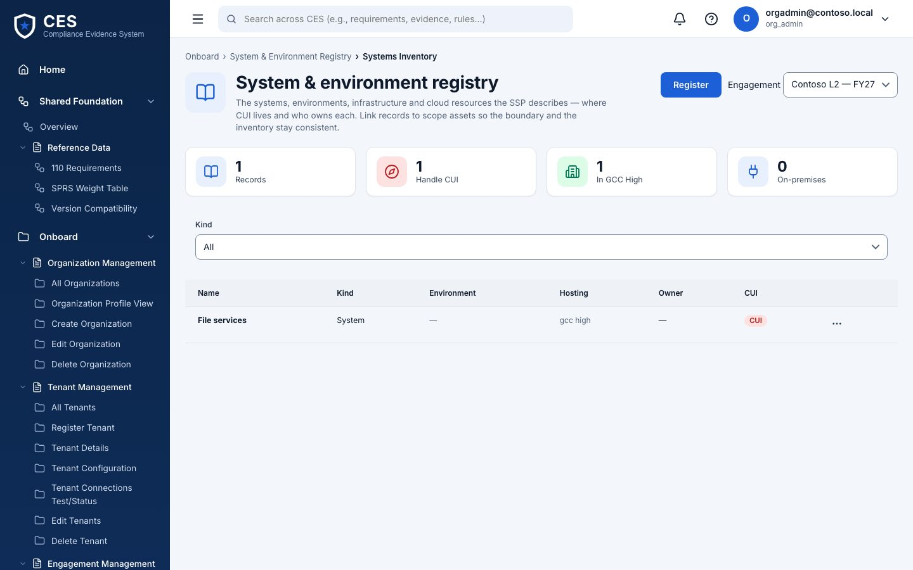
5. Systems inventory
Who compliance manager · org admin
Where #/onboard/systems
The systems and environments registry: name, environment, owner. Feeds the SSP system description later.
Add a system with its environment and owner
Everyone reads; compliance manager and org admin edit
Notes:
Systems inventory — The systems and environments registry: name, environment, owner. Feeds the SSP system description later.

Slide 14
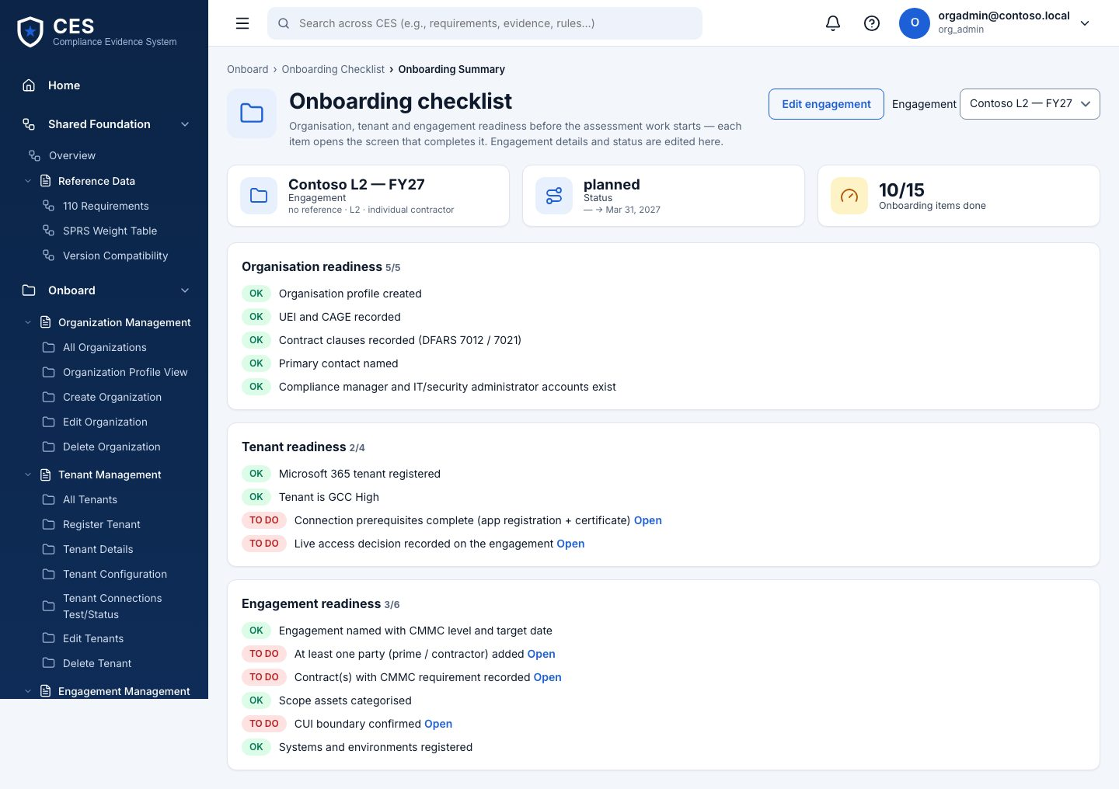
6. Onboarding checklist
Who everyone
Where #/onboard/checklist
What is done and what is still missing before an assessment makes sense. No actions here — it tells you where to go.
Organization, tenant, boundary, systems, first run
Each item links to the page that completes it
Notes:
Onboarding checklist — What is done and what is still missing before an assessment makes sense. No actions here — it tells you where to go.

Slide 15
Assess
7. Readiness assessment · 8. Gap analysis

Slide 16
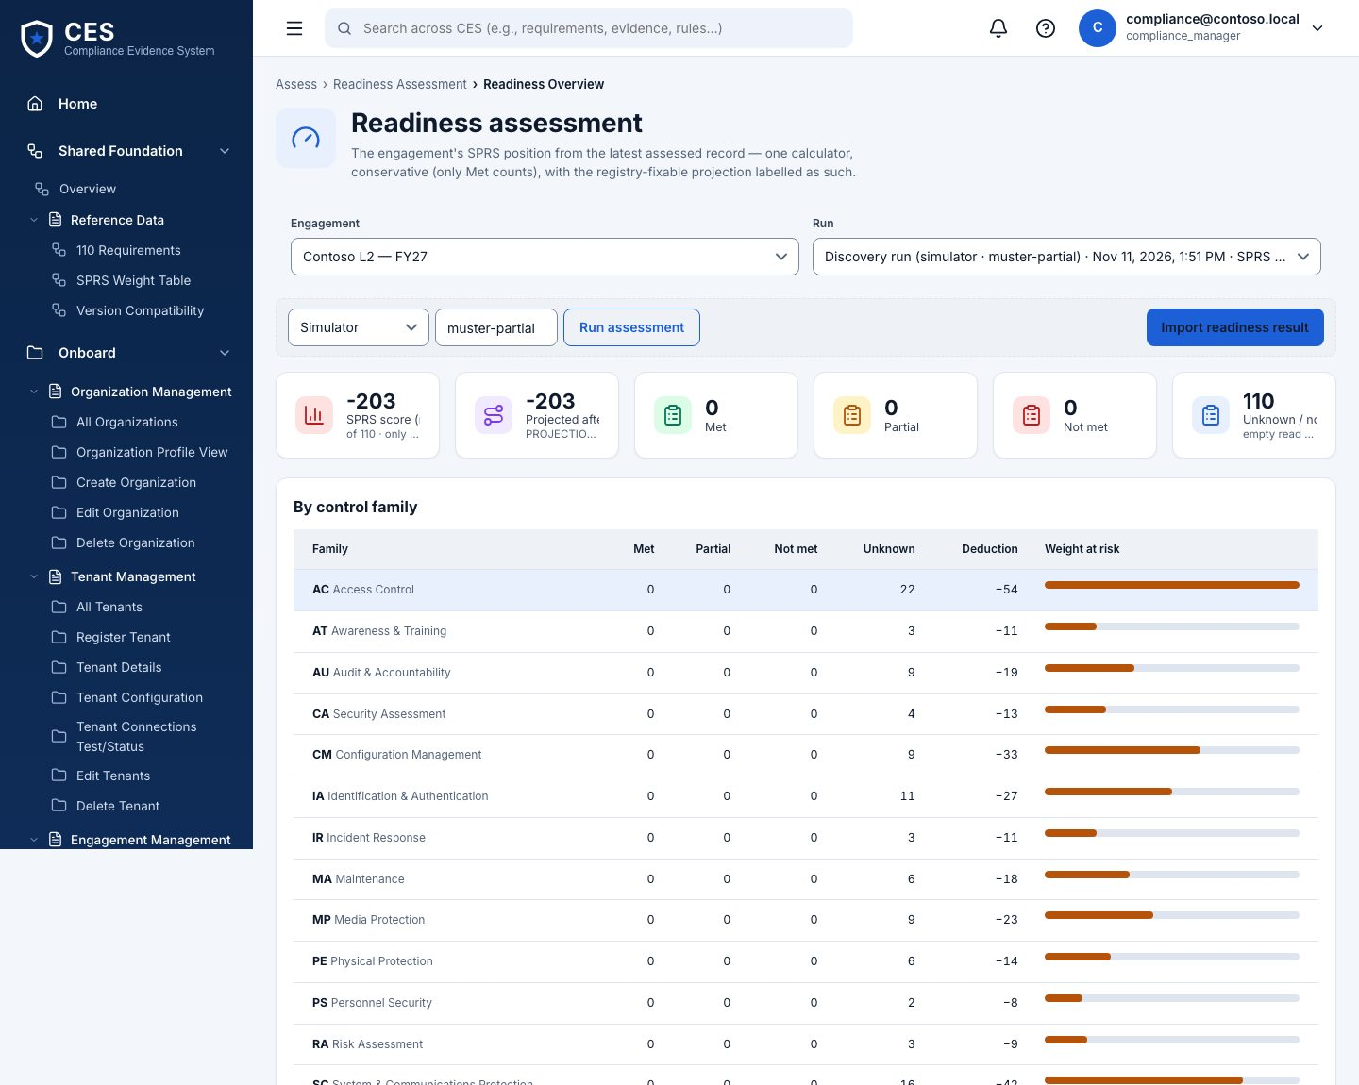
7. Readiness assessment
Who compliance manager · IT security admin · BHD operator
Where #/assess/readiness
The main screen. Pick the engagement and a run; the family table shows met / partial / not met / unknown per control family and the SPRS score. Run assessment reads the tenant (simulator or live) — never writes.
Run assessment: 'Engine running…' on Windows, 'Queued…' until a runner picks it up elsewhere
Unknown is honest: ~150 of 320 objectives need a document or a person
Import readiness result: load a result file produced elsewhere (BHD)
Notes:
Readiness assessment — The main screen. Pick the engagement and a run; the family table shows met / partial / not met / unknown per control family and the SPRS score. Run assessment reads the tenant (simulator or live) — never writes.

Slide 17
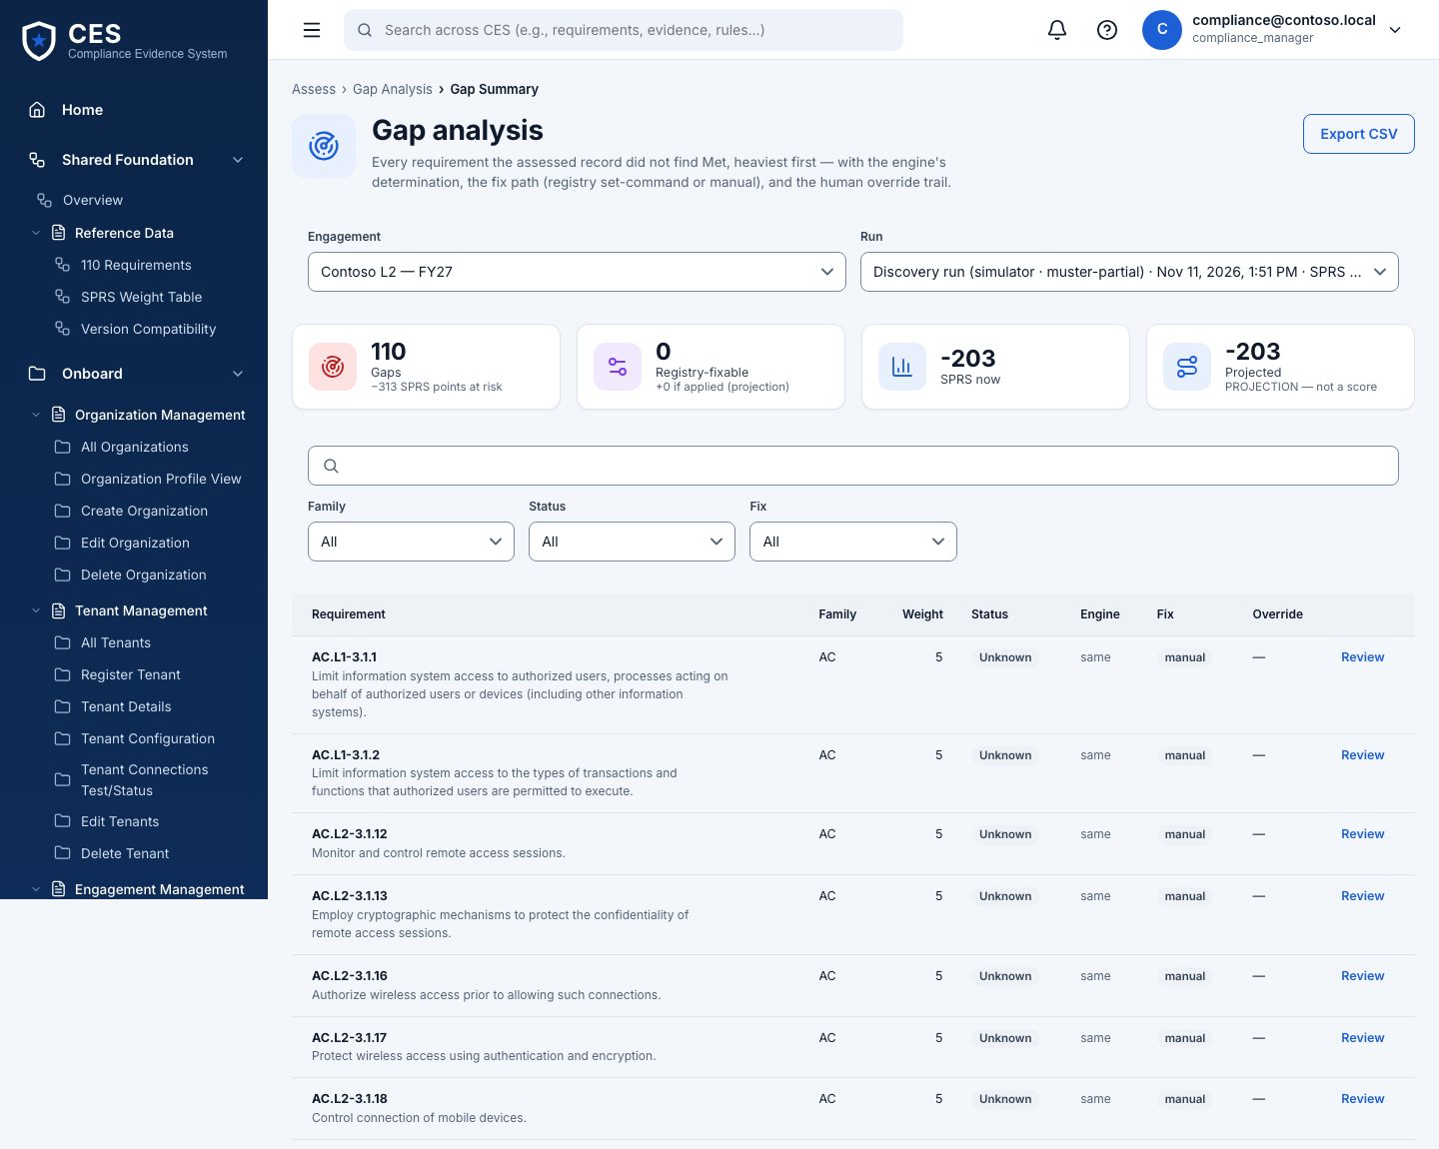
8. Gap analysis
Who compliance manager · BHD operator (override)
Where #/assess/gaps
Every requirement that is not met or unknown, heaviest first (SPRS weights 1/3/5). Open a gap for its objectives; Override sets a status by hand with a reason, recorded under your name.
Export CSV for the working session with the customer
Override needs a reason of at least ten characters and is audited
Fixable gaps point at Stamper registry entries
Notes:
Gap analysis — Every requirement that is not met or unknown, heaviest first (SPRS weights 1/3/5). Open a gap for its objectives; Override sets a status by hand with a reason, recorded under your name.

Slide 18
Plan
9. Planning overview · 10. Action items · 11. POA&M

Slide 19
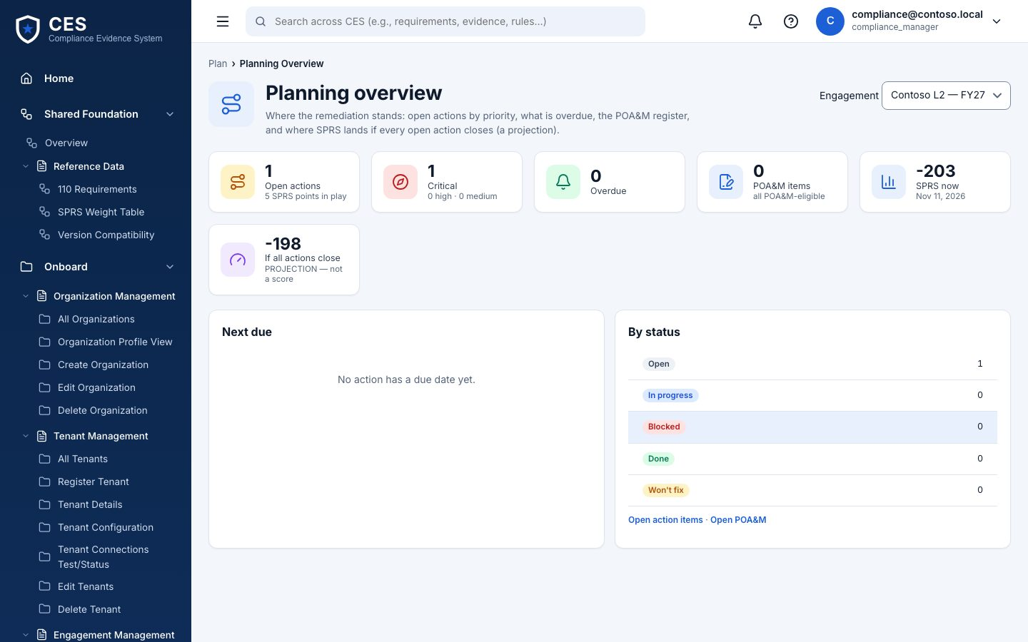
9. Planning overview
Who everyone
Where #/plan/overview
Counts by priority and status across actions and POA&M items.
Open vs in progress vs done
Which gaps have no action yet
Notes:
Planning overview — Counts by priority and status across actions and POA&M items.

Slide 20
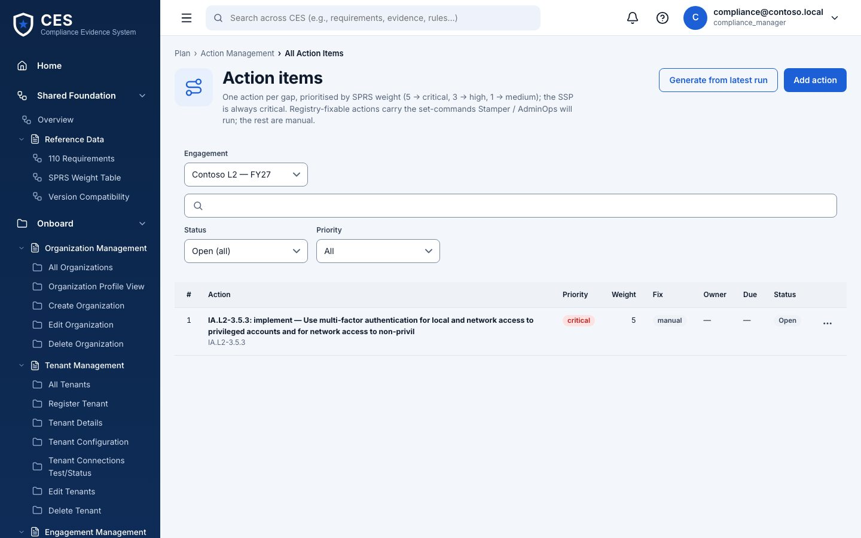
10. Action items
Who compliance manager
Where #/plan/actions
One row per thing to do: requirement, owner, priority, due date, fix kind. 'Registry' fix kind means Stamper can do it automatically.
Generate from gaps, or add by hand
open → in progress → done / won't fix
Export CSV
Notes:
Action items — One row per thing to do: requirement, owner, priority, due date, fix kind. 'Registry' fix kind means Stamper can do it automatically.

Slide 21
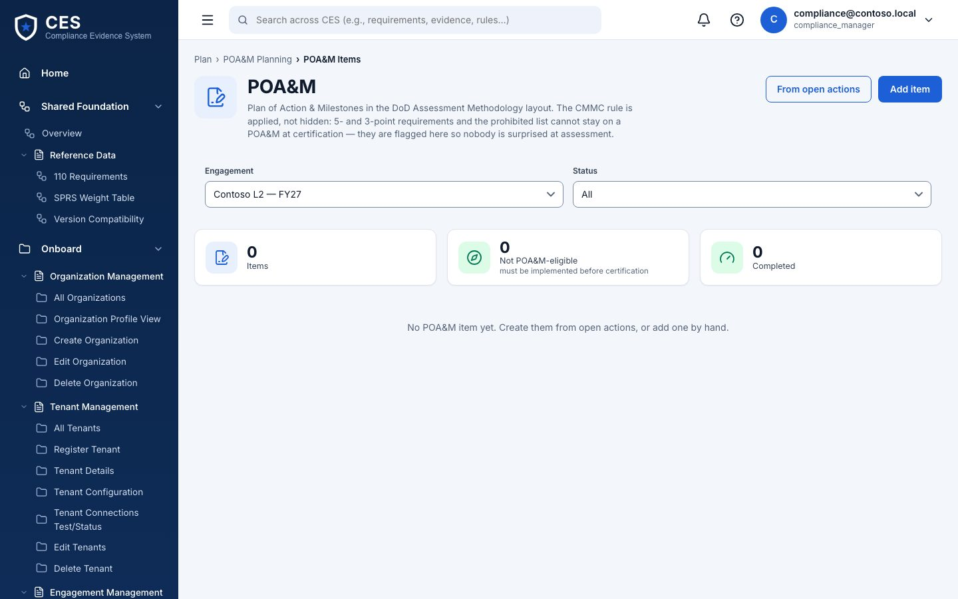
11. POA&M
Who compliance manager edits · senior approver approves
Where #/plan/poam
The Plan of Action & Milestones an assessor expects: weakness, mitigation, milestones with dates, and whether a POA&M is even allowed for that requirement.
Build from actions in one click
Rows marked NO cannot be deferred — they must be met
Notes:
POA&M — The Plan of Action & Milestones an assessor expects: weakness, mitigation, milestones with dates, and whether a POA&M is even allowed for that requirement.

Slide 22
Remediate
12. Remediation overview · 13. Stamper — configuration management · 14. AdminOps — governed admin operations

Slide 23
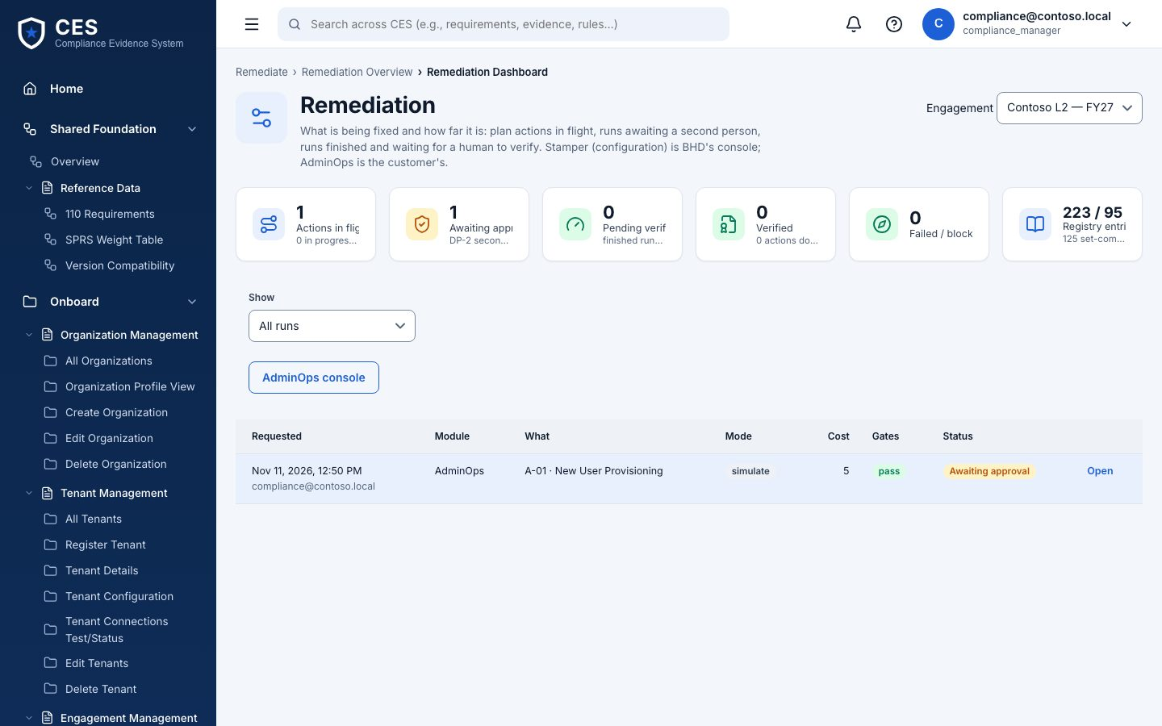
12. Remediation overview
Who everyone (Stamper runs: BHD only)
Where #/remediate/overview
Every run across both engines: who requested, module, mode (simulate / live), cost, gates, status. Open a run for its drawer: gates, result, and the actions your role has.
Awaiting approval → Approved → (Queued → Running) → Finished · verify → Verified
Rejected, Blocked by gate, Cancelled are terminal
Simulate never touches the tenant
Notes:
Remediation overview — Every run across both engines: who requested, module, mode (simulate / live), cost, gates, status. Open a run for its drawer: gates, result, and the actions your role has.

Slide 24
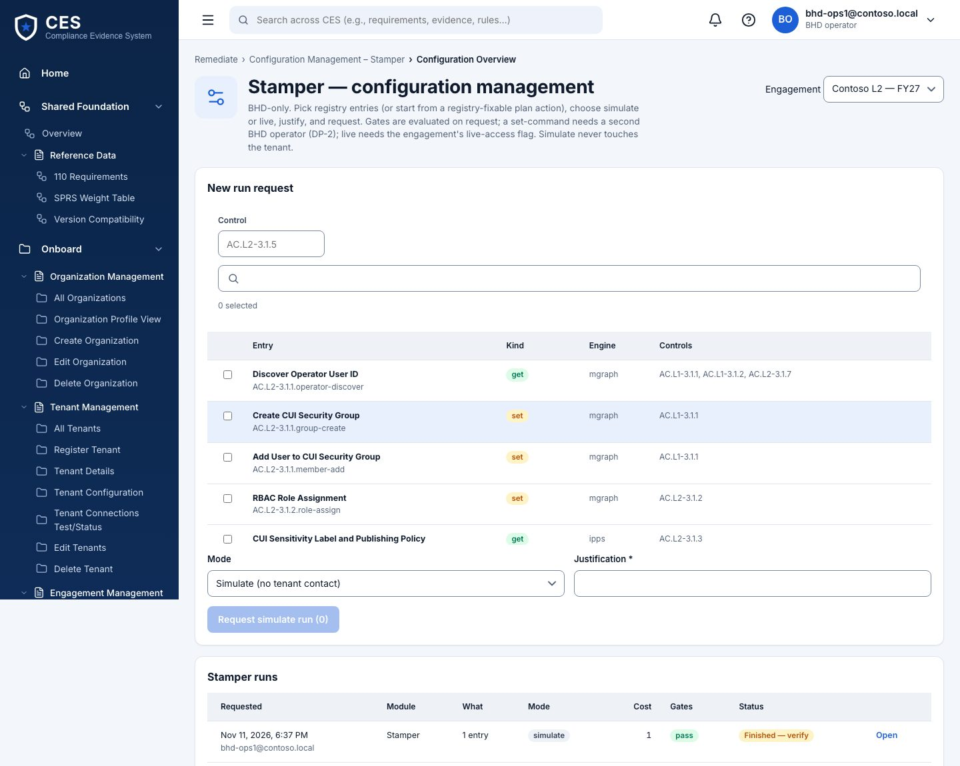
13. Stamper — configuration management
Who BHD operator only
Where #/remediate/stamper
Configuration changes from BHD's registry. Pick entries (get = read-only check, set = changes something, HELD = manual), choose simulate or live, justify, request.
A get-only run is approved on request; any set entry needs a second BHD operator (DP-2)
Live needs the engagement's live-access flag and consent, re-checked at every hop
Execute records the plan (simulate) or queues it for the Windows runner (live)
Notes:
Stamper — configuration management — Configuration changes from BHD's registry. Pick entries (get = read-only check, set = changes something, HELD = manual), choose simulate or live, justify, request.

Slide 25
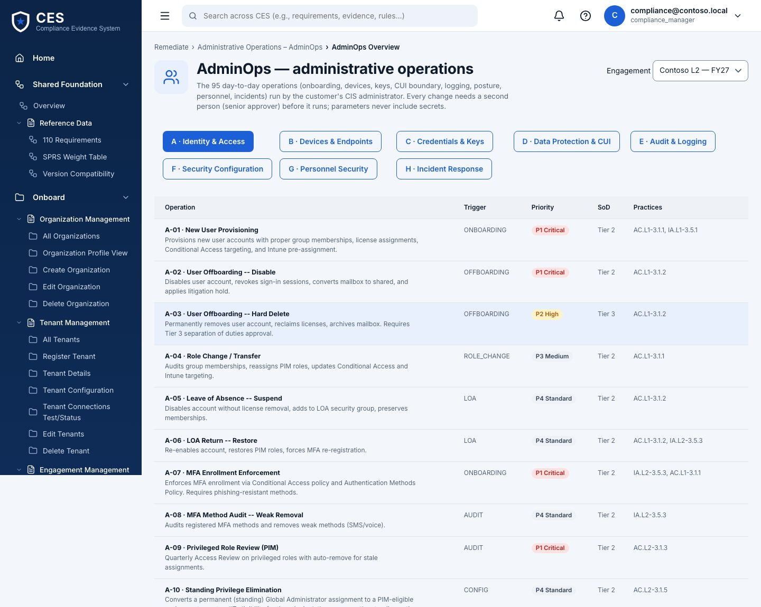
14. AdminOps — governed admin operations
Who IT security admin requests · senior approver or BHD approves
Where #/remediate/adminops
Day-2 admin operations by domain (Identity & Access, Devices, Credentials, Data Protection, Audit…). Pick an operation, fill its parameters, justify, request.
Parameters never hold secrets — the platform refuses them (PB-02)
Same approval and execute flow as Stamper
Other customer roles see the queue, cannot request
Notes:
AdminOps — governed admin operations — Day-2 admin operations by domain (Identity & Access, Devices, Credentials, Data Protection, Audit…). Pick an operation, fill its parameters, justify, request.

Slide 26
Collect Evidence
15. Evidence overview · 16. Evidence explorer · 17. Collect evidence · 18. NIST evidence catalog · 19. Review (as evidence reviewer)

Slide 27
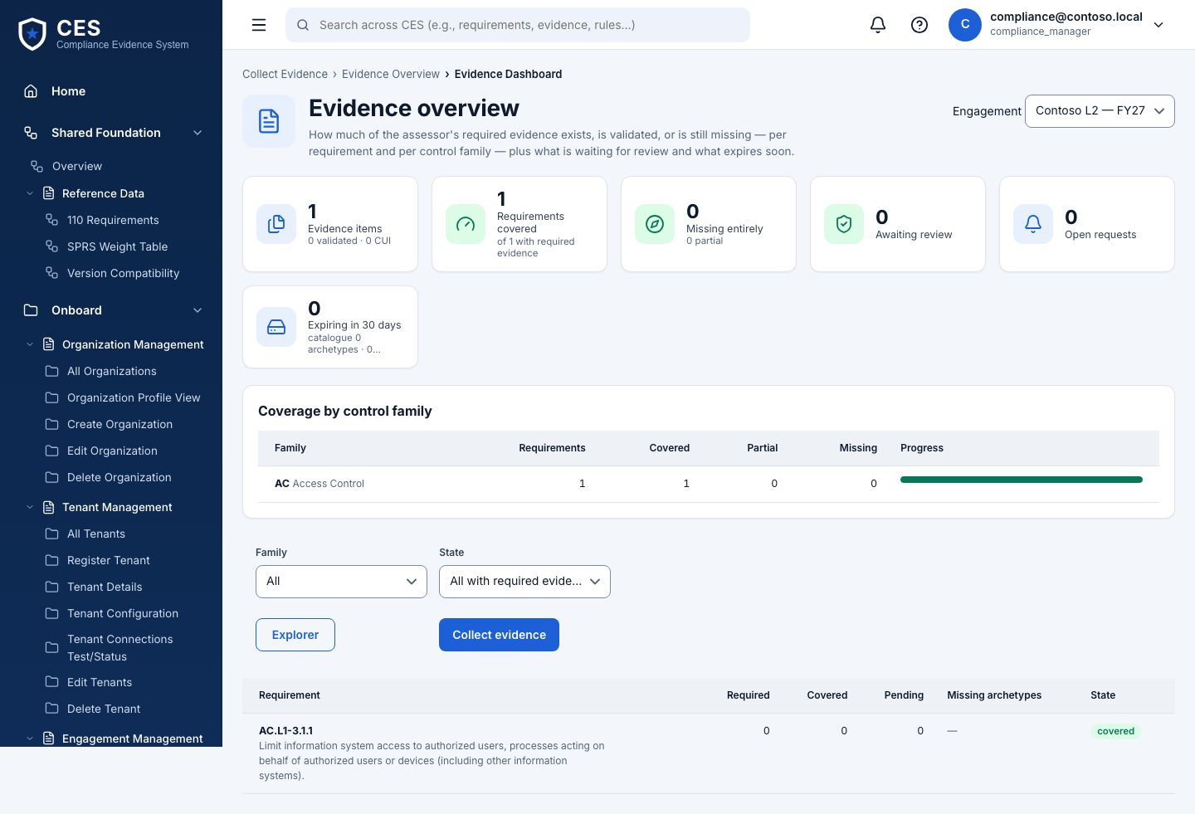
15. Evidence overview
Who everyone
Where #/evidence/overview
Counts by status (draft, submitted, validated, rejected) and by source (discovery, stamper, adminops, manual).
Coverage: which requirements have evidence, which do not
Evidence requests outstanding
Notes:
Evidence overview — Counts by status (draft, submitted, validated, rejected) and by source (discovery, stamper, adminops, manual).

Slide 28
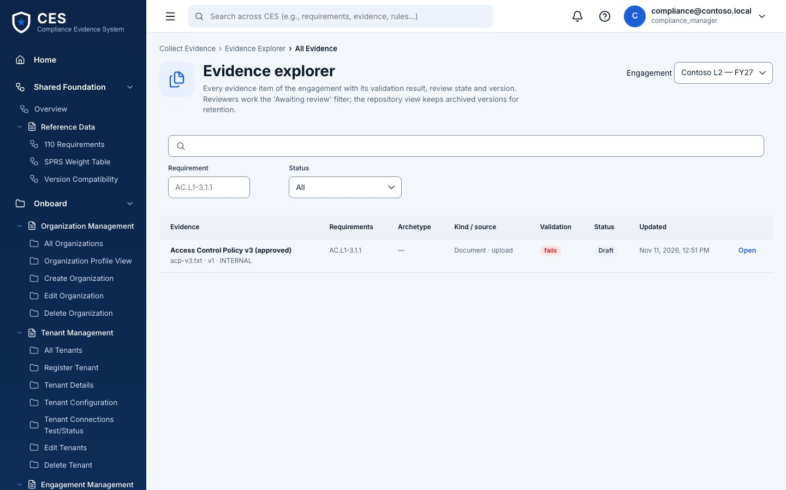
16. Evidence explorer
Who everyone
Where #/evidence/explorer
Every item: title, requirement(s), objective(s), source, SHA-256, size, status. Open one for the content preview, who created and reviewed it, and the run it came from.
Lists never load content — open the item
Captures from assessment runs arrive here as drafts automatically
Notes:
Evidence explorer — Every item: title, requirement(s), objective(s), source, SHA-256, size, status. Open one for the content preview, who created and reviewed it, and the run it came from.

Slide 29
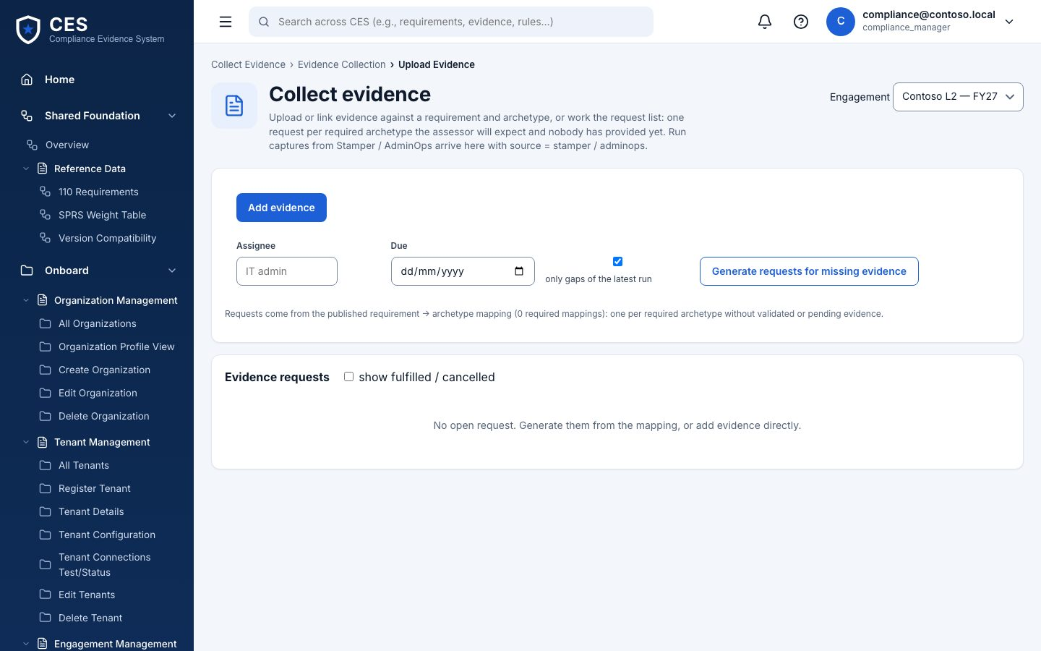
17. Collect evidence
Who compliance manager · IT security admin · BHD operator
Where #/evidence/collect
Upload a file or paste text; choose requirement and objectives; optionally pick a catalog definition — what the assessor expects for that requirement. Submit for review.
Inline evidence up to 10 MB; hash computed on save
Pre-set definition from the catalog page lands here
Notes:
Collect evidence — Upload a file or paste text; choose requirement and objectives; optionally pick a catalog definition — what the assessor expects for that requirement. Submit for review.

Slide 30
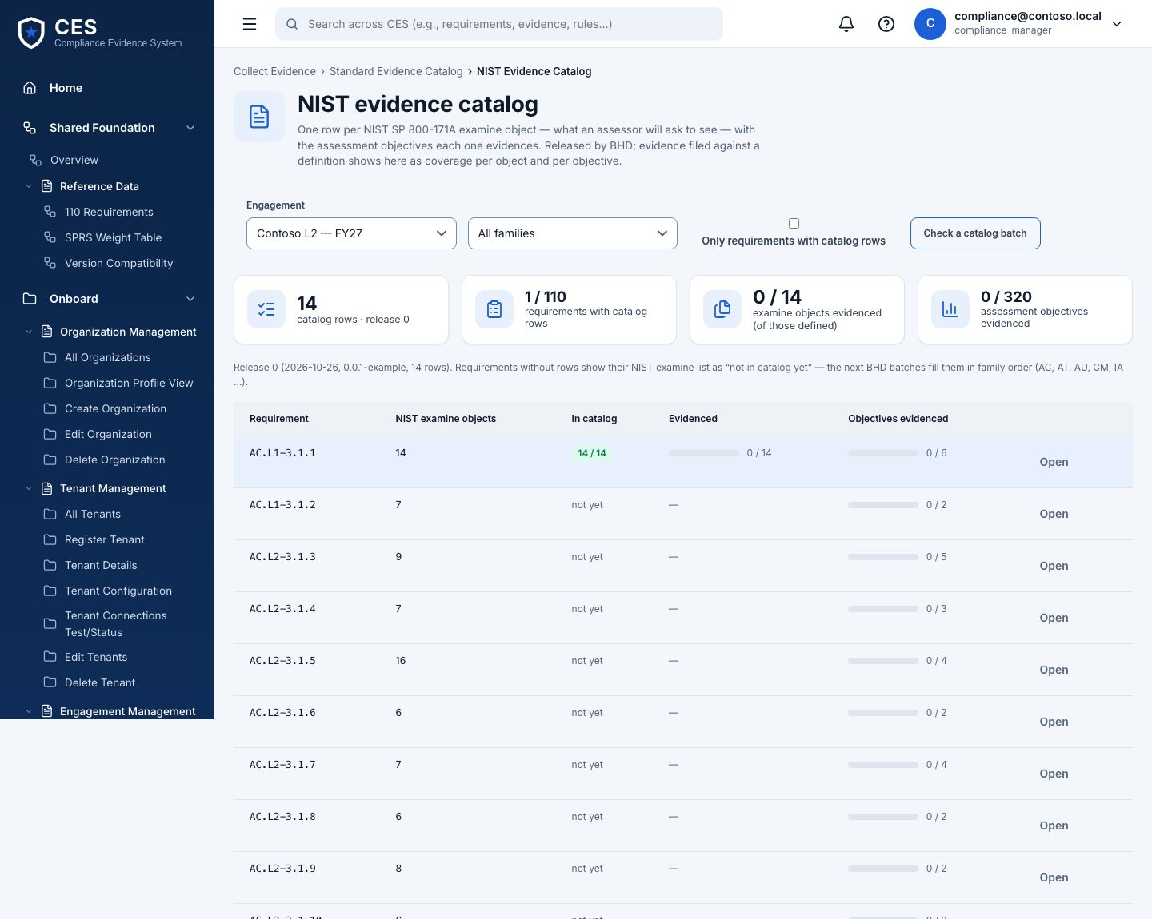
18. NIST evidence catalog
Who everyone
Where #/evidence/catalog
Per requirement, the NIST 800-171A examine items and the evidence definitions (form ids, what to collect, which objectives it satisfies). Release 0 covers AC.L2-3.1.1; BHD delivers the rest in batches.
Click a definition → pre-filled Collect form
Batch validator checks new releases before they are vendored
Notes:
NIST evidence catalog — Per requirement, the NIST 800-171A examine items and the evidence definitions (form ids, what to collect, which objectives it satisfies). Release 0 covers AC.L2-3.1.1; BHD delivers the rest in batches.

Slide 31
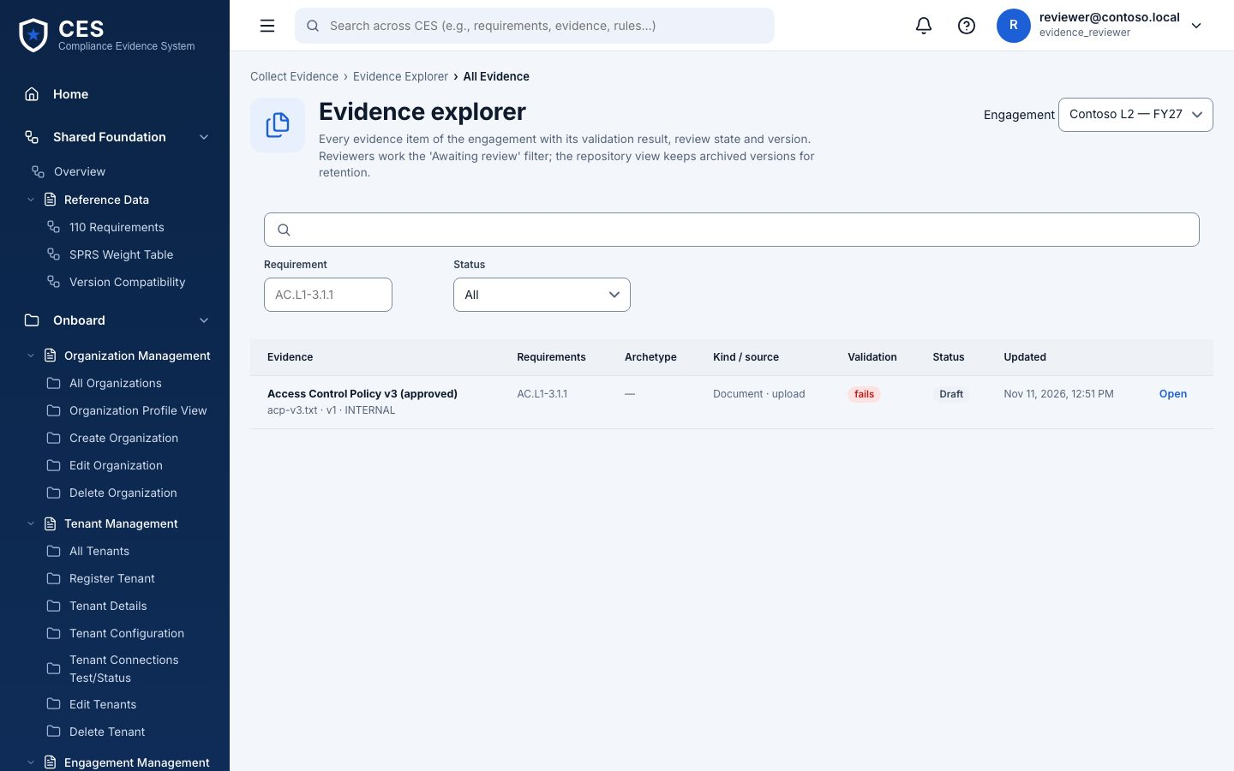
19. Review (as evidence reviewer)
Who evidence reviewer
Where #/evidence/explorer
The same explorer seen by the reviewer: submitted items can be approved or rejected with a note. You cannot review what you submitted yourself — the page says so.
Separation of duties enforced by the API, hinted by the UI
New version supersedes, keeps the chain
Notes:
Review (as evidence reviewer) — The same explorer seen by the reviewer: submitted items can be approved or rejected with a note. You cannot review what you submitted yourself — the page says so.

Slide 32
Monitor
20. Monitoring overview · 21. Alerts · 22. Audit & activity

Slide 33
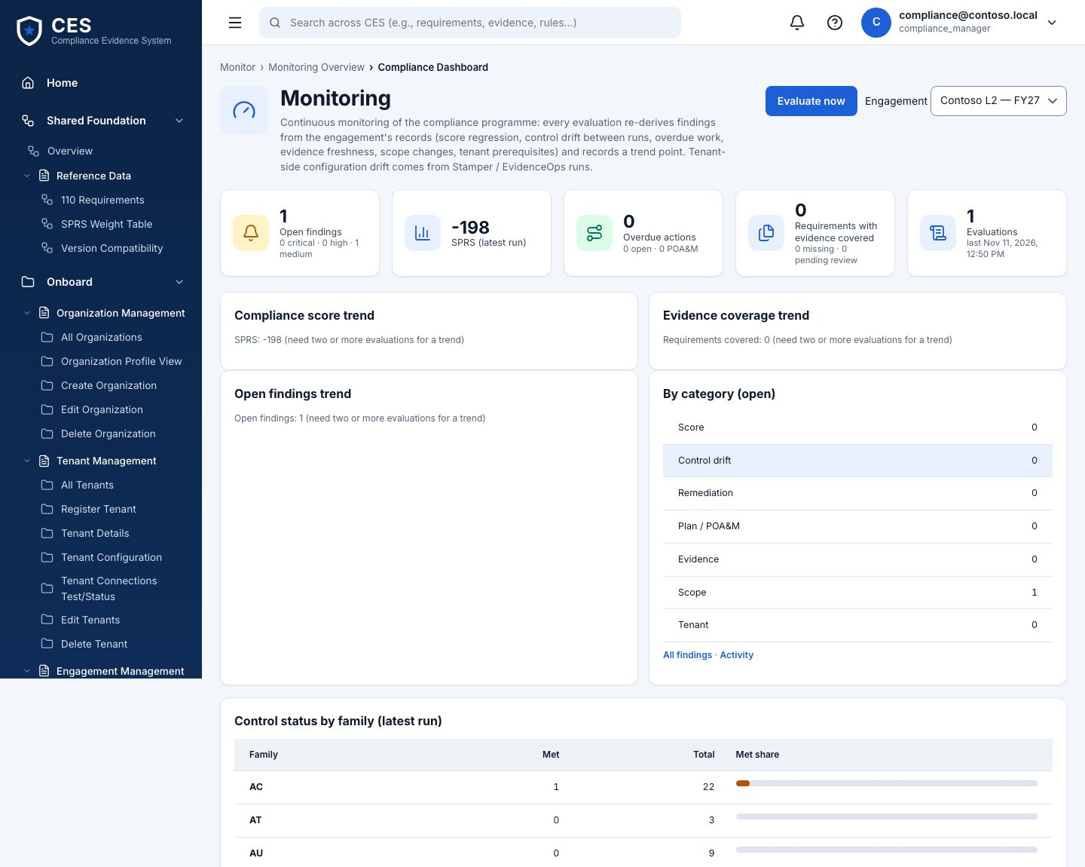
20. Monitoring overview
Who IT security admin runs · everyone reads
Where #/monitor/overview
Compliance posture over time: findings open / acknowledged / resolved, last evaluation, drift since the last assessment. Evaluate now re-reads what it can; the scheduler does it on the engagement's cadence when switched on.
Snapshots per evaluation
Drift = requirements that were met and no longer are
Notes:
Monitoring overview — Compliance posture over time: findings open / acknowledged / resolved, last evaluation, drift since the last assessment. Evaluate now re-reads what it can; the scheduler does it on the engagement's cadence when switched on.

Slide 34
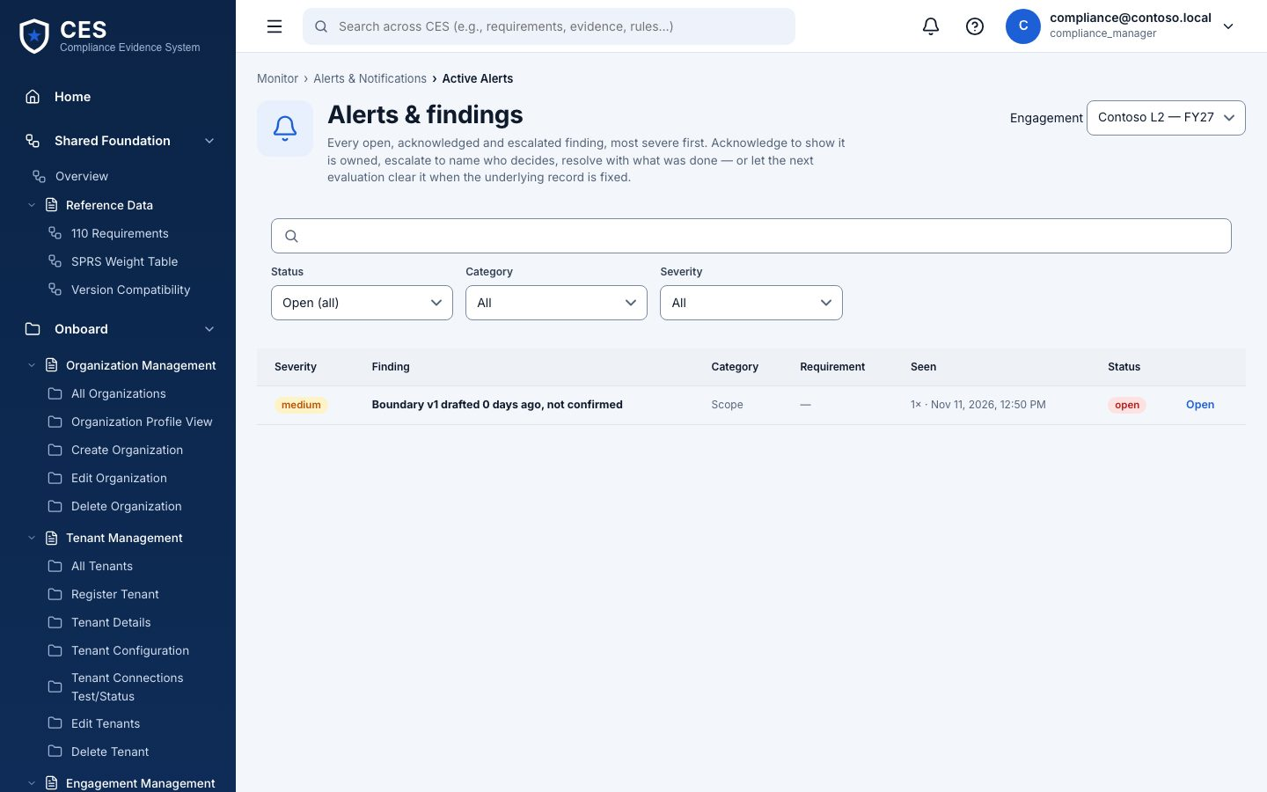
21. Alerts
Who anyone with edit acknowledges · senior approver resolves / escalates
Where #/monitor/findings
Findings by family and status. Open one to acknowledge with notes, resolve, or escalate.
open → acknowledged → resolved; escalated from either
Every change lands in Activity
Notes:
Alerts — Findings by family and status. Open one to acknowledge with notes, resolve, or escalate.

Slide 35

22. Audit & activity
Who everyone
Where #/monitor/activity
The audit trail for this engagement: who did what, when, filterable by text. This is the answer to 'who changed that'.
Actor, action, target, time
Approvals, executions, claims, results, overrides all appear here
Notes:
Audit & activity — The audit trail for this engagement: who did what, when, filterable by text. This is the answer to 'who changed that'.

Slide 36
Prepare
23. Assessment readiness · 24. System Security Plan (SSP) · 25. Evidence packages · 26. Assessor workspace (read-only) · 27. Reports & exports

Slide 37
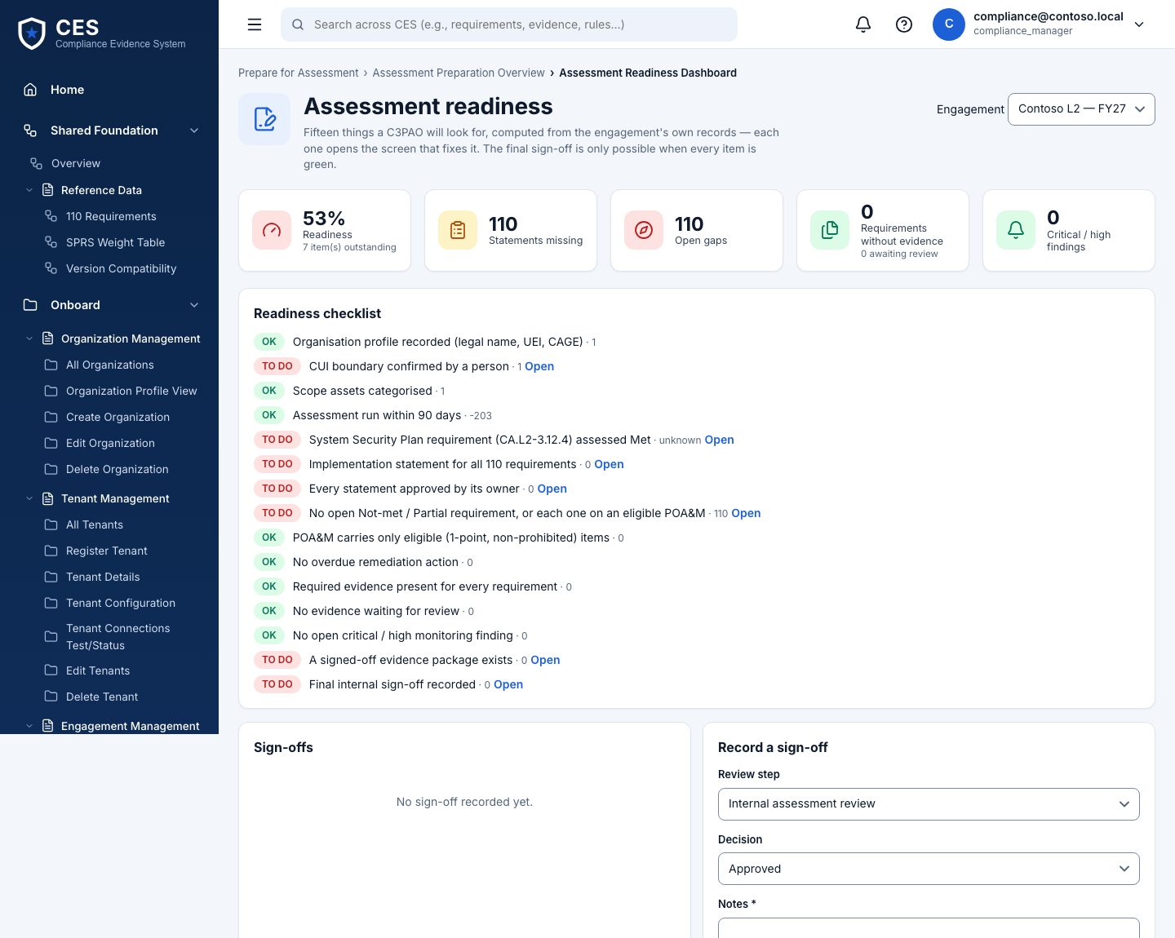
23. Assessment readiness
Who everyone
Where #/prepare/overview
The checklist for the package: boundary confirmed, assessment run exists, POA&M present, evidence coverage, SSP statements, sign-offs.
Each line says what is missing and where to fix it
Notes:
Assessment readiness — The checklist for the package: boundary confirmed, assessment run exists, POA&M present, evidence coverage, SSP statements, sign-offs.

Slide 38

24. System Security Plan (SSP)
Who compliance manager edits and approves
Where #/prepare/ssp
One row per requirement: implementation statement (draft → approved), implementation status, linked evidence. Generate drafts from the assessment and evidence; export as Markdown.
Status: implemented · partially · planned · alternative · not applicable
Approving a statement is a separate, audited click
Notes:
System Security Plan (SSP) — One row per requirement: implementation statement (draft → approved), implementation status, linked evidence. Generate drafts from the assessment and evidence; export as Markdown.

Slide 39
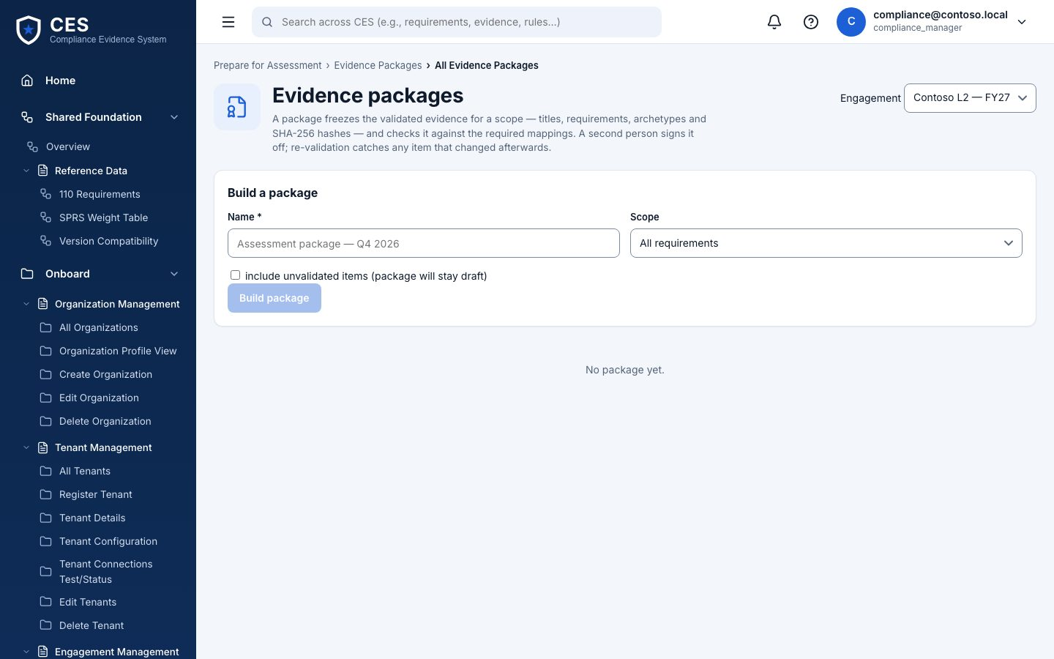
25. Evidence packages
Who compliance manager builds and signs (not the same person)
Where #/prepare/packages
Build an evidence package for a scope (all, a family, a requirement list): Build → Validate → Sign off. Versions are kept; a signed package is immutable.
The builder cannot sign their own package
Export the manifest for the assessor
Notes:
Evidence packages — Build an evidence package for a scope (all, a family, a requirement list): Build → Validate → Sign off. Versions are kept; a signed package is immutable.

Slide 40
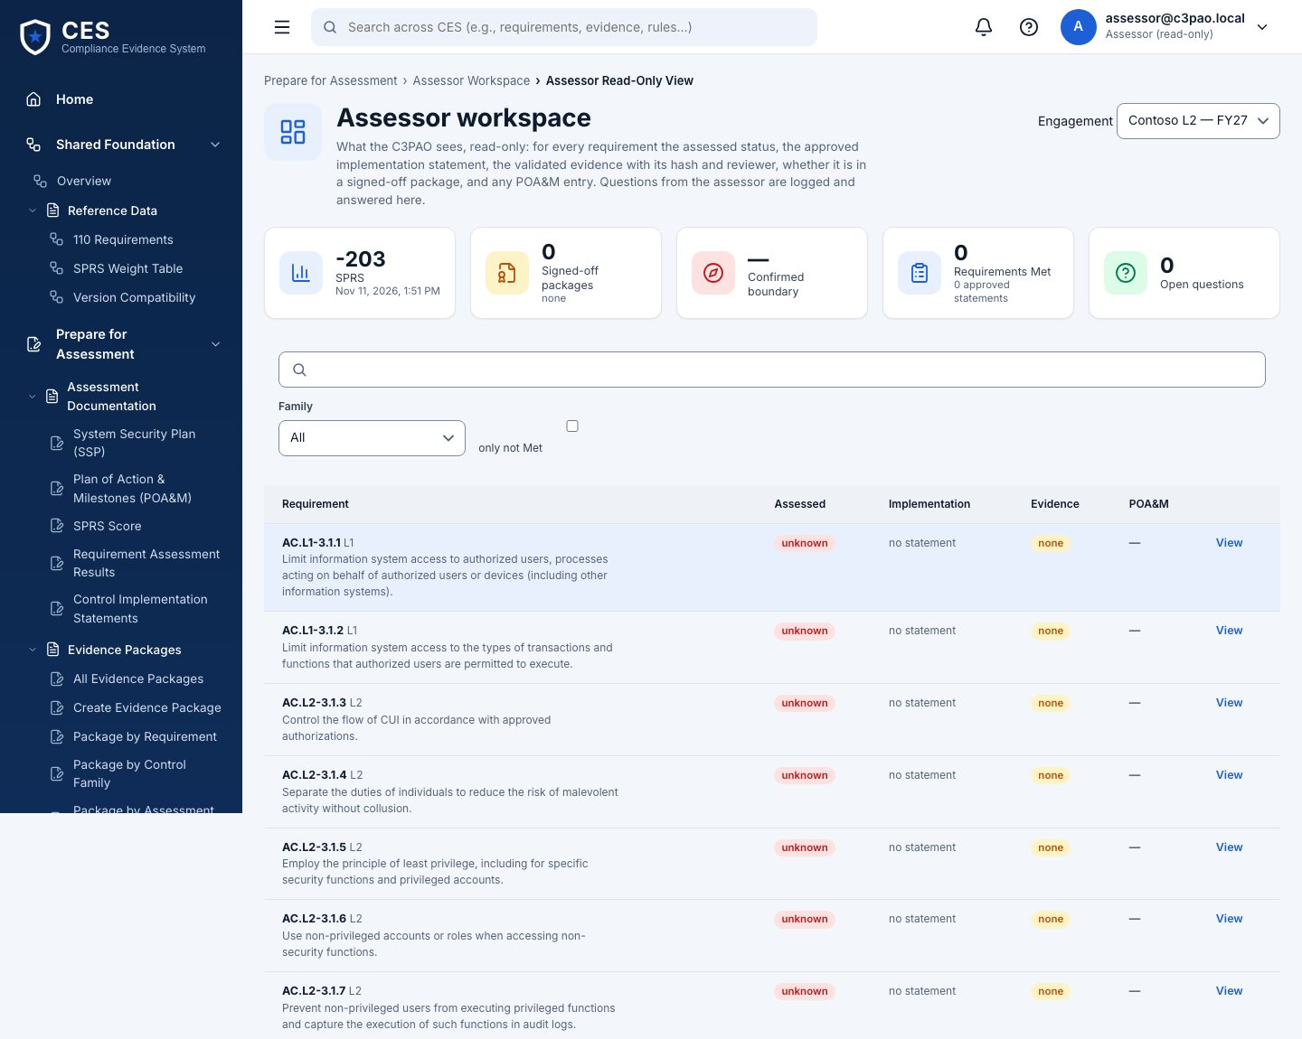
26. Assessor workspace (read-only)
Who assessor
Where #/prepare/assessor
What the C3PAO assessor sees: the package, read-only, and a request list. They ask for an item; the compliance manager answers with evidence or a note.
Nothing in this view can change the engagement
Requests: open → answered → closed
Notes:
Assessor workspace (read-only) — What the C3PAO assessor sees: the package, read-only, and a request list. They ask for an item; the compliance manager answers with evidence or a note.

Slide 41
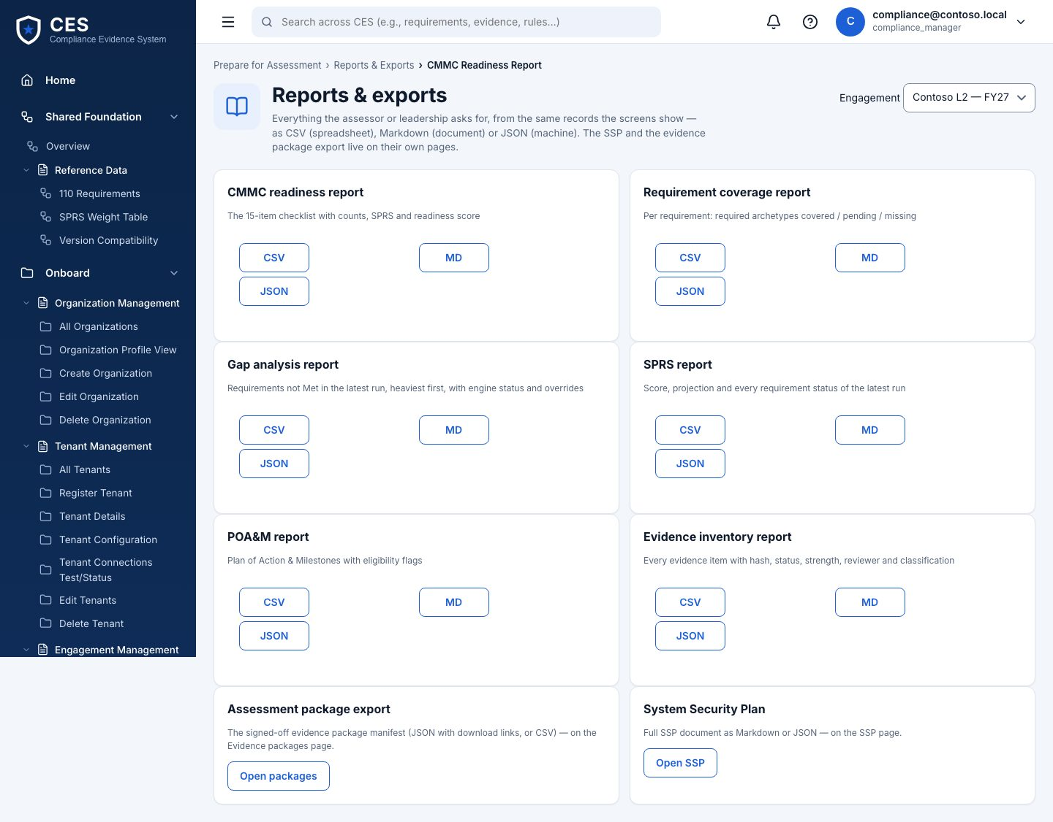
27. Reports & exports
Who everyone
Where #/prepare/reports
Readiness, coverage, gaps, SPRS, POA&M and evidence inventory as JSON, Markdown or CSV.
CSV cells are formula-safe
Same numbers as the screens — one calculator
Notes:
Reports & exports — Readiness, coverage, gaps, SPRS, POA&M and evidence inventory as JSON, Markdown or CSV.

Slide 42
Administration
28. Settings · 29. Access management · 30. System health

Slide 43
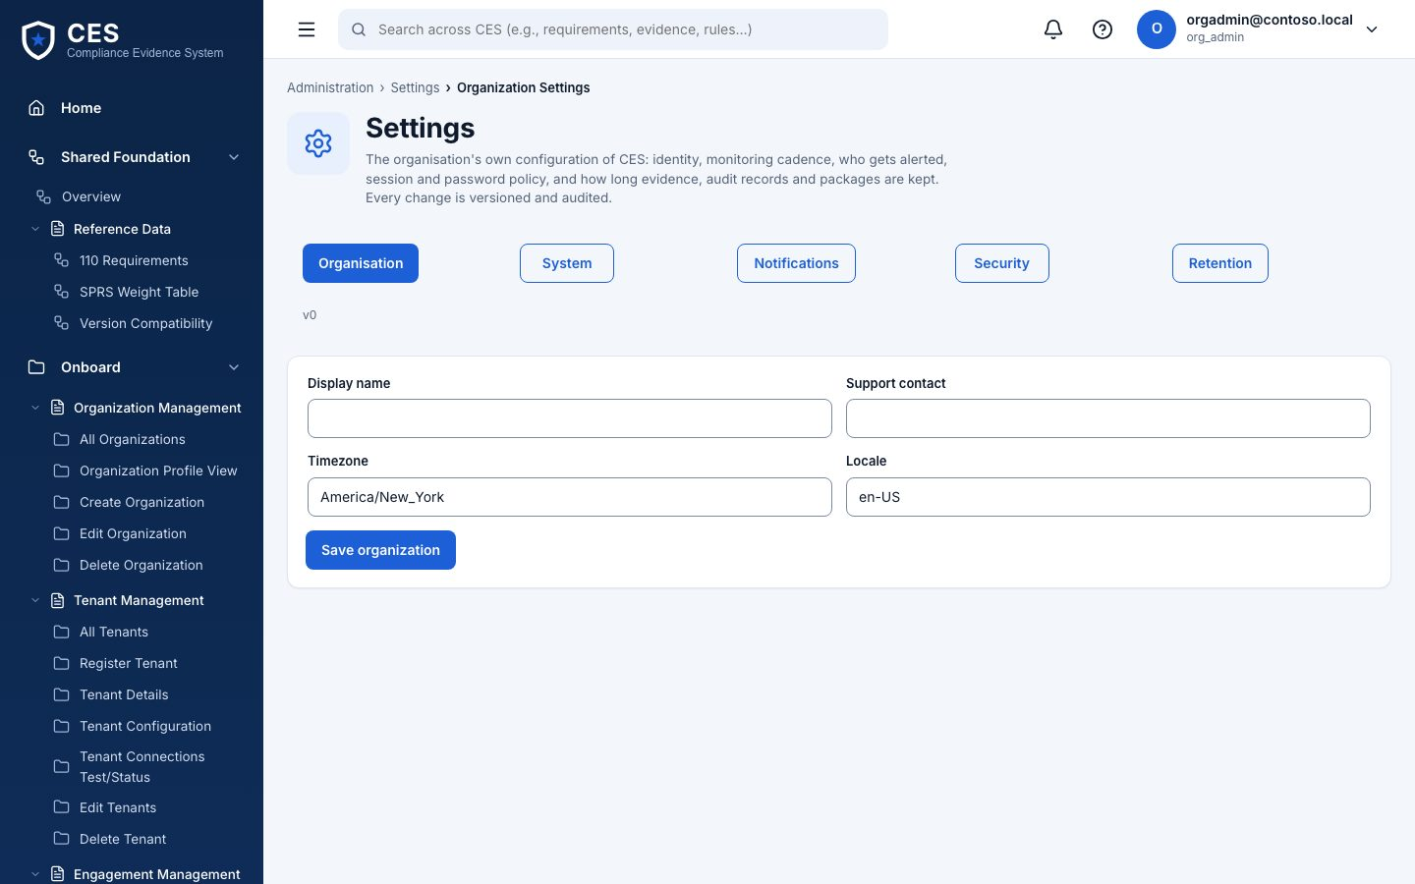
28. Settings
Who org admin edits · others view
Where #/admin/settings
Engagement details (name, reference, CMMC level, status, dates), monitoring cadence, notification settings.
Some settings are recorded but not yet enforced — the tab says which (open with BHD)
Notes:
Settings — Engagement details (name, reference, CMMC level, status, dates), monitoring cadence, notification settings.

Slide 44
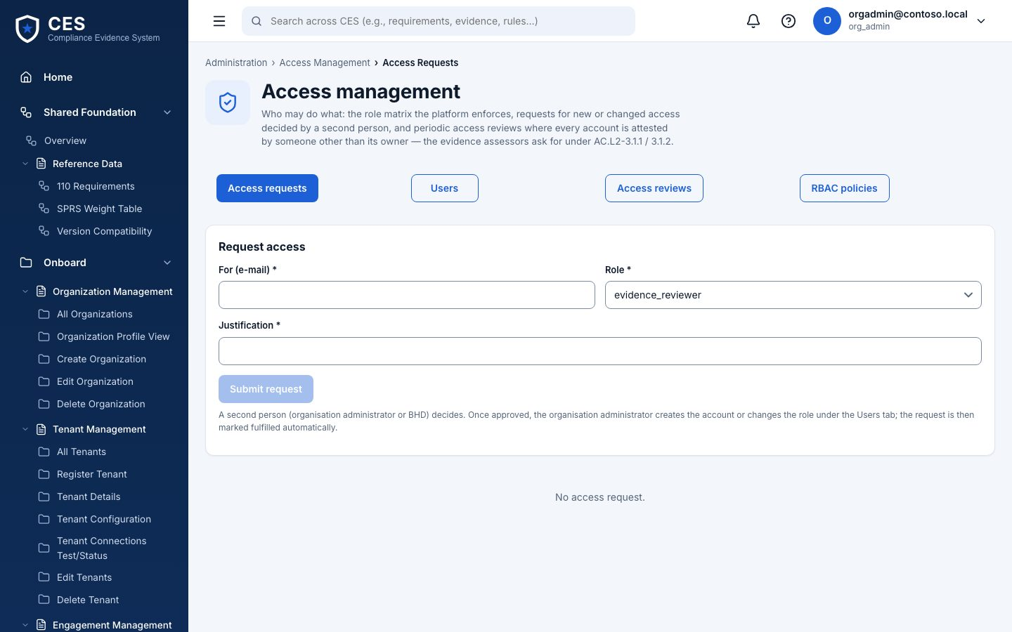
29. Access management
Who org admin
Where #/admin/access
Requests (anyone asks for a role, org admin decides), periodic access reviews (completion attested by a different admin), and Users: org-scoped user admin with customer roles only.
Never grants platform or BHD roles
Temporary password shown once; last org admin cannot be removed
Notes:
Access management — Requests (anyone asks for a role, org admin decides), periodic access reviews (completion attested by a different admin), and Users: org-scoped user admin with customer roles only.

Slide 45
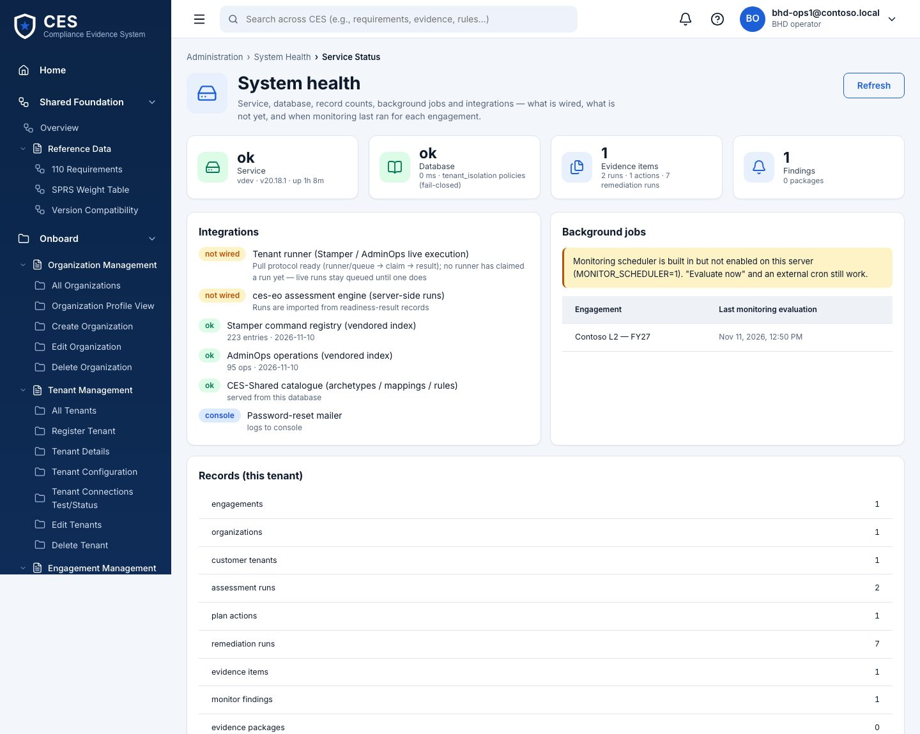
30. System health
Who BHD operator
Where #/admin/health
Database, integrations (simulator / Graph reachability), the scheduler (on/off, last tick), and when a runner last claimed work. If Run assessment sits in Queued…, look here.
Platform admin is fenced from tenant health (PB-01) — decision pending with BHD
Notes:
System health — Database, integrations (simulator / Graph reachability), the scheduler (on/off, last tick), and when a runner last claimed work. If Run assessment sits in Queued…, look here.

Slide 46
The permission matrix
V view · E edit · A approve · X execute — the same table the sidebar and the API use
Section | BHD op | Org admin | Compliance | IT sec admin | Ev. reviewer | Sr approver | Assessor
Onboard | V E | V E A | V E | V E | V | V
Assess | V E X | V | V E X A | V E X | V | V
Plan | V E X | V A | V E A | V E | V | V A
Remediate · Stamper | V E A X
Remediate · AdminOps | V A X | V | V | V E X |  | V A
Remediate · tracking | V E | V | V E | V E | V | V
Collect Evidence | V E | V | V E | V E | V A | V
Monitor | V E | V | V E | V E X | V | V A
Prepare | V E | V | V E A | V | V | V | V
Administration | V | V E
Route rules on top: the requester never approves their own change (DP-2) · Stamper is BHD-only · the last org admin cannot be removed · platform admin is fenced off customer data (PB-01).
Notes:
Source: muster-api/src/lib/permissions.ts and ces-muster/src/features/portal/lifecycle/rbac.ts — a parity test keeps them identical.

Slide 47
Run it on your laptop
Clone
git clone -c core.autocrlf=false https://github.com/aavya-engineering/CES.git C:\ces
Install
npm ci in four trees: root · ces-muster · ces-muster\muster-api · tenant-stacksim
Database
Postgres 16 · migrate as postgres · scripts\bootstrap-app-role.sql (least-privilege app role)
Configure
.env from .env.example: DATABASE_URL (app role), JWT_SECRET
Seed
npm run seed:dev:win — demo accounts, password Ces!Local2026
Run
API npm run dev (:4000) · portal npm run dev (:5173) · simulator npm run sim (:4390) · runner npm run runner
Verify
npm run smoke:postgres · CES_E2E_LIVE=1 npm run test:e2e:live
Only one thing cannot work on macOS/Linux: Run assessment — the registry reads are Windows PowerShell, so the job queues for a Windows runner. Full guide: docs/DEV-SETUP-WINDOWS.md.
Notes:
Troubleshooting table with every error we hit is at the end of DEV-SETUP-WINDOWS.md.

Slide 48
New engineer: five days to a first PR
Day 1
Day 2
Day 3
Day 4
Day 5
Run it; click through as four roles
The user journeys J1–J5
Read the code the way it runs
Engine, runner, Windows
Ship a change
smoke green · sign in · one action per role · three confusions written down
draw the sidebar from memory; who can do what; check against rbac.ts
trace Run assessment UI → proxy → guards → route → PowerShell → DB; then a Stamper run
runner --once on Mac (fails honestly) and Windows (done); CES_ENGINE_LOCAL=0; read poll.ts
test first · browser check · PR · CI · doc in the same PR · graduation: guard one legacy router
Notes:
Long form with file-by-file traces and exercises: docs/NEW-JOINER-TRAINING.md.

Slide 49
What is proven, what is next
Done
Next
Lifecycle end to end on the simulator (Mac): smoke, browser walk 5/5, runner round trip
Role matrix server-side with parity test and path-bypass probes
Tenant isolation by Postgres RLS; API refuses a superuser
Evidence catalog release 0 with batch validator
Threat model (STRIDE) and a security review; High finding fixed
CI: unit suites + Postgres smoke + dependency gate
Run assessment on a Windows host (first real engine proof)
Dedicated runner identity and signed results
MFA / SSO — BHD’s choice
Live discovery grants on the runner; kit CLI for live Stamper/AdminOps
A BHD test tenant in GCC High for live runs
Legacy routers under the matrix guard; token revocation on disable
Notes:
Detail and owners: production readiness plan (doc 50), security review (doc 49), runner and walk (doc 47).

Slide 50
Where to find things
docs/USER-GUIDE.md · docs/NEW-JOINER-TRAINING.md · docs/DEV-SETUP-WINDOWS.md · docs/architecture/ces-platform.drawio
API reference: /api/docs on a running API · permission matrix: lifecycle/rbac.ts = lib/permissions.ts
SDLC set (PRD, FRS, SRS, HLD v2, LLD v2, tests, threat model, security review, ADRs): Aavya project “CES-BlueHeron”

