Slide 1
How a requirement becomes evidence an assessor can trust
Where the evidence comes from, how it is checked, where the reports are, and what the assessor sees
CES platform, master · 12 November 2026
Notes:
Answers the three questions a customer or assessor asks: how was evidence generated and checked, how were the 110 requirements fulfilled, where is the report.

Slide 2
The chain — every link is a row in the database with an actor and a time
1
2
3
4
5
110 requirements
320 objectives
Registry read
Capture
Evidence item
NIST SP 800-171 · SPRS weight 1/3/5
NIST 800-171A assessment objectives
201 PowerShell get-commands · entry_id → objectives
raw output file · SHA-256 · run id
source · requirement/objective ids · hash · status
6
7
8
9
Review
SSP statement
Package
Assessor view
a different person approves (SoD)
per requirement · draft → approved
versioned · validated · signed · immutable
read-only · request → answer trail
Nothing is credited that was not read: an objective the engine could not read stays “unknown” until a document or a person settles it; a run where every command failed records nothing.
Notes:
Walk the chain left to right. Every box is a table or a column in muster_db; every transition writes an audit_events row.

Slide 3
How evidence is generated — three sources, one review
Discovery (engine)
Remediation runs
Manual uploads
Run assessment walks the registry against the tenant (or simulator), read-only. Each observation carries a raw_capture_ref; the capture becomes a draft evidence item with its SHA-256, the run id, the entry ids and the objectives it supports.
Stamper / AdminOps runs post their steps and captures; each capture becomes evidence tagged with the run, so “what changed and what it looked like after” is on file. Simulate mode records the plan only — the tenant is not touched.
Policies, training records, physical controls: a person uploads or pastes, picks requirement and objectives, and — where the NIST catalog has a definition — the exact artefact the assessor expects.
source = discovery
source = stamper · adminops
source = manual
Checked, not just collected
Every item goes draft → submitted → validated or rejected. The reviewer must be a different person from the submitter (the API refuses otherwise). A new version supersedes, never overwrites. Engine captures are hashed at ingest; a changed file no longer matches its stored SHA-256.
Notes:
Three sources, one review path. Separation of duties is enforced by the API, not just hinted in the UI.

Slide 4
How the 110 requirements get to “met”
96 of 110 controls
have at least one automated read in the registry (201 get-commands). The engine can observe their technical state.
~133 of 320 objectives
are plausibly settled by those reads alone (41 %).
~150 objectives
sit on readable controls but are procedural, documentary, physical or training — they need a document or a person (manual evidence + review).
14 controls (37 objectives)
are manual-only: no readable surface at all.
SPRS
computed from the 110 statuses with the DoD weights (1/3/5): −203 to 110. Only “met” counts; “unknown” and “not met” both subtract.
Source: registry-objective-coverage (BHD, 2026-07-10); SPRS weights in the vendored reference data. Overrides by a person are allowed, need a written reason, and are shown as overrides to the assessor.
Notes:
This is the honest math: roughly four in ten objectives can be retired by discovery; six in ten are the compliance manager’s evidence work. That is CMMC, not a gap in the tool.

Slide 5
Where the reports are
You want… | In the portal | API / export
Status of all 110 + SPRS | Assess › Readiness (family table) | Prepare › Reports › readiness · GET /assessments/:run/results
Which requirements have evidence, which do not | Evidence › Overview | Reports › coverage
Gaps, heaviest first | Assess › Gaps (CSV) | Reports › gaps
SPRS calculation | Assess › Readiness | Reports › sprs
POA&M | Plan › POA&M | Reports › poam
Every evidence item with hash, source, run, reviewer | Evidence › Explorer (open item) | Reports › evidence-inventory
The assessor bundle | Prepare › Packages → Build → Validate → Sign off | GET /prepare/packages/:id/export (manifest + items)
SSP | Prepare › SSP | GET /prepare/ssp/export (Markdown)
Who did what, when | Monitor › Activity · Administration › Audit log | GET …/monitor/activity · /api/audit-events
Formats: JSON, Markdown, CSV (cells are formula-safe). The numbers on the screens and in the exports come from one calculator.
Notes:
Reports are generated from the same tables the screens read; there is no second copy of the truth.

Slide 6
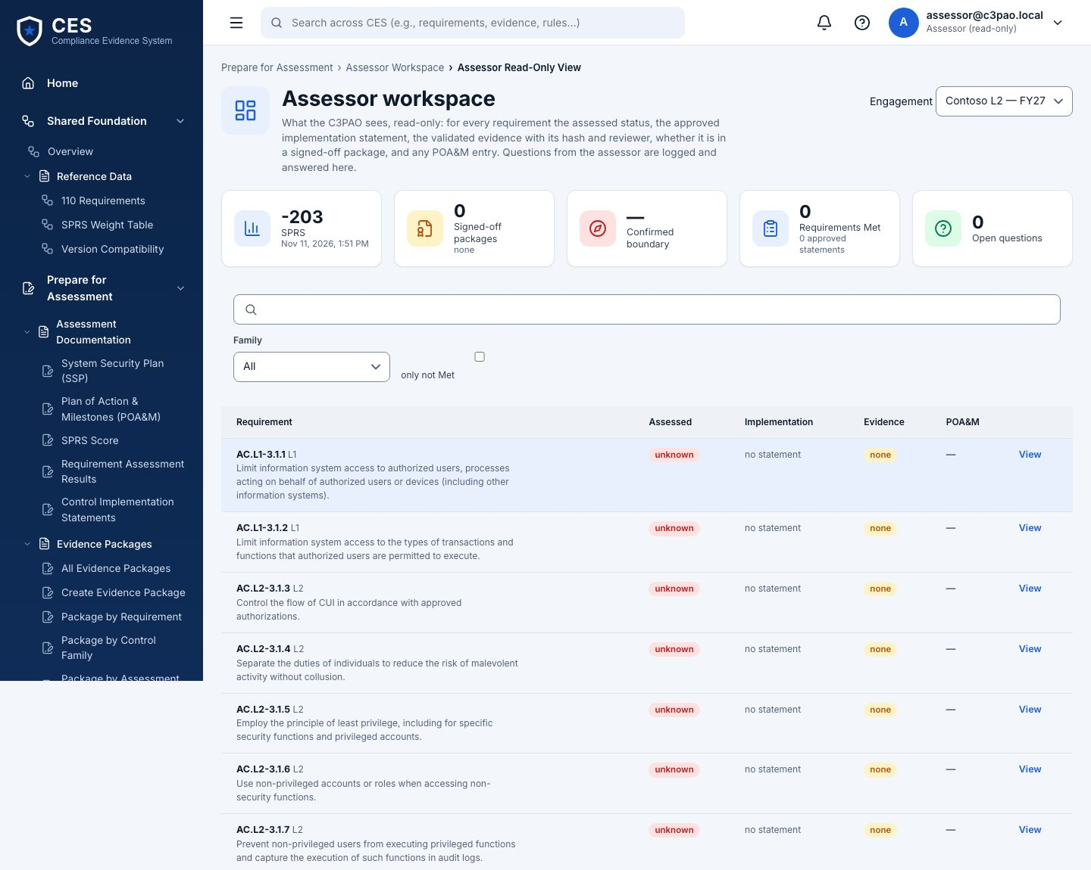
What the assessor sees, and how it is recorded
Role assessor_read_only: Prepare only, nothing else in the sidebar, no write anywhere
Sees the signed package: manifest, items with hashes, SSP statements, POA&M
Asks for an item or a clarification → request (open) → compliance manager answers with evidence or a note → closed. The trail stays with the engagement
Overrides are visible as overrides, with the reason and the person
A signed package cannot change; a new build makes a new version and marks the old one superseded
Notes:
The request/answer trail is the record that the assessor examined the evidence. An assessor dry run (M5) with a C3PAO is still to be scheduled.

Slide 7
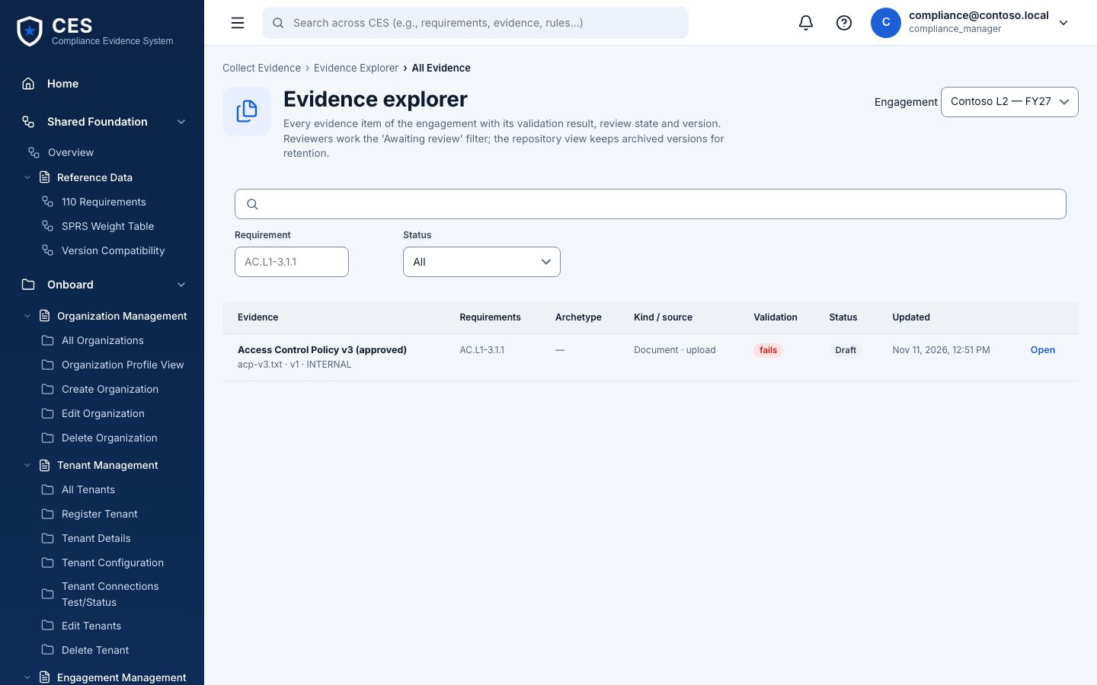
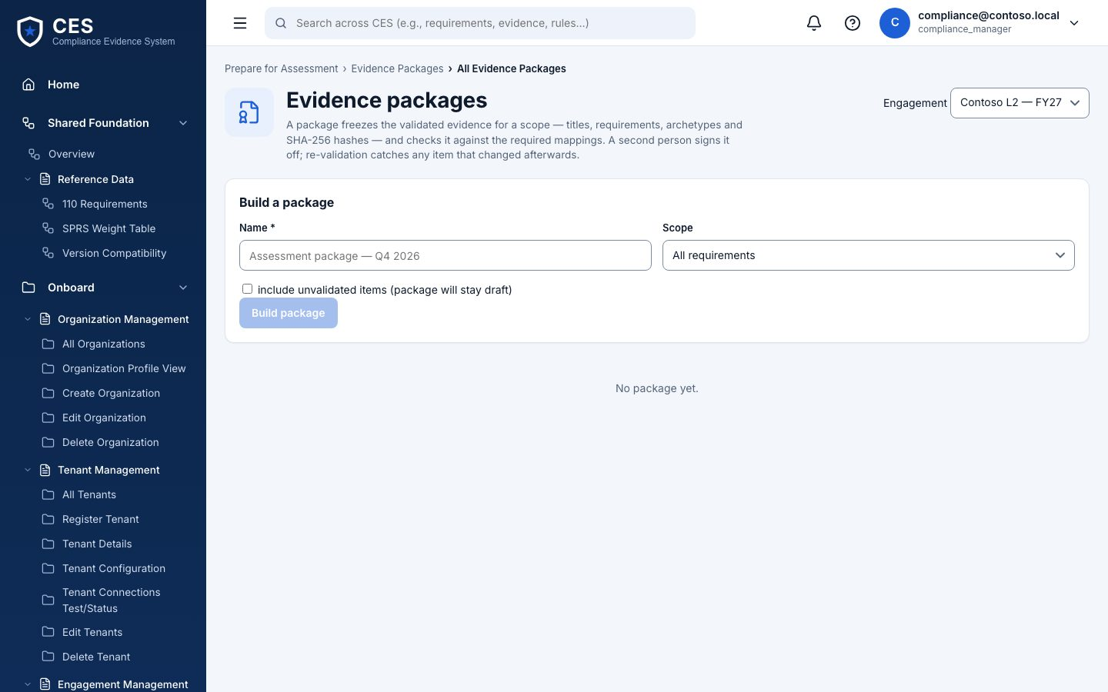
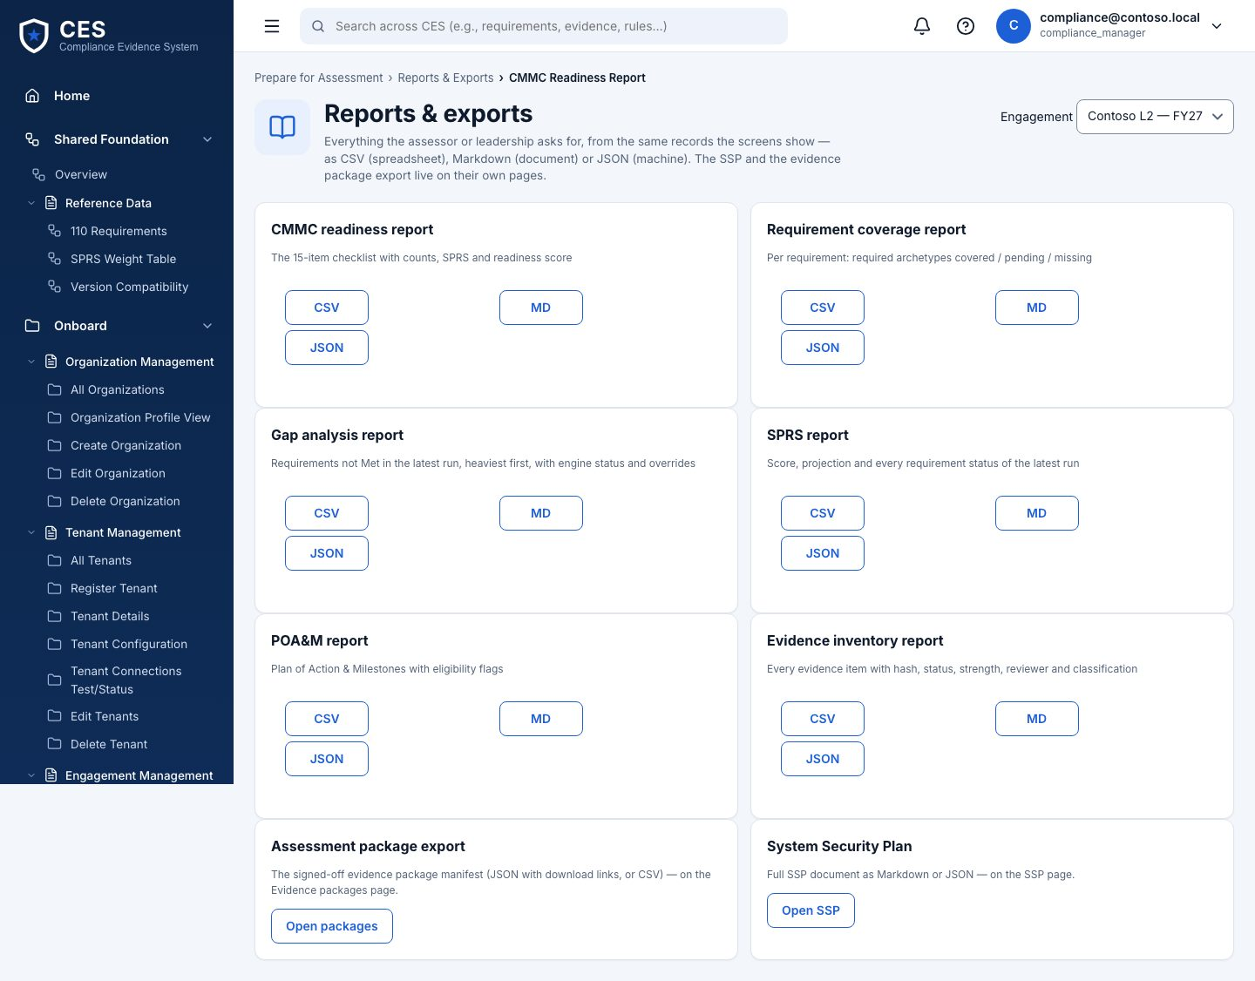
Where to click when someone asks “show me”
Evidence › Explorer — every item, source, hash, status
Prepare › Packages — build, validate, sign off, export
Prepare › Reports — readiness, coverage, gaps, SPRS, POA&M, inventory
Also: Assess › Gaps (open a gap → objectives → override drawer) and Monitor › Activity (the audit trail for the engagement).

Slide 8
What is proven today, and what is still to come
Proven
Next
Chain, hashes, SoD review, overrides with reasons, audit trail — in code, tested, on master
Postgres smoke and the browser walk pass on the simulator
NIST catalog release 0 (AC.L2-3.1.1) with the batch validator
First engine run on a Windows host — the demo tenant still shows an empty read (SPRS −203) because macOS cannot run PowerShell
Catalog rows for the other 109 requirements — BHD batches
Live tenant run (rung 3) on a BHD test tenant
Assessor dry run with a C3PAO (success measure M5)
Signed results from a dedicated runner identity; WORM evidence store if evidence is ruled CUI
Notes:
Say this plainly: the mechanism is built and tested; the first real numbers come from the Windows run and the first live tenant.

