Slide 1
Dashboard
File created on: 8/4/2021 9:16:34 PM

Slide 2
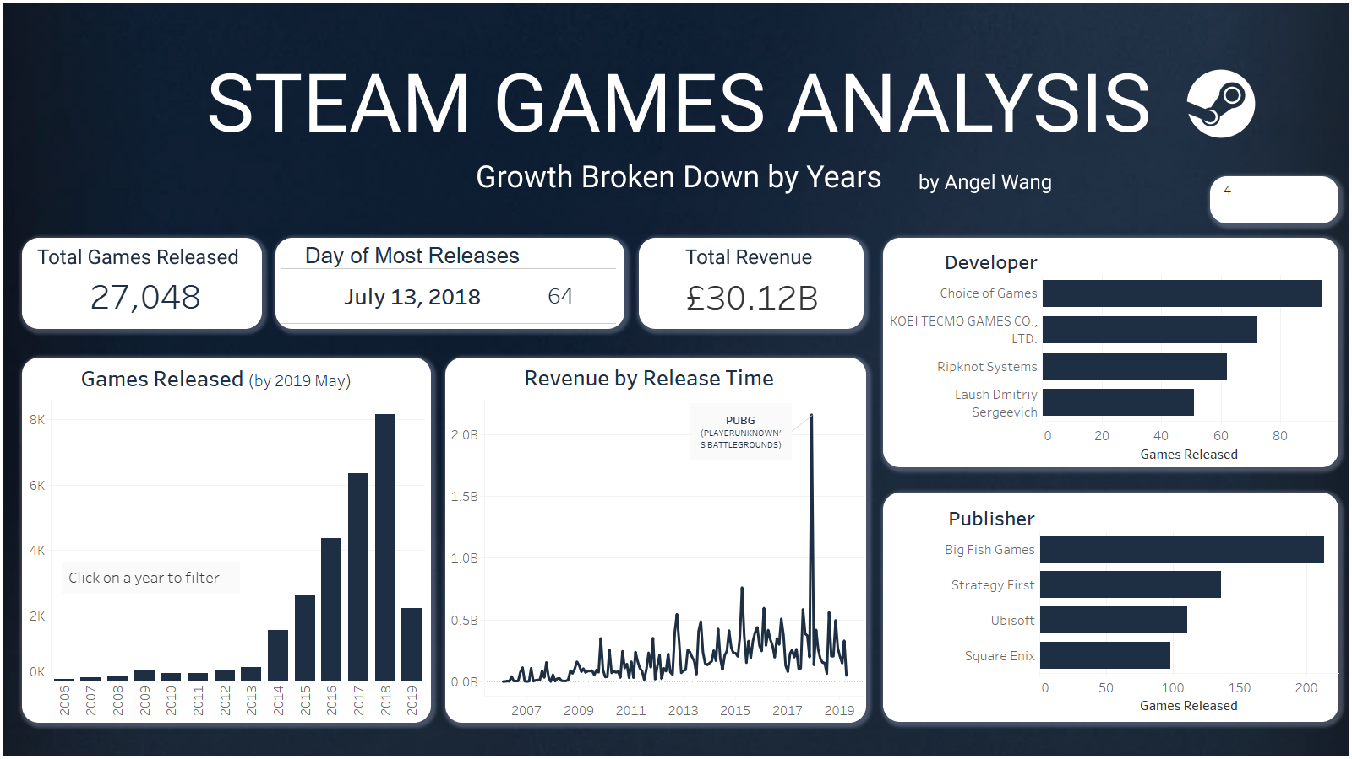

Slide 3
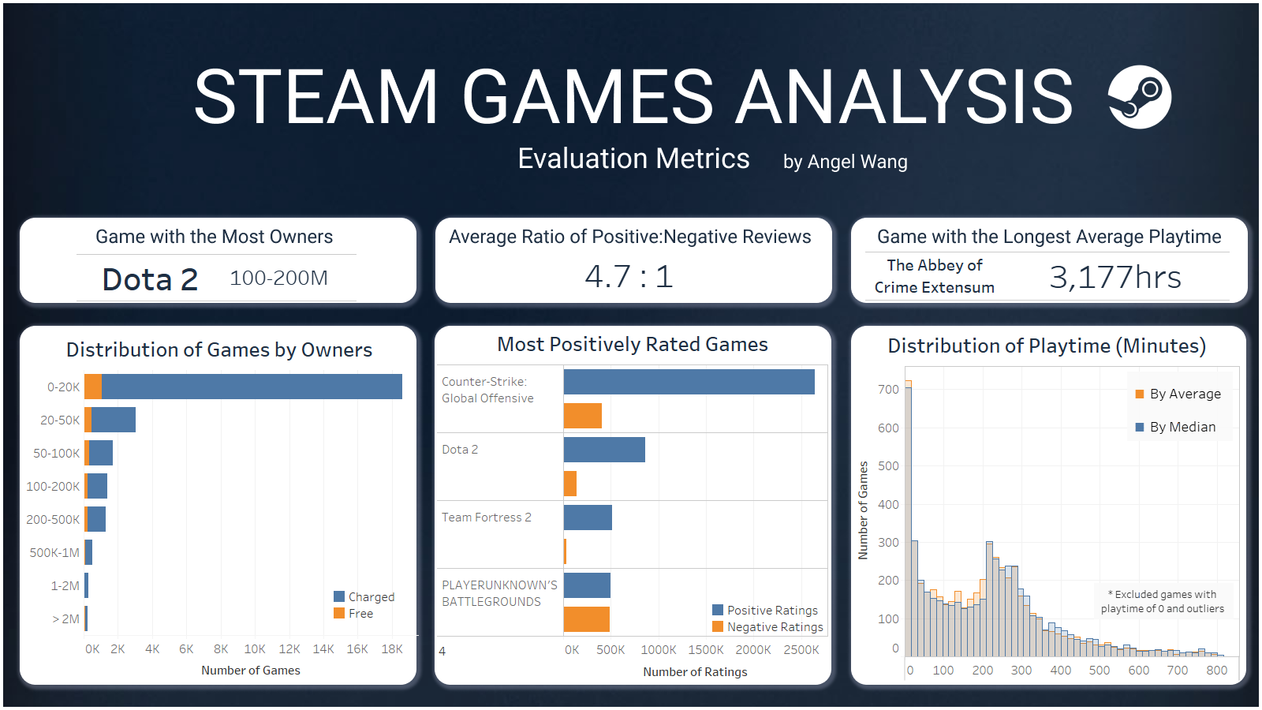

Slide 4
