Slide 1
System Level Cosimulation
02/08/2024

Slide 2
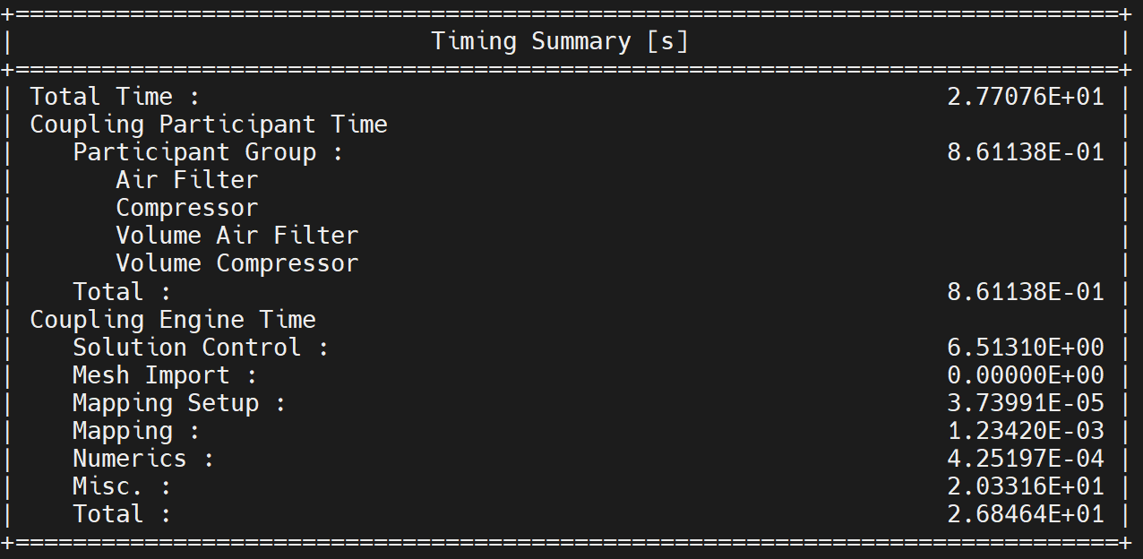
SysC- Simple Engine Model
TimeStepSize = 0.01s
EndTime = 0.1s
Original implementation = 0.021s

Slide 3
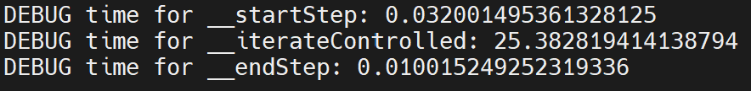
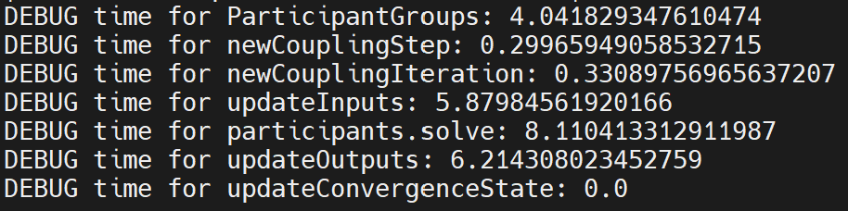
Solve()

Slide 4
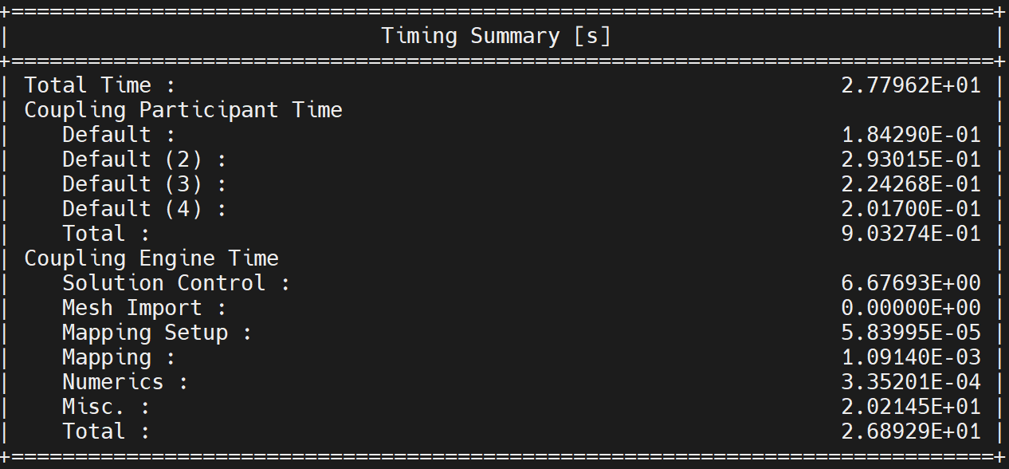
PySystemCoupling

Slide 5
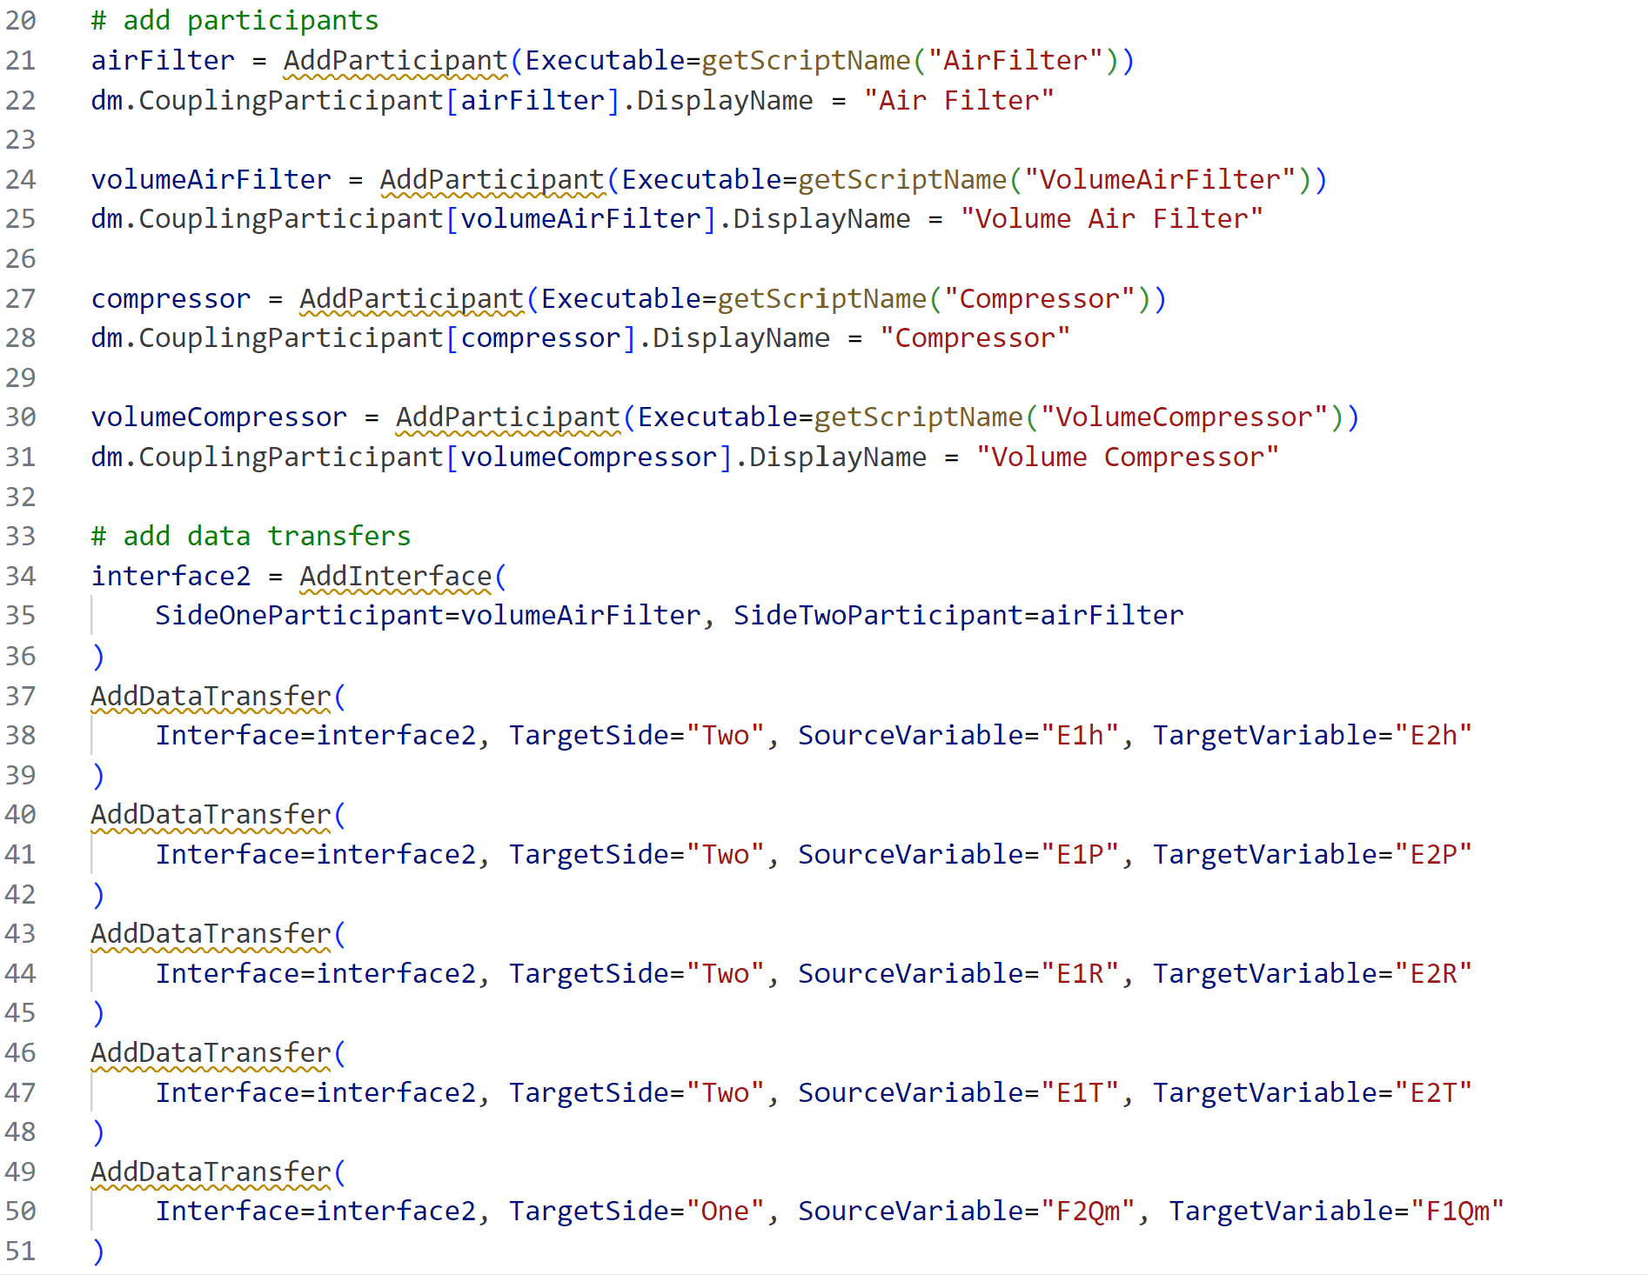
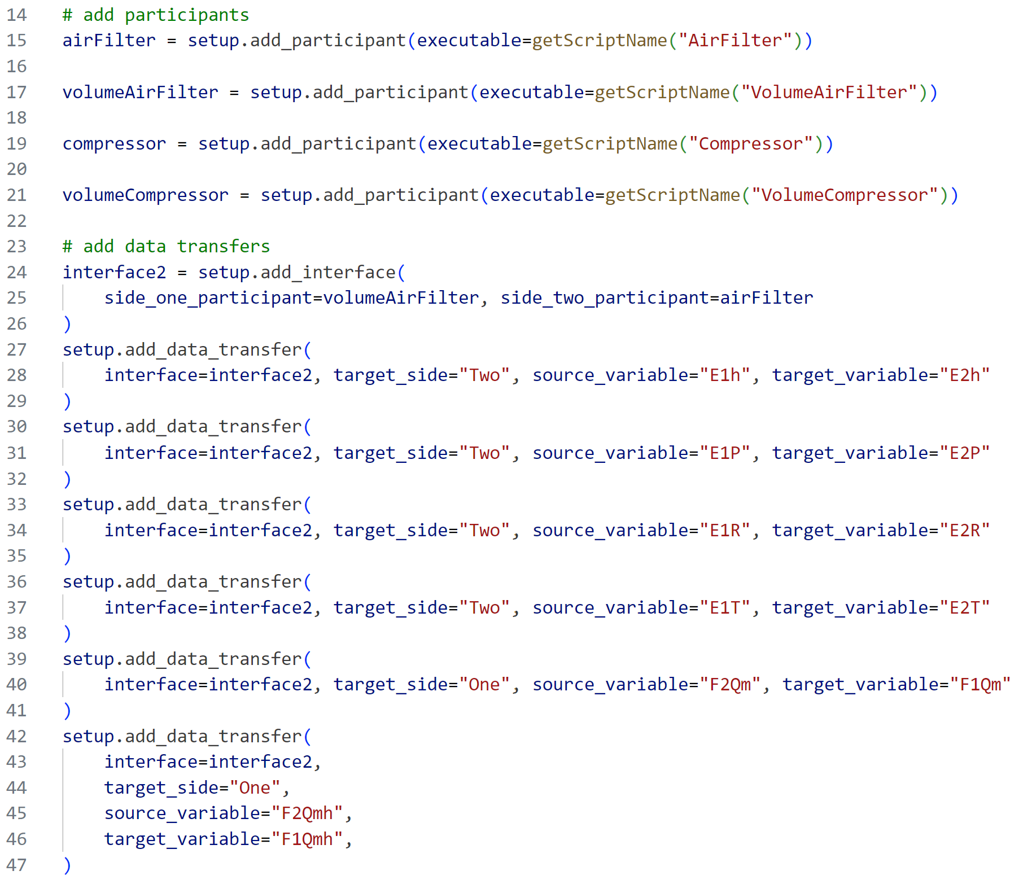
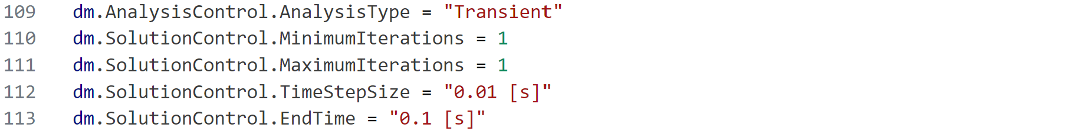
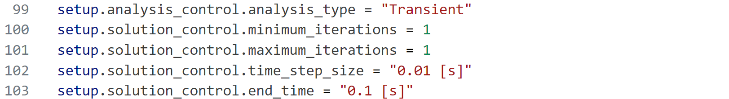
System Coupling
PySystem Coupling

