Slide 1
System Level Cosimulation
02/13/2024

Slide 2
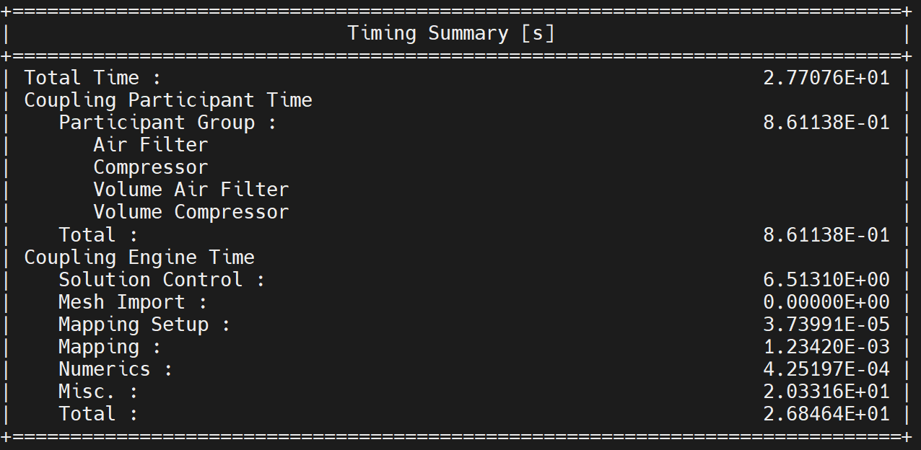
SysC- Simple Engine Model
TimeStepSize = 0.01s
EndTime = 0.1s
Original implementation = 0.021s

Slide 3
One Time Costs

Slide 4
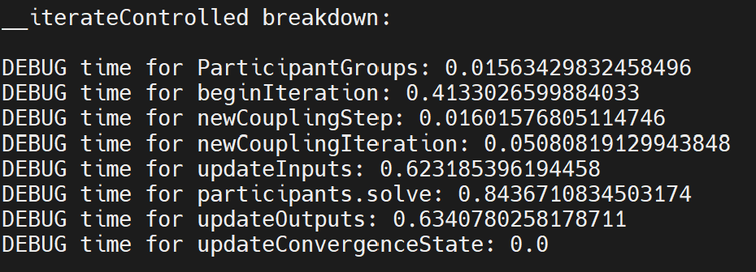
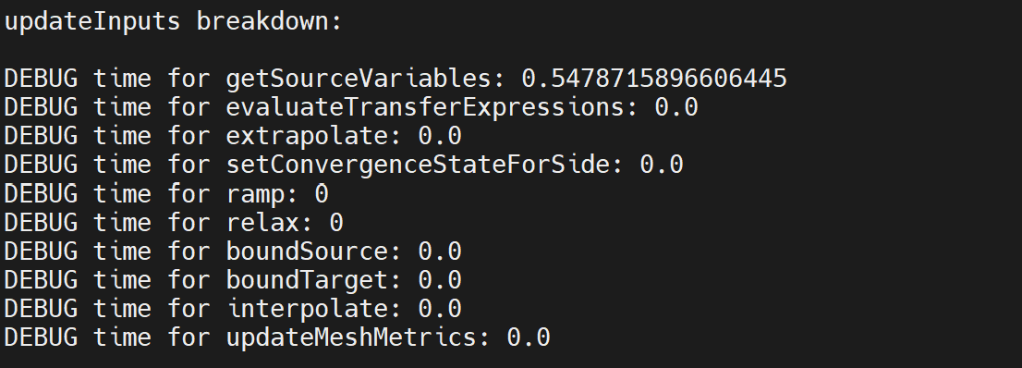
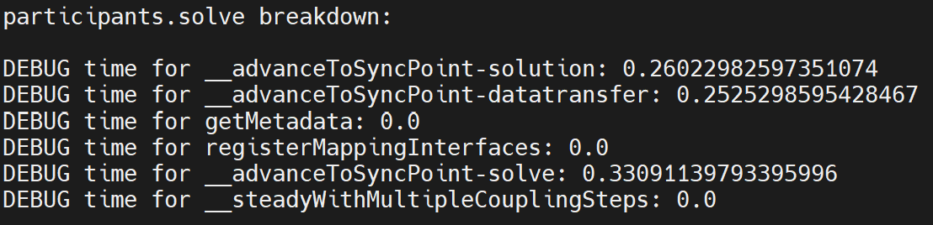
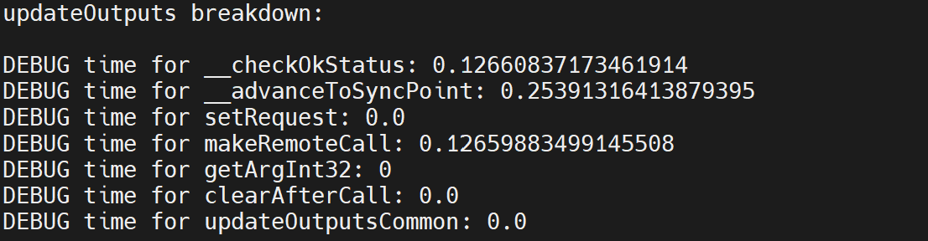
Cost Per Iteration

Slide 5
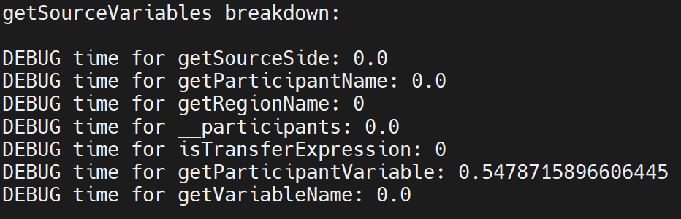
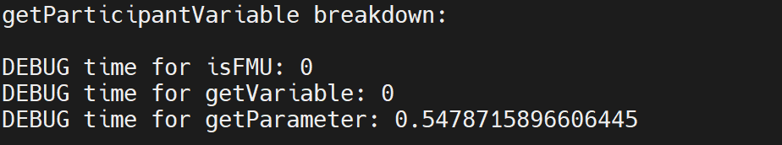
Cost Per Iteration - UpdateInputs

