Slide 1
System Level Co-simulation
03/18/2024

Slide 2
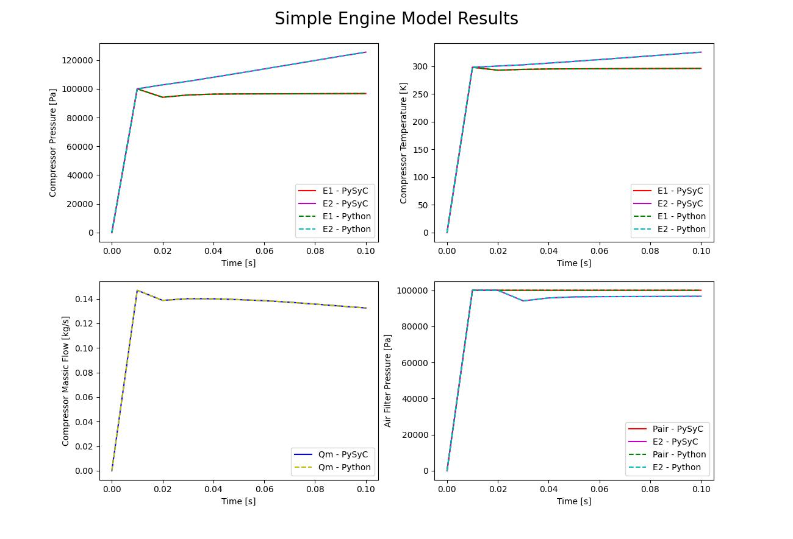
Validation

Slide 3
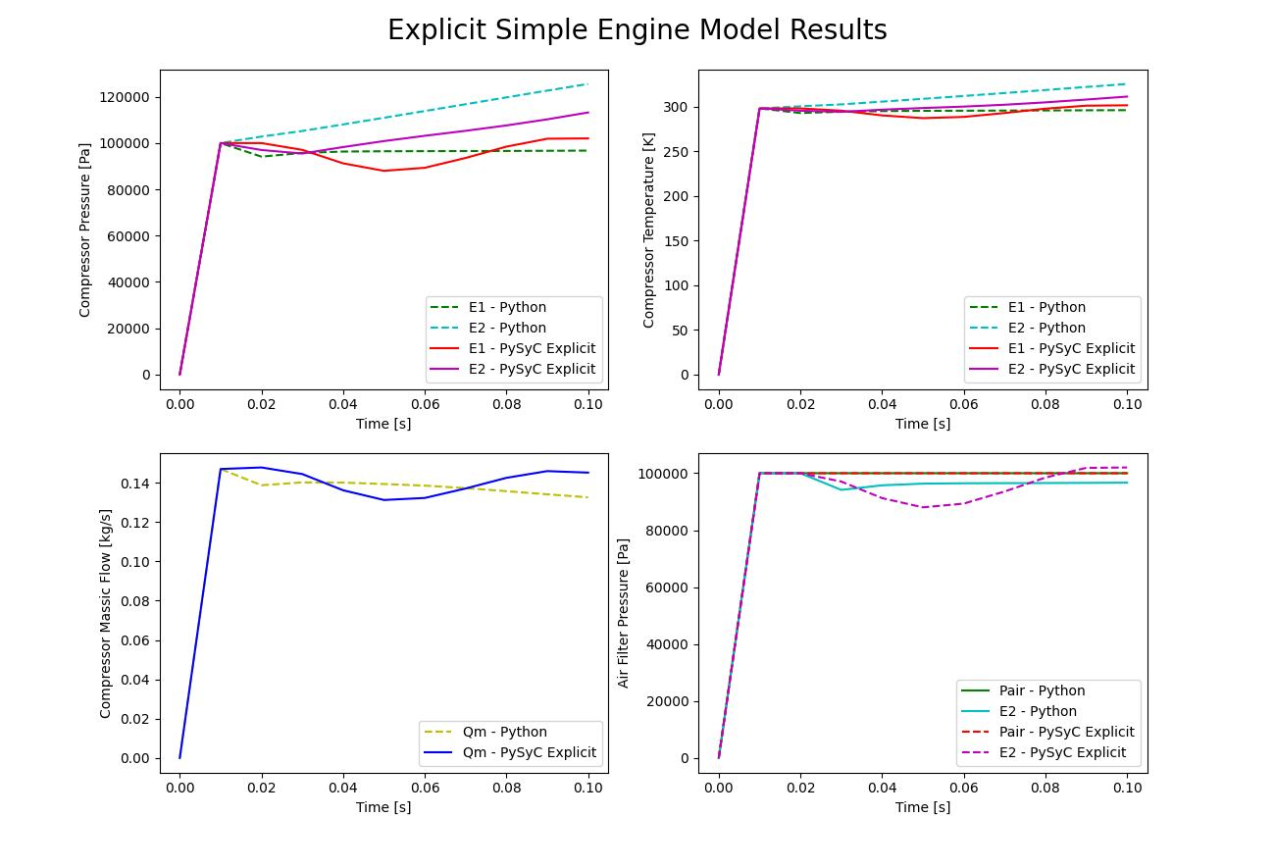
Explicit Implementation

Slide 4
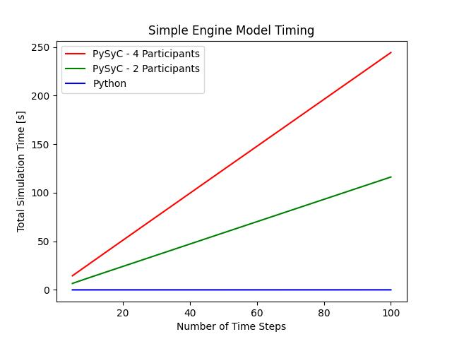
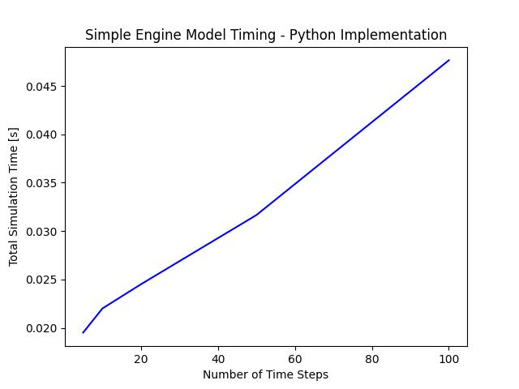
Timing

Slide 5
Timing Solutions
Development work to reduce number of RPC calls and reduce time to create data transfers
Remove some redundant calls
Group some calls into single call
Introduce groups of participant in the Datamodel to reduce number of Data Transfers
Connect to participants on the controller – for example, FMU

Slide 6
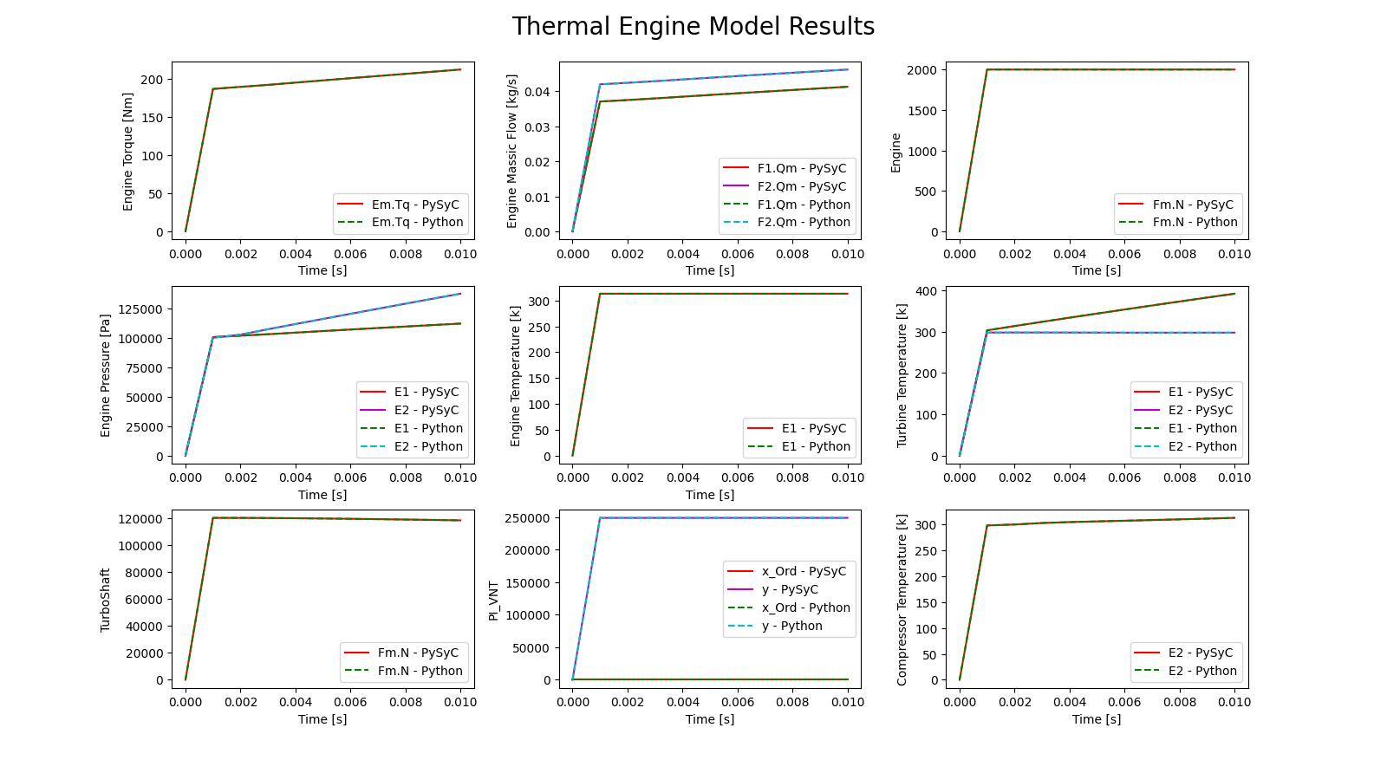
Validation

Slide 7
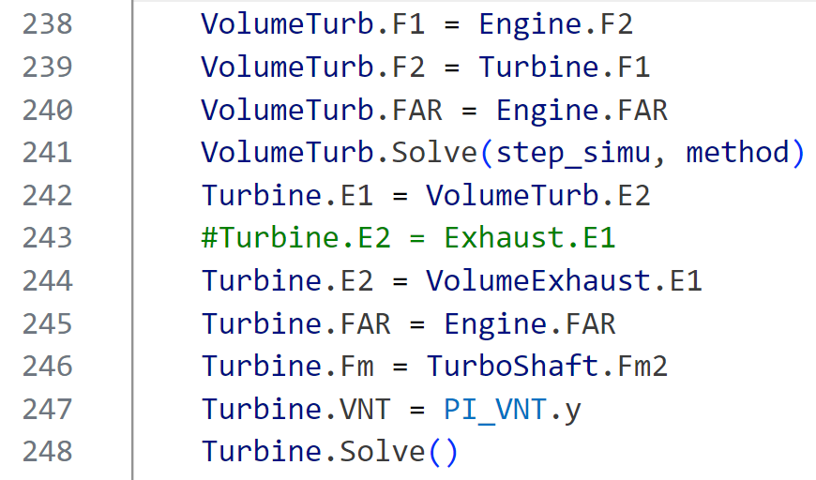
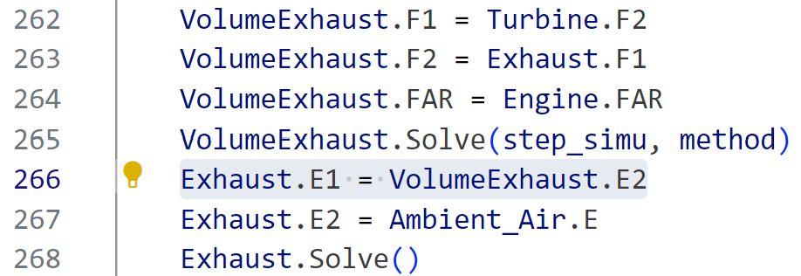
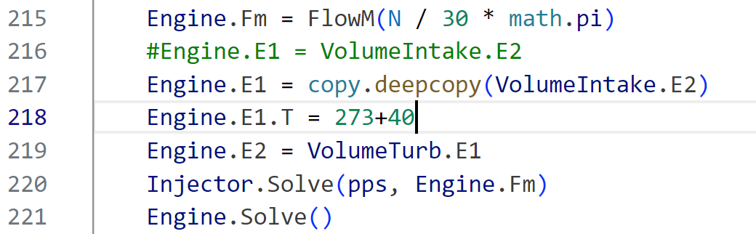
Validation
1.
2.

Slide 8
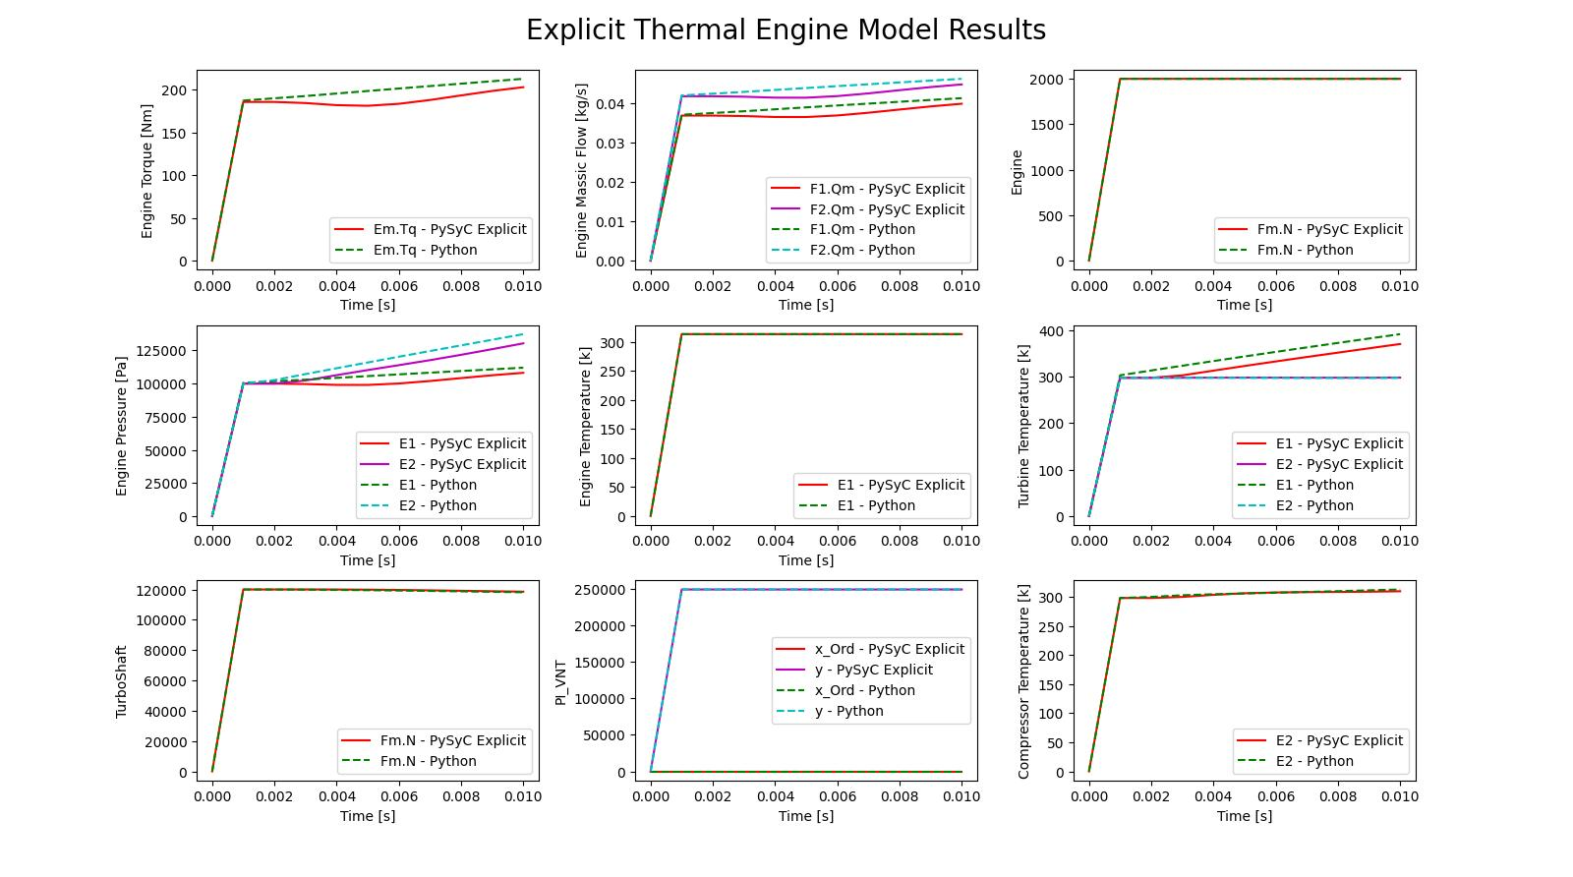
Explicit Implementation

Slide 9
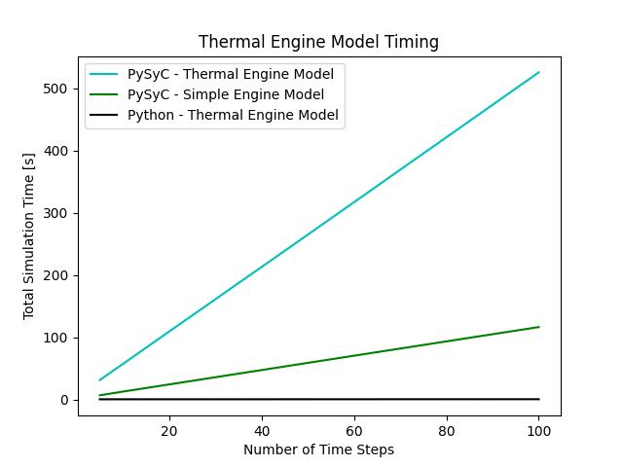
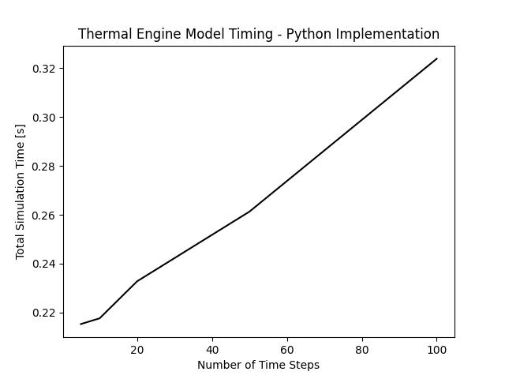
Timing

Slide 10
Observations
Current implementation works but is slow compared to Python implementation by a factor of 10^2 – 10^3
Possible to improve timing without development work such as using FMUs
Cumbersome to set up data transfers manually
Can be improved with solutions infrastructure
One advantage of the SyC approach is access to SyC infrastructure
Data transfer expressions
Ability to properly handle explicit participants
Can easily integrate new participants as the framework is general

