Slide 1
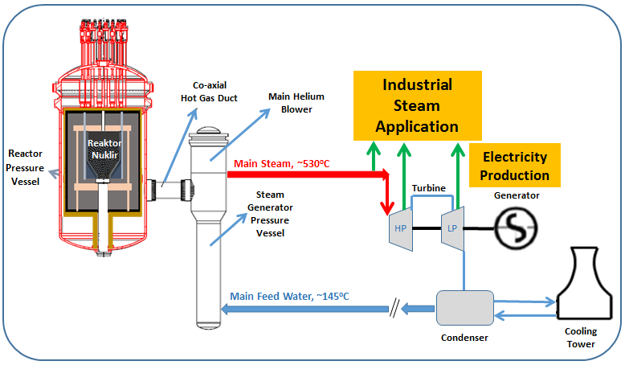
TRIso Analysis Code – BATAN (TRIAC-BATAN)
BADAN TENAGA NUKLIR NASIONAL
2018
Contact:
tsdipura@batan.go.id
adhyaksa@batan.go.id

Slide 2

Fitur
TRISO fuel failure ratio analysis → PANAMApart
Fission product release → FRESCOpart

Slide 3
Fission Product Transport Phenomena

Slide 4
Adsorption & Desorption Processes

Slide 5
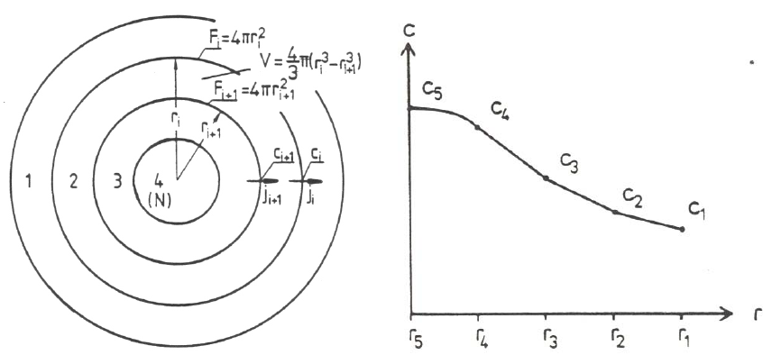
Fuel Sphere Partition
Partitioning of sphere in sub-shells (left), concentration curve in the sphere (right).

Slide 6
General Properties of FRESCO
The diffusion model distinguishes between two types of particle: intact particles and defective/failed particles.
A defective/failed particle is represented by a bare kernel only meaning that fission products are released immediately into the matrix graphite.
At the moment of failure of a particle, the fission product content inside the coating layers is released into the matrix graphite.
For the inventory still left in the kernel, this moment is ‘time zero, from which an independent diffusive release calculation will be starting.
The Calculation procedure within a time step is performed in two consecutive parts:
Calculation of diffusive release from intact and failed particles and from the graphite grains is conducted. The sum of those single releases is the overall source term for the fuel element matrix graphite (grain boundaries).
Calculation of diffusive transport on graphite grain boundaries (quick phase) through the matrix and release by desorption from fuel sphere surgace into the coolant is calculated.

Slide 7
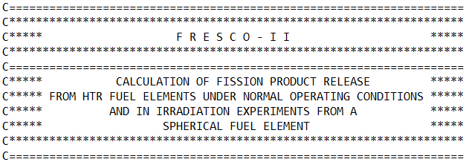

Slide 8
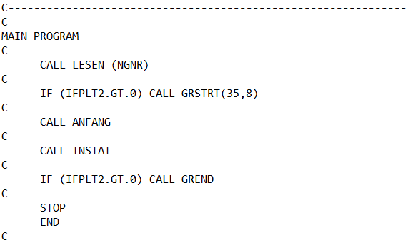
FRESCO Main Program

Slide 9
Input/Prep. Subroutines
No | Subroutines/functions | Assignment
1 | ADSL | Read coeff. For sorption isotherms
2 | GEOL | Read geometry data
3 | DIFFL | Read diffusion coeff. In graph.pore, graph.grain, particle
4 | KONTL | Read uranium contamination for fuel element and particle
5 | LESEN | Read input data (NGNR)
6 | NUKLES | Read nuclear data (initial inventory, decay constant)
7 | NULL | Set zero of all values
8 | OUTL | Read output control data
9 | RECRL | Read recoil lengths
10 | UEBERL | Read title
11 | ZEITL | Read time step control data

Slide 10
Physics Subroutines(1/3)
No | Subroutines/functions | Assignment
1 | ANFANG | Define concentration profiles at initiation of accident
2 | BEDIFF ( FREICP, CGM) | Calculation of fission product transport in graphite
3 | BRUCHP(PZAHL0,IFJN) | Release from partitions of defective particles
4 | INSTAT | Calculation of unsteady state fission product release
5 | KUDIF(N,R,DTI,UEZ,DI,Q,ZERFK,T0,T,GES) | Numerical integration of the fickian diffusion eq. for a fuel sphere for one time step
6 | PADIFF(FREI,C00) | Calculation of fission product diffusion from particles and from graphite grains (recoil is taken into account in the source functions)
7 | RADIF(R,N,R2,N1,N2) | Partition of sphere in zones for diffusion calculations
8 | RECOIL(Q,RCFRPK, RCFRP) | Calculation of recoil release from particle kernel, particle, and fuel element.
9 | SICOR(TT) | Calculation of thinning of SiC-Layer due to corrosion
10 | ZOZA(R,N) | Determine number of zones with different transport data

Slide 11
Physics Subroutines(2/3)
No | Subroutines/functions | Assignment
11 | ADSORP(T,C) | Calculation of ratio between boundary layer concentration and surface concentration from sorption isotherm for A3 Matrix graphite
12 | AINVE(R,C,N1,N2) | Integration of concentrations in a sphere shell between positions N1 dan N2 (linear profile in between)
13 | BETA(V,P,T) | Mass transfer coefficient at the boundary graphite/helium
14 | DIFKO(T) | Diffusion coefficient for graphite grain
15 | DIFPA(T,I) | Diffusion coeff. For particle kernel and layers. I: number of particle zone, 1=center.
16 | DIFPAD(T,I) | Diffusion coeff. for particle kernel of defective CP. I: number of particle zone, 1=center.
17 | DIFPO(T,I) | Diffusion coeff. In graphite pores, I: number of graphite zone, 1=center.
18 | PBRUCH(ZEIT,TEMPER) | Particle failure function

Slide 12
Physics Subroutines(3/3)
No | Subroutines/functions | Assignment
19 | QUELLK(ZEIT) | Time and location dependent function for FP-source term in the graphite grains
20 | QUELLP(I) | Time and location dependent function for FP-source term in particle
21 | QUPOR(ZEIT) | Time and location dependent function for FP-source term in the graphite pores.
22 | TEMP(ZEIT) | Fuel element temperature

Slide 13
Math. Solution Subroutines
No | Subroutines/functions | Assignment
1 | TRIDAG(N,A,B,C,D,T) | Solution of a tridiagonal equation system using the gauss elimination procedure
2 | POLAT(X,X1,X2,Y1,Y2) | Linear interpolation

Slide 14
FRESCO
LESSEN
TEST
ANFANG
INSTAT

Slide 15
Lessen
Null
Ueberl
Zeitl
Outl
Geol
Kontl
Diffl
Recrl
ADSL
Nukles
Radif
zoza
Ini menjadi satu fungsi untuk memanggil input,jumlah parameter sama
Arya

Slide 16
Anfang
Temp
Beta
Difpo
Kudif
Difko
Difpa
Ainve
Out
rezky
almira
almira
Tridag
almira
topan
rezky
topan

Slide 17
INSTAT
Temp
Padiff
Bediff
Out
PBRUCM
AINVE
DIFPA
QUELLP
RECOIL
DIFKO
QUELCK
KUDIF
QUPOR
DIFPO
RECOIL
ADSRP
BETA
KUDIF
TRIDAG

Slide 18
Terima kasih Let’s blow our PeLUIt bagi Kemandirian Industri Energi Nasional

Slide 19








BADAN TENAGA NUKLIR NASIONAL
Jl. Kuningan Barat, Mampang Prapatan Jakarta, 12710
(021) 525 1109 | Fax. (021) 525 1110
humas@batan.go.id
Humas Batan
@humasbatan
badan_tenaga_nuklir_nasional
Humas Batan

Slide 20







Jl. Kuningan Barat, Mampang Prapatan Jakarta, 12710
(021) 525 1109 | Fax. (021) 525 1110
humas@batan.go.id
contact us
@humasbatan
Humas Batan
badan_tenaga_nuklir_nasional
Humas Batan

